Slide 1


Little rides.
Big memories.
Practice starts, stops, turns, and looking back away from traffic. Get feedback from an instructor. Supervise children. Find groups and rides at 3fp.org.
3fp.org
Find your people. Find your next ride.
Notes:
Practice Before Traffic
Specific training programs may improve some learning or assessed-skill outcomes; injury results are mixed or not demonstrated. A leaflet or practice scene does not establish traffic readiness or crash reduction. Helmet evidence concerns injury mitigation, not collision prevention. The imagery shows illustrative closed-court practice, not a certified program.
This exact copy and artwork have not been tested with the intended audience. Treat the emotional framing as an audience hypothesis, not an effectiveness claim. Intended direction: Encouragement and shared possibility; preserve ABC Quick Check, no traffic-readiness certification.
Complete ABC Quick Check: air, brakes, chain/cranks, quick releases, then a short check ride. This check does not certify readiness for traffic. Children need adult supervision in a closed, traffic-free practice area.
Artwork: original generated illustration, not a named real person or testimonial. Relationship wording is illustrative campaign framing, not a verified biography.
Implementation: check the scene and action with intended recipients before broad release. Measure distribution, understanding, and behavior separately; no design in this deck has been shown to reduce crashes.
Image variant A. Copy and layout held constant. Social export is 1080 x 1350 RGB PNG; not a printer file.
Sources:
https://pubmed.ncbi.nlm.nih.gov/24263707/
https://www.nfer.ac.uk/media/je0cski0/research_into_the_impact_of_bikeability_training_on_childrens_ability_to_perceive_and_appropriately_respond_to_hazards_when_cycling_on_the_road.pdf
https://pmc.ncbi.nlm.nih.gov/articles/PMC9990551/
https://academic.oup.com/ije/article-abstract/46/1/278/2617198
https://www.nhtsa.gov/book/countermeasures-that-work/bicycle-safety/countermeasures/unproven-further-evaluation/bicycle
https://www.vias.be/storage/main/cast-wp3-deliverable-3.2b.pdf
https://www.nationalacademies.org/publications/29154
QR destination: https://3fp.org
Revision v9, 29 October 2026. Applied Safer Cycling, Better Messages public report edition4.4. Exact creative remains a draft for local comprehension and behavior testing. Safer road design and speed management remain priorities. Use the adjoining campaign guide to arrange delivery, appropriate support, and evaluation. Printed content is national unless marked Arizona. 3fp.org finds groups and public rides; do not promise unlisted services.

Slide 2
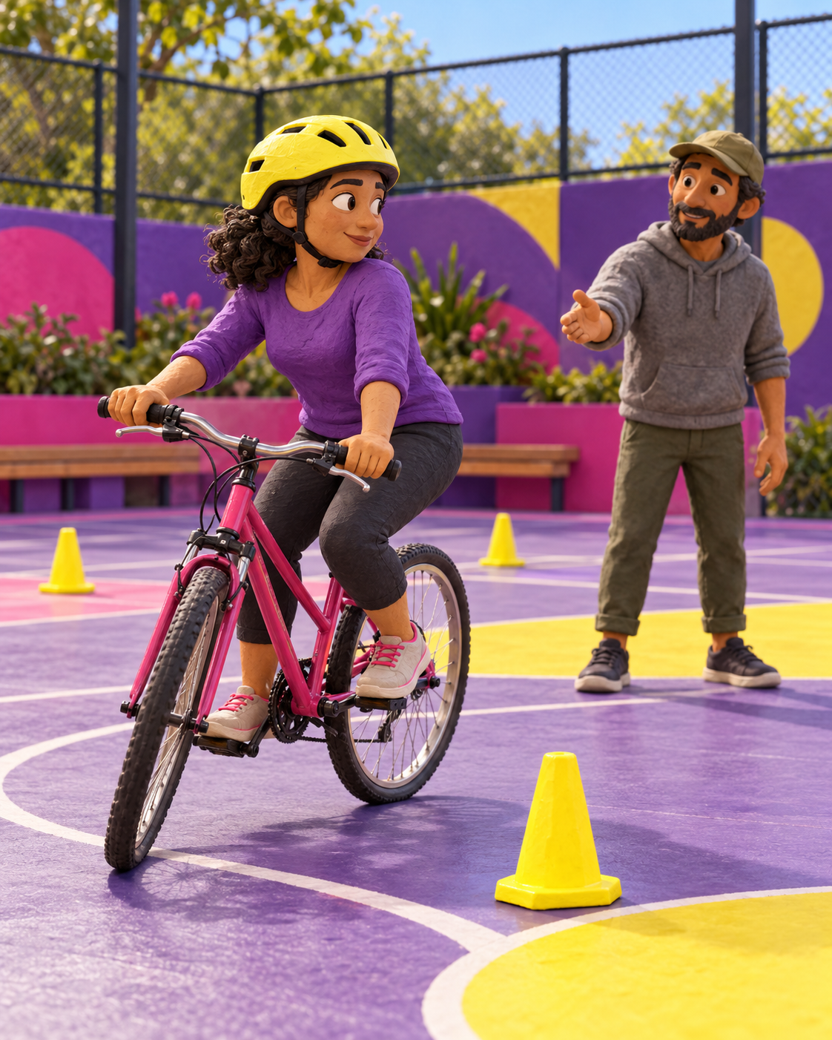
Little rides.
Big memories.
Practice starts, stops, turns, and looking back away from traffic. Get feedback from an instructor. Supervise children. Find groups and rides at 3fp.org.
3fp.org
Find your people. Find your next ride.
Notes:
Practice Before Traffic
Specific training programs may improve some learning or assessed-skill outcomes; injury results are mixed or not demonstrated. A leaflet or practice scene does not establish traffic readiness or crash reduction. Helmet evidence concerns injury mitigation, not collision prevention. The imagery shows illustrative closed-court practice, not a certified program.
This exact copy and artwork have not been tested with the intended audience. Treat the emotional framing as an audience hypothesis, not an effectiveness claim. Intended direction: Encouragement and shared possibility; preserve ABC Quick Check, no traffic-readiness certification.
Complete ABC Quick Check: air, brakes, chain/cranks, quick releases, then a short check ride. This check does not certify readiness for traffic. Children need adult supervision in a closed, traffic-free practice area.
Artwork: original generated illustration, not a named real person or testimonial. Relationship wording is illustrative campaign framing, not a verified biography.
Implementation: check the scene and action with intended recipients before broad release. Measure distribution, understanding, and behavior separately; no design in this deck has been shown to reduce crashes.
Image variant B. Copy and layout held constant. Social export is 1080 x 1350 RGB PNG; not a printer file.
Sources:
https://pubmed.ncbi.nlm.nih.gov/24263707/
https://www.nfer.ac.uk/media/je0cski0/research_into_the_impact_of_bikeability_training_on_childrens_ability_to_perceive_and_appropriately_respond_to_hazards_when_cycling_on_the_road.pdf
https://pmc.ncbi.nlm.nih.gov/articles/PMC9990551/
https://academic.oup.com/ije/article-abstract/46/1/278/2617198
https://www.nhtsa.gov/book/countermeasures-that-work/bicycle-safety/countermeasures/unproven-further-evaluation/bicycle
https://www.vias.be/storage/main/cast-wp3-deliverable-3.2b.pdf
https://www.nationalacademies.org/publications/29154
QR destination: https://3fp.org
Revision v9, 29 October 2026. Applied Safer Cycling, Better Messages public report edition4.4. Exact creative remains a draft for local comprehension and behavior testing. Safer road design and speed management remain priorities. Use the adjoining campaign guide to arrange delivery, appropriate support, and evaluation. Printed content is national unless marked Arizona. 3fp.org finds groups and public rides; do not promise unlisted services.

