Slide 1
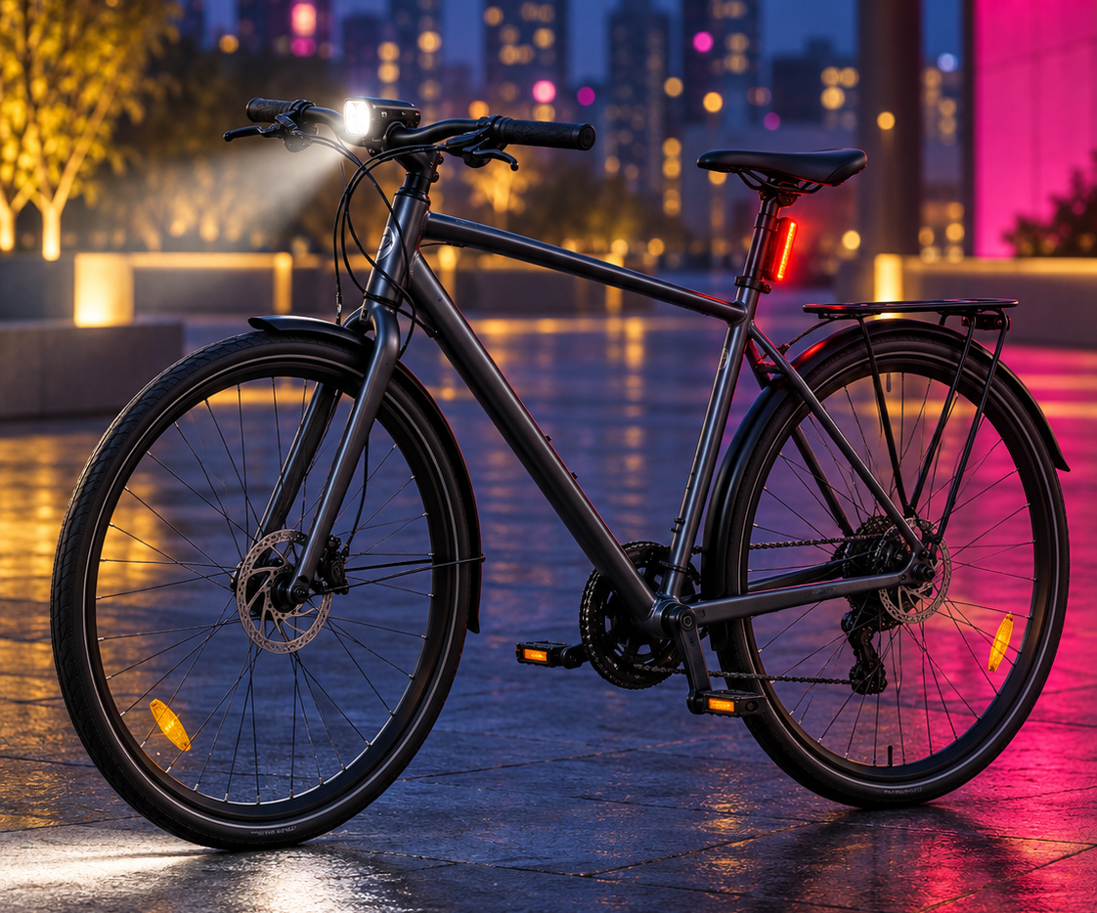

Before the ride home,
check your lights.
Secure your lights. Check the power. Switch both on. Aim the front light without glare. Ask a bike shop about fitting help. Find groups and rides at 3fp.org.
3fp.org
Find your people. Find your next ride.
Notes:
Light the Ride
Lighting aids can improve detection in some experiments, and equipment-plus-education programs have increased observed use; results do not isolate printed messaging. A 2025 light trial had substantial reporting and participation limitations and did not establish an injury benefit. Lights do not guarantee a rider will be seen or prevent a crash.
This exact copy and artwork have not been tested with the intended audience. Treat the emotional framing as an audience hypothesis, not an effectiveness claim. Intended direction: Warmth and useful preparation, without detection or safe-arrival guarantees.
Advice about lighting does not promise that a driver will see or yield to a rider, or that a rider will arrive safely. Advertise fitting, supplies, or financial support only after a partner confirms availability.
Artwork: original generated illustration, not a named real person or testimonial. Relationship wording is illustrative campaign framing, not a verified biography.
Implementation: check the scene and action with intended recipients before broad release. Measure distribution, understanding, and behavior separately; no design in this deck has been shown to reduce crashes.
Image variant A. Copy and layout held constant. Social export is 1080 x 1350 RGB PNG; not a printer file.
Sources:
https://www.cochrane.org/evidence/CD003438_increasing-pedestrian-and-cyclist-visibility-prevent-deaths-and-injuries
https://doi.org/10.55329/qwqe8132
https://pmc.ncbi.nlm.nih.gov/articles/PMC2593412/
https://www.nhtsa.gov/book/countermeasures-that-work/bicycle-safety/countermeasures
https://www.vias.be/storage/main/cast-wp3-deliverable-3.2b.pdf
https://www.nationalacademies.org/publications/29154
QR destination: https://3fp.org
Revision v9, 29 October 2026. Applied Safer Cycling, Better Messages public report edition4.4. Exact creative remains a draft for local comprehension and behavior testing. Safer road design and speed management remain priorities. Use the adjoining campaign guide to arrange delivery, appropriate support, and evaluation. Printed content is national unless marked Arizona. 3fp.org finds groups and public rides; do not promise unlisted services.

Slide 2
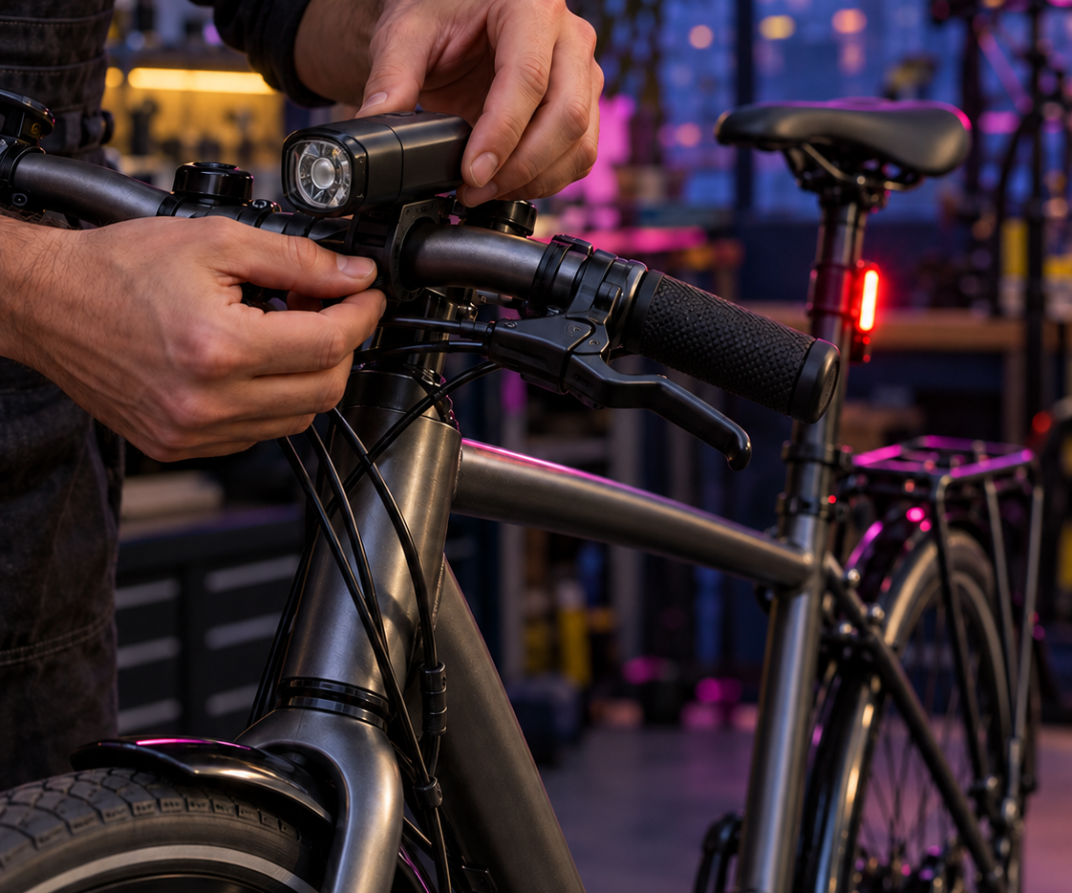
Before the ride home,
check your lights.
Secure your lights. Check the power. Switch both on. Aim the front light without glare. Ask a bike shop about fitting help. Find groups and rides at 3fp.org.
3fp.org
Find your people. Find your next ride.
Notes:
Light the Ride
Lighting aids can improve detection in some experiments, and equipment-plus-education programs have increased observed use; results do not isolate printed messaging. A 2025 light trial had substantial reporting and participation limitations and did not establish an injury benefit. Lights do not guarantee a rider will be seen or prevent a crash.
This exact copy and artwork have not been tested with the intended audience. Treat the emotional framing as an audience hypothesis, not an effectiveness claim. Intended direction: Warmth and useful preparation, without detection or safe-arrival guarantees.
Advice about lighting does not promise that a driver will see or yield to a rider, or that a rider will arrive safely. Advertise fitting, supplies, or financial support only after a partner confirms availability.
Artwork: original generated illustration, not a named real person or testimonial. Relationship wording is illustrative campaign framing, not a verified biography.
Implementation: check the scene and action with intended recipients before broad release. Measure distribution, understanding, and behavior separately; no design in this deck has been shown to reduce crashes.
Image variant B. Copy and layout held constant. Social export is 1080 x 1350 RGB PNG; not a printer file.
Sources:
https://www.cochrane.org/evidence/CD003438_increasing-pedestrian-and-cyclist-visibility-prevent-deaths-and-injuries
https://doi.org/10.55329/qwqe8132
https://pmc.ncbi.nlm.nih.gov/articles/PMC2593412/
https://www.nhtsa.gov/book/countermeasures-that-work/bicycle-safety/countermeasures
https://www.vias.be/storage/main/cast-wp3-deliverable-3.2b.pdf
https://www.nationalacademies.org/publications/29154
QR destination: https://3fp.org
Revision v9, 29 October 2026. Applied Safer Cycling, Better Messages public report edition4.4. Exact creative remains a draft for local comprehension and behavior testing. Safer road design and speed management remain priorities. Use the adjoining campaign guide to arrange delivery, appropriate support, and evaluation. Printed content is national unless marked Arizona. 3fp.org finds groups and public rides; do not promise unlisted services.

