Slide 1
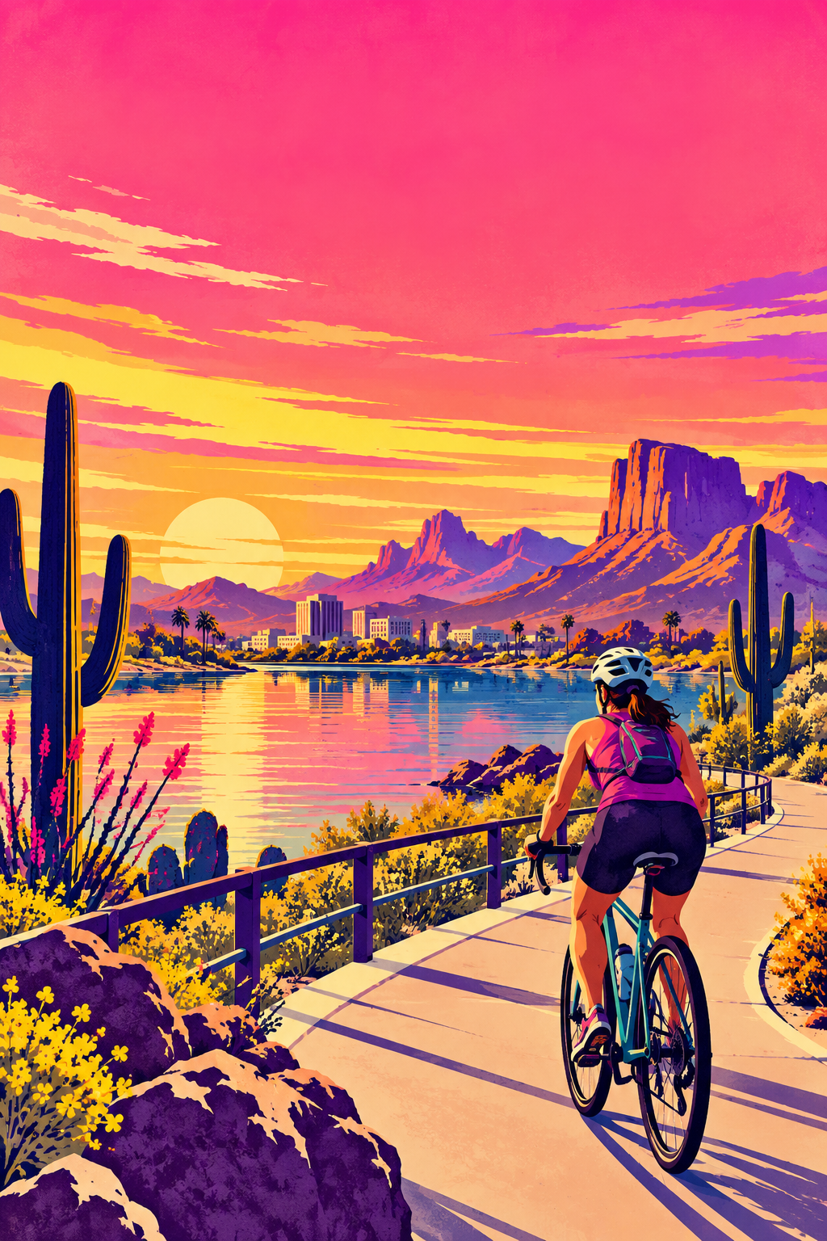


ARIZONA EDITION
ARIZONA RIDING
ESSENTIALS
Arizona adventures start with a little preparation.
Road rules and ride-ready reminders for every Arizona ride.
3fp.org
Find groups and public rides at 3fp.org.
RIDE A.L.E.R.T.
ARIZONA RULES AT A GLANCE
A
Aware
Passing distance
Scan ahead for turning cars, opening doors, debris, and changing road conditions.
Arizona law requires at least three feet when passing a bicycle traveling in the same direction, until safely past.
L
Lawful
Rider rights
Ride predictably with traffic, obey signals, and use the correct lane position.
On a roadway or adjoining shoulder, bicyclists have the applicable rights and duties of vehicle drivers. Ride with traffic and obey signs and signals. Arizona’s keep-right rule has exceptions, including passing, left turns, hazards, and lanes too narrow to share safely.
E
Eye-catching
Use bright lights, visible clothing, and a road position where drivers can see you.
R
Ride ready
At night
Check your bike, helmet, route, weather, and supplies before rolling out.
At night: a white front lamp visible from 500 feet and an approved red rear reflector are required. A red rear lamp may be added; it does not replace the reflector.
T
Telegraph
Check current Arizona rules and travel conditions at azdot.gov and az511.gov.
Signal, look, and position yourself early so every move is easy to understand.
Look first. Signal only when safe; move only when clear.
3 FEET PLEASE
3fp.org · Find groups and public rides.
Notes:
Arizona statewide edition. Legal wording is summarized from the linked Arizona statutes. Check current state rules and conditions before a ride.
VERSION REVIEW: v8 local edition; reviewed 2026-10-22. Exact 3FP message/artwork remains untested.
Emotional copy: “Arizona adventures start with a little preparation.” is a creative proposal informed by audience and behavior guidance. The exact print copy is untested and has not demonstrated crash reduction or crash prevention.
Evidence and endpoint: Arizona statutes and agency pages support the summarized legal/resource facts, not the effectiveness of this compiled guide. Official A.R.S. §§ 28-735, 28-812, 28-815, and 28-817 and the ADOT Bike Book were checked 2026-10-21; no change to the visible law summaries was needed.
Practitioner delivery: statewide Arizona use only. Recheck laws, weather, road conditions, emergency guidance, and live services before printing or use. Track guide distribution, resource access, and comprehension separately from travel behavior or injury.
CAST (Delhomme et al., 2009) and NASEM (2025) evaluation practice: pretest with the intended audience; plan evaluation before delivery; separate process/reach, comprehension, behavior, safety, and economic outcomes; select a design suited to the campaign and any concurrent enforcement, education, equipment, or infrastructure.
Phillips et al. (2011) pooled estimate is from heterogeneous campaigns and is not a cyclist-print forecast. Public research review: output/public-safety-review/REPORT.md.
Source references:
Arizona passing law, A.R.S. § 28-735: https://www.azleg.gov/ars/28/00735.htm
Arizona roadway rights, A.R.S. § 28-812: https://www.azleg.gov/ars/28/00812.htm
Arizona position rules, A.R.S. § 28-815: https://www.azleg.gov/ars/28/00815.htm
Arizona night equipment, A.R.S. § 28-817: https://www.azleg.gov/ars/28/00817.htm
ADOT Bike Book (2014 edition; official ADOT file): https://azdot.gov/sites/default/files/2025-02/adot-bike-book.pdf
AZ 511 road conditions: https://www.az511.gov/
Arizona heat safety: https://www.azdhs.gov/preparedness/epidemiology-disease-control/extreme-weather/heat-safety/index.php
National Weather Service Arizona forecast and alerts: https://www.weather.gov/
NWS Phoenix Monsoon Safety: https://www.weather.gov/psr/MonsoonSafety
Official Arizona statutes and ADOT Bike Book checked 2026-10-21; current visible summaries match the linked sources.
Relationship roles in campaign copy and generated artwork are illustrative, not biographies or testimonials.
CAST manual: https://www.vias.be/storage/main/cast-wp3-deliverable-3.2b.pdf
NASEM guide: https://www.nationalacademies.org/publications/29154
Phillips et al.: https://doi.org/10.1016/j.aap.2011.01.002
Revision v9, 29 October 2026. Applied Safer Cycling, Better Messages public report edition4.4. Exact creative remains a draft for local comprehension and behavior testing. Safer road design and speed management remain priorities. Use the adjoining campaign guide to arrange delivery, appropriate support, and evaluation. Printed content is national unless marked Arizona. 3fp.org finds groups and public rides; do not promise unlisted services.

Slide 2
CHECK THE CONDITIONS
BEFORE YOU RIDE.
Arizona edition · Weather, route, and crash guidance
3fp.org
WEATHER + ROUTE
You matter.
HEAT
Care comes first.
Check the forecast and heat alerts. Carry water, plan shade and breaks, and choose a cooler time when possible. Stop in a safe place if you feel unwell. Confusion or collapse in the heat can be an emergency: call 911 and begin cooling.
01
Get out of traffic and check for injuries.
Call 911 for serious injury, danger, or possible head, neck, or spine injury. Avoid unnecessary movement; follow dispatcher instructions.
STORMS, DUST + FLOODING
02
Call police and make a report.
Check alerts before leaving. Stop safely off the road if conditions turn unsafe. For thunder, shelter inside a sturdy building or hard-topped vehicle. Never enter flooded water; seek higher ground if flooding threatens.
For an emergency, call 911. For other crashes, contact local law enforcement and follow Arizona and local reporting requirements.
ROUTE
03
Photograph the scene and exchange information.
Check for road work, closures, and changing conditions before you leave. Choose a route that fits your experience and the conditions.
If it is safe, photograph the location, bicycle, vehicle, visible damage, and road conditions. Exchange names and contact, driver, and insurance details; note witness contacts.
VISIBILITY
Use a front white light and rear reflector at night as Arizona law requires. Add a working red rear light. Check mounts, aim, and charge; avoid glare.
04
Seek medical care.
ARIZONA RESOURCES
Get medical attention for injuries promptly; do not delay care for reports or photos. Follow a clinician’s advice.
ADOT bicycle information · AZ 511 road conditions · National Weather Service alerts · Arizona heat safety
05
Protect your records and your rights.
Save the report number, photos, medical and repair records, and related messages. Consider speaking with your insurer or a qualified attorney about your options.
3 FEET PLEASE
3fp.org · Find groups and public rides.
Notes:
Arizona statewide edition. Crash steps provide general information. Emergency calls are limited to serious injury, immediate danger, or urgent medical help. Reporting requirements vary by locality.
VERSION REVIEW: v8 local edition; reviewed 2026-10-22. Exact 3FP message/artwork remains untested.
Emotional copy: “You matter. After a crash, care comes first.” is a creative proposal informed by audience and behavior guidance. The exact print copy is untested and has not demonstrated crash reduction or crash prevention.
Evidence and endpoint: Arizona statutes and agency pages support the summarized legal/resource facts, not the effectiveness of this compiled guide. Official A.R.S. §§ 28-735, 28-812, 28-815, and 28-817 and the ADOT Bike Book were checked 2026-10-21; no change to the visible law summaries was needed.
Practitioner delivery: statewide Arizona use only. Recheck laws, weather, road conditions, emergency guidance, and live services before printing or use. Track guide distribution, resource access, and comprehension separately from travel behavior or injury.
CAST (Delhomme et al., 2009) and NASEM (2025) evaluation practice: pretest with the intended audience; plan evaluation before delivery; separate process/reach, comprehension, behavior, safety, and economic outcomes; select a design suited to the campaign and any concurrent enforcement, education, equipment, or infrastructure.
Phillips et al. (2011) pooled estimate is from heterogeneous campaigns and is not a cyclist-print forecast. Public research review: output/public-safety-review/REPORT.md.
Source references:
Arizona passing law, A.R.S. § 28-735: https://www.azleg.gov/ars/28/00735.htm
Arizona roadway rights, A.R.S. § 28-812: https://www.azleg.gov/ars/28/00812.htm
Arizona position rules, A.R.S. § 28-815: https://www.azleg.gov/ars/28/00815.htm
Arizona night equipment, A.R.S. § 28-817: https://www.azleg.gov/ars/28/00817.htm
ADOT Bike Book (2014 edition; official ADOT file): https://azdot.gov/sites/default/files/2025-02/adot-bike-book.pdf
AZ 511 road conditions: https://www.az511.gov/
Arizona heat safety: https://www.azdhs.gov/preparedness/epidemiology-disease-control/extreme-weather/heat-safety/index.php
National Weather Service Arizona forecast and alerts: https://www.weather.gov/
NWS Phoenix Monsoon Safety: https://www.weather.gov/psr/MonsoonSafety
Official Arizona statutes and ADOT Bike Book checked 2026-10-21; current visible summaries match the linked sources.
Relationship roles in campaign copy and generated artwork are illustrative, not biographies or testimonials.
CAST manual: https://www.vias.be/storage/main/cast-wp3-deliverable-3.2b.pdf
NASEM guide: https://www.nationalacademies.org/publications/29154
Phillips et al.: https://doi.org/10.1016/j.aap.2011.01.002
Revision v9, 29 October 2026. Applied Safer Cycling, Better Messages public report edition4.4. Exact creative remains a draft for local comprehension and behavior testing. Safer road design and speed management remain priorities. Use the adjoining campaign guide to arrange delivery, appropriate support, and evaluation. Printed content is national unless marked Arizona. 3fp.org finds groups and public rides; do not promise unlisted services.

