Slide 1
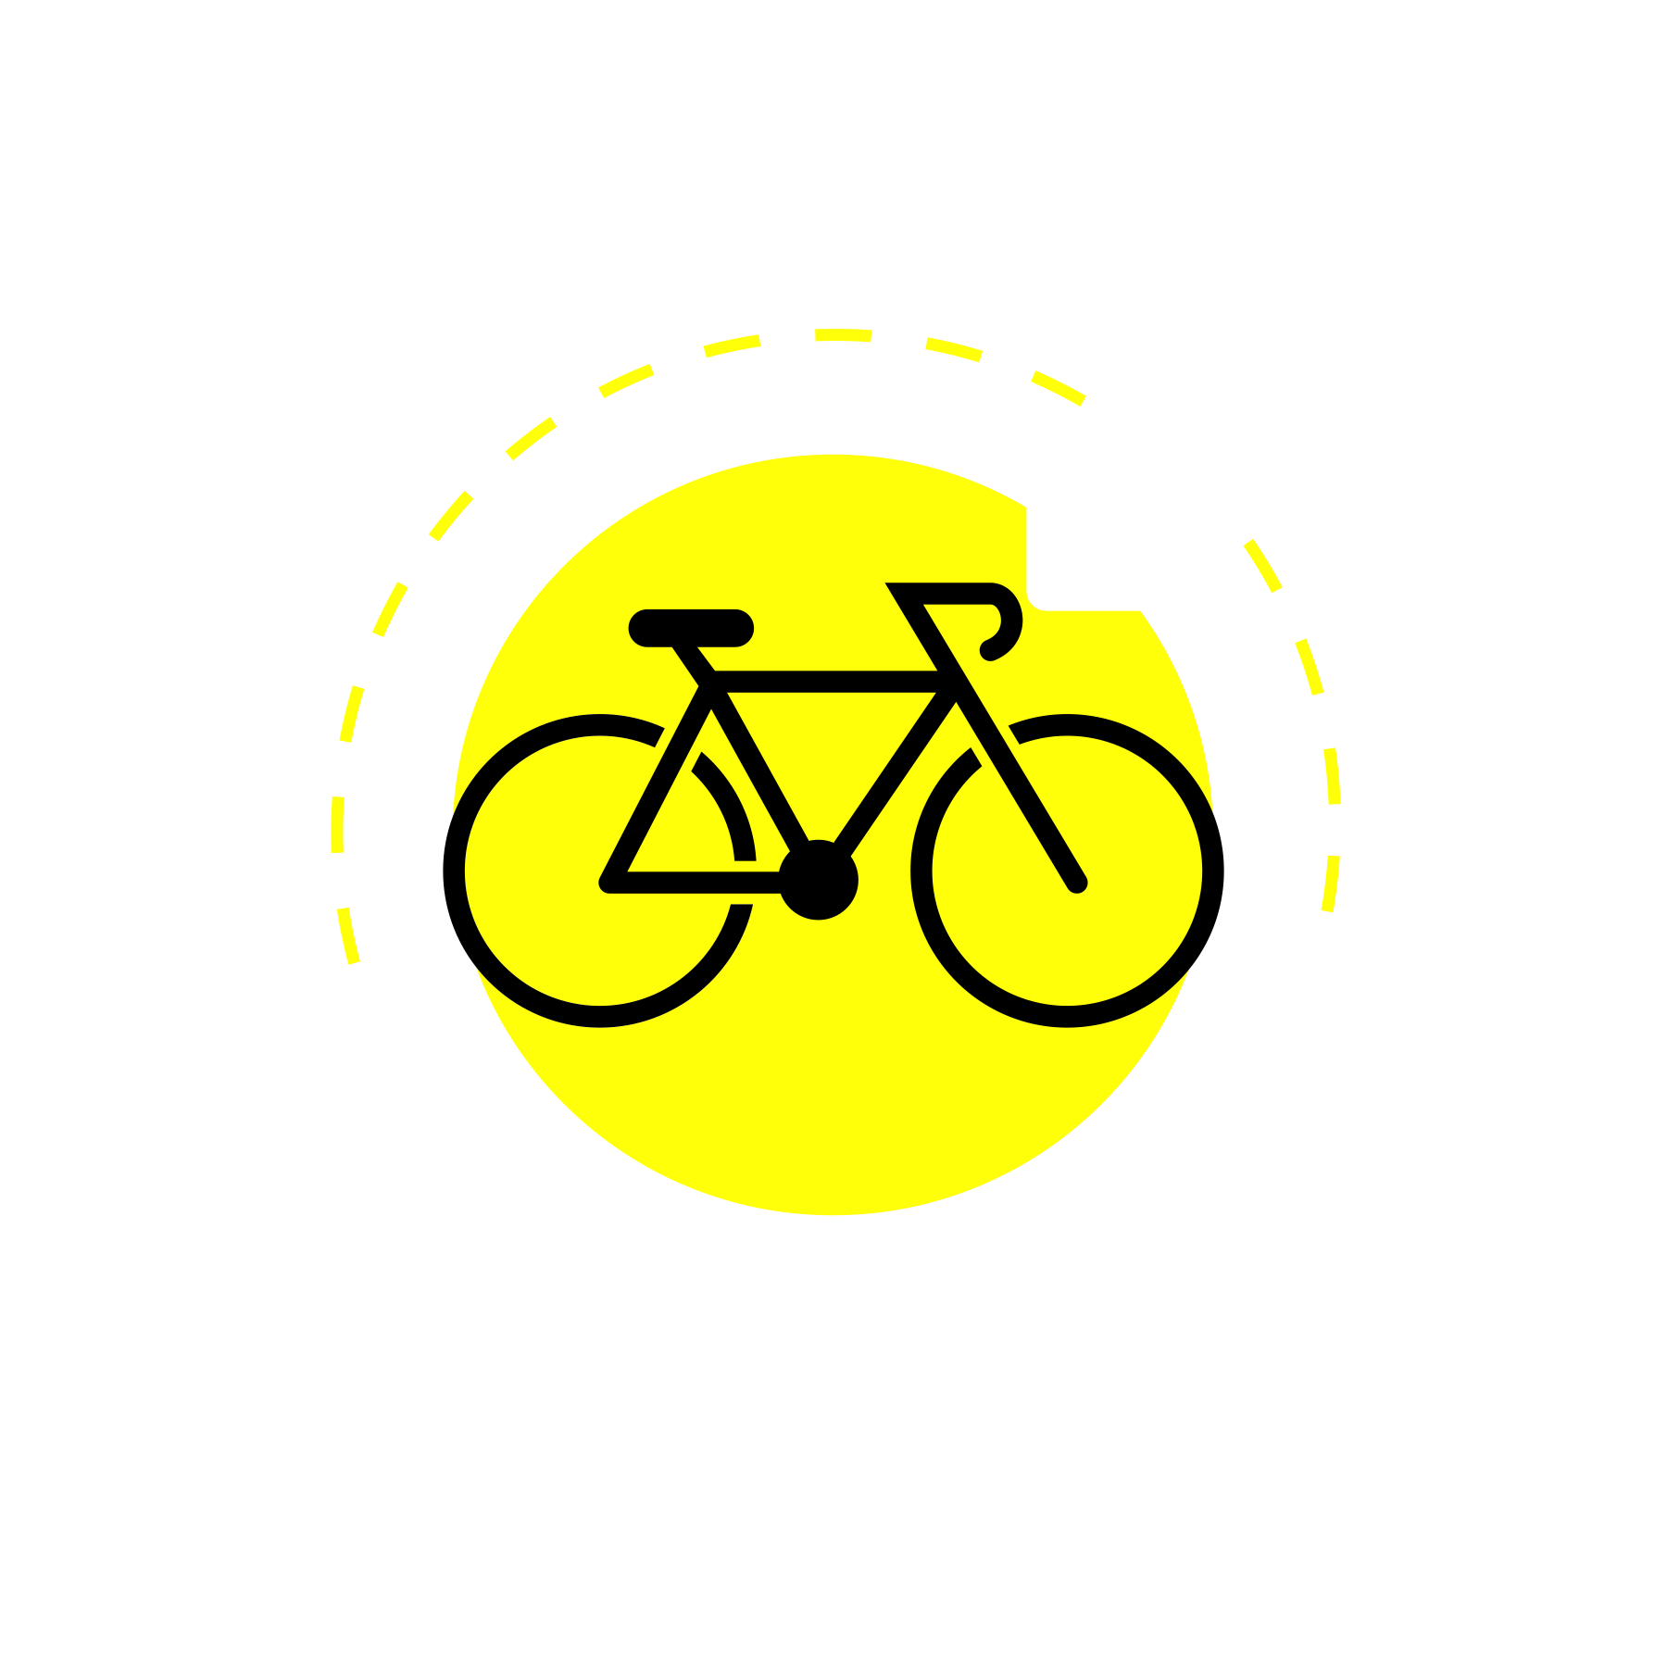

WHEN YOU ARE DRIVING
CHECK.
THEN WAIT.
RIDER
BIKE
PATH
WAIT
Before turning across a rider’s path, check ahead, beside and behind. Wait until the rider has cleared.
Dashed pink: intended turn. Purple arrow: rider.
3fp.org
Find groups and public rides.
Notes:
3FP v9 | Check before turning | 29 October 2026. Original native vector illustration. Draft for comprehension testing, not an evaluated intervention. Prioritize safer infrastructure and speeds. Arrange real delivery and support before use. Sources: R45 WHO Cyclist safety; R67 Houts2006 (indirect design guidance). Public report edition4.4, output/public-safety-review/REPORT.md. QR to https://3fp.org.

Slide 2
FOR A DRIVING LESSON OR FLEET BRIEFING
Explain the turn.
Rehearse the check.
1
SHOW THE CROSSING
Use a local junction scene. Point out where the turn crosses a rider’s path.
2
USE THE ACTUAL VEHICLE
With a qualified trainer, review direct vision, mirrors and visibility equipment. Keep the vehicle secured and parked.
3
SAY WHEN TO WAIT
Ask: “Who waits? What must be clear before the turn?” Ask for the answer in the driver’s own words.
Follow up later with the same road scene.
3fp.org
Find groups and public rides.
Notes:
3FP v9 | Turning teach-back with an actual vehicle | 29 October 2026. Original native vector illustration. Draft for comprehension testing, not an evaluated intervention. Prioritize safer infrastructure and speeds. Arrange real delivery and support before use. Sources: R45; R47 CAST; R68 NHTSA driver education audit. Public report edition4.4, output/public-safety-review/REPORT.md. QR to https://3fp.org.

