Slide 1
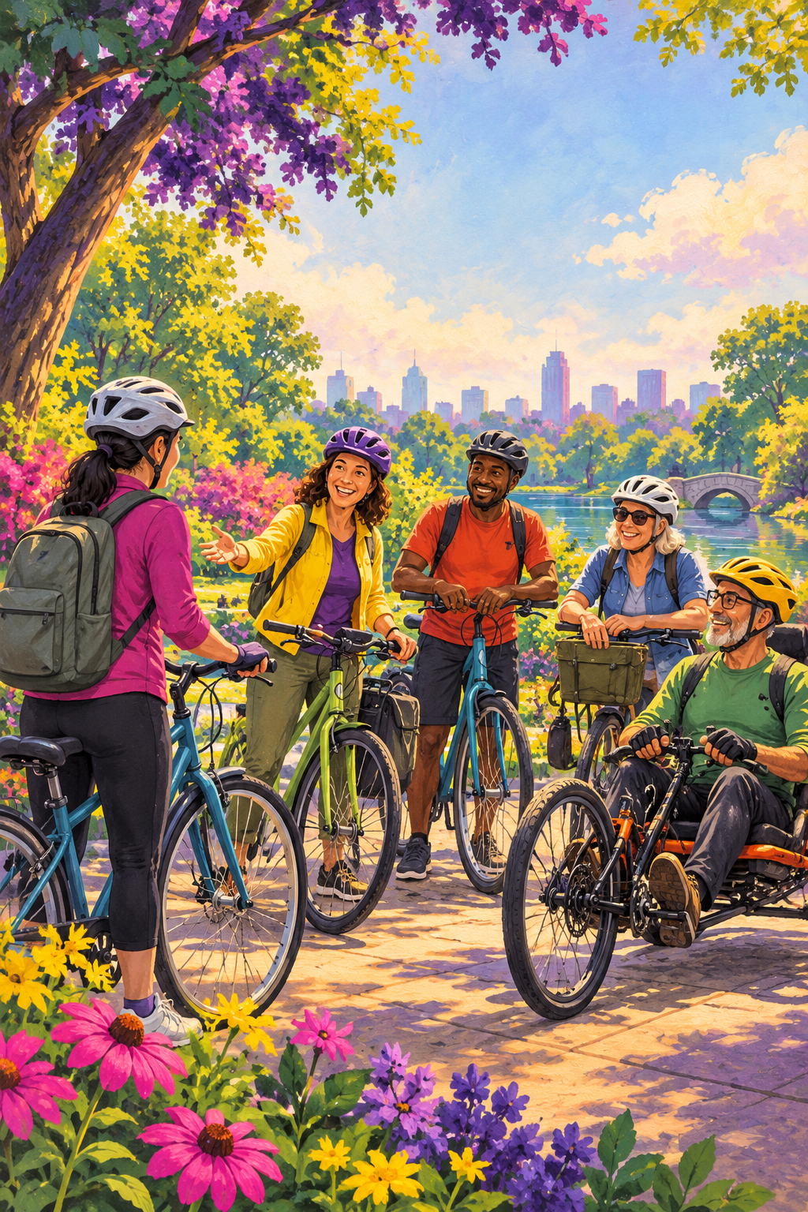


YOUR FIRST GROUP RIDE
Meet your next riding buddy.
Before you head out, check the listing and ask the host:
1
Where and when does the ride start?
2
How far is it, and what pace and route should I expect?
3
What is the surface like? Are there hills or busy streets?
4
Where can the group stop or regroup?
5
What should I bring? Are there access, ride, or equipment requirements?
FIND PUBLIC RIDES
3fp.org/ride
Check current details with the ride host.
3fp.org · Find groups and public rides.
Notes:
Front: questions to help a rider decide whether a listed public ride fits. Confirm current details with the host. QR opens 3fp.org.
VERSION REVIEW: v8 local edition; reviewed 2026-10-22. Exact 3FP message/artwork remains untested.
Emotional copy: “Meet your next riding buddy.” is a creative proposal informed by audience and behavior guidance. The exact print copy is untested and has not demonstrated crash reduction or crash prevention.
Evidence and endpoint: these materials help people find current listings; participation and listing use are access outcomes, not a safety intervention or proof of safety-in-numbers effects.
Practitioner delivery: confirm listings and direct participants to each host for current route, pace, access, regrouping, and format. Record successful navigation and participation separately from behavior and safety.
CAST (Delhomme et al., 2009) and NASEM (2025) evaluation practice: pretest with the intended audience; plan evaluation before delivery; separate process/reach, comprehension, behavior, safety, and economic outcomes; select a design suited to the campaign and any concurrent enforcement, education, equipment, or infrastructure.
Phillips et al. (2011) pooled estimate is from heterogeneous campaigns and is not a cyclist-print forecast. Public research review: output/public-safety-review/REPORT.md.
Source references:
3FP public ride directory: https://3fp.org/ride
League of American Bicyclists ABC Quick Check: https://bikeleague.org/videos/basic-bike-check/
NHTSA Bicycle Safety: https://www.nhtsa.gov/road-safety/bicycle-safety
Relationship roles in campaign copy and generated artwork are illustrative, not biographies or testimonials.
CAST manual: https://www.vias.be/storage/main/cast-wp3-deliverable-3.2b.pdf
NASEM guide: https://www.nationalacademies.org/publications/29154
Phillips et al.: https://doi.org/10.1016/j.aap.2011.01.002
Revision v9, 29 October 2026. Applied Safer Cycling, Better Messages public report edition4.4. Exact creative remains a draft for local comprehension and behavior testing. Safer road design and speed management remain priorities. Use the adjoining campaign guide to arrange delivery, appropriate support, and evaluation. Printed content is national unless marked Arizona. 3fp.org finds groups and public rides; do not promise unlisted services.

Slide 2
BEFORE, DURING, AFTER
BEFORE YOU ROLL
Do an ABC Quick Check. Bring water, a charged phone, and supplies that fit the route and weather. Arrive with time to find the group and introduce yourself.
DURING THE RIDE
Listen to the host’s ride plan. Ride at a pace you can manage. Signal when safe; move only when clear. Call out hazards you notice and tell the host if you need a break or plan to leave.
AFTER THE RIDE
Thank your host. Save the group or ride page if you want to check for another outing.
Find your next ride at 3fp.org/ride.
Each ride is different. Confirm details and expectations with its host.
3fp.org · Find groups and public rides.
Notes:
Back: practical guidance for any group ride. It makes no promise about pace, leader, sweep, or no-drop format. QR code on the front opens 3fp.org.
VERSION REVIEW: v8 local edition; reviewed 2026-10-22. Exact 3FP message/artwork remains untested.
Creative proposal boundary: exact emotional print copy is untested and has not demonstrated crash reduction or crash prevention.
Evidence and endpoint: these materials help people find current listings; participation and listing use are access outcomes, not a safety intervention or proof of safety-in-numbers effects.
Practitioner delivery: confirm listings and direct participants to each host for current route, pace, access, regrouping, and format. Record successful navigation and participation separately from behavior and safety.
CAST (Delhomme et al., 2009) and NASEM (2025) evaluation practice: pretest with the intended audience; plan evaluation before delivery; separate process/reach, comprehension, behavior, safety, and economic outcomes; select a design suited to the campaign and any concurrent enforcement, education, equipment, or infrastructure.
Phillips et al. (2011) pooled estimate is from heterogeneous campaigns and is not a cyclist-print forecast. Public research review: output/public-safety-review/REPORT.md.
Source references:
3FP public ride directory: https://3fp.org/ride
League of American Bicyclists ABC Quick Check: https://bikeleague.org/videos/basic-bike-check/
NHTSA Bicycle Safety: https://www.nhtsa.gov/road-safety/bicycle-safety
Relationship roles in campaign copy and generated artwork are illustrative, not biographies or testimonials.
CAST manual: https://www.vias.be/storage/main/cast-wp3-deliverable-3.2b.pdf
NASEM guide: https://www.nationalacademies.org/publications/29154
Phillips et al.: https://doi.org/10.1016/j.aap.2011.01.002
Revision v9, 29 October 2026. Applied Safer Cycling, Better Messages public report edition4.4. Exact creative remains a draft for local comprehension and behavior testing. Safer road design and speed management remain priorities. Use the adjoining campaign guide to arrange delivery, appropriate support, and evaluation. Printed content is national unless marked Arizona. 3fp.org finds groups and public rides; do not promise unlisted services.

