Slide 1
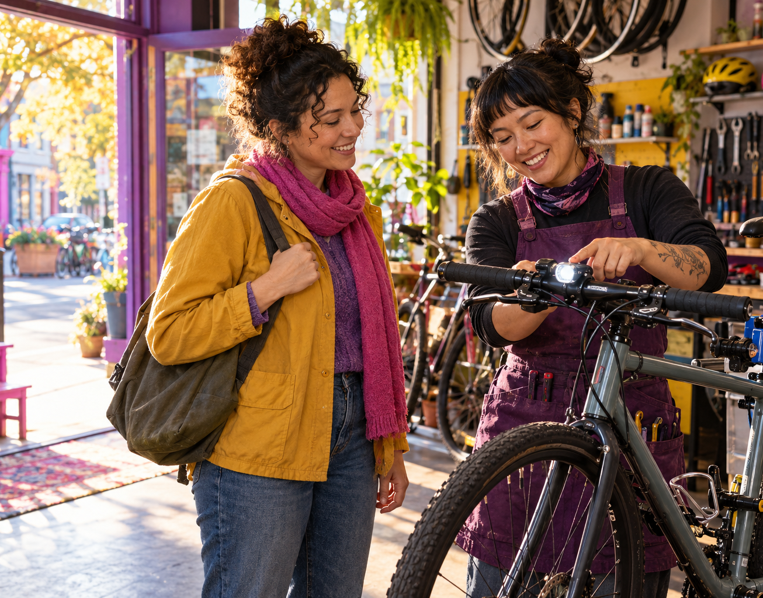


FOR STAFF AND DEMONSTRATORS
Partner demonstration guide
One conversation. A better next ride.
Keep every practice stationary. Do not open the door or enter the roadway.
S.P.A.C.E. · C
C — Check before opening a door or turning across a rider’s path.
Door: In a secured parked vehicle, check the mirror and look beside and behind toward the traffic side. Keep the door closed during practice. Open only when clear.
Turn: In a stationary diagram or vehicle, identify the rider’s path and describe the checks. Wait until the rider has cleared before turning.
ASK FOR A TEACH-BACK
“What will you check?
When will you wait?”
Listen for a full check and a clear wait condition.
3fp.org
Find groups and public rides at 3fp.org.
Notes:
Partner-facing script. Demonstrate from a parked vehicle with doors closed. Do not enter traffic and do not imply the demonstration has been shown to prevent crashes. S.P.A.C.E. is original 3FP campaign language, not an established safety standard. The exact card, script, or art has not been directly evaluated. The visual is AI-generated illustrative art, not a real participant or testimonial.
VERSION REVIEW: v8 local edition; reviewed 2026-10-22. This exact material is not evaluated.
Relationship roles in campaign copy and generated artwork are illustrative, not biographies or testimonials.
Emotional copy: “One conversation. A better next ride.” is a creative proposal informed by audience and behavior guidance. The exact print copy is untested and has not demonstrated crash reduction or crash prevention.
Evidence and endpoint: this door-check prompt is untested. Measure whether people understand the check-beside/behind and open-only-when-clear action; knowledge or teach-back does not establish real-world checking or prevented dooring.
Practitioner delivery: teach with a parked vehicle only, keep learners away from moving traffic, and use teach-back. Record reach and comprehension separately from observed on-road behavior and crashes.
CAST (Delhomme et al., 2009) and NASEM (2025) provide campaign planning and evaluation practice: pretest with the intended audience; plan evaluation before rollout; distinguish process/reach, comprehension, behavior, safety, and economic outcomes; select a design appropriate to the campaign and concurrent activities.
ACT humanization experiment is a separate, small immediate-rating study and does not evaluate this material. Phillips et al. (2011) pooled heterogeneous road-safety campaigns; that average is not a forecast for this print piece.
Public research review: output/public-safety-review/REPORT.md.
Source references:
3FP approved S.P.A.C.E. copy: output/print-v4/COPY.md, Driver handout.
NHTSA, Bicycle Safety: https://www.nhtsa.gov/road-safety/bicycle-safety
Carey, McDermott & Sarma (2013), Fear appeals and driver behavior: https://doi.org/10.1371/journal.pone.0062821
QR destination: https://3fp.org
CAST manual: https://www.vias.be/storage/main/cast-wp3-deliverable-3.2b.pdf
NASEM guide: https://www.nationalacademies.org/publications/29154
Phillips et al.: https://doi.org/10.1016/j.aap.2011.01.002
Revision v9, 29 October 2026. Applied Safer Cycling, Better Messages public report edition4.4. Exact creative remains a draft for local comprehension and behavior testing. Safer road design and speed management remain priorities. Use the adjoining campaign guide to arrange delivery, appropriate support, and evaluation. Printed content is national unless marked Arizona. 3fp.org finds groups and public rides; do not promise unlisted services.

Slide 2
Bike-light setup and session notes
For bike shops, schools, and community partners
Eye-catching
Use bright lights, visible clothing, and a road position where drivers can see you.
Ride ready
Check your bike, helmet, route, weather, and supplies before rolling out.
Offer a simple setup check
Ask before touching equipment. Invite the rider to show how the front and rear lights attach and switch on. Check power and secure mounting, and help aim the lights without glare using the maker’s instructions. Discuss applicable local rules.
If someone asks for help getting or fitting lights, ask whether this shop or a local cycling group has support available. Do not promise that it does.
Record what the session delivered
In your usual program log, note how many people you reached, which practice you demonstrated, whether the teach-back explained the action, and any fitting or access requests.
These are delivery, comprehension, and access outputs. These outputs do not measure driving behavior, crash prevention, or injury reduction.
3fp.org
Find groups and public rides at 3fp.org.
Notes:
A.L.E.R.T. headings and sequence retain the approved structure. The E/EYE-CATCHING sentence says bright clothing and lights may help, but neither guarantees a driver will see a rider; R and all remaining rider actions retain approved wording. Keep the light help invitation conditional because a shop or local group may not have equipment assistance. The evaluation items are process outputs only and must not be reported as safety outcomes. There is no proven training dose or claimed effect for this guide or these exact cards. Artwork and copy should not imply that visible clothing or lights transfer responsibility from drivers to riders.
VERSION REVIEW: v8 local edition; reviewed 2026-10-22. This exact material is not evaluated.
Relationship roles in campaign copy and generated artwork are illustrative, not biographies or testimonials.
Creative proposal boundary: exact emotional print copy is untested and has not demonstrated crash reduction or crash prevention.
Evidence and endpoint: visibility-aid research concerns detection/recognition under specific conditions and is distinct from evidence about print messages. This exact light card is untested; do not promise detection or crash/injury prevention.
Practitioner delivery: demonstrate fitting and operation in a stationary setting; offer access only where the partner can provide it. Explain that equipment may help in some conditions but cannot guarantee a driver will see or yield.
CAST (Delhomme et al., 2009) and NASEM (2025) provide campaign planning and evaluation practice: pretest with the intended audience; plan evaluation before rollout; distinguish process/reach, comprehension, behavior, safety, and economic outcomes; select a design appropriate to the campaign and concurrent activities.
ACT humanization experiment is a separate, small immediate-rating study and does not evaluate this material. Phillips et al. (2011) pooled heterogeneous road-safety campaigns; that average is not a forecast for this print piece.
Public research review: output/public-safety-review/REPORT.md.
Source references:
3FP approved A.L.E.R.T. copy: output/print-v4/COPY.md, Public display pair and Rider field card.
Kwan & Mapstone, Cochrane review on pedestrian/cyclist visibility and detection: https://www.cochrane.org/evidence/CD003438_increasing-pedestrian-and-cyclist-visibility-prevent-deaths-and-injuries
Hels et al. (2025), daytime running lights randomized trial: https://doi.org/10.55329/qwqe8132
QR destination: https://3fp.org
CAST manual: https://www.vias.be/storage/main/cast-wp3-deliverable-3.2b.pdf
NASEM guide: https://www.nationalacademies.org/publications/29154
Phillips et al.: https://doi.org/10.1016/j.aap.2011.01.002
Revision v9, 29 October 2026. Applied Safer Cycling, Better Messages public report edition4.4. Exact creative remains a draft for local comprehension and behavior testing. Safer road design and speed management remain priorities. Use the adjoining campaign guide to arrange delivery, appropriate support, and evaluation. Printed content is national unless marked Arizona. 3fp.org finds groups and public rides; do not promise unlisted services.

