Slide 1
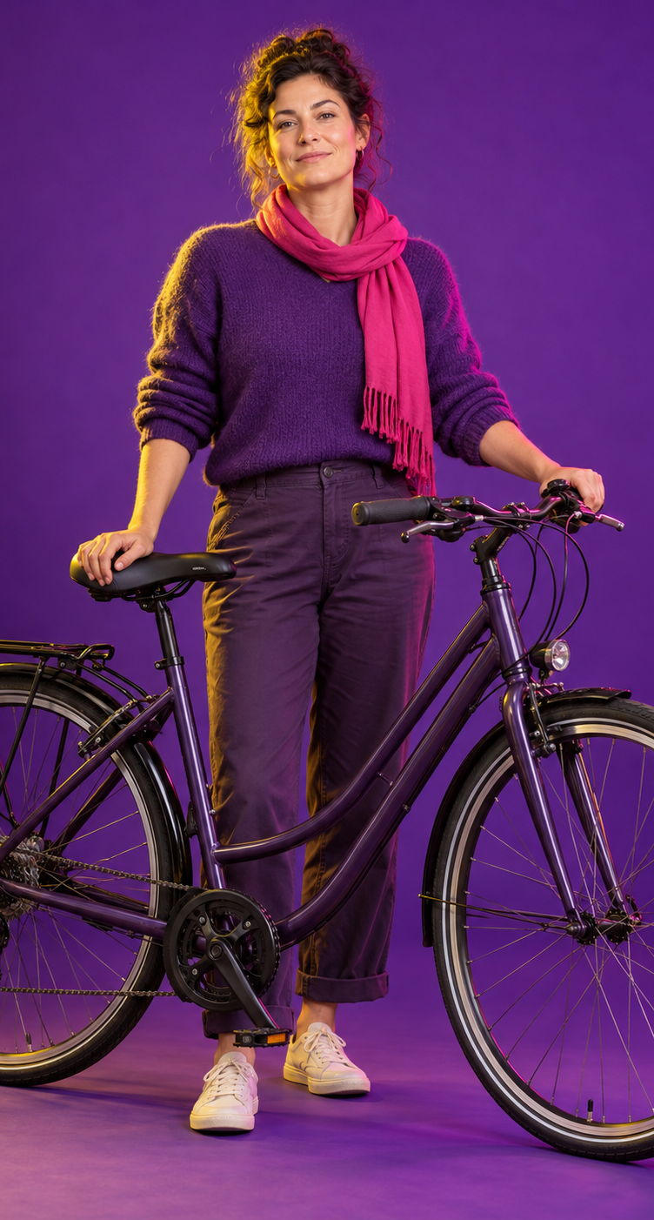


3 FEET PLEASE
THAT’S A DAUGHTER YOU’RE PASSING.
GIVE HER ROOM.
No safe room to pass? Slow down and wait behind. Pass only when there is enough room, including the space local law requires.
3fp.org
Find groups and rides.
Notes:
Series: Relationships | Role: DAUGHTER | Placement: poster
All portraits are fictional illustrations, not actual people or testimonials.
The exact relationship headline and slogan in this series are untested.
Crundall story-package evidence concerns a humanization package and does not establish efficacy for a noun-only relationship headline. No crash or injury reduction is established by that evidence or by these materials.
Portrait asset: Existing fictional editorial portrait of an adult woman beside a commuter bicycle. This role represents a daughter; it is not a named or identifiable person.
Evidence source: https://www.vias.be/storage/main/cast-wp3-deliverable-3.2b.pdf
QR destination: https://3fp.org
Revision v9, 29 October 2026. Applied Safer Cycling, Better Messages public report edition4.4. Exact creative remains a draft for local comprehension and behavior testing. Safer road design and speed management remain priorities. Use the adjoining campaign guide to arrange delivery, appropriate support, and evaluation. Printed content is national unless marked Arizona. 3fp.org finds groups and public rides; do not promise unlisted services.

Slide 2
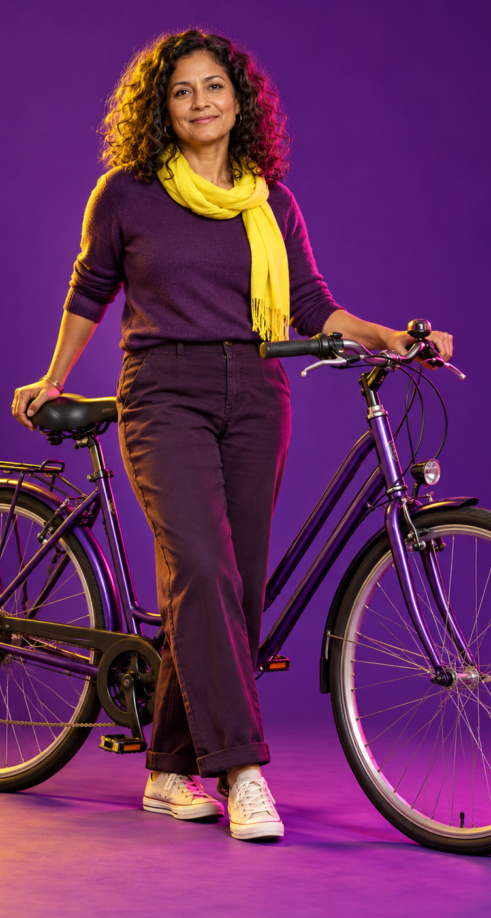
3 FEET PLEASE
THAT’S A MOTHER YOU’RE PASSING.
GIVE HER ROOM.
No safe room to pass? Slow down and wait behind. Pass only when there is enough room, including the space local law requires.
3fp.org
Find groups and rides.
Notes:
Series: Relationships | Role: MOTHER | Placement: poster
All portraits are fictional illustrations, not actual people or testimonials.
The exact relationship headline and slogan in this series are untested.
Crundall story-package evidence concerns a humanization package and does not establish efficacy for a noun-only relationship headline. No crash or injury reduction is established by that evidence or by these materials.
Portrait asset: New fictional editorial portrait representing a mother who rides a bicycle. Use the same purple studio campaign style, everyday clothing, and dignified natural pose.
Evidence source: https://www.vias.be/storage/main/cast-wp3-deliverable-3.2b.pdf
QR destination: https://3fp.org
Revision v9, 29 October 2026. Applied Safer Cycling, Better Messages public report edition4.4. Exact creative remains a draft for local comprehension and behavior testing. Safer road design and speed management remain priorities. Use the adjoining campaign guide to arrange delivery, appropriate support, and evaluation. Printed content is national unless marked Arizona. 3fp.org finds groups and public rides; do not promise unlisted services.

Slide 3
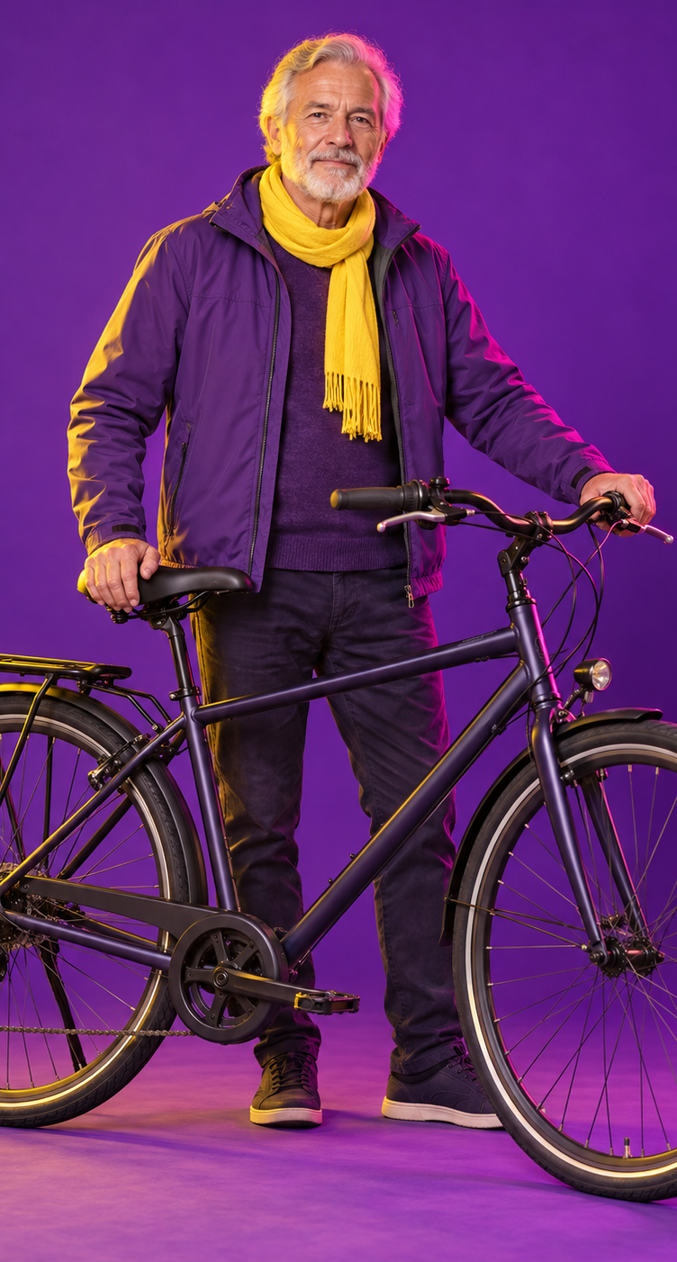
3 FEET PLEASE
THAT’S A FATHER YOU’RE PASSING.
GIVE HIM ROOM.
No safe room to pass? Slow down and wait behind. Pass only when there is enough room, including the space local law requires.
3fp.org
Find groups and rides.
Notes:
Series: Relationships | Role: FATHER | Placement: poster
All portraits are fictional illustrations, not actual people or testimonials.
The exact relationship headline and slogan in this series are untested.
Crundall story-package evidence concerns a humanization package and does not establish efficacy for a noun-only relationship headline. No crash or injury reduction is established by that evidence or by these materials.
Portrait asset: Existing fictional editorial portrait of an older adult man beside a commuter bicycle. This role represents a father; it is not a named or identifiable person.
Evidence source: https://www.vias.be/storage/main/cast-wp3-deliverable-3.2b.pdf
QR destination: https://3fp.org
Revision v9, 29 October 2026. Applied Safer Cycling, Better Messages public report edition4.4. Exact creative remains a draft for local comprehension and behavior testing. Safer road design and speed management remain priorities. Use the adjoining campaign guide to arrange delivery, appropriate support, and evaluation. Printed content is national unless marked Arizona. 3fp.org finds groups and public rides; do not promise unlisted services.

Slide 4
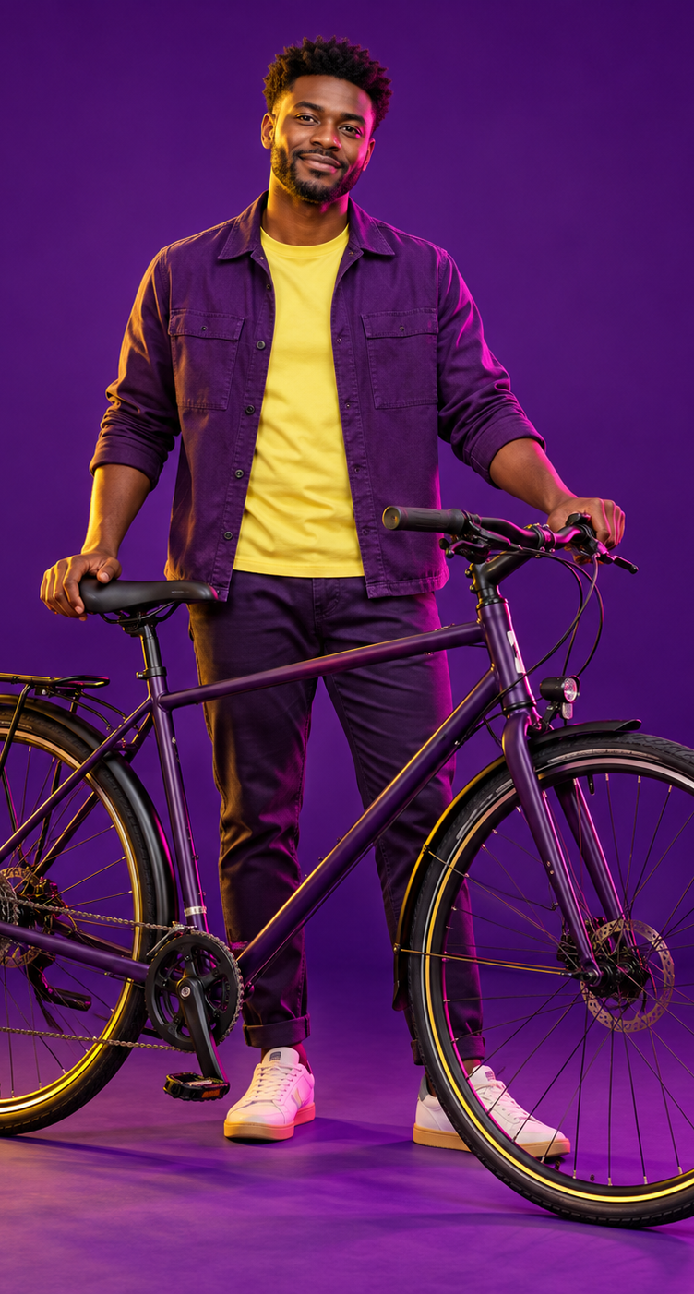
3 FEET PLEASE
THAT’S A BROTHER YOU’RE PASSING.
GIVE HIM ROOM.
No safe room to pass? Slow down and wait behind. Pass only when there is enough room, including the space local law requires.
3fp.org
Find groups and rides.
Notes:
Series: Relationships | Role: BROTHER | Placement: poster
All portraits are fictional illustrations, not actual people or testimonials.
The exact relationship headline and slogan in this series are untested.
Crundall story-package evidence concerns a humanization package and does not establish efficacy for a noun-only relationship headline. No crash or injury reduction is established by that evidence or by these materials.
Portrait asset: New fictional editorial portrait representing a brother who rides a bicycle. Use an adult man in everyday clothing, with a natural pose and the same purple studio campaign style.
Evidence source: https://www.vias.be/storage/main/cast-wp3-deliverable-3.2b.pdf
QR destination: https://3fp.org
Revision v9, 29 October 2026. Applied Safer Cycling, Better Messages public report edition4.4. Exact creative remains a draft for local comprehension and behavior testing. Safer road design and speed management remain priorities. Use the adjoining campaign guide to arrange delivery, appropriate support, and evaluation. Printed content is national unless marked Arizona. 3fp.org finds groups and public rides; do not promise unlisted services.

Slide 5
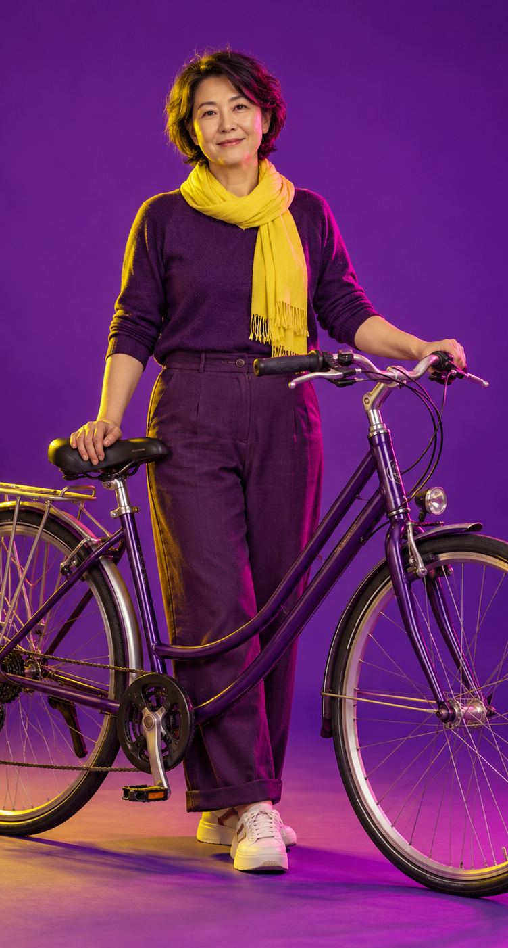
3 FEET PLEASE
THAT’S A TEACHER YOU’RE PASSING.
GIVE HER ROOM.
No safe room to pass? Slow down and wait behind. Pass only when there is enough room, including the space local law requires.
3fp.org
Find groups and rides.
Notes:
Series: Relationships | Role: TEACHER | Placement: poster
All portraits are fictional illustrations, not actual people or testimonials.
The exact relationship headline and slogan in this series are untested.
Crundall story-package evidence concerns a humanization package and does not establish efficacy for a noun-only relationship headline. No crash or injury reduction is established by that evidence or by these materials.
Portrait asset: New fictional editorial portrait representing a woman teacher who rides a bicycle. Use everyday clothing, a natural dignified pose, and the same purple studio campaign style.
Evidence source: https://www.vias.be/storage/main/cast-wp3-deliverable-3.2b.pdf
QR destination: https://3fp.org
Revision v9, 29 October 2026. Applied Safer Cycling, Better Messages public report edition4.4. Exact creative remains a draft for local comprehension and behavior testing. Safer road design and speed management remain priorities. Use the adjoining campaign guide to arrange delivery, appropriate support, and evaluation. Printed content is national unless marked Arizona. 3fp.org finds groups and public rides; do not promise unlisted services.

