Slide 1
Capstone Three Presentation
Classifying Respiratory Diseases from Chest X-Ray Images

Slide 2
Problem Statement
This project aims to build a machine learning model that can classify chest X-ray images into five categories:
1. COVID-19
2. Pneumonia
3. Tuberculosis
4. Lung Opacity
5. Normal
The goal is to assist radiologists in diagnosing respiratory diseases more accurately and efficiently.

Slide 3
Data Overview
The dataset contains chest X-ray images representing five categories, including respiratory diseases.
The images were collected from multiple sources and underwent preprocessing, including:
1. Resizing and Normalization
2. Image Augmentation (rotation, flipping, scaling)
3. Splitting into training, validation, and test sets.

Slide 4
Approach
The project approach involved the following steps:
1. Preprocessing chest X-ray images
2. Fine-tuning pre-trained convolutional neural networks (CNNs) such as ResNet and EfficientNet
3. Evaluating the model using metrics such as accuracy, precision, recall, and F1-scores.

Slide 5
Model Architecture
A convolutional neural network (CNN) was used for this classification task. The architecture was based on fine-tuning pre-trained models such as ResNet, leveraging transfer learning to improve accuracy given the moderate dataset size.

Slide 6
Findings
The model achieved high accuracy in distinguishing between the five categories. COVID-19 was successfully detected, but some confusion occurred between Pneumonia and Lung Opacity due to their overlapping radiographic features.

Slide 7
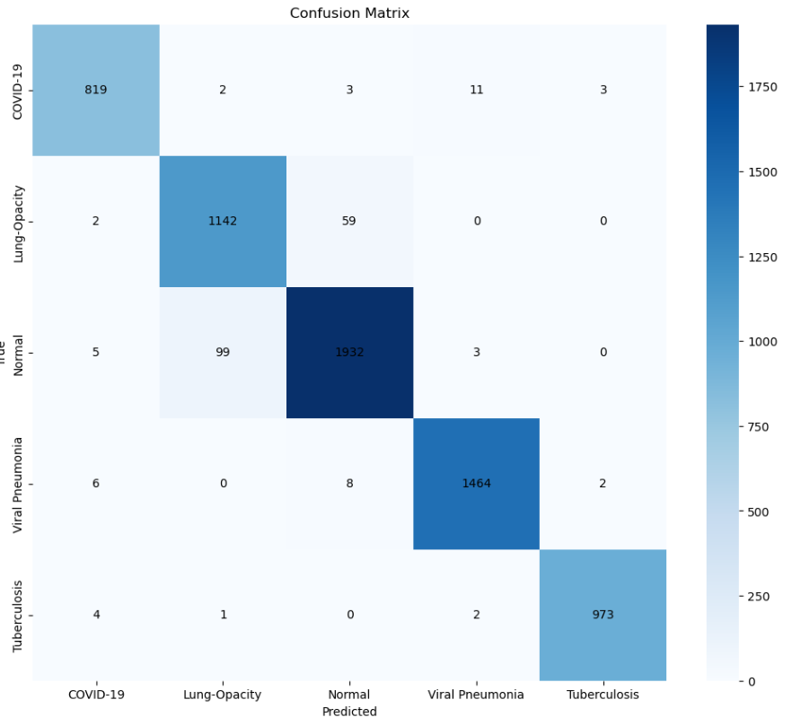
Confusion Matrix

Slide 8
Further Research
Further research opportunities include:
1. Data augmentation and collection to expand the dataset, particularly for rare diseases like Tuberculosis.
2. Multi-modal analysis, combining chest X-ray images with clinical data such as patient history and symptoms.
3. Deployment of the model in real-world clinical settings for real-time diagnostics.

Slide 9
Recommendations
Based on the findings, we recommend the following:
1. Incorporate the model into radiologists' workflows to enhance diagnostic accuracy for respiratory diseases.
2. Use the model in public health monitoring to track the prevalence of diseases like COVID-19.
3. Deploy the model in resource-limited settings for remote diagnostics and telemedicine.

Slide 10
Conclusion
This project demonstrated the potential of using machine learning models to assist in diagnosing respiratory diseases from chest X-ray images. The model performed well in distinguishing between multiple diseases, particularly COVID-19, and offers valuable assistance to healthcare providers.

