Slide 1




Using R to evaluate Smart Meter energy data
@etalbot1291
Notes:
Hello my name is Ellen, and I’m here to tell you about my first PhD project today. I come from a geographical background, with a bachelors in Human geography and a masters in Geographical data science. I’m currently part of the Geographic Data Science Lab at the University of Liverpool and working with the Consumer Data Research Centre and I fit into the R world through my research, running and attending both R ladies Liverpool and Manchester meetups and through my work with Locke Data as a freelancer producing beginner R tutorials, blogs and videos.

Slide 2
292,855,095
6,141,494
That’s more data than I’ve ever seen in my life
That’s still quite a lot
Notes:
Being based in the consumer data research centre presents me with a unique opportunity to access unprecedented amounts of new big data, and the one I’m working with is provided to us by one of the UK’s top five leading domentic energy providers. my brief was to investigate it, understand it and analysis it. Where do you even start with that?

Slide 3

Notes:
The best place to start is often the literature. The domestic energy sector has been marked as one sector where energy usage continues to grow, despite increasingly efficient appliances and modern understanding of energy reduction methods. This is most likely due to the huge appetite in western countries in particular for convenience, comfort and cleanliness.
In the UK especially, the government suggests that a full Smart Meter rollout will be complete for both gas and electric by 2020, and this represents the biggest change to the UK energy market since the changeover to North Sea Gas.
Smart meters are considered to be innovative meters that provide real time data on consumption and are instrumental to increasing efficiency. The data generated by these meters is available in a cadence never previously available, enabling the profiling of consumer behaviours and it is the aim of this paper to evaluate to what extent the socio-demographics act as indicators for energy consumption. It is suggested that trends in energy consumption have utility when defining patterns of daily life and that demographics are often a good indicator of enrgy consumption levels.

Slide 4
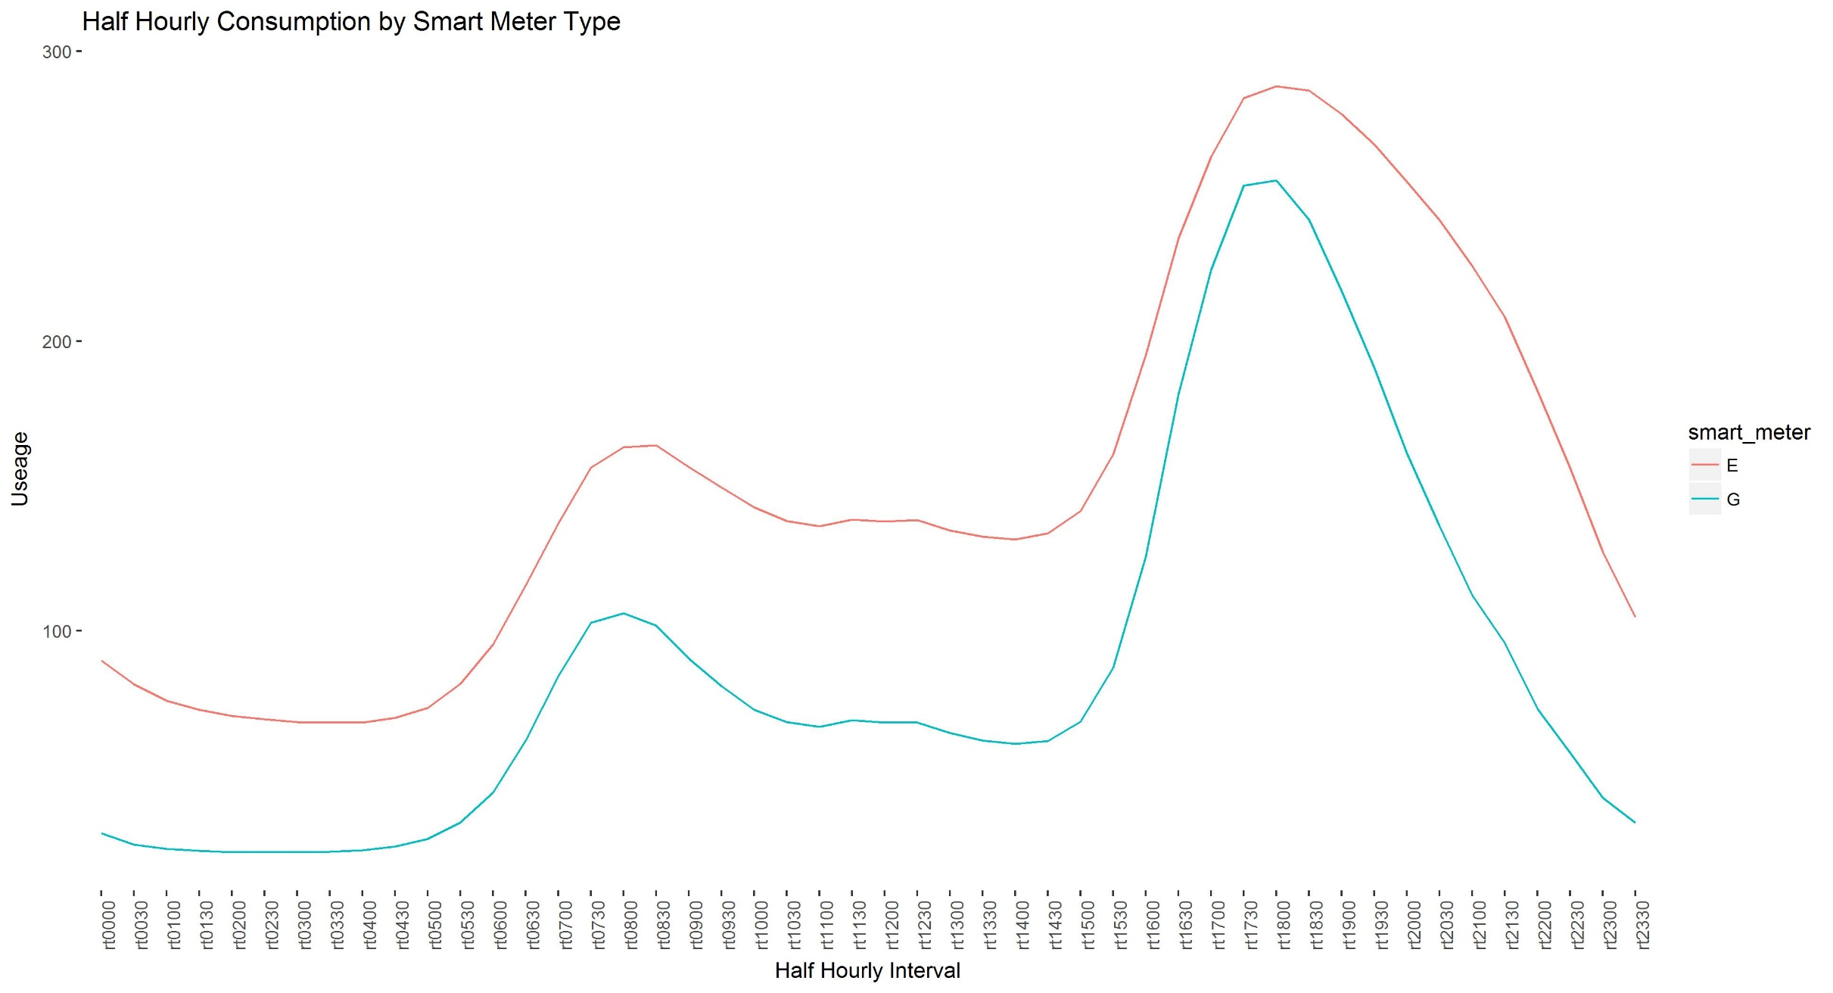
Notes:
This first analysis was done on the entire dataset, and as you can see, the results are somewhat what we were expecting. An AM peak in both gas and electricty as people get up and begin their day, and a bigger PM peak when people tend to be at home for a longer period of time, before tailing off to a ‘standby’ rate during the night.
The raw dataset of 292,855,095 rows had to be aggregated in order to avoid issues of re-identification of individuals. This was done to Postcode sector level, which equates to about 300 households, of which there are around 9300 across the United Kingdom, creates one row in the dataset for each recorded day, per postcode sector, per smart meter type.
This data was then appended to the reweighted census data and Townsend scores. We used a population headcount for both postcode sector and LSOA,and apportioned the census variables this way as against using a GIS method such as union by area as we found these are much more prone to inaccuracies such as slither polygons.

Slide 5
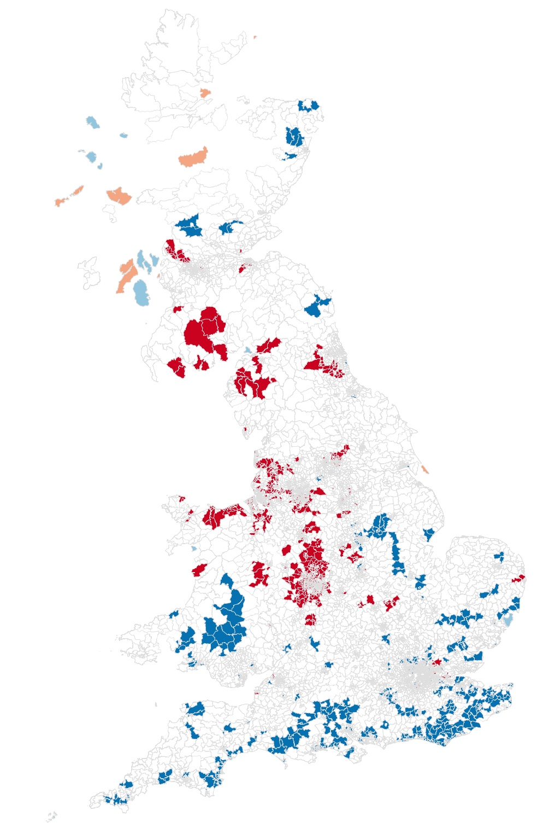
Notes:
I think spatial analysis is really valuable for bridging the gap between what we understand through common and local knowledge and what patterns we see in the data without a spatial visualisation. Without this local morans I analysis above, we would never have seen the distinct north/south divide. Even though the data we hold is inherantly spatial, postcodes within a dataset are meaningless out of context.
This map shows the ratio of smart meters to total number of households per postcode sector across the UK, which reveals a really interesting spatial pattern. A LISA analysis is a local morans I, describing which areas are surrounded by other similar areas, so along the south coast blue represents low penetration areas surrounded by other low penetration areas, whereas in the Midlands and the North West, there are many areas of high penetration surrounded by other areas of high penetration. But what this can’t tell us is why.
Unfortunately neither can the Domestic Energy Provider. Their roll out scheme introduces a lot of bias into the dataset – they knock on doors and if you’re home and you want one, they’ll fit one for you, otherwise you have to go to them and ask for one. Have they just not reached the south coast by this point?
Looking into the dataset in more detail, and with an unprecidented granuality to the data, it was suggested that by clustering the small area users we might reveal interesting patterns of usage over the day, depending on peoples demographic characteristics.

Slide 6
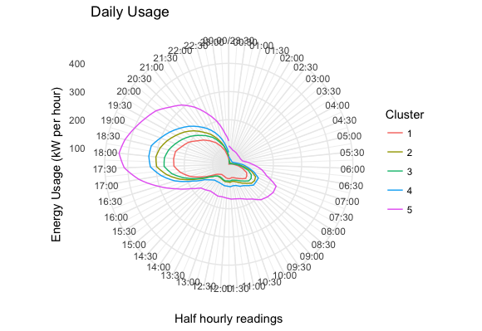
Notes:
To investigate this I used a partioning around mediods clustering algorithm as against a K-means as much of the literature suggested, because of it’s scaleability and given the size of the dataset, a kmeans which produces an NxN matrix was likely to cause horrendous problems – a lesson I learned in my masters dissertation.
Clustering on the absolute values does show that there is some variation in the volume of energy usage between clusters, but honestly, doesn’t tell us a great deal else. So those patterns we were expecting to see? In order to better investigate what percetage of the days energy use is used during any one half an hour slot, we standardised the dataset, and reclustered.

Slide 7
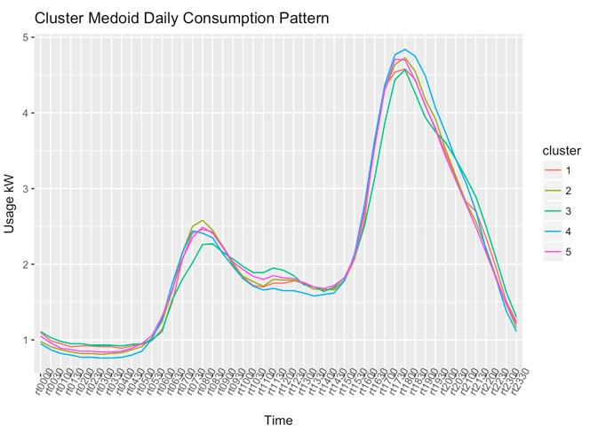
Notes:
Oh. I know we can all agree that no result is a result in itself, but unfortunately this isn’t what the journals, or supervisors, want

Slide 8
Notes:
So after 18 months work coming to, essentially nothing,

Slide 9
Notes:
and having the crisis that I’m sure many PhD students have…

Slide 10
Notes:
I went to the pub.
And then after some thought and returning to the literature I decided that re-framing the work in terms of deprivation and fuel poverty was my best bet.

Slide 11
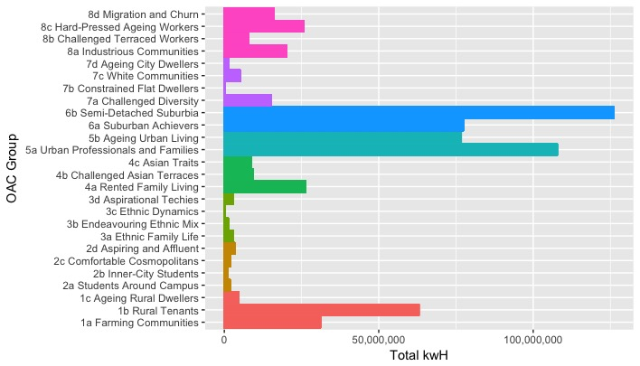
Notes:
Taking a different tack, first off I attributed the energy data to the OAC groups. OAC stands for Output area classification and is generated from 2011 census data by the ONS
There are some particularly interesting groups that are worth mentioning here. With regards to the literature on demographics, time and again, housing comes up as the most positively correlated with energy usage and these results would seem to corroborate that. Groups 5a and 6b in particular, when we look at their pen portraits, are said to be most likely to live in detached and semi detached aka larger houses, which could point to them having larger families and be able to afford the higher energy consumption.
It is also worth looking into the characteristics of 7b and 3c as the lowest consuming groups – of 7b the pen profile states that “This group is characterised by people living in flats, with a higher proportion living in socially rented accommodation.
This could be for several resaons. As they are most likely to be living in flats they have overall less space to heat and lights, there are likely to be fewer people living in them to consume energy but also they are considered constrained, and fewer households have two or more cars – an indication that they are deprived – and are therefore likely to be frugal and less wasteful with their energy for economic reasons.
There is also literature to suggest that social housing is usually some of the most energy efficient in the UK housing stock, as the upkeep is undertaken by local authorities, where making savings and providing quality housing are both important.
Finally for some in depth analysis I modelled the relationship between Townsend score, housing type and energy consumption.
A townsend score - a measure of relative deprivation - and is made up of four census variables and is useful for understanding deprivation as it adheres most closely to the concepts of material disadvantage. The four index variables; percentage of homes with access to a car or van, percentage of homes with more than 1 person per room, percentage of homes not owner occupied and percentage of people economically active yet unemployed; are totaled and converted to a z-score (Townsend 1987). Because this was to be used in tandem with the energy data, an original townsend score was calculated from the reweighted census variables at the PCS level.
The model attempts to explain the energy consumption by levels of deprivation. It included the proportion of accomodation types in each PCS; detached, semi-detached, terrace, flat or shared accomodation.
The energy consumption model was significant to 0.05, suggesting that these results have not occured randomly.
A detached and typically larger house than the reference category (semi-detached) would use on average an extra 1953.2 kW per day in comparison, whereas a smaller terrace house would use 135.5 less kW per day. Detached houses typically have a greater number of rooms and lower levels of overcrowding, therefore more rooms need heating and lighting
This model also suggests that as Townsend scores increase, energy usage decreases overall, which as a measure of deprivation is to be expected – the higher the level of deprivation the less likely people are to be able to afford to be wasteful and consume unnecessary energy. They are also likely to live in smaller houses with lower heating and lighting requirement, own and use fewer appliances and have smaller families.

Slide 12

Notes:
And so having finally got Gaz and Leccy under control, I’m happy to take any questions or comments

