Slide 1


“Estimating Deprivation Through Smart Meter Energy and Socio-Demographic Data”
Ellen Talbot
University of Liverpool
Consumer Data Research Centre
Notes:
This research focuses on using Smart Meter energy data, combined with socio-demographic data such as OAC groups, and a Townsend score to attempt to understand variations in energy usage in relation to people’s characteristics and levels of deprivation. For the benefit of those of you not from the UK, the OAC is the output area classification, a small area geodemographic classification built entirely from the 2011census in partnership with the office for national statistics.
Some of you may have noticed that this isn’t the original title I submitted, but there’s a good reason for that, which I’ll come to so I hope none of you are here especially to hear about clustering methods because I’m afraid you might be disappointed!

Slide 2
Background and Literature
Huge appetite in the westerns world for convenience, comfort and cleanliness.
Smart metering featuring high on Government agendas.
This highly granular data is very well suited to a spatio-temporal analysis.
Notes:
The domestic energy sector has been marked as one sector where energy usage continues to grow, despite increasingly efficient appliances and modern understanding of energy reduction methods. This is most likely due to the huge appetite in western countries in particular for convenience, comfort and cleanliness.
In the UK especially, the government suggests that a full Smart Meter rollout will be complete for both gas and electric by 2020, and this represents the biggest change to the UK energy market since the changeover to North Sea Gas.
Smart meters are considered to be innovative meters that provide real time data on consumption and are instrumental to increasing efficiency. The data generated by these meters is available in a cadence never previously available, enabling the profiling of consumer behaviours and it is the aim of this paper to evaluate to what extent the socio-demographics act as indicators for energy consumption. It is suggested that trends in energy consumption have utility when defining patterns of daily life and that demographics are often a good indicator of enrgy consumption levels.

Slide 3
292,855,095 (rows)
6,141,494 (rows)
That’s more data than I’ve ever seen in my life
That’s still quite a lot
Notes:
So having covered the what and the why, a quick word on the how, and the problematic method that meant doing a full 180 with the finish line in sight. Whilst I think we all can agree that no result is a result in itself, it’s much harder to make something of nothing than it is, and for the purpose of today, to just do something different and pretend it never happened.
The raw dataset of 292,855,095 rows had to be aggregated in order to avoid issues of re-identification of individuals. This was done to Postcode sector level, which equates to about 300 households, of which there are around 9300 across the United Kingdom, creates one row in the dataset for each recorded day, per postcode sector, per smart meter type.
This data was then appended to the reweighted census data and Townsend scores. We used a population headcount for both postcode sector and LSOA,and apportioned the census variables this way as against using a GIS method such as union by area as we found these are much more prone to inaccuracies such as slither polygons.

Slide 4
Half hourly consumption
Notes:
To get some insight into the dataset in its entirity, this first analysis was done on the whole unaggregated data, and as you can see, the results are somewhat what we were expecting andcan be made sense of through common knowledge.
An AM peak in both gas and electricity as people get up and begin their day, a dip as some but not all people leave for work, and a bigger PM peak when people tend to be at home for a longer period of time, doing activities such as cooking and relaxing – watching TV, using computers, using lighting as it gets dark and so on before tailing off to a ‘standby’ rate during the night where only appliances that must be left on are consuming energy, such as the fridge, freezer and home security systems.

Slide 5
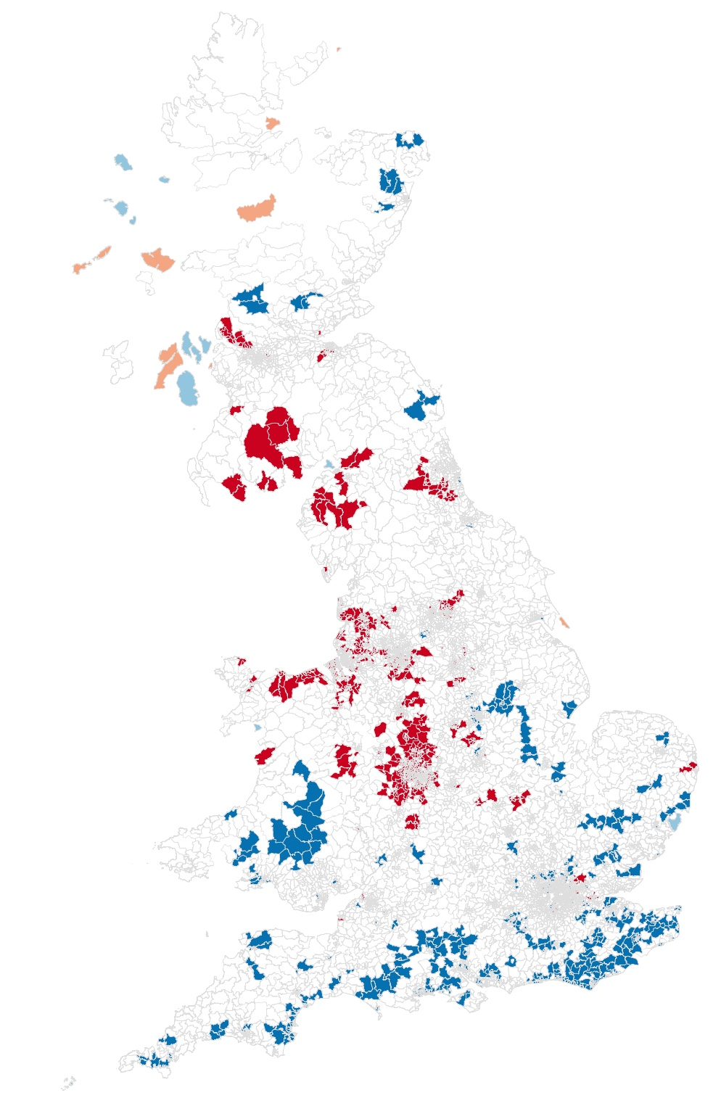
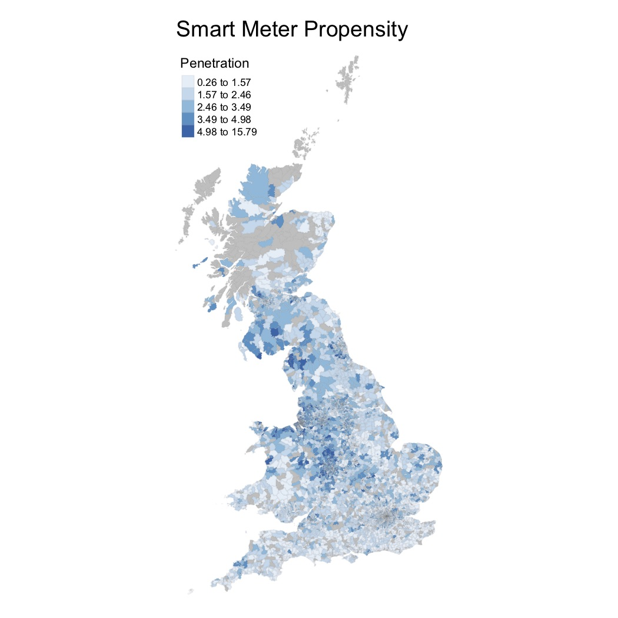
Spatial analysis
 | H-H
 | H-L
 | L-H
 | L-L
Notes:
The first map on the left shows the propensity of smart meters to total houses per postcode sector in the UK and the second map shows a LISA analysis , showing more clearly which areas are surrounded by other similar areas, so along the south coast blue represents low penetration areas surrounded by other low penetration areas, whereas in the Midlands and the North West, there are many areas of high penetration surrounded by other areas of high penetration
However we do have to consider that the DEP roll out scheme introduces a lot of bias into the dataset – all we know is that they knock on doors and if you’re home and you want one, they’ll fit one for you, otherwise you have to go to them and ask for one. Have they just not reached the south coast by this point in the dataset, or are people in the North West particularly good citizens of the earth? This data would suggest that the roll out has only taken place in certain parts of the UK, but we also have to consider the demographic of people who are likely to be at home during the day when they are doing the rounds – those who are unemployed, retired, or have caring duties – and that leads us to ask whether or not they consume energy differently to the rest of the population because of the profile of their daily routine and if so, how are they impacting the data we receive? And I think it might be fair to say that these biases impacted the clustering .

Slide 6
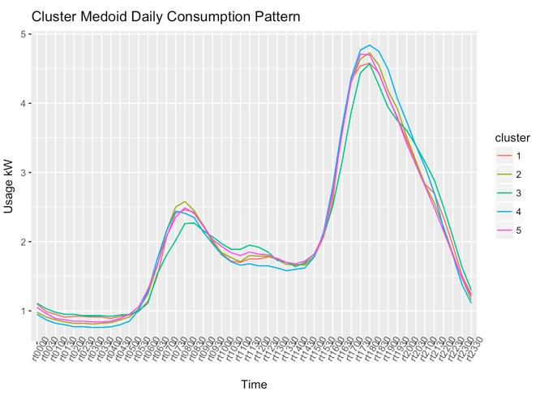
Notes:
With the energy dataset investigated in full, and aggregation complete it was firstly suggested that clustering of the energy usage would reveal some interesting patterns. Well. All this tells us is that regardless of your demographic, your temporal energy usage profile is very similar to the rest of the population. So with no variation, it was deemed best to move swiftly on. Although, I would be happy to talk afterwards if you've got any idea what might have gone on here!

Slide 7
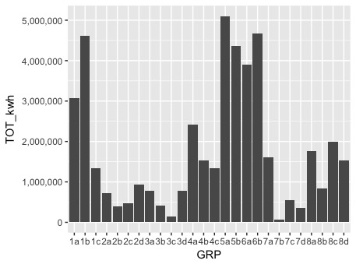
OAC group variations
Urban professionals and families
Semi-Detached Suburbia
Ethnic Dynamics
Constrained flat dwellers
Notes:
Taking a different tack, first off I attributed the energy data to the OAC groups.
There are some particularly interesting groups that are worth mentioning here. With regards to the literature on demographics, time and again, housing comes up as the most positively correlated with energy usage and these results would seem to corroborate that. Groups 5a and 6b in particular, when we look at their pen portraits, are said to be most likely to live in detached and semi detached aka larger houses, which could point to them having larger families and be able to afford the higher energy consumption.
It is also worth looking into the characteristics of 7b and 3c as the lowest consuming groups – they are most likely to live in flats or terraces, and and less likely to own their homes. The literature also states that tenure is positively correlated with consumption, the reasons for this being that as a landlord of a privately rented property, there is little to no incentive to put in place energy efficiency measures as the utility bills are typically covered by the tenant and they see little return on their investment. The same can of course be said for the tenant themselves – they won’t want to invest in long term solutions to a house they don’t own as they’re unlikely to reap the full benefit.
Secondly for some in depth analysis I did a linear regression model to understand the relationship between Townsend score, housing type and energy consumption, with significant results. Using semi detached housing as the reference variable as it is the largest in the dataset, the regression model showed that larger accommodation types use statistically more energy than smaller terrace houses and flats. It also shows that as a households townsend score and therefore relative deprivation levels rise, energy consumption decreases.

Slide 8

Notes:
And so to summarise, in some senses I have managed to get Gaz and Leccy under control. We can confidently say that this research fits into the existing literature and corroborates the idea the housing type is a relevant factor in energy consumption and we can build on this by making a clear argument for using deprivation level as a predicting factor as well, but we do have to consider how biased this data could be.
The ideal scenario is now to use this data to predict the energy usage where we have very sparse data, but the bias in the raw data, for now at least, probably inhibits that line of investigation.
Thank you very much, and I’m happy to take any questions.

