Slide 1
Clustering in R to evaluate domestic energy usage
library(dplyr)
rladies_global %>%
filter(city == ’Liverpool')
Notes:
I agreed to speak tonight because I need to give my current work in progress a dry run before I have to present it in New Orleans in May, and also because, and I’m not ashamed to admit it, I have hit a wall and run out of ideas – my results haven’t come out the way any of us thought they would and so, the brakes are on; so I’d like to make my questions at the end more of a discussion of what you think might be a good next step, if any of you have encountered this kimd of thing before.

Slide 2

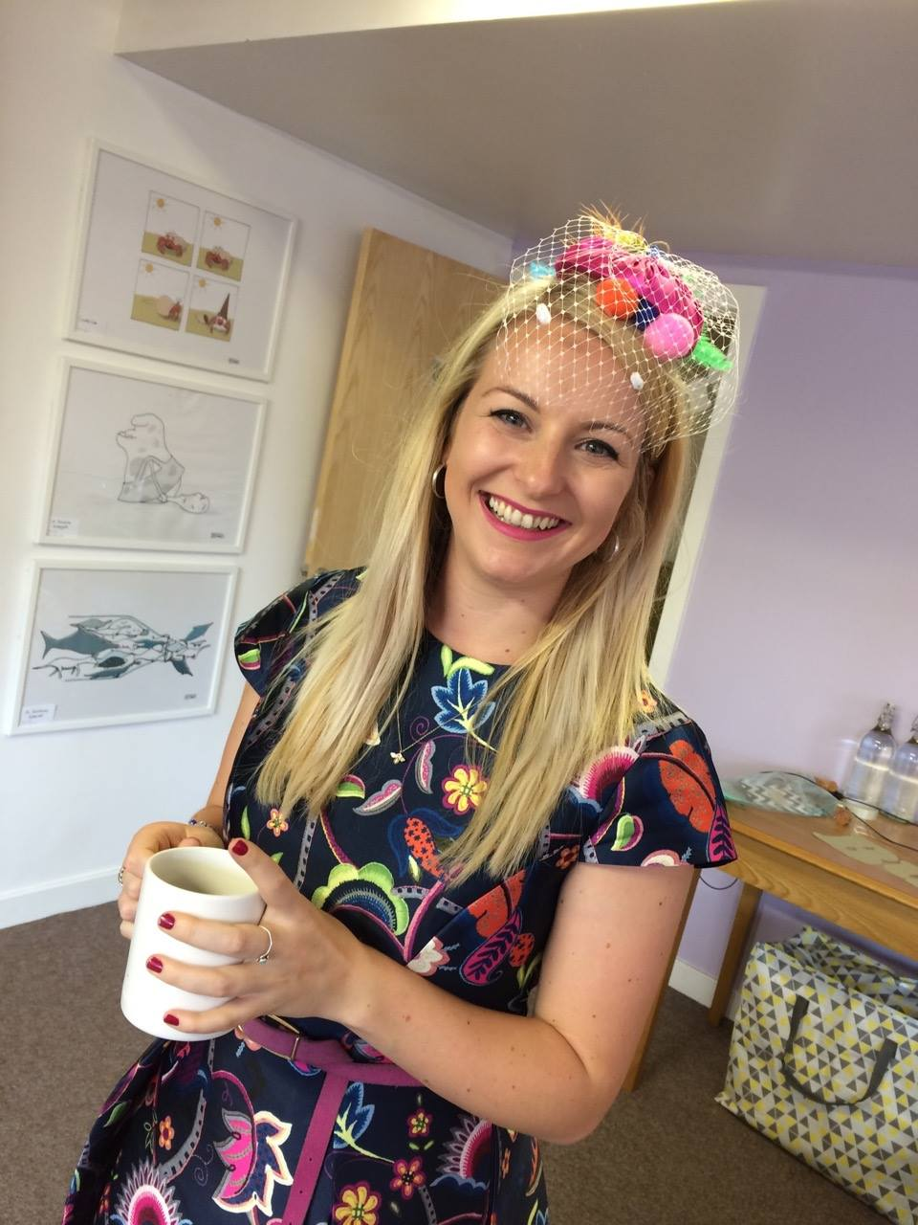

Hello!
R-Ladies Liverpool – est. 2017
Geographic Data Science Lab
@etalbot1291 (mostly dogs and nonsense)
Notes:
I founded R-Ladies Liverpool at the end of last year, mostly because my supervisor suggested it might be a great idea, and that’s basically the same as him giving me permission to procrastinate from my PhD even more than I already do. When I’m not procrastinating – see my twitter for more details – I’m part of the GDSL at the University of Liverpool and I’m very lucky to be sponsored by the CDRC.

Slide 3

R-Ladies Liverpool
Notes:
So procrastination aside, I have many other reasons for wanting to be involved in R-Ladies. I attended a great meet-up here in Manchester after struggling to find anything similar in Liverpool and decided it was definitely something we needed.

Slide 4
You cannot be what you cannot see”
Reshma Saujani
Founder and CEO of GirlsWhoCode
Notes:
My personal motivation comes from the fact that I truly believe in this statement. I’m exceptionally lucky to have a fabulous mum who has worked in a STEM job my entire life, and I’ve always been able to see what I wanted to be, but that isn’t the case for many women and girls.
This years girl guides survey reported that This year’s Girl Guides survey shows that only 37% of girls aged 7-21 would even consider a job in technology, even though 76% are confident in their skills! What chance do I have of changing the minds of the female undergraduate students I meet and teach for one hour a week when they are resenting having to take a coding module or feeling like this isn’t an industry where they are welcome and they have been feeling this way for 15 years? Even though women in STEM jobs is increasing, we still only make up 24% of the core STEM workforce and by starting R-Ladies Liverpool I wanted to create a safe space for these girls to come and explore and meet real life women in industry, so that they can start to see what they could be.

Slide 5
2018
Bi-monthly meet-ups
1st Meet-up : RStudio and Github 101
In person and twitter led book club
1st Book : Inferior by Angela Saini
Notes:
And so these are the plans we have in the pipeline for the coming year
Bi-monthly meet-ups, with a simple starter at first to get everybody up to speed.
I also found online that Rladies NYC run a successful bookclub on Goodreads.com and this is something I’m particularly interested in doing to reach those women who are interested in science and tech but don’t necessarily code, and ease them in – another way of making these girls feel like they belong, by reading empowering books, both fiction and non fiction. Which is why we are starting with Angela’s Saini’s imensley popular book : Inferior, how science got women wrong. After seeing Angela give a guest lecture in Liverpool in collaboration with the Liverpool Literay festival and the LivWise society, I really felt like this was a book everybody needed to read. And discuss, and tweet about. So look out for that on twitter in the near future, and join us on Goodreads to keep up with our latest choices – and suggest some too, if you’ve read anything good lately.

Slide 6
Smart Metering
Notes:
And now to the dull stuff. Smart metering. The domestic energy sector has been marked as one sector where energy usage continues to grow, despite increasingly efficient appliances and modern understanding of energy reduction methods. This is most likely due to the huge appetite in western countries in particular for convenience, comfort and cleanliness.
In the UK especially, the government suggests that a full Smart Meter rollout will be complete for both gas and electric by 2020, and this represents the biggest change to the UK energy market since the changeover to North Sea Gas.
Smart meters are considered to be innovative electricity meters that provide real time data on consumption and are instrumental to increasing efficiency. The data generated by these meters is available in a cadence never previously available enabling the profiling of consumer behaviours

Slide 7
292,855,095
6,141,494
That’s more data than I’ve ever seen in my life
That’s still loads
Notes:
We were suggestng that temporal trends in energy consumption had utility when defining daily life.
It is of course true to say that much of a persons daily routine can be understood both through their household characteristics such as family size, employment type and hobbies, and their energy usage – who makes breakfast without using any electricity? Who leaves the house at the same time most weekdays?
The kind of things we might have expected to see are:
- A drop in energy usage once the children have gone to bed in family households
- A steady use of energy throughout the day for those who are retired or
unemployed
- Peaks in energy usage at weekends for those who work long hours during the
week
- Some more unusual patterns – electric car users who’s energy usage may peak late
at night whilst they charge
The raw dataset of 292,855,095 rows had to be aggregated in order to avoid issues of re-identification of individuals. This was done to Postcode sector level, which equates to about 300 households, of which there are around 9300 across the United Kingdom, creates one row in the dataset for each recorded day, per postcode sector, per smart meter type.

Slide 8
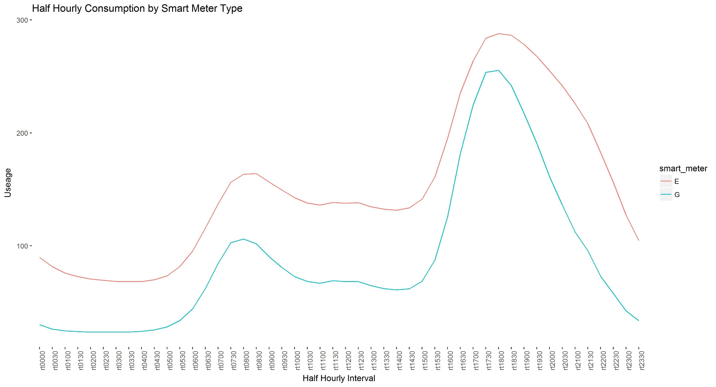
Half hourly consumption
Nice image!
Notes:
This first analysis was done on the entire dataset, and as you can see, the results are somewhat what we were expecting. An AM peak in both gas and electricty as people get up and begin their day, and a bigger PM peak when people tend to be at home for a longer period of time, before tailing off to a ‘standby’ rate during the night.

Slide 9
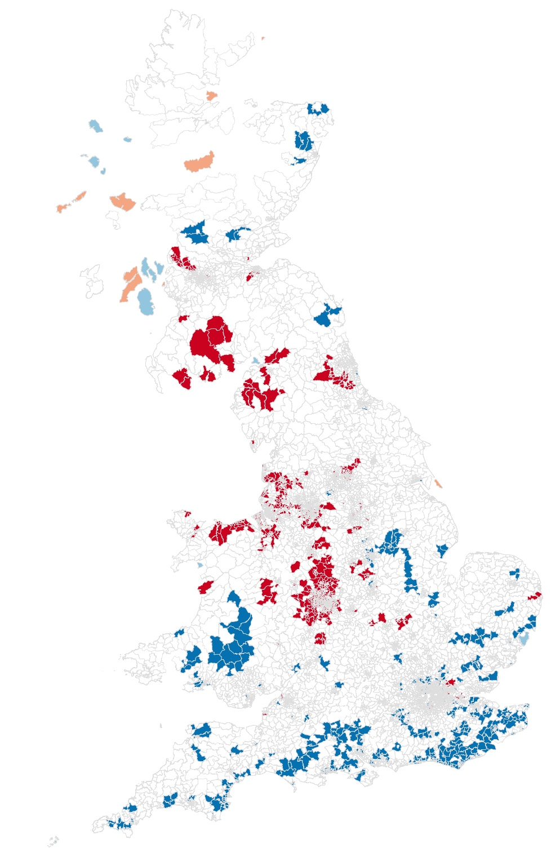
Spatial analysis
LISA analysis
Notes:
This map shows the ratio of smart meters to total number of households per postcode sector across the UK, which reveals a really interesting spatial pattern. A LISA analysis is a local morans I, describing which areas are surrounded by other similar areas, so along the south coast blue represents low penetration areas surrounded by other low penetration areas, whereas in the Midlands and the North West, there are many areas of high penetration surrounded by other areas of high penetration. But what this can’t tell us is why.
And neither can the Domestic Energy Provider. Their roll out scheme introduces a lot of bias into the dataset – they knock on doors and if you’re home and you want one, they’ll fit one for you, otherwise you have to go to them and ask for one. Have they just not reached the south coast by this point? I can only specualte about the reasons at this point, so let’s get on to the really troublesome part. Clustering.

Slide 10
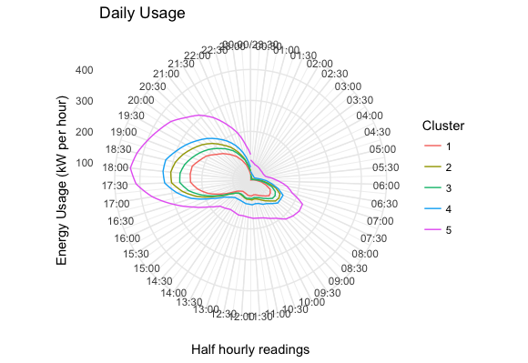
Clustering Absolute values
Notes:
I used a partioning around mediods clustering algorithm as against a K-means as much of the literature suggested, because of it’s scaleability and given the size of the dataset, a kmeans which produces an NxN matrix was likely to cause some kind of small fire.
Clustering on the absolute values does show that there is some variation in the volume of energy usage between clusters, but honestly, doesn’t tell us a great deal else. So remember those patterns we were expecting to see? In order to better investigate what percetage of the days energy use is used during any one half an hour slot, we standardised the dataset, and reclustered.

Slide 11
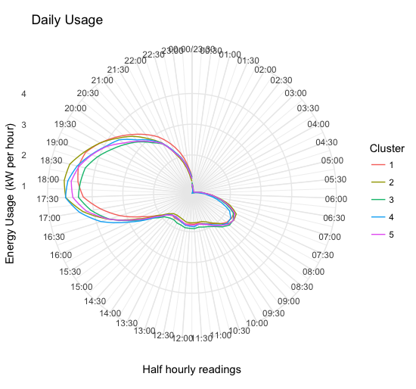
Clustering standardised values
Notes:
Oh.
And this is where the fun stops. There’s nothing to see here! All this tells us is that regardless of your demographic, your energy usage pattern is very similar to the rest of the population. Whether this is because ‘it just is’ or because of bias in the dataset, we are unable to tell.

Slide 12

Notes:
So I am hoping that some of you have similar stories to tell, suggestions or next steps for me. Please help me get Gaz and Leccy under control!

