Slide 1
An introduction to spatial analysis and the meetup API
library(dplyr)
rladies_global %>%
filter(city == ’Liverpool')

Slide 2
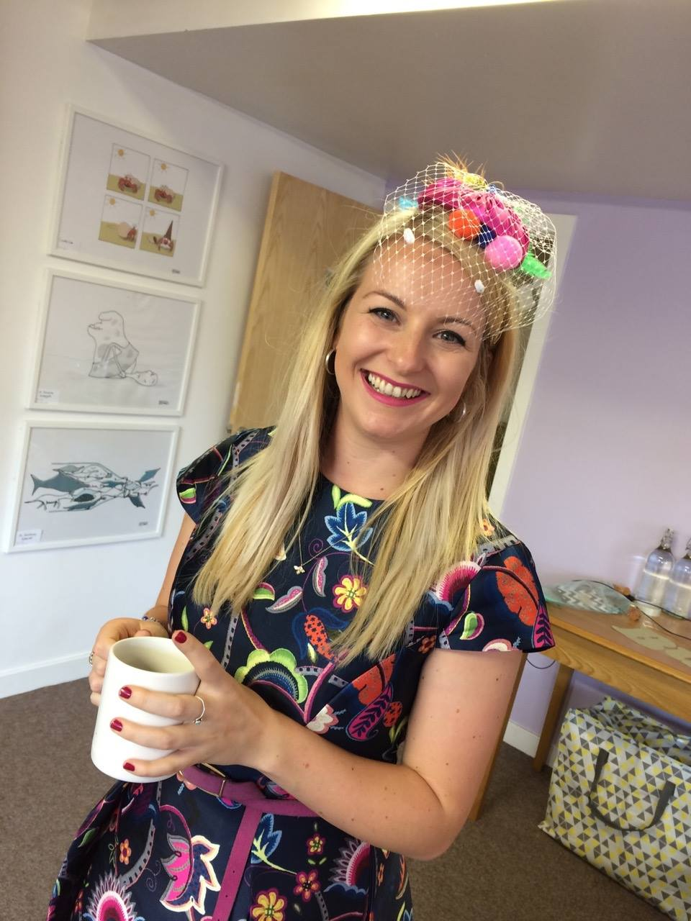




Hello!
R-Ladies Liverpool – est. 2017
Geographic Data Science Lab
@etalbot1291
Notes:
I come from a geographical background, with a bachelors in Human geography and a masters in Geographical data science. I’ currently part of the Geographic Data Science Lab at the University of Liverpool and working with the Consumer Data Research Centre.
This is where my R – journey began and since then I’ve found a community of likeminded people and come to love it, most days. My r picture currently looks a little like this – I would never have started using R if it weren’t for my masters, I would never have found and set up R-Ladies Liverpool if it wasn’t using R every day, and I would never have met fellow R Lady Steph and started working for her fantastic start up Locke Data, if it weren’t for R-Ladies Global, and I certainly wouldn’t be here at eRum if it weren’t for the generous sponsorship of R Forwards which again, I came across through R ladies, so I guess I have a lot to thank R for, and offering to speak tonight when R Ladies Budapest asked for volunteers seemed only fair.

Slide 3
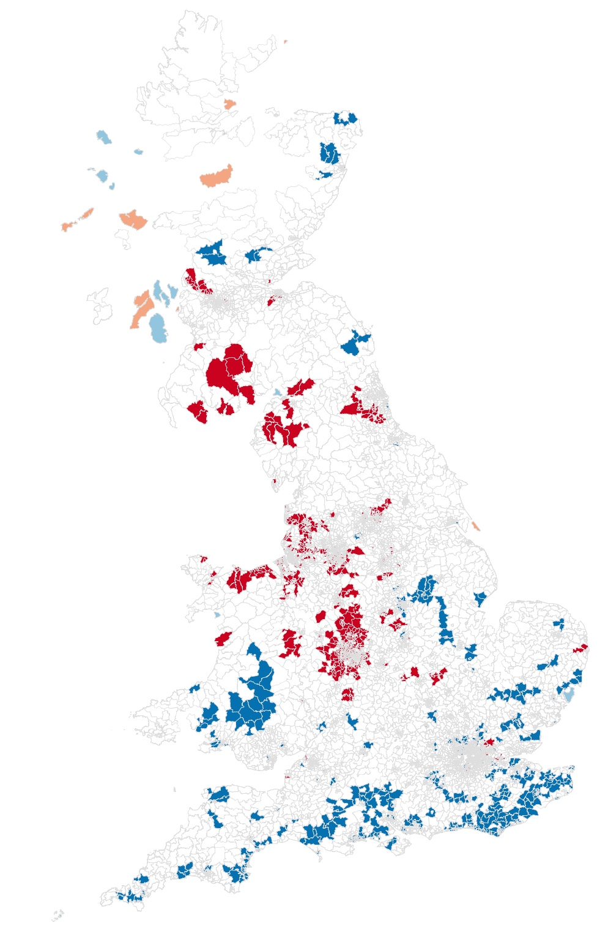
Spatial analysis
LISA analysis
Notes:
This is the kind of thing I do day to day, and I think spatial analysis is really important for bridging the gap between what we understand through common and local knowledge and what patterns we see in the data without a spatial visualisation. Without this global morans I analysis above, we would never have seen the distinct north/south divide. Even though the data we hold is inherantly spatial, postcodes within a dataset are meaningless out of context.
Now the statistical analysis that goes into producing a visualisation like this is what makes it complicated – actually generating your first map is relatively simple.

