Slide 1
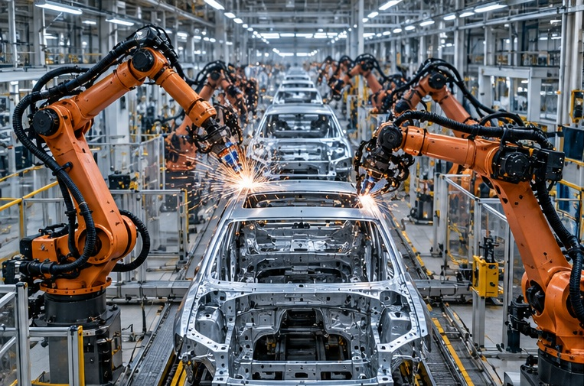
CONCEPTUAL ILLUSTRATION
TECHNOLOGICAL
CHINA
From the world's factory
to a technological powerhouse
INDUSTRIAL TRANSFORMATION
SERGIO GEVATSCHNAIDER
Notes:
TECHNOLOGICAL
CHINA
From the world's factory
to a technological powerhouse
SERGIO GEVATSCHNAIDER
INDUSTRIAL TRANSFORMATION
CONCEPTUAL ILLUSTRATION
Sources and further reading:

Slide 2
THE CENTRAL QUESTION
How does a technological powerhouse emerge?
The answer cannot be reduced to one invention, one company, or one policy.
01
INVENT
02
MANUFACTURE
Discover, design, and develop.
Turn ideas into reliable products.
03
LEARN
04
COORDINATE
Improve with every production cycle.
Connect talent, suppliers, and capital.
Notes:
THE CENTRAL QUESTION
How does a technological powerhouse emerge?
The answer cannot be reduced to one invention, one company, or one policy.
01
INVENT
Discover, design, and develop.
02
MANUFACTURE
Turn ideas into reliable products.
03
LEARN
Improve with every production cycle.
04
COORDINATE
Connect talent, suppliers, and capital.
Sources and further reading:

Slide 3
ROAD MAP
Five questions about industrial transformation
History, industrial case studies, and exercises to examine underlying mechanisms.
01
Where does industrial capability come from?
History + UNIDO
02
How does an advanced factory operate?
Shougang + Midea
03
Why do robots matter?
IFR + Unitree + Xiaomi
04
What is China pursuing by 2030?
AI+ + 15th Plan
05
Where do the limitations emerge?
Chips + demand + exports
Notes:
ROAD MAP
Five questions about industrial transformation
History, industrial case studies, and exercises to examine underlying mechanisms.
01
Where does industrial capability come from?
History + UNIDO
02
How does an advanced factory operate?
Shougang + Midea
03
Why do robots matter?
IFR + Unitree + Xiaomi
04
What is China pursuing by 2030?
AI+ + 15th Plan
05
Where do the limitations emerge?
Chips + demand + exports
Sources and further reading:

Slide 4

CONCEPTUAL ILLUSTRATION
SECTION 01
HISTORY
Before AI,
there was industry
Today's advantage rests on decades of investment,
learning, and production networks.
Notes:
SECTION 01
HISTORY
Before AI,
there was industry
Today's advantage rests on decades of investment,
learning, and production networks.
CONCEPTUAL ILLUSTRATION
Sources and further reading:

Slide 5
INDUSTRIAL TRAJECTORY
Four stages, one continuous accumulation of capabilities
Teaching periodization: stages overlap and do not imply abrupt transitions.
1978–2001
2001–2014
2015–2025
2026–2030
Reform and
opening up
Global
integration
Industrial
modernization
Intelligent
convergence
Investment, special economic zones,
initial capabilities
Exports, logistics,
suppliers, and learning
Automation, R&D,
batteries, and equipment
AI+, industrial AI, robotics,
and selective autonomy
Notes:
INDUSTRIAL TRAJECTORY
Four stages, one continuous accumulation of capabilities
Teaching periodization: stages overlap and do not imply abrupt transitions.
1978–2001
Reform and
opening up
Investment, special economic zones,
initial capabilities
2001–2014
Global
integration
Exports, logistics,
suppliers, and learning
2015–2025
Industrial
modernization
Automation, R&D,
batteries, and equipment
2026–2030
Intelligent
convergence
AI+, industrial AI, robotics,
and selective autonomy
Sources and further reading:

Slide 6
THE GREAT SHIFT
From less than 3% to nearly one-third of the world
China's share of global manufacturing value added.
×11.4
increase in the share
between the two
years
This share measures manufacturing value added, not productivity per worker.
Notes:
THE GREAT SHIFT
From less than 3% to nearly one-third of the world
China's share of global manufacturing value added.
×11.4
increase in the share
between the two
years
This share measures manufacturing value added, not productivity per worker.
Sources and further reading:
https://stat.unido.org/publications/international-yearbook-industrial-statistics-2025
https://www.unido.org/sites/default/files/unido-publications/2025-11/UNIDO%20Industrial%20Statistics%20Yearbook%202025.pdf

Slide 7
INDUSTRIAL CAPABILITIES
A factory's strength depends on its ecosystem
Knowledge is distributed among firms and organizations.
Universities
Suppliers
Financing
COMPLEX PRODUCT
Logistics
Companies
Government and cities
Connections enable the sharing of knowledge, resources, and responsiveness.
Notes:
INDUSTRIAL CAPABILITIES
A factory's strength depends on its ecosystem
Knowledge is distributed among firms and organizations.
COMPLEX PRODUCT
Universities
Logistics
Suppliers
Companies
Financing
Government and cities
Connections enable the sharing of knowledge, resources, and responsiveness.
Sources and further reading:

Slide 8
TEACHING EXERCISE 01
Two companies design the same robotic hand
Hypothetical example illustrating supplier coordination times.
COMPANY A
COMPANY B
Dispersed suppliers
Integrated supplier network
20 weeks
8 weeks
The difference is not “innate intelligence”: it is coordination, prototypes, learning, and logistics.
Notes:
This is a hypothetical teaching example. Its numbers do not describe an observed plant.
TEACHING EXERCISE 01
Two companies design the same robotic hand
Hypothetical example illustrating supplier coordination times.
COMPANY A
Dispersed suppliers
20 weeks
COMPANY B
Integrated supplier network
8 weeks
The difference is not “innate intelligence”: it is coordination, prototypes, learning, and logistics.
Sources and further reading:

Slide 9
INSTITUTIONS AND COMPETITION
Planning, local experimentation, and competition
Central coordination coexists with provincial experimentation and business competition.
CENTRAL GOVERNMENT
LOCAL GOVERNMENTS
Plans, standards, priorities
Industrial parks, infrastructure, incentives
COMPANIES
SUPPLIERS
Design, manufacturing, competition
Components, lead times, improvements
POTENTIAL ADVANTAGE: learning / RISK: overinvestment and duplication
Notes:
INSTITUTIONS AND COMPETITION
Planning, local experimentation, and competition
Central coordination coexists with provincial experimentation and business competition.
CENTRAL GOVERNMENT
Plans, standards, priorities
LOCAL GOVERNMENTS
Industrial parks, infrastructure, incentives
COMPANIES
Design, manufacturing, competition
SUPPLIERS
Components, lead times, improvements
POTENTIAL ADVANTAGE: learning / RISK: overinvestment and duplication
Sources and further reading:

Slide 10
INDUSTRIAL GEOGRAPHY
China is a network of technological hubs
Specializations are not exclusive: they overlap and evolve.
BEIJING
Universities, research, AI
SHANGHAI / SUZHOU
Advanced manufacturing and equipment
SHENZHEN / GUANGDONG
Electronics, hardware, and vehicles
HANGZHOU
Digital platforms and software
HEFEI / WUHAN / CHENGDU
Specialized industrial hubs
Notes:
INDUSTRIAL GEOGRAPHY
China is a network of technological hubs
Specializations are not exclusive: they overlap and evolve.
BEIJING
Universities, research, AI
SHANGHAI / SUZHOU
Advanced manufacturing and equipment
SHENZHEN / GUANGDONG
Electronics, hardware, and vehicles
HANGZHOU
Digital platforms and software
HEFEI / WUHAN / CHENGDU
Specialized industrial hubs
Sources and further reading:

Slide 11
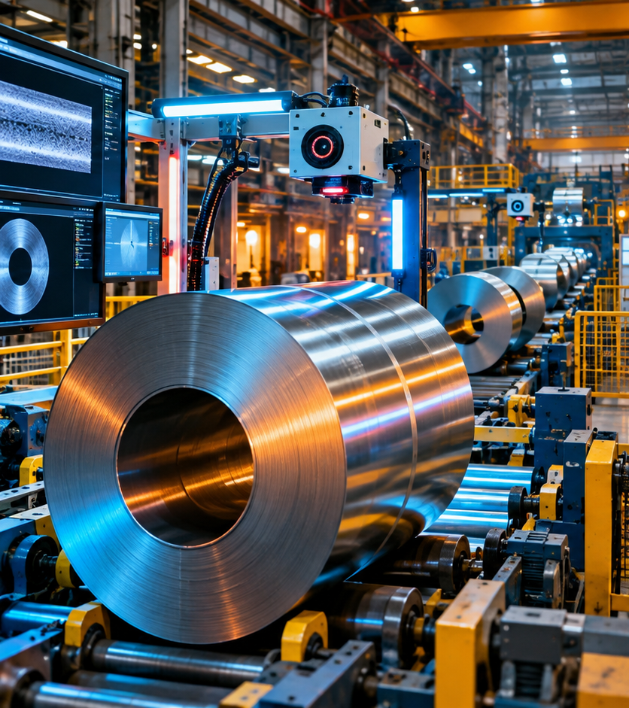
CONCEPTUAL ILLUSTRATION
SECTION 02
THE SMART FACTORY
A machine is not
a factory
Digitalization, automation, and AI are distinct layers
of industrial capability.
Notes:
SECTION 02
THE SMART FACTORY
A machine is not
a factory
Digitalization, automation, and AI are distinct layers
of industrial capability.
CONCEPTUAL ILLUSTRATION
Sources and further reading:

Slide 12
THREE DISTINCT CONCEPTS
Digitalization, automation, and artificial intelligence
A factory can do one of these without necessarily doing the others.
01
02
03
DIGITALIZE
AUTOMATE
USE AI
Record and connect information
Perform tasks under automatic control
Infer patterns and support
decisions
Sensors, data, traceability
PLCs, CNC, robots, actuators
Computer vision, prediction, optimization
Notes:
THREE DISTINCT CONCEPTS
Digitalization, automation, and artificial intelligence
A factory can do one of these without necessarily doing the others.
01
DIGITALIZE
Record and connect information
Sensors, data, traceability
02
AUTOMATE
Perform tasks under automatic control
PLCs, CNC, robots, actuators
03
USE AI
Infer patterns and support
decisions
Computer vision, prediction, optimization
Sources and further reading:

Slide 13
DECISION CHAIN
From a weld to a verifiable action
AI helps detect problems; control, engineering, and safety remain essential.
1
2
3
4
5
WELDING
CAMERA
MODEL
VALIDATION
ACTION
Physical process
Image capture
Estimated anomaly
Technician / rules
Rework / alert
A model cannot “see” every defect or bypass quality validation.
Notes:
DECISION CHAIN
From a weld to a verifiable action
AI helps detect problems; control, engineering, and safety remain essential.
1
WELDING
Physical process
2
CAMERA
Image capture
3
MODEL
Estimated anomaly
4
VALIDATION
Technician / rules
5
ACTION
Rework / alert
A model cannot “see” every defect or bypass quality validation.
Sources and further reading:

Slide 14
REAL-WORLD CASE · SHOUGANG
Can AI help produce higher-quality steel?
Beijing Shougang Cold Rolling · Global Lighthouse Network.
CONCEPTUAL ILLUSTRATION
67
advanced manufacturing
technology applications
61%
of them incorporated AI
TRADITIONAL INDUSTRY CASE
Notes:
REAL-WORLD CASE · SHOUGANG
Can AI help produce higher-quality steel?
Beijing Shougang Cold Rolling · Global Lighthouse Network.
67
advanced manufacturing
technology applications
61%
of them incorporated AI
TRADITIONAL INDUSTRY CASE
CONCEPTUAL ILLUSTRATION
Sources and further reading:
https://www.weforum.org/media/global-lighthouse-network-2025-world-economic-forum-recognizes-companies-transforming-manufacturing-through-innovation/

Slide 15
SHOUGANG · MEASURED IMPACT
Fewer defects; greater production efficiency
Figures reported by the WEF case study, not a controlled causal experiment.
−35%
+21.2%
−55%
Product defects
Production-line efficiency
Customer complaints
If there were 100 defects before, a 35% reduction would leave 65.
Notes:
SHOUGANG · MEASURED IMPACT
Fewer defects; greater production efficiency
Figures reported by the WEF case study, not a controlled causal experiment.
−35%
Product defects
+21.2%
Production-line efficiency
−55%
Customer complaints
If there were 100 defects before, a 35% reduction would leave 65.
Sources and further reading:
https://www.weforum.org/media/global-lighthouse-network-2025-world-economic-forum-recognizes-companies-transforming-manufacturing-through-innovation/

Slide 16
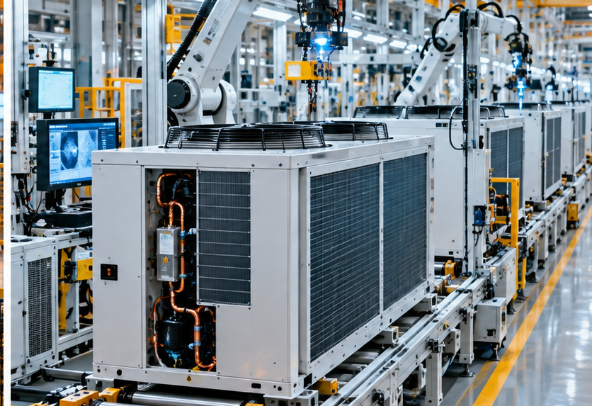
REAL-WORLD CASE · MIDEA
A factory that learns to produce different orders
Midea General Refrigeration, Chongqing · Refrigeration and industrial equipment.
CONCEPTUAL ILLUSTRATION
FLEXIBLE PRODUCTION
79
digital use cases deployed
Customized orders:
from 31% to 87%
Notes:
REAL-WORLD CASE · MIDEA
A factory that learns to produce different orders
Midea General Refrigeration, Chongqing · Refrigeration and industrial equipment.
FLEXIBLE PRODUCTION
79
digital use cases deployed
Customized orders:
from 31% to 87%
CONCEPTUAL ILLUSTRATION
Sources and further reading:
https://www.weforum.org/media/global-lighthouse-network-2025-world-economic-forum-recognizes-companies-transforming-manufacturing-through-innovation/

Slide 17
MIDEA · RESULTS
Customization without sacrificing speed or quality
WEF case study: indicators reported following the plant's digital transformation.
−81%
−45%
−31%
Setup time
Design time
After-sales failures
If setup took 100 minutes, an 81% reduction would bring it down to 19 minutes.
Notes:
MIDEA · RESULTS
Customization without sacrificing speed or quality
WEF case study: indicators reported following the plant's digital transformation.
−81%
Setup time
−45%
Design time
−31%
After-sales failures
If setup took 100 minutes, an 81% reduction would bring it down to 19 minutes.
Sources and further reading:
https://www.weforum.org/media/global-lighthouse-network-2025-world-economic-forum-recognizes-companies-transforming-manufacturing-through-innovation/

Slide 18
REAL-WORLD ROBOTICS · IFR
China accounts for 59% of new robot installations
Industrial robot installations in 2025, a different category from humanoids.
354,000
59%
Industrial robots installed in China
Share of global installations
55%
share held by Chinese suppliers in their domestic market
Notes:
REAL-WORLD ROBOTICS · IFR
China accounts for 59% of new robot installations
Industrial robot installations in 2025, a different category from humanoids.
354,000
Industrial robots installed in China
59%
Share of global installations
55%
share held by Chinese suppliers in their domestic market
Sources and further reading:
https://ifr.org/downloads/press_docs/EN-2026-SEP-24-IFR_Press_Release_WR-CHINA.pdf
https://ifr.org/downloads/press_docs/EN-2026-SEP-24-IFR_Press_Release_WR-USA.pdf
https://ifr.org/ifr-press-releases/five-million-robots-now-operate-in-factories-globally

Slide 19

TWO KINDS OF ROBOTICS
An industrial arm and a humanoid are not equivalent
Humanoids are visually compelling; evidence of mass industrial adoption is different.
CONCEPTUAL ILLUSTRATION
INDUSTRIAL ROBOT · repeatable task
HUMANOID · mobility and manipulation
Notes:
TWO KINDS OF ROBOTICS
An industrial arm and a humanoid are not equivalent
Humanoids are visually compelling; evidence of mass industrial adoption is different.
INDUSTRIAL ROBOT · repeatable task
HUMANOID · mobility and manipulation
CONCEPTUAL ILLUSTRATION
Sources and further reading:

Slide 20
UNITREE CASE · G1
A humanoid embodies an entire industrial network
Behind its movements lie electronics, motors, control, sensors, and batteries.
CONCEPTUAL ILLUSTRATION
ACTUATORS
Motors and transmission
PERCEPTION
Cameras and sensors
COMPUTING
Chips and software
ENERGY
Batteries and management
CONTROL
Motion and balance
Notes:
UNITREE CASE · G1
A humanoid embodies an entire industrial network
Behind its movements lie electronics, motors, control, sensors, and batteries.
ACTUATORS
Motors and transmission
PERCEPTION
Cameras and sensors
COMPUTING
Chips and software
ENERGY
Batteries and management
CONTROL
Motion and balance
CONCEPTUAL ILLUSTRATION
Sources and further reading:
https://www.unitree.com/g1/

Slide 21
UNITREE · EVIDENCE
An impressive video does not prove industrial autonomy
Three levels of evidence that must not be confused.
01
DEMONSTRATION
Walks, dances, or performs a routine.
Teleoperated? How many attempts?
02
TECHNICAL CAPABILITY
Perceives, controls joints, manipulates objects.
With what precision and in what environment?
03
PRODUCTIVE VALUE
Works safely, reliably, and at competitive cost.
What are its uptime, failure rate, and cost?
Notes:
UNITREE · EVIDENCE
An impressive video does not prove industrial autonomy
Three levels of evidence that must not be confused.
01
DEMONSTRATION
Walks, dances, or performs a routine.
Teleoperated? How many attempts?
02
TECHNICAL CAPABILITY
Perceives, controls joints, manipulates objects.
With what precision and in what environment?
03
PRODUCTIVE VALUE
Works safely, reliably, and at competitive cost.
What are its uptime, failure rate, and cost?
Sources and further reading:
https://www.unitree.com/g1/

Slide 22
TEACHING EXERCISE 02
The same 20 robots, different outcomes
Assumptions: same workforce, shifts, complexity, and required quality.
FACTORY A
FACTORY B
100 workers + 20 robots
100 workers + 20 robots
1,000 parts · 5% defects
1,150 parts · 2% defects
950
1,127
good parts per day
good parts per day
Factory B produces 177 more good parts per day: +18.6% without buying more robots.
Notes:
This is a hypothetical teaching example. Its numbers do not describe an observed plant.
TEACHING EXERCISE 02
The same 20 robots, different outcomes
Assumptions: same workforce, shifts, complexity, and required quality.
FACTORY A
100 workers + 20 robots
1,000 parts · 5% defects
950
good parts per day
FACTORY B
100 workers + 20 robots
1,150 parts · 2% defects
1,127
good parts per day
Factory B produces 177 more good parts per day: +18.6% without buying more robots.
Sources and further reading:

Slide 23
THE ECONOMIC LOGIC
More robots do not automatically mean higher productivity
Five conditions must be evaluated before investing.
01
CAPITAL
Purchase price and installation
02
OPERATIONS
Uptime and failures
03
PEOPLE
Engineering and training
04
QUALITY
Defects and rework
05
DEMAND
Sales needed to recoup investment
Notes:
THE ECONOMIC LOGIC
More robots do not automatically mean higher productivity
Five conditions must be evaluated before investing.
01
CAPITAL
Purchase price and installation
02
OPERATIONS
Uptime and failures
03
PEOPLE
Engineering and training
04
QUALITY
Defects and rework
05
DEMAND
Sales needed to recoup investment
Sources and further reading:
https://sgevatschnaider.github.io/Inteligencia-Artificial-y-Rob-tica-en-China/recursos/Capital%20Rob%C3%B3tico%20vs%20Capital%20Com%C3%BAn%20%E2%80%94%20Efecto%20del%20Data%20Flywheel.html

Slide 24
CASE STUDY · XIAOMI
From electronics to the electric car
A case of capability transfer: software, hardware, suppliers, and engineering.
CONCEPTUAL ILLUSTRATION
BEFORE
Electronics and connected devices
CAPABILITY TRANSFER
Design, software, supply chain
NEW SECTOR
Electric vehicles and integrated manufacturing
Notes:
CASE STUDY · XIAOMI
From electronics to the electric car
A case of capability transfer: software, hardware, suppliers, and engineering.
BEFORE
Electronics and connected devices
CAPABILITY TRANSFER
Design, software, supply chain
NEW SECTOR
Electric vehicles and integrated manufacturing
CONCEPTUAL ILLUSTRATION
Sources and further reading:
https://www.xiaomiev.com/hyperfactory

Slide 25
THE ELECTRIC VEHICLE ECOSYSTEM
China turns industrial capabilities into a new sector
Electric vehicles in China, BEVs and PHEVs. Data for 2025.
≈ 16 M
≈ 75%
>2.5 M
Electric vehicles manufactured in
China
Share of global production, 2025
China's electric vehicle exports
in 2025
Batteries + motors + chips + software + suppliers + market = integrated industry
Notes:
THE ELECTRIC VEHICLE ECOSYSTEM
China turns industrial capabilities into a new sector
Electric vehicles in China, BEVs and PHEVs. Data for 2025.
≈ 16 M
Electric vehicles manufactured in
China
≈ 75%
Share of global production, 2025
>2.5 M
China's electric vehicle exports
in 2025
Batteries + motors + chips + software + suppliers + market = integrated industry
Sources and further reading:
https://www.iea.org/reports/global-ev-outlook-2026/manufacturing-and-trade

Slide 26
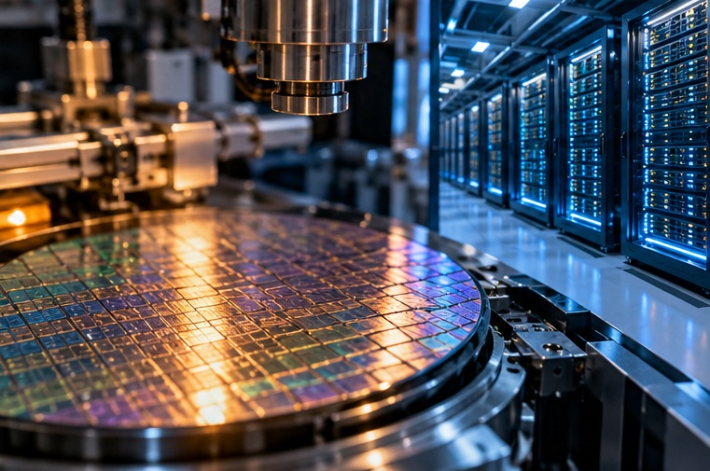
CONCEPTUAL ILLUSTRATION
SECTION 03
AI + INDUSTRY
Artificial
intelligence leaves
the laboratory
Its value depends on data, people, and processes
capable of putting it to work.
Notes:
SECTION 03
AI + INDUSTRY
Artificial
intelligence leaves
the laboratory
Its value depends on data, people, and processes
capable of putting it to work.
CONCEPTUAL ILLUSTRATION
Sources and further reading:

Slide 27
OFFICIAL CONCEPT · AI+
Six areas of application for artificial intelligence
China's State Council · Guidelines issued in August 2025.
1
SCIENCE
2
INDUSTRY
3
CONSUMPTION
Discovery and simulation
Manufacturing and processes
Products and services
4
PUBLIC WELL-BEING
5
GOVERNANCE
6
COOPERATION
Health and education
Public administration
International cooperation
Notes:
OFFICIAL CONCEPT · AI+
Six areas of application for artificial intelligence
China's State Council · Guidelines issued in August 2025.
1
SCIENCE
Discovery and simulation
2
INDUSTRY
Manufacturing and processes
3
CONSUMPTION
Products and services
4
PUBLIC WELL-BEING
Health and education
5
GOVERNANCE
Public administration
6
COOPERATION
International cooperation
Sources and further reading:
https://www.cac.gov.cn/2025-08/27/c_1758018277755538.htm

Slide 28
AI+ · TARGETS
The AI+ targets for 2027 and 2030
Target penetration of next-generation smart terminals and AI agent applications.
>70%
>90%
2035
Official target for 2027
Official target for 2030
Horizon for an intelligent economy
and society
The indicator refers to smart terminals and AI agent applications.
Notes:
AI+ · TARGETS
The AI+ targets for 2027 and 2030
Target penetration of next-generation smart terminals and AI agent applications.
>70%
Official target for 2027
>90%
Official target for 2030
2035
Horizon for an intelligent economy
and society
The indicator refers to smart terminals and AI agent applications.
Sources and further reading:
https://cset.georgetown.edu/publication/china-ai-plus-opinions-2025/

Slide 29
TEACHING EXERCISE 03
How can AI help prevent a machine from stopping?
HYPOTHETICAL example of predictive maintenance.
BEFORE
AFTER
160 h
80 h
of unplanned downtime per year
of unplanned downtime per year
50% less downtime does NOT mean 50% more total production.
Notes:
This is a hypothetical teaching example. Its numbers do not describe an observed plant.
TEACHING EXERCISE 03
How can AI help prevent a machine from stopping?
HYPOTHETICAL example of predictive maintenance.
BEFORE
160 h
of unplanned downtime per year
AFTER
80 h
of unplanned downtime per year
50% less downtime does NOT mean 50% more total production.
Sources and further reading:

Slide 30
CONDITIONS FOR USE
The requirements for industrial AI adoption
Buying a model is not the same as improving a factory.
DATA
MODELS
Are the sensors reliable?
Do they solve a real problem?
PEOPLE
PROCESSES
Who validates and repairs?
Can the decision actually be implemented?
Integration determines how effectively technology is used.
Notes:
CONDITIONS FOR USE
The requirements for industrial AI adoption
Buying a model is not the same as improving a factory.
DATA
Are the sensors reliable?
MODELS
Do they solve a real problem?
PEOPLE
Who validates and repairs?
PROCESSES
Can the decision actually be implemented?
Integration determines how effectively technology is used.
Sources and further reading:

Slide 31
CONCEPTUAL ILLUSTRATION
SECTION 04
STRATEGY 2030
The 15th
Five-Year Plan:
new productive
capabilities
The objective is to reshape the industry's technology mix, not merely increase its output.
Notes:
SECTION 04
STRATEGY 2030
The 15th Five-Year Plan:
new productive
capabilities
The objective is to reshape the industry's technology mix,
not merely increase its output.
CONCEPTUAL ILLUSTRATION
Sources and further reading:

Slide 32
THREE POLICY HORIZONS
Three instruments of industrial modernization
Distinct instruments that overlap and respond to changing needs.
2015
2025
2026–2030
MADE IN CHINA 2025
ARTIFICIAL
INTELLIGENCE+
15TH FIVE-YEAR PLAN
Modernize industries, equipment,
and components.
Spread AI across many sectors
of the economy.
Integrate innovation, industry,
and technological security.
Notes:
THREE POLICY HORIZONS
Three instruments of industrial modernization
Distinct instruments that overlap and respond to changing needs.
2015
MADE IN CHINA 2025
Modernize industries, equipment,
and components.
2025
ARTIFICIAL
INTELLIGENCE+
Spread AI across many sectors
of the economy.
2026–2030
15TH FIVE-YEAR PLAN
Integrate innovation, industry,
and technological security.
Sources and further reading:
https://www.moe.gov.cn/jyb_xwfb/xw_zt/moe_357/2026/2026_zt03/yw/202603/t20260314_1430877.html
https://www.ndrc.gov.cn/fggz/fzzlgh/gjfzgh/202603/U020260317369114704096.pdf

Slide 33

A NEW DEVELOPMENT CONCEPT
“New quality productive forces”
Three industrial horizons under the 15th Five-Year Plan.
01
UPGRADE EXISTING INDUSTRIES
Steel, machinery, chemicals: quality and efficiency.
02
SCALE UP EMERGING INDUSTRIES
Robotics, smart vehicles, new materials.
03
EXPLORE FUTURE INDUSTRIES
Embodied AI, quantum technologies, 6G, and more.
Notes:
A NEW DEVELOPMENT CONCEPT
“New quality productive forces” · 新质生产力
Three industrial horizons under the 15th Five-Year Plan.
01
UPGRADE EXISTING INDUSTRIES
Steel, machinery, chemicals: quality and efficiency.
02
SCALE UP EMERGING INDUSTRIES
Robotics, smart vehicles, new materials.
03
EXPLORE FUTURE INDUSTRIES
Embodied AI, quantum technologies, 6G, and more.
Sources and further reading:
https://www.moe.gov.cn/jyb_xwfb/xw_zt/moe_357/2026/2026_zt03/yw/202603/t20260314_1430877.html
https://www.ndrc.gov.cn/fggz/fzzlgh/gjfzgh/202603/U020260317369114704096.pdf
Chinese term: 新质生产力. The glyphs on this slide reproduce the supplied English PDF.

Slide 34
FROM POLICY DECISIONS TO DATA
A plan is not an operational factory
How to assess an industrial program at four different levels.
01
02
03
04
ANNOUNCEMENT
POLICY INSTRUMENT
IMPLEMENTATION
OUTCOME
Goals and priorities
Rules, budgets,
incentives
Plants, contracts,
training
Productivity, quality,
sales
Four distinct levels: an official target does not prove that an investment was profitable.
Notes:
FROM POLICY DECISIONS TO DATA
A plan is not an operational factory
How to assess an industrial program at four different levels.
01
ANNOUNCEMENT
Goals and priorities
02
POLICY INSTRUMENT
Rules, budgets,
incentives
03
IMPLEMENTATION
Plants, contracts,
training
04
OUTCOME
Productivity, quality,
sales
Four distinct levels: an official target does not prove that an investment was profitable.
Sources and further reading:

Slide 35
CONCEPTUAL ILLUSTRATION
SECTION 05
GEOPOLITICS
The network also has
weak points
Manufacturing strength can coexist with
dependence, overinvestment, and vulnerability.
Notes:
SECTION 05
GEOPOLITICS
The network also has
weak points
Manufacturing strength can coexist with
dependence, overinvestment, and vulnerability.
CONCEPTUAL ILLUSTRATION
Sources and further reading:

Slide 36
TEACHING EXERCISE 04
One missing part can stop the entire line
Hypothetical example: one essential chip per device, with no substitute.
10,000
6,000
Weekly factory capacity
Critical chips available
Maximum possible output: 6,000 devices → 40% of capacity unused
Notes:
This is a hypothetical teaching example. Its numbers do not describe an observed plant.
TEACHING EXERCISE 04
One missing part can stop the entire line
Hypothetical example: one essential chip per device, with no substitute.
10,000
Weekly factory capacity
6,000
Critical chips available
Maximum possible output: 6,000 devices →40% of capacity unused
Sources and further reading:

Slide 37
TECHNOLOGICAL RIVALRY
China and the United States have different strengths
Competition depends on the segment analyzed, not one overall scoreboard.
CHINA
UNITED STATES
Manufacturing scale
Frontier-model ecosystem
Dense supplier networks
Cloud computing and digital platforms
Industrial robot installations
Specialized software and tools
Batteries and electric vehicles
International technology alliances
Notes:
TECHNOLOGICAL RIVALRY
China and the United States have different strengths
Competition depends on the segment analyzed, not one overall scoreboard.
CHINA
UNITED STATES
Manufacturing scale
Dense supplier networks
Industrial robot installations
Batteries and electric vehicles
Frontier-model ecosystem
Cloud computing and digital platforms
Specialized software and tools
International technology alliances
Sources and further reading:
https://hai.stanford.edu/ai-index/2026-ai-index-report

Slide 38
THE PARADOX OF SUCCESS
A strong industry can also generate excess capacity
Hypothetical example of installed capacity and demand in comparable units.
INSTALLED CAPACITY
1,000,000
EFFECTIVE DEMAND
650,000
65% utilization · 35% idle capacity
Notes:
This is a hypothetical teaching example. Its numbers do not describe an observed plant.
THE PARADOX OF SUCCESS
A strong industry can also generate excess capacity
Hypothetical example of installed capacity and demand in comparable units.
INSTALLED CAPACITY
1,000,000
EFFECTIVE DEMAND
650,000
65% utilization · 35% idle capacity
Sources and further reading:

Slide 39
REAL-WORLD CASE · ELECTRIC VEHICLES
More production, intense competition, and rising exports
Electric vehicles in 2025. Production, sales, and exports are different series.
≈16 M
>13 M
>2.5 M
EVs manufactured in
China
Domestic sales in 2025
Exports from China in 2025
Price competition squeezes margins: exports can help sustain sales.
Notes:
REAL-WORLD CASE · ELECTRIC VEHICLES
More production, intense competition, and rising exports
Electric vehicles in 2025. Production, sales, and exports are different series.
≈16 M
EVs manufactured in
China
>13 M
Domestic sales in 2025
>2.5 M
Exports from China in 2025
Price competition squeezes margins: exports can help sustain sales.
Sources and further reading:
https://www.iea.org/reports/global-ev-outlook-2026/manufacturing-and-trade

Slide 40
A RIGOROUS READING
Four common confusions to avoid
Government, corporate, and teaching data have different evidentiary weight.
01
ANNOUNCEMENT ≠ ACHIEVEMENT
A plan specifies targets, not results.
02
DEMO ≠ AUTONOMY
A walking robot does not prove profitable work.
03
ROBOTS INSTALLED ≠ MANUFACTURED
Adoption and production are different measures.
04
REPORTED CASE ≠ CAUSALITY
Improvement may reflect several technologies.
Notes:
A RIGOROUS READING
Four common confusions to avoid
Government, corporate, and teaching data have different evidentiary weight.
01
ANNOUNCEMENT ≠ ACHIEVEMENT
A plan specifies targets, not results.
02
DEMO ≠ AUTONOMY
A walking robot does not prove profitable work.
03
ROBOTS INSTALLED ≠ MANUFACTURED
Adoption and production are different measures.
04
REPORTED CASE ≠ CAUSALITY
Improvement may reflect several technologies.
Sources and further reading:

Slide 41
THE CENTRAL THESIS
How did China build a technological powerhouse?
A sequence of accumulated capabilities, not a single-cause explanation.
01
02
03
04
05
HISTORY
NETWORKS
LEARNING
TECHNOLOGY
OUTCOMES
Build the capacity
to manufacture
Connect firms
and knowledge
Improve design
and processes
Integrate robots,
data, and AI
Compete, innovate,
and face limits
Innovation is built through manufacturing, coordination, and learning. It is not
necessarily guaranteed.
Notes:
THE CENTRAL THESIS
How did China build a technological powerhouse?
A sequence of accumulated capabilities, not a single-cause explanation.
01
HISTORY
Build the capacity
to manufacture
02
NETWORKS
Connect firms
and knowledge
03
LEARNING
Improve design
and processes
04
TECHNOLOGY
Integrate robots,
data, and AI
05
OUTCOMES
Compete, innovate,
and face limits
Innovation is built through manufacturing, coordination, and learning. It is not
necessarily guaranteed.
Sources and further reading:

Slide 42
THREE QUESTIONS FOR DISCUSSION
What we still need to investigate
Three perspectives on China's technological future.
How much of China's advantage comes from scale, and how much from
innovation of its own?
1
When does a robot improve productivity, and when does it simply add costs?
2
Can industrial leadership exist without full autonomy in advanced chips?
3
Notes:
THREE QUESTIONS FOR DISCUSSION
What we still need to investigate
Three perspectives on China's technological future.
1
How much of China's advantage comes from scale, and how much from
innovation of its own?
2
When does a robot improve productivity, and when does it simply add costs?
3
Can industrial leadership exist without full autonomy in advanced chips?
Sources and further reading:

Slide 43
CONCEPTUAL ILLUSTRATION
AI MODELS AND INTELLIGENT ROBOTS
FROM THE
INDUSTRIAL SYSTEM
TO EMBODIED
INTELLIGENCE
DeepSeek · Qwen · agents · Unitree · UBTech
What can models and robots actually do?
Notes:
AI MODELS AND INTELLIGENT ROBOTS
FROM THE
INDUSTRIAL SYSTEM
TO EMBODIED
INTELLIGENCE
DeepSeek · Qwen · agents · Unitree · UBTech
What can models and robots actually do?
CONCEPTUAL ILLUSTRATION
Sources and further reading:

Slide 44
SOURCES · I
Statistics and international organizations
Selected references for verifying the main indicators.
UNIDO · International Yearbook of Industrial Statistics 2025
↗
Global share of manufacturing value added.
IFR · World Robotics 2026
↗
Industrial robot installations in China and global share.
IFR · China and the United States, World Robotics 2026
↗
2025 installations and the distinction between adoption and manufacturing.
IEA · Global EV Outlook 2026
↗
Production, sales, exports, and batteries.
Stanford HAI · AI Index 2026
↗
International comparison of AI development.
Notes:
SOURCES · I
Statistics and international organizations
Selected references for verifying the main indicators.
UNIDO · International Yearbook of Industrial Statistics 2025
Global share of manufacturing value added.
IFR · World Robotics 2026
Industrial robot installations in China and global share.
IFR · China and the United States, World Robotics 2026
2025 installations and the distinction between adoption and manufacturing.
IEA · Global EV Outlook 2026
Production, sales, exports, and batteries.
Stanford HAI · AI Index 2026
International comparison of AI development.
Sources and further reading:
https://hai.stanford.edu/ai-index/2026-ai-index-report
https://ifr.org/downloads/press_docs/EN-2026-SEP-24-IFR_Press_Release_WR-CHINA.pdf
https://ifr.org/downloads/press_docs/EN-2026-SEP-24-IFR_Press_Release_WR-USA.pdf
https://ifr.org/ifr-press-releases/five-million-robots-now-operate-in-factories-globally
https://ifr.org/ifr-press-releases/news/robot-density-surges-in-europe-asia-and-americas
https://stat.unido.org/publications/international-yearbook-industrial-statistics-2025
https://www.iea.org/reports/global-ev-outlook-2026/executive-summary
https://www.iea.org/reports/global-ev-outlook-2026/manufacturing-and-trade

Slide 45
SOURCES · II
Corporate cases and manufacturing studies
Reported outcomes must be attributed to the sources presenting them.
World Economic Forum · Global Lighthouse Network 2025
↗
Shougang: 67 applications, defects −35%, efficiency +21.2%.
World Economic Forum · Global Lighthouse Network 2025
↗
Midea Chongqing: 79 digital use cases, setup time −81%.
Unitree Robotics · Official G1 specifications
↗
Components and technical capabilities claimed by the manufacturer.
Xiaomi Auto · Hyperfactory
↗
Company description of manufacturing and processes.
IEA · Manufacturing and Trade 2026
↗
The electric vehicle value chain and its economic tensions.
Notes:
SOURCES · II
Corporate cases and manufacturing studies
Reported outcomes must be attributed to the sources presenting them.
World Economic Forum · Global Lighthouse Network 2025
Shougang: 67 applications, defects −35%, efficiency +21.2%.
World Economic Forum · Global Lighthouse Network 2025
Midea Chongqing: 79 digital use cases, setup time −81%.
Unitree Robotics · Official G1 specifications
Components and technical capabilities claimed by the manufacturer.
Xiaomi Auto · Hyperfactory
Company description of manufacturing and processes.
IEA · Manufacturing and Trade 2026
The electric vehicle value chain and its economic tensions.
Sources and further reading:
https://www.iea.org/reports/global-ev-outlook-2026/manufacturing-and-trade
https://www.unitree.com/g1/
https://www.weforum.org/media/global-lighthouse-network-2025-world-economic-forum-recognizes-companies-transforming-manufacturing-through-innovation/
https://www.xiaomiev.com/hyperfactory

Slide 46
SOURCES · III
Official documents, economics, and teaching resources
Policy texts and references for further reading after class.
State Council · AI+ Guidelines (2025)
↗
Targets and six areas of action. Official Chinese text.
CSET Georgetown · Technical translation of AI+
↗
Reference for interpreting official terminology.
NDRC · 15th Five-Year Plan, 2026–2030
↗
Industrial modernization strategy and future industries.
World Bank · China Economic Update 2026
↗
Demand, structural reforms, and growth.
Instructor's simulator · Robotic capital and learning
↗
Teaching experiment, not an empirical estimate.
Notes:
SOURCES · III
Official documents, economics, and teaching resources
Policy texts and references for further reading after class.
State Council · AI+ Guidelines (2025)
Targets and six areas of action. Official Chinese text.
CSET Georgetown · Technical translation of AI+
Reference for interpreting official terminology.
NDRC · 15th Five-Year Plan, 2026–2030
Industrial modernization strategy and future industries.
World Bank · China Economic Update 2026
Demand, structural reforms, and growth.
Instructor's simulator · Robotic capital and learning
Teaching experiment, not an empirical estimate.
Sources and further reading:
https://cset.georgetown.edu/publication/china-ai-plus-opinions-2025/
https://sgevatschnaider.github.io/Inteligencia-Artificial-y-Rob-tica-en-China/recursos/Capital Robótico vs Capital Común — Efecto del Data Flywheel.html
https://sgevatschnaider.github.io/Inteligencia-Artificial-y-Rob-tica-en-China/recursos/Capital%20Rob%C3%B3tico%20vs%20Capital%20Com%C3%BAn%20%E2%80%94%20Efecto%20del%20Data%20Flywheel.html
https://www.cac.gov.cn/2025-08/27/c_1758018277755538.htm
https://www.moe.gov.cn/jyb_xwfb/xw_zt/moe_357/2026/2026_zt03/yw/202603/t20260314_1430877.html
https://www.ndrc.gov.cn/fggz/fzzlgh/gjfzgh/202603/U020260317369114704096.pdf
https://www.worldbank.org/en/news/press-release/2026/07/07/rebalancing-growth-china-economic-update

Slide 47
CONCEPTUAL ILLUSTRATION
THANK YOU
Understanding capabilities,
mechanisms, and limitations
Material prepared by Professor
Sergio Gevatschnaider
Notes:
THANK YOU
Understanding capabilities,
mechanisms, and limitations
Material prepared by Professor
Sergio Gevatschnaider
CONCEPTUAL ILLUSTRATION
Sources and further reading:

