Slide 1
Tonight: React JS
New DNUG Meetup Site
Deprecating Google Group!
meetup.com/sgfdotnet
Possible New Meeting Location
Classic Rock Coffee
classicrockcoffee.com
Next Month: Power Query/BI
Tue, July 28 6pm Library Center
meetup.com/sgfdotnet/events/222463453
SGF Web Devs - Sails.js
Wed July 1st 6pm Patton Alley Pub
meetup.com/sgf-web-devs
MATA - Getting Off the Runway
Thu July 16th 4pm eFactory
matasgf.com
Mini Maker Faire & Innov. Expo
Sat Aug 29th 10am-6pm Springfield Expo Center
theozarksmakerfaire.com

Slide 2
Tim Franklin
User Experience Architect
-> Ambassador of Surprise and Delight
Old Town IT
Supreme Chancellor of DNUG
BS in CIS, MO State 2005
GWD, IMS (HealthTronics),
ABF, Jack Henry, OTI

Slide 3
React JS
Springfield .NET Users Group
June 2015

Slide 4

What is React JS?
JavaScript library for building UI
Just the V in MVC
No built-in routing, models, etc.
Plays nice with others as needed
Declarative
‘reacts’ when data changes, refreshes components
Encapsulated components
Easy to reuse, relevant code together
Virtual DOM
JSX (optional)
facebook.github.io/react
Built/used by Facebook, Instagram
Out of scope:
Flux (optional)
React Native (mobile app dev)

Slide 5
Example React Component
var HelloMessage = React.createClass({
render: function() {
return (
<div>
Hello {this.props.name}
</div>
);
}
});
React.render(
<HelloMessage name="John" />,
document.getElementById("content")
);
<html>
<body>
<div id="content">
<div>
Hello John
</div>
</div>
</body>
</html>

Slide 6
JSX: Before and After (JSX is optional, but helpful)
var HelloMessage = React.createClass({
render: function() {
return (
<div>
Hello {this.props.name}
</div>
);
}
});
React.render(
<HelloMessage name="John" />,
document.getElementById("content")
);
facebook.github.io/react/jsx-compiler.html
var HelloMessage = React.createClass({
displayName: "HelloMessage",
render: function() {
return (
React.createElement("div", null, "Hello ",
this.props.name)
);
}
});
React.render(
React.createElement(HelloMessage, {name: "John"}),
document.getElementById("content")
);

Slide 7
JSX Gotchas
HTML Entities
&amp; double escaped
Use Unicode number, arrays, or dangerouslySetInnerHTML
Custom HTML Attributes
Won’t render unless begins with data-
facebook.github.io/react/docs/jsx-gotchas.html
CSS Classes
className= instead of class=
Inline Styles
style={{marginTop:4px,fontSize:1em}}

Slide 8
React Interactions
Props (immutable)
Data, callback functions, etc.
Receiving new re-renders
State
Managed within component
Setting re-renders
Custom functions
Prop types
Mixins
facebook.github.io/react/docs/component-specs.html
Component Lifecycle
getInitialState
getDefaultProps
componentWillMount
(render)
componentDidMount
componentWillReceiveProps
shouldComponentUpdate
componentWillUpdate
componentDidUpdate
componentWillUnmount

Slide 9
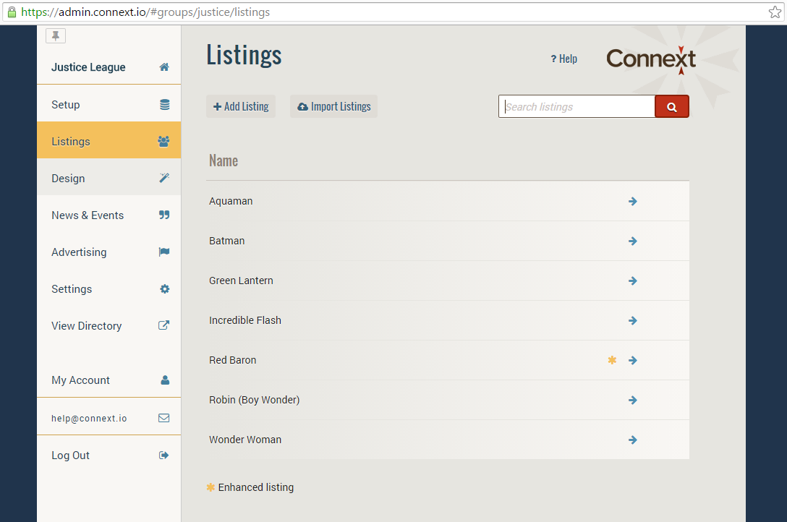
React Example: Connext Admin
React
jQuery, AJAX, JSON (models)
Backbone (routing only), Require JS
HTML5, CSS3, etc.
Python API
MongoDb document database
PyCharm IDE
Grunt, Node, Solr, Jetty, Flask, etc.
admin.connext.io

Slide 10
What is ReactJS.NET?
Installable library (NuGet)
Makes using React easy with .NET
ASP.NET MVC, but also WebForms and others
Plays well with:
ASP.NET Optimization Framework
Webpack, MSBuild
npm
Flow, Cassette
reactjs.net
Bundling, minification integration
JSX to JavaScript compilation
on-the-fly or precompiled
Server-side component rendering
for initial load

Slide 11
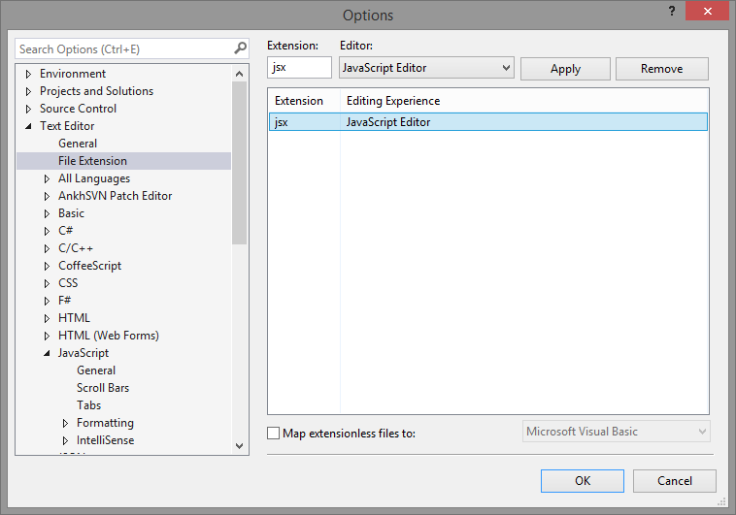
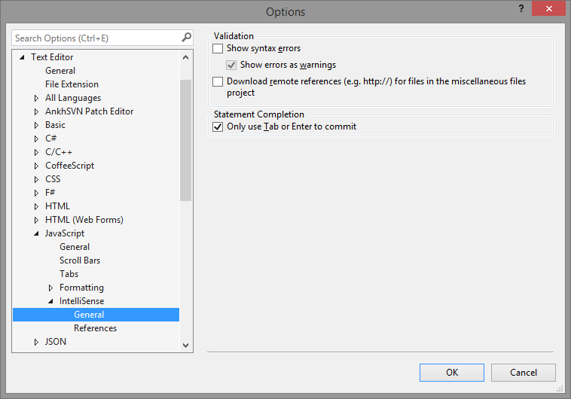
JSX and Visual Studio (pre-2015)

Slide 12
Code Demo
Part I
New ASP.NET MVC 4 project
Install NuGet package
Create MVC controller & view
Part II
Create first JSX and component
Compose [more] components
Good practice to put in separate JSX’s
Utilize component properties
reactjs.net/getting-started/tutorial.html
Part III
Populate comments from server
First use fake JSON array on client
Then get data from server via controller
Utilize component state
Add new comments
Part IV
Bundle and minify
Install NuGet package
Add BundleConfig
Register in Global.asax
Server-side [initial] rendering

Slide 13
Tim Franklin
Email pureux@gmail.com
Twitter @pureux
DNUG
meetup.com/sgfdotnet
4th Tue/mo
Web Dev Meetup
meetup.com/sgf-web-devs
1st Wed/mo
React
facebook.github.io/react
React JS.NET
reactjs.net
React [Chrome] Developer Tools
facebook.github.io/react/blog/2014/01/02/react-chrome-developer-tools.html

