Slide 1
Xamarin
Mobile cross-platform development

Slide 2
Dr. Tiffany ford
Department Chair, CIS & CSC – Ozarks Technical Community College
More about me – www.rhysma.com
Get today’s project - https://github.com/rhysma/SpaceLaunchApp
Xamarin Tutorials - https://www.youtube.com/user/TheRhysma

Slide 3
What’s the deal with mobile development?
To be a cross-platform developer, you need to know three languages:
Java, C#, Swift
Each platform requires their own IDE and toolset
Hard to find developers willing to work in all three

Slide 4
Types of mobile apps
Native apps - an application program that has been developed for use on a particular platform or device. Because native apps are written for a specific platform, they can interact with and take advantage of operating system features and other software that is typically installed on that platform.
Web apps – If you’ve ever seen the ‘mobile version’ of a site, that’s what we’re talking about. An “app” like this loads within a mobile browser, like Safari or Chrome, like every other website. Your audience doesn’t have to install a web app. They don’t need to have available space on their devices.
Hybrid apps - Somewhere between native and web apps you’ll find hybrid apps. They are usually quicker to build (and thus cheaper) than native apps. The bulk of the app is built using cross-compatible web technologies, such as HTML5, CSS and JavaScript — the same languages used to write web apps. Some native code is used however to allow the app to access the wider functionality of the device and produce a more refined user experience.

Slide 5
What is xamarin?
Xamarin is a software company founded in 2011
Created by the engineers of the Mono Project (Mono, Mono for Android, MonoTouch…) – cross-platform implementations of the Common Language Infrastructure (CLI) and Common Language Specifications (often called Microsoft .NET).
Allows developers to create Android, iOS, and Windows apps with native user interfaces with C#
Purchased by Microsoft in February 2016
Allows you to write native apps with device-specific experiences with access to native APIs.

Slide 6
Benefits of using xamarin
Allows you to leverage existing dev talent/experience in C#
Write C# applications on run on:
Android
iOS
Mac OSX
Windows Phone
Tremendous code sharing across mobile platforms
Reduces your time to market
Meet customer demand in multiple markets
Reduce cross-platform complexity

Slide 7
Benefits of using xamarin
Each of the core platforms that are supported has custom tooling.
Windows Phone | Use the XAML/Silverlight presentation layer, using Visual Studio or Blend’s UI designer
Windows 8 | Use the Windows Store APIs to create a native user experience.
iOS | Use the MonoTouch.UIKit APIs to create native-looking applications, optionally utilizing Apple’s Interface Builder.
Android | Use Android.Views to create native-looking applications, taking advantage of Xamarin’s UI designer

Slide 8
Two project paths
Xamarin.Forms
Xamarin.Forms is a cross-platform UI toolkit that allows developers to easily create native user interface layouts that can be shared across Android, iOS, and Windows Phone.
Xamarin.Forms is best for:
Data entry apps
Prototypes and proofs-of-concept
Apps that require little platform-specific functionality
Apps where code sharing is more important than custom UI
Xamarin Native
Includes Xamarin.Android, Xamarin.iOS, Windows Phone, Windows RT - Separate project types for native platforms
Native apps are best for:
Apps that require specialized interactions
Apps with highly polished design
Apps that use many platform-specific APIs
Apps where custom UI is more important than code sharing

Slide 9
Demo app

Slide 10
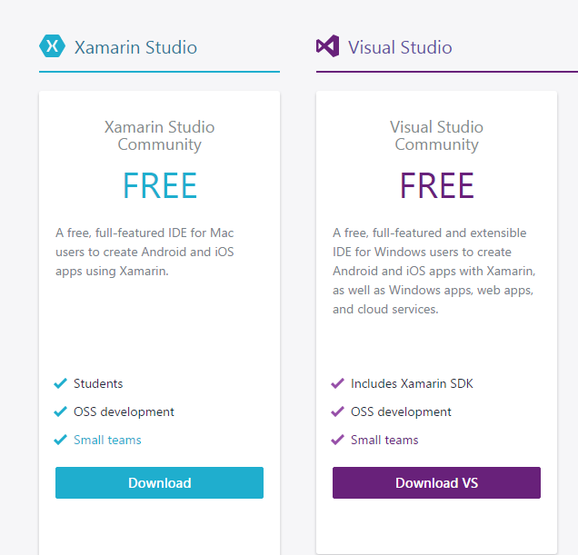
How to get started?
2 IDEs
Visual Studio
Xamarin Studio is a fully-featured IDE that is built for mobile app development.
Download the tools and get started - https://www.xamarin.com/

