Slide 1
MEASUREMENT & VERIFICATION TRAINING
Choose the right
data periods.
Prove coverage.
THE CORE IDEA
Coverage depends
on operating
conditions.
A practical guide to representative baselines, post-implementation measurement, and model support.
Represent the conditions that drive the savings question.
Source: ITVCookbook guide · Data Coverage and Sufficiency
Notes:
Opening: ask participants what “a year of data” guarantees. It guarantees elapsed time, not coverage of operating modes or driver conditions. The deck follows the guide’s period-selection and Appendix A1.4 coverage framework.

Slide 2
LEARNING GOALS
Defend the period choice and model range
A defensible M&V plan connects the savings question to the data that can answer it.
Select
Diagnose
Document
Choose baseline and reporting windows that represent material seasons, operating modes, and process cycles.
Check data quality, variable coverage, and model support before interpreting savings.
Set adjustment, gap, and exception rules before results are known; explain limitations and uncertainty.
Ask two questions: how many months, and which conditions are represented where the model will be used?
02
Notes:
Learning outcomes: period choice, coverage diagnostics, documentation. Invite participants to use these three verbs as a review rubric for their current projects.

Slide 3
FRAMING THE PROBLEM
Duration alone cannot establish coverage
Compare the range of operating conditions, not just the start and end dates.
12 months · narrow operating band
Observed baseline support
Hot-weather / high-load conditions unseen
6 months · broader relevant conditions
Observed range spans more of the driver conditions
Interpretation
Sufficiency depends on representativeness, model support, and the project decision.
03
Notes:
These bars are conceptual, not actual data. A 12-month period may still omit an unusual but savings-relevant regime, while a shorter window may cover the key range for a stable isolated measure. Never infer sufficiency from duration alone.

Slide 4
PLAN THE MEASUREMENT
Define the savings question before choosing dates
These decisions determine what “representative” means for this project.
1
2
3
4
5
Boundary
Outcome
Drivers
Method
Decision
Which equipment, process, and commodities are included?
Energy, demand, water, emissions, cost, or intensity?
Weather, throughput, mix, hours, shifts, setpoints, availability?
What is measured, modeled, or stipulated?
What uncertainty or risk is acceptable for the decision?
Same dates do not guarantee comparable conditions. Use matched calendar or operating-cycle boundaries where practical, then test comparability.
04
Notes:
Walk from boundary to decision. Ask participants: which independent variables can materially affect use or savings? Distinguish variables measured as model inputs from values merely stipulated.

Slide 5
BASELINE PERIOD
A representative baseline reflects normal operation
Seasonal facilities
Campaign processes
Stable isolated loads
A full annual cycle is a sound starting point when weather or seasonal operation matters. Consider multiple years if one year was atypical.
Capture representative grades, batches, startup and shutdown, shifts, and maintenance. If a cycle exceeds a year, observe enough complete cycles.
A shorter baseline can work when the boundary is narrow, relevant drivers are stable, and the method captures material variation.
Before installation
Agree dates, instrumentation, sampling, and objective rules for abnormal events. Preserve the intended baseline definition.
05
Notes:
The examples are starting points, not universal duration rules. The guide advises identifying commissioning, breakdowns, curtailments, strikes, shutdowns, atypical weather, process changes, and meter faults, with documented treatment.

Slide 6
POST-IMPLEMENTATION PERIOD
Verification and reporting use different windows
Separate the initial check from the period used to calculate savings.
01
Verify
02
Report
03
Monitor
Commission, inspect, tune, and confirm that equipment and controls match design.
Begin after stable operation. Include seasons, cycles, and modes needed for the savings question.
Check persistence when drift, maintenance, controls, or operator behavior can change performance.
Record the first stable operating date and keep startup, tuning, and transition data identifiable.
06
Notes:
A commissioning check is not a full-year savings result. For seasonal whole-facility savings, a full annual reporting period is generally clearest. Stable isolated measures may justify shorter or continuous periods if all material variation is captured and the M&V plan supports the choice.

Slide 7
DATA FREQUENCY
Measure at a time scale that can reveal the behavior
Behavior to resolve
Sampling implication
Alignment check
Starts, stops, peaks, control response
Interval data fine enough to capture the event
Match energy/water readings with hours, production, and weather
Fast process cycles
Sub-hourly or event-based data may be needed
Record time zone, daylight saving, clock offsets, units
Stable system with periodic sampling
Define sample population, strata, size, and frequency
Explain how unsampled periods are represented
Highly variable or interactive system
Continuous monitoring when risk and savings justify it
Use same instruments and interval conventions when possible
A monthly bill can establish totals. It usually cannot explain short cycling or control response.
07
Notes:
The guide does not mandate one universal interval. It says match frequency to system behavior, align timestamps and variables, and define sampling for sampled systems in advance.

Slide 8
DATA QUALITY
Set data rules before seeing the savings result
Instrumentation
Meter ID, location, units, range, accuracy, calibration, dates, owner
Time series
Coverage, gaps, duplicates, resets, communication failures, outliers
Operating context
Throughput, product mix, hours, setpoints, outages, maintenance, changes
Lineage
Measured vs. calculated vs. estimated vs. stipulated; transformations and model version
If rules fail
Repair or extend data, justify a substitute, or report limitation and uncertainty. Never silently fill gaps or window-shop for a favorable result.
08
Notes:
Set acceptance rules in advance for required coverage and maximum gaps. Keep raw data and a reproducible record of exclusions, imputations, transformations, and model versions. Reconcile utility invoices to interval data where both exist.

Slide 9
COMPARABILITY AND ADJUSTMENTS
Classify changes before adjusting the model
Routine adjustments
Non-routine adjustments
Predictable drivers that vary within normal operation.
Examples: weather, production volume, operating hours.
Use measured independent variables and a method suited to the M&V option.
Material one-time changes in the facility or system.
Examples: added production line, major schedule change, prolonged shutdown.
Document evidence, method, direction, magnitude, and approval.
If the model is applied outside represented conditions, justify the method and state the added uncertainty.
09
Notes:
Routine adjustment examples in the guide include weather, production volume, and operating hours. Non-routine events include new lines, changed mix outside modeled range, equipment replacement, schedule changes, and prolonged shutdowns. Pause and agree revised analysis if baseline or boundary becomes unrepresentative.

Slide 10
MODEL SUPPORT
Check support where each model is applied
First identify each model’s training data. Then compare it with the data used for the savings estimate.
Approach
Model trained on
Application data
Coverage question
Normalized
Baseline/post, separate or combined
Agreed typical conditions
Are typical inputs within support for every model used?
Forecast
Baseline period
Post-period drivers
Do post drivers stay within baseline support?
Backcast
Post period
Baseline-period drivers
Do baseline drivers stay within post-model support?
Pre/post indicator
Combined observations + period indicator
Observed periods or agreed typical conditions
Check overlap, confounding, period effect, and fit by period.
Report the out-of-support share and, where possible, its energy or savings relevance.
10
Notes:
This is the guide’s common application pattern matrix. Model names and definitions can vary by M&V plan and protocol. Separately fitted baseline/post normalized models each need their own support check. A pre/post model does not automatically solve poor coverage or confounding.

Slide 11
RANGE AND EXTRAPOLATION
Treat range limits as protocol-specific
Observed model support
outside
Training range
outside
Protocol-specific example
Use judgment and document
BPA v3.1 describes an ASHRAE Guideline 14 allowance of up to 10% beyond the baseline ambient-temperature range for models using ambient temperature.
Not a universal rule for every variable. Out-of-range data trigger review, not automatic exclusion. Quantify extent, distance, energy relevance, and uncertainty.
For positive-scale variables, a project may use [0.90 × Xmin, 1.10 × Xmax] only when the governing protocol supports it. Do not apply blindly to °C/°F or negative-scale variables.
11
Notes:
Source: BPA Meter-Based Energy Modeling Protocol v3.1, §3.1.3. Its cited allowance is variable- and protocol-specific. Proportional multiplication is not meaningful for temperatures with arbitrary zero points. A min/max test can miss unsupported combinations or change-point regimes. Consider bins or expected energy to assess relevance.

Slide 12
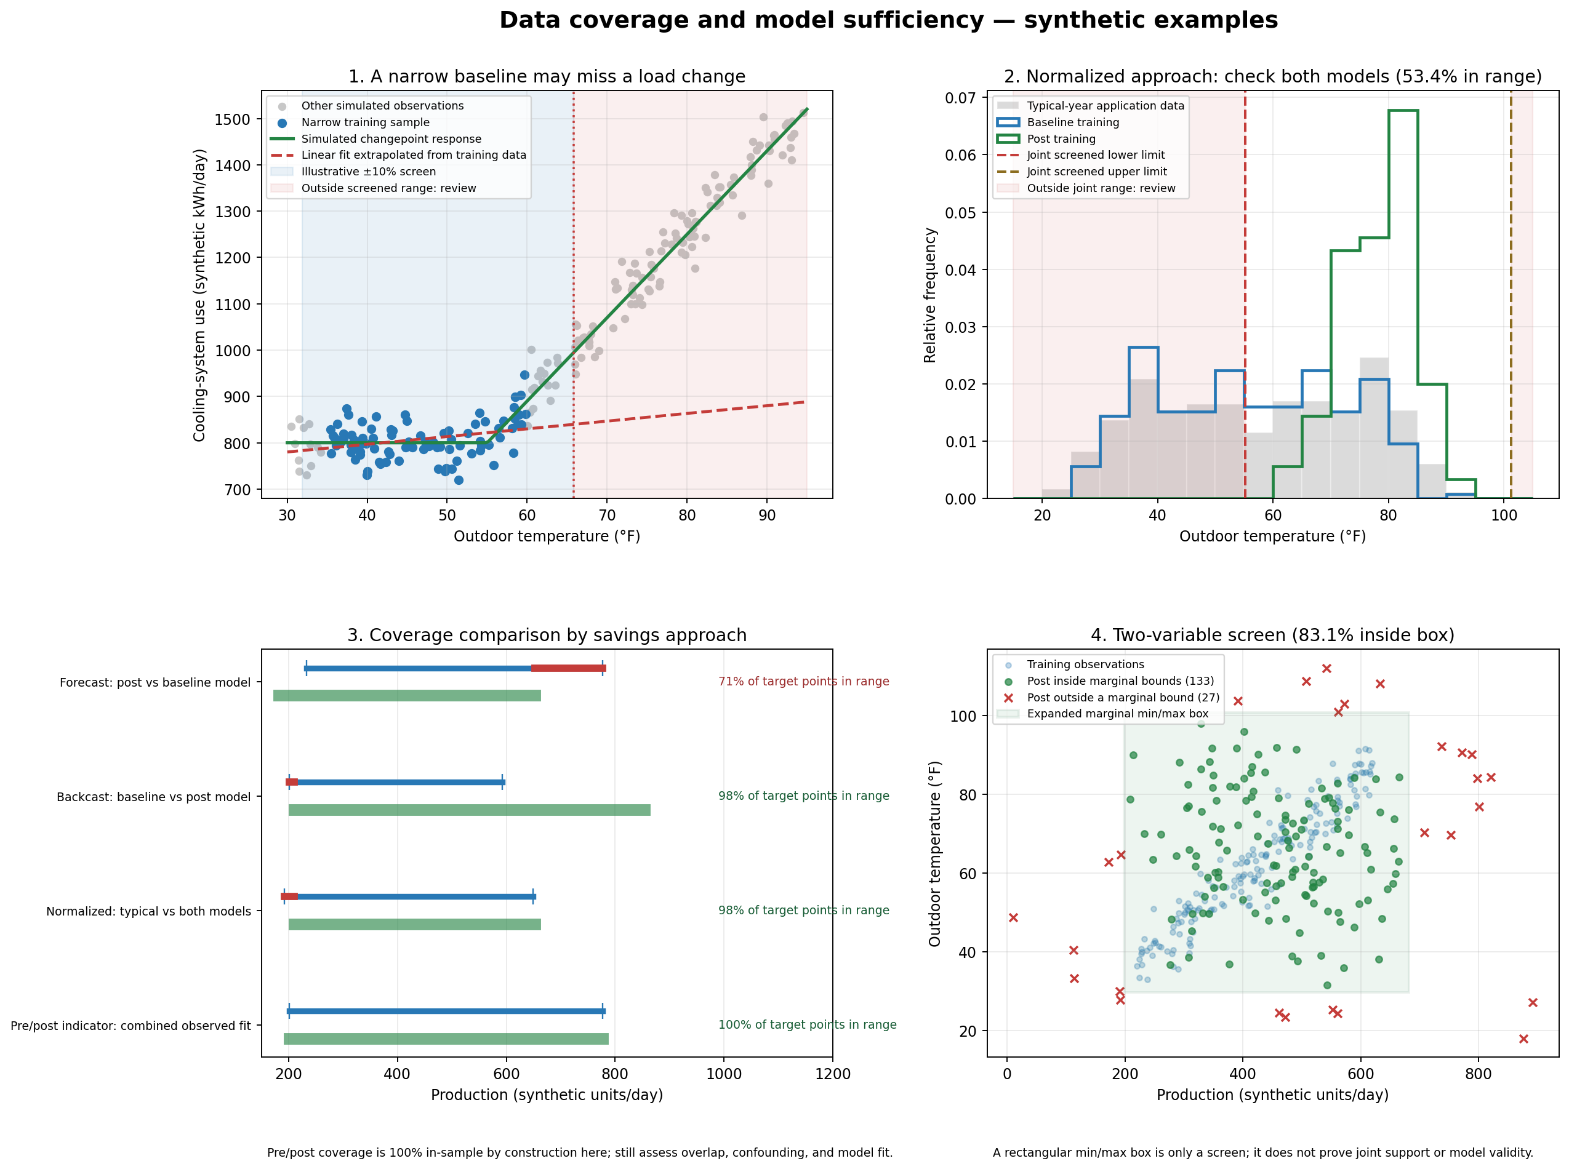
MULTIVARIABLE COVERAGE
Marginal ranges can hide unsupported combinations
Read the joint-support panel as a warning.
Separate min/max ranges do not show whether driver combinations occurred together.
Look for clustered modes, gaps, and combinations unique to post conditions.
The displayed rectangle is a screen, not proof of model validity.
Synthetic illustration · not a project result
12
Notes:
The figure is the static companion to the interactive demo and Python script. Emphasize panel 4: a point may fall inside each variable’s marginal min/max range while occupying a combination never seen in training. Evaluate joint support, modes, nonlinearities, and residuals.

Slide 13
GUIDED DEMONSTRATION
Explore coverage with the interactive demo
Change one assumption at a time. Observe how the diagnostic changes, then explain what the visual cannot decide.
Open the interactive data coverage demo ↗
A
B
C
D
Narrow the baseline range
Change the operating pattern
Switch analysis approach
Increase the review margin
Which post points become extrapolation candidates?
Does the distribution shift, or only its endpoints?
Which dataset trains the model and which applies it?
What changes in the screen, and what still requires judgment?
The demo uses synthetic data. It does not certify real project sufficiency or automatically exclude observations.
13
Notes:
Facilitation: ask learners to predict the result before changing a control. Discuss why an interactive review-margin slider is illustrative only and why protocol-specific thresholds and energy weighting matter. Direct URL: https://sgfernandes.github.io/ITVCookbook/guides/data-coverage-sufficiency-demo.html

Slide 14
DOCUMENT THE EVIDENCE
A sufficiency log turns data limits into planned actions
The guide’s example is hypothetical. Use it to separate coverage evidence from the decision.
Parameter
Observed information
Coverage concern
Action to consider
Production volume
April–September (6 months); 85% of typical range
Winter modes not represented; range share is not energy share
Assess savings relevance; extend period or run sensitivity if material
Frequency / gaps
Hourly data; 0.5% missing; two outages totaling 4 hours
Treatment can influence interval estimates
Apply pre-approved rule; preserve raw data; test sensitivity
Variables / alignment
Energy, production, hours, outdoor temperature present
Need common timestamps, units, boundary, and support
Confirm alignment and each model input’s training/application range
The log documents the question, evidence, rule, action, and effect on uncertainty. It does not create a universal pass/fail threshold.
14
Notes:
Source is the guide’s hypothetical Table A1.4.1. Be careful: April through September is six months; the example does not claim nine months. An 85% share of a variable’s typical range is not the same as 85% of expected energy or savings.

Slide 15
PRACTICE EXERCISE
Apply the framework before reporting
Scenario
Discuss
A project has hourly energy, production, operating hours, and outdoor temperature from April through September. The log says 85% of typical production range is covered; winter modes are absent; 0.5% of hourly data are missing.
What is the savings question and model application range?
Could winter conditions materially affect estimated savings?
What must be checked before using a gap treatment?
Would you extend data, test sensitivity, or report a limitation?
Debrief: decide from evidence and the M&V plan, not from a single coverage percentage.
15
Notes:
Use this as a 5–8 minute small-group exercise. It is the hypothetical example in the guide, reframed as a case prompt. No correct answer can be given without knowing the measure, savings approach, protocol, energy relevance of winter, and approved gap rule.

Slide 16
CLOSE THE LOOP
Put the decision, rule, and owner in the M&V plan
Period schedule
Baseline dates and rationale; implementation, commissioning, stable start, reporting years
Data plan
Meters, variables, interval, sampling, coverage rule, owner, timestamp conventions
Model support
Training range, application range, out-of-range share and energy relevance
Adjustments
Routine variables; non-routine event evidence, calculation, and approval path
Exceptions
Gaps, abnormal operation, exclusions, substitutions, sensitivity, uncertainty effect
Review cadence
Interim checks, persistence monitoring, reporting dates, decision owner
Defensible reporting begins before implementation and continues through the final uncertainty statement.
16
Notes:
Close with an action: before data collection, owners should be able to fill these fields. Update the plan when field conditions materially differ; retain original and approved revisions.

Slide 17
SOURCES AND BOUNDARIES
Follow project rules and document the reasoning
Primary training source
ITVCookbook · Selecting Baseline and Post-Implementation Data Collection Periods, including Appendix A1.4.
Protocol references listed in the guide
BPA, Meter-Based Energy Modeling Protocol v3.1, §3.1.3 (coverage and extrapolation).
DOE FEMP, M&V Guidelines for Federal Energy Projects, Version 5.0.
Efficiency Valuation Organization, IPMVP.
The project M&V plan, contract, program rules, and selected protocol control where they specify requirements.
17
Notes:
URLs: Guide https://github.com/sgfernandes/ITVCookbook/blob/main/guides/baseline-and-post-implementation-data-periods.md ; BPA protocol https://www.bpa.gov/-/media/Aep/energy-efficiency/measurement-verification/7-bpa-mv-energy-modeling-protocol.pdf ; FEMP version 5 https://www.energy.gov/sites/default/files/2024-10/mv_guide_5_0.pdf ; IPMVP https://evo-world.org/en/products-services-mainmenu-en/protocols/ipmvp.

