Slide 1

ECE 580 Mini Project 1: Compressed Sensing Image Recovery
Sanika Gupte
March 3, 2022

Slide 2
Background

Slide 3
Compressed Sensing – Project Overview
Objective: Estimate the original form of a damaged or compressed image with many missing or bad pixels using a discrete cosine transform (DCT) basis function and a L1 cost function to enforce sparsity
  This is relevant in for low-exposure images and for images with Salt & Pepper noise (astronomy) or with Poisson distributed noise (X-Ray, CT, or mammograms)
  This is also relevant in image compression where a large signal needs to be represented in fewer bytes of storage
Procedure:
  An image clean image (truth) will be divided into k x k blocks
  A set number of pixels will be randomly damaged (set to have a value of -1) in each block
  Compressed sensing will be implemented by using a lasso regression and DCT bases
  Final image will be median filtered with a 3x3 kernel
  The effects of number of sampled pixels, block size, and median filtering on error will be analyzed

Slide 4
Compressed Sensing - Goals
Recovering missing pixels in the image by utilizing lasso regularization and the 2D discrete cosine transform (DCT) basis function
Understanding how median filtering affects the quality of the image and the number of samples at which it is no longer beneficial to use a median filter
Understanding how block size affects the quality of the final image
Understanding how the number of pixels sampled affect the quality of the final image

Slide 5
Key Results

Slide 6
Mathematical Formulation

Slide 7
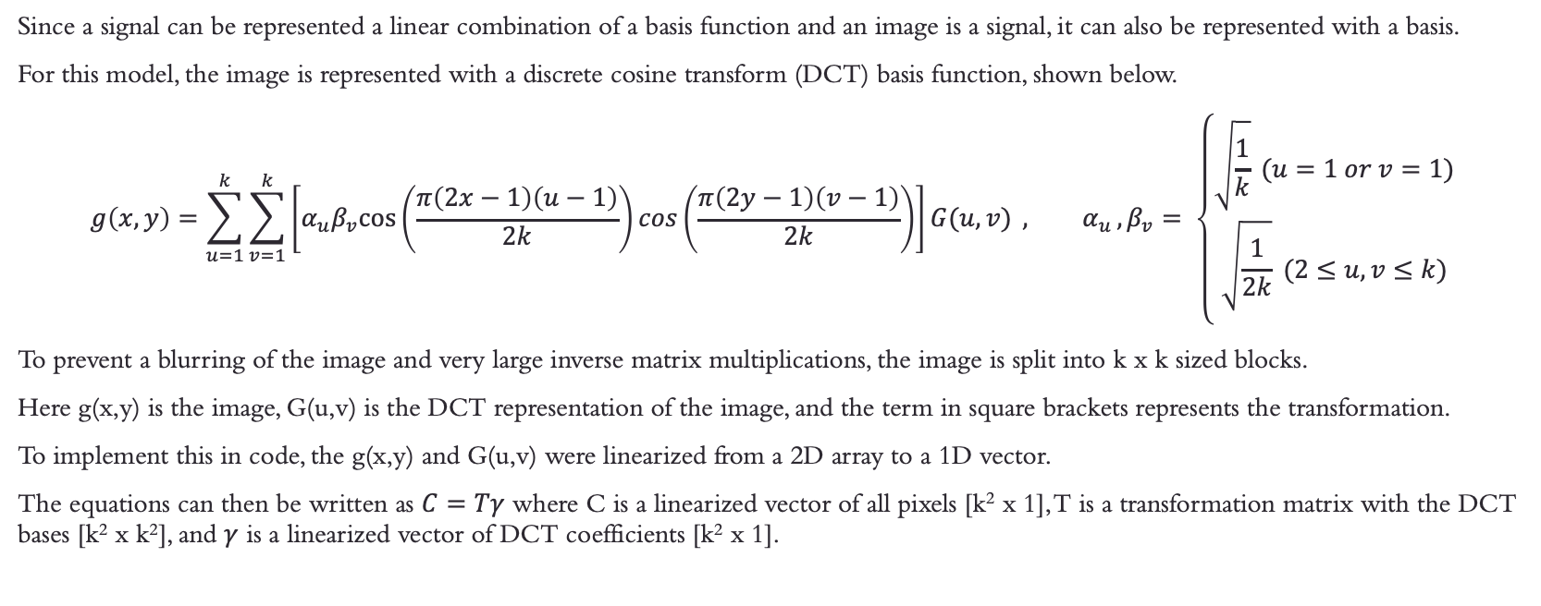
Representation of Signal with DCT Basis
Since a signal can be represented a linear combination of a basis function and an image is a signal, it can also be represented with a basis.
For this model, the image is represented with a discrete cosine transform (DCT) basis function, shown below.
$$g\left(x,y\right)=\sum_{u=1}^{k}{\sum_{v=1}^{k}{\left[α_{u}β_{v}cos⁡\left(\frac{π\left(2x−1\right)\left(u−1\right)}{2k}\right)cos\left(\frac{π\left(2y−1\right)\left(v−1\right)}{2k}\right)\right]G(u,v)}} , α_{u },β_{v}= \left\{\begin{aligned}\sqrt{\frac{1}{k}} (u=1 or v=1) \\ \sqrt{\frac{1}{2k}} (2≤u, v≤k) \\ \end{aligned}\right.$$
To prevent a blurring of the image and very large inverse matrix multiplications, the image is split into k x k sized blocks.
Here g(x,y) is the image, G(u,v) is the DCT representation of the image, and the term in square brackets represents the transformation.
To implement this in code, the g(x,y) and G(u,v) were linearized from a 2D array to a 1D vector.
The equations can then be written as $C=Tγ$ where C is a linearized vector of all pixels [k² x 1], T is a transformation matrix with the DCT bases [k² x k²], and $γ$ is a linearized vector of DCT coefficients [k² x 1].

Slide 8
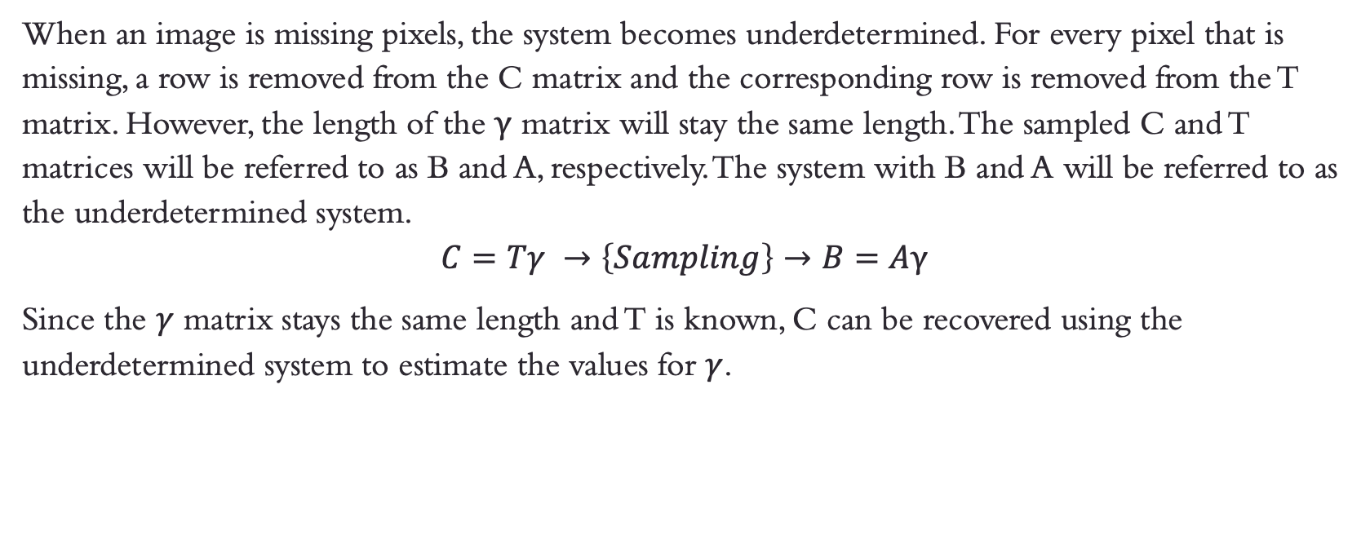
Generating an Undetermined System by Sampling and
How to Recover It
When an image is missing pixels, the system becomes underdetermined. For every pixel that is missing, a row is removed from the C matrix and the corresponding row is removed from the T matrix. However, the length of the $γ$ matrix will stay the same length. The sampled C and T matrices will be referred to as B and A, respectively. The system with B and A will be referred to as the underdetermined system.
$$C=Tγ →\left\{Sampling\right\}→B=Aγ$$
Since the $γ$ matrix stays the same length and T is known, C can be recovered using the underdetermined system to estimate the values for $γ$.

Slide 9
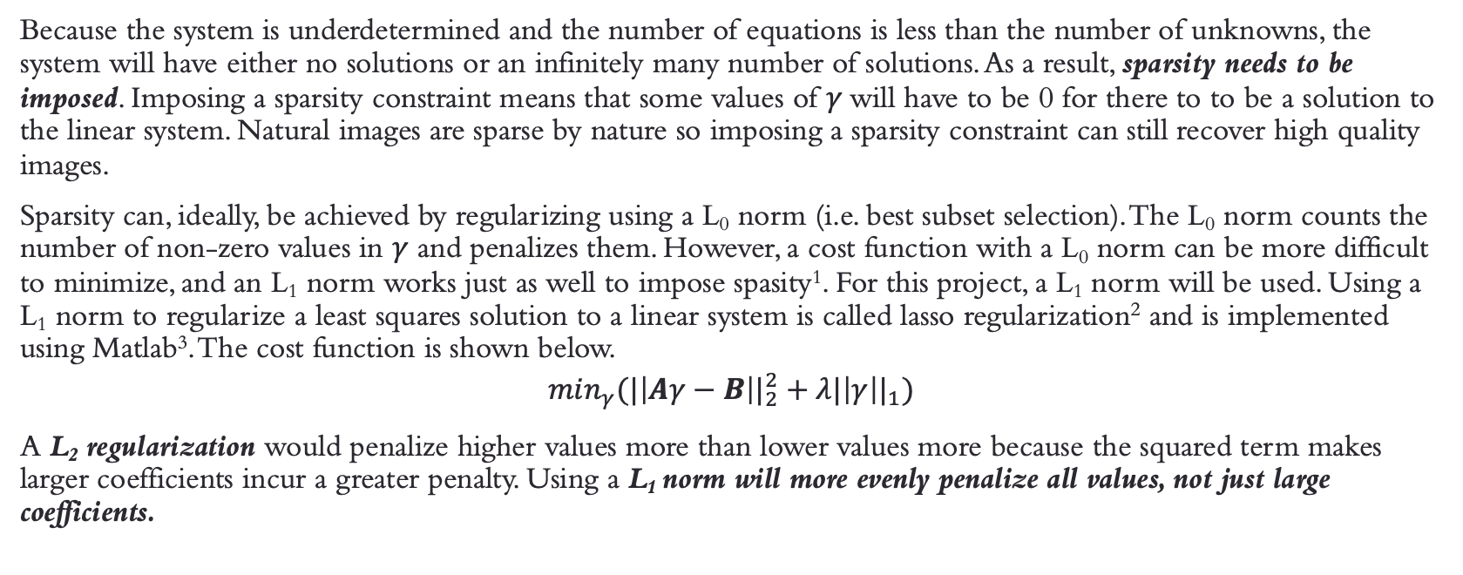
Sparsity Constraint and Lasso Regularization
Because the system is underdetermined and the number of equations is less than the number of unknowns, the system will have either no solutions or an infinitely many number of solutions. As a result, sparsity needs to be imposed. Imposing a sparsity constraint means that some values of $γ$will have to be 0 for there to to be a solution to the linear system. Natural images are sparse by nature so imposing a sparsity constraint can still recover high quality images.
Sparsity can, ideally, be achieved by regularizing using a L₀ norm (i.e. best subset selection). The L₀ norm counts the number of non-zero values in $γ$ and penalizes them. However, a cost function with a L₀ norm can be more difficult to minimize, and an L₁ norm works just as well to impose spasity¹. For this project, a L₁ norm will be used. Using a L₁ norm to regularize a least squares solution to a linear system is called lasso regularization² and is implemented using Matlab³. The cost function is shown below.
$${\min_{γ}(|\left|Aγ−B\right||}_{2}^{2}+λ{|\left|γ\right||}_{1})$$
A L₂ regularization would penalize higher values more than lower values more because the squared term makes larger coefficients incur a greater penalty. Using a L₁ norm will more evenly penalize all values, not just large coefficients.

Slide 10
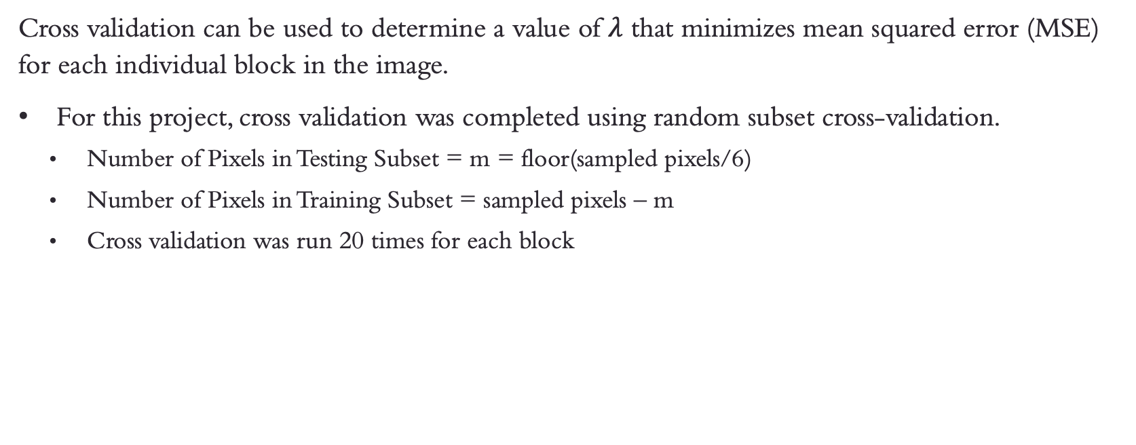
Cross-Validation to Find Lambda Parameters
Cross validation can be used to determine a value of $λ$ that minimizes mean squared error (MSE) for each individual block in the image.
For this project, cross validation was completed using random subset cross-validation.
  Number of Pixels in Testing Subset = m = floor(sampled pixels/6)
  Number of Pixels in Training Subset = sampled pixels – m
  Cross validation was run 20 times for each block

Slide 11
Median Filtering
Median filtering with a 3x3 kernel sets each pixel equal to the median value of the 3x3 neighborhood it is in.
  High pass filtering is not appropriate because it would only preserve the edges of the image and not the low frequency signal that dominates natural images.
Median filtering smooths out the image and eliminate salt & pepper noise in the image.
  However, if a median filter is applied to an image that is already sharp, it will just blur the image and distort the detail.
  With very low sampling rates, median filtering may improve the quality of the image but there will be a point when the image is sampled sufficiently, and a median filter will decrease performance and over smooth the image. The fidelity of a median filter will be further explored in this experiment.
The function medfilt2 was used in Matlab to implement 3x3 median filtering⁴.

Slide 12
Median over Gaussian?
It’s because of the type of noise we have
Since pixels in the images for compressed sensing are removed completely instead of having their value altered based on a statistical distribution, the “noise” in the image resembles pepper noise so a median filter is more appropriate than a Gaussian.
Median filtering also typically produces results that are sharper than some other linear filtering methods.
Figure 1 on the next slide shows an example of how median filtering impacts the image without introducing too much blur.

Slide 13
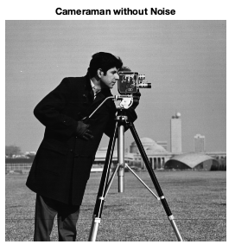



Median over Gaussian? (cont.)
Figure 1: Cameraman image denoising with Gaussian and median filters. Notice that the median filtered image removes the salt & pepper noise while preserving the sharpness of the image. The Gaussian preserves much of the noise and adds blur so it is less favorable.

Slide 14
Experimental Results

Slide 15
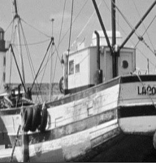
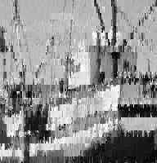




Fishing Boat (Small Test Image) – without Median Filter
a
b
c
Figure 2: Compressed sensing without a median filter on the fishing boat image (8x8 blocks) with different number of pixels sampled
a: original image
b: 10 pixels sampled
c: 20 pixels sampled
d: 30 pixels sampled
e: 40 pixels sampled
f: 50 pixels sampled
d
e
f

Slide 16





Fishing Boat (Small Test Image) – with Median Filter
a
b
c
Figure 3: Compressed sensing with a median filter on the fishing boat image (8x8 blocks) with different number of pixels sampled
a: original image
b: 10 pixels sampled
c: 20 pixels sampled
d: 30 pixels sampled
e: 40 pixels sampled
f: 50 pixels sampled
d
e
f

Slide 17
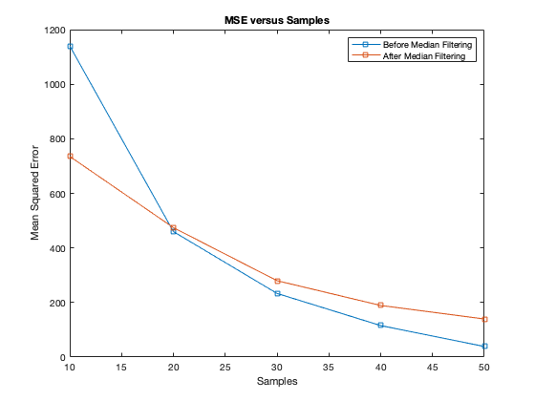
Fishing Boat Results
Figure 4 is a plot of the mean squared error of compressed sensing of the fishing boat model for different numbers of samples.
Number of Samples: Based on the plot, as the number of samples increases, the mean squared error decreases.
Median Filtering: At 20 samples, the quality of the image with a median filter is worse than without a median filter but prior to 20 samples, the image quality is significantly better with a median filter.
Figure 4: The effect of number of samples on mean squared error

Slide 18
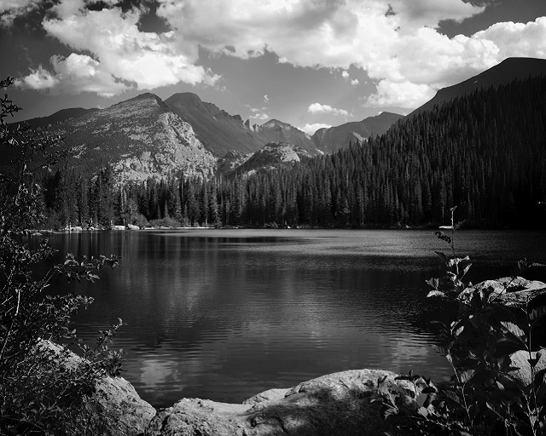

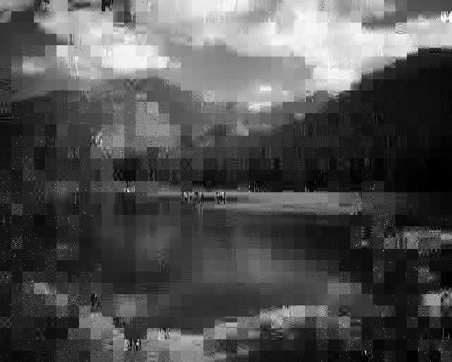
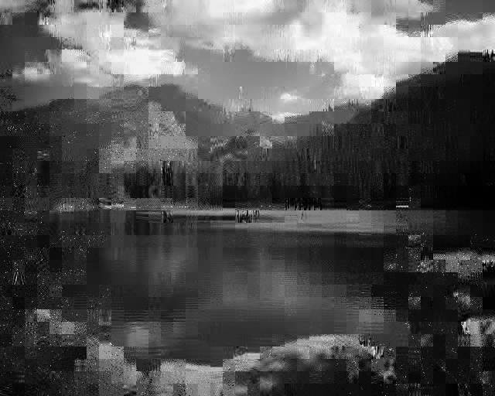


Nature (Large Test Image) – without Median Filter
a
b
c
Figure 5: Compressed sensing without a median filter on the nature image (16x16 blocks) with different number of pixels sampled
a: original image
b: 10 pixels sampled
c: 30 pixels sampled
d: 50 pixels sampled
e: 100 pixels sampled
f: 150 pixels sampled
d
e
f

Slide 19





Nature (Large Test Image) – with Median Filter
a
b
c
Figure 6: Compressed sensing with a median filter on the nature image (16x16 blocks) with different number of pixels sampled
a: original image
b: 10 pixels sampled
c: 30 pixels sampled
d: 50 pixels sampled
e: 100 pixels sampled
f: 150 pixels sampled
d
e
f

Slide 20
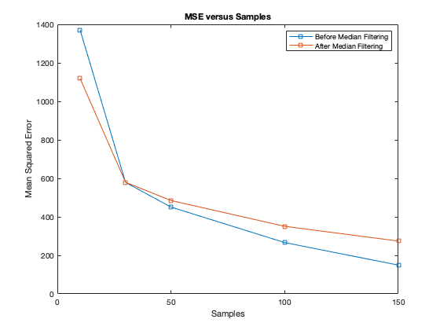
Nature Results
Figure 7 is a plot of the mean squared error of compressed sensing of the nature model for different numbers of samples.
Number of Samples: Based on the plot, as the number of samples increases, the mean squared error decreases.
Median Filtering: At 30 samples, the quality of the image with a median filter is worse than without a median filter but prior to 30 samples, the image quality is significantly better with a median filter.
Figure 7: The effect of number of samples on mean squared error

Slide 21
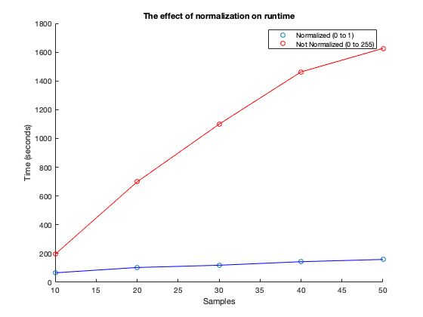
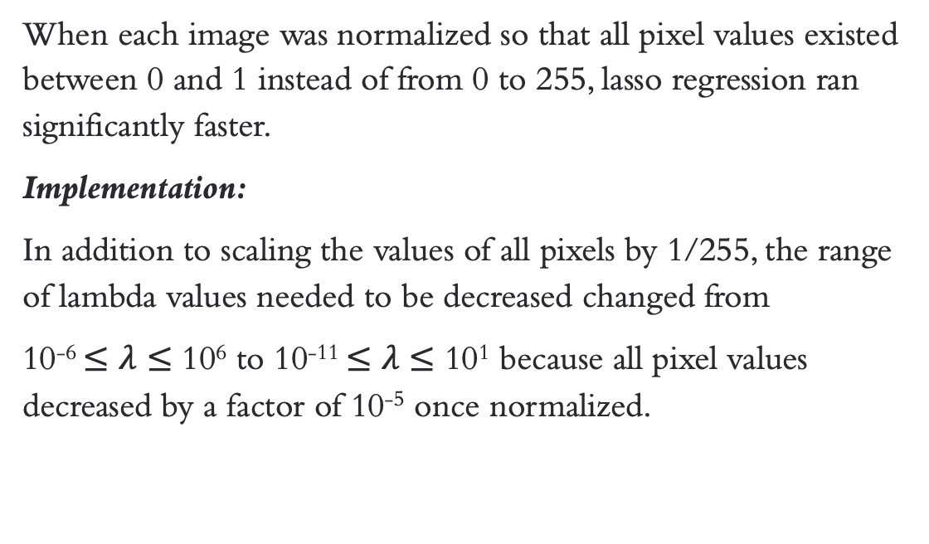
Lasso Runtime under Normalization Conditions
When each image was normalized so that all pixel values existed between 0 and 1 instead of from 0 to 255, lasso regression ran significantly faster.
Implementation:
In addition to scaling the values of all pixels by 1/255, the range of lambda values needed to be decreased changed from
10⁻⁶ $≤λ≤$ 10⁶ to 10⁻¹¹ $≤λ≤$ 10¹ because all pixel values decreased by a factor of 10⁻⁵ once normalized.
Figure 8: The effect of normalization on runtime

Slide 22
Discussion & Conclusions

Slide 23
Effect of Number of Sampled Pixels on MSE
For both the small image and the large image, as the number of pixels sampled increases, MSE improves
Explanations:
There are more original pixels (i.e. pixels with 0 error) averaged with the rest of the data, decreasing MSE.
Having a stronger prior knowledge of the image as a result of more samples can result in a higher fidelity estimate, decreasing MSE.

Slide 24
Effect of Median Filtering on MSE
Lower sampling rates have smaller MSE values with a median filter, but higher sampling rates have a smaller MSE without a median filter.
Median Filtering improves MSE for
  Fishing Boat with ~20 or fewer samples
  Nature with ~30 or fewer samples
Explanations
The median filtering is still a smoothing filter that adds blur. At a high sampling rate, the recovered image is very sharp and median filtering it adds unnecessary blur.

Slide 25
Effect of Block Size on MSE
Block size has a significant effect on MSE at lower sampling rates
For example, if approximately 10% of the pixels were sampled from an 8x8 block versus a 16x16 block, the MSE for the 8x8 block would be higher (MSE = ~1200) compared to the 16x16 block (MSE = ~600) because the 16x16 block has a stronger prior as a result of more data.
As sampling increases, the block size does not matter
When comparing the MSE for fishing boat and nature, if ~50% of the pixels are sampled in each block (32 for fishing boat and 128 for nature), the MSE is around 200, regardless of block size.

Slide 26
Limitations
Time
  Cross-validation takes a very long time to run on the magnitude of hours.
  Recovering even a small batch of images through this method may take days.
  It is not practical for a system with limited computing power.
  Although normalization improves efficiency, it still takes a very long time.
Piecewise Constant Images
  Images recovered through this method appear very blocky (see Figures 5 and 6) because the of the L₁ norm

Slide 27
References

Slide 28
References
^{1.} D. L. Donoho, "Compressed sensing," in IEEE Transactions on Information Theory, vol. 52, no. 4, pp. 1289-1306, April 2006, doi: 10.1109/TIT.2006.871582.
^{2.} Tibshirani, R. “Regression Shrinkage and Selection via the Lasso.” Journal of the Royal Statistical Society. Series B, Vol. 58, No. 1, 1996, pp. 267–288.
^{3.} “lasso,” Lasso or elastic net regularization for linear models - MATLAB, 2021. [Online]. Available: https://www.mathworks.com/help/stats/lasso.html. [Accessed: 26-Feb-2022].
^{4.} “medfilt2,” 2-D median filtering - MATLAB. [Online]. Available: https://www.mathworks.com/help/images/ref/medfilt2.html#References. [Accessed: 02-Mar-2022].

Slide 29
Collaborations
Jayesh Gupta & Erin Liu: helped to debug my code when I was getting an error while trying to display my image, chatted with to understand why image was appearing darker and gamma intercept at DC was lower than expected, conceptually discussed the mathematics behind the project and best practices in running efficient code, compared MSEs and image quality at the end of the project
Thank you!

