Slide 1
Video Game Sales: Market Analysis & Predictors of Success
Stefan Heinze
Data Challenge Week 5

Slide 2
Outline
What are key differences between NA, EU, and JP markets?
Size
Preferred gaming platform
Preferred game genre
What are key indicators of game success?
Linear regression (LASSO/Ridge) vs. random forest regressor

Slide 3
Key differences between markets

Slide 4
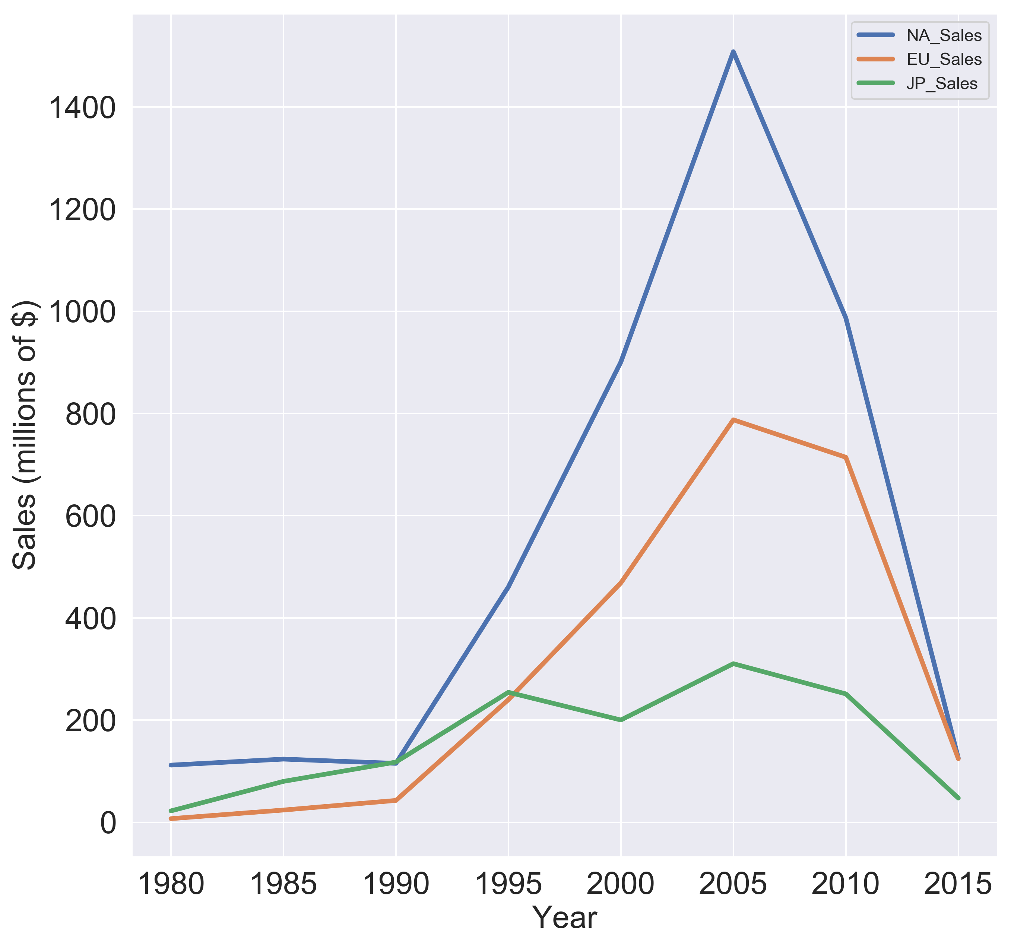
Market size: NA > EU > JP
Market Value
Market Share
NA
1980
1990
EU
JP
2000
2010

Slide 5
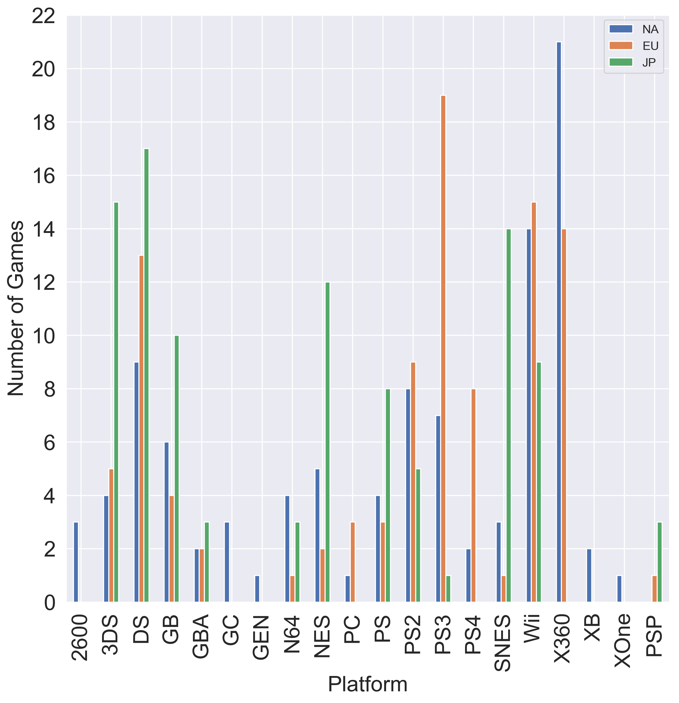
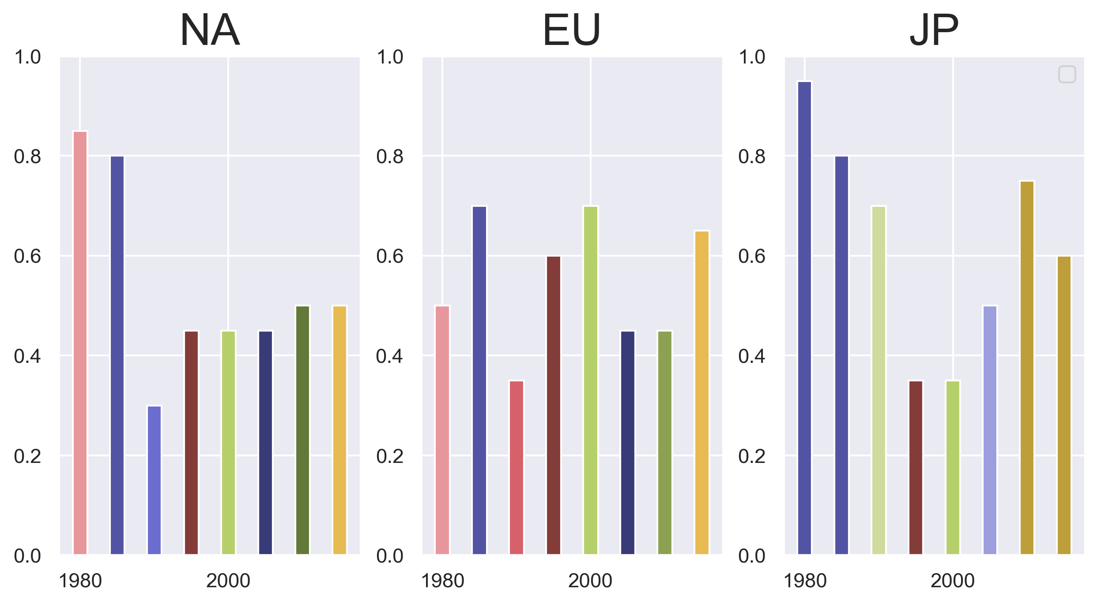
NA/EU prefer stationary platforms while JP prefers mobile platforms
Popular Consoles (Top 100)
Popular Consoles Across Time (Top 20)
Fraction of Games
Xbox360
PS4
PS3
PS4
DS
3DS

Slide 6
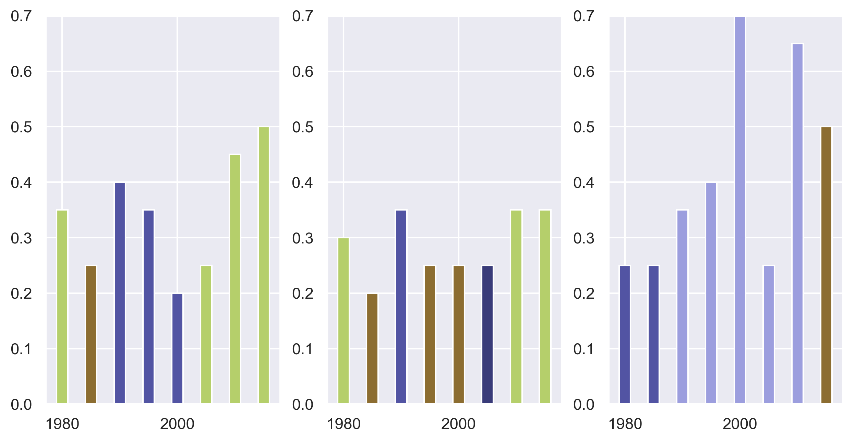
NA/EU prefer shooters while JP prefers RPG/Action
NA
EU
JP
Fraction of Games
Shooters
RPG
Shooters
Action

Slide 7
Key indicators of game success

Slide 8
Data provides minimal features from which to predict game success
Training Data
Target
Models
Linear Regression
Random Forest
 | Platform | Year | Genre | Publisher
game_id0
game_id1
game_id2
game_id3
Global_Sales
Features: platform, year, genre, publisher
Target: global sales
OHE
Normalized
OHE
OHE
620 features

Slide 9
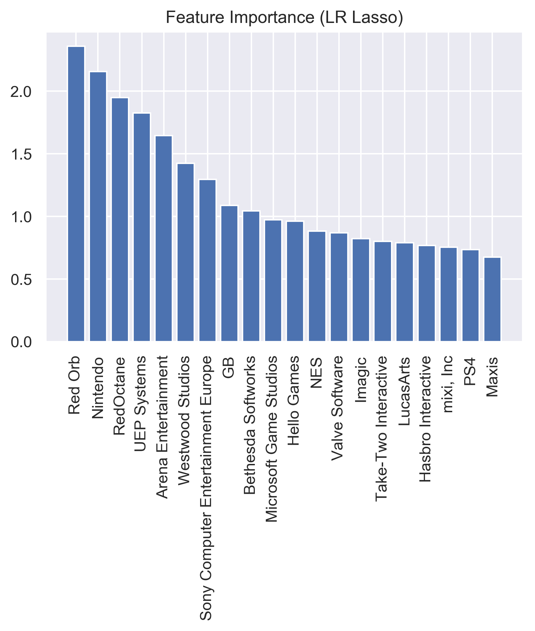
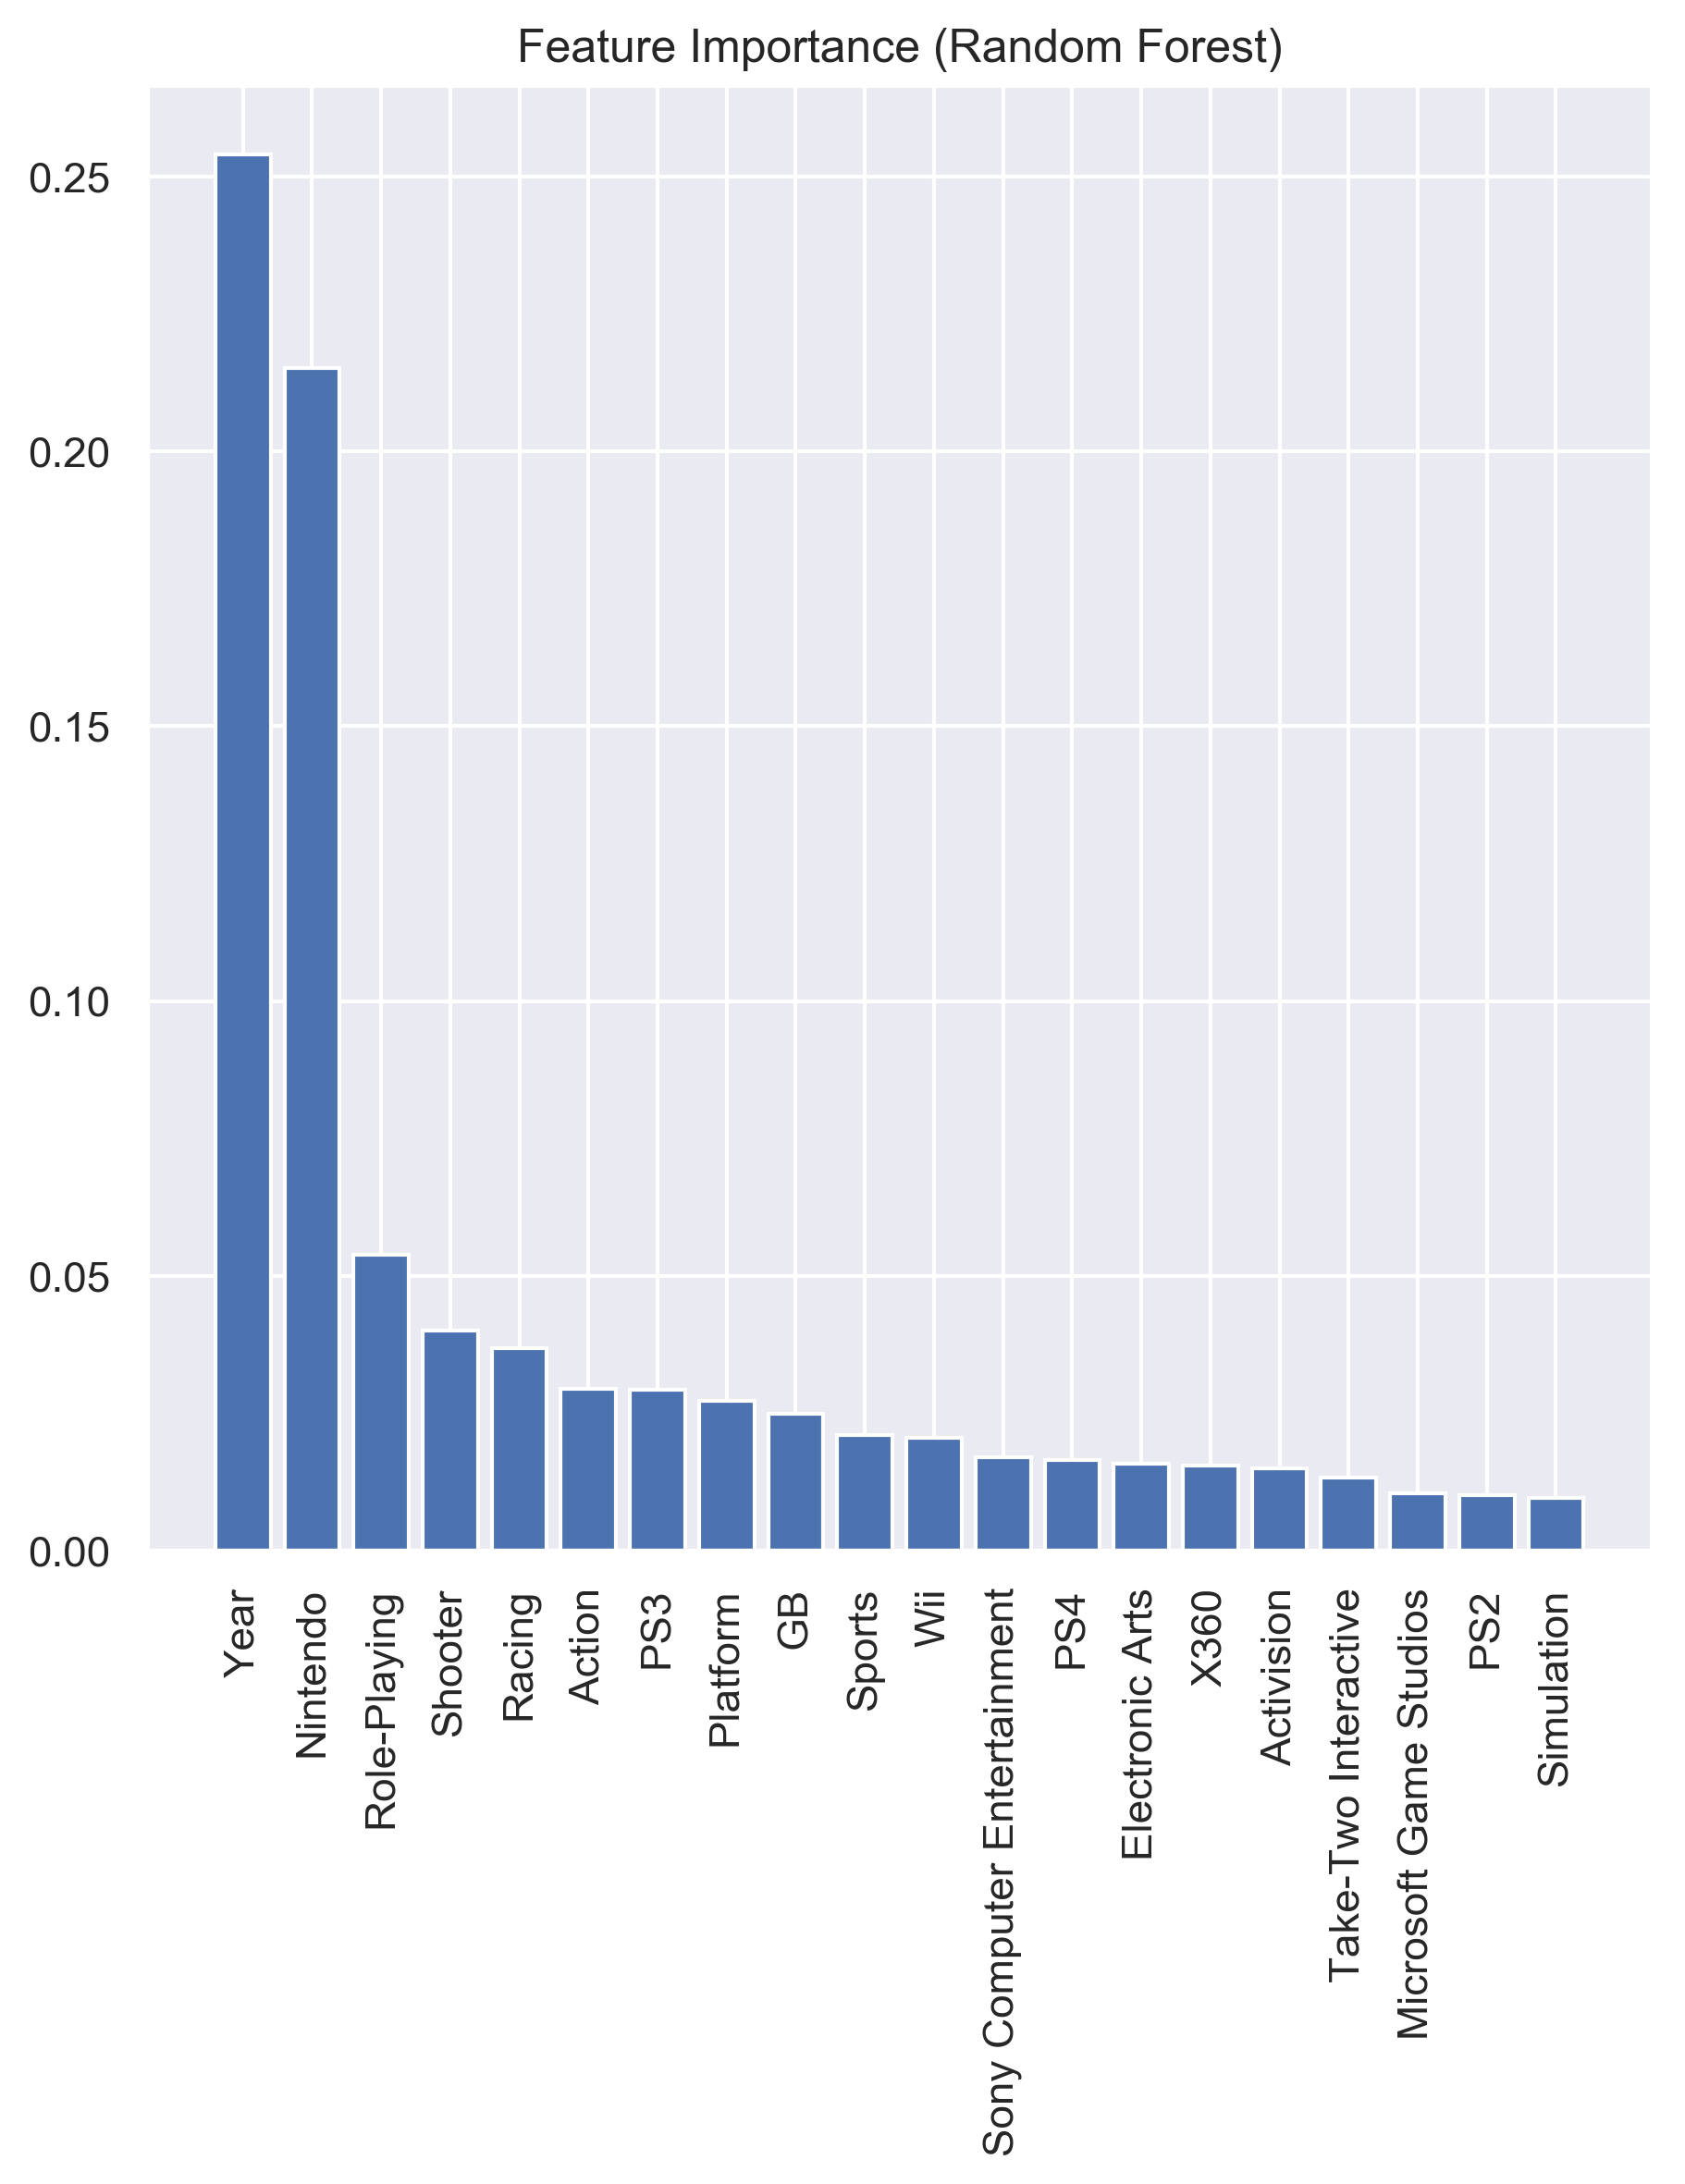
Random forest provides better predictions than linear regression
Linear Regression (LASSO)
Random Forest
R² ~ 0.09
R² ~ 0.16
KPI: Publisher
KPI: Year, Nintendo… Genre

Slide 10
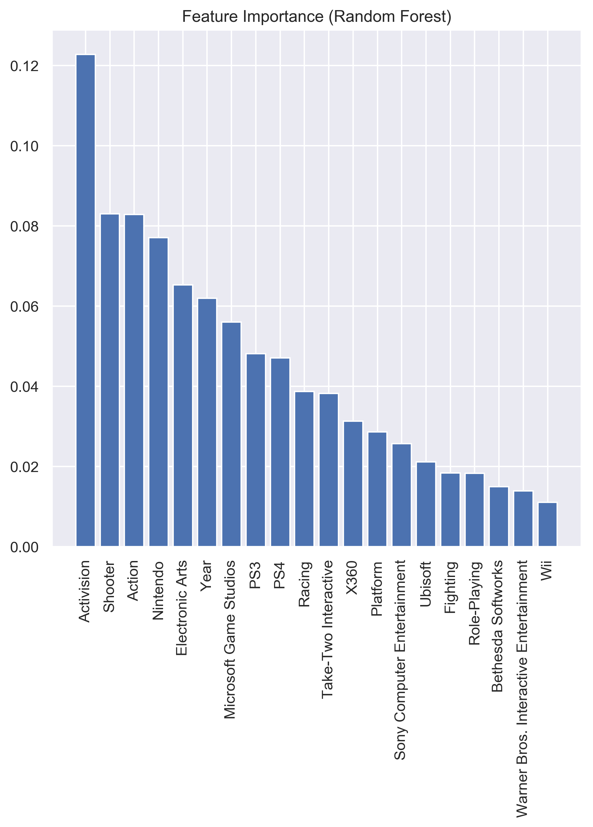
Limiting to past 10 years improves accuracy of model
Random Forest
R² ~ 0.25
KPIs: Publisher, Genre

Slide 11
Summary
What are key differences between NA, EU, and JP markets?
Size: NA > EU > JP
Preferred gaming platform: NA/EU-stationary, JP-mobile
Preferred game genre: NA/EU-shooters, JP-RPG/action
What are key indicators of game success?
Publisher and genre

