Slide 1
PLASTECH MANUFACTURING CO.
Manufacturing Plant
Operational Performance
A Root-Cause Analysis of Downtime, Quality & Cost Across the Plant Floor
Prepared for: Plant Operations Leadership & Interview Panel Data Period: January 2018 - March 2026 | 3,000 Production Batch Records Presented by: Data Analyst, Business Intelligence Track

Slide 2
01
The Business Problem
Why the plant floor manager commissioned this study
02
Data & Method
3,000 records, 20 machines, 8+ years - how we approached it
What We'll
Cover Today
03
Five Investigations
Assets, quality, shifts, environment, cost - tested against the data
From a production log to a plant-wide action plan.
04
Beyond the Brief
Translating findings into rupees, benchmarks & risk
05
Recommendations
A phased roadmap the plant can act on immediately
02

Slide 3
THE BUSINESS PROBLEM
Tight Margins, Despite Hitting Production Targets
The Plant Operations & Floor Manager commissioned this study with a specific worry: daily output targets are being met, but unpredictable asset failures, excessive rework time, and material waste spikes are quietly eating into margins. The brief was not “work harder” - it was “show me, with evidence, where the money is actually leaking.”
“
We are meeting our baseline daily production targets, but we are noticing unacceptably tight margins due to unpredictable asset failures, excessive rework times, and material waste spikes.
Which shifts or machines really suffer from lower efficiency?
Are scrap and rework tied to a specific cause we can fix?
Is our shop-floor climate control worth the investment?
How do we get to an optimal, defensible cost-per-unit?
Chief Floor & Production Manager
Business Requirement Document, v1.0
This deck answers that brief with evidence -not opinion.
03

Slide 4
PROJECT SCOPE
Four Questions the Business Needed Answered
01
02
03
04
Asset Reliability
Quality Assurance
Environmental Control
Resource & Cost
Which machines fail most, and does pouring in more maintenance hours actually help?
Which product types and lines are driving defects, scrap and failed QC checks?
Do shop-floor temperature and humidity swings really move the needle on quality?
Is labour over-allocated, and what is really inflating overhead per unit?
04

Slide 5
DATA & METHOD
One Clean Source of Truth - No Estimates, No Gaps
The dataset is the plant's own operational log: one row per production batch, capturing machine, shift and product type, alongside output, quality, cost, environmental and downtime figures. After cleaning, there were zero missing values in any field used in this analysis - every number in this deck is drawn from the full record set, not a sample.
DATA DICTIONARY SNAPSHOT
Down time Hours
Critical KPI - unplanned stops
Scrap Rate
Wasted material at setup
3,000
8+ yrs
20
3
5
Rework Hours
Production batch
records
Jan 2018 --Mar 2026
coverage
Machines
tracked
Shifts -Day,
Swing, Night
Product lines
in scope
Hidden labour cost
Quality Checks Failed
QA gate rejections
TOOLCHAIN
Avg. Temp / Humidity
Python (pandas) —-cleaning & exploratory analysis
Climate tolerance check
Statistical correlation testing across 6 hypotheses
Maintenance Hours
Power BI - interactive executive dashboard
Proactive vs. reactive care
05

Slide 6
EXECUTIVE SUMMARY
The Headline Finding: It's Not One Fire - It's Many Small Ones
Every major lever we normally blame for plant losses -temperature, humidity, headcount, maintenance hours, shift timing, product mix - was tested against the data. None of them meaningfully explains our downtime, defects or scrap. Losses are spread evenly across the operation, with one exception: a small group of machines that consistently underperform the fleet.
375,113
3.64%
12.2%
7,522 hrs
4 Machines
Units Produced
Overall Defect Rate
Downtime-to-Production
Maintenance Invested
Flagged High-Risk
across 8-year review period
13,655 total defects logged
4,613 hrs lost of 37,733 run
with no measurable downtime cut
IDs 6, 9, 11 & 18
06

Slide 7
INVESTIGATION 01 -ASSET RELIABILITY
Five Machines Are Losing More Time Than the Rest of the Fleet
FLEET AVERAGE
12.2%
of active production time lost to unplanned downtime, fleet-wide.
THE FIVE OUTLIERS
Machines 6, 11, 9, 7 & 12 each lose 13.0-14.0% of running time - a real, addressable gap above the fleet norm.
This is a spread, not a single outlier - which is why the fix has to be targeted engineering inspection, not a blanket policy change.
07

Slide 8
INVESTIGATION 01 (CONT.) -THE MAINTENANCE PARADOX
More Maintenance Hours Are Not Buying Less Downtime
CORRELATION
- 0.004
Maintenance Hours vs. Down Time Hours -effectively zero relationship.
THE STORY HERE
Average downtime stays flat at roughly 1.5 hours whether a machine received 1 hour or 5 hours of maintenance. This doesn't mean maintenance is worthless -it means it's being applied on a fixed calendar rather than in response to a machine's actual condition, so the hours aren't landing where they're needed.
08

Slide 9
INVESTIGATION 02 -QUALITY & SCRAP
Defects Are a Plant-Wide Pattern -Not One Product's Problem
DEFECT RATE BAND
3.54% - 3.77%
across all five product lines -too narrow a gap to call any single line the culprit.
SCRAP RATE SPREAD
2.98%-3.12% by product, 2.99%-3.09% by shift. Rework hours also show almost no link to labour pay tier (r = 0.02) -we are not overpaying premium shifts to fix mistakes; rework itself is the cost to target.
09

Slide 10
INVESTIGATION 03 -SHIFT & STAFFING
Night Shift Isn't the Problem -and Neither Is More Headcount
OUTPUT & DEFECT RATE BY SHIFT
PRODUCTION PER HOUR BY OPERATOR COUNT
Swing shift actually edges out Day and Night on both output and defect rate -the long-held “night shift underperforms” assumption isn't supported.
Correlation between Operator Count and Units Produced: 0.007. Output per hour does not climb with headcount -pointing to a bottleneck in machine speed or material supply, not staffing.
Business read:
Some lines may be over-staffed relative to what they can actually produce -a near-term headcount review is worth more than a shift-schedule overhaul.
10

Slide 11
INVESTIGATION 04 -ENVIRONMENTAL CONTROL
The Climate-Control Hypothesis Doesn't Hold Up
Temp.
Humidity
Defects
QC Failed
Downtime
Scrap
Temperature
1.00
0.01
0.01
0.01
0.02
0.02
VERDICT
Hypothesis: Disproven
Humidity
0.01
1.00
0.00
0.02
0.05
0.03
Defects
0.01
0.00
1.00
-0.03
0.03
0.00
Temperature and humidity, within the ranges recorded on our floor, are not driving defect or breakdown patterns. That's a cost-saving finding: tighter climate control is not the lever to pull for quality or downtime -and it frees up that budget for the machine-level fixes that actually move the needle.
QC Failed
0.01
0.02
-0.03
1.00
-0.01
0.02
Downtime
0.02
0.05
0.03
-0.01
1.00
0.02
All values between -0.03 and 0.05 -statistically indistinguishable from no relationship.
11

Slide 12
BEYOND THE BRIEF -ADDED ANALYSIS
Translating the Floor Data Into a Language Leadership Trades In: Money
SHOP-FLOOR HEALTH vs. WORLD-CLASS BENCHMARK
HIDDEN COST OF VARIABILITY
Reframing two of our own KPIs the way lean-manufacturing / TPM programs benchmark plants worldwide.
A cost-of-poor-quality (COPQ) estimate -what downtime, defects and rework are worth in rupees, not just percentages.
₹18.6 Lakh
estimated recoverable value across the review period, at current downtime, scrap and rework levels.
Lost output value from unplanned downtime
₹13.83 L
Material cost tied up in defective units
₹4.12 L
Rework labour cost
₹0.68 L
Availability (89.1%) is within reach of world-class. The real gap is Quality Rate -96.4% vs. a 99% benchmark -which is where scrap and rework live.
This is a floor, not a ceiling -it excludes second-order costs like expedited freight, customer credits, or overtime to catch up after a breakdown.
12

Slide 13
DELIVERABLE -AT-RISK ASSET DIRECTORY
Four Machines, One Priority List for Engineering
Priority | Machine ID | Downtime Ratio | Defect Rate | Avg. Maint. Hrs | QC Failures
1 | Machine 6 | 14% | 4.11% | 2.65 | 129
2 | Machine 9 | 13% | 4.36% | 2.54 | 123
3 | Machine 18 | 12% | 4.52% | 2.75 | 133
4 | Machine 11 | 14% | 4.04% | 2.48 | 171
Machine 11 is a close fourth and worth including in the same inspection cycle. All four run maintenance hours in line with the fleet average -confirming the issue is asset condition, not lack of attention.
13

Slide 14
RECOMMENDATIONS
A Phased Roadmap -Not a Single Silver Bullet
IMMEDIATE
NEAR-TERM
ONGOING
0-3 Months
3-6 Months
Continuous
Send Machines 6, 9, 11 & 18 for urgent engineering inspection
Review staffing line-by-line against actual throughput; reallocate headcount from over-staffed to constrained lines
Do not prioritize climate-control spend as a quality/downtime fix -the evidence doesn't support it
Audit the maintenance schedule; shift from fixed-interval to condition-based servicing on the 4 at-risk machines first
Investigate rework drivers directly -operator training, calibration, material quality -not labour cost tier
Build a rolling machine-health scorecard; re-run this analysis quarterly to track the at-risk list
14

Slide 15
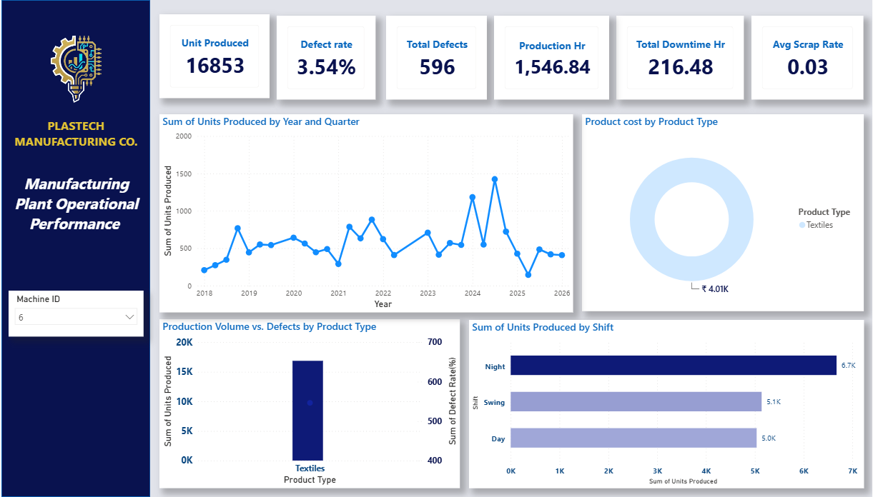
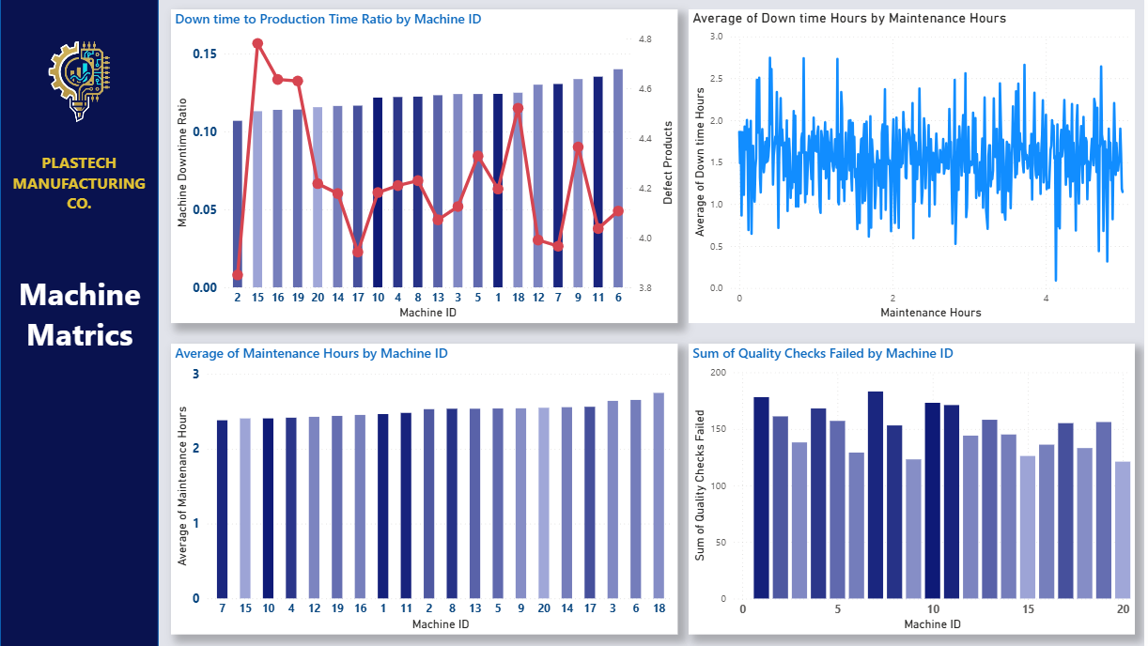
THE DELIVERABLE
A Live Dashboard Behind Every Slide
Every chart in this deck is also a live, filterable view in the Power BI dashboard delivered alongside this report -sliced by Machine ID, Shift, Product Type and Month, so plant leadership can self-serve the same answers going forward.
Machine Metrics page -downtime ratio & QC failures by asset
Quality & Cost page -defects, rework, energy vs. temperature
Operational Overview -KPIs, trend, shift & product mix
Thank You
Happy to walk through any metric live, or open the dashboard for a filtered drill-down on request.
15

