Slide 1
Team Name Kinetic Nexus Members: Rahul Singh Gautam Shetty
Background: Hybrid vehicles combine multiple energy sources to enhance fuel efficiency and reduce emissions. In two-wheelers, hybridization could involve electric-assist systems, regenerative braking, or alternative energy storage solutions. However, challenges such as weight, cost, packaging constraints, and user adoption need to be considered.
Problem Statement 3: What innovative hybrid technologies can be integrated in two-wheelers to improve energy efficiency while maintaining performance and affordability?

Slide 2
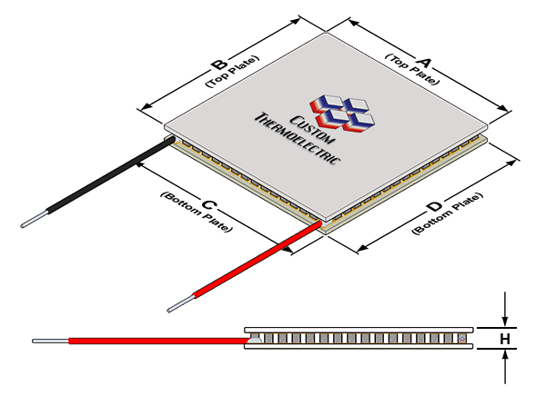
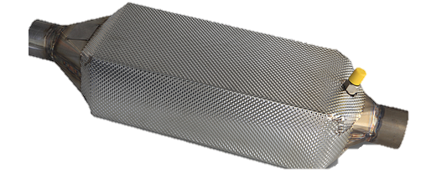
Overview of the solution
Current Trends in Hybrid Technologies:
Our Solution:
“Turning Waste into Watts”
Regenerative Braking:
Converts kinetic energy during braking into electricity
Engine Heat Recovery:
Rankine cycle-based heat recovery from exhaust
Electric-Assist:
Combines ICE with electric motor
CNG Hybrid:
Uses CNG + petrol; ECU switches fuels dynamically
Retrofitting Kits:
Adds electric powertrain to existing ICE vehicles
1. Exhaust Heat Recovery System
Direct TEG Attachment
Silencer Heat Exchanger
Coolant Integration
2. Radiator-Modified TEG System
3. Software Monitoring System
Thermoelectric Generator Module (TEG)
Engine
Why Focus on Engine Heat Recovery?
Benchmarks
60%
250M
62%
Rankine Cycle Based Heat recovery from exhaust:
BMW’s Turbosteamer improves fuel efficiency by 15% in prototypes.
Exhaust
Pump
Alternator
of fuel energy is wasted as heat in ICEs
Suitable for India’s 250M+ ICE two-wheeler fleet
Gasoline in India is consumed by Two-wheelers
Radiator
Controller
TEG
Along with these, it also aligns with Bharat Stage VI and EV30@30 goals
Battery
Exhaust Gases
Refined Problem Statement:
How can Engine Heat recovery methods be implemented in existing ICE 2 wheelers?
ECU
DC - DC Converter

Slide 3
Implementation & Feasibility
Our Solution 1: Exhaust Heat Recovery System
Implementation Roadmap:
Design: Hexagonal-shaped engine waste heat recovery system.
Hot Side: Hexagonal finned heat exchanger attached to exhaust.
Cold Side: Aluminium coolant box connected to engine coolant loop.
TEG Configuration: 3 TEGs per face (18 TEGs total), arranged in a row for uniform heat distribution.
Phase 1: Prototyping
(3 months)
Phase 2: Integration
(2 months)
Phase 3: Optimization
(1 month)
Fine-tune heat exchanger design for better thermal uniformity.
Implement IoT sensors for real-time monitoring (e.g., temperature, power output).
Fabricate hexagonal heat exchanger and coolant box
Assemble TEGs with clamping system and thermal interface materials
Install the system on a test vehicle
Connect coolant box to engine coolant loop
Heat Exchanger Fins
Mounting
TEG
Coolant Tube
Clamps
TEG Module
Coolant out
Coolant in
Cooling Channels
Cost and Weight of Exhaust Heat Recovery System
Hot Exhaust Gas
Category | Item Description | Specification | Unit Wt. (Kg) | Total Wt. (Kg) | Price | Unit | Unit Cost (INR) | Total Cost (INR)
TEG Modules | Bi₂Te₃-based TEG modules | - | 0.025 | 0.45 | - | 18 | ₹ 150 | ₹ 2,700
Cooling System Components | Cooling Channels | Raw material | 0.12 | 0.72 | ₹ 180 | 6 | ₹ 300 | ₹ 1,800
 |  | Operation cost (Casting) | - | - | ₹ 1620
Heat Exchanger Assembly | Custom extruded aluminium finned design | Raw Material | 1.2 | 1.2 | ₹ 300 | 1 | ₹ 4,200 | ₹ 4,200
 |  | Operational costs(Casting) | - | - | ₹ 3,900
Wiring & Electrical Components | High‑temperature rated wiring, | - | - | - | ₹ 200 | 1 | ₹ 2,200 | ₹ 2,200
 | Controller | - | - | - | ₹ 2,000 | 1
Total |  |  |  | 2.37 Kg |  |  |  | ₹ 10,900
Heat Exchanger
250 mm
100 mm
Feasibility:
2.4 Kg
₹ 11K
6-8 yrs
Overall weight of the Exhaust Heat Recovery system
Cost of the Exhaust Recovery System
ROI, via fuel savings (urban commuter use case)

Slide 4
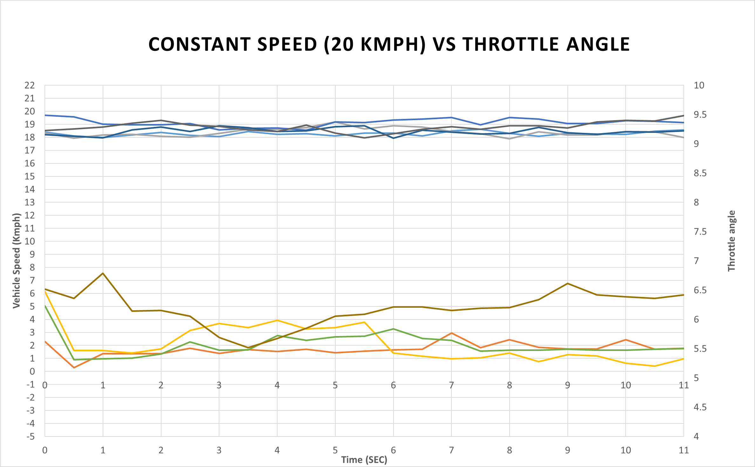


Impact and Benefits
Energy Recovery and Fuel Efficiency (Exhaust + Coolant TEG)
Software based monitoring system (Exhaust + Coolant Data)
3-5%
7.5M tons
Predictive Maintenance:
Early detection of soot buildup, clogged filters, and coolant issues.
Reduces repair costs and prevents unexpected breakdowns .
Efficiency Optimization:
Real-time feedback on driving behavior (e.g., aggressive acceleration, excessive idling).
Cost Savings:
Eliminates the need for additional sensors (e.g., exhaust temperature probes).
Extends engine lifespan by reducing thermal and mechanical stress.
Overall improvement in fuel efficiency [2]
lower CO₂ emissions by reducing engine load and optimizing energy use.
Technical Benefits - Dual Functionality:
Energy Generation: Converts exhaust heat into electricity for auxiliary systems (e.g., lights, infotainment).
Noise Reduction: Integrated muffler designs can reduce exhaust noise by creating modification to design such as a porous structure.
Energy Recovery and Power Generation Calculation
Methodology | Condition | No. of TEG modules | Medium Temp (max load cond.)(°C) | Hot side temp(°C) | Cold side temp(°C) | Power per module(W) | Total power (W) | Energy efficiency / CO2 emission reduction
Exhaust gas recovery system | Base | 18 | 450-500 [1] | Delta = 80 [2] |  | 1 | 18 | 0.30%
 | Base + hot + cold | 18 | 450-500 | 350* | 80 | 8.5 | 153.0 | 2.55%
Engine coolant energy recovery system | Base | 54 | 110 - Coolant | 100* | 40 | 1.4 | 75.6 | 1.26%
Increase in throttle response in order to maintain the same speed – indicative of soot formation
Message on cluster/Phone app-Engine cleaning required!
Notes:
Explain the table (1.5min) – Explain what are the different conditions, no. of modules, medium temperature, hot and cold side, W per module and total and efficiency
Go to the energy recovery and technical benefits (0.5min) – explain figures & energy generation -> capacity increase and noise reduction -> integrated muffler design
Explain software base system (1 min)-> explain all three aspects
Explain example graph (0.5 min)-> explain all three aspects
Explain challenges (1 min) -> what to do with extra power? Rigorous testing data needs to be recovered for sbms?
Calculations justification
Delta = 80 was calculated from paper [1] silencer paper
Efficiency calculations => [2] – Thermoelectric handbook macro to nano 22kW 100hp – 4.5kW 20hp (Waste heat 60%) – 7 kW (total energy) –for 4% at least 280W aim for ~300W

Slide 5
Thank You

