Slide 1
Time-Series Projection of Return on Investment
Multi-Objective optimization

Slide 2






$R_{k,t}$: Annual rocket launches at site k
$E_{p,t}:$ Annual cargo via elevator port p
$S_{t}:$ Project completion in year t
$$Min Z=w_{1}⋅\frac{Z_{C}}{C_{norm}}+w_{2}⋅\frac{Z_{T}}{T_{norm}}$$
STEP1:
Algorithmic Layer
$Z_{C}=\sum_{t=1}^{T_{max}}{(}\sum_{k=1}^{10}{(}{Cost}_{rocket}⋅R_{k,t})+\sum_{p=1}^{3}{(}{Cost}_{lift}⋅E_{p,t}))$ $Z_{T}=\sum_{t=1}^{T_{max}}{t}⋅S_{t}$
Constraints：
$$\sum_{t=1}^{T_{max}}{(}\sum_{k=1}^{10}{(}Cap_{rocket}⋅R_{k,t})+\sum_{p=1}^{3}{E_{p,t}})≥D_{total}$$
$$0≤E_{p,t}≤p_{lift},∀p,∀t$$
$$0≤R_{k,t}≤L_{max}$$
Defines an NP-Hard Mixed-Integer Linear Programming (MILP) problem.
Code-level
Para-meters
POP_SIZE=100
STEP2:
Implementation Layer
$$w_{1}$$
MAX_GENERATIONS=1000
$$Z_{Total}$$
$$w_{2}$$
WEIGHT_RANGE=np.linspace(0,1,11)
PENALTY_WEIGHT=1e6
Hybrid Transportation System is the Optimized Solution

Slide 3
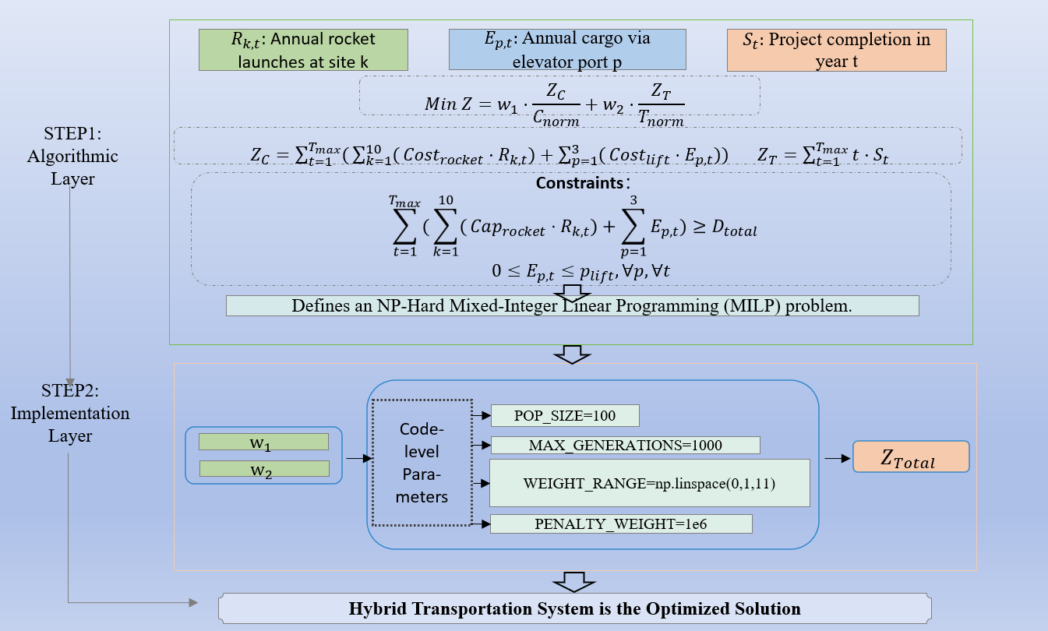
Multi-Objective optimization
Multi-Objective optimization

