Slide 1



Slide 2
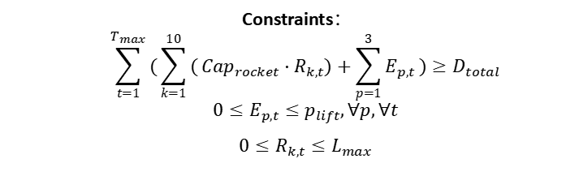





Elevator Path
Elevator Path
STEP1:
Conceptual Layer
Apex Anchor
Rocket Transportation Route
Starting Point and Launch Bases
Destination and Endpoint
$R_{k,t}$: Annual rocket launches at site k
$E_{p,t}:$ Annual cargo via elevator port p
$S_{t}:$ Project completion in year t
$$Min Z=w_{1}⋅\frac{Z_{C}}{C_{norm}}+w_{2}⋅\frac{Z_{T}}{T_{norm}}$$
$Z_{C}=\sum_{t=1}^{T_{max}}{(}\sum_{k=1}^{10}{(}{Cost}_{rocket}⋅R_{k,t})+\sum_{p=1}^{3}{(}{Cost}_{lift}⋅E_{p,t}))$ $Z_{T}=\sum_{t=1}^{T_{max}}{t}⋅S_{t}$
STEP2:
Algorithmic Layer
Constraints：
$$\sum_{t=1}^{T_{max}}{(}\sum_{k=1}^{10}{(}Cap_{rocket}⋅R_{k,t})+\sum_{p=1}^{3}{E_{p,t}})≥D_{total}$$
$$0≤E_{p,t}≤p_{lift},∀p,∀t$$
$$0≤R_{k,t}≤L_{max}$$
Defines an NP-Hard Mixed-Integer Linear Programming (MILP) problem.
Code-level
Para-meters
POP_SIZE=100
STEP3
Implementation Layer:
$$w_{1}$$
MAX_GENERATIONS=1000
$$Z_{Total}$$
$$w_{2}$$
WEIGHT_RANGE=np.linspace(0,1,11)
PENALTY_WEIGHT=1e6
Hybrid Transportation System is the Optimized Solution

Slide 3


Slide 4
问题建模概念
NSGA-II算法流程
核心算法组件

Slide 5








Elevator Path
Elevator Path
STEP1:
Conceptual Layer
Apex Anchor
Rocket Transportation Route
Starting Point and Launch Bases
Destination and Endpoint
$R_{k,t}$: Annual rocket launches at site k
$E_{p,t}:$ Annual cargo via elevator port p
$S_{t}:$ Project completion in year t
$$Min Z=w_{1}⋅\frac{Z_{C}}{C_{norm}}+w_{2}⋅\frac{Z_{T}}{T_{norm}}$$
$Z_{C}=\sum_{t=1}^{T_{max}}{(}\sum_{k=1}^{10}{(}{Cost}_{rocket}⋅R_{k,t})+\sum_{p=1}^{3}{(}{Cost}_{lift}⋅E_{p,t}))$ $Z_{T}=\sum_{t=1}^{T_{max}}{t}⋅S_{t}$
STEP2:
Algorithmic Layer
Constraints：
$$\sum_{t=1}^{T_{max}}{(}\sum_{k=1}^{10}{(}Cap_{rocket}⋅R_{k,t})+\sum_{p=1}^{3}{E_{p,t}})≥D_{total}$$
$$0≤E_{p,t}≤p_{lift},∀p,∀t$$
$$0≤R_{k,t}≤L_{max}$$
Defines an NP-Hard Mixed-Integer Linear Programming (MILP) problem.
Code-level
Para-meters
POP_SIZE=100
STEP3
Implementation Layer:
$$w_{1}$$
MAX_GENERATIONS=1000
$$Z_{Total}$$
$$w_{2}$$
WEIGHT_RANGE=np.linspace(0,1,11)
PENALTY_WEIGHT=1e6
Hybrid Transportation System is the Optimized Solution

Slide 6
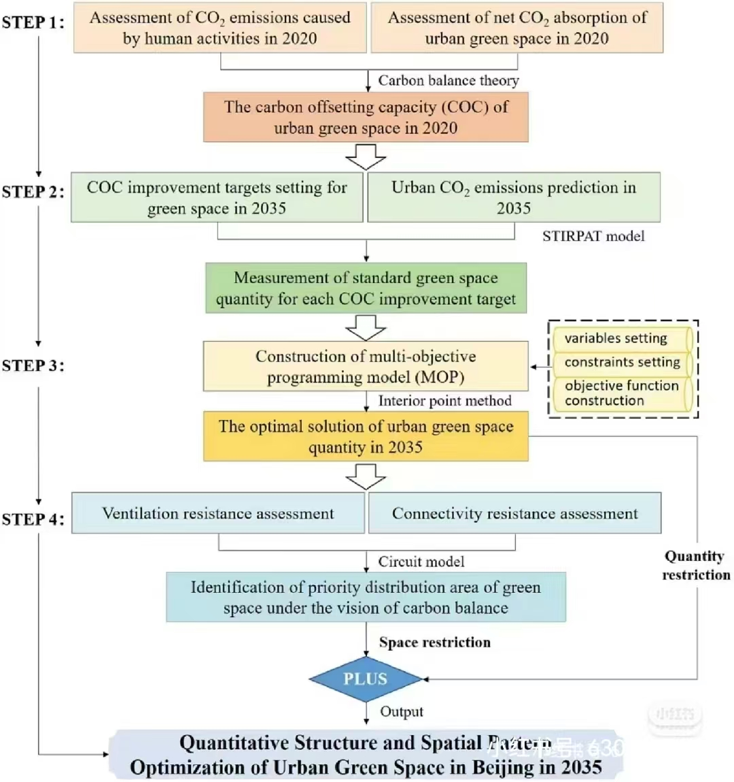

Slide 7
STEP1:
Text
Text
text
Text
STEP1:
Text
Text
text
Text
Text
text
STEP1:
text
text
text
Text
STEP1:
Text
Text
text
text
Text
text
Text
text
Text

Slide 8
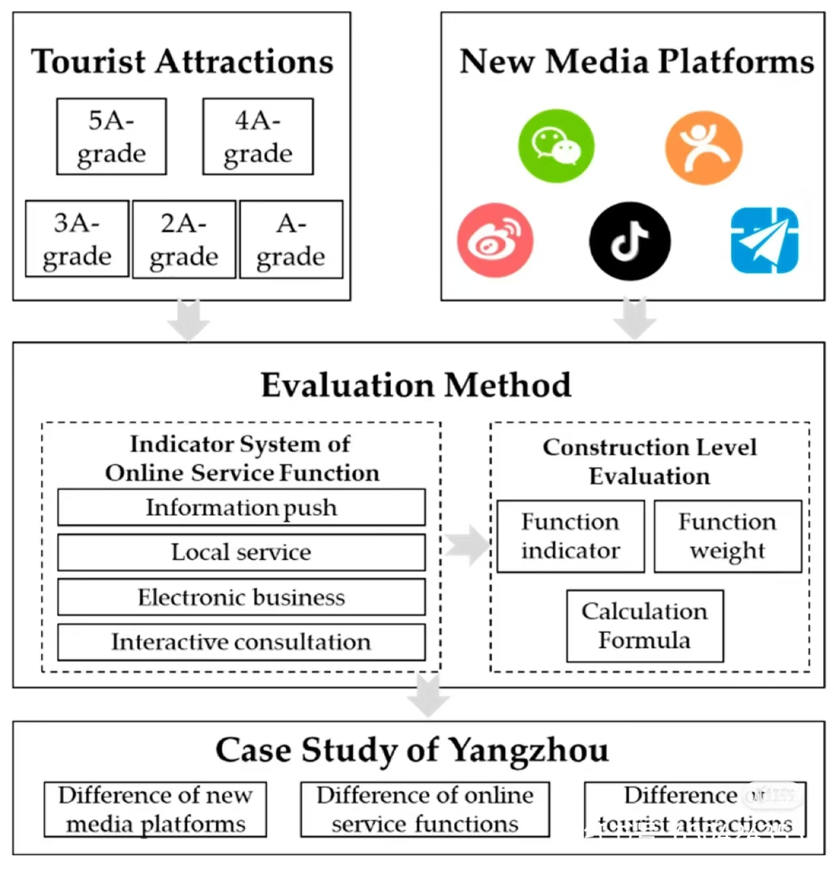

Slide 9

Text Text
Text Text
text
text
text
text
text
text
Text Text
text
text
text
text
text
text
text
text
text
Text Text
text
text
text

Slide 10
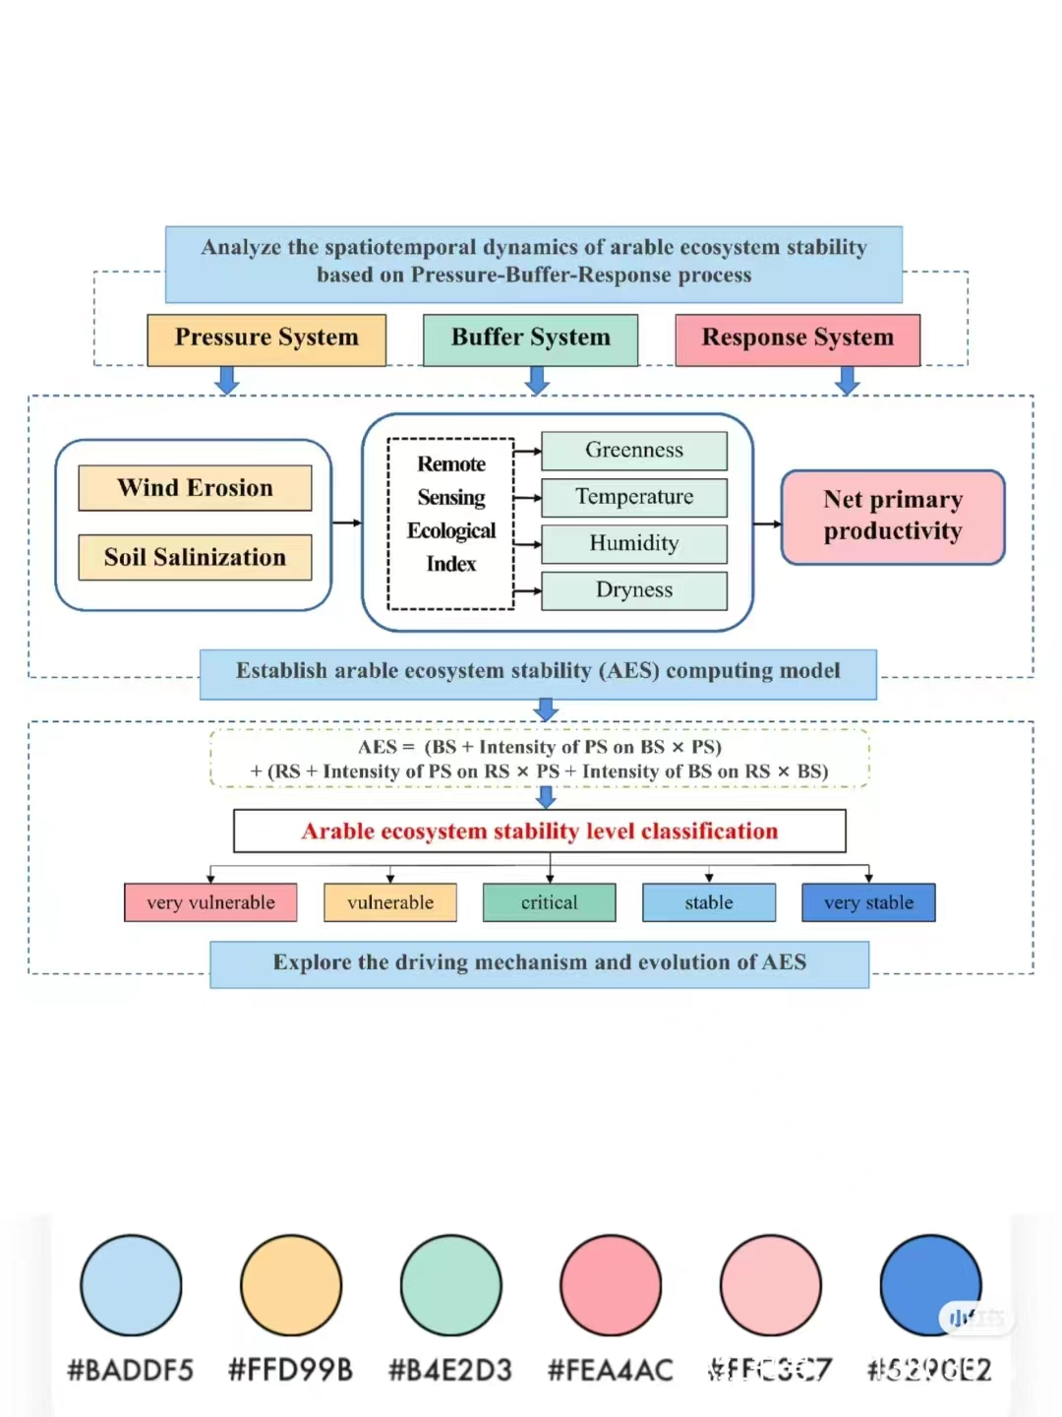

Slide 11

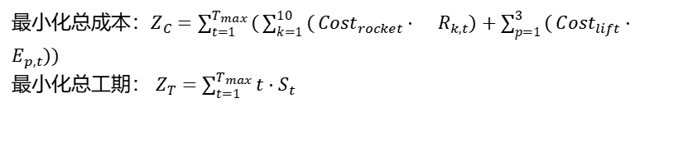



问题概念
Text
$$R_{k,t}$$
$$E_{p,t}$$
$$S_{t}$$
NSGA-Ⅱ算法流程
Text
Text
Text
Text
Text
Text
Text
Text
Text Text
Text
Text
Text
Text
Text
Text
Text
Text Text
约束条件：
$$\sum_{t=1}^{T_{max}}{(}\sum_{k=1}^{10}{(}Cap_{rocket}⋅R_{k,t})+\sum_{p=1}^{3}{E_{p,t}})≥D_{total}$$
$$0≤E_{p,t}≤p_{lift},∀p,∀t$$
$$0≤R_{k,t}≤L_{max}$$
最小化总成本：$Z_{C}=\sum_{t=1}^{T_{max}}{(}\sum_{k=1}^{10}{(}{Cost}_{rocket}⋅R_{k,t})+\sum_{p=1}^{3}{(}{Cost}_{lift}⋅E_{p,t}))$
最小化总工期： $Z_{T}=\sum_{t=1}^{T_{max}}{t}⋅S_{t}$

Slide 12


问题概念
Text
Text
Text
Text
代码层参数
POP_SIZE=200
$$w_{1}$$
MAX_GENERATIONS=1000
WEIGHT_RANGE=np.linspace(0,1,11)
Z
$$w_{2}$$
PENALTY_WEIGHT=1000
Text
Text Text
Text
Text
Text
Text
Text
Text Text

Slide 13


Slide 14
Text
Text
Text
text
text
Text
text
text
text
text

Slide 15
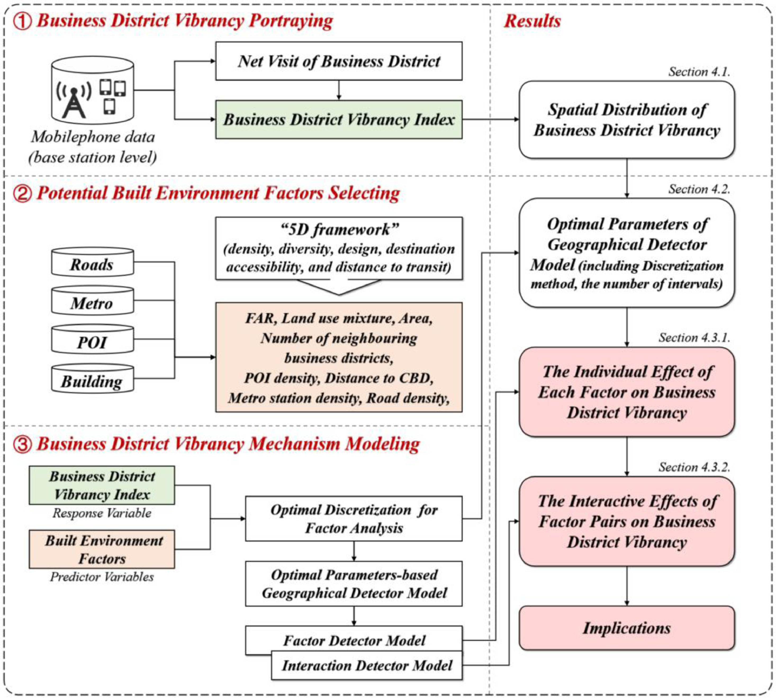

Slide 16


① Text
Text
Text
text
Text
Text
text
②Text
text
Text
Text
Text
text
Text
Text
Text
text
Text
Text
text
text
③Text
text
Text
Text
text
Text
Text
text
Text
Text
Text
Text

Slide 17
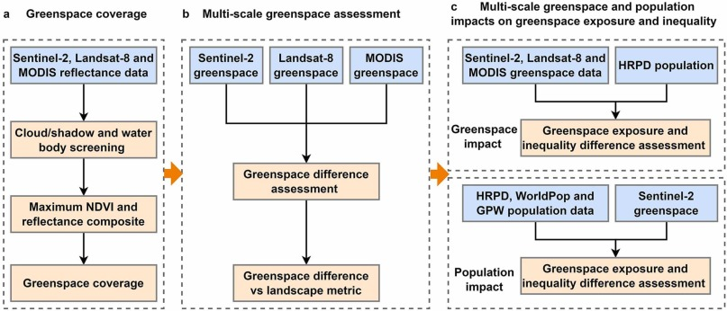
a text
b text
c text

