Slide 1
Temporary Results
Environments:
"HumanoidBulletEnv-v0"
"Walker2DBulletEnv-v0"
"Pendulum-v0"
"HalfCheetahBulletEnv-v0"
Algorithms:
gradient-based
Neural Network Architechtures:
RBF (with different hyperparameters)
MLP (1-2 Layers, 64 or 256 neurons each)
Linear

Slide 2
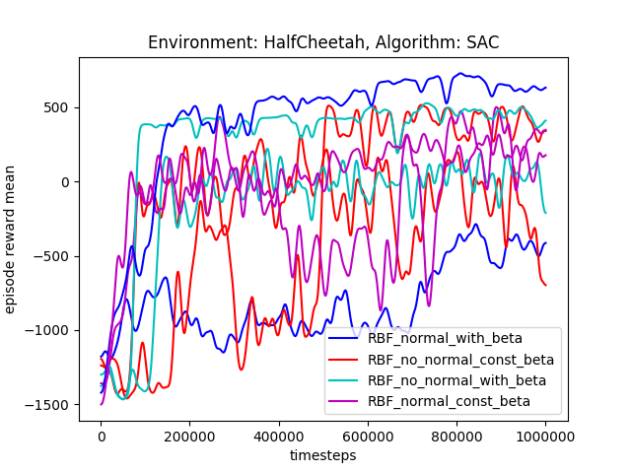
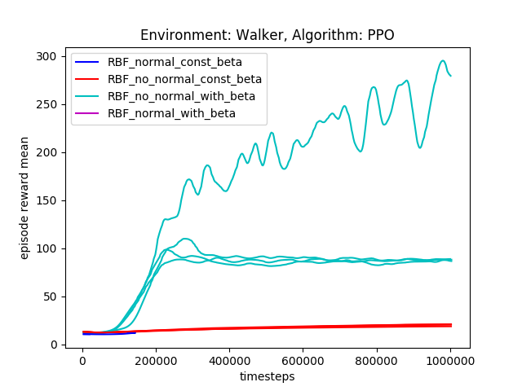
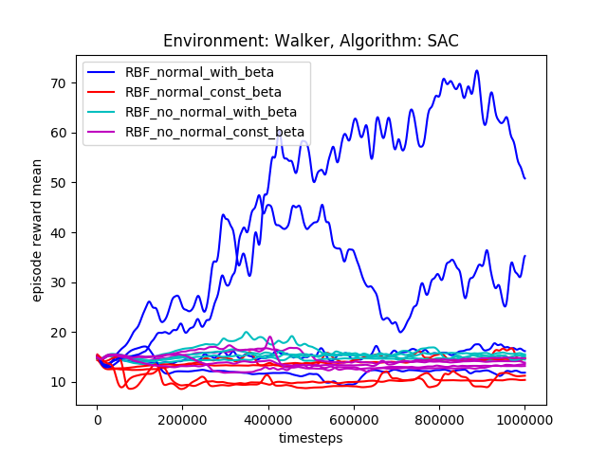
I RBF Hyperparameters
For halfcheetah no clear tendencies
For walker only the networks with no constant beta values achieve higher rewards, but should definitely be investigated further

Slide 3
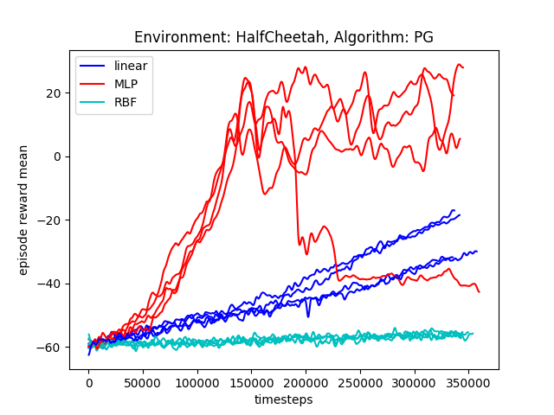
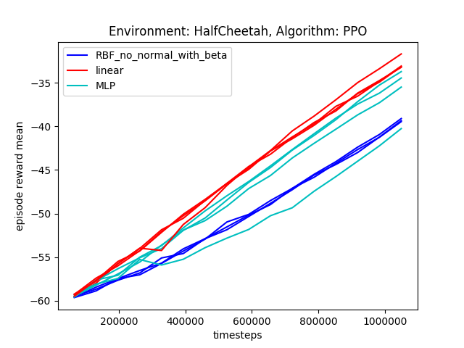
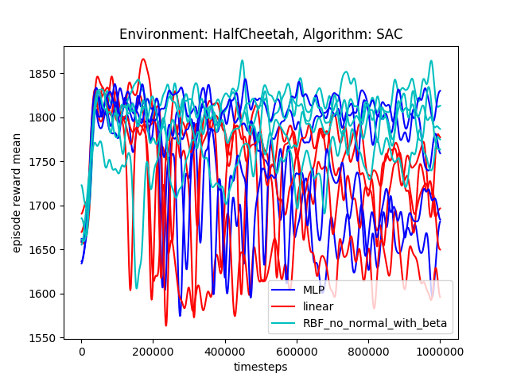
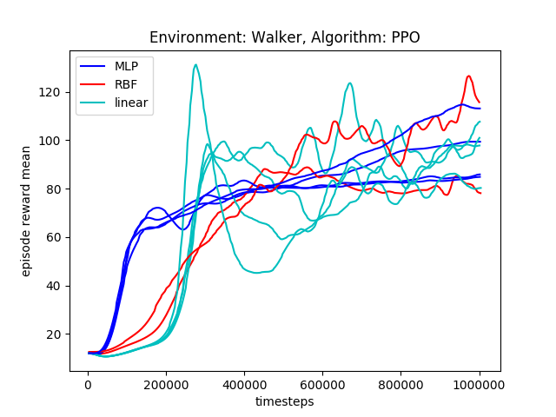
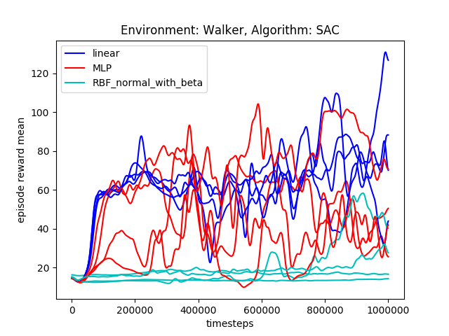
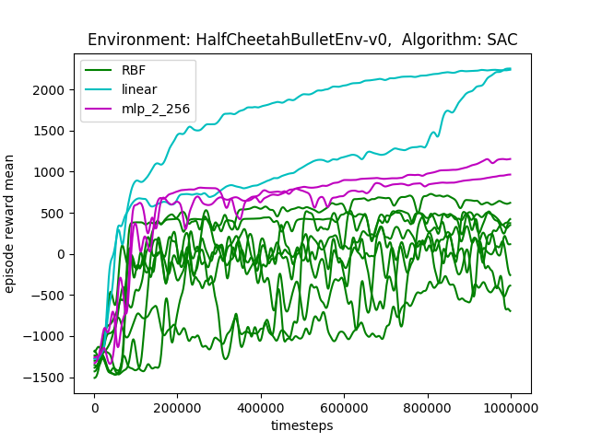
II Linear vs. RBF vs. MLP
Note: the colors are not
Consistent!

Slide 4
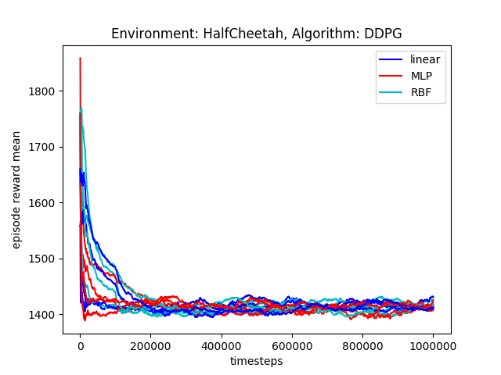
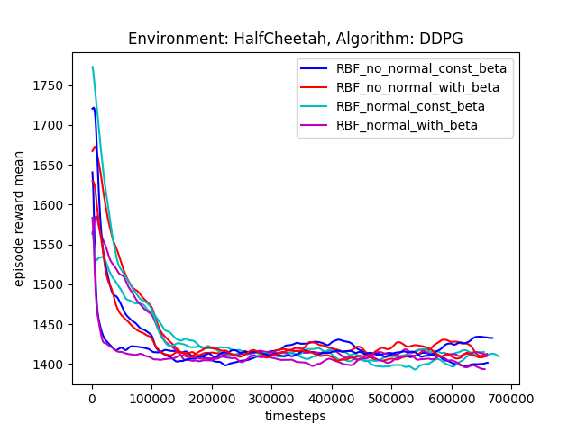
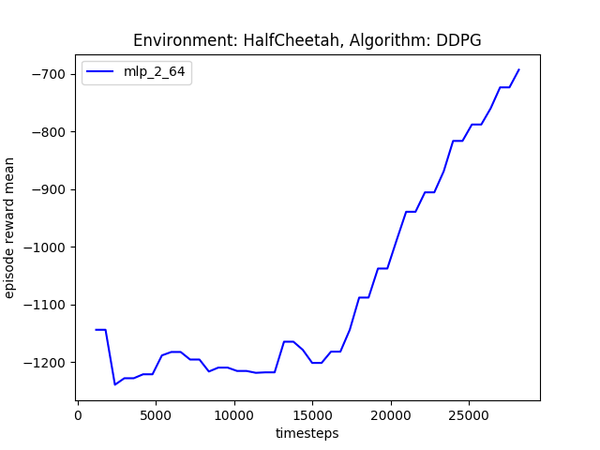
III.1 Trials with strange behavior
Why did it work for that trial? Check hyperparameters
Difference in hyperparameters:
- timesteps per iteration (1000 vs 600)
- mlp code for the second one is newer, but only customizable, the executed code should be the same

Slide 5
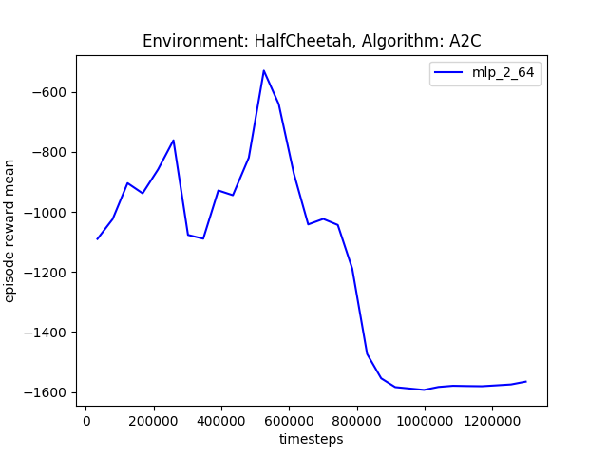
III.2 Trials with strange behaviour
Some hyperparameters look pretty weird, try again with updated learning rate
Weird reward

Slide 6
III.3 Trials with strange behavior
(same trials with different rewards)
Same trials (params.json are the same), just older versions of the mlp and rbf network (linear is the same), but the rewards are completely different ? → look into it again
Newer runs always produce rewards starting around 1600 … → older version of pybullet before etc.?

Slide 7
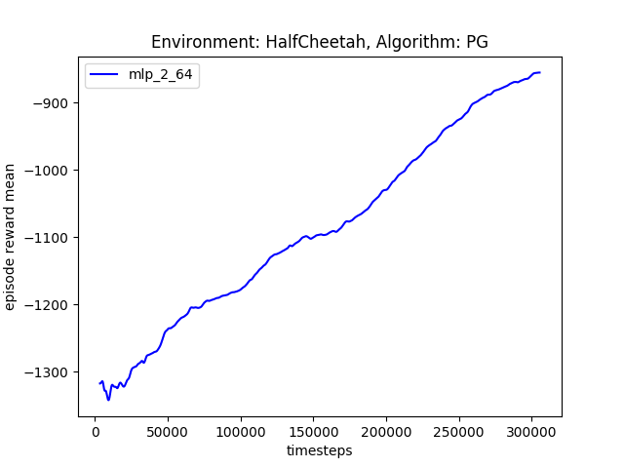
III.4 Trials with strange behavior
(same trials with different rewards)
Same trials (params.json are the same), just older versions of the mlp and rbf network (linear is the same), but the rewards are completely different ? → look into it again

Slide 8
IV Errored Trials
A2C for RBF and A3C for MLP errored if I remember it correctly (should be checked), A3C errored for RBF for some seeds!
The fix with the normalization/regularization didn’t fix the errors

Slide 9
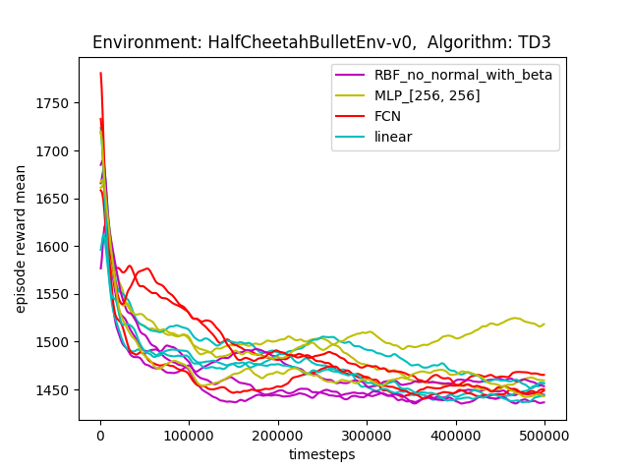
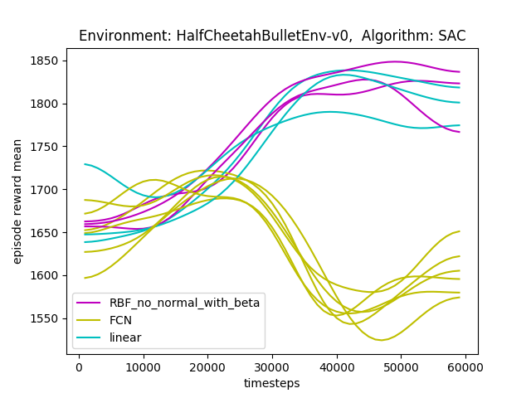
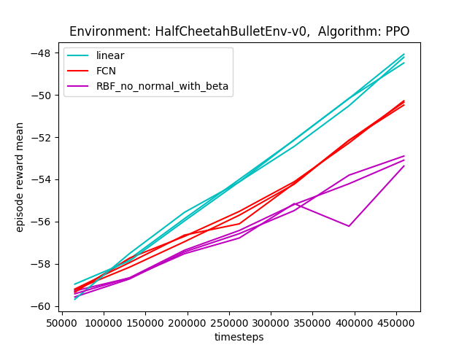
Linear vs RBF vs FCN (MLP failed due to a typo)

Slide 10
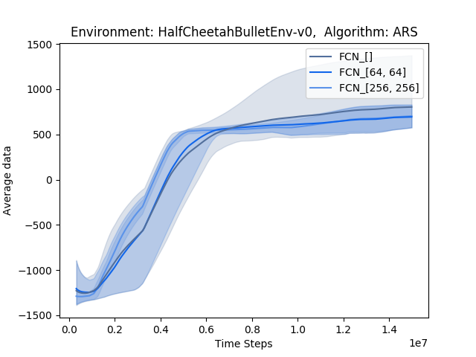
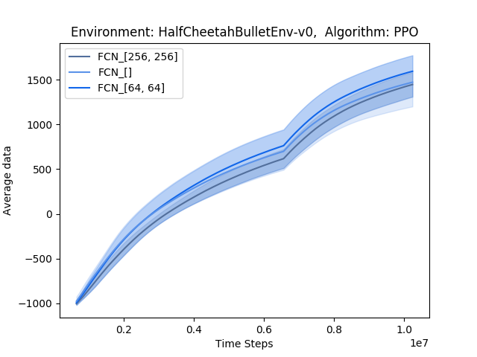
PPO and ARS - HalfCheetah

Slide 11
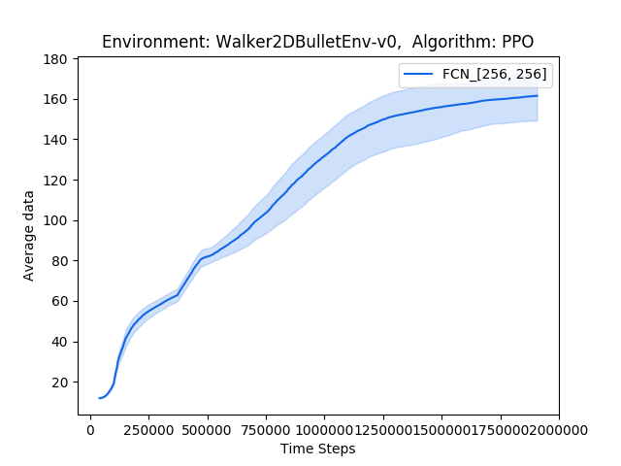
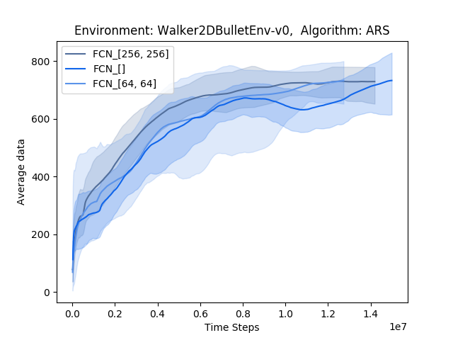
PPO and ARS - Walker

Slide 12
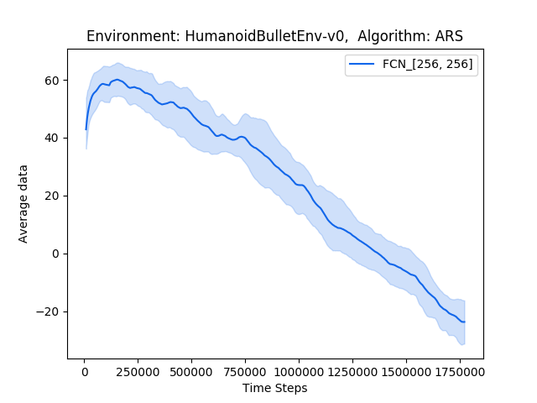
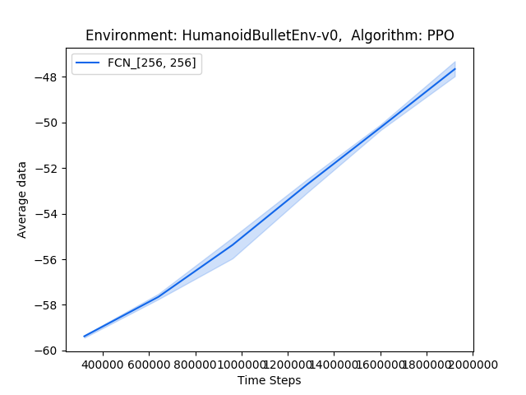
ARS and PPO - Humanoid

