Slide 1
Making research
easier to find
profile
website
paper
The practical goal is accurate discovery and attribution.
Research profiles, concept pages, webmaster checks, and writing that helps the right reader reach the right source
Sam Gilson
Game2Learn Lab, NC State
SEO and generative engine optimization
Open lab
research discovery · Game2Learn Lab · NC State University
1
Notes:
Opening. This talk uses my public research profiles and website as examples. The practical goal is accurate discovery and attribution. I am not reporting a measured increase in rankings or AI citations. Sources and examples checked against the original deck and refreshed where needed.

Slide 2

Lab + Presentation
Each section ends with a short switch into the Research Discovery Lab.
NEXT 1. Profiles
identify the researcher
2. Profile loop
connect profiles and website
3. Crawl & index
check reachability
4. Bot access
choose robots rules
Open the lab
7. Maintain
keep the record coherent
6. Test route
run GenAI checks
5. Explain ideas
build concept routes
sgilson7.github.io/research-discovery-lab
research discovery · Game2Learn Lab · NC State University
2

Slide 3
The discovery problem
A reader can know the topic before they know the paper title.
reader’s question
author records
website explanations
paper / source
Your website should make this path easier to follow.
Build the route to your subject matter expertise, then check whether anyone can use it
working rule for the talk
Lab route: what the website helps a reader do
research discovery · Game2Learn Lab · NC State University
3
Notes:
Research discovery starts with the reader’s task. Someone may remember a problem, method, or concept before they know the formal title of the paper. The site should connect that query to an author record, an explanation, and then to the source.

Slide 4
SEO and GEO are two parts of the same route
Search finds the page. Generated answers may use the page.
Search systems discover and understand a page.
SEO
For research, the useful outcome is:
a reader reaches the right paper or explanation (yours)
the chatbots generated answer represents the source accurately.
AI search systems may find and use the material in an answer.
GEO
Lab route: SEO + GEO as one path
sources in notes
research discovery · Game2Learn Lab · NC State University
4
Notes:
SEO means search engine optimization. GEO is used here for discovery and accurate use in generated answers. Google’s Search Central guidance says the same SEO foundations apply to AI features; I avoid treating GEO as a special guarantee of selection. Source: https://developers.google.com/search/docs/appearance/ai-features

Slide 5
Start with the records that identify you
The website should reinforce the public author record, not replace it.
ORCID
Semantic Scholar
OpenAlex
persistent iD
author page
author record
0009-0002-2394-8649
2387936753
A5125954125
Google Scholar
Website
profile
explanations
UIYAyjoAAAAJ
sgilson7.github.io
Check the actual profile, not just the name.
Names collide. Publications, affiliations, and links let a reader verify that a profile points to the right researcher.
Lab Station 1 · profile records
sources in notes
research discovery · Game2Learn Lab · NC State University
5
Notes:
This slide uses the public identifiers from the original deck. Names alone are insufficient because two researchers can share a name. Open the profile and compare publications, affiliations, and public links.

Slide 6
The profile loop
Claim, correct, link, then check the public view.
Claim
Correct
Link
Check
Claim the profile when the service supports it.
Correct missing work, namesakes, and stale affiliations.
Link the profile and your website in both directions.
View the public version while signed out.
“Make the author record easy to verify before you try to optimize anything else.”
Lab Stations 1–2 · claim, correct, link, check
research discovery · Game2Learn Lab · NC State University
6
Notes:
This is the profile maintenance loop I would recommend: claim where possible, correct the records, connect the profile to the site, and check the public version. This avoids ranking claims and focuses on accurate attribution.

Slide 7
ORCID connects identity, works, and the website
A persistent iD helps the same researcher remain findable across institutions and services.
Researcher
ORCID iD
Works
Website
Add the name you publish under, current affiliation, website, and works. Then inspect the signed-out public record.
My public ORCID record links to my website, and the website footer links back to the ORCID record.
0009-0002-2394-8649
Lab Station 2 · profile loop
sources in notes
research discovery · Game2Learn Lab · NC State University
7
Notes:
ORCID offers imports through connected services, identifiers, BibTeX, and manual entry. Each public item has visibility choices. Avoid creating a second iD if a record already exists. Sources: https://support.orcid.org/hc/en-us/articles/360006896894-How-do-I-add-information-to-my-record ; https://support.orcid.org/hc/en-us/articles/360006973133-Add-works-to-your-ORCID-record

Slide 8
Semantic Scholar and OpenAlex as open source research DBs
They help readers and indexing systems connect the work to the right author.
Semantic Scholar
OpenAlex
Fixing your authorship:
Find a paper you wrote, follow your name, claim the author page, and review the paper list.
Fixing your authorship:
Open the author record, compare the works, and correct missing or misassigned records after claiming.
Lab Station 1 · paper assignment checks
sources in notes
research discovery · Game2Learn Lab · NC State University
8
Notes:
Semantic Scholar automatically creates author pages; claiming allows author information and paper assignments to be corrected. OpenAlex supports claiming and self-service corrections; some metadata still has to be corrected upstream. Sources: https://webflow.semanticscholar.org/author ; https://webflow.semanticscholar.org/faq ; https://help.openalex.org/how-to/fixing-authors/

Slide 9
Other records still matter
Use them as maintenance points rather than promises of ranking lift.
Google Scholar
Institution / lab
Repository
Make the profile public and verify an institutional email for profile search eligibility.
Keep a stable page that points to the current website and publication list.
Deposit permitted versions, data, or software where the field expects them.
These records make the public trail easier to audit.
The rule is boring but useful: keep the same version story across the paper page, author profile, repository, and CV.
Lab Station 1 · maintenance records
sources in notes
research discovery · Game2Learn Lab · NC State University
9
Notes:
Google Scholar profile guidance distinguishes public profile visibility from article indexing. Depositing a paper version depends on the relevant agreement and field norms. Source: https://scholar.google.com/intl/en/scholar/citations.html

Slide 10
Lab checkpoint: profiles and profile loop
Switch to the lab for 10 minutes. Resolve the tasks you can and skip the rest for now.
1. Profiles
2. Loop
3. Crawl
4. Bots
5. Ideas
6. Test
7. Maintain
Do now
Enter only the identifiers you want to use during the lab.
Open the lab
Station 1: check one author profile from a signed-out public view.
Station 2: verify that your website and profile records point to each other.
Keep the lab open in a second window.
Skip anything you do not have yet. The lab should produce next steps, not homework guilt.
research discovery · Game2Learn Lab · NC State University
10

Slide 11

The website is the place readers land
A public profile gets someone to the site. The site explains what they found.
Homepage
Publications
Concepts
Profiles
On my website, the homepage gives the research area, the publication pages identify the evidence, and the concept pages explain the ideas behind the papers.
The footer closes the loop back to public author records.
Lab Station 2 · website as landing place
sources in notes
research discovery · Game2Learn Lab · NC State University
11
Notes:
The live homepage includes visible research descriptions, navigation, profile links, canonical URL, Open Graph metadata, and JSON-LD. Those are implementation details that make the page easier to read and check; they do not demonstrate indexing or AI visibility by themselves.

Slide 12
Crawling, indexing, and use are separate checks
A sitemap helps discovery. Indexing and generated use still have to be checked.
Can it be reached?
Can it be indexed?
Can it be understood?
Can I verify it?
Check stable URLs, crawlable links, robots rules, accidental noindex directives, and the sitemap.
Search Console turns this into a maintenance task: inspect representative URLs, submit the sitemap, and read the indexing reports.
Lab Station 3 · crawling and indexing
sources in notes
research discovery · Game2Learn Lab · NC State University
12
Notes:
Google’s documentation separates crawling from indexing. A sitemap is a discovery aid and does not guarantee crawling or indexing. Sources: https://developers.google.com/search/docs/crawling-indexing/links-crawlable ; https://developers.google.com/search/docs/crawling-indexing/sitemaps/overview ; https://support.google.com/webmasters/answer/9012289

Slide 13
robots.txt belongs with the bot-access decision
It tells crawlers what they may fetch. It does not make a public page private.
robots.txt
crawler request
allow / disallow
fetch decision
Use robots.txt to manage crawler access and point to sitemaps.
Use noindex or access control when the goal is to keep a page out of search results or away from readers.
Lab Station 3 · robots.txt
sources in notes
research discovery · Game2Learn Lab · NC State University
13
Notes:
Google’s robots.txt guidance says the file tells crawlers which URLs they can access and is mainly for managing crawler traffic. It is not a mechanism for keeping a web page out of Google; use noindex or access control when that is the goal. Source: https://developers.google.com/search/docs/crawling-indexing/robots/intro

Slide 14
AI bots are separate access choices
Search visibility, model training, and user-requested visits are not the same decision.
OAI-SearchBot
Discovery for ChatGPT search
Allow if search visibility is wanted
GPTBot
Potential use in model training
Choose training permission separately
ChatGPT-User
A visit initiated by a user
Understand how requested visits work
Lab Station 4 · AI bot access
sources in notes
research discovery · Game2Learn Lab · NC State University
14
Notes:
OpenAI documents OAI-SearchBot, GPTBot, and ChatGPT-User separately. The site owner’s decision for search access is not identical to the decision for training access. Sources: https://developers.openai.com/api/docs/bots ; https://sgilson7.github.io/robots.txt

Slide 15
Webmaster tools turn discovery into a checkable workflow
Verify the site, submit the sitemap, inspect the pages that matter.
Verify property
Submit sitemap
Inspect URL
Read reports
Lab Station 3 · webmaster tools
sources in notes
research discovery · Game2Learn Lab · NC State University
15
Notes:
Google Search Console is the current name for Google Webmaster Tools. For a URL-prefix property, HTML-file verification requires publishing the supplied file unchanged at the required URL and keeping it deployed. After verification, submit the sitemap and inspect important URLs. Sources: https://support.google.com/webmasters/answer/9008080 ; https://support.google.com/webmasters/answer/7576553 ; https://support.google.com/webmasters/answer/9012289

Slide 16
Lab checkpoint: reachability and bot access
Switch to the lab for 10 minutes. Resolve the tasks you can and skip the rest for now.
1. Profiles
2. Loop
3. Crawl
4. Bots
5. Ideas
6. Test
7. Maintain
Do now
Station 3: check robots.txt, sitemap, noindex, and one important URL.
Open the lab
Station 4: separate search discovery, model training, and user-requested visits.
Record one bot-access decision you would make for your site.
Keep the lab open in a second window.
robots.txt records crawler access. It does not make public material private.
research discovery · Game2Learn Lab · NC State University
16

Slide 17
Concept pages and public writing
Give a reader a route into the ideas behind the papers.
A reader may know the problem before they know the title of my paper. The website can make that route visible.
topic
concept
paper
Lab Station 5 · concept route
research discovery · Game2Learn Lab · NC State University
17
Notes:
Transition slide. The second half of the talk moves from author records to public writing: concept pages, blog posts, and internal links.

Slide 18
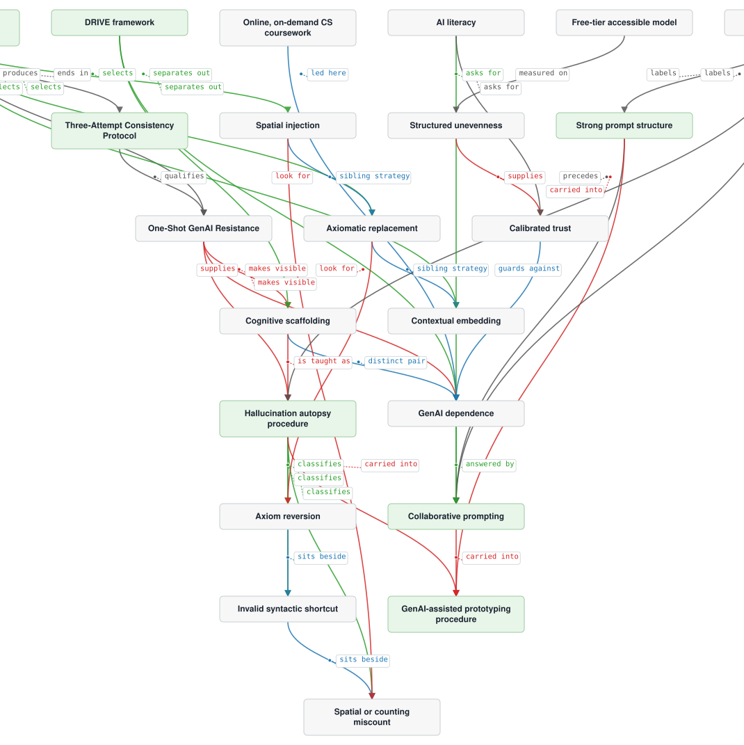
The Concepts tab gives the site an idea layer
Each concept page explains an idea and points to the work that uses it.
22 concept pages
Each page has enough text to be useful on its own.
The map shows relationships, and text links give a direct path for readers and crawlers.
A graphic can orient the reader. Text still has to carry the discovery work.
Lab Station 5 · concept pages
sources in notes
research discovery · Game2Learn Lab · NC State University
18
Notes:
The concept map and the 22 concept-page links were observed on the live Concepts page in the original deck. A graphic alone should not be the only route to a page; the site also needs text links and relationship explanations. Source: https://sgilson7.github.io/concepts/

Slide 19
A useful concept page makes the evidence path visible
Define the idea, explain it, set the scope, and point to the source.
Definition
What idea is this page about?
Explanation
How does it work in this research?
Scope
What claim does the evidence support?
Source
Which paper or protocol should the reader check?
Related ideas
Where can the reader go next?
Example: iterative perturbation process
The page explains the method and links back to the AIED paper where the formal protocol appears.
Lab Station 5 · evidence path
sources in notes
research discovery · Game2Learn Lab · NC State University
19
Notes:
The iterative perturbation page describes testing responses against a rubric, revising questions, retaining versions, and preserving the instructional purpose. It limits claims about resistance across models and updates, and it points to the AIED paper and formal protocol. Source: https://sgilson7.github.io/concepts/iterative-perturbation-process/

Slide 20
Internal links should explain a relationship
Link where the destination helps the reader understand the current page.
Three-attempt protocol
How the question was tested
Iterative perturbation
AIED paper
Where the formal procedure appears
Axiom reversion
An error to examine after changing premises
Axiomatic replacement
Iterative perturbation
The broader procedure using the strategy
Lab Station 5 · internal links
sources in notes
research discovery · Game2Learn Lab · NC State University
20
Notes:
This reframes the original table as a relationship diagram. The relationship is explanatory and scoped: a perturbation strategy does not guarantee a particular model error. Link to relevant work rather than forcing every concept to point to every paper.

Slide 21
A research blog can hold the reasoning around the paper
Use it for explanations that are useful but too informal or exploratory for your publication record.
What confused me
Why this example
What to check next
Route to evidence
A post can use the language an instructor or researcher actually uses when asking about a problem.
When an interpretation is still a proposal, keep that status visible near the claim and link the research that supports it.
Lab Station 5 · public writing
sources in notes
research discovery · Game2Learn Lab · NC State University
21
Notes:
This is an editorial recommendation and a hypothesis about useful entry points for readers. A blog creates additional pages addressing genuine questions, but publishing more posts is not itself evidence of SEO or GEO improvement. Source: https://sgilson7.github.io/blog/thinking-about-curriculum-as-a-knowledge-graph/

Slide 22
Lab checkpoint: build the idea route
Switch to the lab for 8 minutes. Resolve the tasks you can and skip the rest for now.
1. Profiles
2. Loop
3. Crawl
4. Bots
5. Ideas
6. Test
7. Maintain
Do now
Station 5: choose one concept a literature-review reader might search for.
Open the lab
Draft the page shape: definition, explanation, scope, source.
Add one internal link because it explains a real relationship.
Keep the lab open in a second window.
Concept pages work when the explanation helps the reader, not when links are added for count.
research discovery · Game2Learn Lab · NC State University
22

Slide 23
Conversational sources show what generated answers can cite
The practical lesson is to test the route, not to imitate every cited domain.
217,000 prompts
248,000 Reddit URLs
AI search tools
The useful signal is that conversational explanations can enter generated answers.
For research sites, I would test whether public explanations of my work are found and represented accurately.
Lab Station 6 · discovery tests
sources in notes
research discovery · Game2Learn Lab · NC State University
23
Notes:
The Semrush study motivates testing conversational explanations. It does not establish that a research blog inherits Reddit visibility or that informal language causes citations. Source from original deck: https://www.semrush.com/blog/reddit-ai-search-visibility-study/

Slide 24
Use GenAI to test the public discovery route
Run repeatable prompts and save the answer, date, product, and cited URLs.
Profile test
Literature test
Website test
Synthesis
Can the agent describe my work from public sources?
Does a related proposal surface my papers or concepts?
Which pages does the agent use, and what fixes does it suggest?
Turn the three reports into a maintenance list.
A saved answer shows which public pages were found, how they were used, and where the route needs work.
Lab Station 6 · saved prompts
sources in notes
research discovery · Game2Learn Lab · NC State University
24
Notes:
The original deck included a long Claude Code prompt with three subagents. I would make the workflow visible instead of placing the full prompt on the slide: profile test, literature test, website test, synthesis. Save outputs so a later run can be compared.

Slide 25
Lab checkpoint: test the public discovery route
Switch to the lab for 8 minutes. Resolve the tasks you can and skip the rest for now.
1. Profiles
2. Loop
3. Crawl
4. Bots
5. Ideas
6. Test
7. Maintain
Do now
Station 6: run the researcher test or website test.
Open the lab
Save the prompt, answer, date, product, and cited URLs.
Mark whether the answer preserved the source and its limits.
Keep the lab open in a second window.
The goal is a repeatable check, not a one-off search result.
research discovery · Game2Learn Lab · NC State University
25

Slide 26
Publishing a concept page or blog post
Make the page useful to a person first. That is also the part a system can read.
Entry point
Descriptive title and stable, topic-specific URL
Explanation
Readable text with examples and limits
Attribution
Named author, sources, publication status
Connections
Links to related concepts and relevant papers
Maintenance
Accurate dates and a route from the index
Normal discovery practices come before unsupported optimization tricks.
Lab Station 5 · publish a useful page
sources in notes
research discovery · Game2Learn Lab · NC State University
26
Notes:
Use an author/date presentation suitable for a blog and metadata that matches the visible content. Google’s AI guidance says no special AI text file or special schema is required for AI search features. Sources: https://developers.google.com/search/docs/crawling-indexing/links-crawlable ; https://developers.google.com/search/docs/appearance/ai-features

Slide 27
Measure the route, not the vibe
Keep a small, repeatable record of whether the changes helped discovery and attribution.
Can search find it?
Does someone use it?
URL inspection, indexing status, impressions
Visits to concept pages and onward visits to papers
Does AI search cite it?
Is the citation accurate?
Question, date, product, answer, cited URL
Whether the answer preserves the source and limits
Search and model behavior changes. The record lets you compare runs without overstating causality.
Lab Station 7 · measurement
sources in notes
research discovery · Game2Learn Lab · NC State University
27
Notes:
This is a proposed measurement plan. No private analytics, Search Console data, or measured GEO outcomes were available for the original presentation. Use a small repeatable set of questions, retain outputs, and distinguish a mention from a clickable citation. Source: https://developers.google.com/search/docs/appearance/ai-features

Slide 28
A maintenance routine keeps the public record coherent
The work is small if each publication and explanation gets checked when it changes.
After a publication or profile change
After a new explanation
Check the DOI record, public author profiles, paper page, and CV.
Link it from the blog index and any existing page where it helps the reader.
Record the date, inspect the links, and repeat the discovery checks.
Lab Station 7 · maintenance routine
sources in notes
research discovery · Game2Learn Lab · NC State University
28
Notes:
This is a suggested workflow, not an assertion that the site already follows a measured schedule. Work from a verified publication list and stable identifiers. Save enough information to distinguish a content change from a correction in an external index.

Slide 29
Lab checkpoint: measure and maintain
Switch to the lab for 5 minutes. Resolve the tasks you can and skip the rest for now.
1. Profiles
2. Loop
3. Crawl
4. Bots
5. Ideas
6. Test
7. Maintain
Do now
Station 7: copy the one-page discovery log pattern.
Open the lab
Add one trigger you will use after a new paper, profile change, or blog post.
Copy your next steps before discussion.
Keep the lab open in a second window.
This is the maintenance piece: a small record makes future checks comparable.
research discovery · Game2Learn Lab · NC State University
29

Slide 30
Selected sources in the notes
Profiles and examples
ORCID · Semantic Scholar · OpenAlex · Google Scholar · sgilson7.github.io
Thank you
sagilson@ncsu.edu
sgilson7.github.io
Crawling and webmaster checks
Google Search Central · Search Console Help · OpenAI crawler documentation
research discovery · Game2Learn Lab · NC State University
31
Notes:
Selected source categories. Most URLs are also noted on individual slides.

