Slide 1
Perturbed Assignments and Subgoal-Labeled AI Literacy Instruction in Undergraduate Discrete Mathematics
Sam Gilson sgilson7.github.io
Game2Learn Lab, Department of Computer Science
North Carolina State University
Published foundation: Gilson, Tabarsi & Barnes (AIED 2026) · Summer 2026 follow-up
SPLICE LLM Working Group · October 9, 2026 · 10 a.m. ET
1
Notes:
PRESENTER CUE • 0:00–0:35 • target 0:35 • 30-minute meeting: ~27 min talk, ~3 min discussion.
In the discrete mathematics course I taught, a finished proof could tell me what a student handed in, but not how they handled a chatbot's answer along the way. That is the problem behind this work. I'll show you the perturbed assignments in our AIED 2026 paper with Benyamin Tabarsi and Tiffany Barnes, then a separate Summer 2026 class in which I taught students ways to check AI-generated reasoning. The earlier findings are published. For the later class, instruction and data collection are complete, but the interaction-log analysis is still underway. I'll finish with enough time to discuss what would count as evidence of meaningful checking.
COURSE CONTEXT TO STATE ALOUD: Both summer studies were conducted in NC State CSC 226 Discrete Mathematics with me as instructor of record. Both took place in the final third of the course during the computer science applications unit.

Slide 2
One course setting, two summer studies
NC State · CSC 226 · Discrete Mathematics
Sam Gilson was the instructor of record for both summer sections.
Summer 2025 · AIED pilot
Summer 2026 · instructional study
Perturbed final-exam review
18 students assigned it; eight used the chatbot
182 coded query–response pairs
Two perturbed lab parts with a checking lesson between them
21 enrolled; eight consented
Post-instruction log analysis ongoing
Both studies collected data in the final third of the course, during the computer science applications unit.
Game2Learn Lab · NC State University
2
Notes:
PRESENTER CUE • 0:35–1:20 • target 0:45 • 30-minute meeting: ~27 min talk, ~3 min discussion.
Both studies took place in NC State CSC 226, Discrete Mathematics. I was the instructor of record for both summer course sections. In each summer, I ran the study and collected its data during the final third of the course, when we were working through the computer science applications unit. The 2025 study used a perturbed final-exam review and examined the interactions of the eight students who used the chatbot. The 2026 study was a separate course offering and a separate set of students. There I placed explicit checking instruction between two perturbed labs. This is a comparison of study designs across course offerings, not a longitudinal comparison of the same students. The timing within the course is important: these tasks took place after the earlier counting and proof units, when students were applying the discrete mathematics to computing problems.

Slide 3
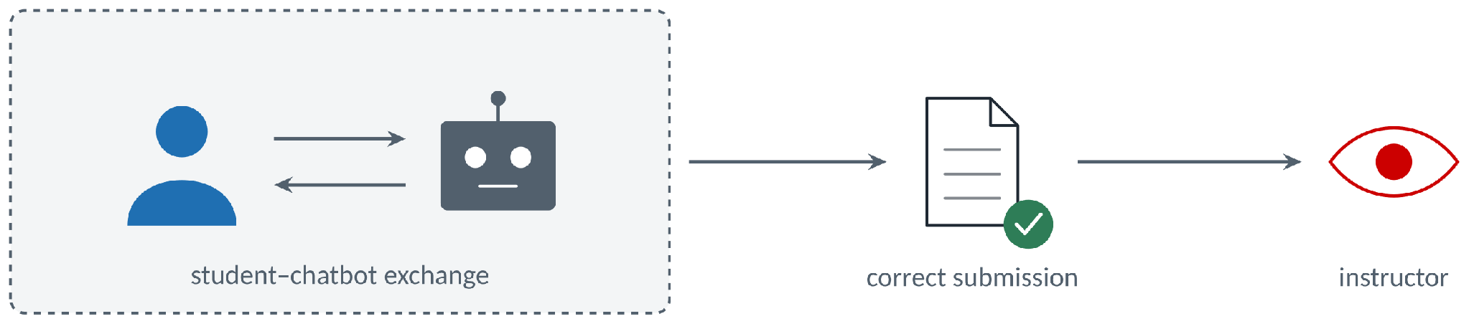
A submitted proof provides no evidence of chatbot aid
ChatGPT passed exams in a theory-of-computing course, but student submitted proofs using ChatGPT as a partner were often nonsensical[1].
The submission shows the answer; the chat log shows what students asked, questioned, or corrected.
[1] Golesteanu, Vowinkel, and Dougherty 2024
Game2Learn Lab · NC State University
3
Notes:
PRESENTER CUE • 1:20–2:15 • target 0:55 • 30-minute meeting: ~27 min talk, ~3 min discussion.
Imagine receiving a proof that looks complete. Did the student understand it, or did the chatbot supply a convincing argument that nobody checked? In a theory-of-computing course, Golesteanu and colleagues reported passing ChatGPT exam performance alongside nonsensical proof claims. The final submission alone will not tell me whether a student caught that kind of mistake. If I can also examine the student's conversation with the chatbot, I can see the questions and corrections that made it into the exchange. I still need the written work to interpret those turns accurately.

Slide 4
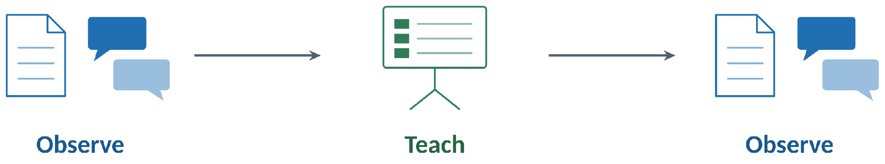
Research questions
RQ1
RQ2
How can we make students’ chatbot interactions change easier to observe from a pedagogical design perspective?
Do students adapt when receiving feedback relating to their generative AI use for completing coursework?
Game2Learn Lab · NC State University
4
Notes:
PRESENTER CUE • 2:15–3:05 • target 0:50 • 30-minute meeting: ~27 min talk, ~3 min discussion.
For the Summer 2026 class, I have two questions. First, after instruction, do the students interact differently with the chatbot on another perturbed assignment? Second, how do they describe using the taught checking procedures? The first question needs a coded comparison of the logs. The second has some preliminary interview evidence. These questions concern the newer class, not the eight-student study published at AIED 2026. I cannot report an instructional effect yet.

Slide 5
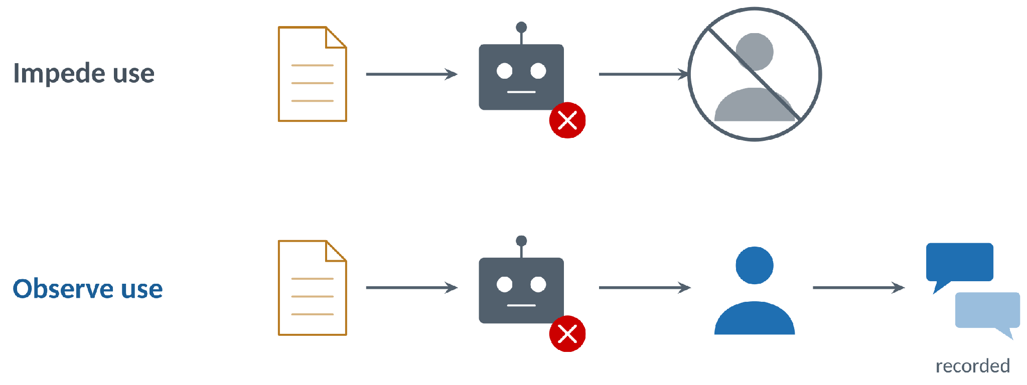
Design a task where a wrong AI answer can be checked
Salim et al. perturbed introductory programming assignments [4] to reduce instances / catch cheating
AI Contracts; Students can use the chatbot, but must judge its response [5].
[4] Salim et al. 2024 [5] Gilson, Tabarsi, and Barnes 2026
Game2Learn Lab · NC State University
5
Notes:
PRESENTER CUE • 3:05–4:15 • target 1:10 • 30-minute meeting: ~27 min talk, ~3 min discussion.
Here is how we designed the assignment in the published work. I start with a legitimate discrete mathematics task and ask a chatbot to solve it. I score the response against a fixed rubric. If the model can still earn enough credit, I revise the problem and try it again. The aim is not to hide the chatbot from the students. They are allowed to use it. The aim is to give them a response they have reason to inspect and a rubric that lets us identify a failure. This approach builds on earlier work perturbing programming assignments. The next examples show two different changes to the task.

Slide 6
Three perturbation strategies target different failures
Spatial injection
01
The salad-bar question adds rows, columns, and placement conditions to an ordinary counting task.
Axiomatic replacement
02
The Squemp problem changes the successor rule to S(n) = 2n + 3, so familiar arithmetic rules need checking.
Contextual embedding
03
The problem introduces course-specific context that the chatbot must preserve when it reasons.
[5] Gilson, Tabarsi, and Barnes 2026 · Original AIED 2026 slides 7–8
Game2Learn Lab · NC State University
6
Notes:
PRESENTER CUE • 4:15–5:10 • target 0:55 • 30-minute meeting: ~27 min talk, ~3 min discussion.
The original AIED talk distinguishes three strategies. Spatial injection is visible in the restaurant salad bar: each placement has a row and column, and later parts constrain adjacency. Axiomatic replacement is visible in Squemp numbers. The ordinary natural-number successor is S(n) = n + 1; the Squemp successor is S(n) = 2n + 3. Students need to check a familiar rule against the axioms supplied, not simply reproduce Peano arithmetic. Contextual embedding introduces task-specific information the chatbot must maintain. In the perturbation process, we tested and revised questions against a single target model using the grading rubric. That makes one-shot resistance an operational property of that question and model combination. We should not claim it defeats every chatbot. The next two slides show the spatial and axiomatic cases in more detail.
Source: original AIED 2026 presentation, slides 4, 7–8, 16–21.

Slide 7
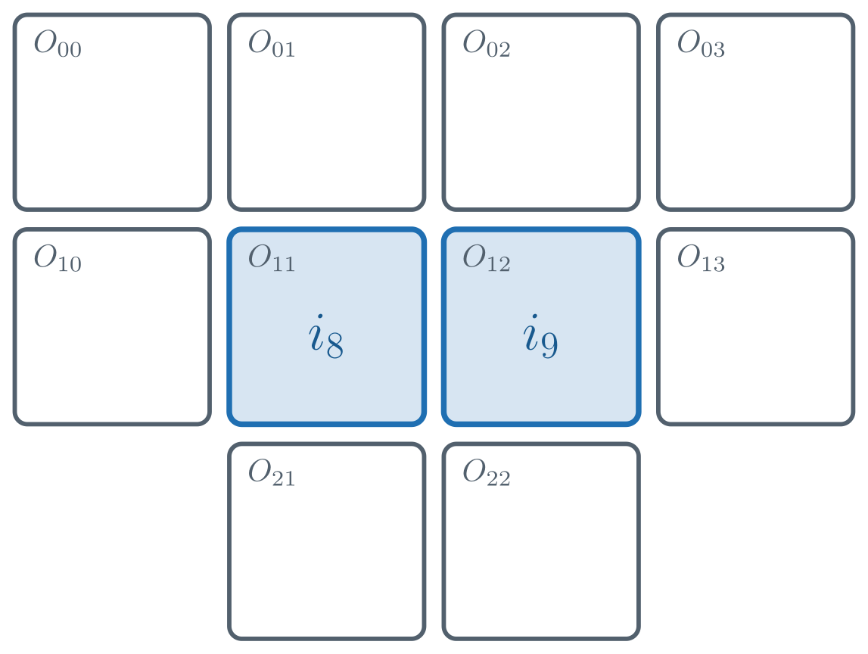
A salad bar adds spatial constraints to counting
Ten items are placed in a 4-4-2 grid, so counting depends on position.
Later parts constrain rows, columns, and adjacency.
Part 7
[ x > y + 6 ] → [ a > c ]
for item x in slot (a, b) and item y in slot (c, d)
Game2Learn Lab · NC State University
7
Notes:
PRESENTER CUE • 5:10–6:30 • target 1:20 • 30-minute meeting: ~27 min talk, ~3 min discussion.
Look at the salad bar. Ten items occupy slots in a four-four-two layout. An ordinary counting question now has rows, columns, and adjacency conditions. The displayed predicate connects an ordering of items to their rows. A model has to coordinate the formula with the pictured arrangement, and a student can check each constraint rather than accepting the first plausible count. Ask which specific condition a proposed arrangement violates. That is the step I want to observe in a chat log: not just 'that's wrong,' but what the student inspected and how they corrected it.

Slide 8
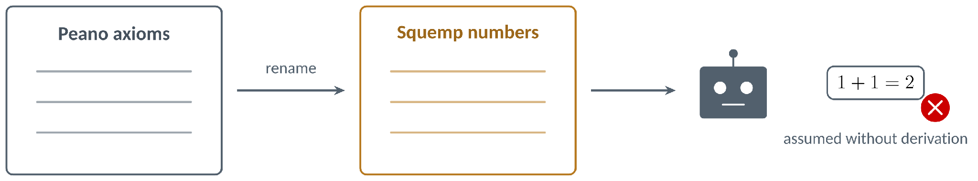
Squemp numbers: prove from the given axioms
The structure mirrors Peano arithmetic under invented names.
A full-credit proof derives each property from the stated axioms [5].
[5] Gilson, Tabarsi, and Barnes 2026
Game2Learn Lab · NC State University
8
Notes:
PRESENTER CUE • 6:30–7:20 • target 0:50 • 30-minute meeting: ~27 min talk, ~3 min discussion.
The second example changes the mathematical vocabulary instead of the physical arrangement. I called the invented system Squemp numbers. It mirrors Peano arithmetic, but the proof still has to start from the axioms actually printed on the assignment. A fluent response may borrow an ordinary arithmetic property without deriving it. The student can test the claimed step against those axioms. Notice the difference between recognizing the familiar structure and proving that a property follows in this stated system. The grading rubric requires the latter.

Slide 9
The 2025 pilot captured the chatbot exchanges
18
8
182
students assigned the review
used the provided chatbot
query–response pairs coded
Collection
MerryQuery (Gemini 2.0 Flash) · assessment submission · chatbot logs · exam and homework scores
Why DRIVE?
ICAP’s broad engagement categories were hard to distinguish in dialogue. DRIVE records more specific kinds of help-seeking.
CSC 226 · Summer 2025 · Instructor of record: Sam Gilson · Final third: CS applications
[5] Gilson, Tabarsi, and Barnes 2026 [6] Oliveira et al. 2025 · Original AIED slides 23–24, 32
Game2Learn Lab · NC State University
9
Notes:
PRESENTER CUE • 7:20–8:15 • target 0:55 • 30-minute meeting: ~27 min talk, ~3 min discussion.
The AIED deck includes more detail about the classroom protocol than the shorter SPLICE version. In Summer 2025, eighteen students received a final review containing three perturbed questions. Eight used the provided MerryQuery chatbot, backed by Gemini 2.0 Flash, and these are the eight students in the chatbot analysis. The research also collected submissions, exam grades, and homework grades. We coded 182 query-response pairs. We initially considered the ICAP engagement framework, but active, constructive, and interactive turns were difficult to separate in this form of student-chatbot dialogue. DRIVE gave us more specific codes, including students asking for arguments, justifications, and critical evaluation. There is an important selection limit: the interaction results are about the eight students who used this particular provided chatbot, not all eighteen students who received the assignment.
Source: original AIED 2026 presentation, slides 12–13, 23–24, 32.
COURSE CONTEXT TO STATE ALOUD: The timing and teaching role should be explicit: I was the instructor of record for this Summer 2025 CSC 226 section. We ran the perturbed-assignment study and collected these chatbot logs during the final third of the course, in the computer science applications unit.

Slide 10
DRIVE: coding students’ chatbot requests
Writing
01
Instructions, Criteria, Evaluate: provide a task or rubric, or ask the chatbot to assess a draft.
Argument
02
Objection, Justify, Conceptual Clarity: ask for a reason, challenge a step, or clarify the argument.
Content
03
Definitions, Example, Critical: request concepts or examples, or correct generated content.
DRIVE = Directive Reasoning Interaction & Visible Expertise.
A DRIVE tag describes the visible request, not what the student did before sending it.
[6] Oliveira et al. 2025 · Categories and example tags from the AIED 2026 presentation
Game2Learn Lab · NC State University
10
Notes:
PRESENTER CUE • 8:15–9:00 • target 0:45 • 30-minute meeting: ~27 min talk, ~3 min discussion.
We first tried the ICAP framework, but the Active, Constructive, and Interactive categories blurred together when we applied them to chatbot dialogue. DRIVE stands for Directive Reasoning Interaction and Visible Expertise, the two things the original framework asks us to look for in student–AI dialogue. DRIVE gave us more specific codes for what a student asked the model to do. In the published AIED pilot, we coded 182 query–response pairs. These three broad groupings are Writing, Argument, and Content. Under Writing, a student might paste the instructions or rubric, or ask the system to evaluate a draft. Argument codes include asking for justification, making an objection, or seeking conceptual clarity. Under Content, students may request a definition or an example, or critically engage with generated content. The label describes the visible move, not the entire learning process. For example, a request to evaluate a proof could follow a student’s own work or could substitute for that work. This is why the later follow-up combines coded chat logs with written submissions and interviews.

Slide 11
DRIVE coding on our perturbed salad-bar task
Writing · Instructions
01
“Arrange the ten salad-bar items in the 4–4–2 grid. Here is the assignment.”
Argument · Justify
02
“Explain why your proposed layout satisfies x > y + 6 ⇒ a > c.”
Content · Critical
03
“Your layout puts i9 above i1; 9 > 1 + 6 means its row must be lower. Correct that.”
[5] Gilson, Tabarsi, Barnes 2026 · [6] Oliveira et al. 2025 · AIED 2026 taxonomy slides
Game2Learn Lab · NC State University
11
Notes:
PRESENTER CUE • 9:00–9:50 • target 0:50 • 30-minute meeting: ~27 min talk, ~3 min discussion.
These are constructed example prompts set in the actual salad-bar assignment from our Summer 2025 pilot, not verbatim quotations from the eight students. They illustrate three of the DRIVE codes included in the taxonomy we used to annotate the 182 query–response pairs. A request to solve the assignment is Writing: Instructions. Asking why an arrangement satisfies the part-seven constraint is Argument: Justify. Challenging a specific violated row-ordering condition is Content: Critical. For the final example, the condition 9 > 1 + 6 is true; therefore the row holding i9 must have a greater index than the row holding i1. A layout placing i9 above i1 does not satisfy that constraint. The distinctions matter because an instruction to solve the task is different from demanding a reason or correcting a model error. These are codes for what is observable in the interaction, not direct measures of a student's understanding or proof of an instructional effect.
Source: Oliveira et al. (2025), DRIVE: Directive Reasoning Interaction & Visible Expertise; Gilson, Tabarsi, and Barnes (AIED 2026), the salad-bar perturbation and classroom coding design.

Slide 12
AIED 2026: two help-seeking patterns emerged
182 DRIVE-coded query–response pairs · eight students · Summer 2025
Cognitive scaffolding
GenAI dependence
Students noticed errors, challenged a claim, and added reasoning or constraints to help the chatbot reach a valid solution.
Students leaned on the generated answer without adequately checking its reasoning, even when the response contained errors.
Observable move: identify the failed step, then ask the model to reconsider it.
Observable move: accept or reuse an answer without testing the unsupported step.
The behavioral patterns were not grade groups. They were associated with assignment scores in this small sample, but did not sort students cleanly by grade.
[5] Gilson, Tabarsi, and Barnes 2026 [6] Oliveira et al. 2025
Game2Learn Lab · NC State University
12
Notes:
PRESENTER CUE • 9:50–11:40 • target 1:50 • ~27 min talk, ~3 min discussion.
In the Summer 2025 CSC 226 pilot, we coded 182 query–response pairs from eight students with DRIVE. Independent component analysis helped us identify two contrasting patterns of help-seeking in these conversations. The first is cognitive scaffolding. The student notices a hallucinated step, supplies missing constraints or counterexamples, or asks the model to justify and correct its reasoning. The student is doing some of the intellectual work of checking. The second is GenAI dependence: the student treats a fluent output as a source of truth and does not adequately interrogate the error. The distinction is not whether the student uses AI at all, but how they respond when it is wrong. Importantly, ICA was run on patterns in the coded dialogue, not on grades. We interpreted these behaviors from the exchanges and submitted assignments; we did not define a high-grade cluster and a low-grade cluster. The published analysis found an association with grades on the perturbed assignment in the eight-student sample, but these help-seeking patterns should not be read as clean grade-based groups or fixed student types. This is why I want to teach and measure actual checking behaviors in the Summer 2026 follow-up, rather than treating an assignment score as sufficient evidence of AI literacy.
Source: Gilson, Tabarsi, and Barnes (AIED 2026), published study and original presentation, especially slides 32–39. These are behavior descriptions, not verbatim examples from a participant.

Slide 13
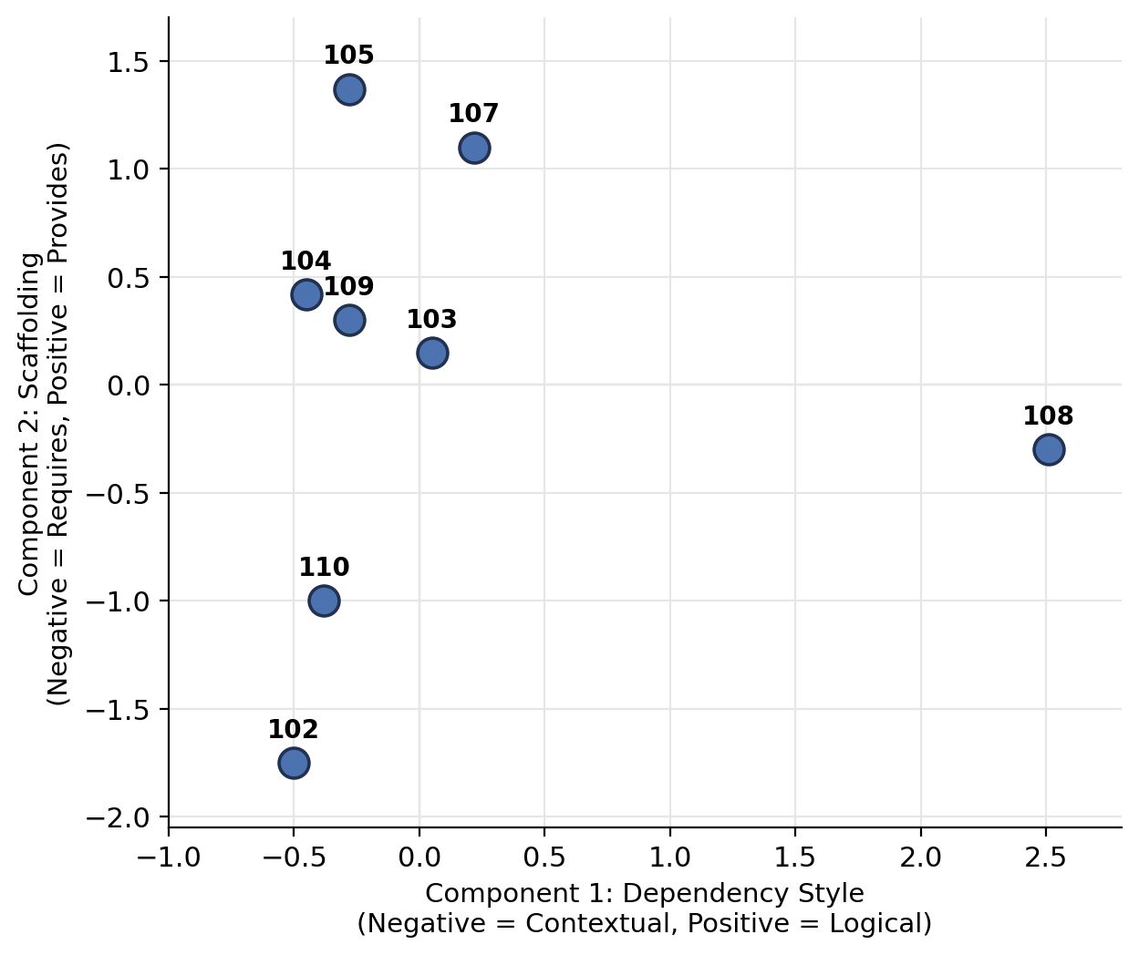
ICA components describe dialogue—not grade groups
Dependence-style axis
Horizontal: seeking help with contextual constraints versus formal logic or proof reasoning.
Scaffolding-style axis
Vertical: requesting scaffolding from the chatbot versus supplying constraints, reasoning, and corrections.
Each dot is a student; the axes do not show grades. Exploratory results (n = 8).
[5] Gilson, Tabarsi, and Barnes 2026 · AIED 2026 presentation, slides 34–35 (original plot)
Game2Learn Lab · NC State University
13
Notes:
PRESENTER CUE • 11:40–13:05 • target 1:25 • ~27 min talk, ~3 min discussion.
This is the student-level ICA plot from the original AIED talk. Each labeled point represents one student. The components summarize patterns in the DRIVE-coded interactions; neither coordinate is a grade. The horizontal axis contrasts requests about contextual constraints with requests about logic and proofs. The vertical axis contrasts students who request scaffolding with those who provide the model additional constraints, reasoning, or corrections. We used the associated submitted work to interpret these mathematical components as help-seeking styles: cognitive scaffolding and GenAI dependence. The scores are not automatically psychological traits, and a student may exhibit more than one kind of move across their conversations. Crucially, the behavioral grouping does not necessarily reproduce high-score and low-score groups. The publication reports an association with grades on the perturbed assignment in a sample of only eight; that is not the same as a one-to-one correspondence between ICA position and a grade. Nor did the ICA results predict final-exam scores in the original presentation. Those limitations motivated more explicit instruction and a second observation in Summer 2026.
Source: original AIED 2026 presentation slides 32–35 and 39; Gilson, Tabarsi, and Barnes (2026).

Slide 14
The pilot did not establish self-correction
What the pilot showed
What remained open
Patterns in chatbot dialogue were associated with perturbed-assignment grades (n = 8), but were not themselves grade groups.
ICA did not predict final-exam scores.
The original AIED analysis did not observe self-correction that improved final-exam results.
Distinguishing patterns is not the same as teaching a better way to use AI.
Summer 2026: teach checking between two perturbed assignments, then compare the logs.
[5] Gilson, Tabarsi, and Barnes 2026 · Original AIED 2026 slides 39–40
Game2Learn Lab · NC State University
14
Notes:
PRESENTER CUE • 13:05–13:55 • target 0:50 • ~27 min talk, ~3 min discussion.
The AIED study detected different help-seeking patterns, and within this small sample we saw an association between engagement style and the grade students earned on the perturbed assignment. But ICA was based on chatbot logs, not grades: the patterns did not form perfect high-score versus low-score groups. The original presentation also reported that the ICA results did not predict final-exam scores, whereas perturbed-assignment scores did. And exposing students to an assignment where shallow AI use fails did not yield observed final-exam self-correction in this eight-student pilot. That does not demonstrate that the students could not learn better appraisal strategies; it points to something our design did not yet teach directly. In Summer 2026, I introduced a lesson on checking AI-generated reasoning between two perturbed assignments to study how those interactions change.
Source: AIED 2026 talk slides 39–40; same eight-student observational pilot, no causal result.

Slide 15
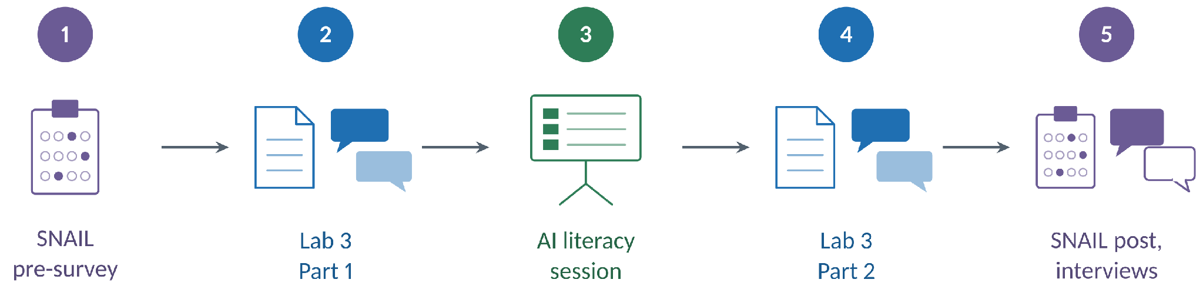
Summer 2026: teach the checking procedures
First perturbed lab → instruction on checking chatbot solutions → second perturbed lab.
CSC 226 · Summer 2026 · Instructor of record: Sam Gilson · Final third: CS applications
The published AIED 2026 study [5] describes the earlier pilot and perturbation method.
Game2Learn Lab · NC State University
15
Notes:
PRESENTER CUE • 13:55–15:10 • target 1:15 • 30-minute meeting: ~27 min talk, ~3 min discussion.
In Summer 2026 I taught another discrete mathematics section. Instead of only observing students' chatbot use, I placed a class session about checking AI-generated reasoning between two perturbed lab assignments. There was also an AI-literacy survey before and after the instruction, and we collected chat logs in the labs and class exercises. This is a different data set from our published AIED paper. I have not finished coding the before-and-after logs. The instruction itself asked students to examine the chatbot's steps; it did not ask the chatbot to follow the procedure on the student's behalf.
COURSE CONTEXT TO STATE ALOUD: This was a separate Summer 2026 offering of the same course, CSC 226 Discrete Mathematics, with me again serving as instructor of record. This two-lab intervention and its data collection took place in the final third of class, during the computer science applications unit.

Slide 16
Summer 2026: eight of 21 students consented
21
8
2
1
students enrolled
students consented
perturbed assignments
class session of instruction
I taught one undergraduate discrete mathematics section under IRB approval.
Students could use Gemini 3.5 Flash under a university license. Both lab parts served as the final exam review.
CSC 226 · Instructor of record · Study and data collection in the final-third CS applications unit
Game2Learn Lab · NC State University
16
Notes:
PRESENTER CUE • 15:10–16:05 • target 0:55 • 30-minute meeting: ~27 min talk, ~3 min discussion.
The classroom setting matters for interpreting these results. I was the instructor. Twenty-one students were enrolled; eight consented to contribute research data under IRB approval. The two perturbed lab parts also served as final-exam review, with one dedicated AI-literacy lesson between them. Students could use the university-licensed Gemini 3.5 Flash chatbot. All findings from the follow-up must be described as evidence from the consenting students, not from all twenty-one students in the section.
COURSE CONTEXT TO STATE ALOUD: I was instructor of record for the Summer 2026 CSC 226 section. The study was run and data were collected during the computer science applications unit in the final third of the course, as in Summer 2025, although the cohorts and interventions differed.

Slide 17
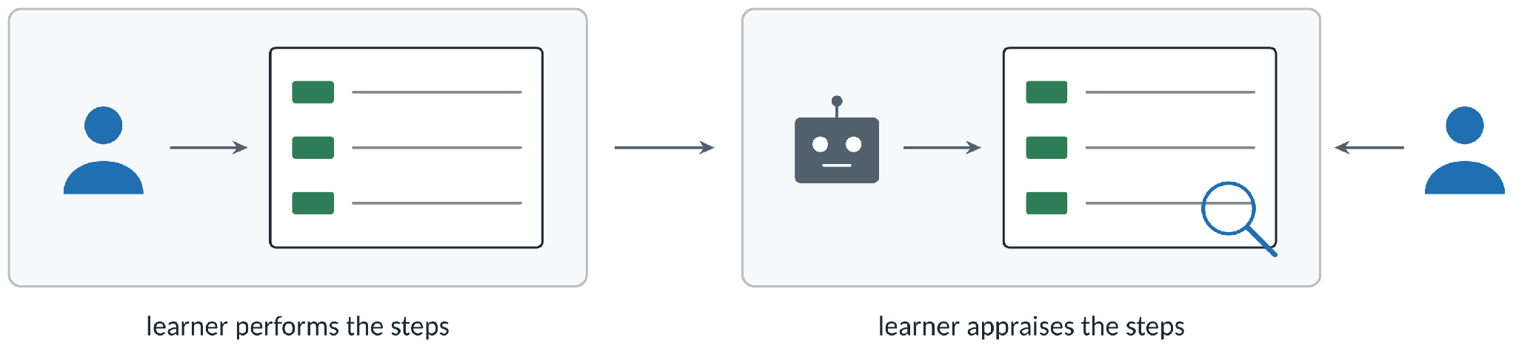
Subgoal labels tell students what to check
Subgoal labels name the job of each step in a worked example [7].
Here, students use the labels to appraise a solution produced by a chatbot.
[7] Morrison, Margulieux, and Guzdial 2015
Game2Learn Lab · NC State University
17
Notes:
PRESENTER CUE • 16:05–16:50 • target 0:45 • 30-minute meeting: ~27 min talk, ~3 min discussion.
Subgoal labels name what a particular step in a procedure is supposed to accomplish. In previous computing instruction, that idea has been used for steps learners perform themselves. Here, the object of attention is different: the chatbot has already produced a solution, and I am teaching the student how to appraise it. The labels give the student something specific to check instead of the general advice to 'think critically.' I taught three procedures. Their functions differ: diagnose a faulty response, make a prompt easier to verify, and collaborate one checked step at a time.

Slide 18
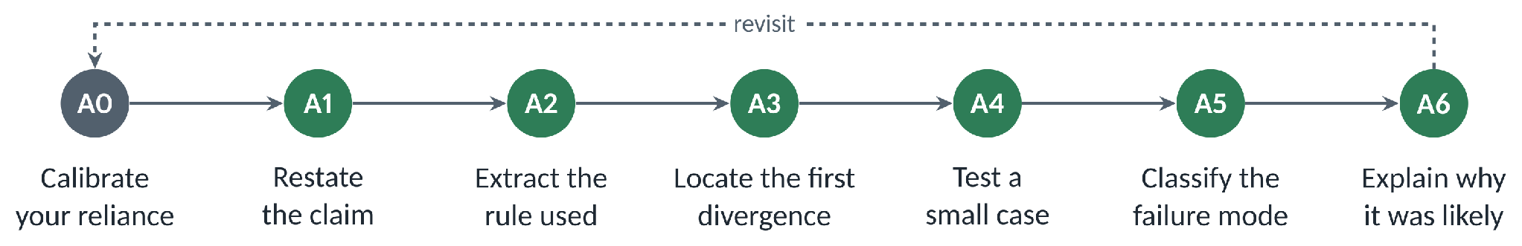
Hallucination Autopsy
Each label appears with identical wording in the reference box, worked example, and exercise.
Exercise A applies the procedure to a wrong chatbot transcript and marks the first failing line.
Game2Learn Lab · NC State University
18
Notes:
PRESENTER CUE • 16:50–18:00 • target 1:10 • 30-minute meeting: ~27 min talk, ~3 min discussion.
Take a chatbot answer that sounds certain but is wrong. Procedure A asks the student to restate the claim, identify the rule being used, and find the earliest step that no longer follows. Then the student tests a small case and explains why that error was plausible. The lesson provided a reference box, a worked example, and an exercise using the same labels. The important observation is the first unsupported line. A student who can identify that line has done something more informative than simply reporting that the final answer is incorrect.

Slide 19
Induction example: locate the incorrect hypothesis
Correct hypothesis: the sum is k(3k + 1)/2.
A1 · Target claim
2 + 5 + ··· + (3n − 1) = n(3n + 1) / 2
A3 · Flawed induction hypothesis
Flawed substitution: k(k + 1)/2 is used instead.
2 + 5 + ··· + (3k − 1) = k(k + 1) / 2
A4 · Check a small case (n = 2)
Check n = 2: the actual sum is 7; the substituted formula gives 3.
Actual: 2 + 5 = 7 Flawed formula: 2(2 + 1)/2 = 3
Schematic incorrect step; not a verbatim chatbot transcript.
Game2Learn Lab · NC State University
19
Notes:
PRESENTER CUE • 18:00–19:10 • target 1:10 • 30-minute meeting: ~27 min talk, ~3 min discussion.
This schematic makes the exact mathematical failure visible. The target identity is 2 + 5 + ... + (3n - 1) = n(3n + 1)/2. A valid induction hypothesis at k must keep that same right-hand side, k(3k + 1)/2. The faulty step silently substitutes k(k + 1)/2, the closed form for the ordinary sum 1 + 2 + ... + k. Test n = 2: the actual sum is 2 + 5 = 7, while the substituted form gives 2(2 + 1)/2 = 3. That is the first incorrect equation; correcting or identifying it is the point of the Hallucination Autopsy procedure. This is a deliberately constructed illustration of the error pattern, not a verified quotation from a particular student or chatbot response. The point is to show students what evidence is needed before attributing a wrong proof step to the model.

Slide 20
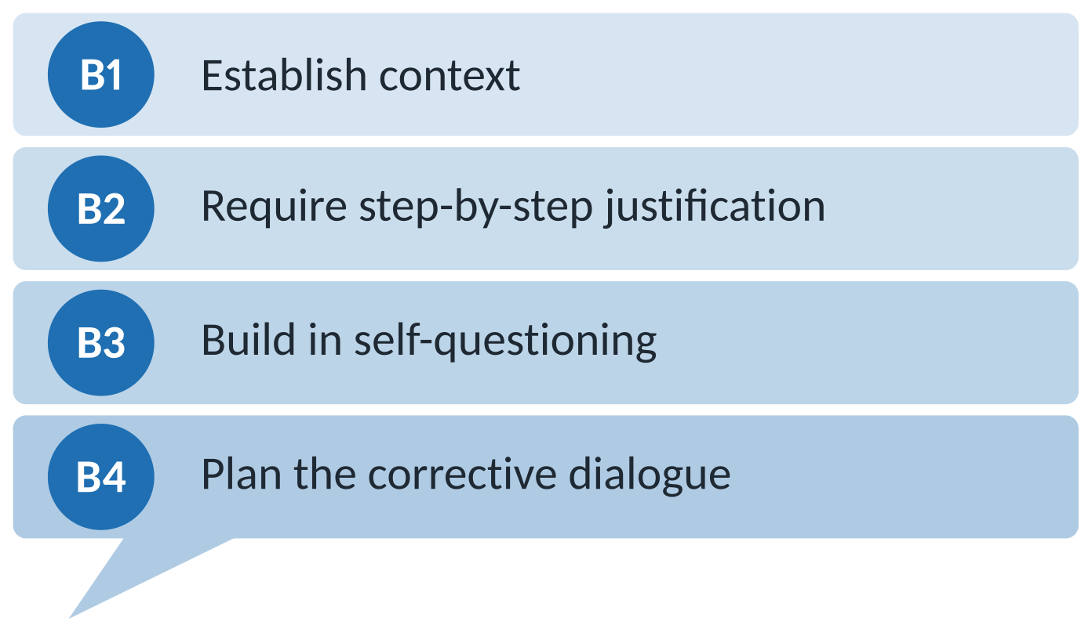
Strong Prompting
B2: ask each step to name the rule or prior line it uses.
B3: have the chatbot list and check assumptions before finishing.
Exercise B compares weak and strong prompts and records what changes.
Game2Learn Lab · NC State University
20
Notes:
PRESENTER CUE • 19:10–20:00 • target 0:50 • 30-minute meeting: ~27 min talk, ~3 min discussion.
Procedure B changes the interaction before an answer is generated. A vague prompt such as 'solve this' does not give the student much structure to inspect. Instead, the prompt should request reasons for each step, named assumptions, and checks against the conditions of the problem. Students compared weaker and stronger prompts in class and recorded what changed. This does not mean a better prompt makes an answer correct. The hypothesis is narrower: asking for inspectable justifications may make it easier for the student to find what needs checking. Whether students actually use that opportunity is an empirical question for the logs.

Slide 21
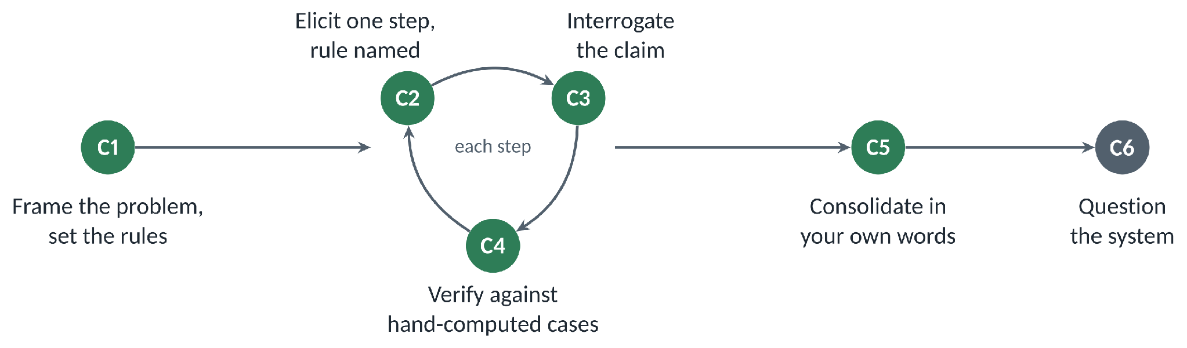
Collaborative Prompting
Ask for one step, interrogate it, verify it by hand, then request the next. The final write-up is the student’s own.
Game2Learn Lab · NC State University
21
Notes:
PRESENTER CUE • 20:00–20:50 • target 0:50 • 30-minute meeting: ~27 min talk, ~3 min discussion.
Procedure C slows the exchange down. Rather than requesting a full proof at once, ask for a single proposed step and the rule supporting it. Check that step yourself. If it holds, ask for the next one; if it fails, challenge it before continuing. The student then writes the final argument. I used this as a collaboration procedure because it gives the student an explicit decision between steps. It remains possible to click through without thinking, so whether the student truly verifies the steps is something to observe, not something I can assume from the prompt format alone.

Slide 22


Summer 2026: interviews completed; log coding pending
RQ1
RQ2
Next
Initial accounts
Logs are being anonymized and prepared for coding.
Two interviews show how students positioned the chatbot relative to their own work.
Game2Learn Lab · NC State University
22
Notes:
PRESENTER CUE • 20:50–21:40 • target 0:50 • 30-minute meeting: ~27 min talk, ~3 min discussion.
The instruction and data collection for this class are complete. Here is where the analysis stands. For RQ1, the interaction logs are being prepared and coded, so I do not have a before-and-after result to show. For RQ2, I conducted two cued interviews after the final exam. The students read their conversations beside their submitted work and explained what they thought they had been doing. These are useful reports about their experiences. Two interviews, particularly with their instructor, cannot establish how the lesson affected the whole class.

Slide 23
Students often attempted first, then checked
P2
“I’ll try and solve it myself, and then kind of use it as a confirmation.”
P1
“I think I’ve got it … Let me just compare it to the AI so I can be 100% certain.”
Both reported attempting the problem before asking for confirmation.
Game2Learn Lab · NC State University
23
Notes:
PRESENTER CUE • 21:40–22:35 • target 0:55 • 30-minute meeting: ~27 min talk, ~3 min discussion.
Both interviewees described a pattern that could be missed by looking at the chat log alone: they said they often tried the proof first and then asked the chatbot for confirmation. Read their comments here. A query such as 'is this correct?' starts the record of that chatbot interaction. It does not reveal what was done before sending it. The interviews help me formulate an interpretation, but the timing and substance of any earlier work still need corroboration wherever the submitted material allows it.

Slide 24
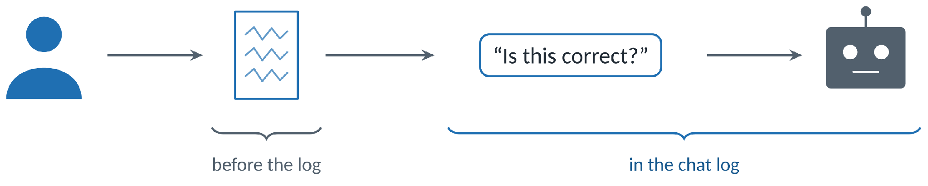
A confirmation prompt does not reveal the earlier work
The log begins with the prompt. Written work and interviews help establish the context.
I will read confirmation requests alongside submitted work, then compare the coded patterns with the earlier pilot [5].
[5] Gilson, Tabarsi, and Barnes 2026
Game2Learn Lab · NC State University
24
Notes:
PRESENTER CUE • 22:35–23:20 • target 0:45 • 30-minute meeting: ~27 min talk, ~3 min discussion.
Imagine two identical prompts: 'Is this proof correct?' One student may be checking a proof they have already built; another may be asking the chatbot to do the reasoning. The words in the prompt cannot distinguish those situations. The written submission and the student's account give additional context, though even those sources have limits. For RQ1, I plan to code confirmation turns with that context rather than assigning dependence from the prompt alone. Then I can compare the broader interaction patterns with those identified in the published pilot.

Slide 25
Label recall and procedure use need separate measures
P1
“Did I apply them explicitly? No, but they were in my head … Is it hallucinating, or … is my prompt strong enough?”
P2
Correcting the chatbot was “stuff that I haven’t necessarily thought as much about before.”
The interviews motivate coding what students do separately from what labels they remember.
Game2Learn Lab · NC State University
25
Notes:
PRESENTER CUE • 23:20–24:15 • target 0:55 • 30-minute meeting: ~27 min talk, ~3 min discussion.
One interviewee said the checking ideas were 'in my head' without consciously reciting the labels. The other described correcting chatbot responses as something that had become more salient. Those are reports from two students, not observations that the whole section executed the procedures. They change how I would measure the instruction. If I assessed only whether students remembered a label, I could miss a checking action; if I assessed only what they said afterward, I could mistake an intention for an action. The logs and written work are needed to test procedure use separately from label recall.

Slide 26
One student decided to rely on the chatbot less
P2
“… in my head a lot about whether or not I’m using AI correctly.” The session “felt like confirmation” that they were.
P1
Relying on it for certainty “hurt me in other areas.” “It’s hard to learn things if you can’t make mistakes.”
P1 reported a decision to reduce chatbot use.
Game2Learn Lab · NC State University
26
Notes:
PRESENTER CUE • 24:15–25:10 • target 0:55 • 30-minute meeting: ~27 min talk, ~3 min discussion.
A second complication came from the interviews. One student described the session as reassuring about the way they used AI. Another questioned how much they relied on the chatbot for certainty, saying that missing opportunities to make mistakes could limit learning, and reported a decision to use it less. I did not set out to measure 'more AI use' as success. This account suggests a distinct possibility worth studying: good appraisal may sometimes end in choosing not to ask the chatbot. At present it is one student's retrospective account, not an observed behavior change caused by the lesson.

Slide 27
What the follow-up adds to the published pilot
1
2
3
Reused the published perturbation method [5]
AI literacy procedures for proof work
Interviews to interpret what the logs omit
Retested against a newer model; workbench built afterward
Three labeled procedures for checking chatbot output
Students explain prompts beside their submitted work
[5] Gilson, Tabarsi, and Barnes 2026
Game2Learn Lab · NC State University
28
Notes:
PRESENTER CUE • 25:55–26:50 • target 0:55 • 30-minute meeting: ~27 min talk, ~3 min discussion.
There are three concrete pieces to carry forward. The published study supplied a method for building assignments that elicit checkable chatbot mistakes. In Summer 2026, I retested perturbed tasks against the available model and taught three explicit checking procedures in an undergraduate course. Afterward, I built the public workbench to make the design process easier to repeat; it was not used during that course. Finally, the cued interviews showed where a chat log may omit a student's preceding reasoning. The remaining question is whether students actually perform more of the taught checks after instruction. That requires the coded evidence I have not reported yet.

Slide 28


Discussion: what counts as evidence of checking?
When a student asks AI to confirm a proof, what shows checking rather than outsourcing?
Should we measure students remembering the checking labels, actually using them, or both?
Sam Gilson
sagilson@ncsu.edu
sgilson7.github.io/perturbation-workbench
sgilson7.github.io
Game2Learn Lab · NC State University
29
Notes:
PRESENTER CUE • 26:50–27:05 • target 0:15 • 30-minute meeting: ~27 min talk, ~3 min discussion.
I'll leave the two questions on screen. When you read 'is this correct?' in a student's chatbot log, what additional evidence would persuade you that they were checking rather than outsourcing? And when we teach these labeled routines, what should count as successful use: recalling the labels, doing the checks, or both? I'd welcome examples from your own teaching or coding work. The published AIED 2026 paper and the workbench link are available on the deck; the Summer 2026 results remain preliminary.

