Slide 1
Applications of AI Literacy to GenAI-Assisted Game Development
CSC 484/584 Game AI, guest lecture
Sam Gilson, PhD student in Dr. Barnes’ Game2Learn lab
September 2026

Slide 2
Four parts
Context, justification, and system architecture for easily deployable, browser based artifacts
AI Literacy: Catching hallucinations, prompt engineering, collaborative prompting
From design docs to a game prototype
Ideas / Examples for project; multiplayer with no server, Q-learning for enemies
CSC 484 · guest lecture
2

Slide 3
1. Why am I here talking to you?
Motivations for Game Engine + AI Design
CSC 484 · guest lecture
3

Slide 4
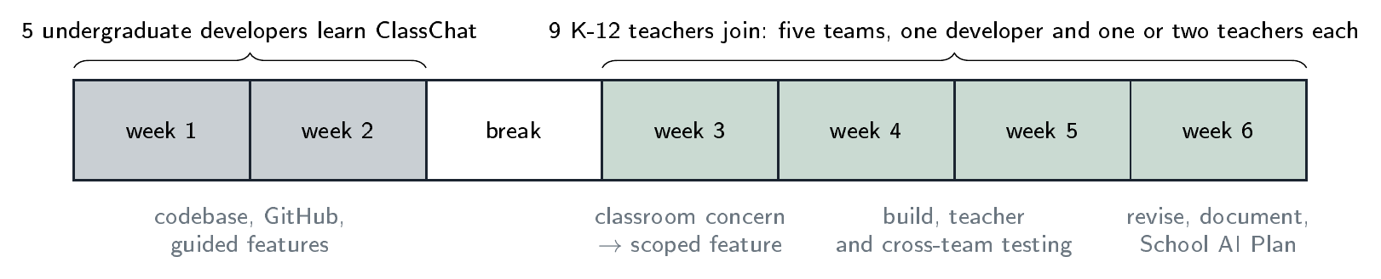
Exclaim Teacher Professional Development
Six weeks around one classroom chatbot called ClassChat
Developers spent two weeks learning it
Then four weeks building tools for teachers, with teachers
Five teams, five tools
CSC 484 · guest lecture
4

Slide 5
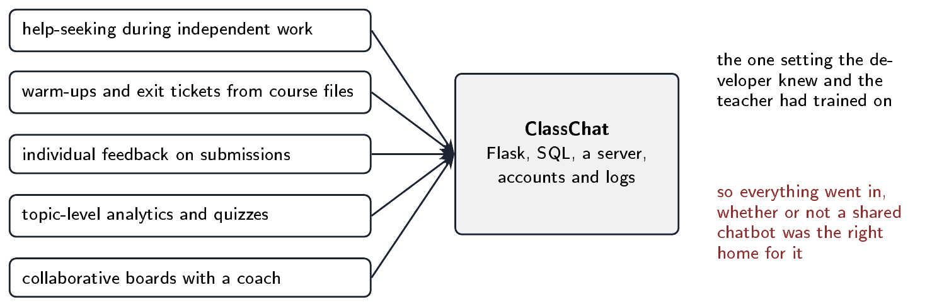
What teachers asked for
Help when a student is stuck and won’t ask
Warm-ups and exit tickets from their own files
Feedback on individual submissions
Practice analytics and quizzes
All of it went into the chatbot
CSC 484 · guest lecture
5

Slide 6
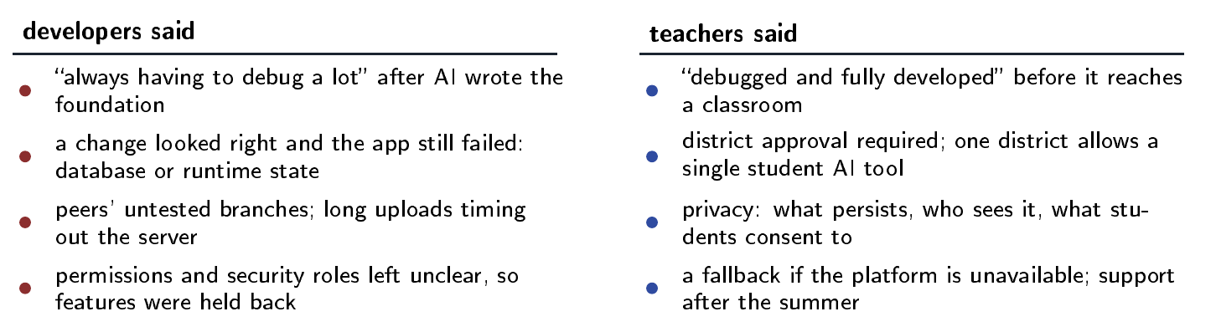
Findings relative to shared technical setting
CSC 484 · guest lecture
6

Slide 7
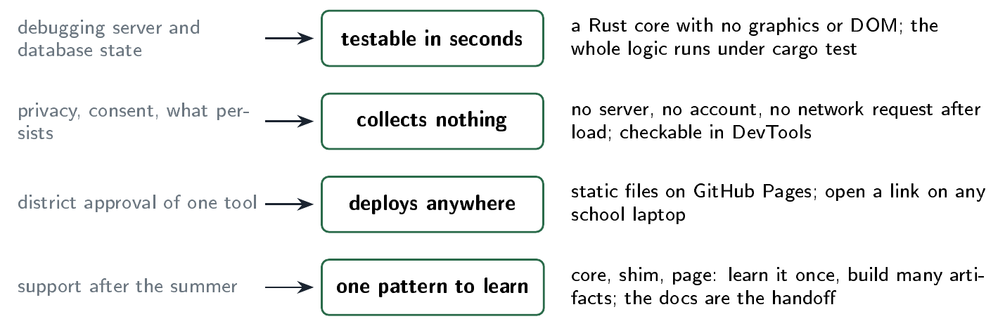
Design Takeaways
CSC 484 · guest lecture
7

Slide 8
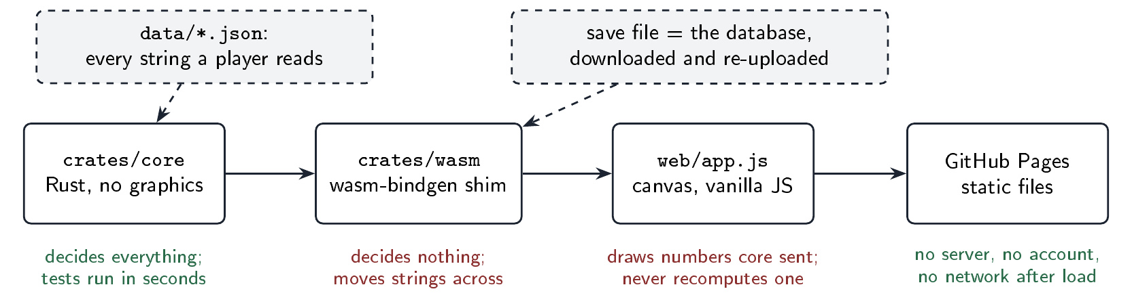
Rust + WASM + JS Architecture for deployable artifacts
Rust core holds all the logic, no graphics
A wasm shim to mediate transfer from rust core to graphical engine
A plain JS page draws what core sends
Static files on GitHub Pages
Content is JSON; state is a save file
CSC 484 · guest lecture
8

Slide 9
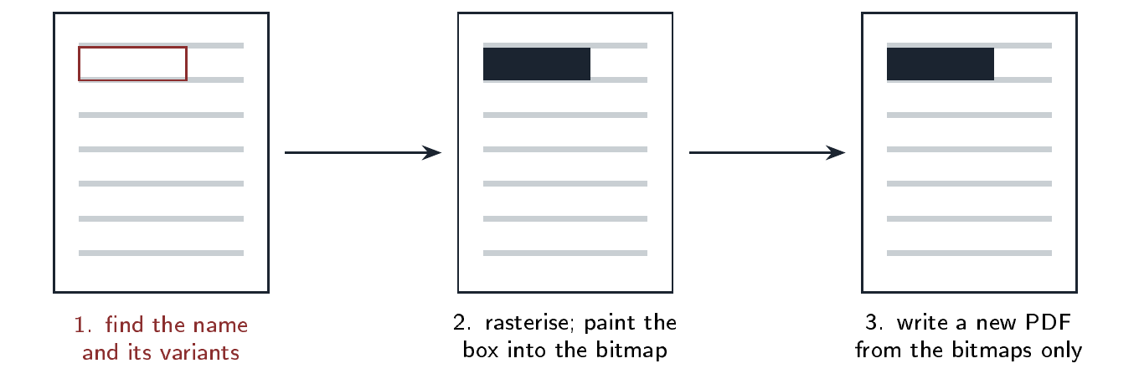
Proof of Concept 1
PDF redactor
CSC 484 · guest lecture
10

Slide 10
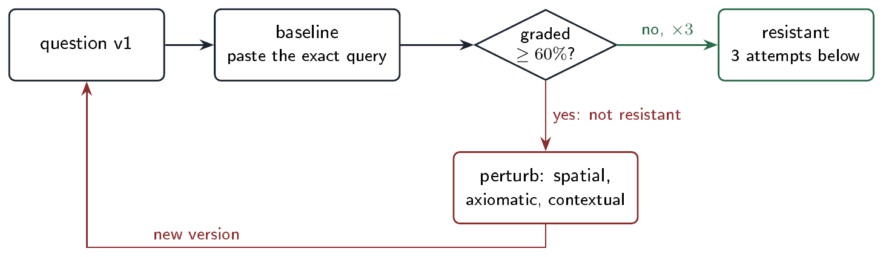
Proof of Concept 2
Perturbation Workbench
Goes with our AIED 2026 paper
You paste the query into a fresh chatbot
Grade it against a rubric you fixed first
Too easy? Perturb it and try again
Three misses in a row, and it’s resistant
CSC 484 · guest lecture
11

Slide 11
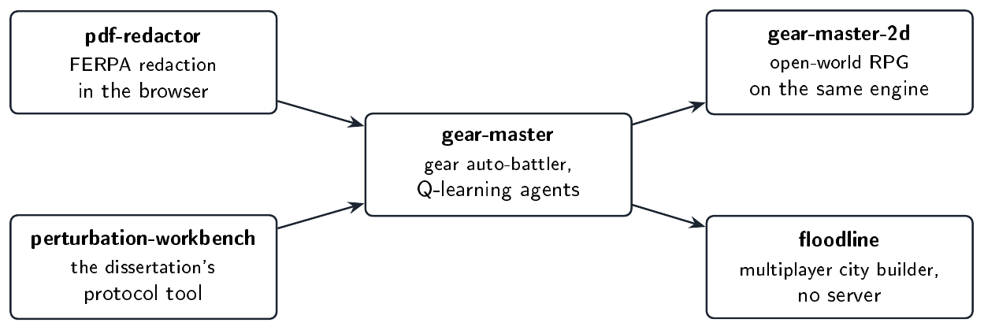
Proof of Concepts worked, so I made some games
CSC 484 · guest lecture
12

Slide 12
2. AI Literacy
How a chatbot writes a proof
CSC 484 · guest lecture
12

Slide 13
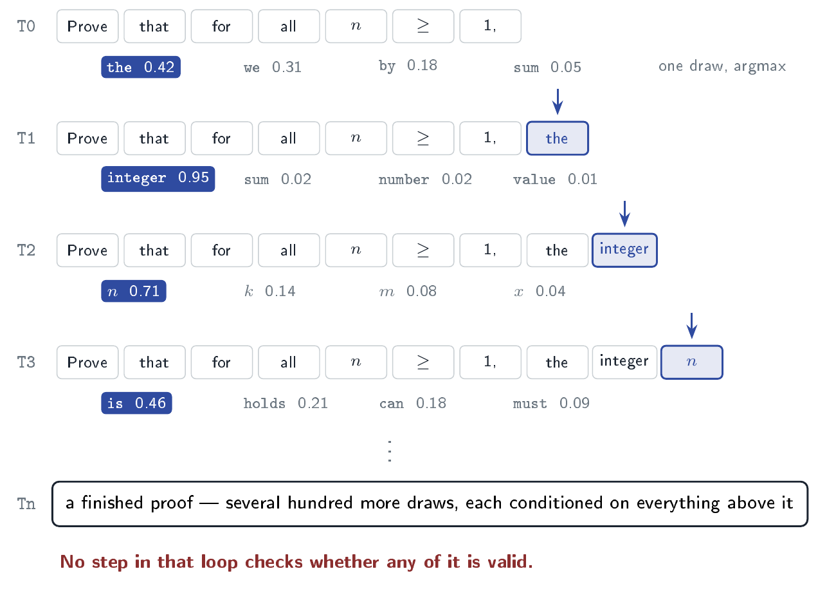
One token at a time
Each token is a draw from a distribution
Conditioned on the internet
Pick the likely one, append, repeat
Nothing in that loop checks first principles and logical validity
It sounds like a textbook because it read textbooks
CSC 484 · guest lecture
13

Slide 14
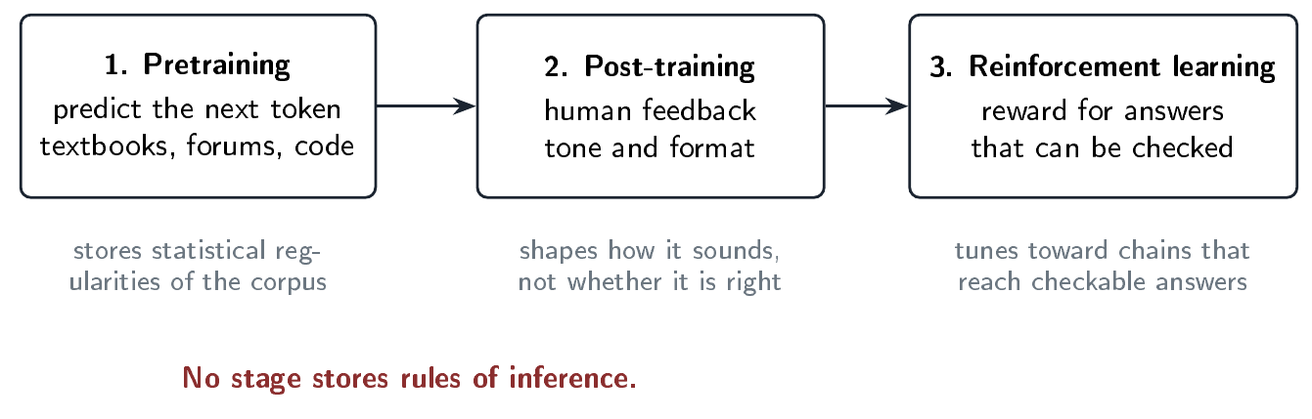
Three stages of training
Pretraining: predict the next token
Post-training: tone and format
RL: reward for answers that can be checked
None of them stores a rule of inference
CSC 484 · guest lecture
14

Slide 15
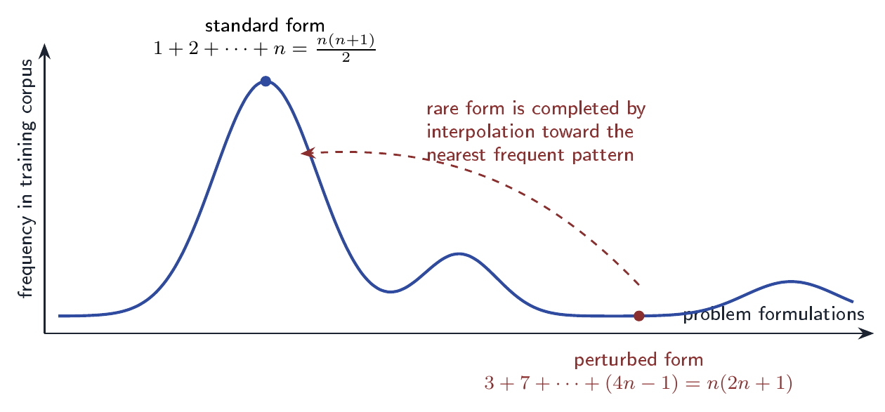
Unfamiliar questions more likely to hallucinate
Reliability tracks how common the problem is
1+2+…+n: thousands of times in the corpus
3+7+11+…: same structure, almost never
The rare one gets filled in from the common one
No harder for a person
CSC 484 · guest lecture
16

Slide 16
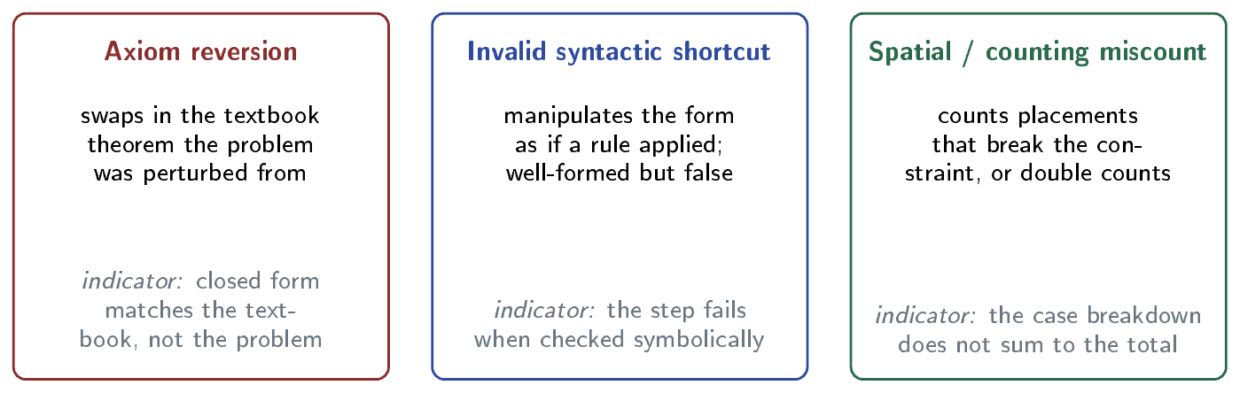
Three ways chatbots mess up when solving proofs
CSC 484 · guest lecture
17

Slide 17
Procedure A
The hallucination autopsy procedure
label | what the step is for | what you do
A0 | Calibrate your reliance | Before reading the response, note how much you expect to trust it for this problem type, and why. Revisit after A6.
A1 | Restate the claim as given | Write down exactly what is to be proven, including its right-hand side.
A2 | Extract the rule the chatbot actually used | Find the closed form it substituted during the inductive step.
A3 | Locate the first divergence | Mark the exact line where the stated hypothesis and the substituted rule part ways.
A4 | Test a small case | Evaluate both sides at a small n. If the numbers agree, verify one derivation step anyway.
A5 | Classify the failure mode | Axiom reversion, invalid syntactic shortcut, or spatial / counting miscount.
A6 | Explain why the failure was likely | Connect the error to how the model generates text.
CSC 484 · guest lecture
18

Slide 18
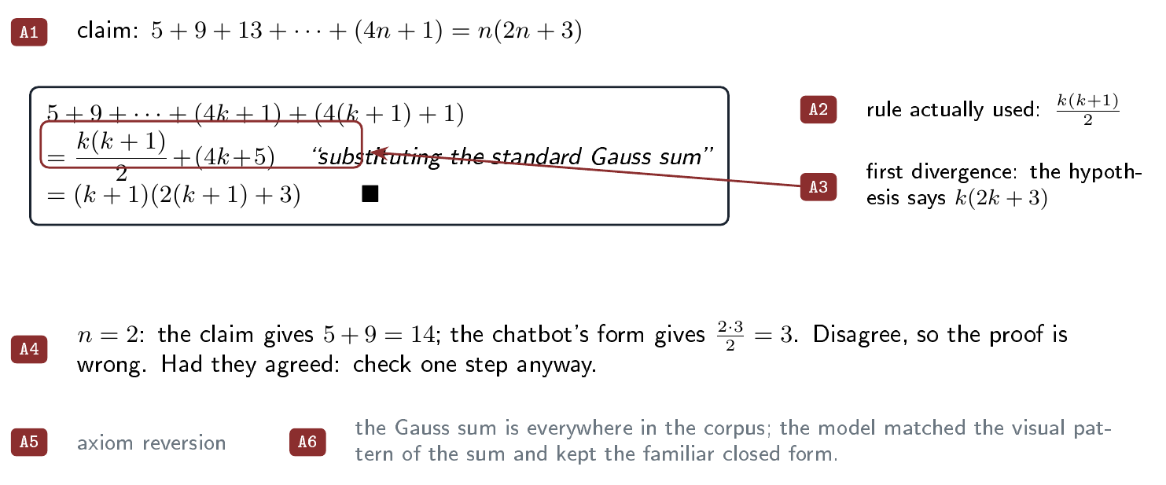
Catching a hallucination
A1 A2 A3 A4 A5 A6
Claim: 5+9+13+…+(4n+1) = n(2n+3)
The chatbot slipped in k(k+1)/2
The hypothesis says k(2k+3)
Try n=2: 14 on one side, 3 on the other
That’s the textbook coming back
CSC 484 · guest lecture
19

Slide 19
Procedure B
Structure of a strong prompt
label | what the step is for | what you do
B1 | Establish context | Tell the chatbot which subject, question type, and goal.
B2 | Require step-by-step justification | Require each step to name the rule or prior line it uses.
B3 | Build in self-questioning | Before the chatbot finishes, have it list its assumptions and check them.
B4 | Plan the corrective dialogue | Know in advance what you will say if you spot an error.
Same label, same words, every time it appears: in this box, in a worked example, and in your own task.
CSC 484 · guest lecture
20

Slide 20
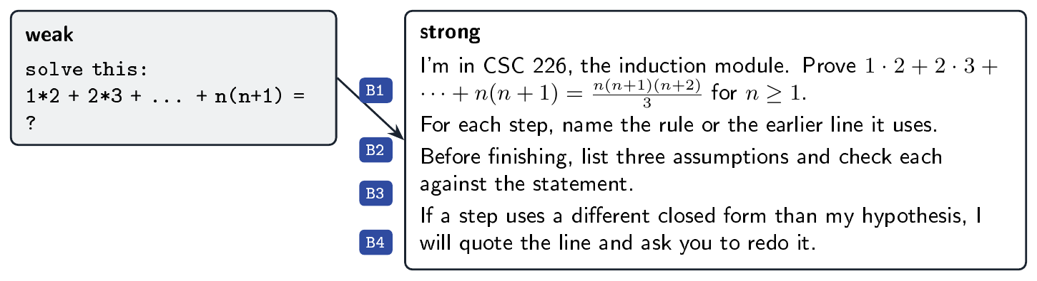
Fixing a weak prompt
B1 B2 B3 B4
Weak: “solve this: 1*2 + 2*3 + … = ?”
Say which course, which module, which claim
Ask for the rule at every step
Ask it to list and check its assumptions
Write the correction before you need it
CSC 484 · guest lecture
21

Slide 21
Procedure C
Scaffolding strong prompts to provide critical feedback
label | what the step is for | what you do
C1 | Frame the problem and set the rules | Give context, state the problem exactly, forbid the final answer.
C2 | Elicit one step with its rule named | Ask for the next step and the counting rule it uses.
C3 | Interrogate the claim | Request a justification or issue a correction; never accept a step silently.
C4 | Verify against hand-computed cases | Small cases computed by hand decide who is right.
C5 | Consolidate in your own words | The write-up is yours, not the chatbot’s.
C6 | Question the system | Ask who built it, on whose data, and why you trust its answer.
CSC 484 · guest lecture
22

Slide 22
If you could make a game right now, what would it be?
CSC 484 · guest lecture
23

Slide 23
Do you think you could make a prototype of your game, and implement AI control of entities for the class project?
CSC 484 · guest lecture
23

Slide 24
Would you incorporate generative AI into your game?
CSC 484 · guest lecture
23

Slide 25
Would you incorporate generative AI into your game?
If you would, what would you use it for?
If you would not, explain why?
CSC 484 · guest lecture
23

Slide 26
3. Generative AI for Game Prototyping
Using AI literacy to optimize agentic game engine development workflows
CSC 484 · guest lecture
23

Slide 27
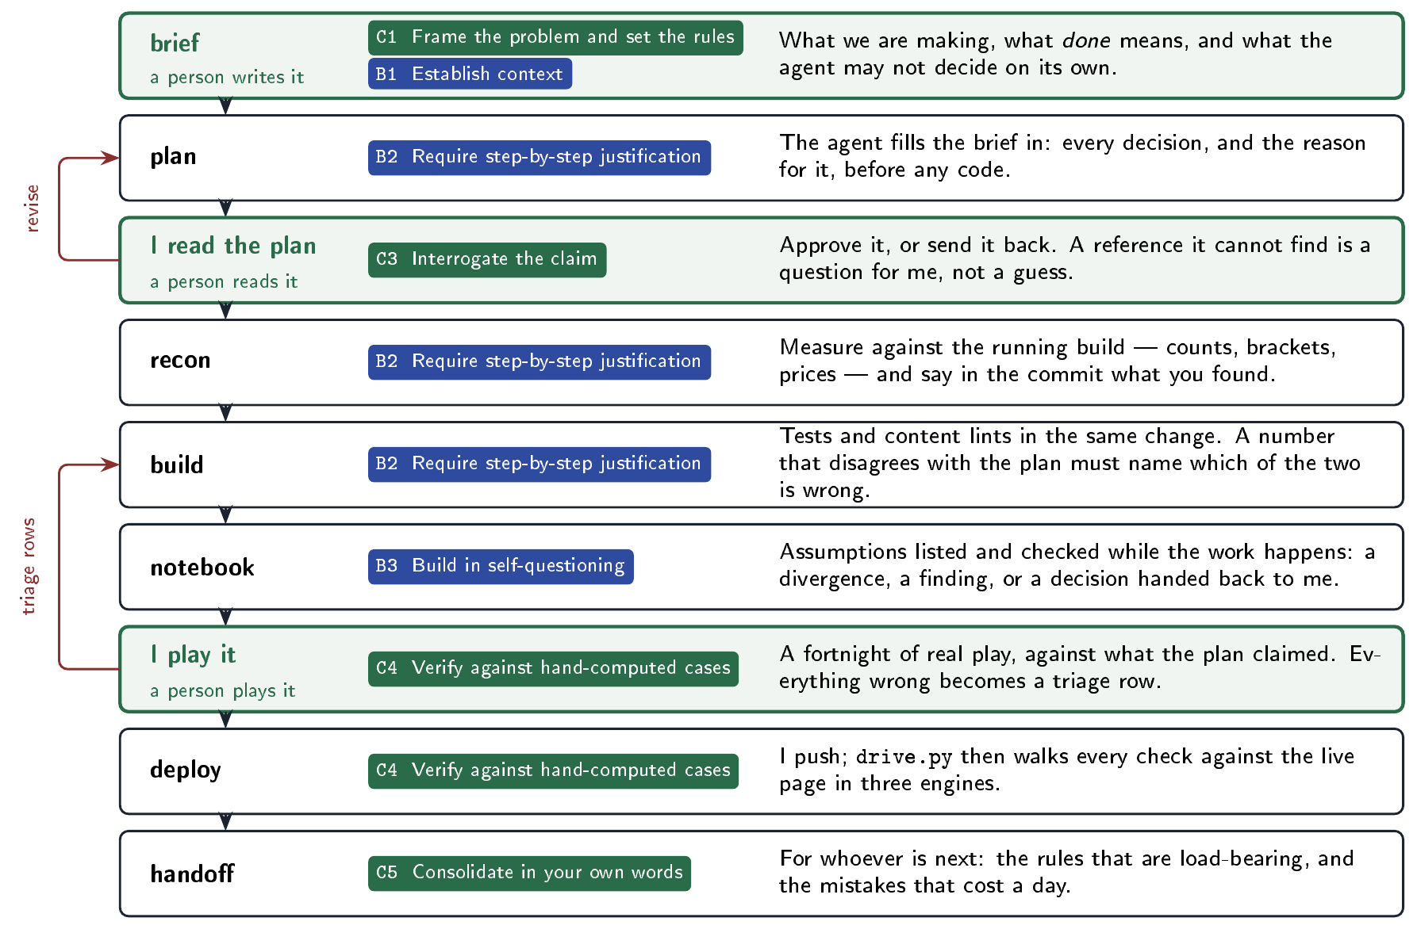
CSC 484 · guest lecture
24

Slide 28
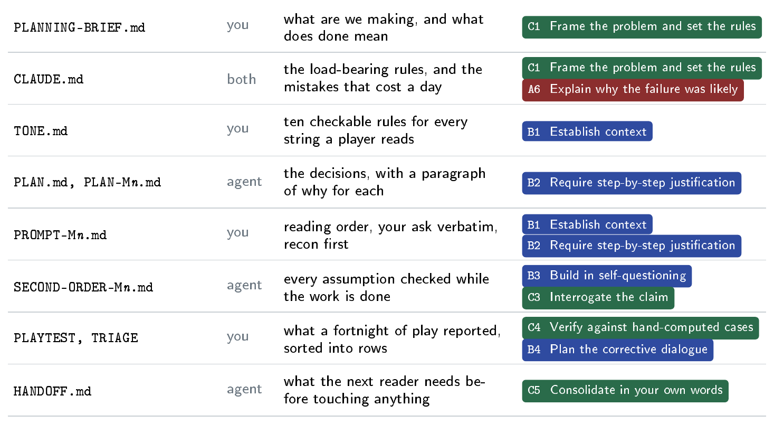
Project Planning Artifacts
CSC 484 · guest lecture
25

Slide 29
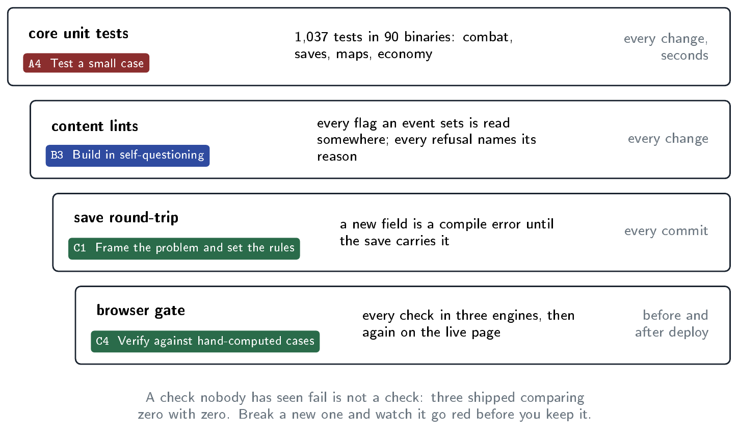
Unit and System Testing
Unit tests on the core, in seconds
Lints on the content, not just the code
Save round-trip on every commit
A browser gate, three engines
Then the same gate against the live page
CSC 484 · guest lecture
26

Slide 30
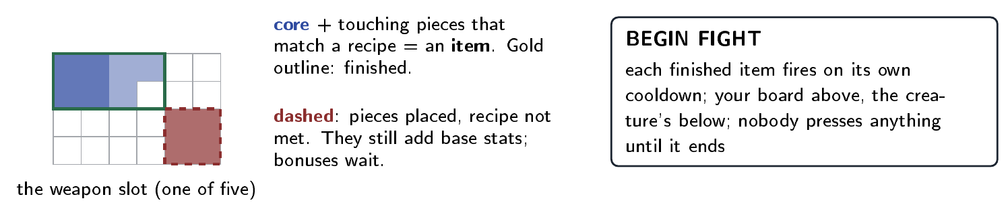
Prototype 1: Gear Master
Inspired by backpack battles
Five slots, each one a grid
Drag parts in; touching parts become an item
Finished items fire on their own cooldowns
Press fight, then watch
CSC 484 · guest lecture
27

Slide 31
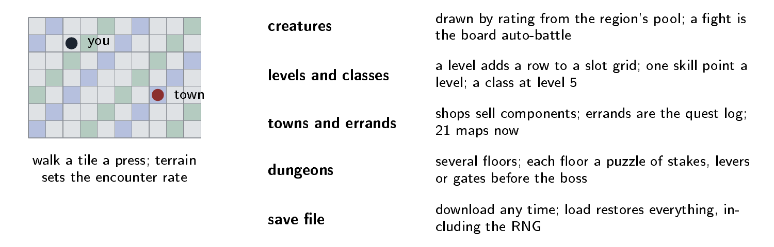
Prototype 2: Gear Master 2D
Same core engine as Gear Master!
CSC 484 · guest lecture
28

Slide 32
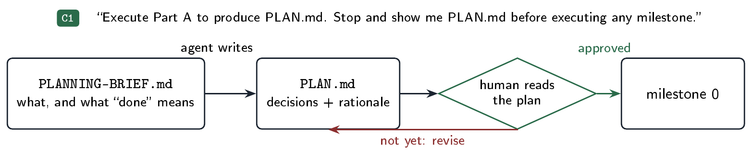
Design Insight 1
No code until I’ve read the plan
C1 Frame the problem and set the rules
CSC 484 · guest lecture
29

Slide 33
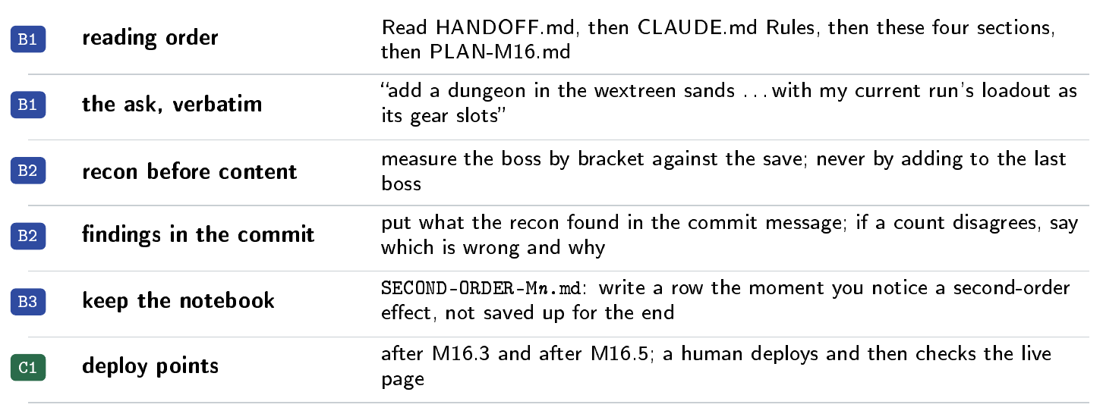
Design Insight 2
How to prompt an agentic chatbot with design docs
B1 Establish context
B2 Require step-by-step justification
CSC 484 · guest lecture
30

Slide 34
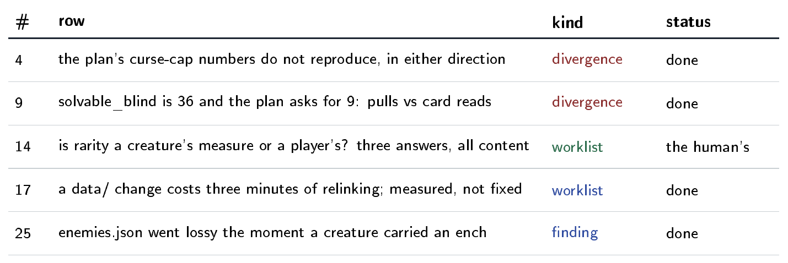
Design Insight 3
Managing Second Order Effects
C3 Interrogate the claim
B3 Build in self-questioning
Second Order Effect notebook explicitly asked for in prompt
Written while the work is happening
One row per assumption
  Divergence, finding, or worklist?
Worklist is brought to the human for guidance on; typically large reaching changes
Example: Seven rows in one block turned up real bugs
CSC 484 · guest lecture
31

Slide 35
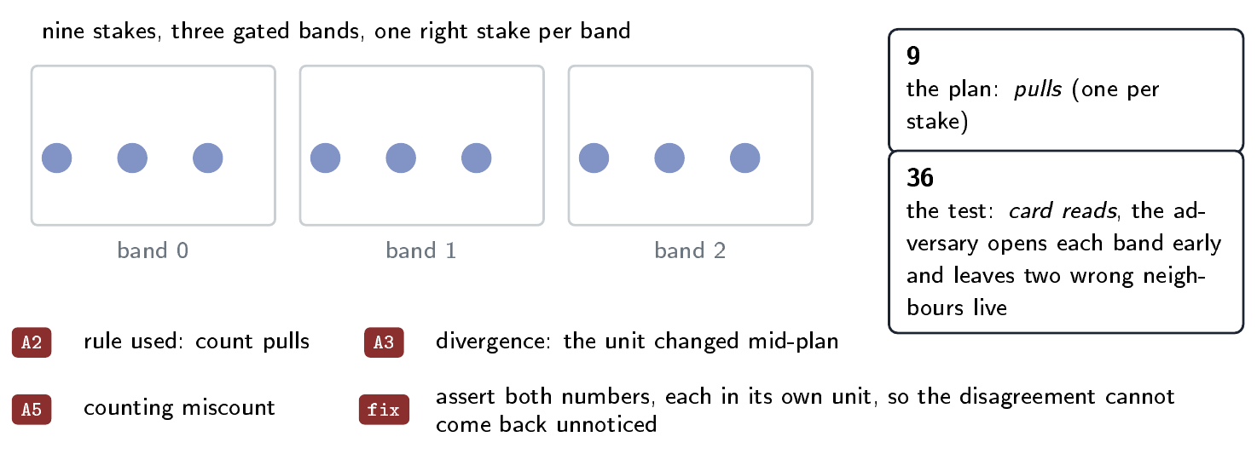
Bug caught by Second Order Notebook
A2 Extract the rule the chatbot actually used
A3 Locate the first divergence
A5 Classify the failure mode
A puzzle floor
  nine stakes in three bands that must be pulled in order to open the door to the next floor
Divergence: The plan used 9 stakes; the test used all 36 stakes
Agent added the divergence to the second order notebook
Human Root Cause Analysis:
  Test was written to try every possibility and assumed every possibility should pass
  Reality: only 9 of them should pass
CSC 484 · guest lecture
32

Slide 36
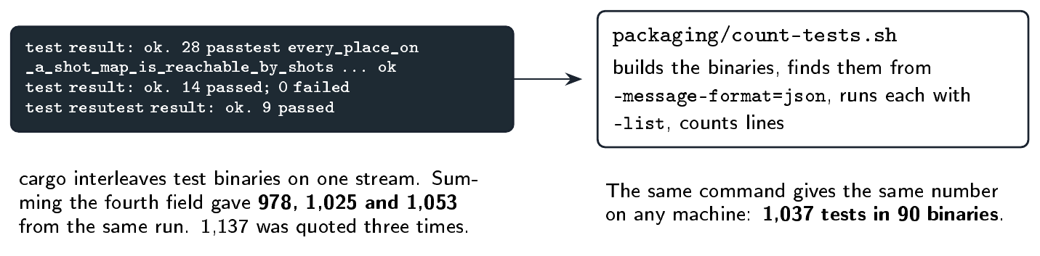
Design Insight 4
Avoid multiple sources of truth
C4 Verify against hand-computed cases
We’d been saying 1,137 tests
Three ways of parsing gave three numbers
cargo mixes its output streams
Actual source of truth: Check the binaries directly
1,037, on any machine
CSC 484 · guest lecture
33

Slide 37
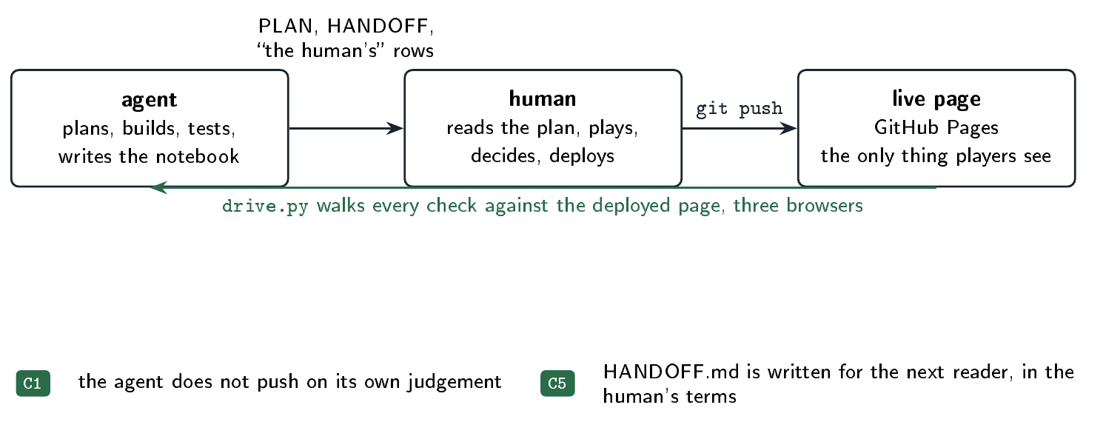
Design Insight 5
Who does what during prototyping
C1 Frame the problem and set the rules
C5 Consolidate in your own words
The agent plans, builds, tests, writes it up
I read, play, decide, deploy
It never pushes on its own
After a deploy, the testing gates walk the live page
Handoff docs are written around at ~700k tokens used in current context
  Around there, model performance starts to degrade
  Handoff doc is to inform context-cleared model how to pick up the work
CSC 484 · guest lecture
34

Slide 38
What sorts of benefits and drawbacks do you think arise from Generative AI use for Game Prototyping?
CSC 484 · guest lecture
23

Slide 39
4. Game AI
Concepts and stuff you can borrow for the project
CSC 484 · guest lecture
35

Slide 40
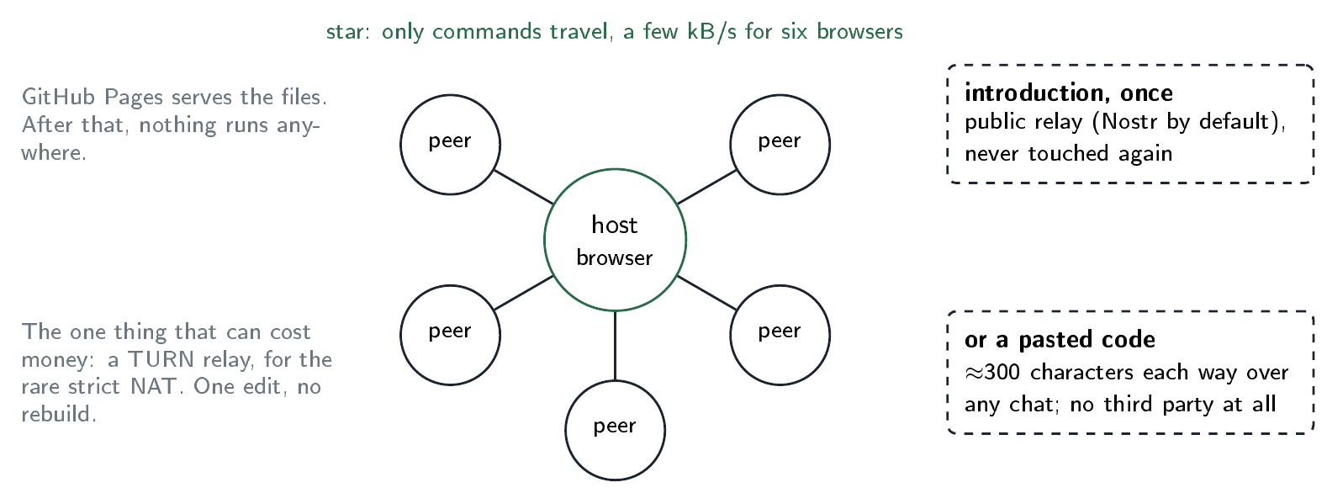
Floodline
Multiplayer without a server
Up to six players share one map
The host’s browser is the hub
A public relay introduces peers, once
CSC 484 · guest lecture
36

Slide 41
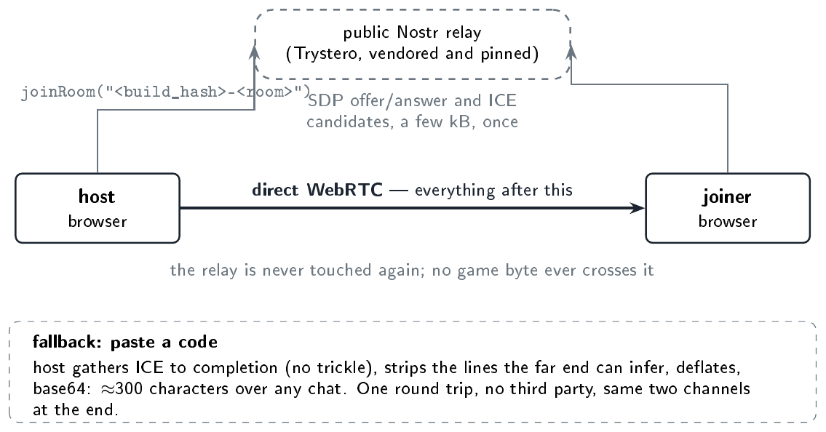
How two browsers find each other
Two browsers cannot dial each other by address, so before a direct link exists they have to exchange an SDP offer, an answer and a handful of ICE candidates through some third channel. That channel is the only part of this that anyone else operates, and the game stops using it the moment the link is up.
CSC 484 · guest lecture
38

Slide 42
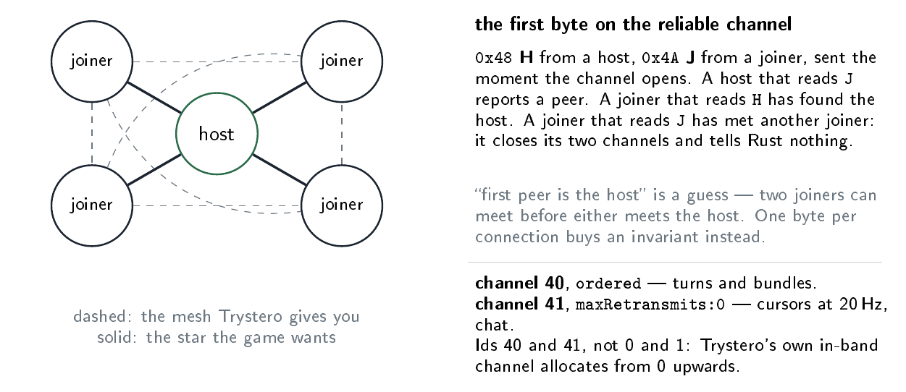
Trystero Room as a mesh network
Every peer in a Trystero room meets every other peer. The lockstep wants joiners talking only to the host.
CSC 484 · guest lecture
39

Slide 43
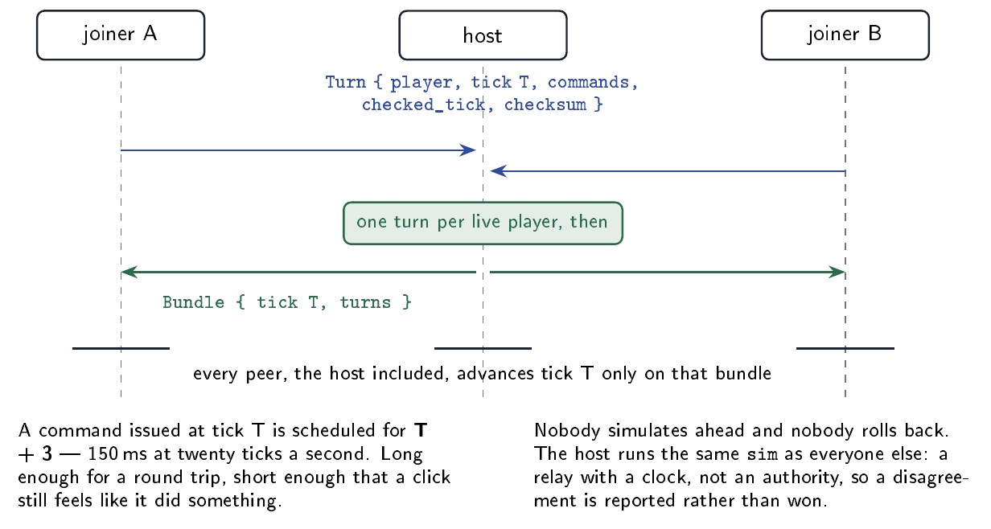
One tick, end to end
Every peer sends the host one turn per tick and waits. The host collects a turn from each live player, bundles them, and sends the bundle back to everyone including itself. That bundle is the only thing any peer advances on.
CSC 484 · guest lecture
40

Slide 44
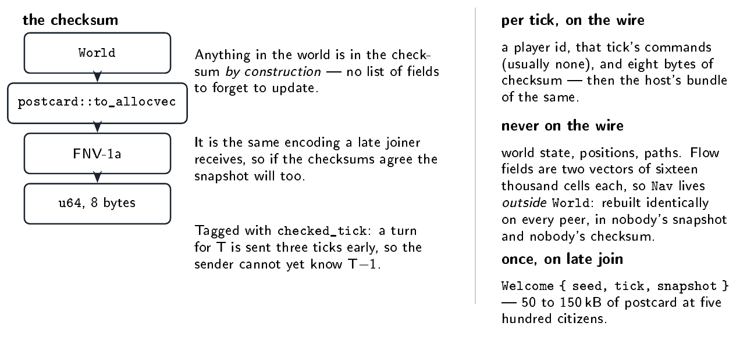
The checksum is the whole world, cheaply
Every turn carries a 64-bit FNV-1a hash of the postcard encoding of the entire World. Hashing the encoding rather than a hand-written list of fields means a new field is covered the day it is added — and it is the same encoding a late joiner receives.
CSC 484 · guest lecture
41
Notes:
The flow-field decision is the one worth dwelling on for this class. One Dijkstra field per destination is two vectors of sixteen thousand cells; a dozen would be more state than the rest of the game. If they lived in World they would ride in every late joiner’s snapshot and be rehashed every tick. So Nav is passed into World::tick rather than owned by it, and a test ticks one world with a warm cache against its clone with a brand new cache every tick and demands they agree, checksum and all — which is exactly the situation a late joiner is in. What is in World is nav_generation, a counter bumped when a footprint appears or disappears, because two peers with different generations have placed different numbers of buildings. The checked_tick tag came from the implementation disagreeing with the design: design said the checksum was of the tick before, which cannot be true when a turn is sent three ticks early, and untagged it threw innocent late joiners out for a desync on the tick they arrived.

Slide 45
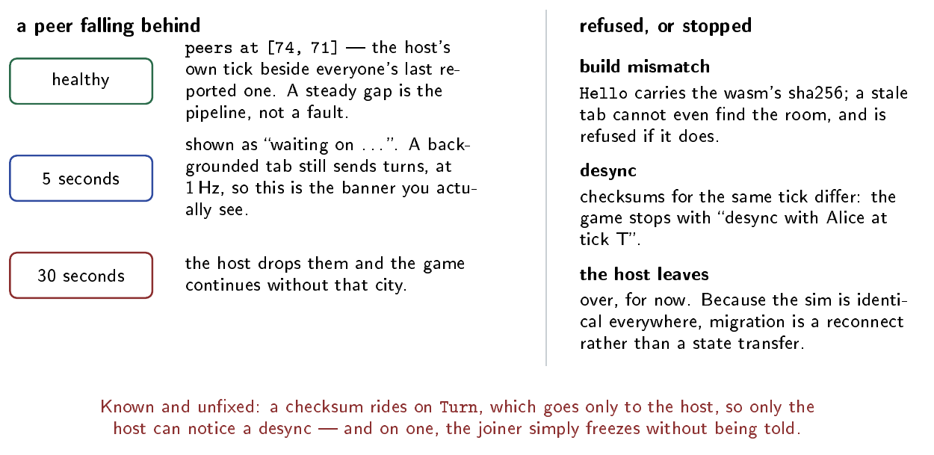
When someone lags, disagrees, or leaves
The pipeline means a peer’s reported tick is always behind the host’s: a round trip old, and three ticks besides. A steady gap is health. A growing one is a peer falling behind, and one that stops moving is a peer that has stopped.
CSC 484 · guest lecture
42

Slide 46
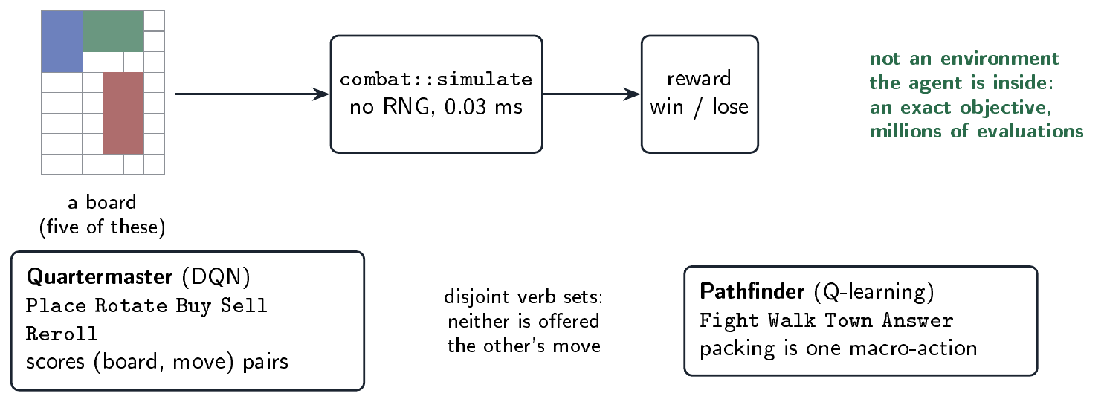
Gear Master
Q-Learning over State Space
Fights are simulations, no RNG, 0.03 ms per fight
So you can evaluate millions of boards quickly
The real decisions are how to shop and pack gear effectively (quartermaster), and how to reach every event in the game (Pathfinder)
Two agents, and they don’t share verbs
CSC 484 · guest lecture
38

Slide 47
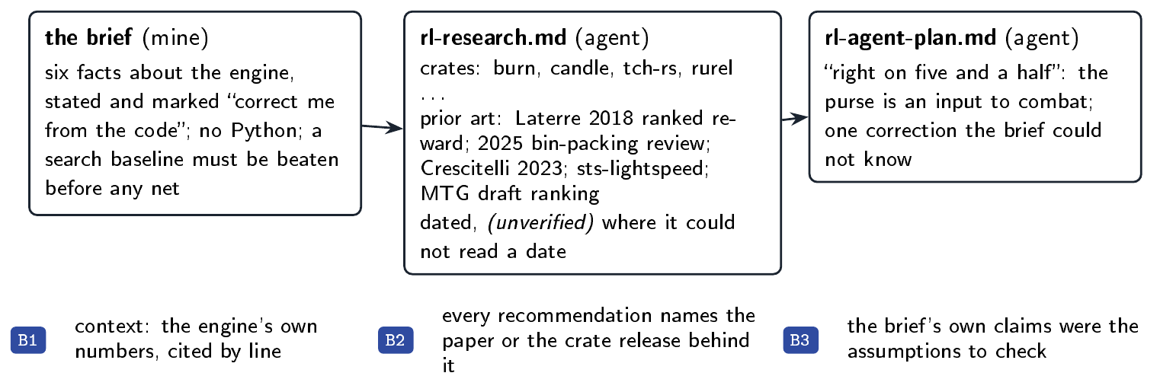
Gear Master
How I started the Q-Learning work
B1 Establish context
B2 Require step-by-step justification
B3 Build in self-questioning
CSC 484 · guest lecture
39

Slide 48
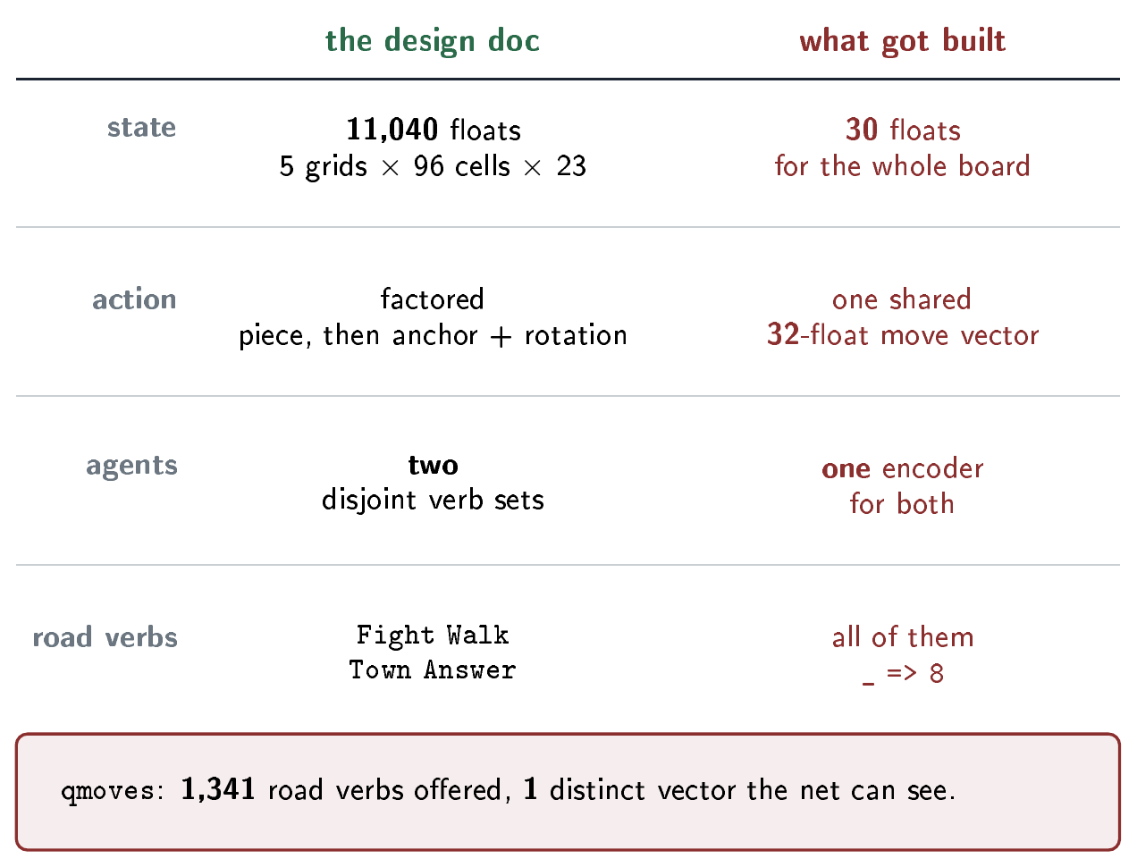
Gear Master
Q-Learning Implementation deviated from design docs
A2 Extract the rule the chatbot actually used
A3 Locate the first divergence
C4 Verify against hand-computed cases
CSC 484 · guest lecture
40

Slide 49
Gear Master
Pathfinding agent as validity solver for quest chains
CSC 484 · guest lecture
40

Slide 50
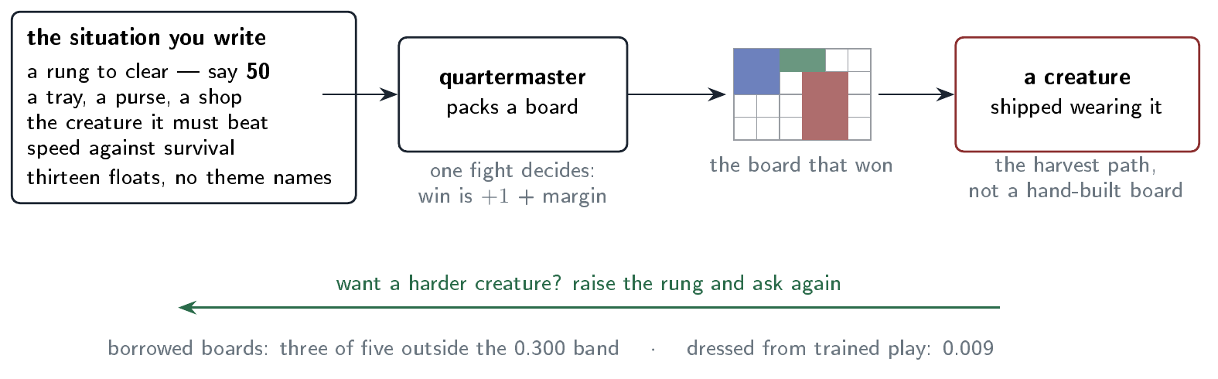
Gear Master
Packer agent as enemy gear author
CSC 484 · guest lecture
41

Slide 51
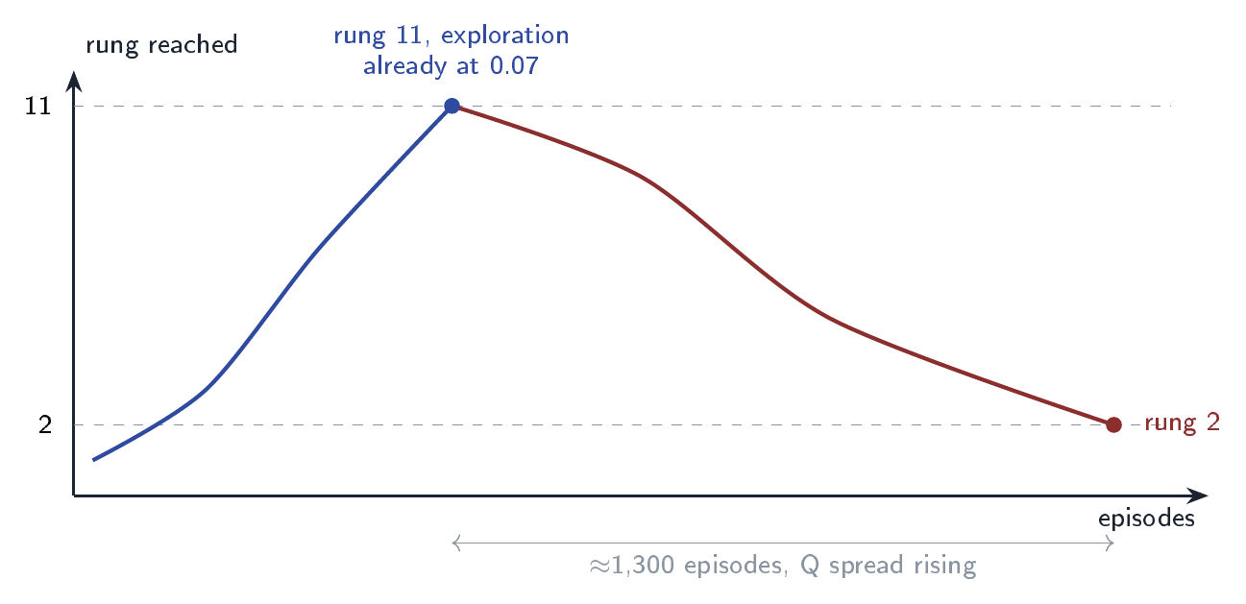
Bug
Q-Learning overfitting
A0 Calibrate your reliance
A3 Locate the first divergence
The packing agent got to rung 11
Then slid back to rung 2 over 1,300 episodes
The shaping reward was too quiet to hear
And the saved nets were loading as None
CSC 484 · guest lecture
42

Slide 52
Question the system
C6 Question the system
Who built it, and on whose work?
Whose math is it good at?
Did the confident tone mislead you?
What would you want to know before leaning on it?
CSC 484 · guest lecture
44

Slide 53
GenAI-Assisted Prototyping Procedure

Slide 54
Resources
github.com/sgilson7/floodline
  WebRTC lockstep, no server
github.com/sgilson7/gear-master
  engine, agents, the RL write-ups
github.com/sgilson7/gear-master-2d
  the full doc set, tests, gate
github.com/sgilson7/pdf-redactor
github.com/sgilson7/perturbation-workbench
CSC 484 · guest lecture
45

Slide 55
Questions?
Sam Gilson
sagilson@ncsu.edu

