Slide 1
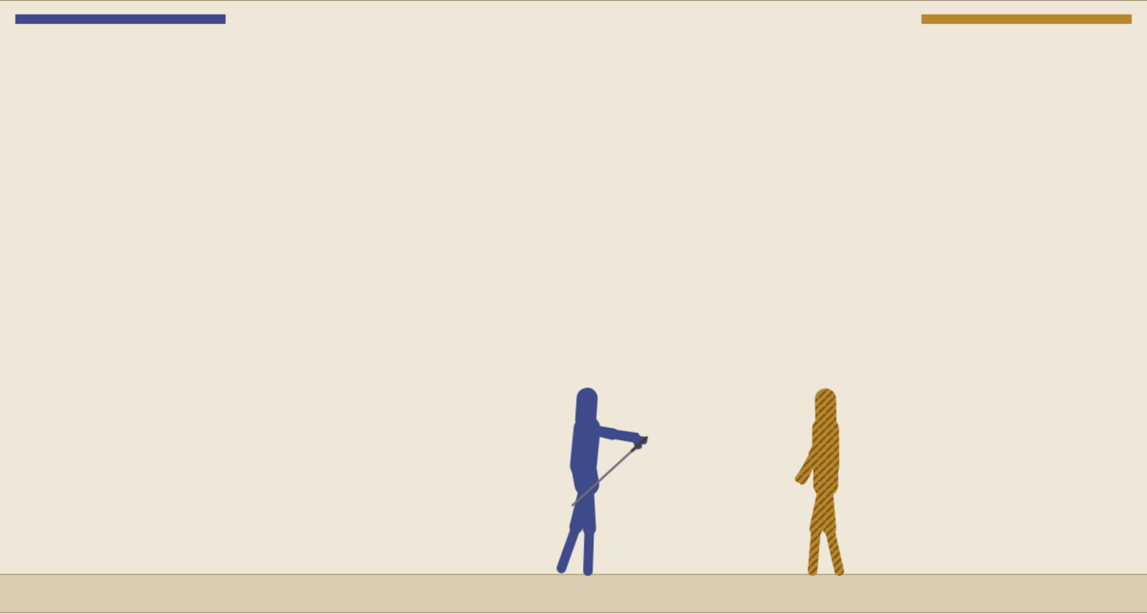
When a tree says “guard high,” what does the character press?
BT Lab · behavior trees, a live demo
A behavior tree chooses an action. The game understands keys: raise the shoulder, bend the elbow, step left or right.
Between the two is a layer the reading leaves out: how an action becomes the keys a character presses on each tick.
Open the lab with me:
sgilson7.github.io/vagrancy/bt-lab.html
Notes:
Open the lab on the projector before class. The tour starts on step 1; press Load this step.

Slide 2
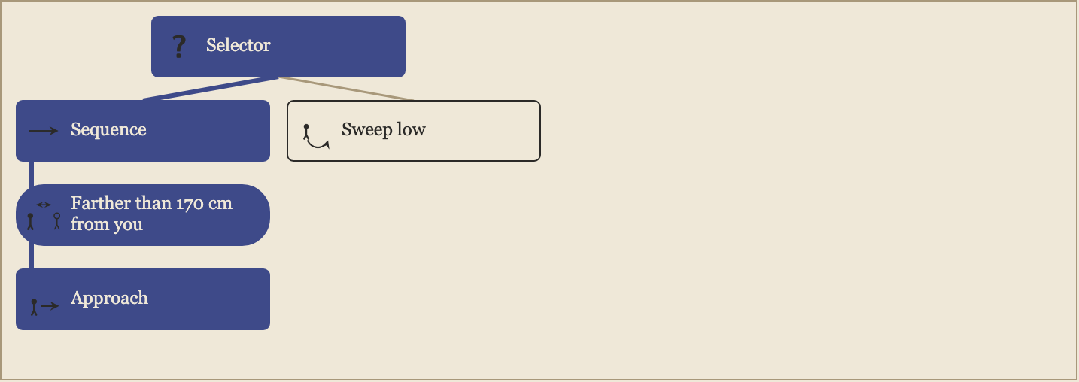
A tree is made of tasks
Conditions check, actions do, composites run other tasks
? Selector: a fallback list.
It tries its children in order and runs the first one that can run.
→ Sequence: a plan.
It runs its children in order and stops at the first that fails. The conditions come first, then the action.
In the lab, the nodes that ran this tick are filled; a condition that held has a gold edge; one that failed fades.
Notes:
Tour steps 1 to 3: the drover, the lamplighter, the cooper. Ask: which nodes are conditions, which are actions, which are composites?

Slide 3
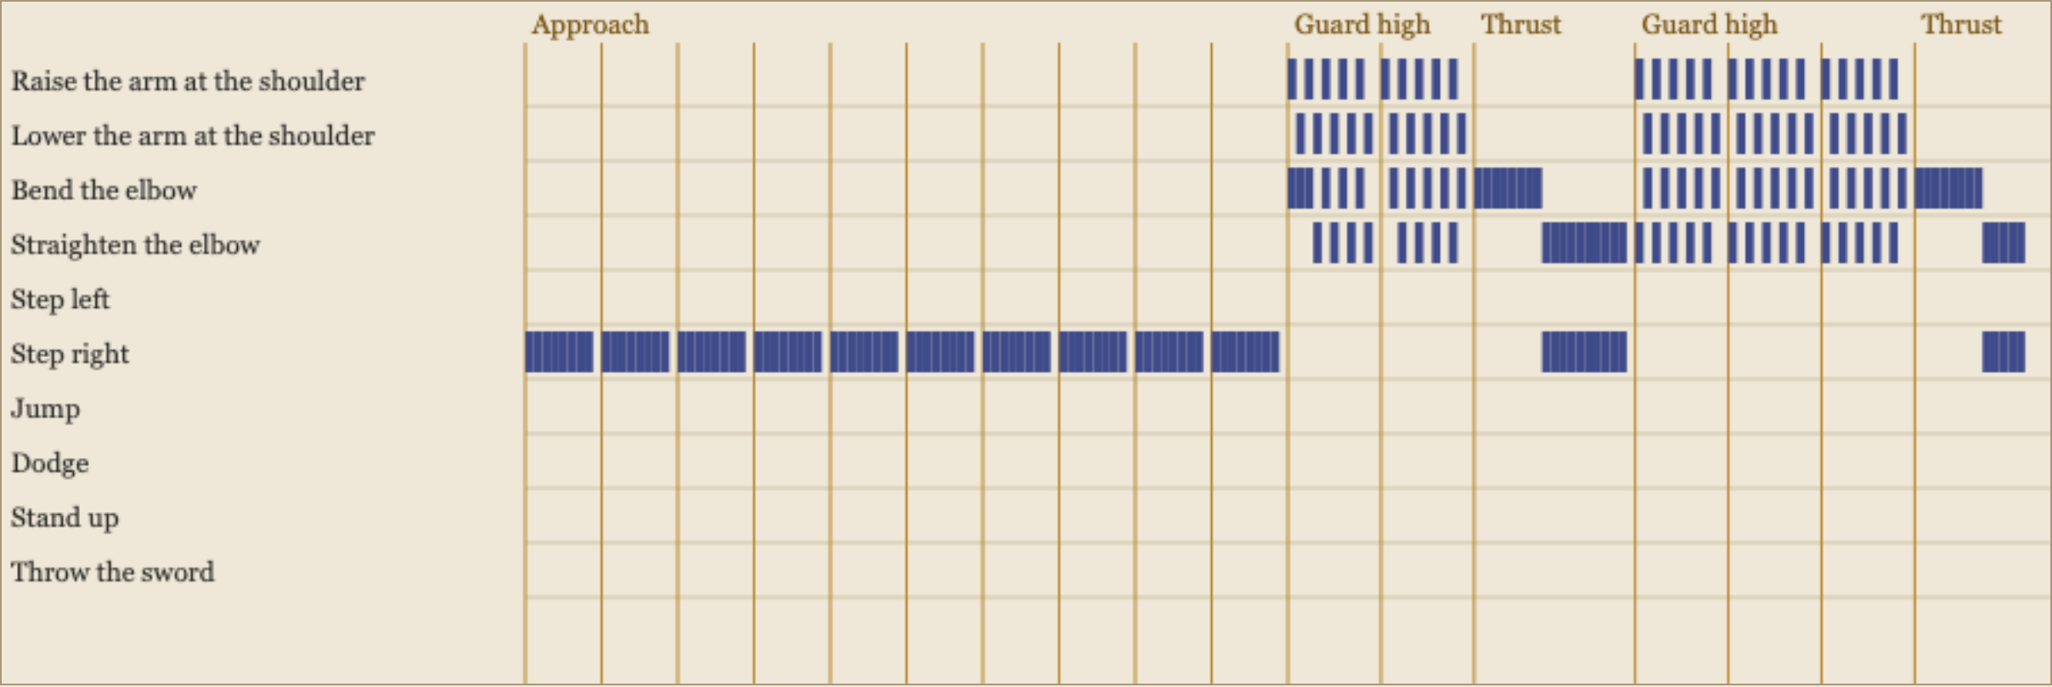
Actions keep running
The reading's question: true and false cannot say “still running”
A move takes many ticks. While it runs, the tree resumes it instead of choosing again. A node with a dashed edge is checked on each tick anyway, and it can cut a running move short.
Notes:
Tour step 4, the courier. The timeline: each row is a key, each column a tick. The gold lines mark where a move started.

Slide 4
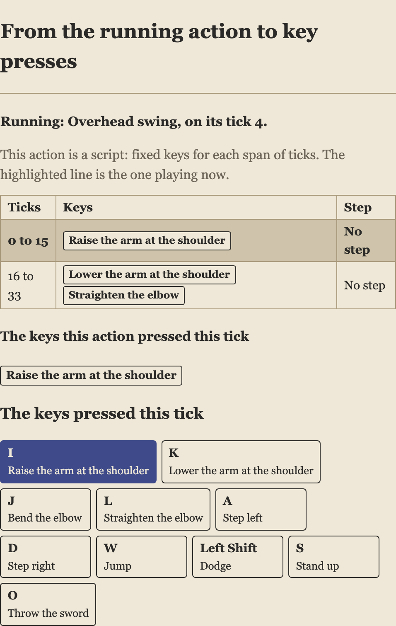
From an action to keys: a script
Fixed keys for each span of ticks
The hay mower's overhead swing holds the shoulder key up for sixteen ticks, then down with the elbow straightened.
Pause, then step one tick at a time: the highlighted line is the one playing.
Ask:** why does a swing need many ticks of the same key, rather than one press?
Notes:
Tour step 5. Space pauses; the full stop key steps one tick.

Slide 5
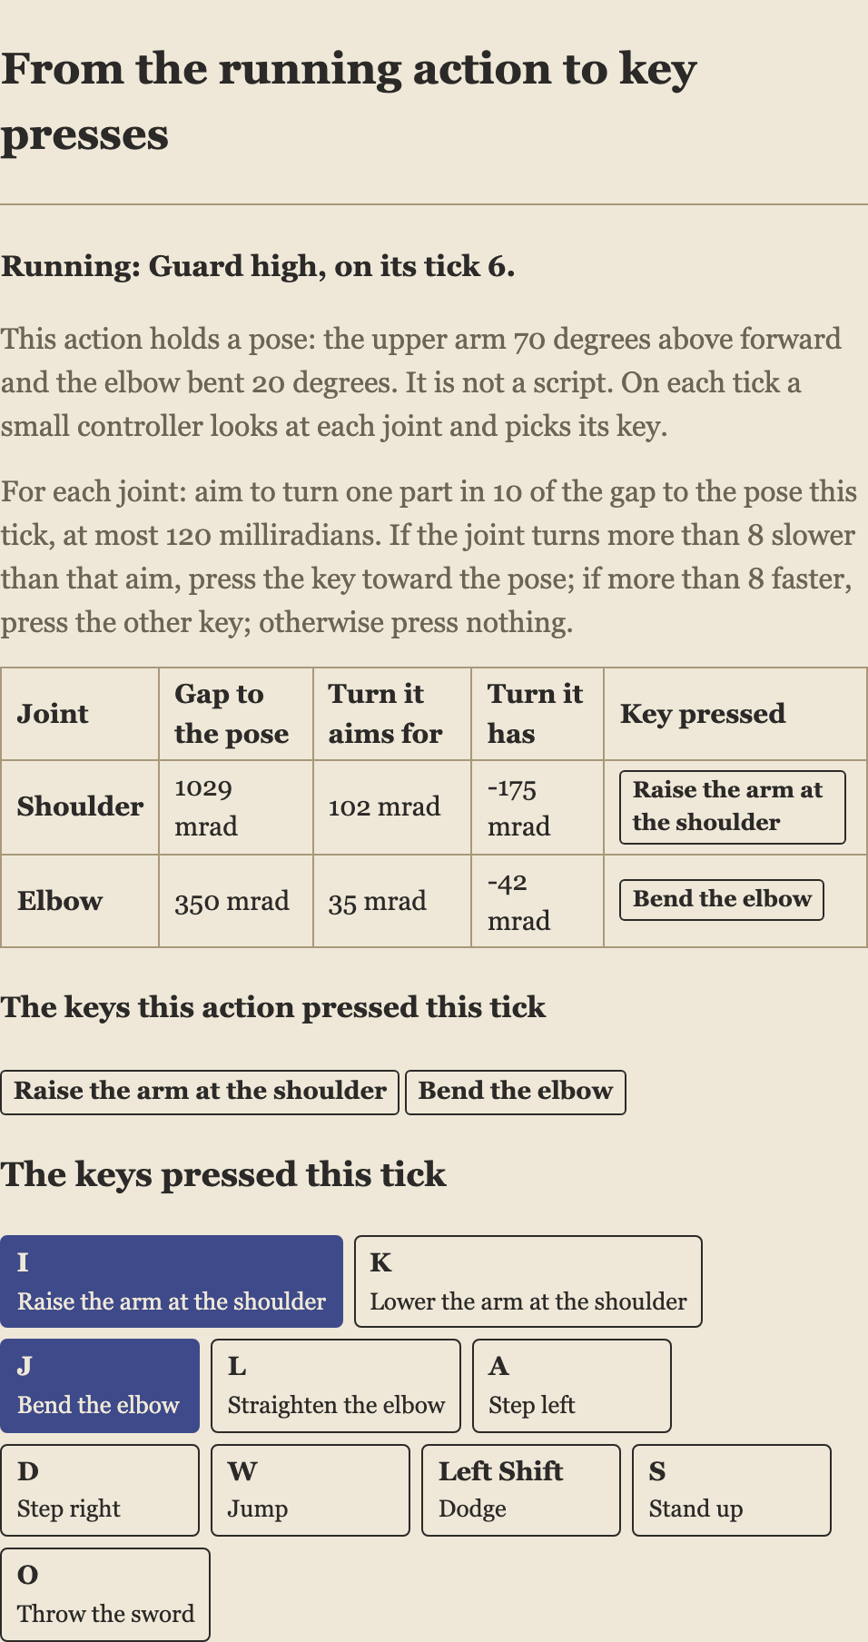
From an action to keys: a controller
“Guard high” names a pose, not keys
On each tick a small controller compares each joint with the pose. It aims to turn a tenth of the gap, and presses a key only when the joint turns too slowly or too fast for that aim.
An earlier version pressed toward the pose until the arm arrived, and swung past it every time.
Ask:** why aim for a speed instead of a position?
Notes:
Tour step 6, the lamplighter. The step pauses as high guard starts. Step through and watch the gap shrink and the keys switch off.

Slide 6
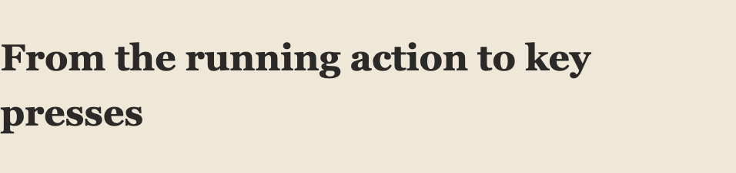
From an action to keys: a search
The tree picks the kind of thing to do; the search picks the keys
The archivist's last rule is a search. It tries a few key combinations on a copy of the world a short way ahead, scores each, and presses the best for a few ticks.
Ask:** where else could a tree hand a choice to a search?
Notes:
Tour step 7. The table lists each combination tried and its score; the chosen one is highlighted.

Slide 7
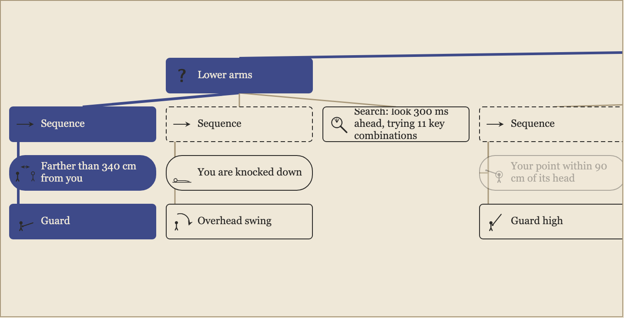
Parallel: a tree for each pair of arms, and one for the legs
The village deity
Each tree presses its own keys, and the body receives them together on the same tick.
Ask:** what could go wrong if two trees pressed the same key? How is that kept from happening here?
Notes:
Tour step 8 is the throw; step 9 is this one; step 10 is the thresher's repeat decorator; step 11 is a fight of your own.

Slide 8
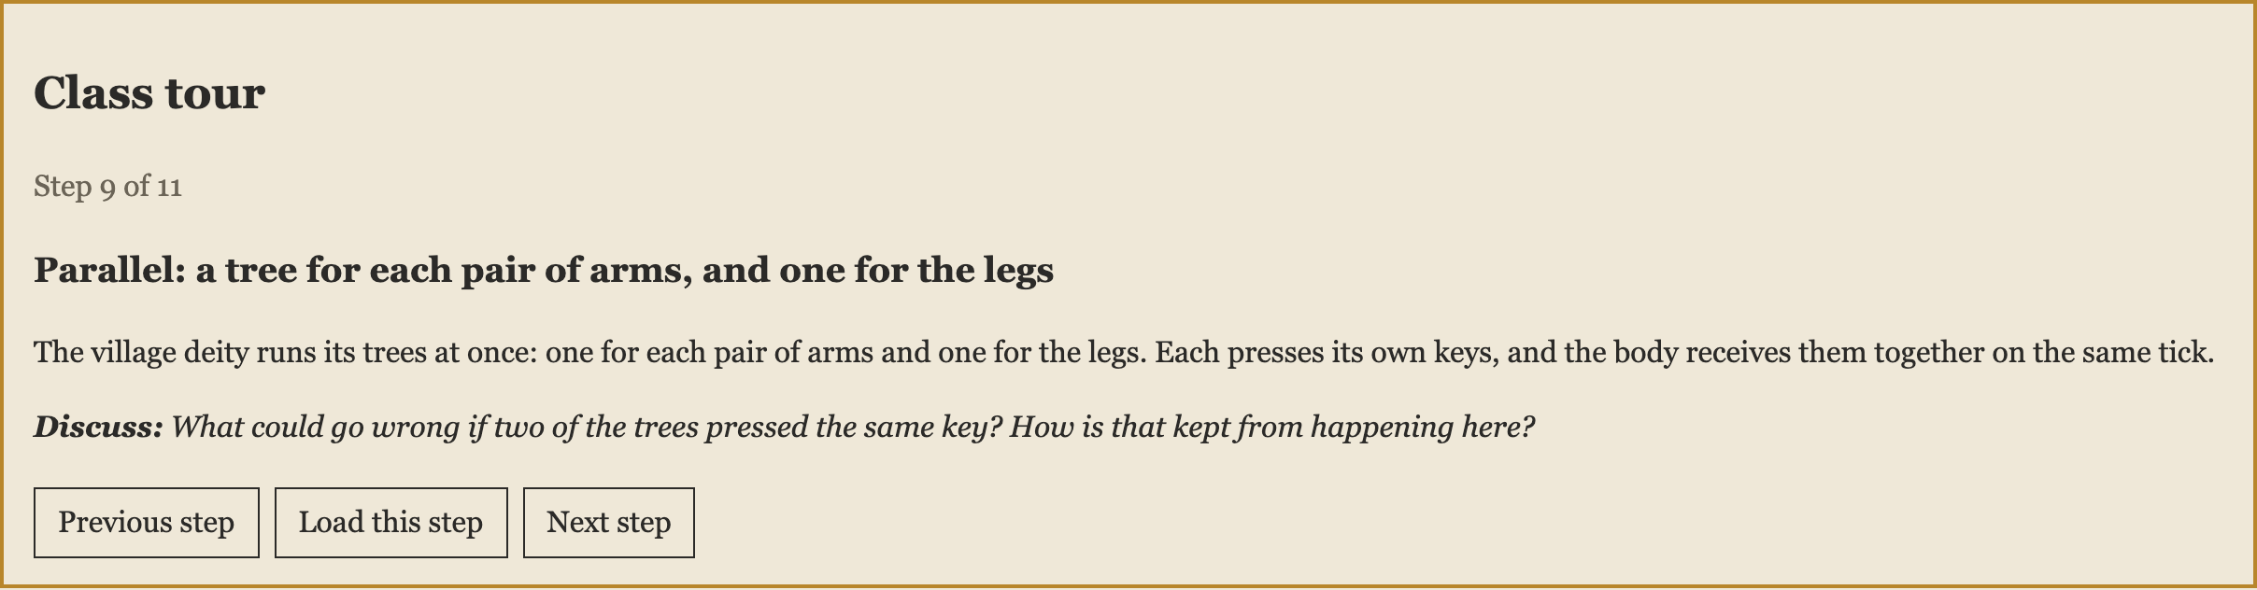
Running the tour in class
Eleven steps, about ten minutes each in pairs, or two to three minutes each as a walkthrough
Load this step** sets up the two fighters and the speed.
Space** pauses and resumes; the **full stop** key steps one tick.
Show the tree of** switches between the two fighters.
Each step ends with a question to discuss.
The last step is yours: fight the lamplighter with the keys and watch its tree answer you.

