Slide 1
A Population-Based Traffic Search
by Scott Giorlando and Parker Saunders

Slide 2
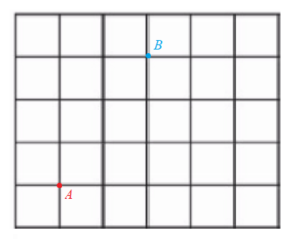
Problem Description
Consider a car traveling from point A to B across a region
This region is populated with obstructions (cars, redlights, ...) that cause some paths to be more or less efficient.
The problem is then to devise a searching algorithm which can find the most productive path from some start to some end, assuming a constant time t.
Worldspace description:
State: Vertex
Action: Road
Characterizations:
Fully Observable
Single Agent
Deterministic
Sequential
Static
Discrete

Slide 3
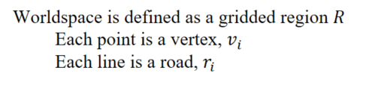
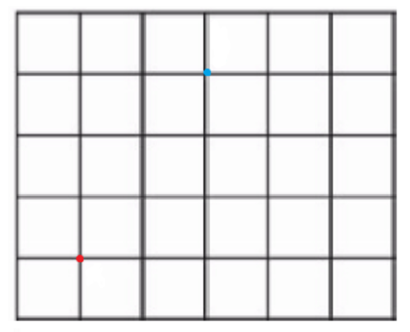

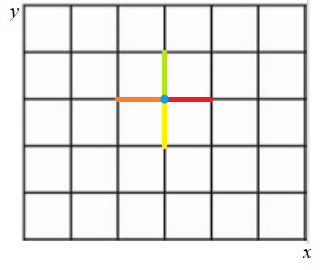

Worldspace
R
We define each state and its possible actions as a vertex that may take one of four possible roads, each with a different cost.

Slide 4
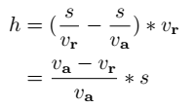
Researched Searching Methodologies
GA: Genetic Algorithms are one of the few ways to have a dynamic traffic routing system that chooses the most optimal/shortest roads to be taken. One way to find the most optimal route is to have each vehicle on the road upload their traffic data to some sort of database and we have a Genetic Algorithm find and choose the most optimal route that way.
A*: One study was found to use an A* algorithm which uses the following heuristic to calculate path costs:
S is the length of a traffic jam on road
Vr is real- time velocity to travel through traffic jam
Va is the speed limit of a given road
Where (s/vr-s/va) then represents the extra time the traffic jam adds to the journey

Slide 5
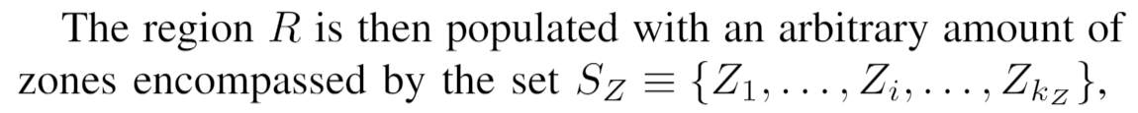
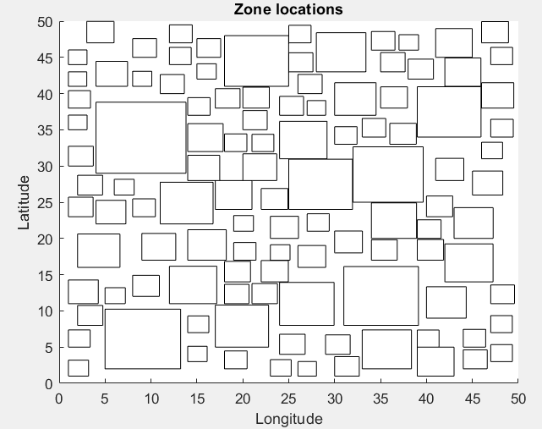
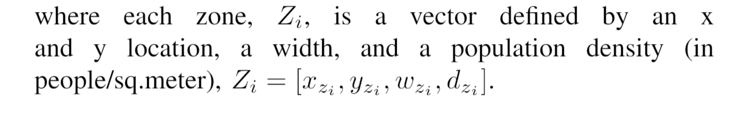

Simplifying the Heuristic with Population Density
For the sake of simplicity, traffic conditions are generalized via an analysis of population density across the given worldspace.
This is justified as the Federal Highway Administration had found "that traffic volumes at typical densities tend to rise at least 80 percent of the rate of population density increase" (Agafonov).
The cost of each road is chosen to be a function of the population density of the zone the road is contained inside

Slide 6
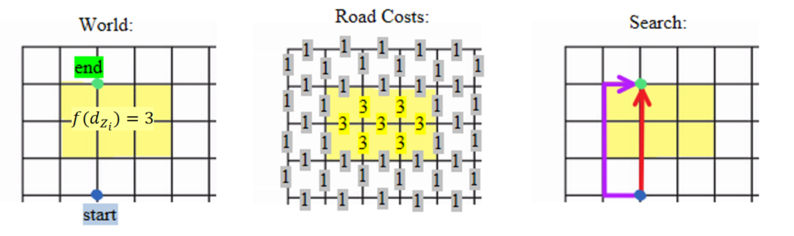
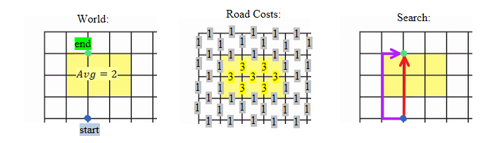
Basic Example
The following scenario illustrates a simple example of how the system should operate. Each road inside the zone has a cost of 3, and any road not in a zone has a default cost of 1.
Red Path: 7
Purple Path: 5

Slide 7
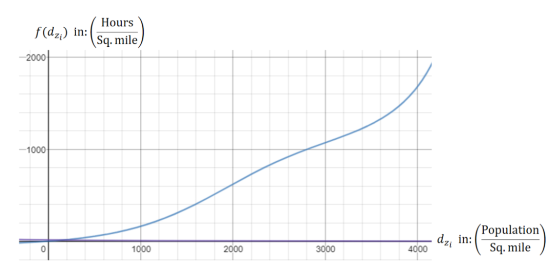
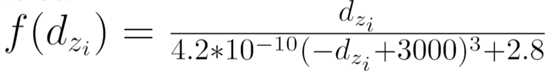
Implementing Cost Function
This function was implemented as the hours/sq.mile it takes to travel the given road, derived from a study from the Texas Transportation Institutute.
The data of the study was modeled through the relation:

Slide 8
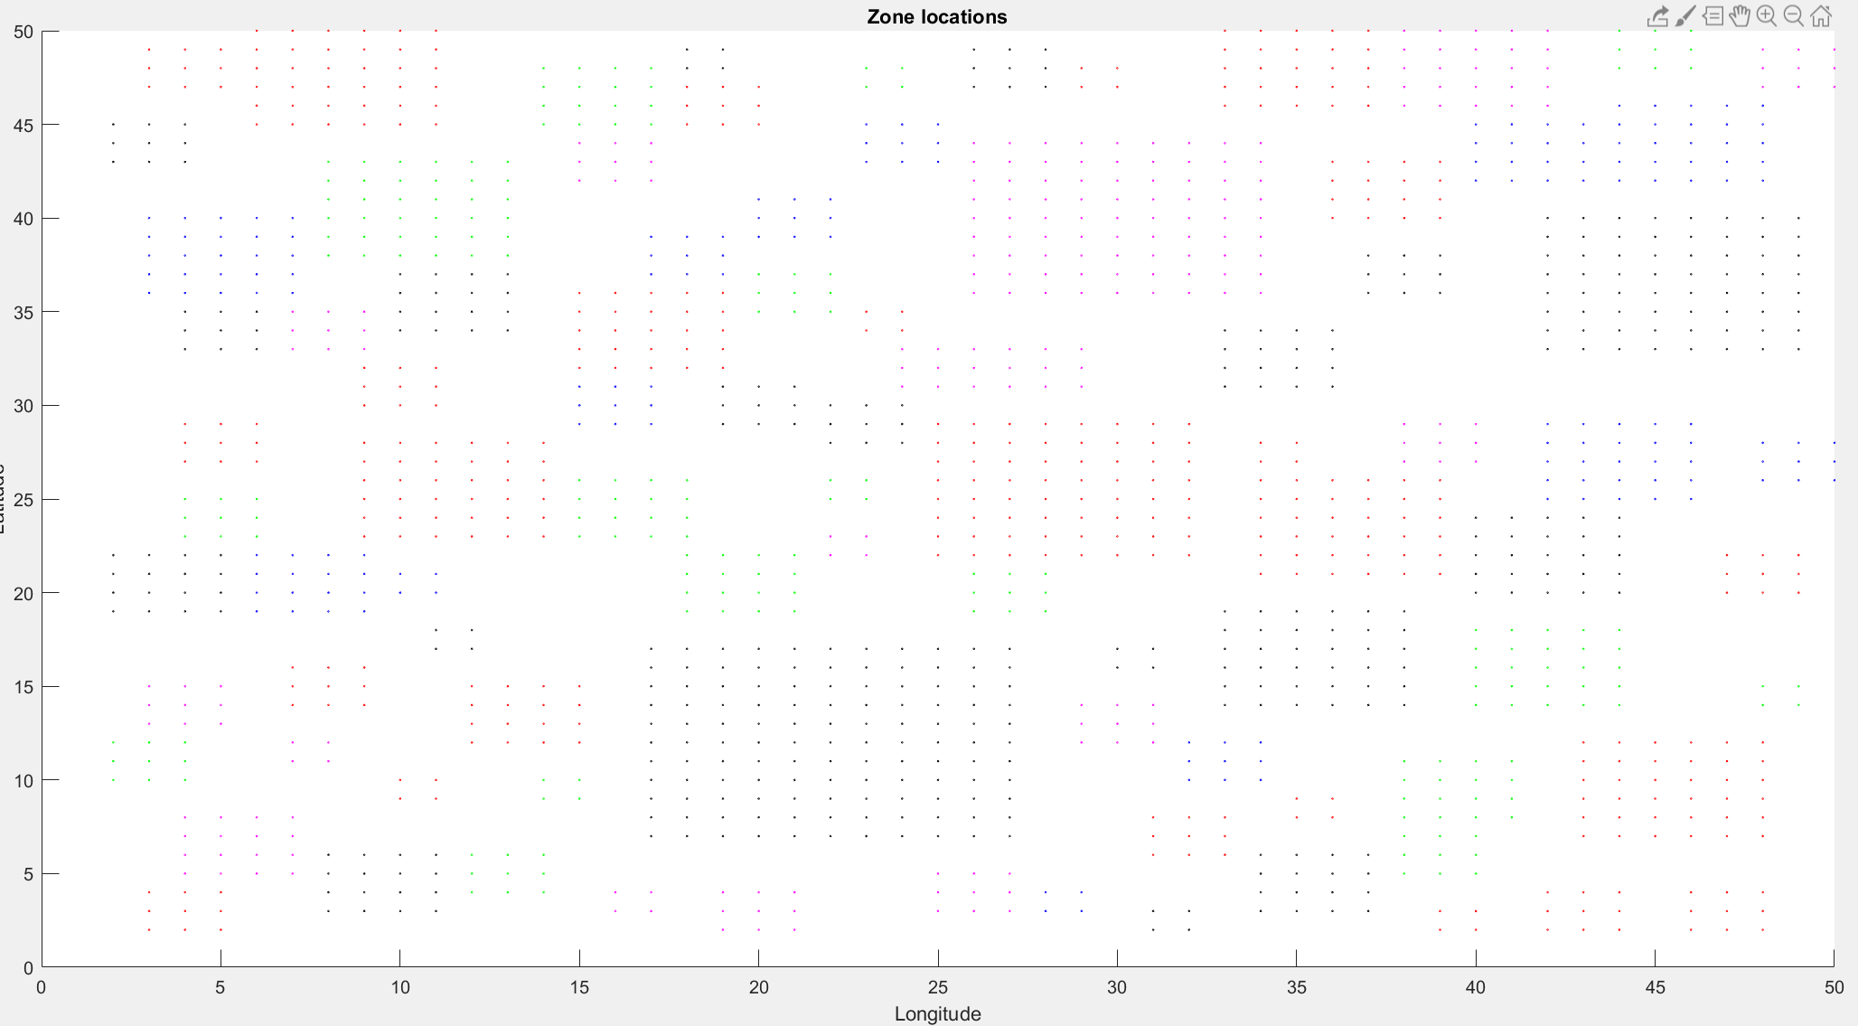
Searching Results: Zoning

Slide 9
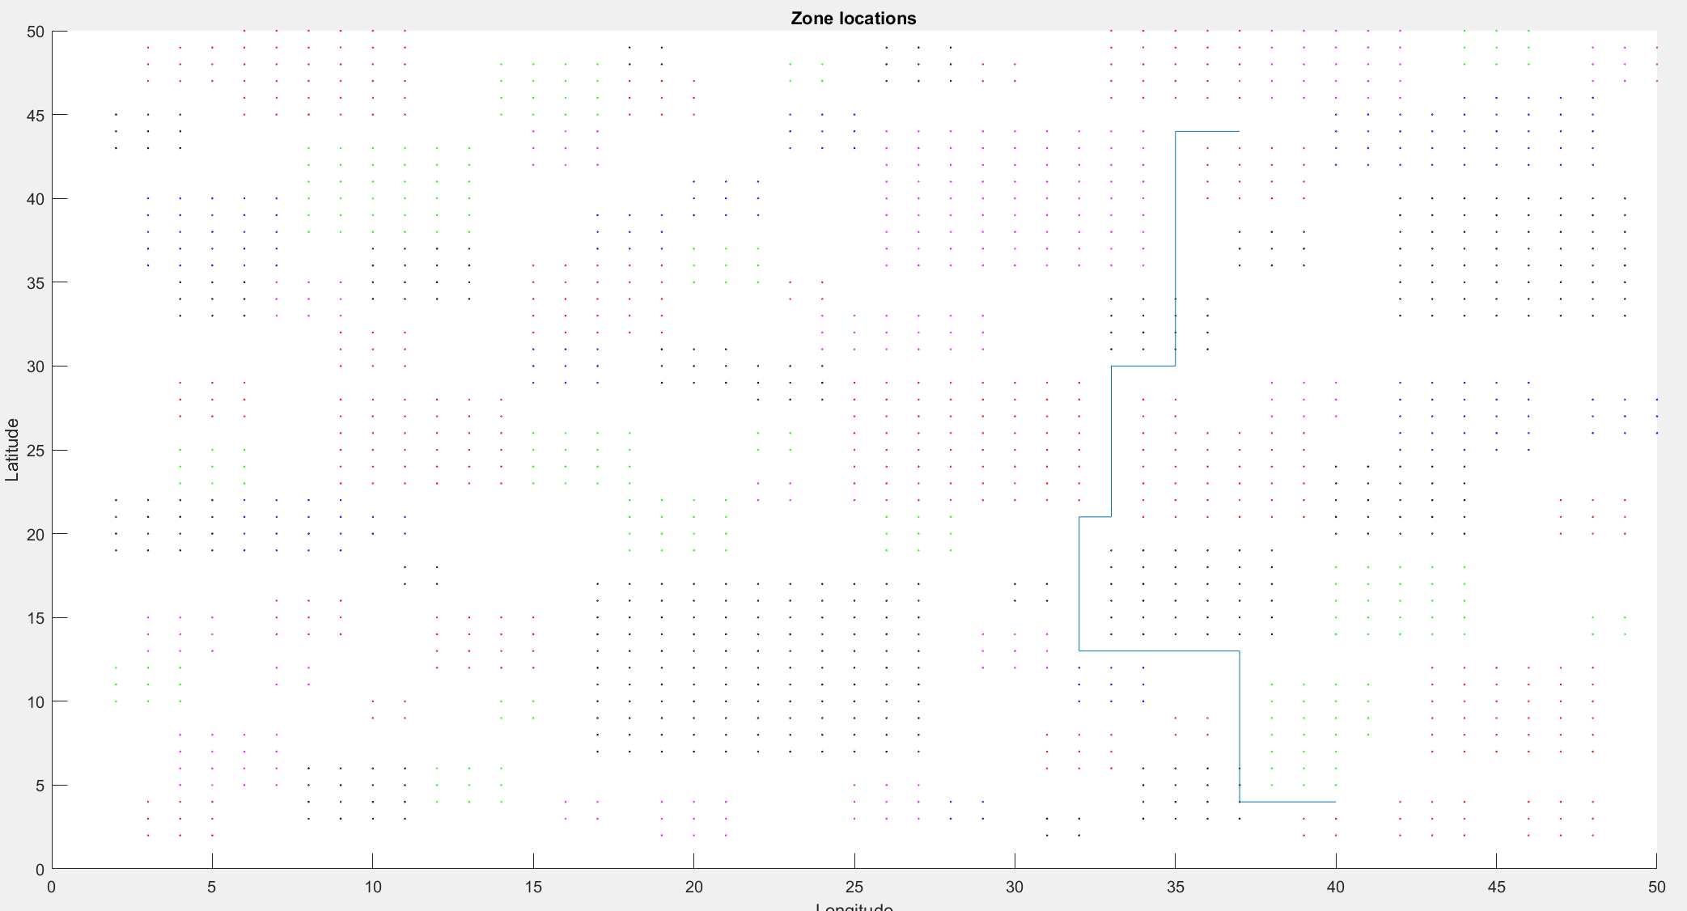
Searching Results: Pathing

Slide 10
Searching Results
Zoning
Pathing
Population Density (x) by Color:
Black: x < 300
Magenta: 300 < x < 600
Green: 600 < x < 900
Blue: 900 < x < 1200
Red: x > 1200
Pathing
Given a start point of (40, 3) our path avoids most zones to reach the end point (37, 45).
As seen above, the worldspace is created in such a way that may require our path to go through a zone.

Slide 11
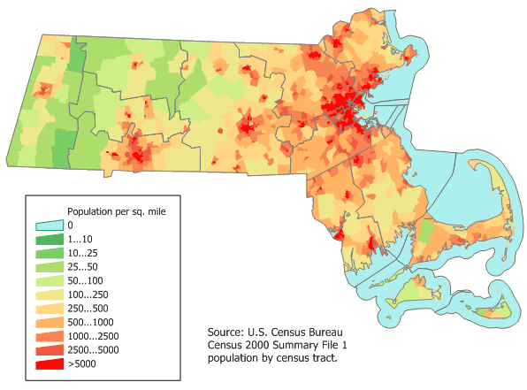
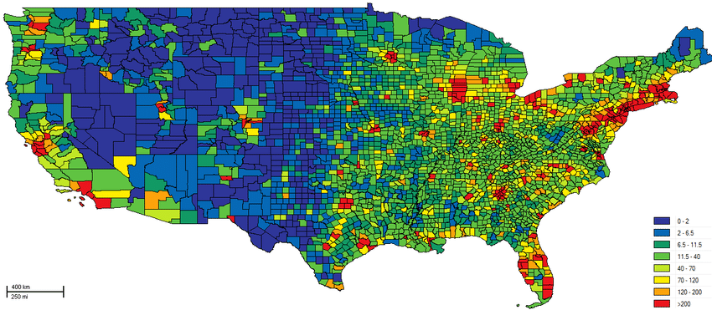
Discussion
Though we simulated the data through randomized values, this searching algorithm could work on any set of population density.
Or Mass:
The US for example:

Slide 12
Concluding Remarks
Based off our results we found that using population density as the point of focus for a worldspace trying to find the shortest path is valid.
We also figured out in our research that population density has high correlations with a few different factors such as: emergencies, crime, construction, etc.
These correlates could provide the basis for creating a more dynamic searching system with different goals than simply avoiding traffic.

Slide 13
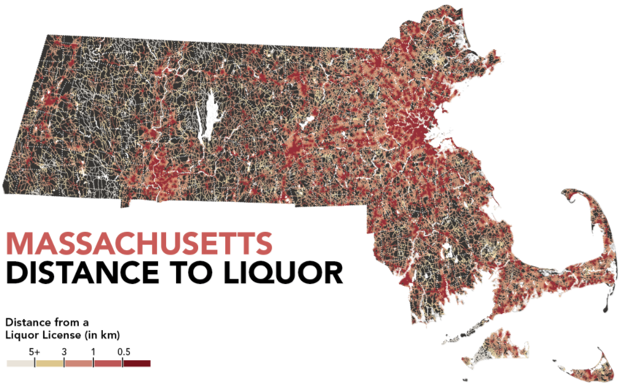
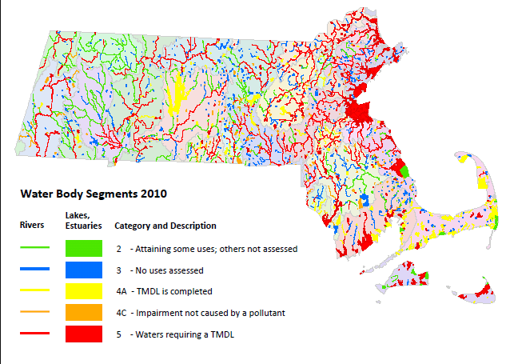
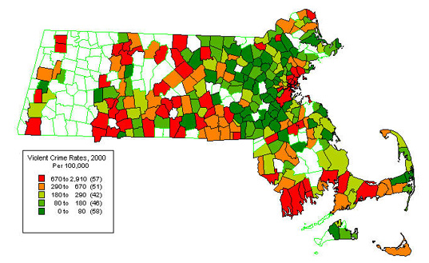
Concluding Remarks
Some interesting correlates that can be searched for/against:
Crime
Pollution

Slide 14
Questions?

