Slide 1
DESIGN FOR INCLUSIVITY USING Conversational Interface Suganthi giridharan @greenpal

Slide 2
agenda
Accessibility & Technology
UX - screen readers
Design conversational interface
Build conversational interface
voice interface options
questions

Slide 3




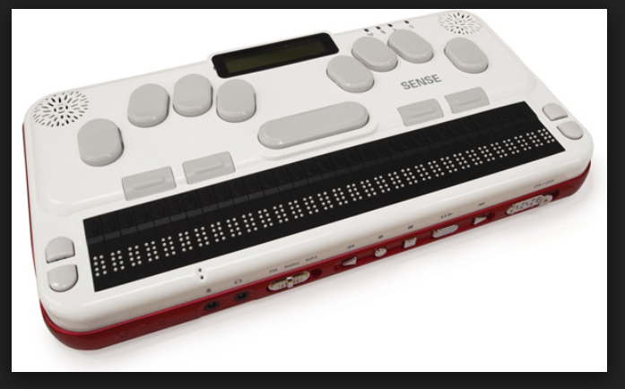
Assistive technologies/devices
screen readers
Mac windows linux
Braille keyboard

Slide 4
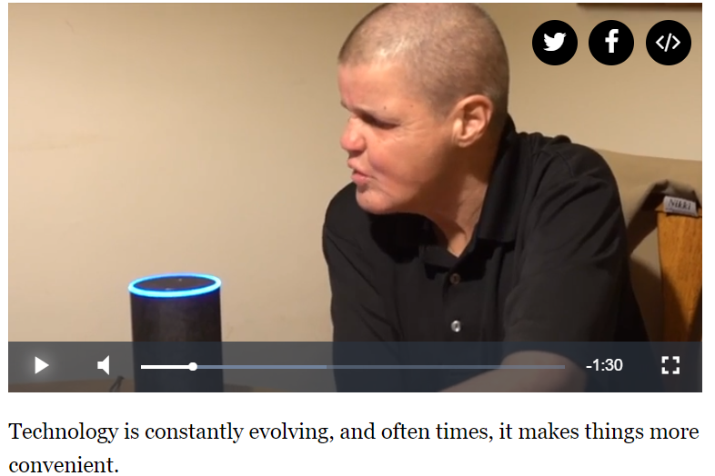
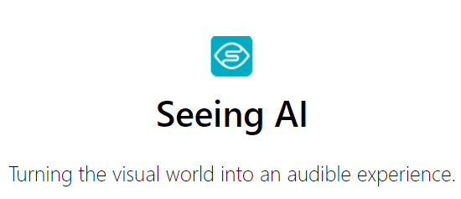

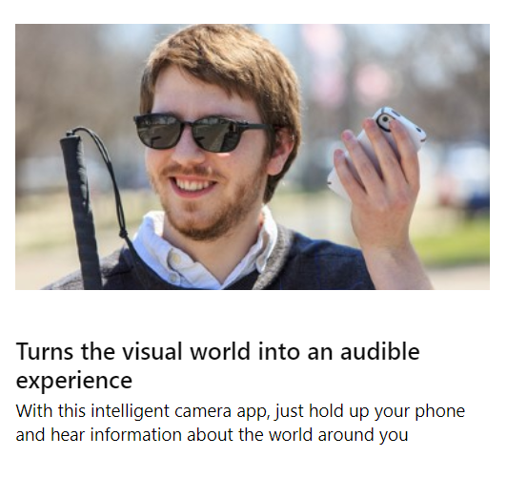
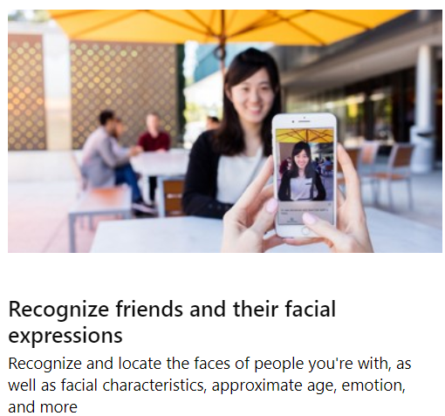
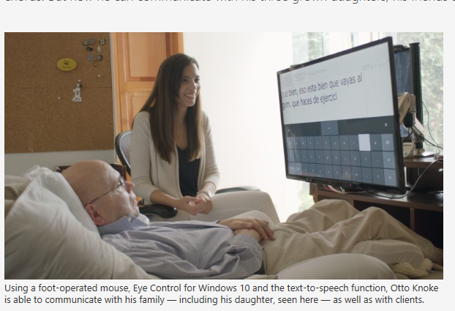
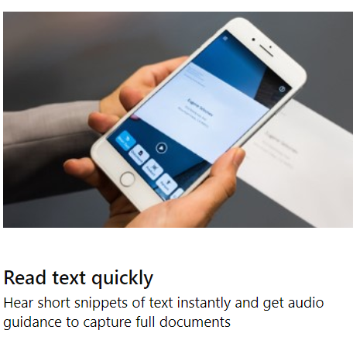
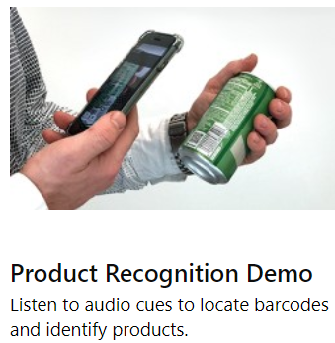
NEWS
https://www.news5cleveland.com/news/technology
Dec 5, 2018
Eye Control for Windows 10

Slide 5
AI for accessibility
USER EMPOWERMENT
USER INDEPENDENCE
BUSINESS CASE

Slide 6
Screen reader demo Kelly willis access technology specialist (Cincinnati Association for the Blind and Visually Impaired)

Slide 7
How do we improve user experience ?

Slide 8

Give your product a voice EXPERIENCE

Slide 9
Sample web site demo

Slide 10
Graphical user interface
Constrained – layout controls
Consistent
nested menus

Slide 11
VOICE user interface
Not Constrained
Not Consistent
All options at top level

Slide 12
Use case check list
Does the voice experience cooperate with the user ?
Does the voice experience solve a problem and/or make life easier for the user ?
Does the voice experience provide reason and motivation for the customer to come back ?

Slide 13
DESIGN CONVERSATIONAL interface

Slide 14
Qualities of a good conversational design
User drive conversation
user speak in their own words
Make it easy to use
Personalize interaction
All options at top level

Slide 15
design technique for conversation scripting

Slide 16
Steps in scripting
Script out happy path
Revise it by adding synonyms
Revise it by allowing for context switching
Refine it to Reduce friction

Slide 17
Search and Place Order – Use case
Person
Alexa, open pet shop
Alexa
Welcome to Pet Shop. What’s your name?
Person
Kelly
Alexa
Hi Kelly! Do you want to hear about our special offers or hear about our products and services?
Person
I want to buy dog food
Alexa
Ah! What kind of dog food would you like? We have dry, wet, puppy or Grain Free food available.
Person
Dry dog food
Alexa
Oh there are more than 100 results. Should I narrow it down to a certain brand? We carry Merrick, Wholehearted and True value.
Person
Merrick

Slide 18
Alexa
We have 10 Merrick products. Would you like me to read the results sorted by price or customer rating?
Person
By price
Alexa
Here are the top 2 results
Merrick Real Chicken Dry food comes in 35 pounds bag and costs 25 dollars
Merrick Diet Turkey Dry food comes in 50 pounds bag and costs 50 dollars
Would you like to hear more information on these 2 products? Or make a selection or hear about the other eight results?
Person
Select one
Alexa
Ok I added Merrick Real Chicken item to cart. Do you want to check out or continue to shop?
Person
Check out
Alexa
How do you want to pay? Credit card or pay pal

Slide 19
Person
Credit card
Alexa
Can I have the card number?
Person
1234 5678 1234 5678
Alexa
Expiration Date
Person
Jan 16th 2020
Alexa
Security code
Person
369
Alexa
Your current order includes one 35 pound bag of Merrick Real Chicken Dry food with a total cost of 27 dollars. May I place this order?
Person
Yes
Alexa
Your order has been placed and the confirmation receipt is sent via email. May I help you with something else?
Person
No, Bye

Slide 20
DEMO - conversational interface

Slide 21
build conversational interface
Technology used – amazon ALEXA SKILL KIT & lambda function

Slide 22
terminology
Intent - Objective of the Voice Interaction
Utterance - How the User Phrases a Command
Slots – Required or optional user input

Slide 23




Steps to build dialog
STEP 1 – IDENTIFY INTENT & UTTERANCES
Intent – search intent
STEP 2 - IDENTIFY SLOTS

Slide 24
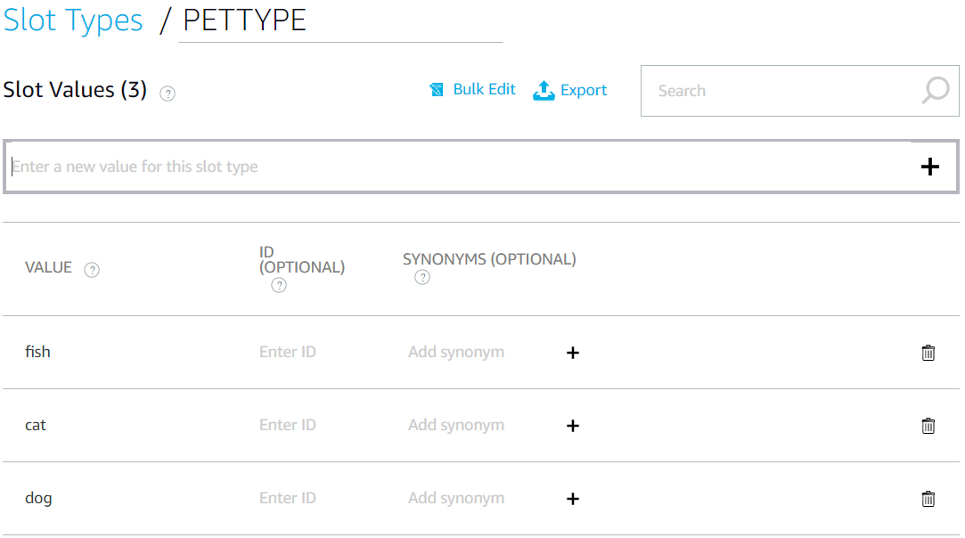
STEP 3 – define custom slot types

Slide 25

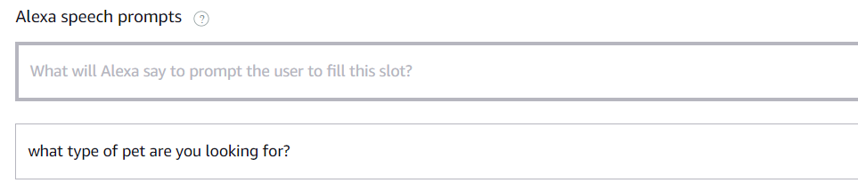
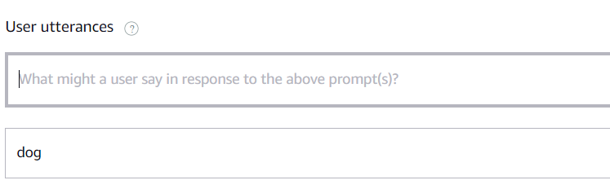
STEP 4 – mark slots required
STEP 5 – PROVIDE PROMPTS FOR EACH SLOT
STEP 6 – provide utterances for each slot

Slide 26
Backend logic
context
** Use session attributes to maintain state **
Dialog management
Context switching
Memory – short and long term
Conditional data collection

Slide 27
Walk through

Slide 28
OTHER VOICE interface OPTIONS
Lex chatbot

Slide 29
resources
Alexa/design/cd
https://github.com/alexa
https://aws.amazon.com/
https://developer.amazon.com/blogs/alexa/post/b0609d07-1e60-44a1-bcd8-cd3eff29f014/new-alexa-skills-training-course-designing-for-conversation
Demo code - https://github.com/sgiri/Alexa

