Slide 1

User Involvement Survey
Ericsson - Initial Results
09.12.2016

Slide 2
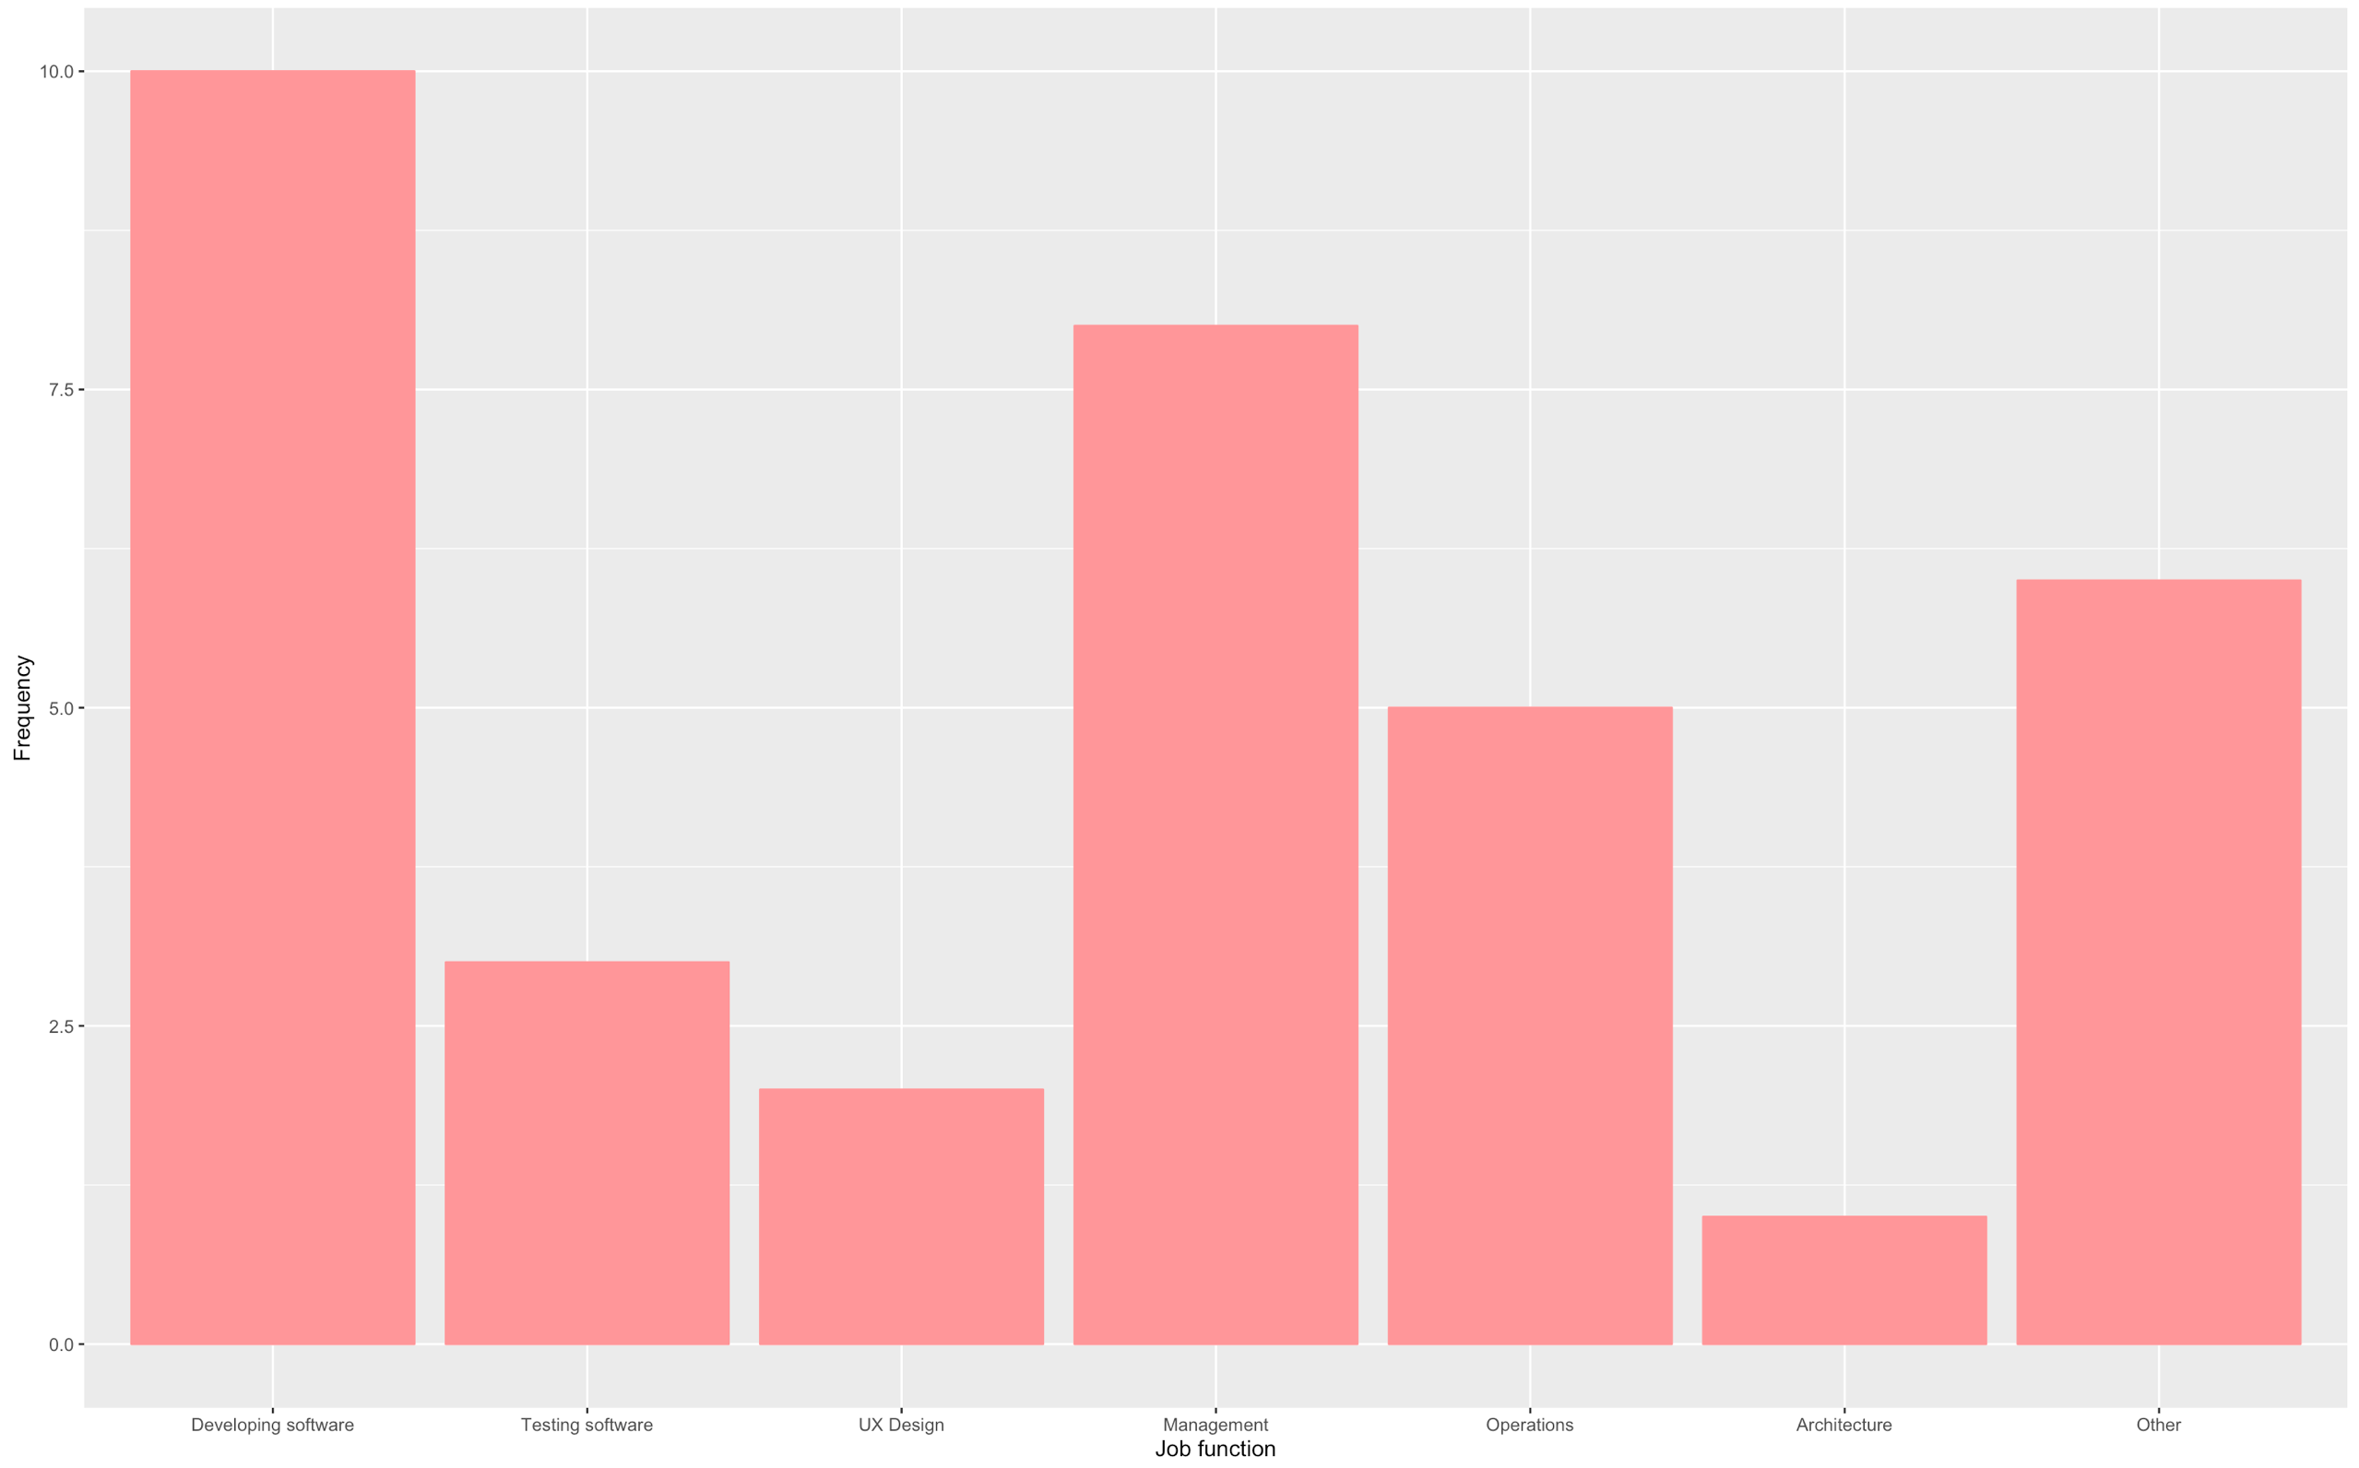

Slide 3
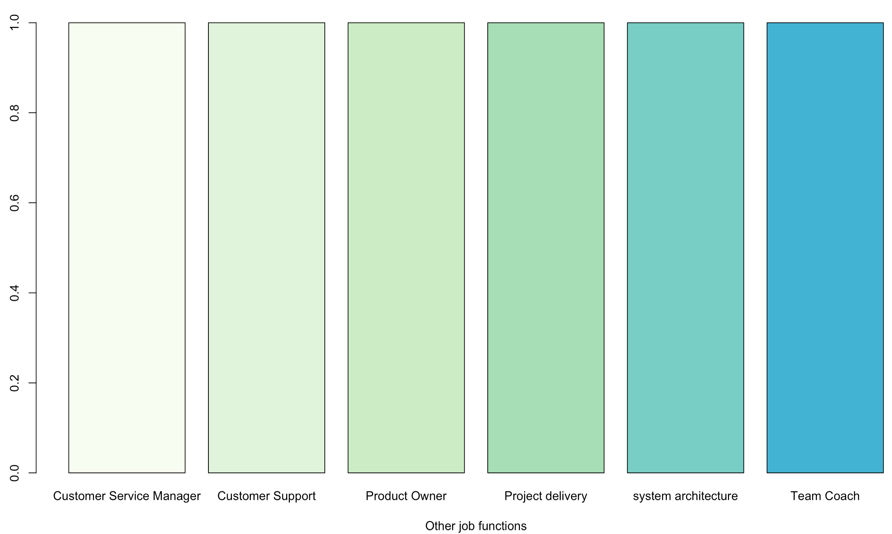

Slide 4
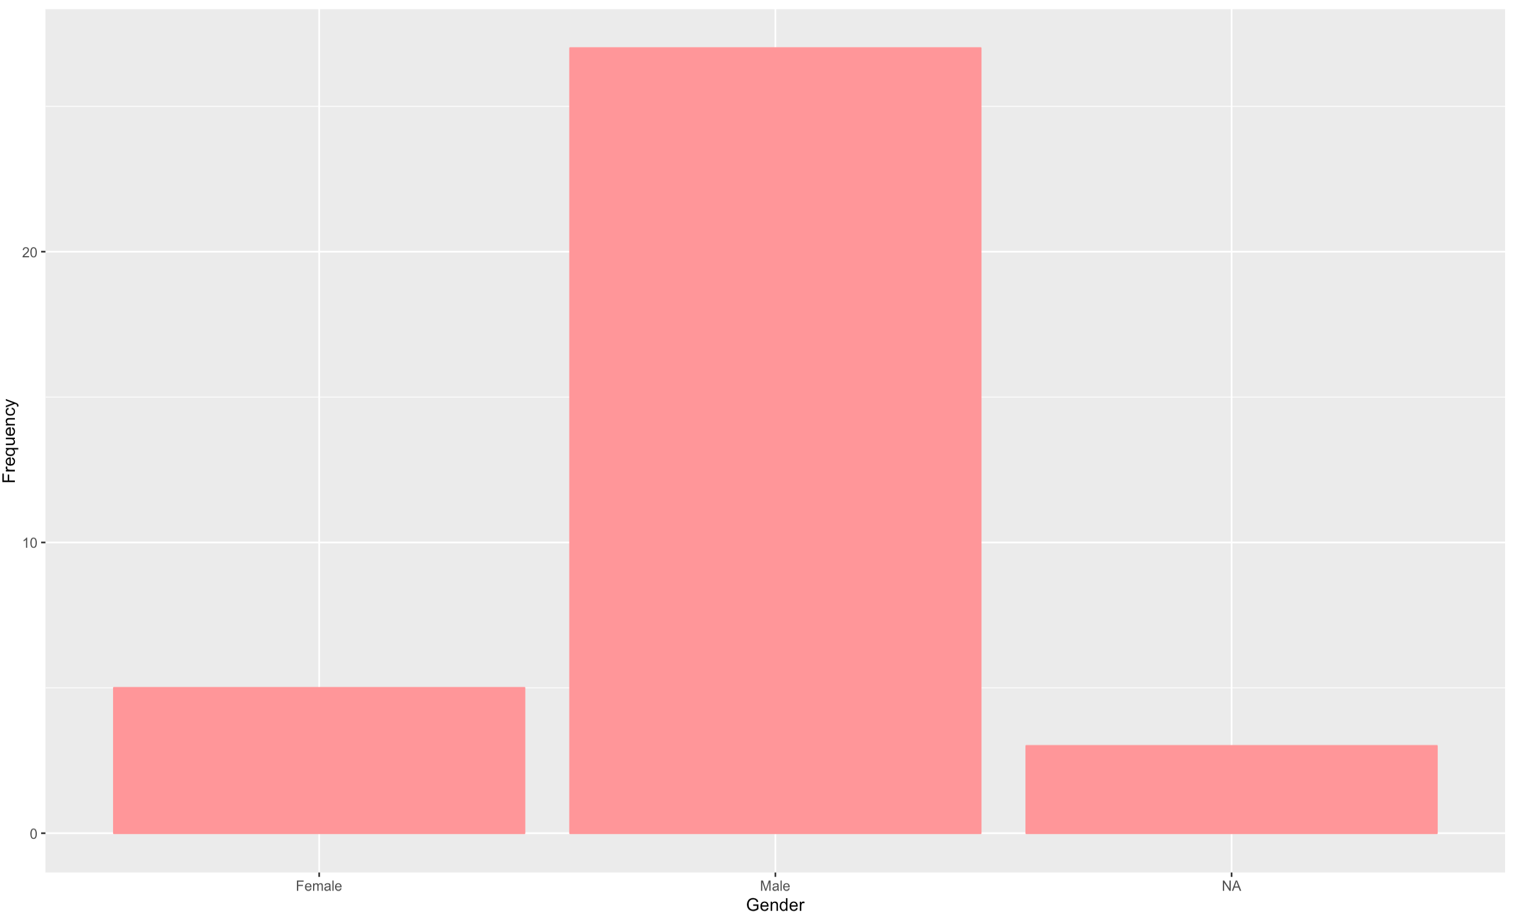

Slide 5
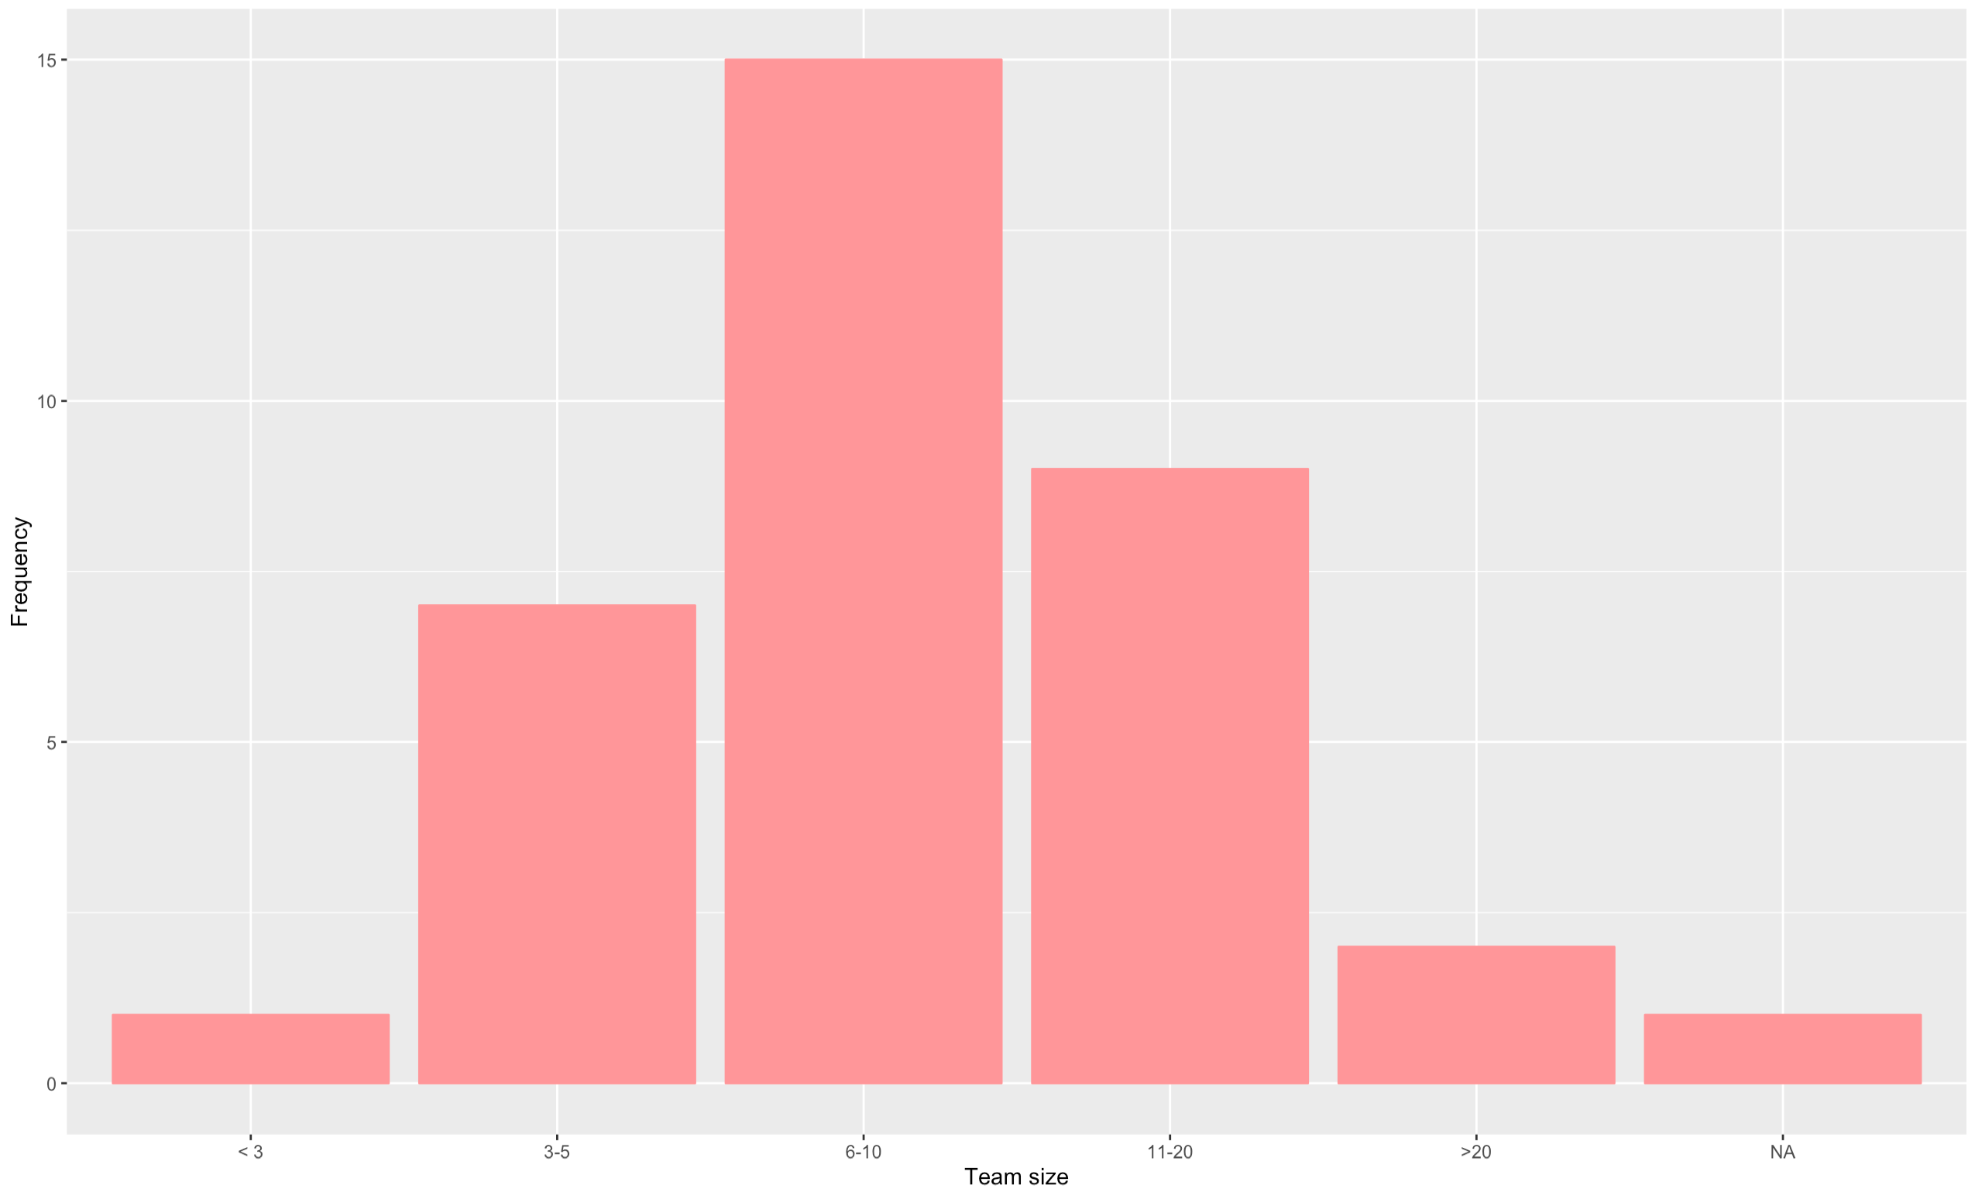

Slide 6
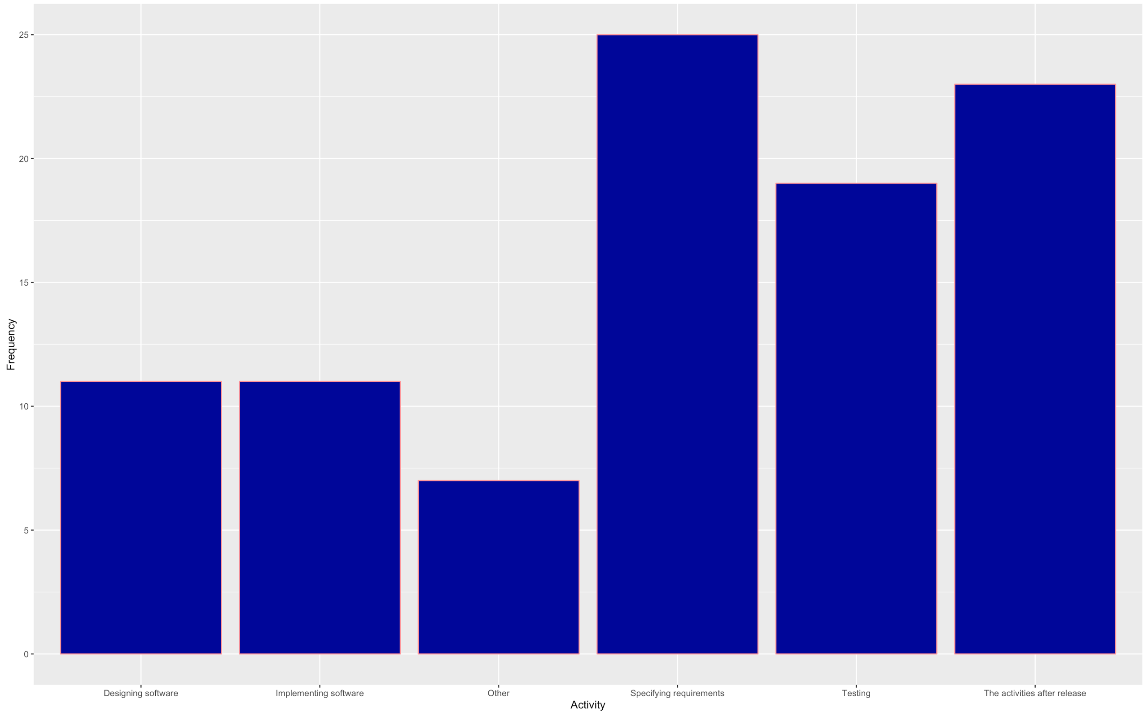

Slide 7
If other, please specify...
“UI design”
“limited testing for end users”
“end-users have little/no contact regarding software dev”
“Bridging UX to Development, Writing User Stories, discussing requirements with architecture, consulting customers, assisting sales in tender workshops”
“Review of on going Development”
“Users do not design or implement the software, but they are involved in test sessions for iteration in several times during development.”
“users input is usually taken from the customer support requests. (for eg. the problems, which are reported by most users)”

Slide 8
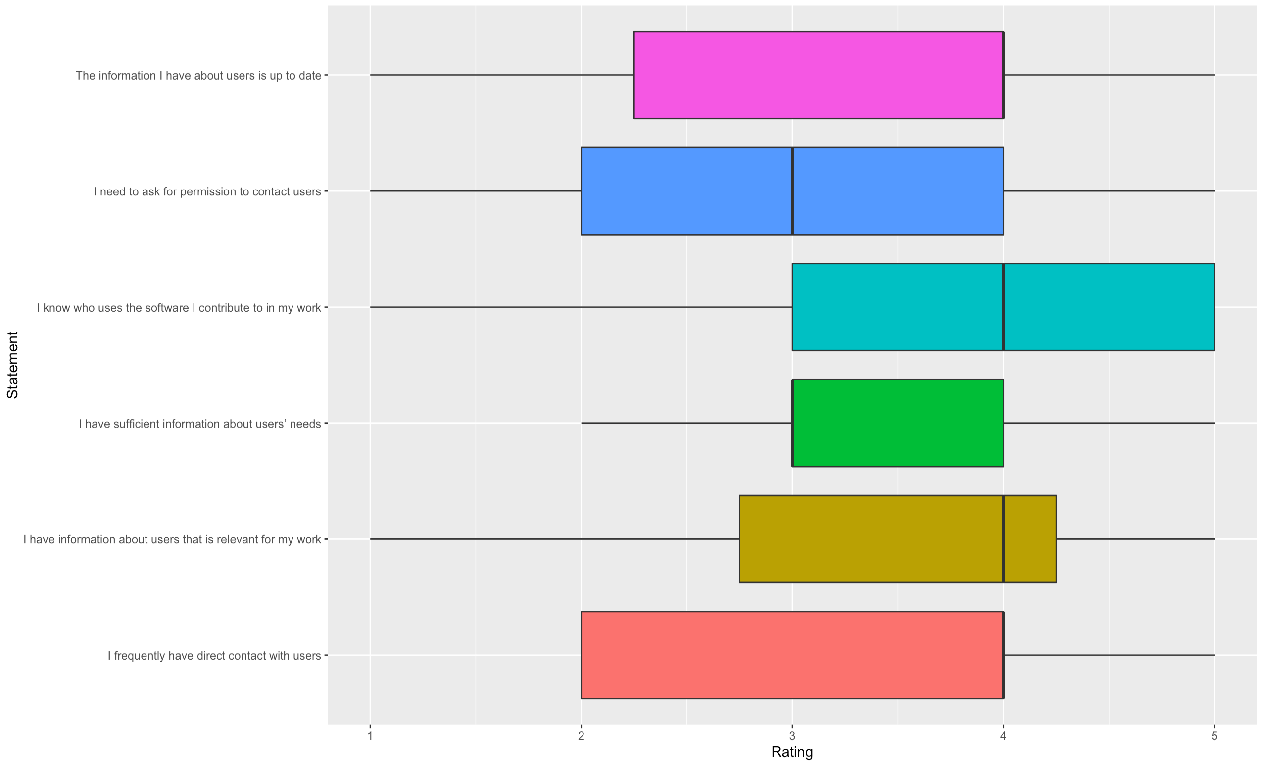
How much do you agree with the following statements?

Slide 9
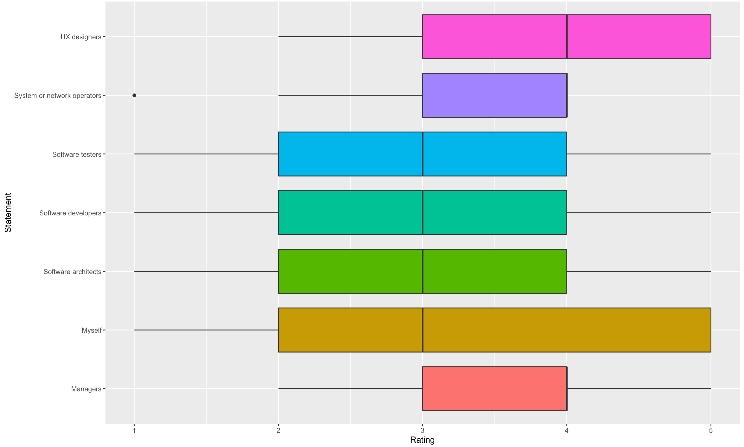
In your experience, how easy is it for the following to get information from users?

Slide 10
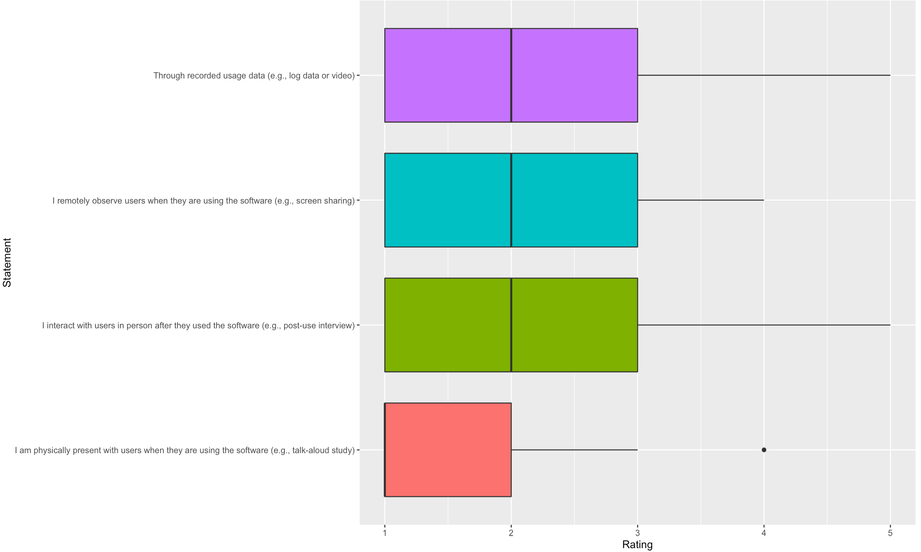
How often do you use the following ways to get information about users?

Slide 11
Try to remember a situation where you knew that involving users in development would be useful, but you could not involve them
The key users who had the answers were on vacation but the development team had deadline for the required feature.
Sometimes the user requirements show the lack of understanding the technical solution. But instead of discussing this with the user and exploring alternatives it is done by the defined requirements. Neither sales nor Key Accounts want to redo this workshops and often experts are involved to late in the process. The resulting solution is often correct by the book but not what the user needed. We could do better if we would spend more time in the exploration phase and don't let the user dictate the solution, but discuss their problems with them and help developing the solution.
I don't develop Portal GUI. So my interest is in the API user. The API user is probably a developer in an enterprise. We had some contact with the enterprise "Springworks" but we were discouraged by the program management from taking direct contact to better understand the needs. The program management were concerned that we might "promise" features or raise expectations that is not in the scope of the contract. We have had other occasional contact with enterprises, even here the concern about not increasing the scope hinders true understanding of the user needs.
none
I'm not sure what 'user' is but if we are considering user=end customer/operator user I would say they are not involved in development more than giving input for requirements.

Slide 12
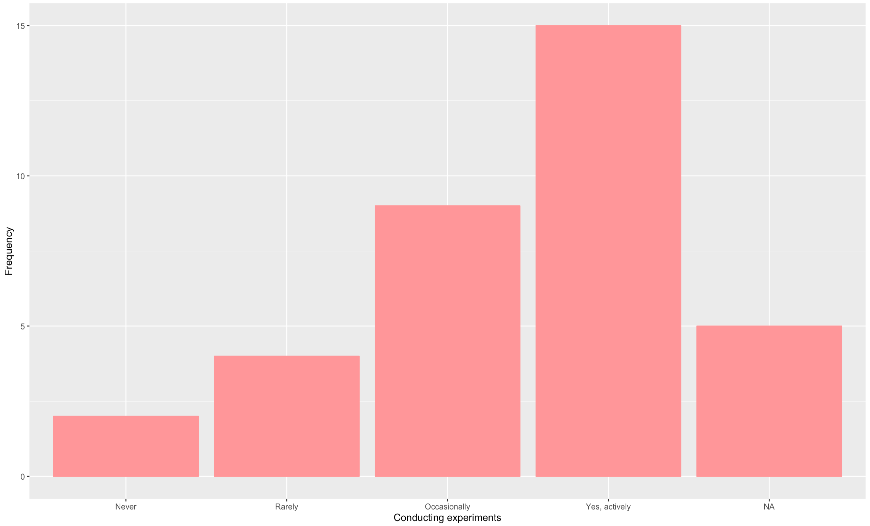

Slide 13
Please describe a typical experiment you have seen or been involved in in your company, including the roles.
1. UX team proves (or disproves) workflow hypotheses with the mock-ups. 2. First experimentations are done with BDD stories. We have a hypotheses (User Story and Scenarios) and we verify those against customer expectations with selected customers. This is usually done by Domain owner or Product owner or UX team or development team depending of the state of the work.
Review of requirements ; Review of on going development ; Review of ergonomy
We test a hypothesis with users, then we update the hypothesis based on the feedback and learning. We try to keep the development teams involved during the iteration rounds. Also we test the iterations that are in test environments. Unfortunately not all feedback is heard = means that no enhancements done necessary.
Usability tests of new functionalities
There are many UX tests, customer surveys and Key Account meetings.
Portal 2.0 presented, RT Analytics experiement with customer
Mock-Up portals, shadowing sessions with end user, remote shadowing.
User is given a task to complete and his or hers operations are then followed
While there is no Notes section in this survey, I will state here that I do not see how this can be entirely relevant to the current situation.
The UX team arrange frequent "Observe" workshops where new use cases are walked through with different customers

Slide 14
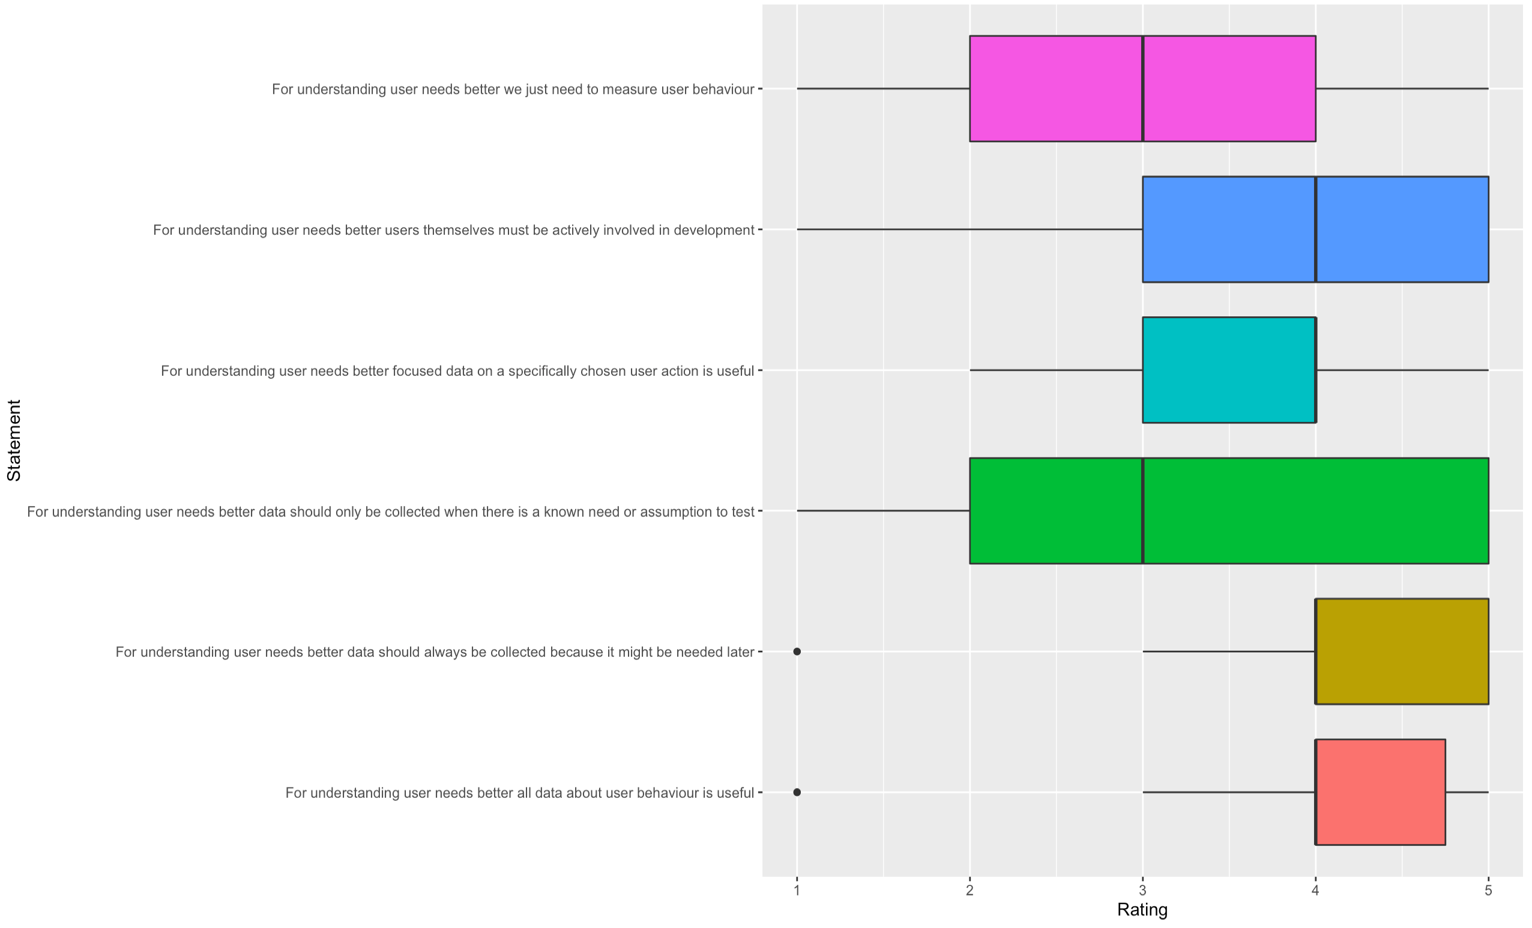
How much do you agree with each statement?

Slide 15
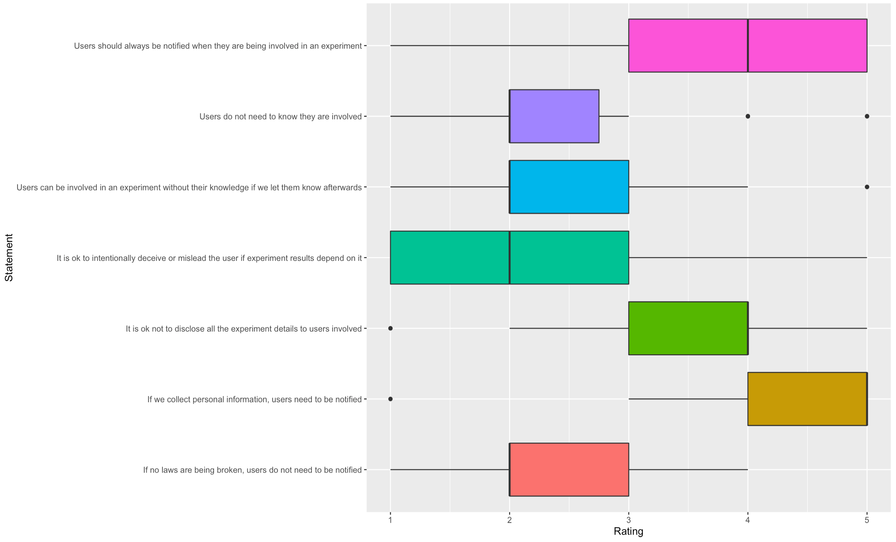
How much do you agree with the following statements regarding notifying users about experiments?

Slide 16
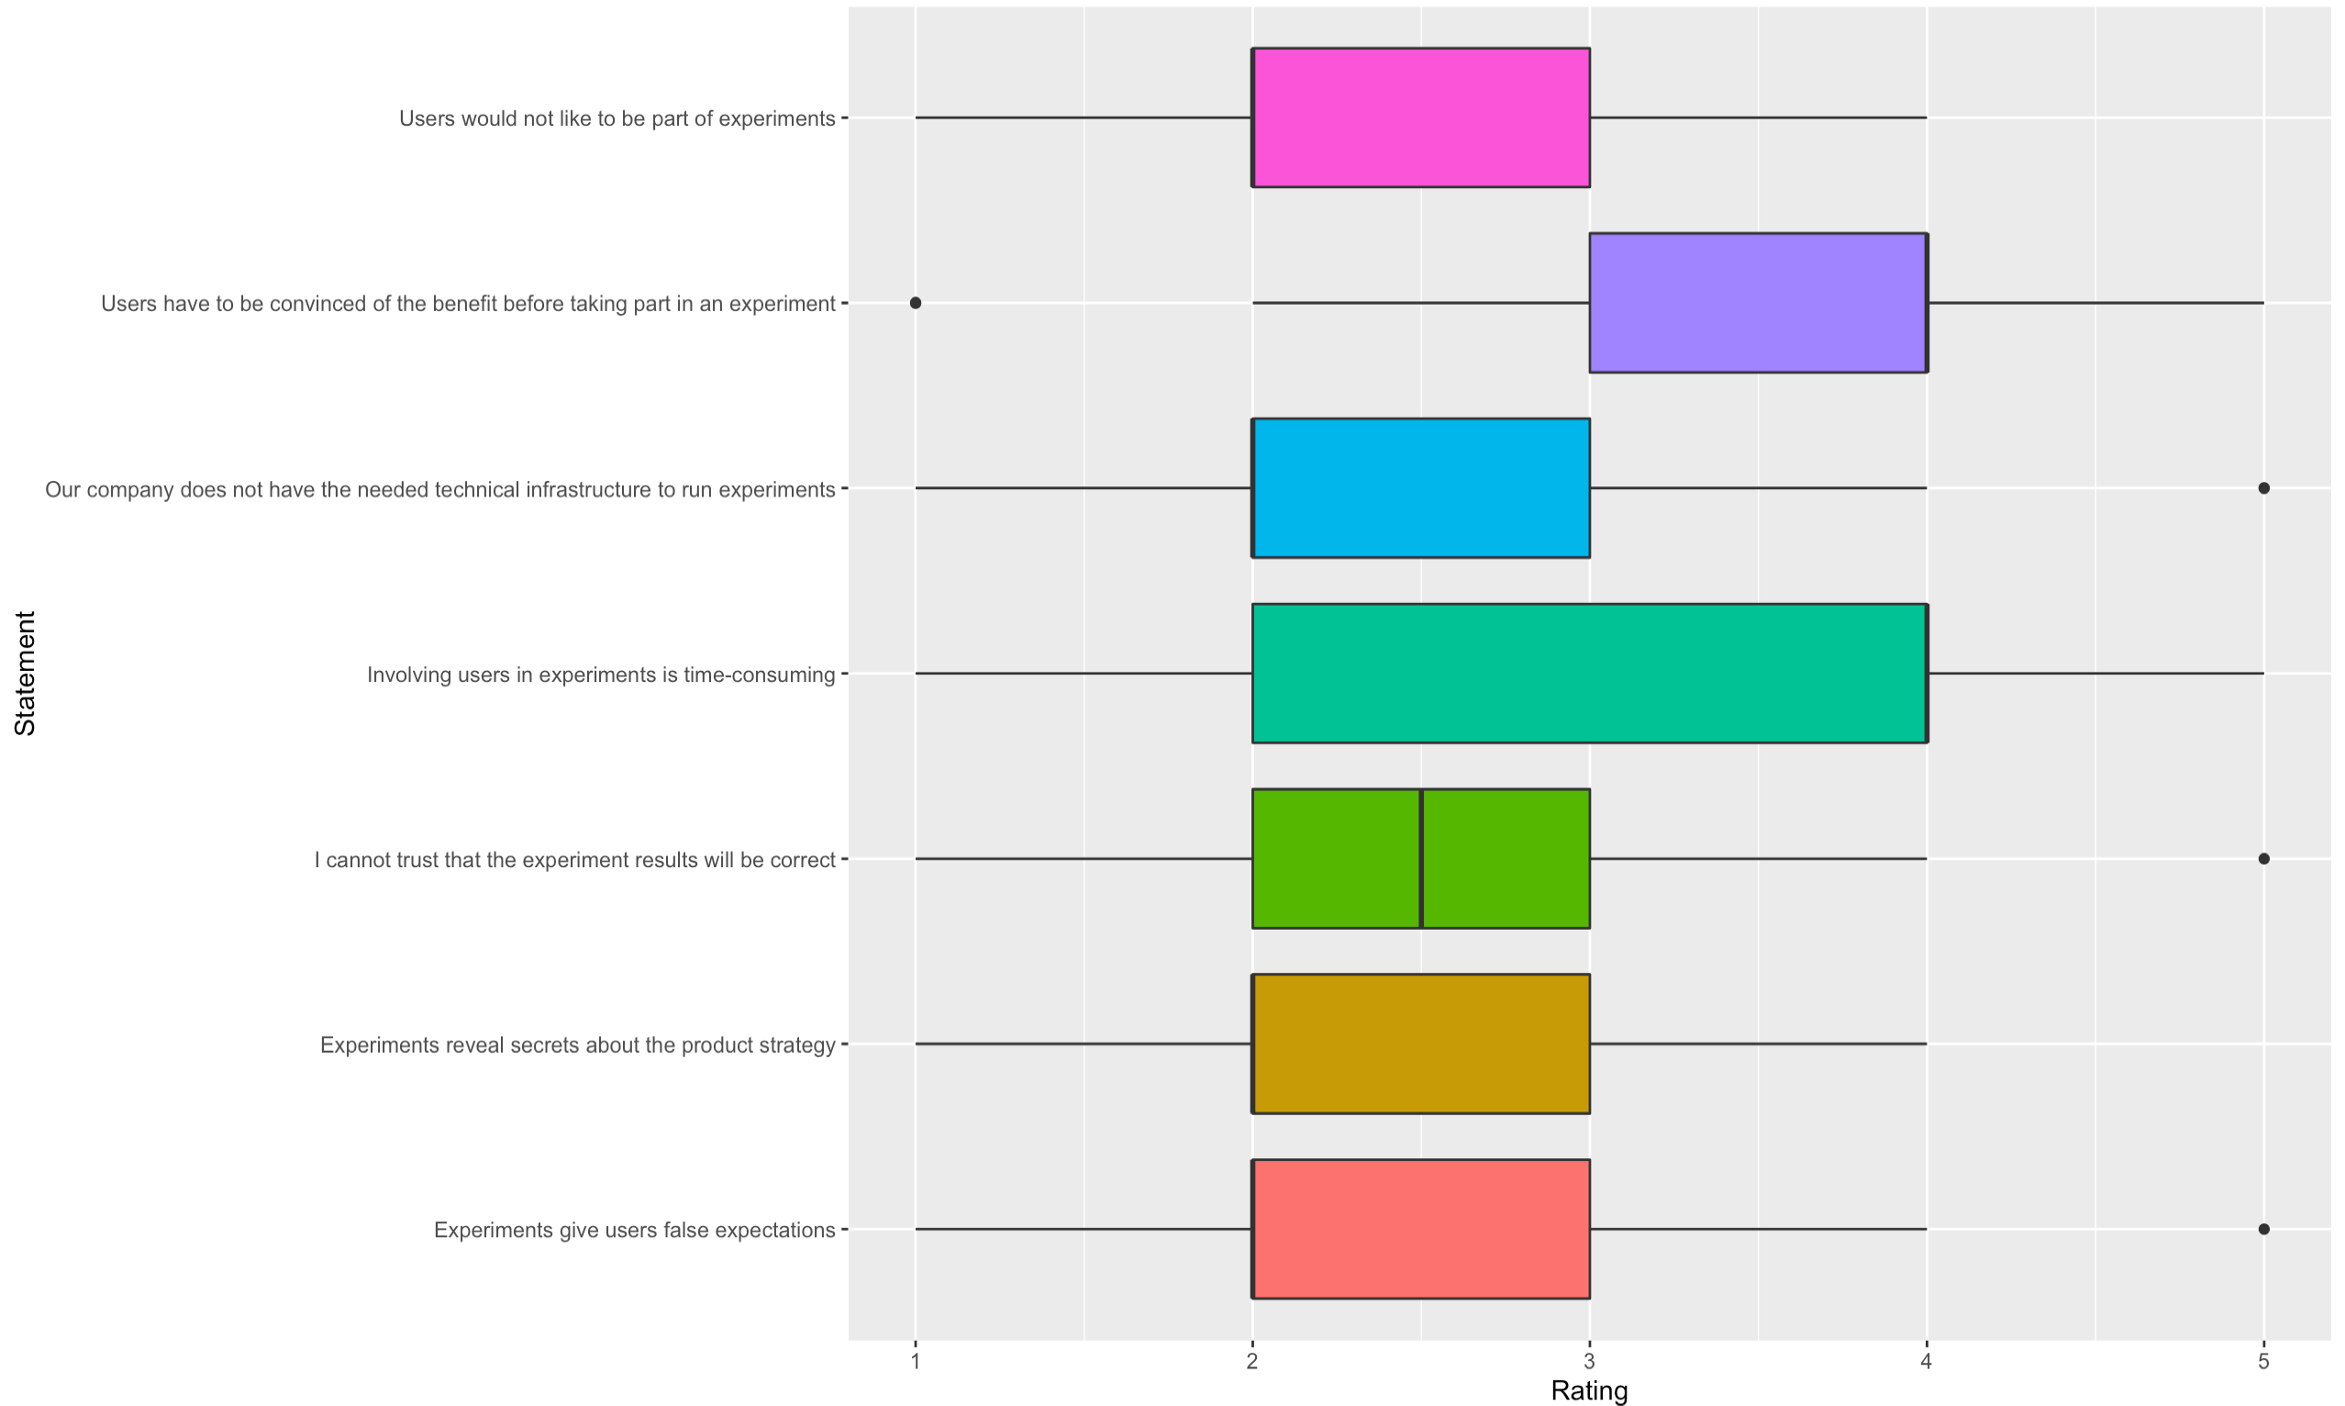
How much do you agree with the following statements about involving users in experiments?

