Slide 1
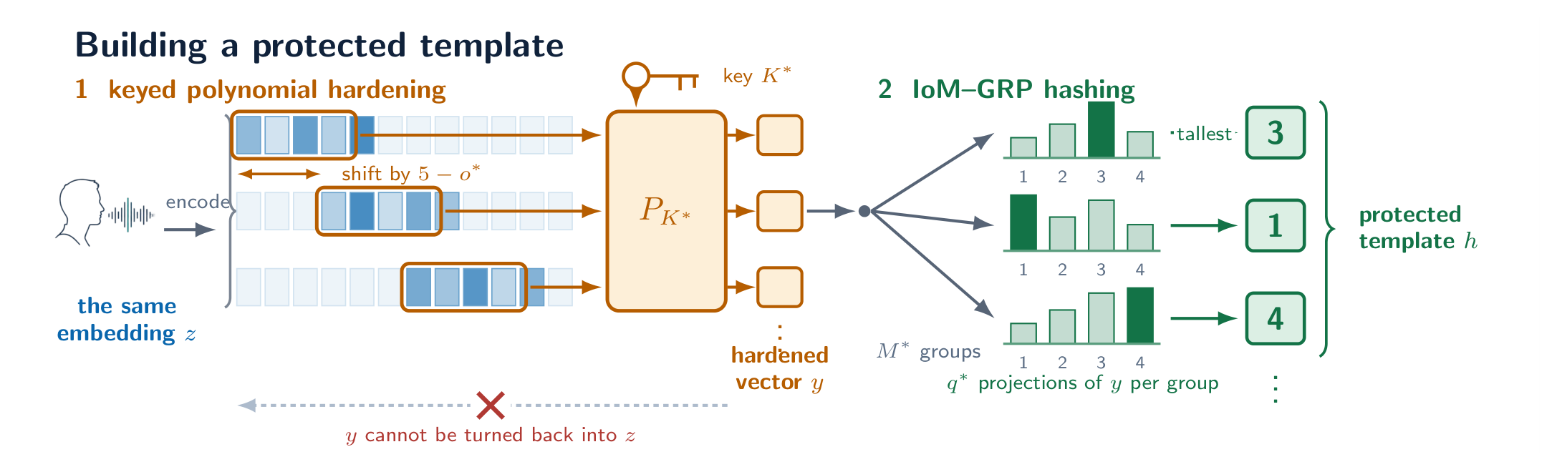
Keyed compression is what makes an IoM-based cancelable biometric revocable
AttackAware PolyIoM v1.1.4 · protocol 1.1.1
A pre-registered evaluation on face and voice
Notes:
A biometric template cannot be changed. If it is stolen, the person cannot be issued a new face or a new voice. Cancelable biometrics address this by storing a transformed template that depends on a key, so that a compromised template can be replaced by issuing a new key. A scheme of this kind must satisfy four requirements at once: it must still recognise people, it must not be reversible to the original biometric, templates from different databases must not be linkable, and a stolen template must be replaceable.
We build and evaluate a scheme that applies a keyed polynomial transform to a face or speaker embedding before Index-of-Maximum (IoM) hashing, and we report all four requirements at a single sealed operating point under one pre-registered protocol. Identities are split once into background, development and evaluation sets. The key and the operating point are chosen on development identities and then sealed. The evaluation identities and an external corpus are read only afterwards, and every later analysis runs at the sealed operating point without refitting it.
The sealed voice system reaches 1.93% equal error rate [1.09, 2.92] with a 93.97% true accept rate at a 0.185% false match rate on 58 unseen speakers, and 2.80% [1.99, 3.81] on 110 external VCTK speakers the configuration had never been exposed to.

Slide 2
Abstract
ABSTRACT
01
The scheme
02
Recognition and unlinkability
A keyed polynomial transform of a face or speaker embedding, then Index-of-Maximum hashing. All four requirements at one sealed operating point, under one pre-registered protocol.
Voice 1.93% EER [1.09, 2.92] on 58 unseen speakers; 2.80% on 110 external speakers, with no supported drop. D_{sys} 0.088 held-out, 0.080 external.
03
Cost and concealment
04
Revocability
Protection costs 1.84 pp of EER on held-out voice and 2.79 pp externally, both firm. A full-knowledge attacker recovers the embedding at cosine 0.222, against 0.913 without the polynomial.
IoM hashing on a raw embedding is not revocable: old templates are still accepted in 80 of 80 fresh key sets. Keyed compression removes this; polynomial versus linear map is a trade.
Notes:
A biometric template cannot be changed. If it is stolen, the person cannot be issued a new face or a new voice. Cancelable biometrics address this by storing a transformed template that depends on a key, so that a compromised template can be replaced by issuing a new key. A scheme of this kind must satisfy four requirements at once: it must still recognise people, it must not be reversible to the original biometric, templates from different databases must not be linkable, and a stolen template must be replaceable.
We build and evaluate a scheme that applies a keyed polynomial transform to a face or speaker embedding before Index-of-Maximum (IoM) hashing, and we report all four requirements at a single sealed operating point under one pre-registered protocol. Identities are split once into background, development and evaluation sets. The key and the operating point are chosen on development identities and then sealed. The evaluation identities and an external corpus are read only afterwards, and every later analysis runs at the sealed operating point without refitting it.
The sealed voice system reaches 1.93% equal error rate [1.09, 2.92] with a 93.97% true accept rate at a 0.185% false match rate on 58 unseen speakers, and 2.80% [1.99, 3.81] on 110 external VCTK speakers the configuration had never been exposed to.

Slide 3
The problem
1.1
Passwords can be changed. Biometrics cannot.
Recognition performance
01
Protected templates still tell people apart about as well as unprotected ones.
Irreversibility
02
Cancelable biometrics store a keyed transform of the template. If it is stolen, issue a new key, re-enrol, and the old template should stop working.
A stolen template does not give back the underlying biometric.
Unlinkability
03
Templates of one person under two keys cannot be tied together.
The first three can be measured on one template at one moment. The fourth needs a second enrolment under a fresh key, and is rarely measured.
Revocability
04
A compromised template is replaced, and the old one stops working.
Notes:
Passwords can be changed. Biometrics cannot. If a database of face embeddings is stolen, the people in it cannot be issued new faces. This is the central difficulty in deploying biometric recognition at scale, and it is why template protection is required by the standard for biometric information protection .
Cancelable biometrics are one response. Instead of storing the biometric feature vector, the system stores a transformed version of it, and the transform depends on a key. If the stored template is compromised, the operator issues a new key, the subject re-enrols, and the old template is meant to stop working. The biometric itself never has to change.
A scheme of this kind has to satisfy four properties at once :
1. Recognition performance. Protected templates must still tell people apart about as well as unprotected ones. 2. Irreversibility. An attacker who obtains a stored template must not be able to recover the underlying biometric. 3. Unlinkability. Templates of the same person held in two databases, protected with different keys, must not be identifiable as belonging to the same person. 4. Revocability. A compromised template must be replaceable, and the old one must stop working.
The first three can be measured on a single template at a single moment. The fourth cannot.

Slide 4
The scheme, and what this paper asks
1.2 – 1.3
Embedding z
Keyed polynomial P_{K*}
IoM-GRP under key R
Template: argmax index per group
Is IoM hashing on a raw embedding revocable?
01
No. The attack recovers the embedding itself (cosine 0.913), which depends on no key: every old template survived re-keying, 80 of 80 key sets.
What makes it revocable?
02
Keyed compression before the hash. The attack then finds only a vector that collides under the old key. The polynomial and a keyed linear map both work.
What does the polynomial itself buy?
03
Concealment of the biometric: cosine 0.222 against 0.490 for a linear map and 0.120 at chance. It costs 1.23 pp of voice EER.
Notes:
Three questions, in order. Each is answered with a measured mechanism, not only with a number.
Is IoM hashing on a raw embedding revocable? It is not. Under an adversary who holds the key, the projection, the algorithm and the stored template, the attack recovers the embedding itself (cosine 0.913 to the truth on voice). An embedding does not depend on any key, so re-keying changes nothing: the adversary re-enrols through the new key and is accepted. Across forty fresh key sets on each of two modalities, every old template remained a working credential. A stolen template is permanent.
What makes it revocable? Keyed compression of the embedding before the hash. With it, the attack finds only a vector that collides *under the old key*, not the embedding, and that vector is worthless under a new one. This holds for the polynomial and equally for a keyed random linear projection of the same output size. The third arm exists to isolate this: it separates "compression under a key" from "this particular polynomial", and shows the credit belongs to the former.
What does the polynomial itself buy? Concealment of the biometric. A linear map is pseudo-invertible: an adversary who holds it recovers the component of the embedding in its row space, cosine 0.49.

Slide 5
Contributions and summary of findings
1.4 – 1.5
Contributions
What the sealed system achieves
01
An ablation that isolates the polynomial, with a linear-map arm of equal output size
1.93%
0.088
02
An inversion attack under a full-knowledge adversary, applied identically to all three arms
voice EER on 58 unseen speakers
D_{sys} held-out; 0 is fully unlinkable
03
A revocation test: does an old template still get in after re-keying?
04
All four criteria reported against the unprotected baseline
0.222
80 / 80
05
A separation of what each keyed stage does, with the mechanism behind each
06
A worked pre-registered protocol that keeps confirmatory and exploratory apart
cosine of the recovered embedding; chance 0.120
raw-IoM key sets in which old templates survive re-keying
Notes:
1. An ablation that isolates the polynomial. We compare the complete scheme against IoM hashing applied directly to the embedding, and against IoM hashing applied to a random linear projection of the same output size. The third arm is necessary because the polynomial also reduces dimensionality; without it, the effect of the polynomial cannot be separated from the effect of the size reduction.
2. An inversion evaluation under a full-knowledge adversary. The adversary holds the key, the projection, the algorithm and the stored template. The same attack, at the same budget, is applied to all three arms, because a scheme can always be made to look secure by attacking it weakly.
3. A revocation test. We ask whether a reconstruction built from an old template is still accepted after the subject re-enrols under completely new keys. To our knowledge this is not routinely measured, and we find it is the property that separates the designs.
4. All four criteria reported against an unprotected baseline. Most studies of this kind report recognition accuracy for the protected system alone. We measure plain cosine matching on the identical enrolment and probe sets, so the cost of protection is stated rather than assumed, and we report it separately for each split.
5. A separation of what the two keyed stages do, with the mechanism behind each.

Slide 6
Background and related work
2
2.1
2.2
2.3
Cancelable biometrics
Index-of-Maximum hashing
How schemes are usually evaluated
Store a revocable transform, not the biometric. Random-projection schemes such as BioHashing are the best known; with a stolen key the linear map can be undone.
Project many times; keep only which projection was largest in each group. No magnitudes are stored, many inputs map to one code, and the score is a count of equal indices.
Three habits weaken the conclusions: a threshold chosen on the reported data; no ablation of multi-stage transforms; irreversibility argued rather than measured.
2.4
The gap
This study already avoided the first habit: the operating point was sealed on development identities. It supplies the missing ablation and attack, and adds a revocation analysis we have not seen reported.
Notes:
The typical evaluation reports equal error rate before and after protection, a measure of unlinkability, and sometimes a reconstruction experiment. The most widely used unlinkability measure is the framework of Gómez-Barrero and colleagues, which compares the score distribution of mated pairs, meaning two protected templates of the same person under different keys, against the distribution of non-mated pairs . It summarises the comparison as a single number, often written D_sys, where lower values indicate better unlinkability.
Three habits are common in this literature and all three weaken the conclusions.
First, the decision threshold is frequently chosen on the same data on which results are reported. This makes the reported error rates optimistic by an unknown amount.
Second, ablations are rare. Many published schemes combine two or three transformation stages and report the performance of the combination without showing what each stage contributes. A combination that performs well is taken as evidence that each part is useful.
Third, irreversibility is often argued from the structure of the transform rather than measured. When a reconstruction attack is run, it is usually run only against the proposed scheme and not against the baselines, which makes the comparison uninformative: a weak attack makes any scheme look secure.

Slide 7
Overview and frozen encoders
3.1 – 3.2
Architecture
Face
E
N
C
O
D
E
R
S
Voice
Architecture
01
01
Inception-ResNet-v1 (FaceNet), facenet-pytorch 2.6.0
ECAPA-TDNN, SpeechBrain 1.1.1
Weights
Weights
02
02
Pretrained on VGGFace2; not fine-tuned
VoxCeleb; revision 3d2520d6a433 pinned, checkpoints hashed
Front end
Front end
03
03
MTCNN detect and align, 160 × 160; no-face images excluded
16 kHz mono; VCTK resampled from 48 kHz
Output
Output
04
04
512-d embedding, L2-normalised
192-d embedding; not fine-tuned
Notes:
For face we use the FaceNet architecture as released in facenet-pytorch : Inception-ResNet-v1 pretrained on VGGFace2 , producing a 512-dimensional embedding. Faces are detected and aligned with MTCNN from the same package, resized to 160 x 160, prewhitened by the package's convention, and L2-normalised. Images in which no face is detected are excluded rather than padded; this gate is what reduces the 13,233 images of LFW to the 7,581 valid embeddings we start from.
For voice we use ECAPA-TDNN as released by SpeechBrain , trained on VoxCeleb , producing a 192-dimensional embedding from 16 kHz mono audio. The checkpoint is pinned to a single repository revision and its weight files are recorded by hash (Section 4.6), so a rerun cannot silently pick up a newer release.
Neither network is fine-tuned at any point. This is deliberate. It means the recognition performance we start from is that of the published model, and any loss we report is attributable to the protection scheme rather than to training choices. It also means the face baseline is whatever this particular released model achieves on LFW, which Section 5.2 shows is the binding constraint on the face arm.
We write the embedding of sample x_m in modality m as z_m = f_m(x_m).

Slide 8
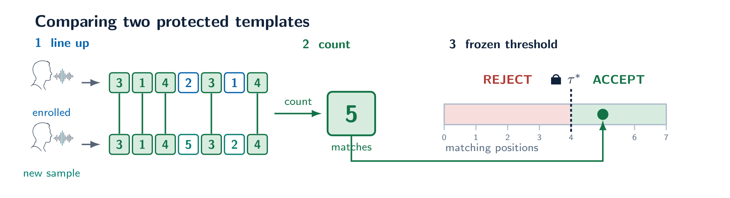
Hardening, IoM-GRP and matching
3.3 – 3.5
3.3
Hardening
Keyed polynomial over overlapping windows of G = 5, shift G − o. Voice d = 192 → k = 48.
3.4
IoM-GRP
M groups × q projections under key R; only the argmax index of each group is stored.
3.5
Matching
Score = number of groups with equal index; accept if the score reaches τ*.
Notes:
The embedding is not transformed as a whole. Instead, a polynomial is applied to overlapping windows of five consecutive components. Consecutive windows advance by 5 - o^{*} positions, so neighbouring windows share o* components. The overlap o* is a design parameter.
Each window produces a single output value. For a window of values v_1, \dots, v_5, the output is \sum_{i} c_i v_i^{e_i}, where the coefficients c_i and the integer exponents e_i are the application key K*. Collecting the outputs of all windows gives the hardened vector y_m = P_{K^{*}}(z_m; o^{*}).
Two consequences matter later. The transform is non-linear and keyed, which is the intended security property. It also shortens the vector: with window size five and overlap o*, an embedding of length d produces a hardened vector of length k = 1 + \lceil (d - 5)/(5 - o^{*}) \rceil. At the sealed overlap of one, face goes from 512 to 128 and voice from 192 to 48. This second consequence is not part of the intended design, but it turns out to matter more than the first.

Slide 9
Selecting the key, then the operating point
3.6 – 3.7
A
Stage A: the polynomial key
B
Stage B: the operating point
Data 50 background identities only
Candidates 10,000 to 20,000 keys, generated deterministically
Score inversion stress test, 5 restarts × 2,000 Adam iterations, lr 0.01
Gate recognition is pass-or-fail; the best survivor is sealed as K*
Data 42 development identities
Grid M ∈ {32, 64, 128, 256}, q ∈ {4, 8, 16, 32}, o ∈ {0…4}: 80 configurations
Rule lowest D_{sys} among configurations meeting the recognition floor
Threshold τ* at the development EER point; sealed
The Stage A stress test selects keys; it is not the evaluation. No part of the pre-registered study measured the selected key's inversion resistance in the deployed configuration. Section 5.5 does.
!
Notes:
The polynomial key is selected on the fifty background identities only. Between ten and twenty thousand candidate keys are generated deterministically. Each is scored by an inversion stress test, and keys that fail a recognition gate are discarded. The best surviving key is selected and frozen as K*.
Two features of this procedure are important for interpreting our results. The selection objective is inversion resistance; recognition enters only as a pass-or-fail gate. And the stress test is applied to candidate keys on background identities, not to the final system on evaluation identities. No part of the pre-registered study measured how well the selected key resists inversion in the deployed configuration.

Slide 10
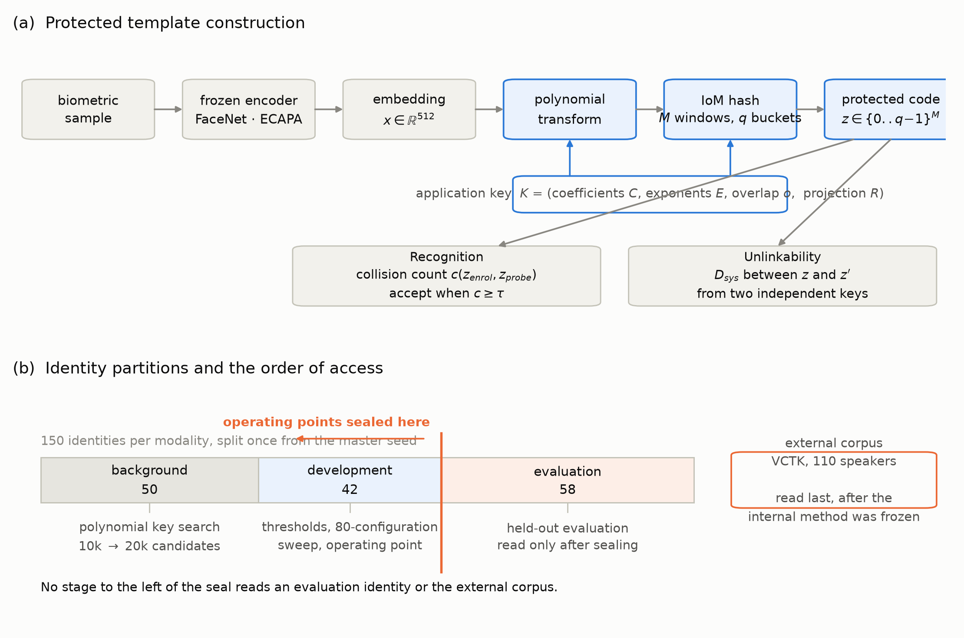
Identities, partitions and sealing
4.1 · 4.4
50
42
background: key search only
development: operating point
58
110
evaluation: read after sealing
external VCTK speakers, read last
Split once master seed 2026, protocol 1.1.1
Seal key, configuration and threshold are written to a sealed record; nothing downstream may change them
Check every later analysis records that it changed no seal
Notes:
The selected key, configuration and threshold are written once and are read-only thereafter. Every analysis reported in Section 5 verifies that it reproduces the sealed results before reporting anything new. In the ablation and attack analyses, the arm corresponding to the complete scheme rebuilds the sealed pipeline exactly — same key, same projection tensors, same seeds — and its equal error rate must match the sealed held-out figure to floating-point precision. If it does not, the analysis stops rather than reporting numbers.

Slide 11
Metrics and confidence intervals
4.2 – 4.3
EER
TAR and FMR
D_{sys}
Bootstrap
Error rate where false match and false non-match are equal; threshold-free.
Rates at the sealed threshold τ*, carried unchanged from development.
Global linkability of templates under two keys; 0 is fully unlinkable.
95% percentile 2,000 replicates
Identities are resampled, not comparisons, so a subject is never compared with itself
Paired one resampling serves every arm in a replicate
Two-level for revocation, keys are resampled as well as identities
SAR
PRAR
Firm
Share of templates for which the inversion attack produces an accepted input.
Share of subjects whose old template's reconstruction is accepted after re-keying.
A difference whose 95% interval excludes zero. Otherwise: not distinguishable.
Notes:
All intervals are 95% percentile bootstrap intervals over 2000 replicates, resampling identities, not individual comparisons. This matters. If comparisons were resampled directly, a subject could be compared against themselves, and the intervals would be too narrow. Each identity receives a multinomial weight; genuine comparisons take the weight of their subject and impostor comparisons take the product of the weights of the two subjects involved.
Where two systems are compared, the bootstrap is paired: one resampling is applied to both arms in each replicate, so the interval on the difference accounts for the two arms sharing identities. An unpaired interval would be substantially too wide.
The revocation analysis in Section 5.6 resamples keys as well as identities, for reasons explained there.
We describe a difference as *firm* when its 95% interval excludes zero, and as *not distinguishable* otherwise. We do not describe a non-distinguishable difference as evidence of equivalence.

Slide 12
Implementation, frameworks and provenance
4.6
Component | What it does here | Version / pin
PyTorch | encoder inference, hashing, the attack's gradients | 2.11.0
facenet-pytorch | MTCNN detection and alignment; Inception-ResNet-v1 (VGGFace2) | 2.6.0
SpeechBrain | ECAPA-TDNN speaker encoder | 1.1.1; revision 3d2520d6a433
NumPy · pandas · SciPy | histograms, bootstrap, manifests, resampling | 2.1.3 · 2.2.3
Corpus | Use | What was taken
LFW | face, internal | 13,233 images → 7,581 pass MTCNN → 900 identities with ≥ 3; 100 removed by CFP-W name match
LibriSpeech train-clean-100 | voice, internal | 150 speakers × 15 utterances
VCTK 0.92, mic1 | voice, external | 110 speakers, 1,650 utterances, resampled to 16 kHz
Embeddings on CPU; everything after on one Tesla T4, CUDA 12.8. Hashing pinned to CPU with deterministic algorithms; every draw seeded from master seed 2026.
Notes:
Everything below is recorded in machine-readable form in the reproducibility package (results/environment/), copied from the sealed project's own stage records rather than reconstructed afterwards. The table gives what a reader needs to rebuild the inputs; the hashes are in the package.
Third-party components, used unmodified.
Corpora.
From the 900 eligible face identities, and from the 150 selected speakers, the partition is 50 background, 42 development, 58 evaluation, drawn once from master seed 2026 under protocol version 1.1.1.
What we implemented ourselves. The keyed polynomial hardening, IoM-GRP hashing and collision matching (Section 3); the identity-cluster paired percentile bootstrap and the two-level key-and-identity bootstrap (Section 4.3); the global and local unlinkability measures of ; and the annealed-softmax inversion attack (Section 5.5), optimised with Adam . The package ships a NumPy rewrite of the pipeline and a parity check against the PyTorch original: one float32 ulp of difference on the hardened vector, and zero differing template indices out of 32,768.
Two attack budgets, kept distinct.

Slide 13
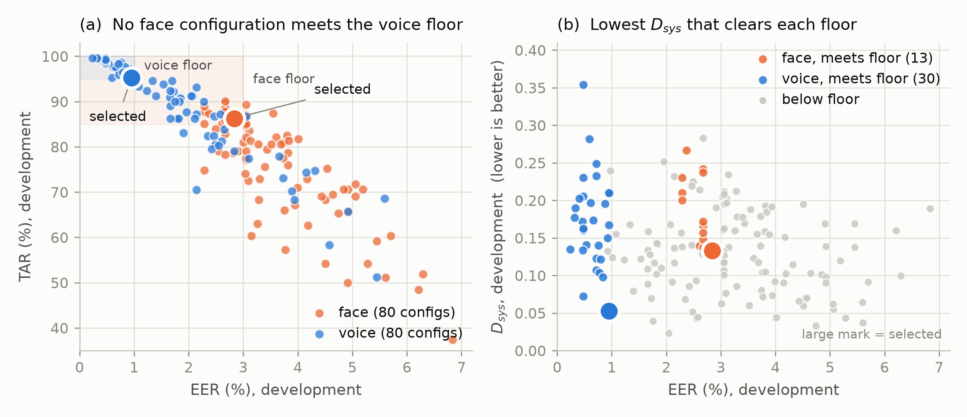
Sealed operating points
5.1 · CONFIRMATORY
 | M* | q* | o* | τ* | EER | TAR | D_{sys} | Eligible
Voice | 128 | 32 | 1 | 37 | 0.952% | 95.238% | 0.052519 | 30 of 80
Face | 256 | 32 | 1 | 68 | 2.839% | 86.260% | 0.133100 | 13 of 80
The face floor was relaxed
No face configuration reaches the voice floor of EER ≤ 1% and TAR ≥ 95%: the best of 80 reaches 2.29% and 90.08%. The floor was relaxed to 3% and 85% and sealed before any evaluation identity was read.
The face encoder's own unprotected EER is 3.475%.
Notes:
The recognition floor used for voice was EER at most 1% and TAR at least 95%. That floor is unattainable for face. Across all eighty face configurations the best achievable EER is 2.29% and the best achievable TAR is 90.08%, so no configuration qualifies. A relaxed face floor of EER at most 3% and TAR at least 85% was therefore fixed, and the deviation and its reason were written into the seal, before any evaluation identity was read. We report the 2.29% and 90.08% figures because they are the evidence that the original floor was impossible rather than merely inconvenient.
We chose 3% and 85% as the tightest floor that still selects from a non-trivial pool. At 3% and 90% exactly one configuration survives, so the selection would have been an artifact of the grid, and that configuration's D_sys of 0.166 is worse in any case.
Figure 3 shows the design space and where the sealed configurations sit within it. Figure 4 shows the trade-off frontier between recognition and unlinkability.

Slide 14
Generalisation to held-out identities
5.2 · CONFIRMATORY
 | EER | TAR at τ* | FMR at τ* | D_{sys}
Voice | 1.928% [1.092, 2.919] | 93.966% [89.655, 97.414] | 0.185% [0.028, 0.480] | 0.0884 [0.0708, 0.2185]
Face | 4.799% [1.945, 10.345] | 82.239% [72.767, 89.933] | 0.041% [0.000, 0.218] | 0.1508 [0.1225, 0.2822]
firm
Voice held-out: +1.84 pp. Baseline below 0.515% at 95%; the protected interval starts at 1.092%.
firm
Voice external: +2.79 pp. Baseline below 0.272%; the protected interval starts at 1.992%.
not resolvable
Face held-out: +1.32 pp. The baseline's own bound, 5.504%, lies inside the protected interval.
No ratio is quoted: the unprotected voice system makes fewer than one genuine error on every split.
Notes:
The sealed configuration and threshold were applied, unchanged, to the 58 evaluation identities. Voice yields 580 genuine and 33,060 impostor comparisons; face yields 259 genuine and 14,763.
The sealed voice system therefore recognises unseen speakers at 1.93% equal error rate and accepts 93.97% of genuine claims while admitting 0.185% of impostor claims, at a threshold that was fixed before these identities were read. Unlinkability at the same operating point is 0.088, on a scale where zero is fully unlinkable.
Voice equal error rate rose from 0.952% on development to 1.928% on held-out identities. The development value lies outside the held-out interval, so this degradation is firm. The system does not meet its own 1% floor on identities it has not seen. This is the expected direction for a threshold and configuration chosen on a different set of people, and the size of the gap is what a reader needs in order to judge the development figures, which is why we report both.
Performance preservation against unprotected matching. Recognition accuracy for a protected system is only interpretable against the unprotected system it replaces. We therefore computed plain cosine matching on the identical enrolment and probe sets, at every split, from the same stored score distributions.

Slide 15
External validation on voice
5.3 · CONFIRMATORY
2.80%
89.00%
EER [1.99, 3.81]
TAR at the sealed τ*
0.080
0.377%
D_{sys}; tighter than held-out
FMR, above the 0.1% target: firm
110 VCTK speakers, 1,100 genuine and 119,900 impostor comparisons. Configuration and threshold sealed on LibriSpeech, applied unchanged. No held-out-to-external difference is supported.
Notes:
The sealed voice system was applied without modification to 110 VCTK speakers.
All four external intervals overlap their held-out counterparts, so no held-out-to-external difference is supported. This is the result the external corpus was read in order to test: a configuration and threshold sealed on LibriSpeech development speakers transfer to 110 VCTK speakers recorded under different conditions, without refitting, at 2.80% equal error rate and an 89.00% true accept rate.
Equal error rate, true accept rate and false match rate all moved in the unfavourable direction. These are three functions of the same two score distributions, so they constitute one observation rather than three, and should not be read as independent evidence of a drop.
One external finding is firm. The entire false match rate interval lies above the 0.1% design target. The sealed threshold therefore does not meet that target on the external corpus. This is a consequence of how the threshold was chosen: it was set at the development equal error rate point, which balances the two error types rather than fixing one of them. Operating at a fixed false match rate would require a different threshold policy. We deliberately do not fit one here, because fitting a threshold on evaluation data is exactly what the sealed protocol exists to prevent.
Unlinkability transfers well.
Figure A. Left: detection error trade-off curves for the protected system on held-out voice, external voice and held-out face, with the equal-error point marked on each. Right: equal error rate for the protected system against the unprotected cosine baseline, at every split. Protected points carry the identity-cluster bootstrap interval. The unprotected baseline is drawn as a measured point where the split can resolve it, and as a one-sided 95% upper bound where it cannot. Each row is labelled firm, not resolvable, or no interval.
What it says: On voice, protection costs 1.84 percentage points of equal error rate on held-out speakers and 2.79 points on the external corpus. Both are firm: the lower end of the protected interval sits above the upper bound on the baseline, so the gap does not depend on where exactly the baseline falls. On face, nothing is settled. The protected interval spans [1.945, 10.345] and the baseline's own upper bound, 5.504%, falls inside it. The 1.32 point difference cannot be distinguished from zero.
What not to conclude: The face row is not evidence that protection is free on face. It is evidence that 259 genuine comparisons cannot resolve an effect of this size. The two are different claims and only the second is supported. No ratio should be quoted for voice. The unprotected voice system makes fewer than one genuine error on every split — one error is 0.172% on held-out and 0.091% on external — so the baseline point estimates fall below what the protocol can resolve. That is why the figure draws an arrow to a bound instead of a point, and why the apparent 22.7-fold and 848-fold ratios are artifacts of dividing by an unresolved number.
[Author note] figA_det_preservation.png not built yet: run the FIGURES notebook, copy it to figures/results/, rerun build_deck.js

Slide 16
What the hardening stage costs
5.4 · SECONDARY
01
PolyIoM
z → P_{K*}(z) → IoM-GRP
voice EER 1.928% · D_{sys} 0.0884
02
randproj_iom
z → Az → IoM-GRP
voice EER 0.700% · D_{sys} 0.1132
03
iom_only
z → IoM-GRP
voice EER 0.273% · D_{sys} 0.0728
Polynomial against linear map +1.228 pp EER [0.29, 2.19], firm. No D_{sys} difference is distinguishable. Face: no contrast resolved.
Notes:
The pre-registered sweep varies M, q and o. All three are parameters of the hashing stage or of the windowing; none removes the polynomial. We therefore added one condition at the sealed configuration, together with two baselines.
The third arm exists because the polynomial does two things at once. It applies a keyed non-linearity, and it shortens the vector. Comparing PolyIoM against iom_only alone would conflate the two. The third arm applies a fixed random linear map to the same output length k, so the comparison between PolyIoM and randproj_iom isolates the polynomial itself.
Voice, held-out identities:
Both equal error rate contrasts are firm and both favour the baseline: -1.655 pp [-2.563, -0.903] for iom_only, and -1.228 pp [-2.187, -0.285] for randproj_iom. Every unlinkability contrast is not distinguishable. The accuracy the polynomial costs is not buying unlinkability.
The three arms decompose the cost cleanly:
The polynomial costs about 2.9 times more recognition accuracy than the size reduction it performs, and 5.7 percentage points of true accept rate at the sealed operating false match rate.
No face contrast is distinguishable, although every face point estimate also favours a baseline. This is consistent with the power limitation noted in Section 5.2.
One asymmetry works in the scheme's favour and should be noted.

Slide 17
What the hardening stage does not buy
5.5 · SECONDARY
Threat model
100%
Adversary holds K*, the projection R, the algorithm and the stored template
Attack annealed-softmax gradient descent on the unit sphere
Budget 5 restarts × 800 steps, lr 0.05, temperature 1.0 → 0.05; identical for every arm
attack success rate: every arm, both modalities
Every template was inverted to an accepted input.
Both are true at once: the system matches on the hardened vector, not the embedding. The attack recovers a vector that collides, not the person.
Notes:
Every template, in every arm, on both modalities, was inverted to acceptance. The success attack rate is 100% throughout, and the contrasts are exactly zero. Under a full-knowledge adversary the scheme is not irreversible, and the polynomial confers no protection at the level of acceptance.
The pre-specified headline metric saturated. The attack reaches 128 of 128 matching positions against a threshold of 37, and 256 of 256 against 68. Any competent attack clears those thresholds, so the success attack rate cannot discriminate between the arms. The pre-specified secondary measures can:
The chance level for the cosine is 0.120, measured between embeddings of different subjects. A random unit vector matches 9.3, 3.8 and 4.2 positions respectively, against a chance level of 4.0, which confirms that the scale is anchored.
Against iom_only the attack recovers the embedding almost exactly. Against PolyIoM it recovers much less. The cosine contrasts are firm.

Slide 18
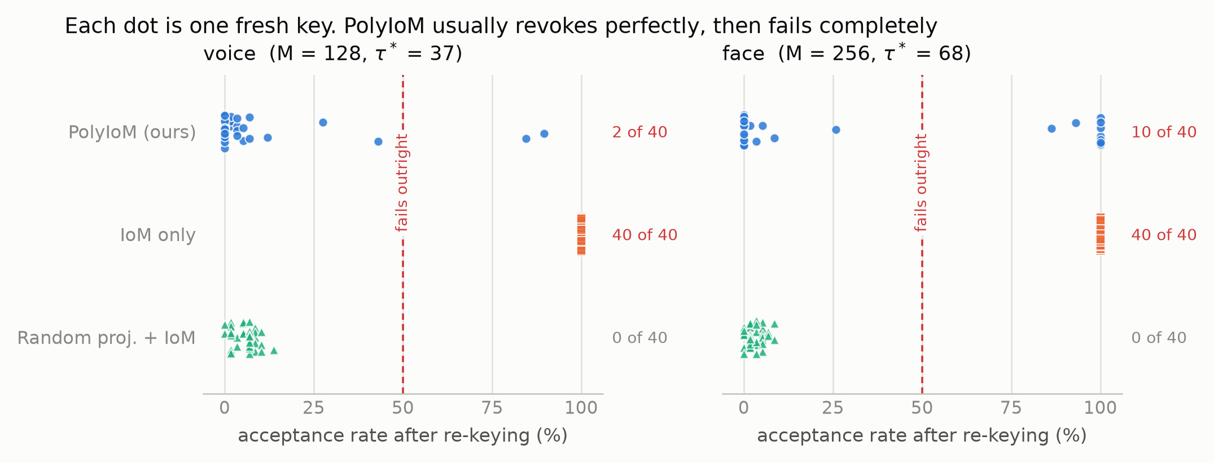
What enables revocability
5.6 · SECONDARY
5.6.3 A correction we made
With 3 keys and an identity-only bootstrap, PolyIoM against the linear map looked firm on voice: +4.598 pp [+1.724, +8.046]. With 40 keys and a two-level bootstrap it is -1.767 pp [-8.793, 3.967]: not distinguishable. The claim was retracted.
80/80
12/80
0/80
raw-IoM key sets: every old template still accepted
PolyIoM key sets: half or more exposed; 8 expose all
linear-map key sets: half or more exposed
Notes:
Finding one: keyed compression is necessary for revocability. Applied directly to the raw embedding, IoM hashing fails completely. Every stolen template remains a valid credential after re-keying, for all forty key sets on both modalities. The contrasts are +92.5 pp on voice and +74.4 pp on face, both firm.
This follows directly from Section 5.5. The attack recovers the embedding itself at a cosine of 0.913, so re-keying the projection cannot help: the attacker holds something close to the biometric, and the new projection is applied to that just as it is applied to the real thing.
Finding two: that the polynomial is the right compression is not supported. PolyIoM's behaviour is bimodal. Its median per-key acceptance rate is 0.00% on both modalities, meaning revocation is usually perfect, but it fails catastrophically for a minority of fresh keys: two of forty on voice, reaching 89.66%, and ten of forty on face, reaching 100%. randproj_iom never does this. Across all eighty key sets, none failed outright, and its worst case leaks 13.79%.
The voice contrast between the two is not distinguishable (-1.767 pp [-8.793, +3.967]). The face contrast is firm and favours the linear map (-22.716 pp [-35.864, -9.996]).
Operationally, unpredictable total failure is a worse property than a small, consistent leak.

Slide 19
Summary of evidence
5.7
Criterion | What the sealed system does | Status
Recognition | Voice 1.93% EER, TAR 93.97% at FMR 0.185% on unseen speakers; 2.80% on an external corpus with no supported drop. | confirmatory
Performance preservation | Costs +1.84 pp on held-out voice and +2.79 pp externally against unprotected matching (firm). Face not resolvable. | confirmatory
Unlinkability | D_{sys} 0.088 held-out, 0.080 external, on a scale where 0 is fully unlinkable. | confirmatory
Irreversibility | Conceals the biometric: reconstruction cosine 0.222 against 0.913 without the polynomial, 0.120 at chance (firm). Does not prevent acceptance: 100% attack success in every arm. | secondary
Revocability | Works in the median case on both modalities, and only because the embedding is keyed-compressed before hashing. | secondary
Keyed compression gives revocability. The polynomial gives concealment of the biometric. The choice between them is a trade.
Notes:
The sealed system, against the four criteria:
What the polynomial specifically contributes, against a keyed random linear projection of the same output size:
Taken together: the sealed scheme meets recognition and unlinkability on unseen and external speakers, and conceals the underlying biometric from a full-knowledge adversary, at a measured and firm cost in accuracy on voice. Its revocability comes from the keyed compression stage rather than from the polynomial, while the concealment of the biometric comes from the polynomial specifically. On this evidence keyed compression before IoM hashing is necessary for revocability and a keyed random linear projection is sufficient for it; the polynomial is what makes the biometric hard to recover, and the choice between the two is a trade, not a dominance.

Slide 20
Discussion
6.1 – 6.3
6.1
6.2
6.3
What the polynomial does, and what it does not
Why revocability is the binding property
Implications for evaluation
It conceals the embedding: cosine 0.222 against 0.913. It does not stop acceptance, because the system compares hardened vectors and the attack recovers those. Measuring fidelity alone would overstate protection.
Recognition differs by a few points across arms; unlinkability not at all; irreversibility fails uniformly. Only revocability splits them, and it is the one property tested by a sequence of events rather than a single measurement.
Attack the baselines with the same attack as the proposal. Ablate multi-stage transforms. Resample the axis that actually varies: keys as well as identities.
Notes:
Of the four standard requirements, revocability receives the least attention in evaluations, and it is the one that separates the designs here. Recognition performance is similar across arms to within a couple of percentage points. Unlinkability is not distinguishable at all. Irreversibility fails uniformly. Revocability is the only property on which the arms behave qualitatively differently: one of them fails completely and the others do not.
We think this happens because revocability is the only one of the four that is tested by a *sequence* of events rather than by a single measurement. The other three are properties of one template at one moment. Revocability asks what happens after the attacker acts and the operator responds. That makes it harder to measure and easier to assume, which is presumably why it is usually assumed.

Slide 21
Design recommendation
6.4
Accuracy
Keyed polynomial
Keyed linear map
Accuracy
01
01
Voice EER 1.928%
T
R
A
D
E
Voice EER 0.700%, better by 1.23 pp (firm)
Concealment
Concealment
02
02
Recovered embedding: cosine 0.222 voice, 0.418 face
Cosine 0.490 voice, 0.492 face
Revocation
Revocation
03
03
12 of 80 key sets leave half or more exposed
0 of 80 key sets leave half exposed
Choose when
Choose when
04
04
the harm is a recovered face or voice, which nothing repairs
the harm is a compromised credential, which re-keying repairs
Either way: compress under a key before the hash. Without it, revocation does not work and a stolen template is permanent.
Notes:
On the evidence here, a practitioner building a cancelable scheme on IoM hashing should compress the embedding under a key before hashing. That part is not optional: without it, revocation does not work and a stolen template is permanent.
Which compression to use is a trade, and we state it as one. A keyed random linear projection is more accurate (by 1.23 percentage points of equal error rate on voice), revokes at least as reliably, and never left half the subjects exposed under any key. The keyed polynomial conceals the underlying biometric far better: the reconstruction reaches cosine 0.22 with the true embedding against 0.49 for the linear map on voice, and 0.42 against 0.49 on face, both firm. Neither prevents an inverted template from being accepted; that is what revocation is for.
So the choice turns on the threat model. Where the harm that matters is a compromised credential, which re-keying repairs, the linear map is the better engineering choice. Where the harm that matters is recovery of the face or voice itself, which nothing repairs, the polynomial buys real protection at a measured cost. A deployment that must satisfy a privacy regulator would reasonably weigh the second harm more heavily than a deployment that only has to keep impostors out.
We state this as a recommendation supported by held-out comparison, not as a validated design. Section 7 records why.

Slide 22
Limitations
7
01
Statistical power
06
Linear arm unsealed
58 held-out identities; face is descriptive only
Evaluated only at PolyIoM's operating point
02
One external corpus
07
Asymmetric enrolment
VCTK validates voice; face has no external estimate
Face uses one sample; voice the mean of five
03
One attack family
08
Voice baselines
Magnitudes are lower bounds on attacker success
Below one genuine error: bounds, never ratios
04
Fresh keys
09
Face encoder
Resampled from K*, not re-selected through Stage A
Caps attainable EER near 3%
05
Unexplained failures
10
Provenance
12 of 80 PolyIoM key sets; cause unknown
Exclusion list from an unverified mirror; exact names only
Notes:
1. Statistical power. All held-out inference rests on 58 identities. Face gives 259 genuine trials and an equal error rate interval spanning a five-fold range. Face is reported descriptively, and no face comparison in Section 5.2 is claimed.
2. One external corpus, one modality. VCTK validates the voice system. No external face corpus was available, so the face results have no external estimate.
3. One attack family. Section 5.5 measures practical inversion resistance under a stated budget. It is not a proof of information-theoretic irreversibility. A perfect solution provably exists in the search space, since the true embedding reproduces the stored template exactly, so a failure to find one would be a statement about optimisation difficulty rather than about information. A stronger attack can only increase attacker success, so the direction of our finding is safe; the magnitudes are lower bounds on what an attacker can achieve.
4. Construction of fresh keys. Fresh polynomial keys are resampled from the selected key's own coefficient and exponent values rather than re-selected through Stage A. This is appropriate for the question asked in Section 5.6, but it means the fresh keys are not distributed exactly as deployed keys would be.
5. An unexplained failure mode. We cannot explain why twelve of eighty fresh key sets produce catastrophic post-revocation acceptance for PolyIoM. The failing keys are not degenerate; all forty passed a check that the re-keyed system still separates different subjects. The asymmetry between modalities, five per cent on voice against twenty-five on face, is likewise unexplained. This is the weakest point in the argument of Section 5.6.
6. The linear-map arm was never sealed. randproj_iom was introduced as an ablation arm.

Slide 23
Keyed compression gives revocability. The polynomial gives concealment.
8 · CONCLUSION
The choice between them is a trade, and we state it as one.
1.93%
80 / 80
0.222 vs 0.490
voice EER on 58 unseen speakers
raw-IoM key sets that fail to revoke
embedding recovered: polynomial against linear map
Evaluate such schemes by attacking their baselines with the same attack, ablating their stages, reporting against the unprotected system, and testing what happens after a template is revoked.
python3 run.py verify → 74 checks · 29 unit tests · NumPy and PyTorch agree on all 32,768 template indices
Notes:
We built a cancelable biometric scheme on index-of-maximum hashing with a keyed polynomial hardening stage, sealed its operating point on development identities, and then measured all four standard requirements without refitting anything.
The sealed system works. On speakers it had never seen it recognises at 1.93% equal error rate, accepting 93.97% of genuine claims while admitting 0.185% of impostor claims, and it holds that behaviour on 110 external speakers recorded under different conditions, with no statistically supported drop. Its unlinkability is strong, 0.088 on a scale where zero is fully unlinkable, and it tightens rather than degrades on the external corpus. Against an adversary holding the key, the projection, the algorithm and the stored template, the polynomial conceals the underlying biometric close to chance: a reconstruction reaches cosine 0.222 with the true embedding, against 0.913 with the polynomial removed and 0.120 at chance.
Protection is not free, and we measured the price rather than assuming it. Against unprotected cosine matching on the identical comparisons it costs 1.84 percentage points of equal error rate on held-out voice and 2.79 points externally, both firm. On face the cost cannot be resolved, because the face encoder we used caps the attainable rate near 3% and the trial count leaves an interval five times wider than the effect.
We then asked what the polynomial itself contributes, and the answer is that the work is done by the stage around it rather than by the polynomial.

Slide 24
Declarations
DECLARATIONS
AI
D
E
Generative AI use
Data and code availability
Ethics
An AI assistant helped write the secondary-analysis code, the figures, the reproducibility package and the manuscript text. Protocol, partitions, key search, sealed operating points and confirmatory results predate it. Every number re-derives from stored results.
Code, stored results, 29 unit tests and a verification script are released. Embeddings are not redistributed: an embedding is a derived representation of a biometric sample, not an anonymisation of it.
No new human-subject data. Public corpora only. The inversion analysis attacks templates generated by the authors; no deployed system and no third party's template was attacked.
References follow the literature pass; citation slots are listed in Section 9 of the paper.
Notes:
*To be adapted to the target venue's required headings. Bracketed items are for the authors to fill.*
Declaration of generative AI use. The authors used a generative AI assistant, [TOOL NAME AND VERSION], in the preparation of this work. Its use extended beyond language editing. It assisted in writing the analysis code for the ablation, inversion, revocation and score-distribution analyses (Sections 5.4 to 5.6 and the results figures), in producing the figures, in building the reproducibility package, and in drafting and revising the manuscript text. The study design, the pre-registered protocol, the identity partitions, the key search, the sealed operating points and the confirmatory results of Sections 5.1 to 5.3 were produced by the authors before and independently of that assistance. The authors reviewed all generated code and text, re-ran the analyses, and take full responsibility for the content. Every numerical claim in this paper can be re-derived from the stored results by the verification script in the accompanying package, independently of the tool that helped produce it.
Author contributions. [CRediT roles: conceptualisation, methodology, software, validation, formal analysis, investigation, data curation, writing (original draft), writing (review and editing), visualisation, supervision.]
Third-party components.

