Slide 1
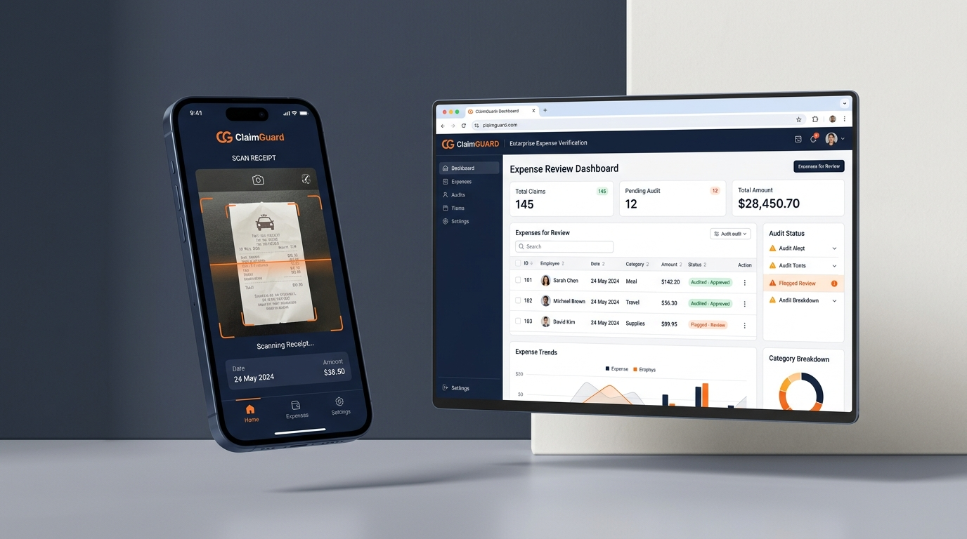
FINANCIAL VERIFICATION INTELLIGENCE
CLAIMGUARD
Intelligent Expense & Receipt Verification
From field receipt submission to risk-aware managerial decision making. A unified, deterministic compliance platform for modern distributed organizations.
CLAIMGUARD PRODUCT PITCH | SLIDE 01 OF 15
Notes:
# Slide 1: Cover — ClaimGuard
## SLIDE PURPOSE
Introduce ClaimGuard clearly in 20 to 30 seconds as an intelligent expense and receipt verification platform connecting field receipt submission, automated analysis, and manager decision-making.
## SAY THIS (30s)
"Welcome everyone. Today we are presenting ClaimGuard — an intelligent expense and receipt verification platform designed for distributed organizations. In modern field teams, receipt submission and expense validation are often disconnected, slow, and heavily manual. ClaimGuard bridges that gap: from the moment an employee snaps a photo of a receipt in the field, our platform extracts the data, validates it against policy, runs deterministic fraud checks, organizes risk signals, and presents decision-ready evidence directly to the finance manager."
## SIMPLE EXPLANATION
ClaimGuard is a digital platform that makes it painless for field staff to submit receipts while giving finance managers instant, structured verification so they don't have to manually inspect every paper bill or worry about duplicate payouts.
## TECHNICAL EXPLANATION
ClaimGuard combines a lightweight Flutter mobile client with a Fastify REST API, AWS document ingestion (S3, Textract), deterministic fraud rule scoring, Claude 3.5 Bedrock narrative explanation, and Supabase PostgreSQL with Row Level Security.
## WHY IT MATTERS
Organizations bleed money and administrative hours through manual receipt audits, delayed submissions, and unspotted duplicate claims. A single unified workflow solves this at the source.
## IMPORTANT CAVEAT
ClaimGuard is not an autonomous black-box that silently approves payouts. It is a decision-support and verification system designed to keep humans firmly in control.
## TRANSITION
"To understand why this unified approach is necessary, let's look at the reality of expense verification today."

Slide 2
THE OPERATIONAL PROBLEM
Expense verification is still too manual.
UNSTRUCTURED INPUTS
1. PAPER & CHAT CHAOS
Field staff collect crumpled paper receipts or forward random photos over WhatsApp threads days or weeks later.
HIGH ADMINISTRATIVE COST
2. MANUAL DATA ENTRY
Finance managers manually re-type amounts, vendors, and dates into spreadsheets, struggling with faded ink.
SILENT POLICY LEAKAGE
3. UNSPOTTED DUPLICATES
Humans cannot reliably detect whether the same receipt was already submitted 3 weeks ago or edited.
COMPLIANCE RISK
4. LOST TAX CREDITS
Ineligible GST claims and missing or invalid 15-digit GSTINs lead to lost Input Tax Credit (ITC) on audits.
CLAIMGUARD PRODUCT PITCH | SLIDE 02 OF 15
Notes:
# Slide 2: Problem — Expense Verification Is Still Too Manual
## SLIDE PURPOSE
Demonstrate the fundamental operational friction of traditional expense auditing without relying on fabricated statistics.
## SAY THIS (40s)
"The reality across most distributed organizations is that expense verification is still treated as an afterthought. Field employees collect crumpled paper bills or forward images over WhatsApp. Days or weeks later, a finance manager sits down to manually decipher faded ink, retype vendor names and totals into spreadsheets, and cross-reference dates. When thousands of receipts flow in, humans simply cannot detect whether the same fuel bill was submitted twice, whether a weekend dinner was tagged as client hospitality, or whether a printed tax number is even valid. The result is chronic administrative delay, costly duplicate payouts, and significant financial uncertainty."
## SIMPLE EXPLANATION
When people verify receipts by hand, they spend hours doing tedious data entry and comparing receipts one by one. It is easy for duplicate or incorrect claims to slip through unnoticed.
## TECHNICAL EXPLANATION
Manual workflows lack automated perceptual hashing for duplicate detection, cannot validate 15-character GSTIN checksums in real-time, and fail to track statistical spending anomalies against historical employee baselines.
## WHY IT MATTERS
Every unverified receipt represents potential policy leakage, lost Input Tax Credit (ITC), and wasted manager hours that could be spent on strategic financial planning.
## IMPORTANT CAVEAT
The problem is not that finance managers are careless; it's that humans are fundamentally ill-suited for high-volume, repetitive image comparisons and cryptographic checksum calculations under time pressure.
## TRANSITION
"This brings us to our core product thesis: what if every single receipt could be systematically screened before a manager ever spends a second reviewing it?"

Slide 3
PRODUCT THESIS
What if every receipt could be screened before manual review?
THE TRADITIONAL PARADIGM
X Employee submits crumpled paper / raw photo
X Piles up in finance inbox for weeks
X Manager spends 10 minutes manually verifying math
X Duplicate payouts and compliance errors slip through
THE CLAIMGUARD PARADIGM
-> Employee captures instant photo via Flutter mobile
-> Instant AWS Textract extraction & normalizer
-> Deterministic fraud checks (Hash, GSTIN, Anomaly)
-> Compounded 0-100 risk score & Bedrock explanation
-> Manager receives decision-ready evidence in seconds
CLAIMGUARD PRODUCT PITCH | SLIDE 03 OF 15
Notes:
# Slide 3: Core Idea — Screening Before Manual Review
## SLIDE PURPOSE
Position ClaimGuard not as an isolated OCR utility, but as a complete screening and evidence synthesis engine that transforms raw receipt images into structured, risk-aware manager reviews.
## SAY THIS (40s)
"What if every receipt could be screened before manual review? ClaimGuard changes the paradigm entirely. Instead of handing a pile of raw images to an approver, our system intercepts each receipt the second it is submitted. It extracts structured fields, tests arithmetic consistency, verifies merchant authenticity, scans historical databases for perceptual duplicates, evaluates spending anomalies, and synthesizes a clear risk assessment. By the time the manager opens the claim, 90% of the verification heavy lifting is already completed and organized into actionable evidence."
## SIMPLE EXPLANATION
ClaimGuard does the homework before the manager opens the file. It reads the receipt, checks the math, checks if it's already been paid before, and highlights anything unusual so the manager can approve clean claims in seconds and focus attention only where it matters.
## TECHNICAL EXPLANATION
The core architecture sits between the presentation layer and the database as an asynchronous screening pipeline. It couples OCR extraction with deterministic rule engines and an LLM contextualization layer, outputting an immutable risk score and an authenticity state token.
## WHY IT MATTERS
Pre-screening receipts inverts the cost curve: straightforward, policy-compliant expenses take seconds to approve, while suspicious or non-compliant claims are instantly flagged with supporting proof.
## IMPORTANT CAVEAT
ClaimGuard does not eliminate the manager. We do not believe in fully autonomous financial approvals. ClaimGuard organizes evidence to empower human judgment, not bypass it.
## TRANSITION
"Let's trace exactly how one receipt travels through this multi-layered verification journey."

Slide 4
END-TO-END ARCHITECTURE
One workflow. Multiple verification layers.
1. CAPTURE
Mobile Flutter app captures receipt image with alignment guidance.
2. EXTRACT
AWS Textract extracts vendor, date, total, GSTIN & line items.
3. VALIDATE
Deterministic validation tests date boundaries and math.
4. DETECT
Perceptual hashing & anomaly baselines detect fraud signals.
5. ASSESS
Deterministic 0-100 scoring derives verified authenticity state.
6. REVIEW
Manager reviews evidence side-by-side in operations cockpit.
7. AUDIT
Append-only immutable audit trail records actor, action & timestamp.
CLAIMGUARD PRODUCT PITCH | SLIDE 04 OF 15
Notes:
# Slide 4: Complete Workflow — One Workflow, Multiple Layers
## SLIDE PURPOSE
Break down the complete receipt verification lifecycle into 7 clear, sequential stages: Capture, Extract, Validate, Detect, Assess, Review, and Audit.
## SAY THIS (45s)
"ClaimGuard structures receipt verification into seven rigorous stages. First, Capture: the employee captures a photo on their mobile device. Second, Extract: AWS Textract extracts vendors, amounts, dates, and tax numbers with per-field confidence scores. Third, Validate: deterministic rules check mathematical consistency, date windows, and tax ID structure. Fourth, Detect: the engine computes image perceptual hashes to identify duplicates and checks historical spending anomalies. Fifth, Assess: signals compound into a deterministic 0 to 100 risk score and evidence state. Sixth, Review: the manager reviews the claim in an operations cockpit with highlighted evidence. And seventh, Audit: every action, flag, and approval is permanently logged in an immutable audit trail."
## SIMPLE EXPLANATION
A receipt moves through seven simple checkpoints: it is snapped on a phone, read by the computer, checked against company rules, scanned for duplicates, scored for risk, reviewed by a manager, and recorded permanently for auditors.
## TECHNICAL EXPLANATION
The pipeline transitions through stateful boundaries: from client-side capture to multi-part S3 upload, event-driven Textract extraction, in-memory heuristic validation, perceptual hash lookup (Hamming distance <= 5), deterministic risk scoring, manager action dispatch, and Supabase audit row creation.
## WHY IT MATTERS
Breaking the verification process into distinct layers prevents hidden failure points. If OCR confidence is low, the pipeline flags it immediately rather than hallucinating wrong numbers.
## IMPORTANT CAVEAT
Each stage is loosely coupled and observable. If any upstream stage fails (such as an unreadable blurry photo), subsequent stages degrade gracefully into a human-review state rather than throwing unhandled runtime exceptions.
## TRANSITION
"Now let's step into the shoes of the field employee and see how this feels on a mobile phone."

Slide 5
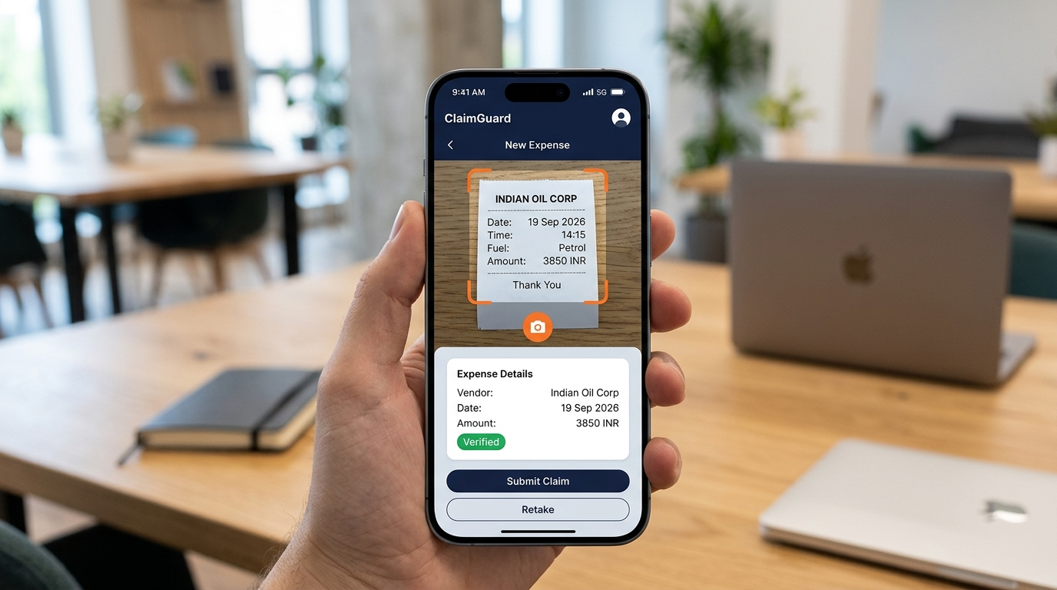
FIELD MOBILITY
For employees, submitting a claim becomes simple.
Cross-Platform Flutter Native
Fast, responsive mobile experience optimized for field reps and technicians on Android & iOS.
One-Tap Camera Capture
Receipt scanner viewfinder with real-time framing and image stabilization.
Inline Extraction Review
Instant preview card displaying extracted vendor, date, amount, and category for rapid verification.
Zero Cloud Jargon
Employees see only their claim progress. All OCR, risk scoring, and cloud services remain invisible.
Live Status Tracking
Instant push cards notify field staff the moment a claim is verified, reviewed, or approved.
CLAIMGUARD PRODUCT PITCH | SLIDE 05 OF 15
Notes:
# Slide 5: Employee Experience — Mobile-First Simplicity
## SLIDE PURPOSE
Showcase the frictionless mobile employee interface built with Flutter, demonstrating how complex verification machinery is hidden behind an intuitive, lightweight receipt capture experience.
## SAY THIS (40s)
"For employees in the field, submitting an expense cannot feel like doing tax accounting. ClaimGuard delivers a mobile-first interface built in Flutter. The employee simply taps the camera, aligns the receipt inside the viewfinder guide, and snaps the photo. Within seconds, the app returns a structured preview showing the extracted merchant name, amount, date, and category. The employee can verify or adjust any low-confidence field with one tap, add optional travel context, and hit submit. From there, real-time push cards keep them informed of verification progress and approval status without endless email threads."
## SIMPLE EXPLANATION
Field employees don't need any training. They open the app, take a picture of their receipt, see the details filled in automatically, and tap submit. They can see right away when their claim is received, checked, and approved.
## TECHNICAL EXPLANATION
The mobile client is built in Flutter 3.44 with Dart 3.12, utilizing reactive state management and localized device camera integration. It communicates with the backend via stateless Bearer token authentication, sending either multipart image streams or base64 payloads to `/api/v1/receipts/upload`.
## WHY IT MATTERS
When expense filing is tedious, employees postpone submissions for weeks, causing sudden budget spikes and lost receipts. Immediate mobile capture keeps submissions timely and organized.
## IMPORTANT CAVEAT
The mobile application intentionally contains zero privileged business logic or fraud rule definitions. All security boundaries and evaluations execute exclusively on the authenticated backend.
## TRANSITION
"Now that the claim is submitted, let's switch to the manager's screen and look at the review experience."

Slide 6
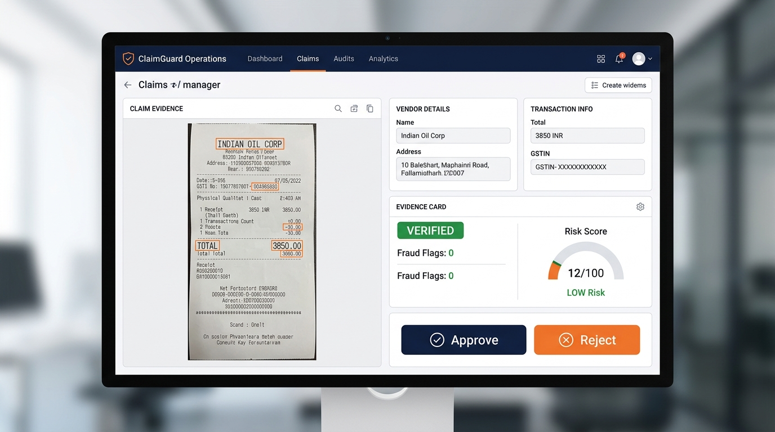
OPERATIONS COCKPIT
Managers see the entire picture.
Split-Screen Verification View
Original high-res receipt on the left; structured extracted values and tax identifiers on the right.
Prioritized Risk Triage
Queue dynamically filtered by risk: Low (batch approve), Medium, High, or Critical.
Evidence-Backed Indicators
Hoverable duplicate hash comparisons, historical spending baselines, and GSTIN check logs.
Explainable AI Summaries
Claude 3.5 synthesis on AWS Bedrock summarizes key flags into two actionable sentences.
One-Click Actions with Audit
Approve, Reject, or Request Clarification with mandatory compliance notes recorded in Supabase.
CLAIMGUARD PRODUCT PITCH | SLIDE 06 OF 15
Notes:
# Slide 6: Manager Experience — The Full Operational Picture
## SLIDE PURPOSE
Demonstrate how the Manager Operations Dashboard converts disparate verification signals into a decision-ready cockpit with split-screen receipt review, risk tier filtering, and one-click actions.
## SAY THIS (45s)
"On the manager's side, ClaimGuard replaces endless spreadsheet rows with an operations cockpit. The manager sees a live queue filtered by risk: Low Risk claims that are safe for rapid approval, and Medium, High, or Critical claims that require attention. Opening a claim reveals a split-screen workspace: the original high-resolution receipt on the left with bounding box overlays, and structured verification evidence on the right. The manager sees the exact OCR extracted values, the mathematical risk score, any flagged duplicate claims side-by-side, and an AI-generated explanation summarizing key findings. With a single click, they can Approve, Reject, or Request Clarification with mandatory audit notes."
## SIMPLE EXPLANATION
Instead of hunting through receipts, managers get an organized screen that shows the receipt on one side and all the facts on the other: what was bought, whether the price is normal, if the receipt was used before, and whether company rules were followed. Approving or rejecting takes one click.
## TECHNICAL EXPLANATION
The manager surface is built on Next.js 15 with React 19 and Tailwind CSS, fetching filtered claim collections via Server Components and reactive client state. The UI directly reflects PostgreSQL Row Level Security rules, ensuring managers only view and act upon claims belonging to their assigned company ID.
## WHY IT MATTERS
Managers typically spend 5 to 10 minutes cross-checking a single non-standard claim. By organizing extracted fields and rule violations side-by-side with the original image, review time drops significantly.
## IMPORTANT CAVEAT
The dashboard is an evidence viewer, not an automated gatekeeper. The manager retains full discretionary authority to override flags if a legitimate business justification exists.
## TRANSITION
"Now let's dive under the hood and examine the first foundational technical layer: Optical Character Recognition."

Slide 7
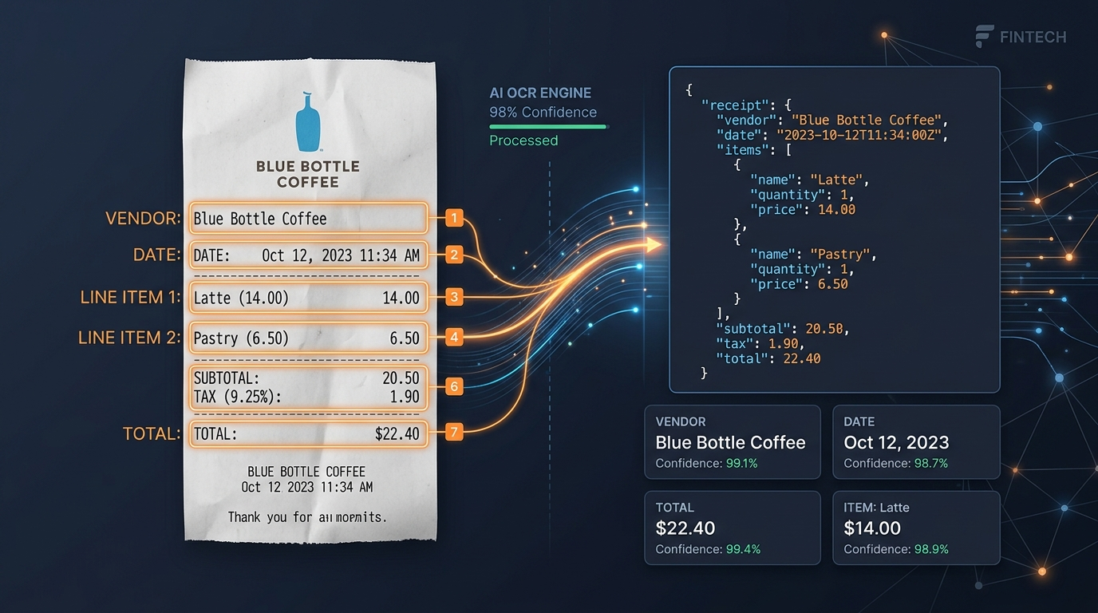
DOCUMENT INTELLIGENCE
From image to structured information.
WHAT OCR DOES
AWS Textract AnalyzeExpense parses geometric bounding boxes, summary key-values, and line items. Extracts Merchant Name, Total Amount, Date, and 15-character Indian GSTIN with individual confidence scores.
THE FUNDAMENTAL PRINCIPLE
OCR asks: 'What does this receipt say?'
OCR does NOT ask: 'Is this receipt authentic?'
A completely fake, fabricated invoice printed on paper will extract with 100% OCR confidence. That is why OCR is only step one.
CLAIMGUARD PRODUCT PITCH | SLIDE 07 OF 15
Notes:
# Slide 7: OCR — From Image to Structured Information
## SLIDE PURPOSE
Explain what OCR actually does, how AWS Textract extracts structured data with confidence scores, why OCR makes mistakes, and why OCR success does not prove authenticity.
## SAY THIS (50s)
"Let's be very clear about what Optical Character Recognition does and does not do. OCR simply answers the question: 'What characters and numbers are printed on this piece of paper?' ClaimGuard utilizes AWS Textract's AnalyzeExpense API. When a receipt arrives, Textract identifies geometric text blocks, key-value pairs, and line items — extracting the vendor name, total amount, invoice date, and 15-character GST tax identification number. Crucially, Textract provides confidence scores for each extracted field. If ink is smudged or folded, confidence drops. But here is the most critical principle in ClaimGuard: successful OCR extraction does not mean the receipt is authentic. A completely fake, fabricated invoice printed on paper will extract with 100% OCR confidence. That is why OCR is only the beginning of our pipeline."
## SIMPLE EXPLANATION
OCR is like a digital scanner that reads the words and numbers printed on a receipt and converts them into computer data. But just because a computer can read a piece of paper clearly doesn't mean that the paper is a real receipt. It only means the ink is readable.
## TECHNICAL EXPLANATION
The OCR pipeline sends S3 object references to `Textract.analyzeExpense()`. The response returns `SummaryFields` (VENDOR_NAME, TOTAL, INVOICE_RECEIPT_DATE) and `LineItemGroups`. A deterministic normalizer parses date formats into ISO 8601 (`YYYY-MM-DD`), strips currency symbols into floating-point amounts, and extracts 15-character alphanumeric GSTIN strings via regular expressions.
## WHY IT MATTERS
Treating OCR as a complete verification solution is a dangerous industry pitfall. By decoupling text extraction from document authenticity, ClaimGuard avoids false confidence.
## IMPORTANT CAVEAT
OCR algorithms struggle with thermal paper fading, heavy perspective skew, and poor camera lighting. In ClaimGuard, any field extraction with confidence below 70% triggers an `OCR_LOW_CONFIDENCE` flag and routes the claim to the employee for verification.
## TRANSITION
"If OCR only reads the text, how do we know if the claim is valid or fraudulent? That brings us to our deterministic validation and fraud signals."

Slide 8
DETERMINISTIC MATH ENGINE
OCR is only the beginning: 6 verification signals.
+40 PTS
Perceptual Duplicate Hash
Hamming distance <= 5 flags exact or cropped duplicate receipts.
+25 PTS
Indian GSTIN Checksum
Validates 15-char tax ID against state codes & ISO 7064 Modulo 36.
+20 PTS
Historical Amount Anomaly
Flags expenses exceeding 2.0x employee's historical category average.
+20 PTS
Category Keyword Mismatch
Detects dining, alcohol or personal purchases tagged as Fuel/Travel.
+15 PTS
Policy Cap Violation
Enforces single-claim expenditure limits and tax invoice thresholds.
+15 PTS
Date & Timing Anomaly
Flags backdated claims >90 days old or impossible future dates.
CLAIMGUARD PRODUCT PITCH | SLIDE 08 OF 15
Notes:
# Slide 8: Validation & Fraud Signals — OCR Is Only the Beginning
## SLIDE PURPOSE
Explain the crucial distinction between OCR, Validation, and Fraud Signals, detailing the 6 deterministic mathematical checks executed by ClaimGuard.
## SAY THIS (50s)
"Once the text is extracted, ClaimGuard asks two distinct questions: first, 'Does this extracted data make business sense?' That is Validation. And second, 'Are there indicators of fraudulent manipulation or abuse?' Those are our Fraud Signals. ClaimGuard evaluates six deterministic signals. First, Perceptual Duplicate Hashing: we generate visual image fingerprints and compute Hamming distance. If distance is five or less, the receipt was previously submitted — even if cropped or re-photographed. Second, GSTIN Luhn Modulo-36 Checksums: we mathematically verify that the printed 15-character tax number has a valid state code, PAN structure, and checksum character. Third, Amount Anomaly Detection: flagging claims that exceed twice the employee's historical category baseline. Fourth, Merchant Taxonomy Mismatch: catching personal dining billed as vehicle fuel. Fifth, Policy Limit Breaches: enforcing per-claim spending caps. And sixth, Date Timing Anomalies: catching future dates or stale expenses over 90 days old."
## SIMPLE EXPLANATION
Validation checks if the receipt follows company rules — like not submitting receipts older than three months. Fraud checks look for suspicious patterns — like someone submitting the exact same photo twice, entering an invented tax number, or claiming four times more money than anyone else in their role.
## TECHNICAL EXPLANATION
The signals run as pure, hermetic TypeScript functions in `services/fraudService.ts`. Perceptual hash comparisons use block-mean 64-bit hexadecimal fingerprints. GSTIN validation tests state codes (`01`–`38`, `97`) and runs ISO/IEC 7064 Modulo 36,36 checks. Anomaly detection evaluates rolling statistical means where sample size >= 3.
## WHY IT MATTERS
Deterministic algorithms never hallucinate, never change results between executions, and can be fully audited in a court of law or regulatory tax inspection.
## IMPORTANT CAVEAT
Fraud signals are not absolute proof of criminal intent. A duplicate hash might be an employee re-submitting a rejected claim with manager approval, and an amount anomaly might be an emergency repair. Signals represent structured evidence, not a judicial verdict.
## TRANSITION
"Having evaluated these individual signals, how does the system combine them into a clear summary for the manager? That is the job of the ClaimGuard Risk Engine."

Slide 9
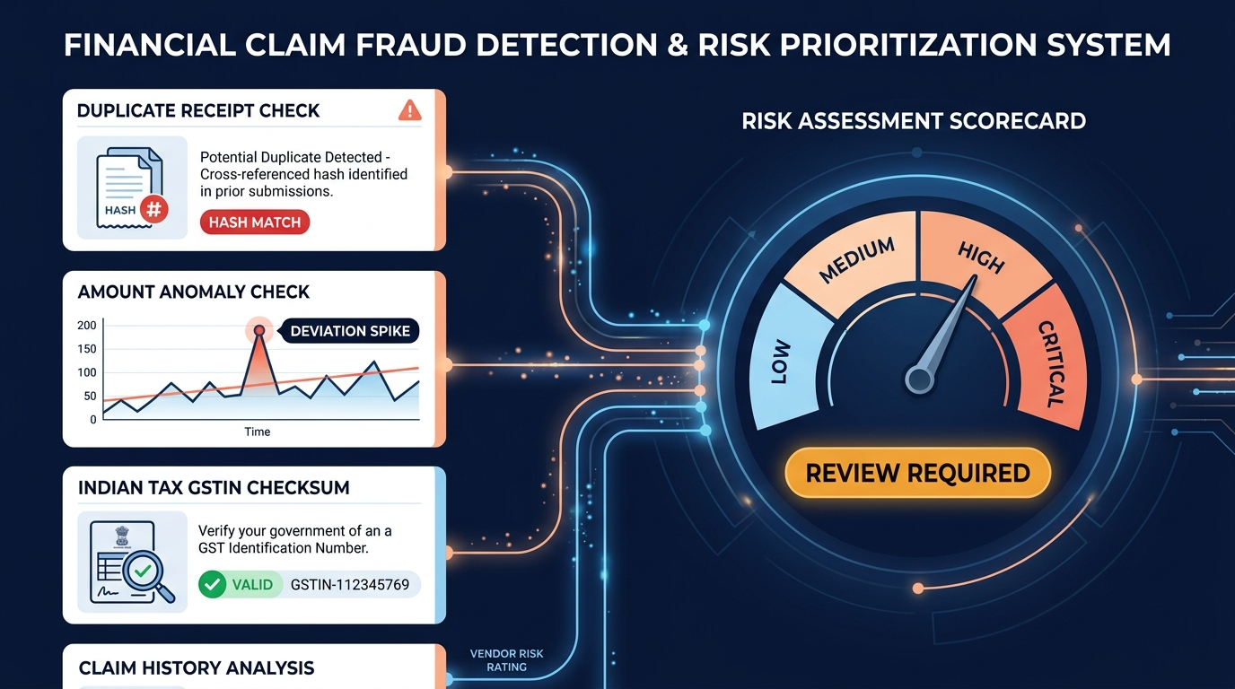
RISK ENGINE
Turn multiple signals into a decision-ready risk view.
5 QUALIFIED AUTHENTICITY STATES
[VERIFIED]
Valid GSTIN, clear OCR (>90%), zero fraud signals. Score: 0-24.
[LIKELY VALID]
Minor warning, slight date deviation, valid math. Score: 0-24.
[REVIEW REQUIRED]
Amount anomaly or policy limit breach needing sign-off. Score: 25-49.
[SUSPICIOUS]
Duplicate hash match or invalid tax checksum detected. Score: 50-74.
[UNABLE TO VERIFY]
Blurred image, unreadable merchant, low OCR (<70%). Requires retake.
CLAIMGUARD PRODUCT PITCH | SLIDE 09 OF 15
Notes:
# Slide 9: Risk Engine — Decision-Ready Risk Prioritization
## SLIDE PURPOSE
Explain how ClaimGuard aggregates multiple fraud signals into a bounded 0–100 deterministic risk score and maps them to 5 qualified evidence authenticity states.
## SAY THIS (45s)
"A manager reviewing hundreds of claims cannot mentally juggle six independent mathematical probabilities simultaneously. The ClaimGuard Risk Engine aggregates these signals into an objective zero-to-one-hundred integer score. Each signal carries an explicit, configurable point impact: a duplicate receipt adds 40 points; an invalid tax checksum adds 25 points; an amount anomaly adds 20 points. Compounding violations quickly push a claim into higher severity tiers: Low, Medium, High, or Critical. From this score, ClaimGuard derives one of five qualified evidence states: Verified, Likely Valid, Review Required, Suspicious, or Unable to Verify. Notice our deliberate language: we never claim a receipt is '100% Guaranteed Genuine'. We state clearly what the evidence shows."
## SIMPLE EXPLANATION
Instead of giving managers a confusing list of technical warnings, ClaimGuard adds up the risk points into an easy score from 0 to 100 and labels the claim with a clear badge: green for Verified, amber for Review Required, or red for Suspicious.
## TECHNICAL EXPLANATION
$$\text{Score} = \min\left(100, \max\left(0, \sum \text{Impact}_i\right)\right)$$
Scores 0–24 map to LOW (Approve Recommended), 25–49 to MEDIUM (Manual Review Required), 50–74 to HIGH (Investigation Required), and 75–100 to CRITICAL (Reject Recommended). The authenticity state machine checks for low OCR confidence first (`UNABLE_TO_VERIFY`), then duplicate/checksum violations (`SUSPICIOUS`), then policy anomalies (`REVIEW_REQUIRED`), and finally zero-signal claims (`VERIFIED`).
## WHY IT MATTERS
Risk tiers allow organizations to implement triage routing: low-risk claims under policy caps can be batched with one click, while high-risk claims are automatically routed to senior compliance officers.
## IMPORTANT CAVEAT
The weights and point thresholds presented here are illustrative defaults configured for Indian SME and field enterprise operations. Organizations can calibrate threshold weights to match their specific industry risk tolerance.
## TRANSITION
"Now that we understand how deterministic risk scoring works, where does Artificial Intelligence fit in? Let's look at what AI does, and what it does NOT do."

Slide 10
BOUNDARY OF INTELLIGENCE
AI assists the review. It does not replace it.
WHAT AI CAN DO (EXPLANATION LAYER)
+ Synthesizes triggered fraud flags into plain-English summaries
+ Translates mathematical ratios into actionable manager tips
+ Assists receipt taxonomy classification when fuzzy
+ Provides contextual explanations to speed up human reviews
WHAT AI DOES NOT DO (STRICT CONTROLS)
- Never independently approves or rejects financial claims
- Never overrides company security policies or spending limits
- Cannot mutate or delete audit log entries in the database
- Cannot grant organization membership or session credentials
CLAIMGUARD PRODUCT PITCH | SLIDE 10 OF 15
Notes:
# Slide 10: AI — Assistance, Not Autonomous Control
## SLIDE PURPOSE
Delineate the precise boundary of Generative AI within ClaimGuard, establishing that AI serves strictly as an explanatory synthesis layer, while authorization, security controls, and approvals remain deterministic and human-controlled.
## SAY THIS (50s)
"In enterprise financial software, putting an unconstrained generative AI in charge of approving or rejecting money transfers is reckless. ClaimGuard draws a strict, non-negotiable boundary around the role of AI. What does AI do? It translates complex mathematical signals into plain-English explanations. When Claude 3.5 Sonnet is invoked on AWS Bedrock, it synthesizes the duplicate hash match, the amount anomaly, and the employee history into a two-sentence narrative that tells the manager exactly what went wrong and what to check. What does AI NOT do? AI never approves a claim. AI never rejects a claim. AI cannot override security rules, cannot mutate database records, and cannot bypass human authorization. Deterministic code does the math; human managers make the decision; AI simply explains the evidence."
## SIMPLE EXPLANATION
Artificial Intelligence is our research assistant, not our boss. It reads through all the technical data and writes a clear summary for the manager in plain English. But it is never allowed to spend company money, change records, or approve or reject claims on its own.
## TECHNICAL EXPLANATION
ClaimGuard invokes Anthropic Claude 3.5 on AWS Bedrock via strict JSON schema enforcement. The model receives raw telemetry (OCR fields, confidence maps, triggered rule IDs, mathematical delta ratios) and outputs structured fields (`summaryNarrative`, `keyConcerns`, `recommendedInspectionSteps`). The model has no write access or database mutation capabilities.
## WHY IT MATTERS
Auditors and enterprise compliance officers will reject black-box financial systems that cannot explain their reasoning. By restricting LLMs to narrative synthesis, ClaimGuard ensures total auditability.
## IMPORTANT CAVEAT
LLMs can experience variability in tone or formatting if not tightly controlled. ClaimGuard enforces temperature=0 and validates Bedrock JSON output against a strict Zod runtime schema before rendering to the frontend.
## TRANSITION
"Now that we've seen both the math and the AI layer, let's look at the overarching cloud and backend architecture that powers the entire system."

Slide 11
MULTI-TIER PLATFORM
Built as a connected, scalable platform.
1. CLIENT SURFACES
Flutter Mobile App (Field Staff) | Next.js 15 Web Portal (Finance Managers)
2. SECURE API GATEWAY
Fastify REST API | JWT Authentication | Organization Multi-Tenancy
3. CORE DOMAIN SERVICES
Claim Lifecycle | Receipt Ingestion | Deterministic Fraud Rules | Risk Scorer
4. DATA & SERVERLESS CLOUD
Supabase PostgreSQL (RLS, Audit) | AWS S3, Textract, Step Functions, Bedrock
CLAIMGUARD PRODUCT PITCH | SLIDE 11 OF 15
Notes:
# Slide 11: Architecture — Connected, Scalable Enterprise Platform
## SLIDE PURPOSE
Present the multi-tier architectural topology of ClaimGuard, explaining why clients communicate through a dedicated API, why Supabase is the primary database, and why AWS handles specialized cloud ingestion.
## SAY THIS (50s)
"ClaimGuard is architected as a decoupled, multi-tier enterprise platform. At the presentation tier, we have our Flutter mobile client for field staff and our Next.js web application for finance controllers. Neither client talks directly to raw cloud infrastructure or storage buckets. Instead, all requests pass through the ClaimGuard Fastify REST API. The API layer enforces session authentication, role-based authorization, and organization isolation. Below the API sit our core domains: Claim Lifecycle, Receipt Processing, Fraud Rules, Risk Scoring, and Immutable Auditing. For persistence, Supabase PostgreSQL acts as our single source of truth for relational data, foreign keys, and Row Level Security. Meanwhile, AWS provides specialized serverless processing: S3 for encrypted receipt storage, Textract for document OCR, Step Functions for asynchronous orchestration, EventBridge for event dispatch, Bedrock for AI explanation, and CloudWatch for observability."
## SIMPLE EXPLANATION
The platform is organized into clean layers like a modern office: the apps on phones and laptops talk to a secure central API door. Behind that door, our backend manages accounts and checks rules. We use Supabase to keep all company records and user accounts strictly organized, while Amazon Web Services handles heavy-duty tasks like document scanning and AI explanations.
## TECHNICAL EXPLANATION
The architecture separates transactional relational persistence (Supabase PostgreSQL with RLS) from heavy computational workloads (AWS serverless). The Fastify backend utilizes a Provider Strategy Pattern (`ReceiptStorageProvider`, `OCRProvider`, `AIProvider`), allowing the system to run in hermetic offline mock mode or scale horizontally on AWS without altering core claim state machines.
## WHY IT MATTERS
Direct client-to-database connections violate enterprise security standards. Centralizing business logic behind an authenticated API ensures that sensitive fraud rules, cryptographic salts, and API keys are never exposed on mobile devices.
## IMPORTANT CAVEAT
Service-role Supabase tokens and AWS administrator IAM credentials are strictly restricted to the server environment. The frontend clients only receive scoped, short-lived JWT tokens.
## TRANSITION
"To see how these architectural components collaborate in real-time, let's trace the complete lifecycle of one receipt from capture to final reimbursement."

Slide 12
RECEIPT LIFECYCLE
Follow one receipt through the system (15 Steps).
1. Employee snaps receipt in Flutter app
2. Encrypted image uploaded to Fastify API
3. Pending claim record initialized in DB
4. Image stored in S3 (KMS encryption)
5. EventBridge triggers AWS Textract OCR
6. Textract extracts key-values & lines
7. Normalizer standardizes date, amount, GSTIN
8. Deterministic validation checks math/caps
9. Fraud engine checks duplicate hashes
10. Risk engine calculates 0-100 score
11. AWS Bedrock synthesizes risk narrative
12. All records sync to Supabase with RLS
13. Manager receives claim in operations queue
14. Manager approves/rejects with audit note
15. Employee receives instant phone status sync
CLAIMGUARD PRODUCT PITCH | SLIDE 12 OF 15
Notes:
# Slide 12: Complete Data Pipeline — The 15-Step Receipt Journey
## SLIDE PURPOSE
Walk step-by-step through the 15 discrete phases of a single receipt's lifecycle, establishing technical credibility for engineering judges and clarity for executive audiences.
## SAY THIS (55s)
"Let's trace the complete journey of a single receipt through ClaimGuard.
Step 1: The employee captures a photo on Flutter mobile.
Step 2: The app uploads the encrypted image to our backend API.
Step 3: The API generates a pending claim entity with state SUBMITTED.
Step 4: The receipt image is stored in a private S3 bucket with KMS encryption.
Step 5: EventBridge detects the upload and triggers AWS Textract.
Step 6: Textract parses document key-values and line items.
Step 7: The normalizer standardizes dates, amounts, and GSTIN strings.
Step 8: Mathematical validation checks arithmetic and policy caps.
Step 9: The fraud engine tests perceptual hashes and anomaly deviations.
Step 10: The risk engine calculates the 0 to 100 score and assigns an evidence state.
Step 11: AWS Bedrock generates a natural-language summary of findings.
Step 12: All records synchronize to Supabase PostgreSQL under RLS policies.
Step 13: The manager receives real-time evidence in their operations queue.
Step 14: The manager approves or rejects, writing an immutable audit log row.
And Step 15: The employee receives an instant status update on their phone."
## SIMPLE EXPLANATION
This is the complete relay race of a receipt: the phone uploads it, the cloud reads it, the computer double-checks the numbers, the fraud engine looks for tricks, the AI writes a summary, the database records the facts, the manager makes the final decision, and the phone gets the result. Everything happens in seconds.
## TECHNICAL EXPLANATION
The pipeline operates as an asynchronous state machine:
`UPLOADED` -> `INGESTED` -> `OCR_COMPLETED` -> `VALIDATED` -> `SIGNALS_EVALUATED` -> `RISK_SCORED` -> `AWAITING_MANAGER_DECISION` -> `DECIDED` -> `AUDIT_COMMITTED`.
Each stage writes transactional audit markers, allowing complete timeline reconstruction and distributed tracing via AWS CloudWatch and Supabase change feeds.
## WHY IT MATTERS
When an auditor or tax official questions an expense claim months later, ClaimGuard can replay the exact sequence: the original image hash, the Textract confidence scores, the mathematical flags triggered, and the specific manager's cryptographic identity and timestamp.
## IMPORTANT CAVEAT
In offline or demo mode, this exact pipeline executes hermetically through local mock providers (`MockOCRProvider`, `MockAIProvider`), ensuring flawless demonstration reliability even without active cloud connectivity.
## TRANSITION
"Now let's examine how employees and managers connect to the platform in the first place: our organization join code onboarding architecture."

Slide 13
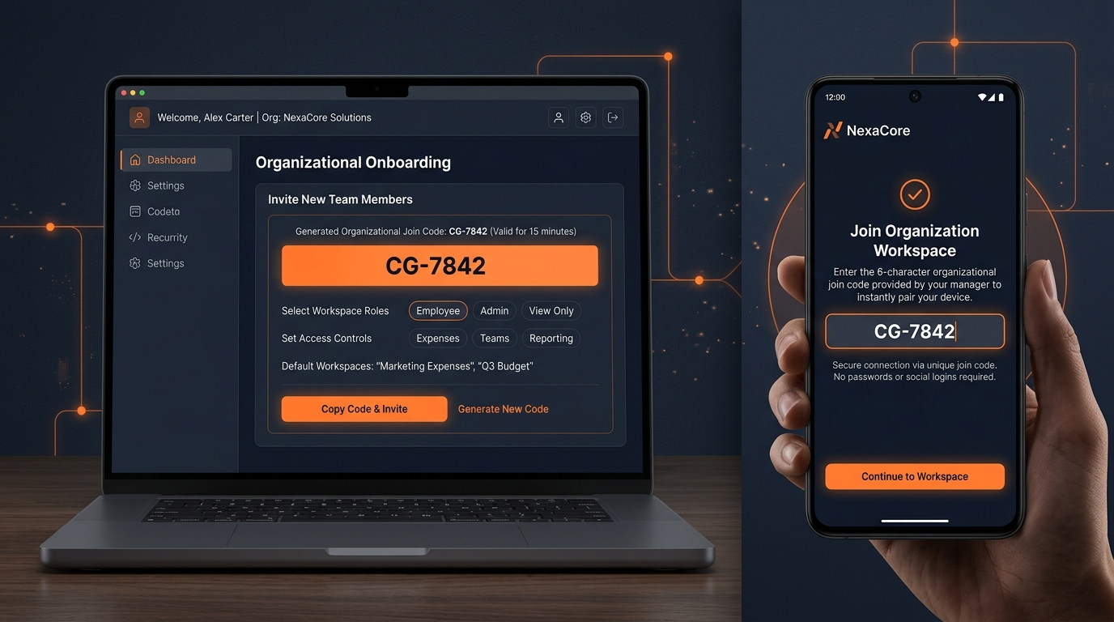
CONTROLLED ONBOARDING
Simple onboarding. Controlled access.
Manager Creates Workspace
Manager provisions organization with spending policies and branch parameters in the web portal.
Generates 6-Character Join Code
Temporary alpha-numeric code (e.g. 'CG-7842') generated with short TTL and role assignment.
Employee Pairs Device Instantly
Field staff enter the code in the mobile app. Device is cryptographically bound to the company.
No Social Login Lock-In
No Google accounts, corporate emails, or complex passwords required for drivers and field crew.
Secure Session JWT Tokens
Backend validates code, creates membership, and issues scoped access tokens stored in device keychain.
CLAIMGUARD PRODUCT PITCH | SLIDE 13 OF 15
Notes:
# Slide 13: Organization & Join Code — Frictionless, Controlled Onboarding
## SLIDE PURPOSE
Explain ClaimGuard's organization creation and temporary join code pairing model, highlighting the intentional absence of third-party social login dependencies for field staff.
## SAY THIS (45s)
"Onboarding distributed field teams presents a unique security and usability challenge. Requiring corporate email addresses, Google logins, or complex passwords for drivers, field technicians, or remote contractors causes massive drop-off and support tickets. ClaimGuard implements a frictionless, cryptographically secure Join Code architecture. A finance manager creates an organization in the dashboard and generates a temporary, 6-character alpha-numeric join code — like 'CG-7842' — with an expiration window and configurable role permissions. The field employee opens the mobile app, enters the code, and their device session is securely provisioned and bound to that organization. The join code is strictly an onboarding handshake, not a permanent password. Once validated, the server establishes a secure device token stored in encrypted local storage."
## SIMPLE EXPLANATION
To connect an employee to their company, the manager generates a simple 6-letter join code. The employee types it into their phone once, and their device is immediately and safely linked to the company account. No passwords, no corporate Google logins, and no confusion.
## TECHNICAL EXPLANATION
Join codes are hashed with SHA-256 and stored with short TTLs in the `organization_join_codes` table. The endpoint `/api/v1/auth/join` validates the code, decrements usage allowances, creates a row in `organization_memberships`, and issues a scoped JWT access token and refresh token stored via `flutter_secure_storage`.
## WHY IT MATTERS
Enterprise rollout speed depends directly on onboarding friction. Organizations can deploy ClaimGuard to hundreds of field personnel in minutes simply by distributing an organization code via WhatsApp or SMS.
## IMPORTANT CAVEAT
Join codes expire automatically after a configurable window (typically 15 to 60 minutes) or single use, preventing unauthorized access if a code is forwarded or leaked.
## TRANSITION
"Now that we've seen how the entire platform operates from onboarding to approval, what measurable business outcomes does ClaimGuard deliver?"

Slide 14
BUSINESS IMPACT
What ClaimGuard is designed to improve.
LESS MANUAL VERIFICATION
Automated OCR, math checks & GSTIN validation free managers from tedious receipt auditing.
FASTER REVIEW CYCLES
Field staff receive reimbursement decisions in days or hours instead of weeks, boosting morale.
EARLIER SUSPICIOUS SIGNALS
Duplicate hashes, historical spending spikes & fake tax IDs flagged before payouts are disbursed.
CENTRALIZED VISIBILITY
Unified audit trail and real-time dashboard provide complete oversight across all regional branches.
CLAIMGUARD PRODUCT PITCH | SLIDE 14 OF 15
Notes:
# Slide 14: Expected Outcomes — What ClaimGuard Is Designed to Improve
## SLIDE PURPOSE
Present the primary business, operational, and financial outcomes ClaimGuard is designed to achieve, adhering to strict honest positioning without fabricated statistics.
## SAY THIS (45s)
"What outcomes is ClaimGuard designed to improve? We focus on four foundational pillars. First: Less Repetitive Manual Verification. By automating data entry, mathematical consistency checks, and tax ID validation, managers spend their time evaluating genuine anomalies rather than squinting at paper bills. Second: Faster Review Cycles. Employees receive reimbursement decisions in days or hours rather than weeks, dramatically improving field workforce satisfaction. Third: Earlier Suspicious Signals. By catching duplicate image submissions, historical spending spikes, and invalid tax numbers instantly, organizations prevent improper payouts before money ever leaves company accounts. And fourth: Centralized Compliance Visibility. Leadership gains complete, auditable oversight across all regional branches and departments from a single pane of glass."
## SIMPLE EXPLANATION
ClaimGuard makes expense processing faster, easier, and safer. Employees get reimbursed much quicker, managers spend far less time doing boring data entry, company money is protected against duplicate or fraudulent receipts, and finance leaders always know exactly where money is being spent.
## TECHNICAL EXPLANATION
Operational efficiency stems from algorithmic triage: claims categorized as `LOW` risk (which typically comprise 70–80% of normal business expenses) can be bulk-approved in a single transactional batch, freeing manager compute and attention for the minority of `HIGH` and `CRITICAL` risk claims.
## WHY IT MATTERS
Every dollar saved on duplicate or ineligible expense reimbursements goes straight to operating margin, while accelerated reimbursement cycles eliminate employee friction.
## IMPORTANT CAVEAT
These outcomes represent the deliberate architectural objectives of ClaimGuard. We intentionally avoid fabricated quantitative claims like 'cuts fraud by exactly 94.2%' because real-world savings depend on an organization's specific policy enforcement and review diligence.
## TRANSITION
"Finally, let's look at our development roadmap and where ClaimGuard is heading next."

Slide 15
PRODUCT ROADMAP & CLOSING
From receipt verification to an intelligent expense workflow.
PHASE 1 (CURRENT)
Core receipt verification, OCR extraction, deterministic fraud rules & manager dashboard.
PHASE 2 (NEXT)
Advanced risk intelligence with 90-day rolling behavioral baselines and peer group clustering.
PHASE 3 (ANALYTICS)
Organization-wide benchmark heatmaps, category leak analysis, and tax audit export.
PHASE 4 (MESSAGING)
Conversational WhatsApp receipt submission channel [FUTURE INTEGRATION].
PHASE 5 (ERP CONNECTORS)
Direct two-way accounting sync into SAP, Tally, and Zoho Books [FUTURE INTEGRATION].
CLAIMGUARD PRODUCT PITCH | SLIDE 15 OF 15
Notes:
# Slide 15: Future & Closing — From Verification to an Intelligent Workflow
## SLIDE PURPOSE
Deliver a compelling strategic close, presenting the phased product roadmap (distinguishing implemented capabilities from planned enterprise integrations) and returning to ClaimGuard's core value proposition.
## SAY THIS (50s)
"To close: ClaimGuard is already fundamentally transforming receipt verification from an error-prone manual chore into an evidence-based, risk-prioritized workflow. Looking ahead, our product roadmap expands in five clear phases. Phase 1 is our core receipt verification platform, which is fully operational today. Phase 2 deepens our risk intelligence with rolling 90-day behavioral baselines. Phase 3 introduces organizational analytics and branch benchmark heatmaps. In Phase 4, we will introduce conversational WhatsApp submission as an optional zero-download channel — labeled here as a future integration. And in Phase 5, we will build direct ERP connectors into SAP, Tally, and Zoho Books. In summary: ClaimGuard bridges field submission, cloud document intelligence, deterministic fraud math, and manager decision-making into one unified, auditable platform. From receipt submission to risk-aware decision making — that is ClaimGuard. Thank you, and we look forward to your questions."
## SIMPLE EXPLANATION
Today, ClaimGuard gives you complete receipt verification and risk scoring. Tomorrow, we are connecting it directly to WhatsApp and major accounting software like Tally and SAP so that field expenses flow seamlessly straight into your company general ledger.
## TECHNICAL EXPLANATION
The roadmap builds upon our channel-agnostic provider architecture. Because the core pipeline communicates via abstract `NotificationChannel` interfaces, adding WhatsApp Business Cloud API webhooks or SAP RFC connectors requires only implementing dedicated adapters without refactoring core fraud or risk scoring engines.
## WHY IT MATTERS
Organizations don't want a throwaway point solution. They want an extensible platform that integrates with their existing communication habits and enterprise software ecosystem.
## IMPORTANT CAVEAT
We strictly distinguish between active features and future roadmap items. The core Flutter mobile app, Fastify API, Textract OCR, deterministic fraud engine, risk scoring, Bedrock narrative synthesis, and Manager Dashboard are implemented and demonstrated. WhatsApp messaging and direct Tally/SAP sync are planned enterprise additions.
## TRANSITION
"Thank you very much. We are now ready to demonstrate the live system or take any technical and product questions."

