Slide 1




A New Catalogue of Europium Abundances for GALAH DR4
Sarah Kane
In collaboration with Zofia Kaczmarek, Andrew Garner, Sven Buder, Stephanie Monty, Vasily Belokurov, and Hanyuan Zhang
Marshall Scholarships

Slide 2






An era of large spectroscopic surveys

Slide 3
Two approaches for stellar spectroscopy
“Traditional”
Data Driven

Slide 4
Two approaches for stellar spectroscopy
“Traditional”
Uses model stellar atmospheres and radiative transfer calculations to determine abundances from observed absorption features
  Either via synthesis of the feature or measurements of equivalent widths
Different tools give different results!

Slide 5
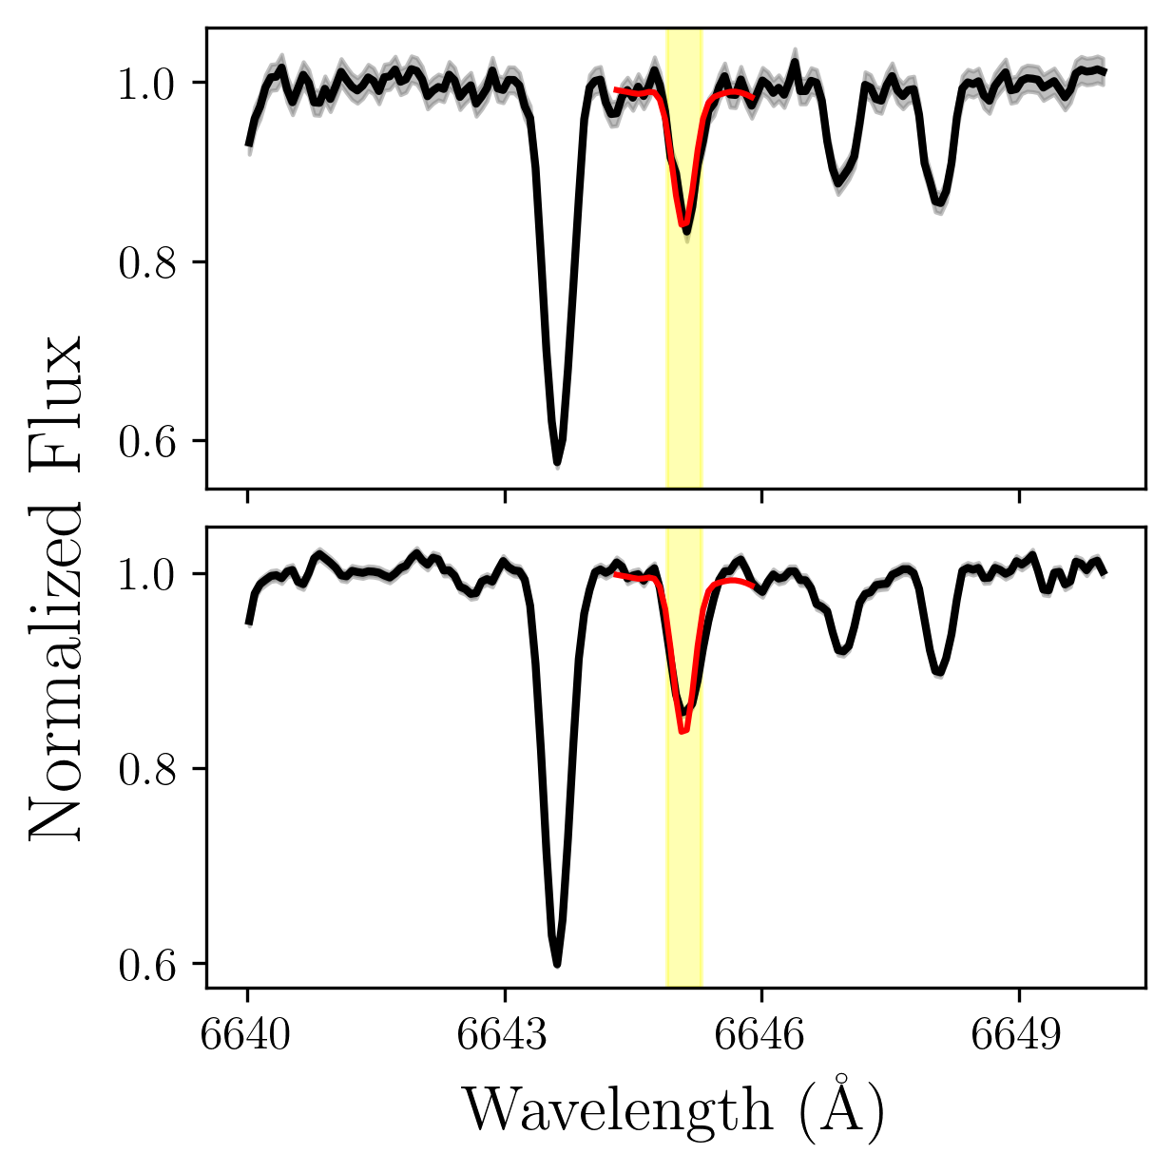
Two approaches for stellar spectroscopy
“Traditional”
Uses model stellar atmospheres and radiative transfer calculations to determine abundances from observed absorption features
  Either via synthesis of the feature or measurements of equivalent widths
Different tools give different results!

Slide 6
Two approaches for stellar spectroscopy
“Traditional”
Data Driven
Uses model stellar atmospheres and radiative transfer calculations to determine abundances from observed absorption features
  Either via synthesis of the feature or measurements of equivalent widths
Different tools give different results!
Takes “reference stars” with trusted labels (see Ness 2018) and fits a model to predict these labels for new spectra
  Examples include: the Cannon, the Payne, astroNN
Does not replace ”traditional” approaches!

Slide 7



Slide 8
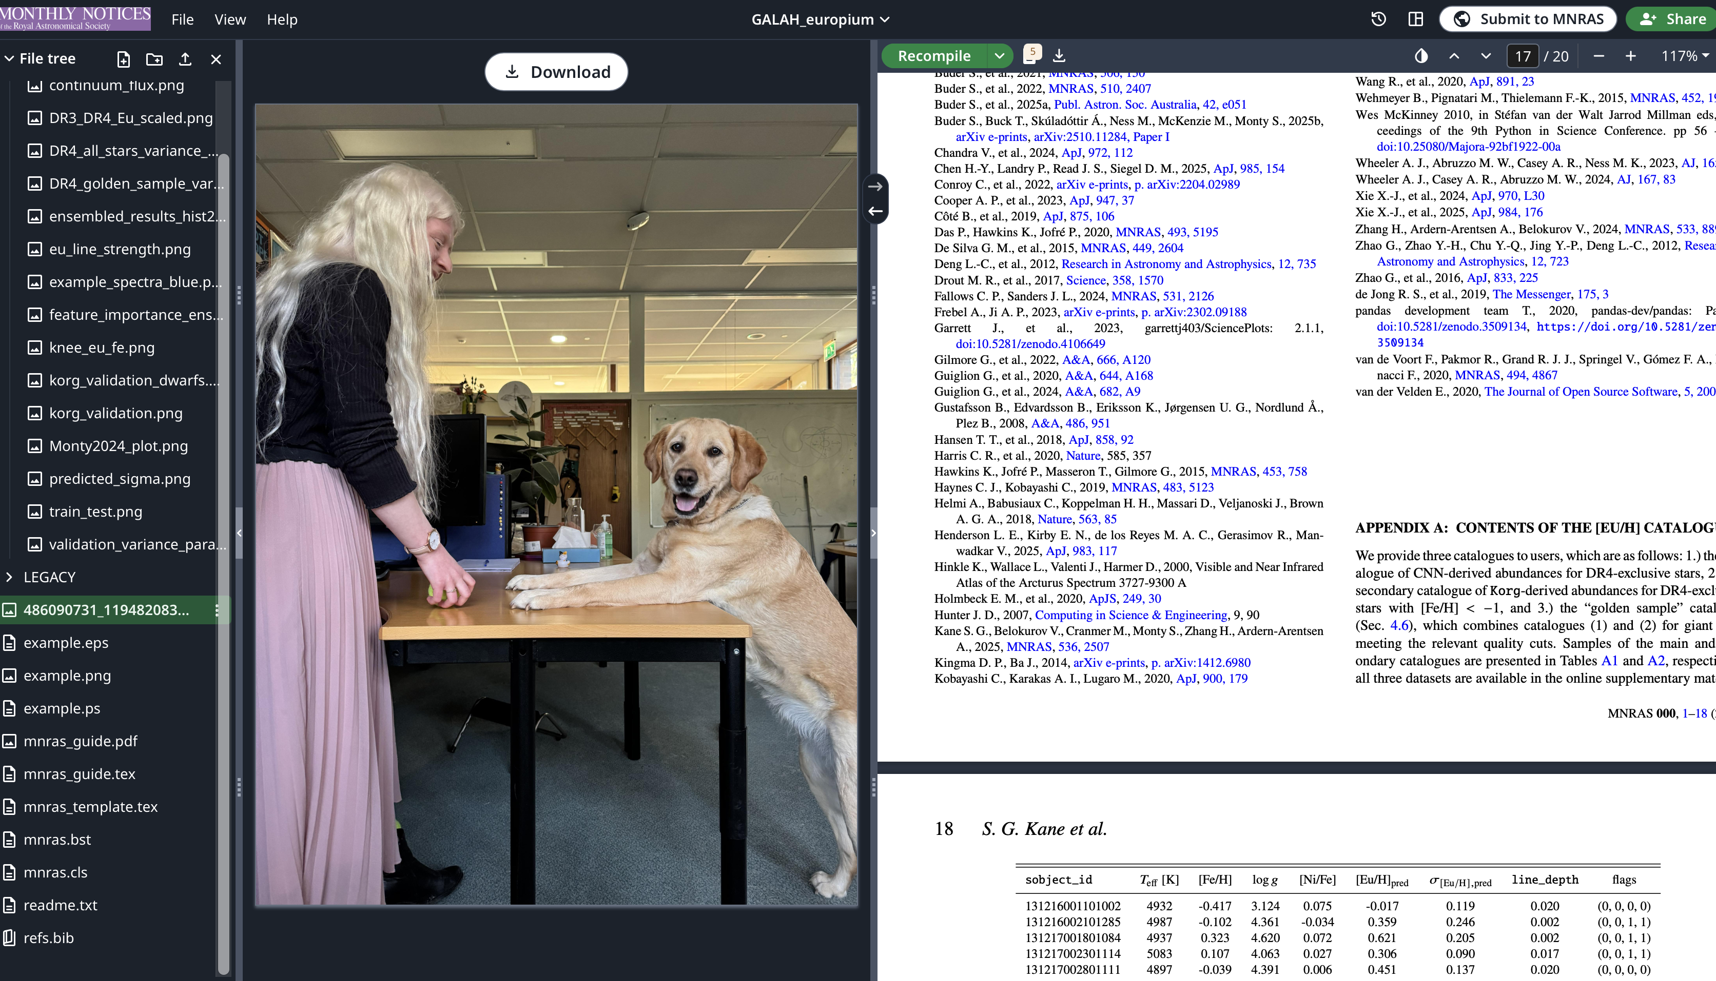

Slide 9
Why does europium need its own catalogue?

Slide 10
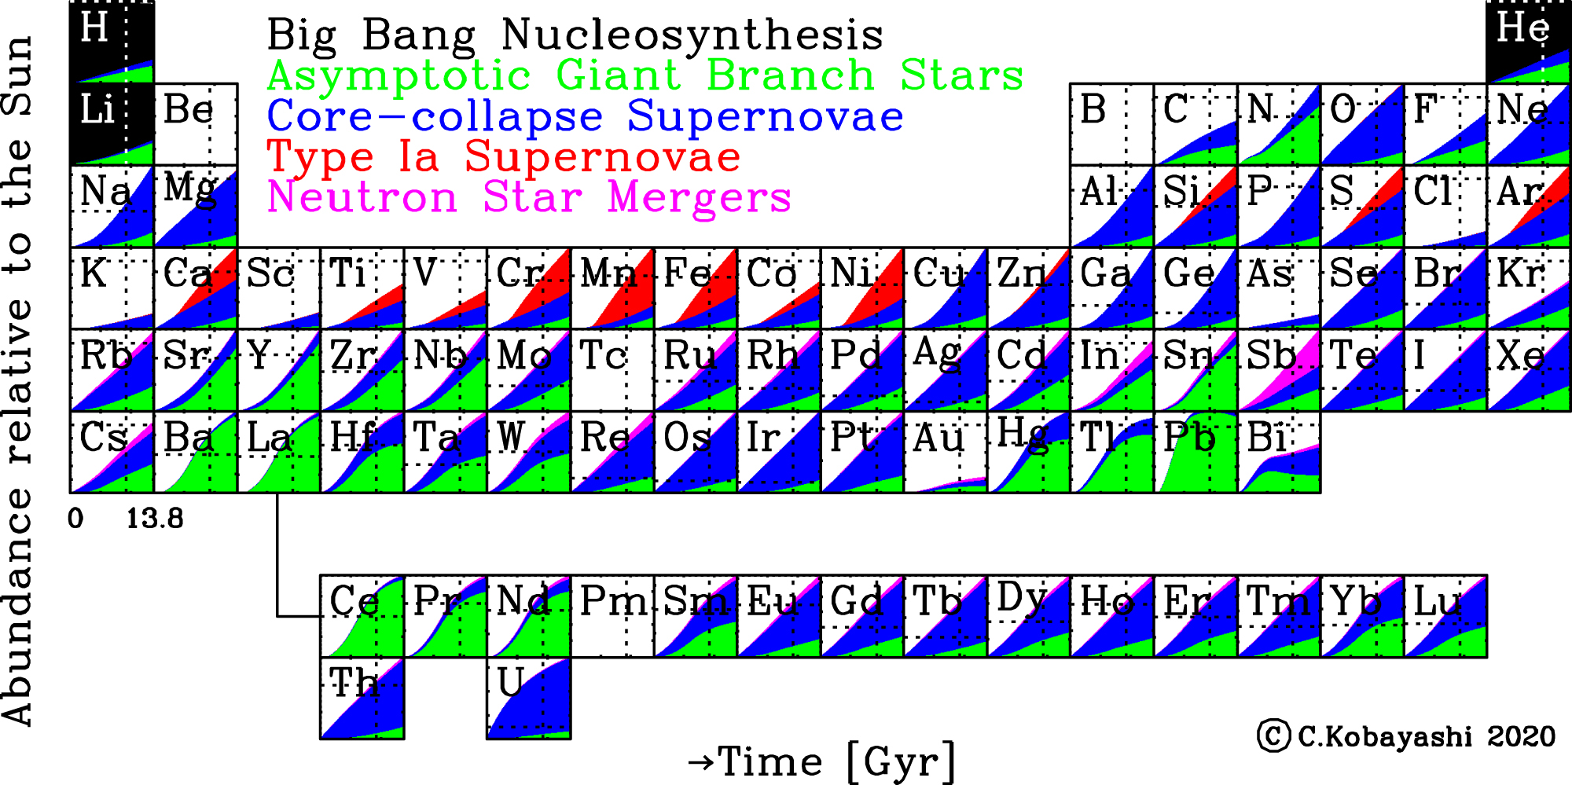
Kobayashi+ 2020

Slide 11
Kobayashi+ 2020

Slide 12
Kobayashi+ 2020

Slide 13
Europium and the r-process
Rapid neutron capture (r-process) creates ~half the heavy elements in the Universe (see e.g., Cowan+ 2021)
  Th, U, Eu…
Occurs in neutron star mergers, (Abbott+ 2017; Smartt+ 2017; Drout+ 2017), maybe also rare core-collapse SNe (e.g., Côté+ 2019, Kobayashi+ 2020)
Many r-process elements are difficult to measure.
  Eu is the most feasible because it has a line in the optical (@ 6645 Å).

Slide 14
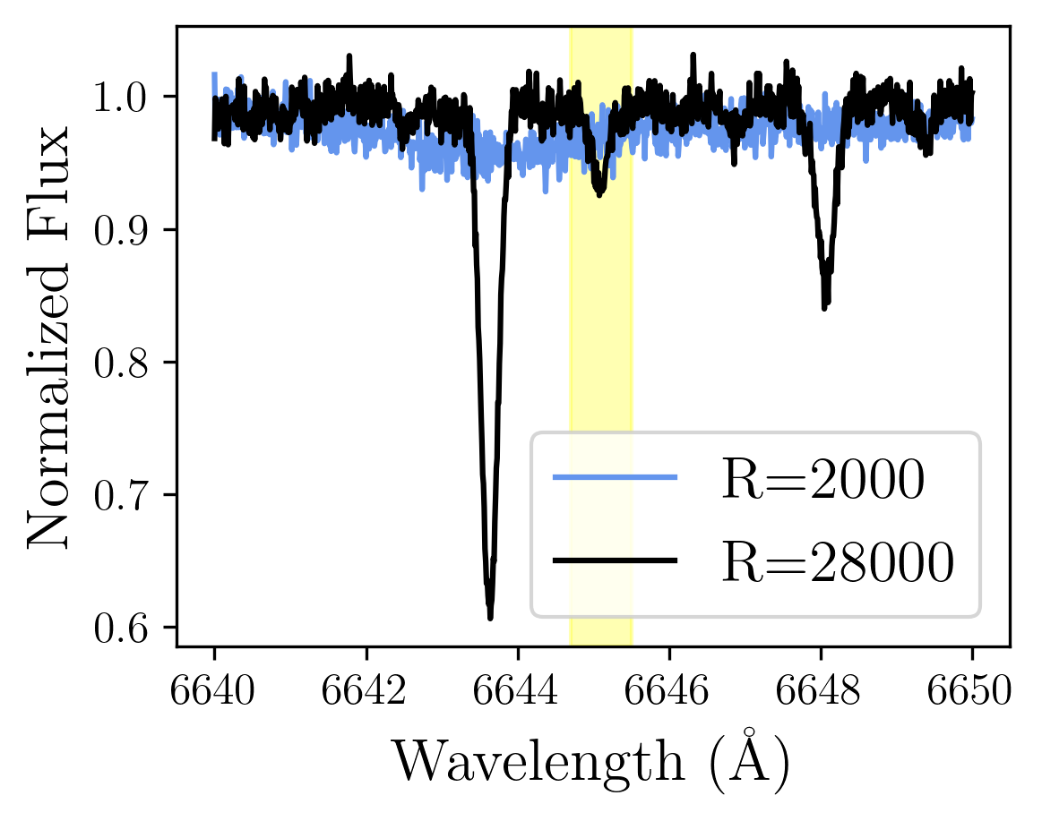
The GALAH Survey
Large, Australian-based stellar spectroscopic survey
Unlike many other surveys (e.g., APOGEE), GALAH has the wavelength range and resolution (R~28,000) to capture the Eu feature at ~6645 Å
Recent DR4 switched from a “traditional” approach to neural network-based abundances trained on synthetic spectra
Eu

Slide 15
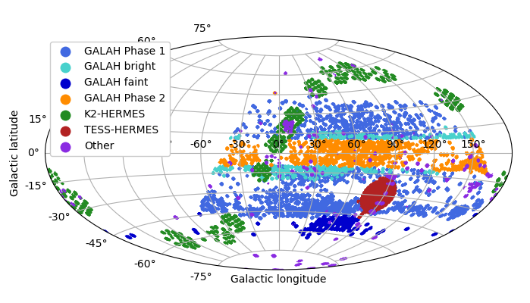
The GALAH Survey
The GALAH Collaboration
GALAH DR4 has 917,588 stars (Buder+ 2025)
  As compared to 588,571 stars in GALAH DR3 (Buder+ 2021)
  Including much more disk coverage

Slide 16
New europium abundances for GALAH DR4
The baseline: GALAH DR3 had Eu measurements that were broadly community-tested and trusted
The problem: GALAH DR4’s Eu abundances are broken
The solution: Produce ”GALAH DR3 style” Eu abundances for DR4

Slide 17
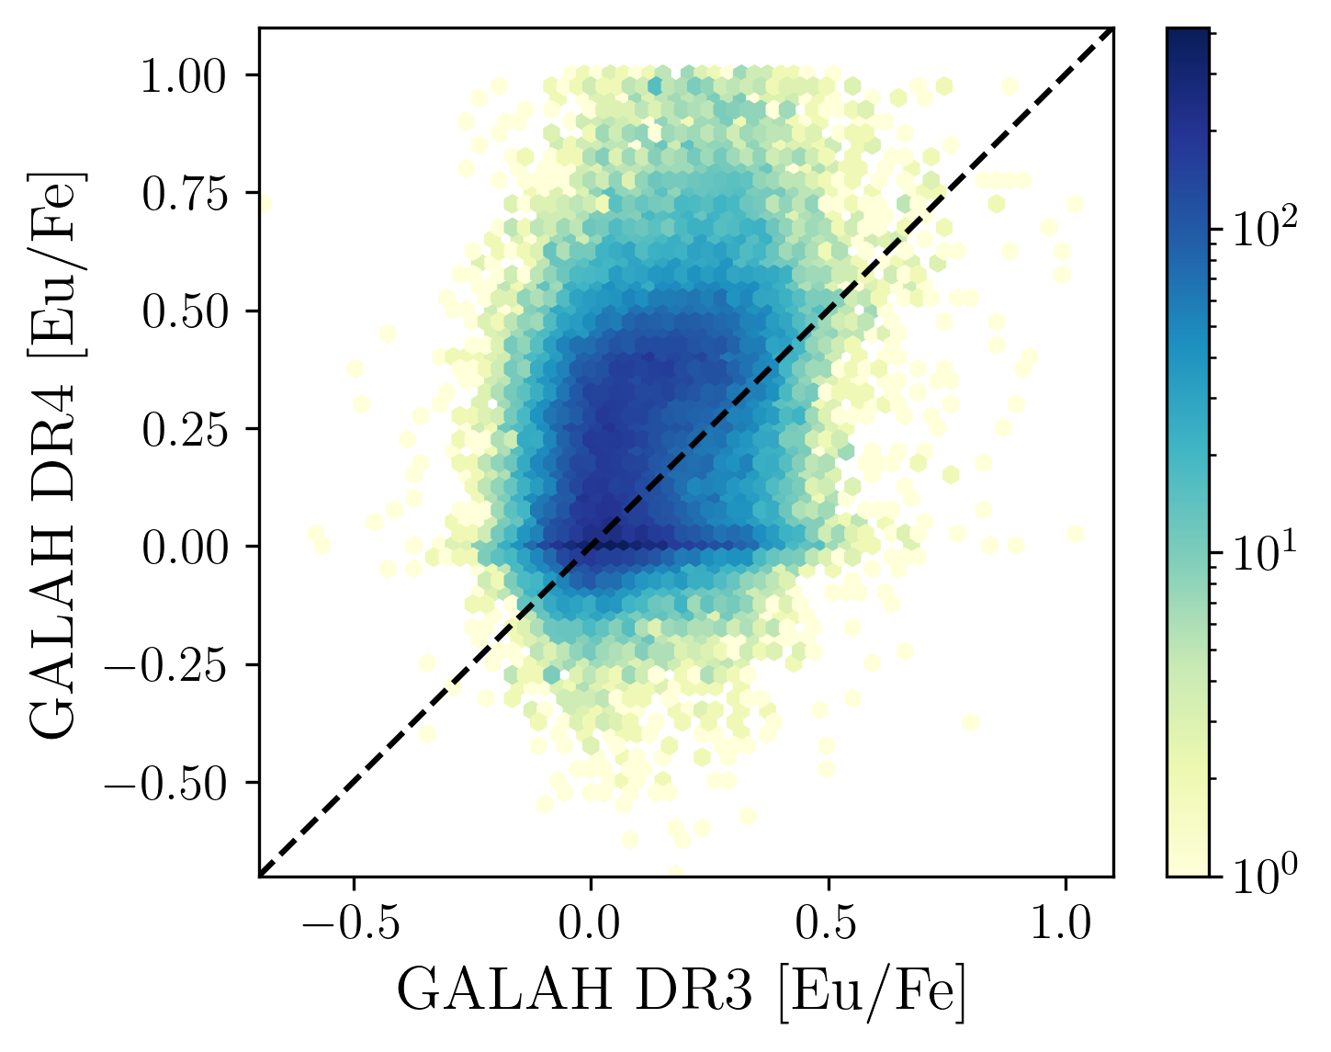
New europium abundances for GALAH DR4
The baseline: GALAH DR3 had Eu measurements that were broadly community-tested and trusted
The problem: GALAH DR4’s Eu abundances are broken
The solution: Produce ”GALAH DR3 style” Eu abundances for DR4

Slide 18
New europium abundances for GALAH DR4
The baseline: GALAH DR3 had Eu measurements that were broadly community-tested and trusted
The problem: GALAH DR4’s Eu abundances are broken
The solution: Produce ”GALAH DR3 style” Eu abundances for DR4

Slide 19
A label transfer exercise:
We want to take GALAH DR4 spectra and predict “DR3 style” [Eu/H] values
An excellent use case for a neural network!

Slide 20
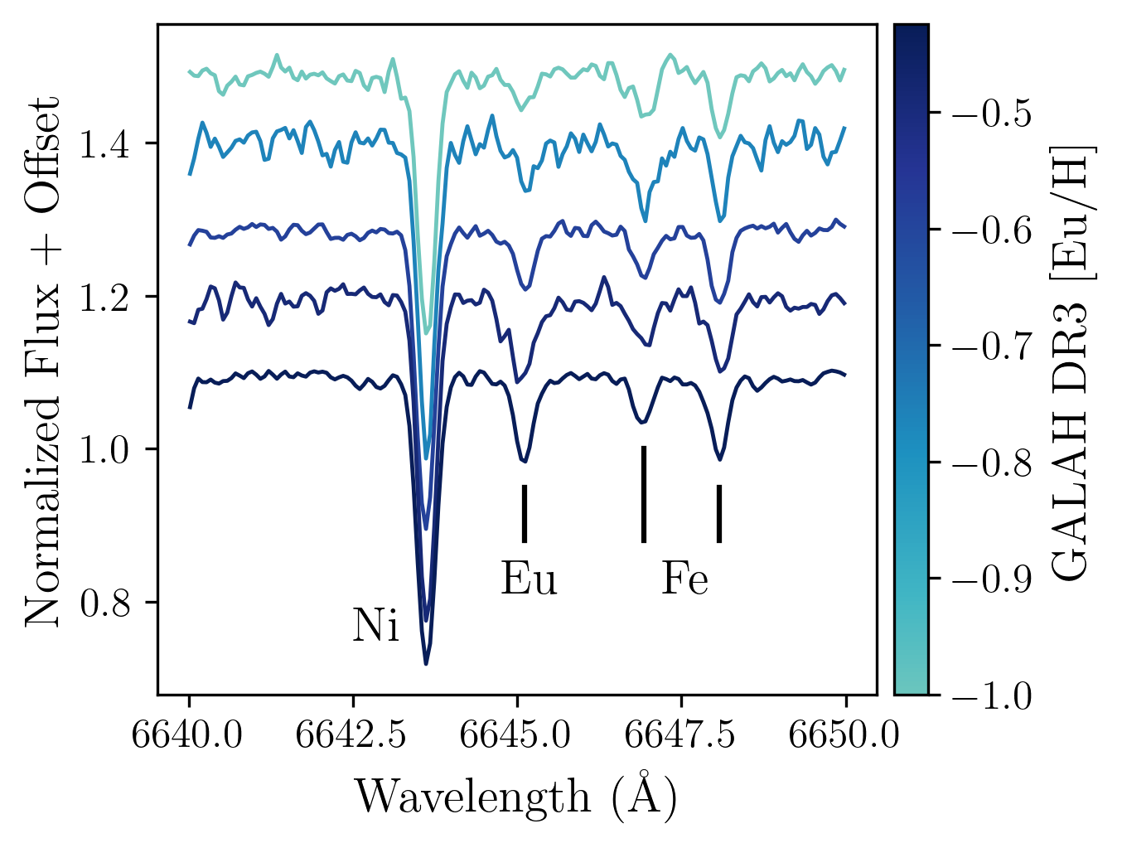
A label transfer exercise:
We want to take GALAH DR4 spectra and predict “DR3 style” [Eu/H] values
10 Å section of a GALAH spectrum
(centered on Eu feature)
GALAH DR4 stellar parameters
(T_{eff}, log(g), [Fe/H], [Ni/Fe])

Slide 21
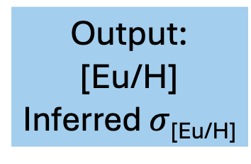
A label transfer exercise:
We want to take GALAH DR4 spectra and predict “DR3 style” [Eu/H] values
10 Å section of a GALAH spectrum
(centered on Eu feature)
1D Convolutions
Output:
[Eu/H]
Inferred $σ$_{[Eu/H]}
Combine
GALAH DR4 stellar parameters
(T_{eff}, log(g), [Fe/H], [Ni/Fe])
Fully Connected
(Linear) Layers

Slide 22
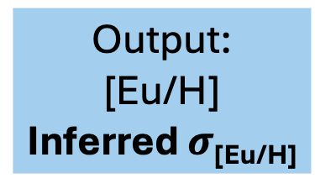

A label transfer exercise:
We want to take GALAH DR4 spectra and predict “DR3 style” [Eu/H] values
10 Å section of a GALAH spectrum
(centered on Eu feature)
1D Convolutions
Output:
[Eu/H]
Inferred $σ$_{[Eu/H]}
Combine
GALAH DR4 stellar parameters
(T_{eff}, log(g), [Fe/H], [Ni/Fe])
Fully Connected
(Linear) Layers
$loss=\frac{(μ_{pred}−y_{true})^{2}}{{(σ}_{pred})^{2}}+log⁡((σ_{pred})^{2}$)

Slide 23
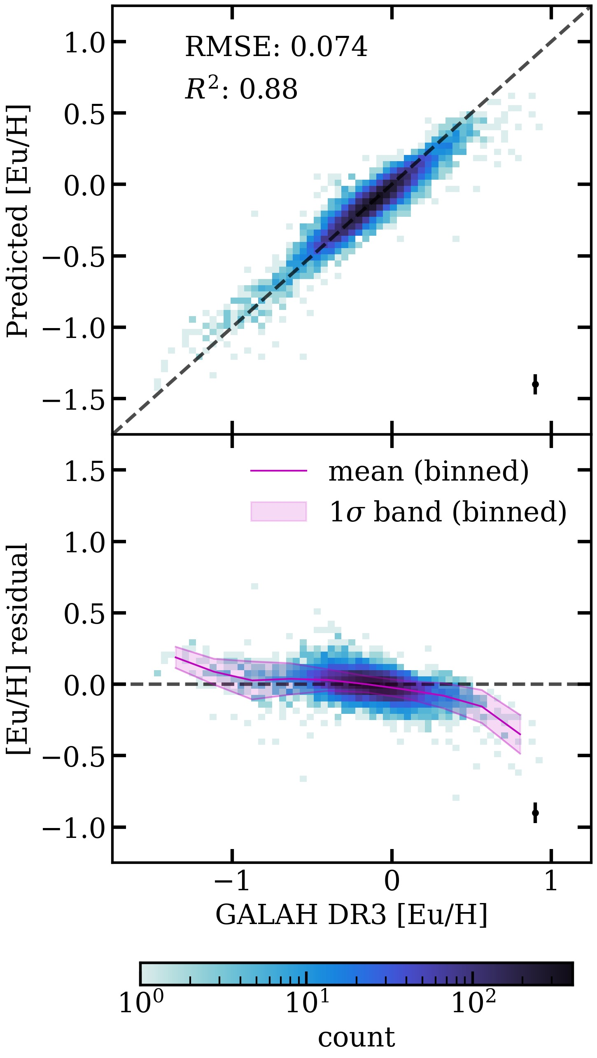

Validation Performance
20% subset of the training data withheld to test the performance of the network
Residuals $≤$ 0.1 dex on average
  $R^{2}=0.88$ (as compared to $R^{2}=−2.1$ from the original GALAH DR4 Eu)

Slide 24
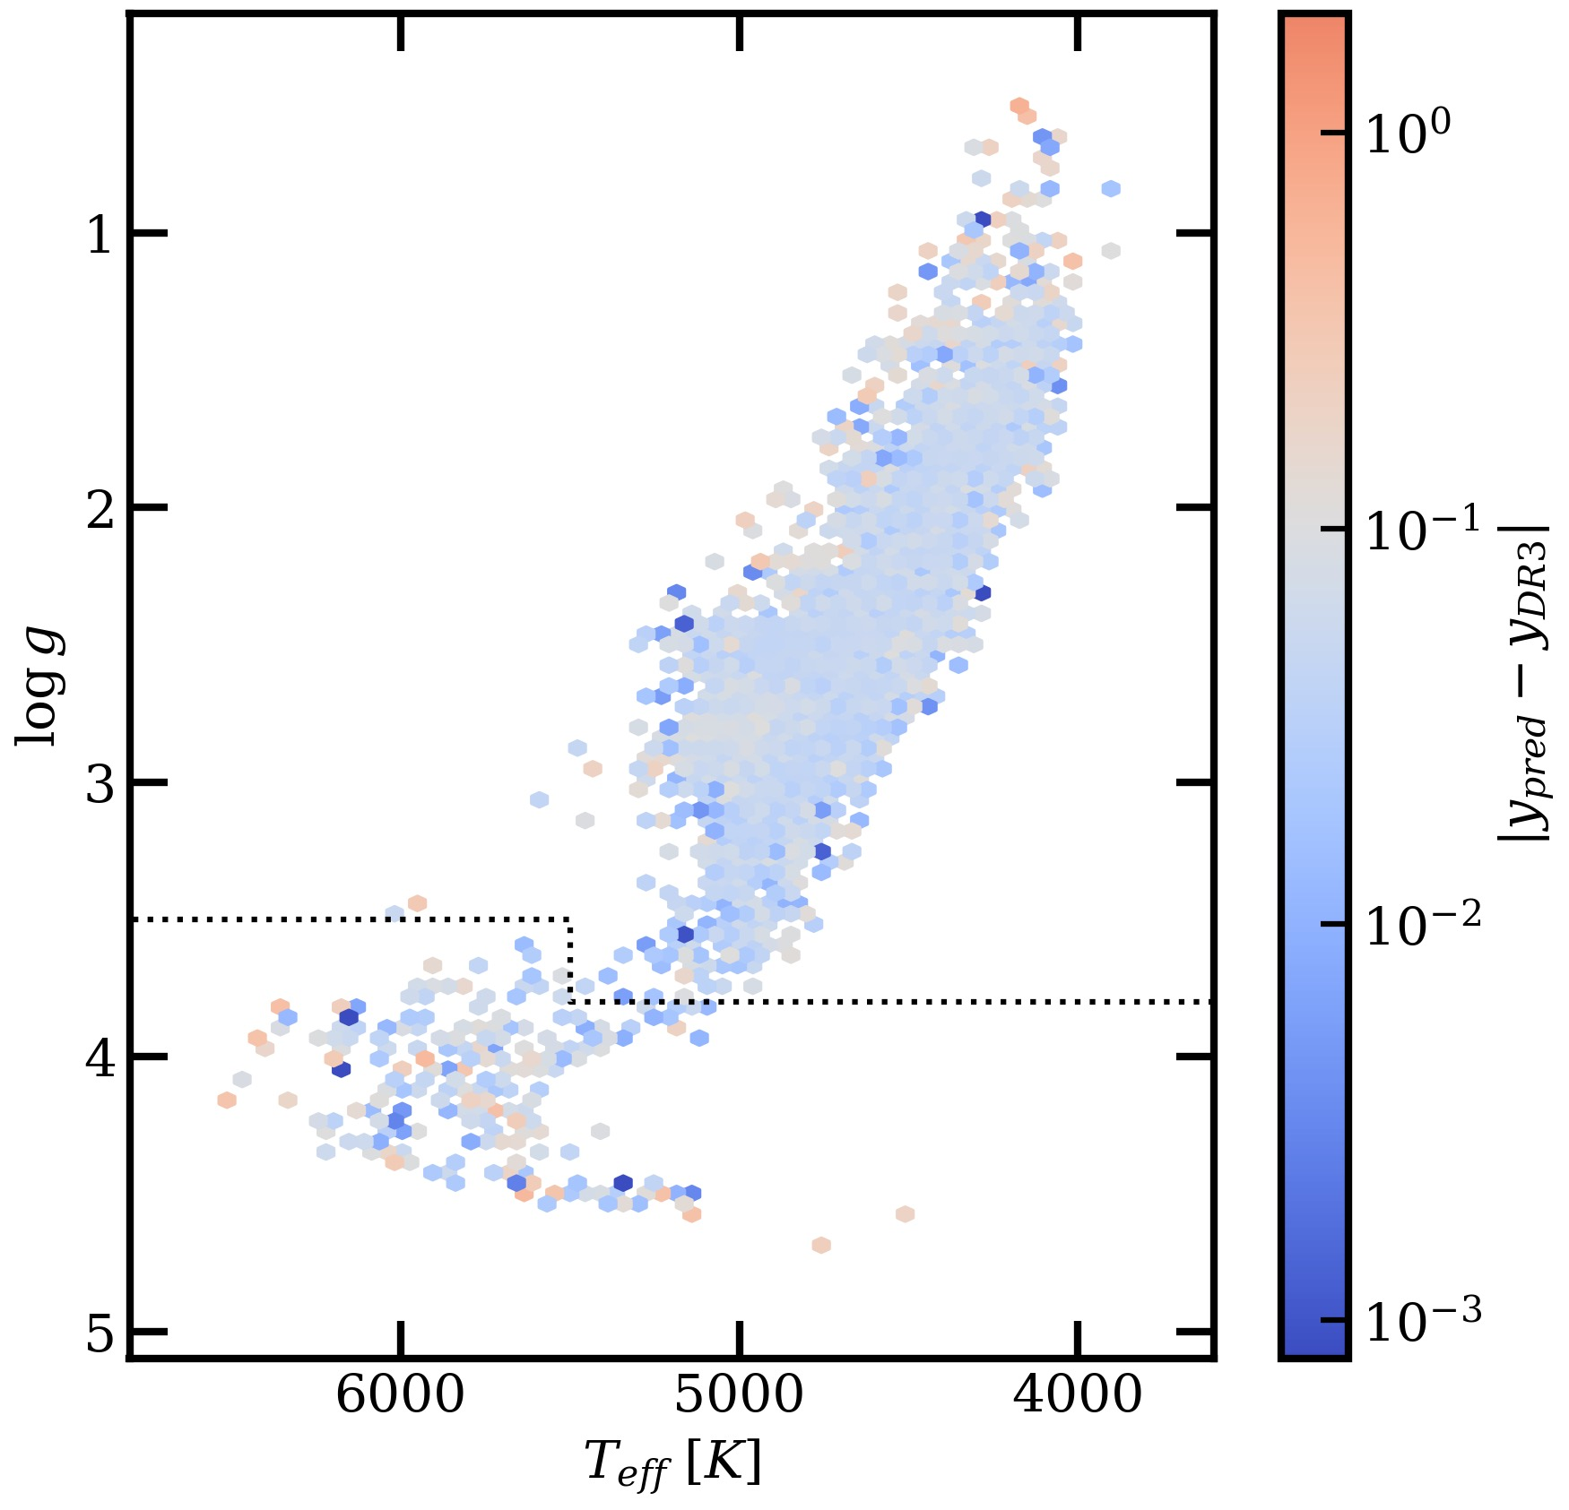

Validation Performance
20% subset of the training data withheld to test the performance of the network
Residuals $≤$ 0.1 dex on average
  $R^{2}=0.88$ (as compared to $R^{2}=−2.1$ from the original GALAH DR4 Eu)
  This performance ~holds true across the Kiel diagram

Slide 25
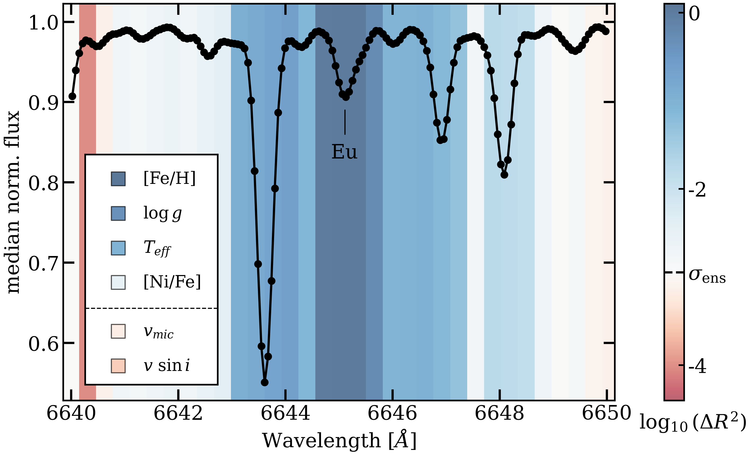

Feature Importance
Colors correspond to how much the $R^{2}$ value decreases by “scrambling” that value
  Darker blue → scrambling decreases performance → this feature is important!
[Fe/H] and the Eu line are the most important features

Slide 26
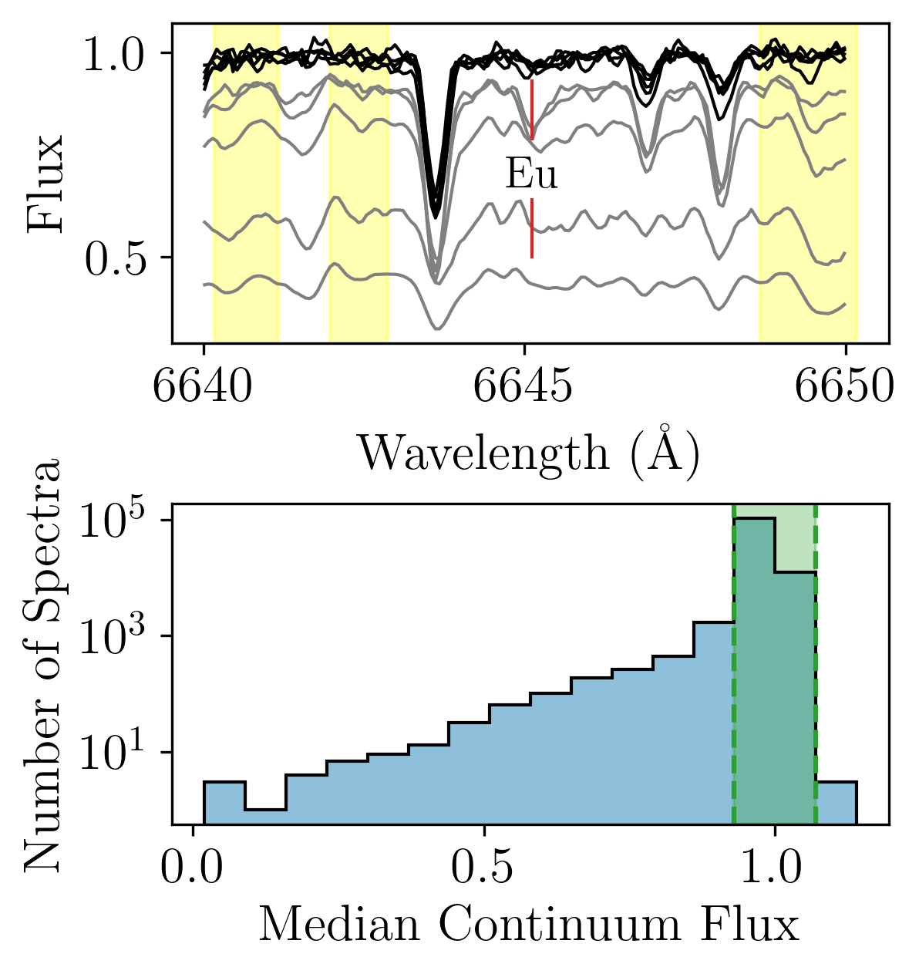
The validation dataset cannot tell the whole story
By its nature, the validation data is well-represented by the training data.
  This is not necessarily true for the new data to which we apply the CNN!
For instance, the new DR4 data included more cool (T < 4000 K) stars with strange continuum normalization

Slide 27
Metal-Poor Stars
Metal-poor stars have the lowest [Eu/H] values
Because of “regression towards the mean,” the CNN consistently over-predicts [Eu/H] for low metallicity stars on the order of a few ~0.1 dex
What doesn’t work?
  Upweighting metal-poor stars
  Upsampling metal-poor stars
  Decreasing SNR requirements

Slide 28
Metal-Poor Stars
Metal-poor stars have the lowest [Eu/H] values
Because of “regression towards the mean,” the CNN consistently over-predicts [Eu/H] for low metallicity stars on the order of a few ~0.1 dex
Solution: calculate Eu abundances for stars with [Fe/H] <-1 using Korg (Wheeler+ 2023, 2024)

Slide 29
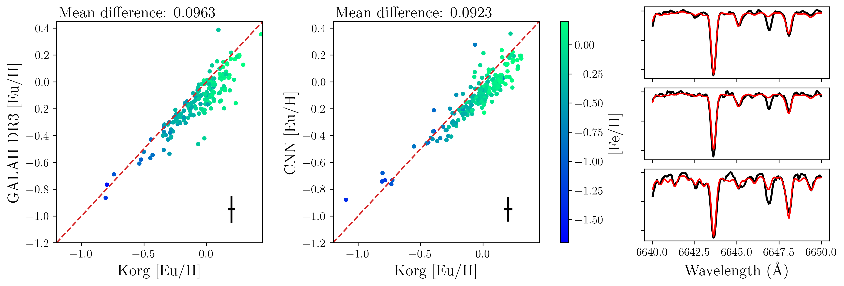
Why data-driven?
Computational speed
Consistency with GALAH DR3
  DR4 uses different methodology → different stellar parameters, different abundances
  A different radiative transfer code (e.g., Korg) using DR4 stellar parameters cannot reproduce GALAH DR3 [Eu/H] abundances

Slide 30

A golden sample of Eu abundances
Giant stars with:
  $T_{eff}>4000$ K
  [Fe/H] $>−1.7$
  No continuum normalization issues
  Eu line depth $>0.01$
Korg abundances are used for all metal-poor stars ([Fe/H] $<−1.0$)
54,068 stars total

Slide 31
Science Validation
AKA: Does the catalogue work?

Slide 32
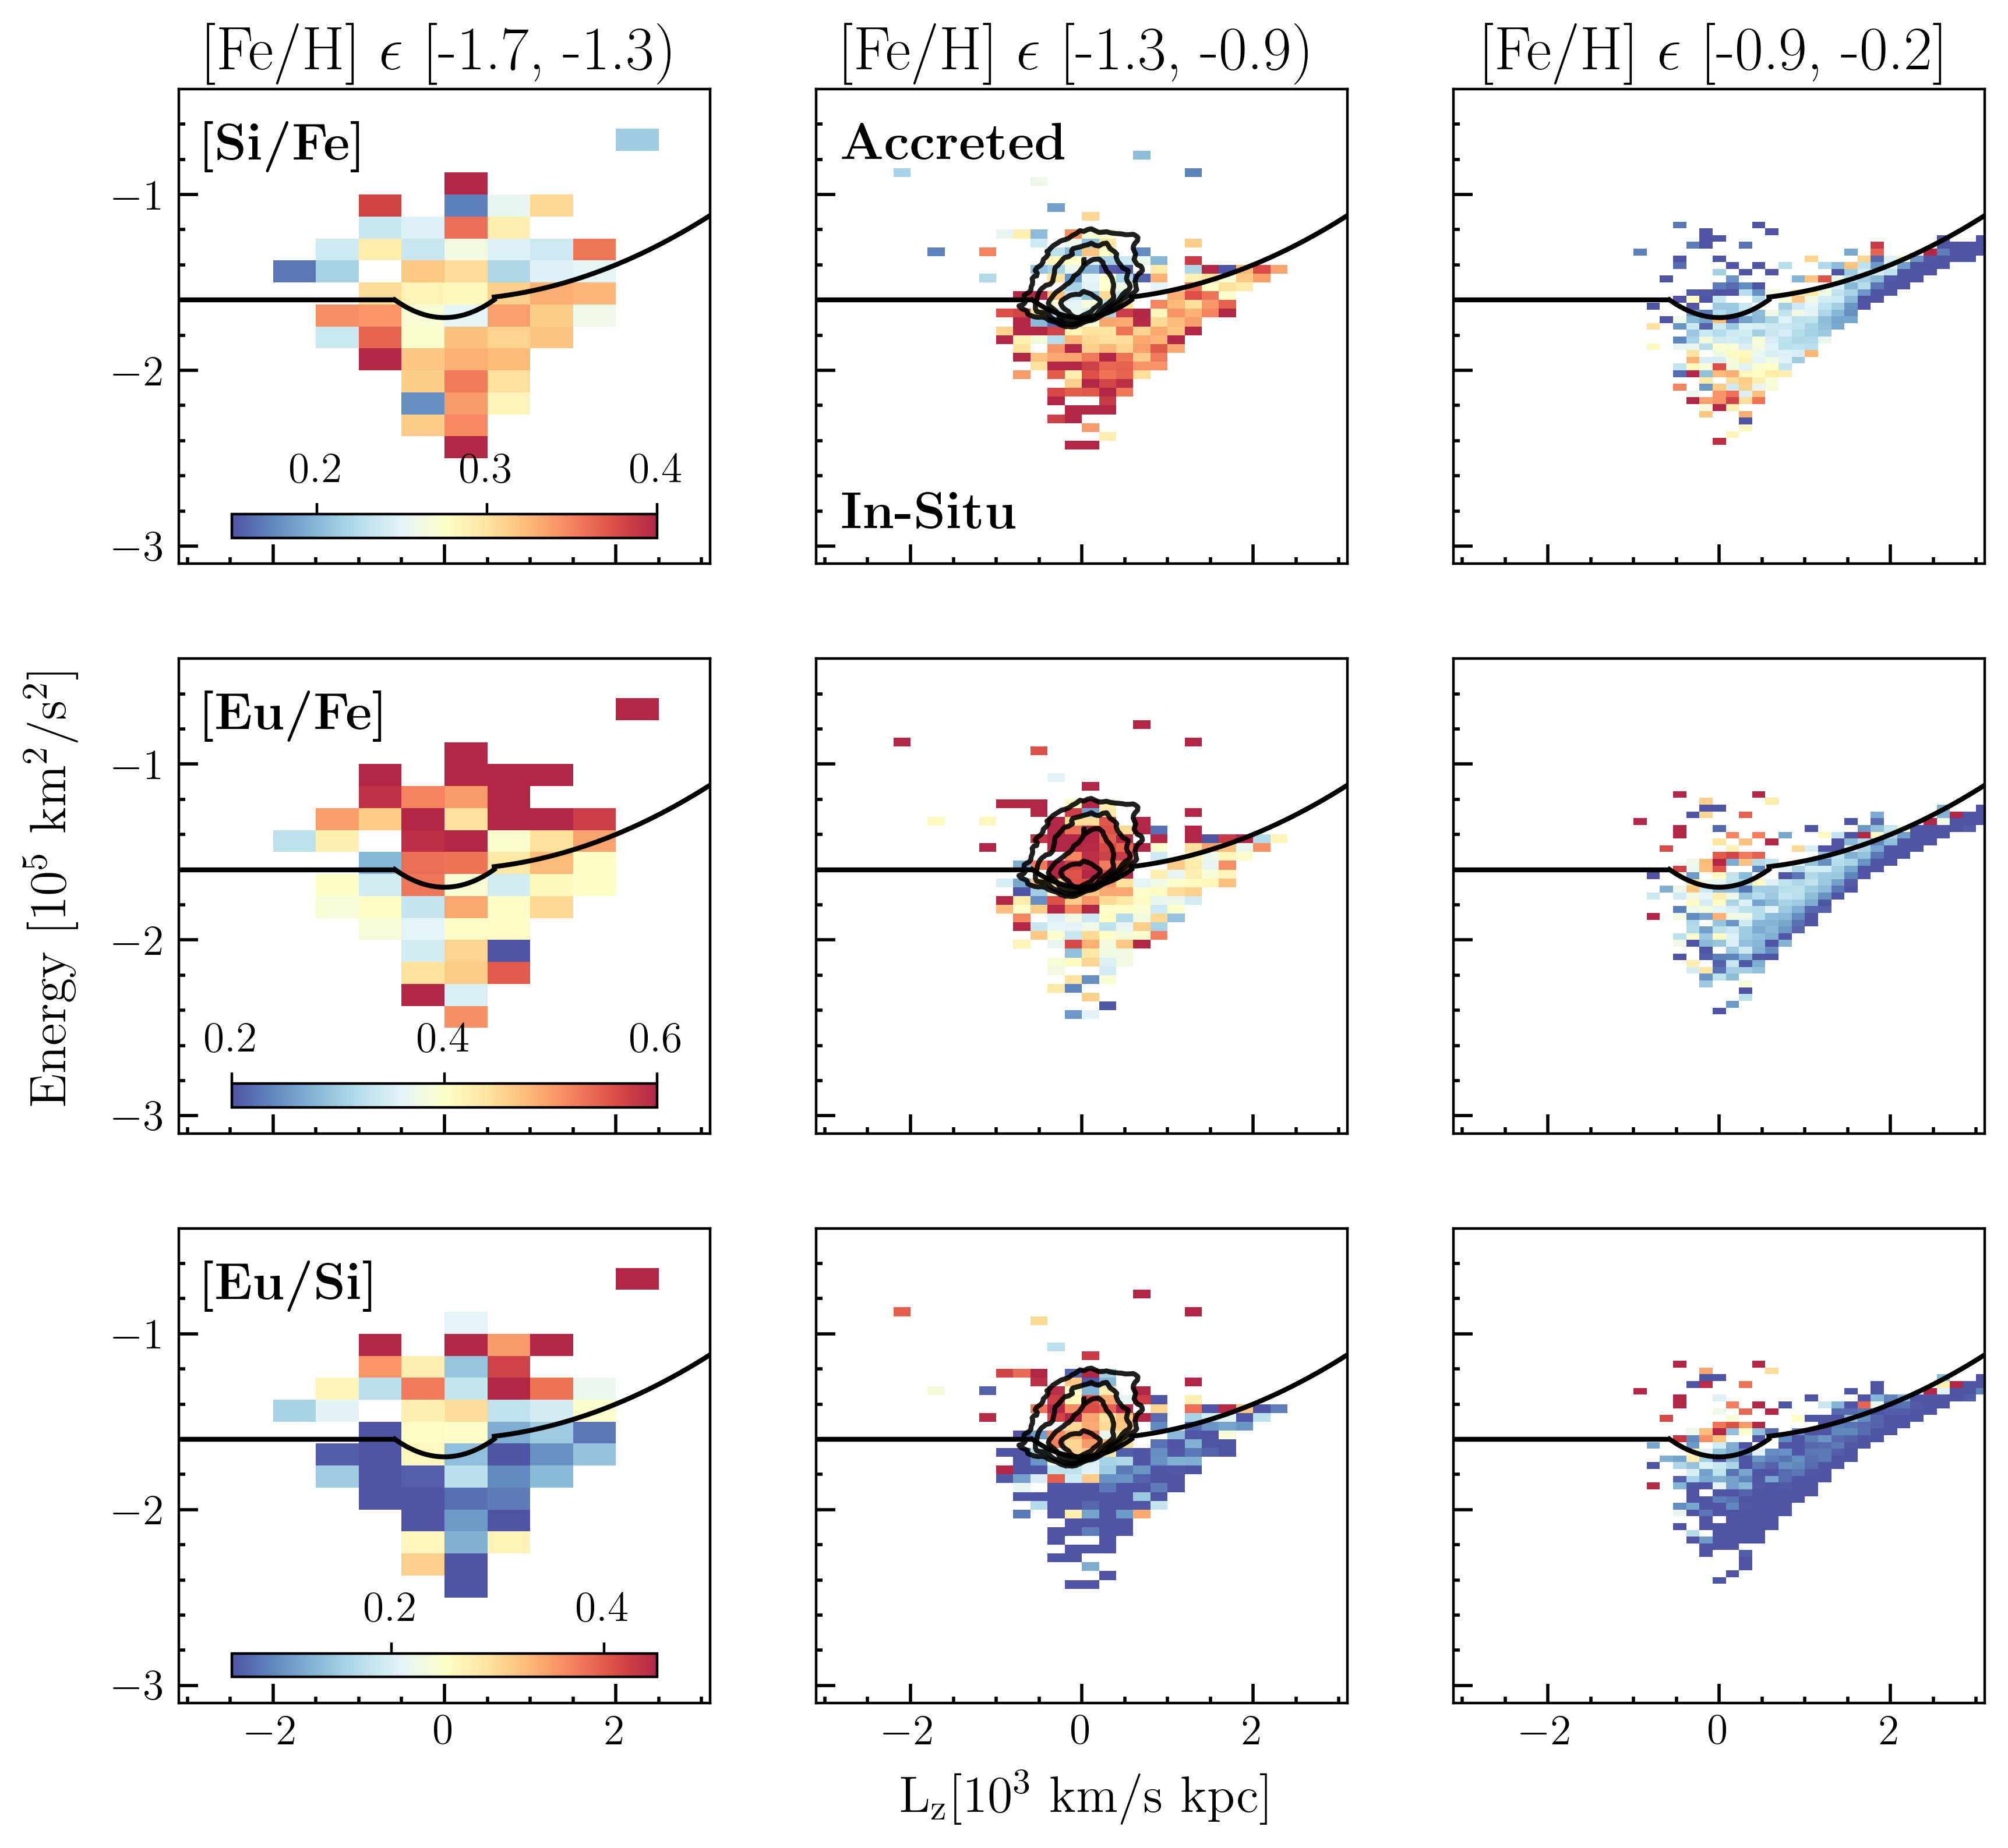
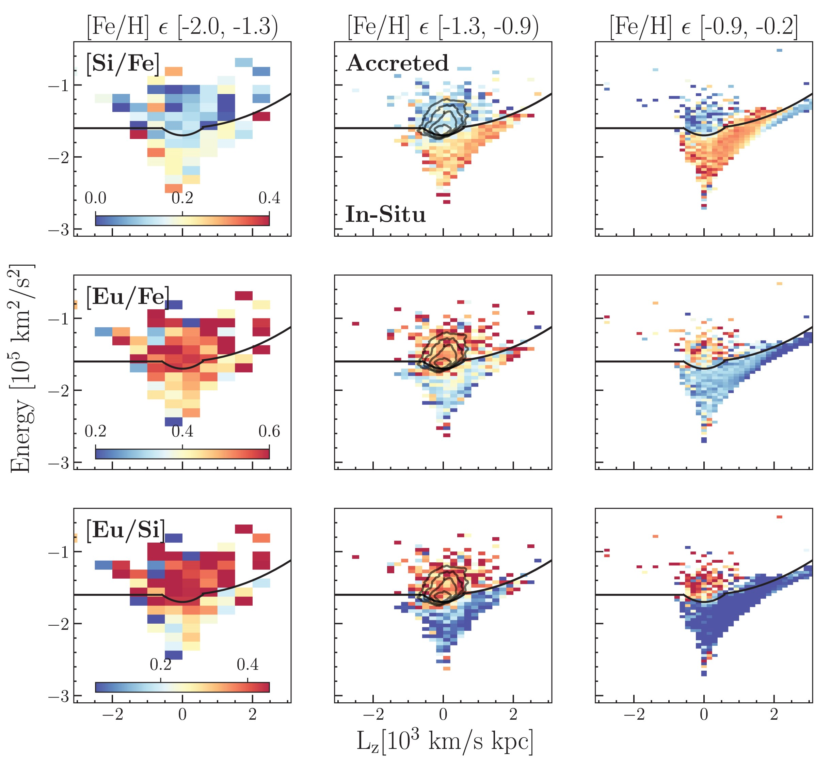

Accreted
With GALAH DR3
Monty+ 2024
In situ
Gaia-Sausage/Enceladus and accreted stars shown to be elevated in Eu compared to in situ stars (Matsuno+ 2021, Aguado+ 2021)
Monty+ 2024 demonstrates that this chemical separation is further improved by using [Eu/$α$]

Slide 33
Accreted
With GALAH DR3
Monty+ 2024
In situ
With GALAH DR4
Kane+ 2025

Slide 34
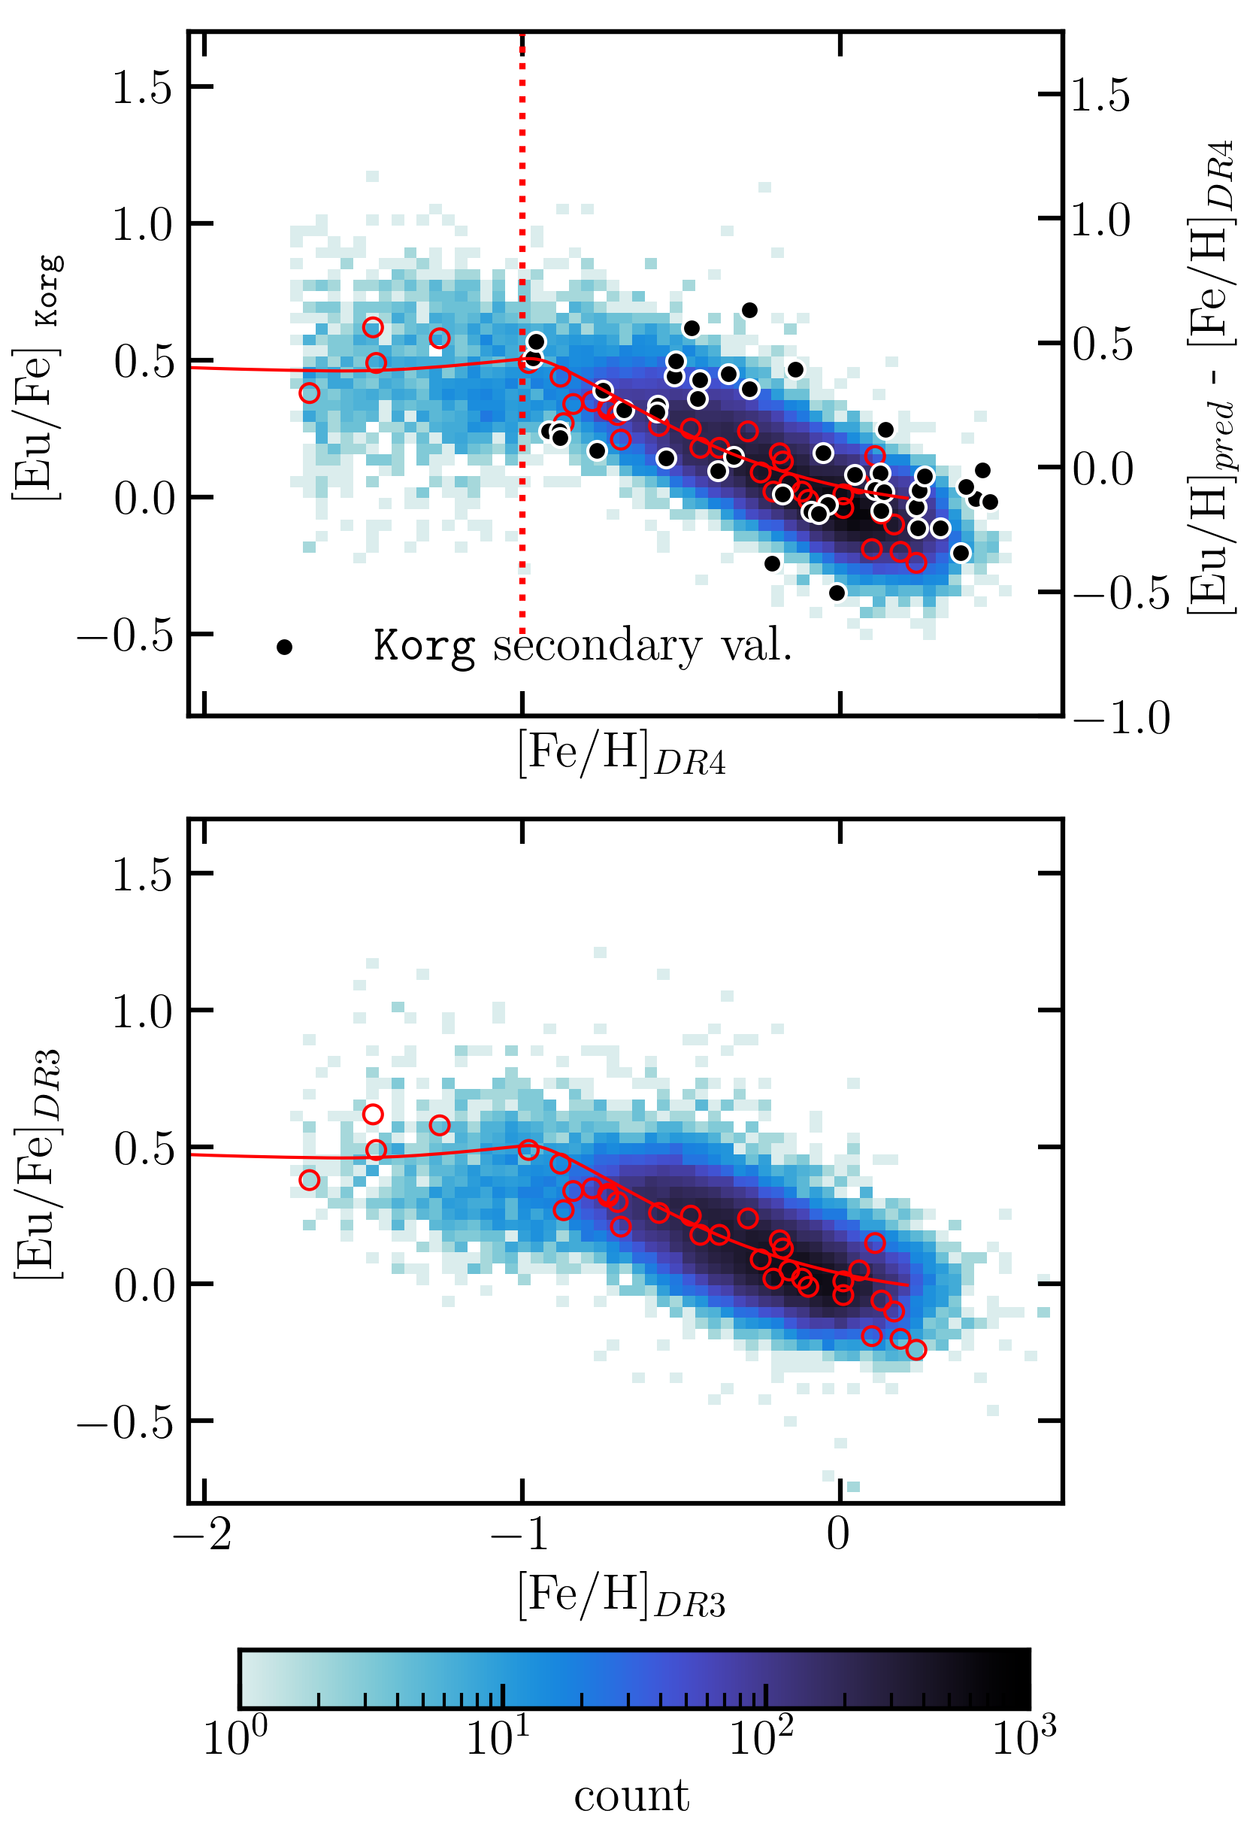
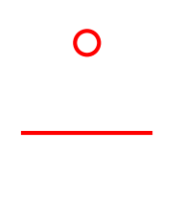
Eu trends with metallicity
GALAH DR4
Clear pattern in [Eu/Fe] versus [Fe/H] (~age)
  Difficult to interpret as a single trend due to contributions of in situ and accreted components (Monty+ 2024)
[Fe/H] < -1: Higher Eu, with significant scatter
[Fe/H] > -1: Steadily decreasing Eu with increasing Fe
  Scatter decreases
GALAH DR3
Zhao et al. (2016)
Kobayashi et al. (2020)

Slide 35


A new catalog of Eu abundances for GALAH DR4
A new catalog of CNN-based Eu abundances for 118,946 GALAH DR4 stars with SNR > 50
  Includes a “golden sample” of 54,068 giants, with Korg synthesis for metal-poor stars
  On a homogenous scale with GALAH DR3 [Eu/H]
Reproduces known science results
  Elevated [Eu/Fe] in accreted stars as compared to in situ stars (Matsuno+ 2021, Aguado+ 2021, Monty+ 2024)
  Known Galactic chemical evolution trends with [Fe/H] (see Kobayashi+ 2020)
Paper
Zenodo catalog

