Slide 1
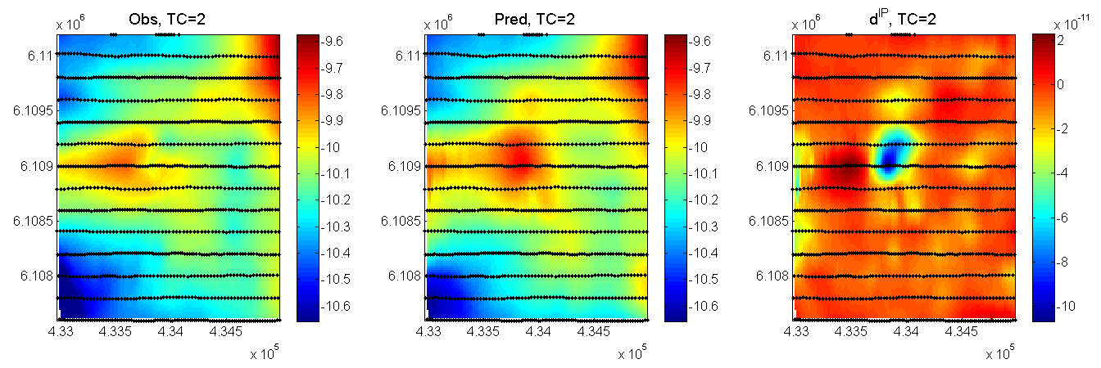
Northing (m)
Easting (m)
(a)
Easting (m)
(b)
Easting (m)
(c)

Slide 2
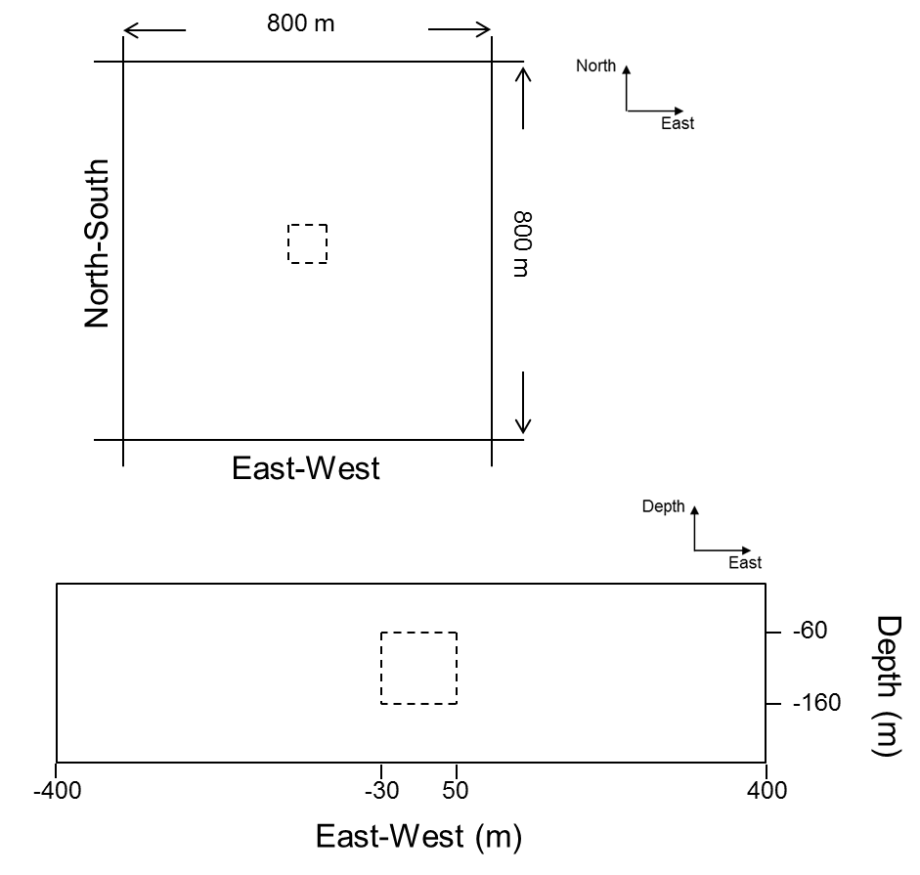
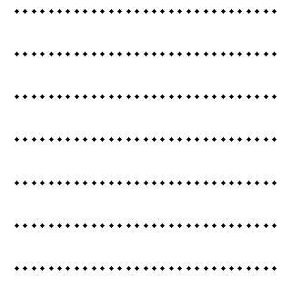
σ_{∞ half-space} = 5×10⁻⁴ S/m
η _{half-space} = 0
σ_{∞ block} = 6.25×10⁻² S/m
η _{block} = 0.2
τ _{block} = 0.01
c _{block} = 1

Slide 3
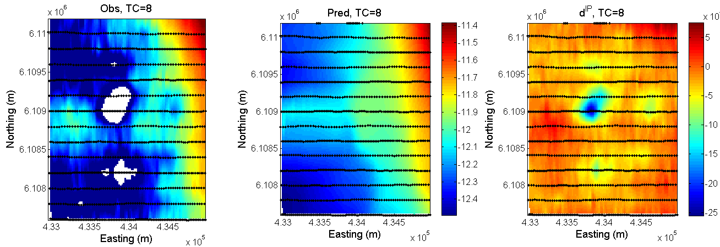
db/dt (T/s)
(b)

Slide 4
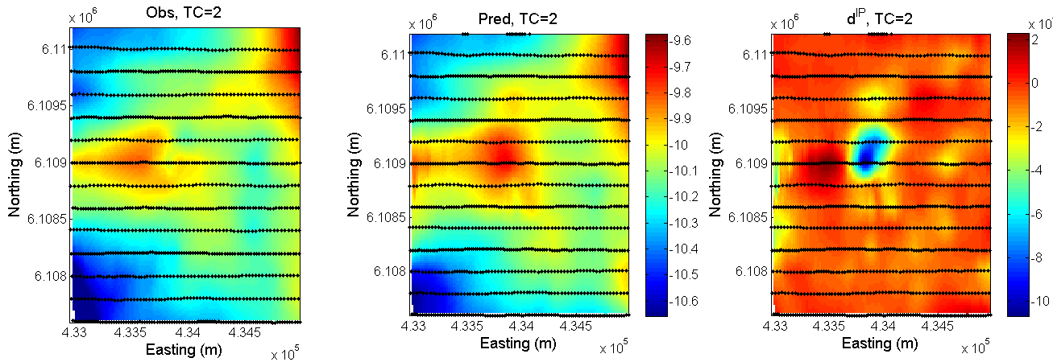
-11
db/dt (T/s)
(a)
db/dt (T/s)
(b)

Slide 5
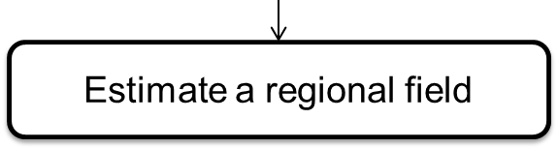
ATEM-IP inversion flow
Attempt to avoid soundings/times that have IP coupling effects
Easy if there are negative transients
Invert TEM to recover a background 3D σ∞ model
Compute d ^{IP} data at multiple time channels
Assume IP data are composed of a smoothly varying regional plus true IP data
Subtract regional to obtain
IP data
Not easy; but this issue is confronted before
Invert individual
time channels

Slide 6
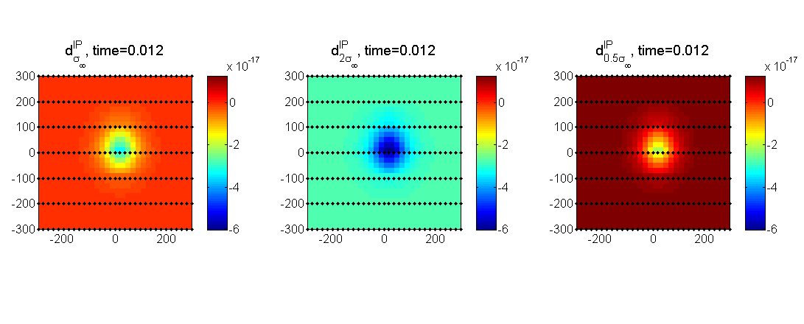
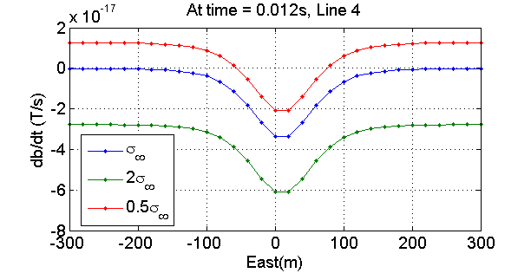
True
background (σ∞)
Wrong
Background (2×σ∞)
Wrong
background (0.5×σ∞)
(a)
(b)
Notes:
It seems that something wrong need to ask dikun?

Slide 7
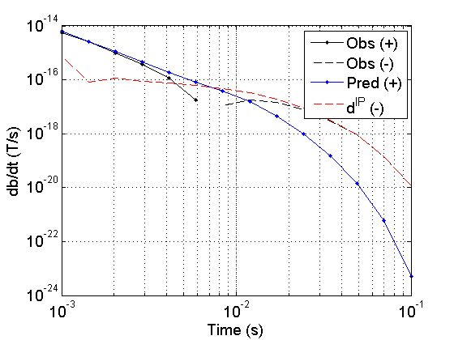
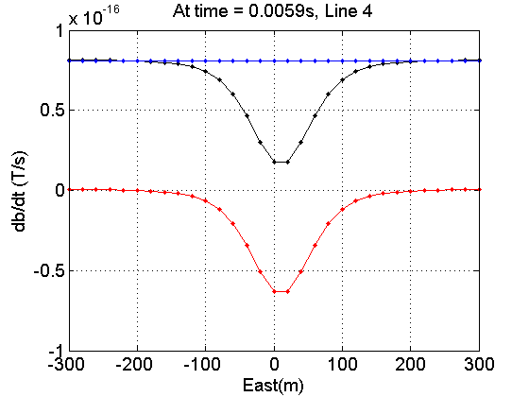
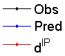
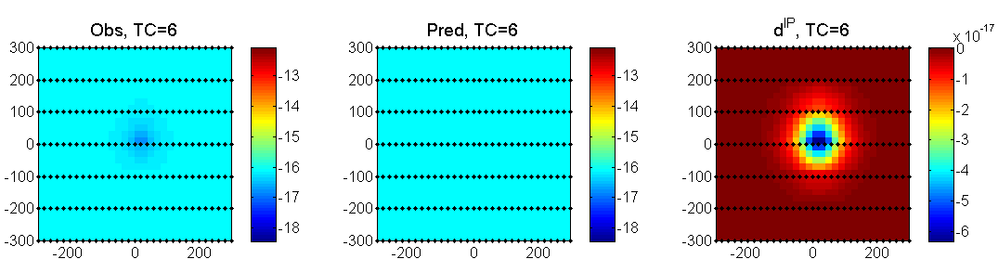
log₁₀ (db/dt)
log₁₀ (db/dt)
db/dt (T/s)

Slide 8
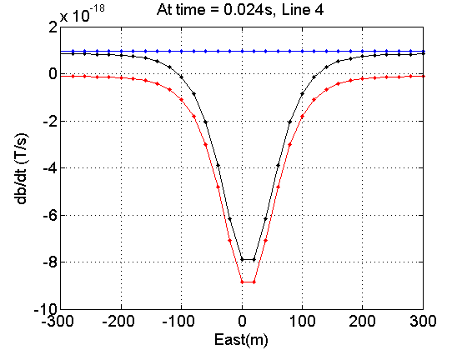
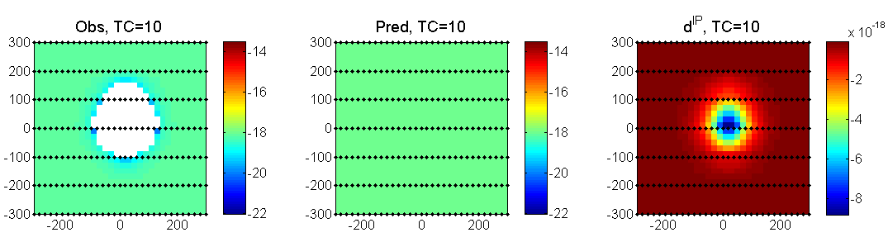
log₁₀ (db/dt)
log₁₀ (db/dt)
db/dt (T/s)

Slide 9
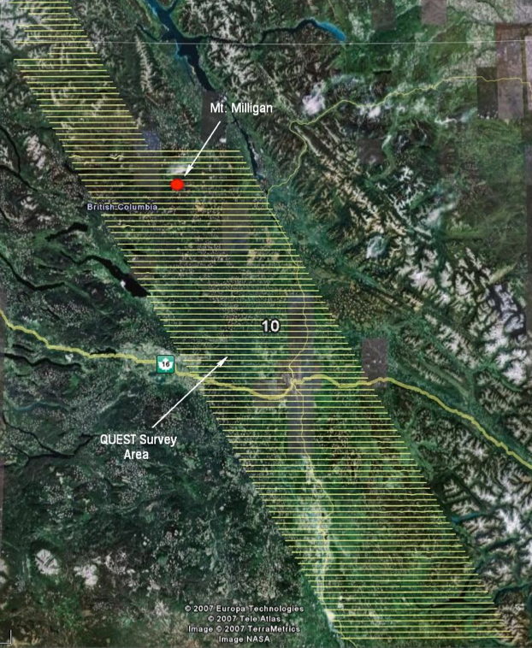
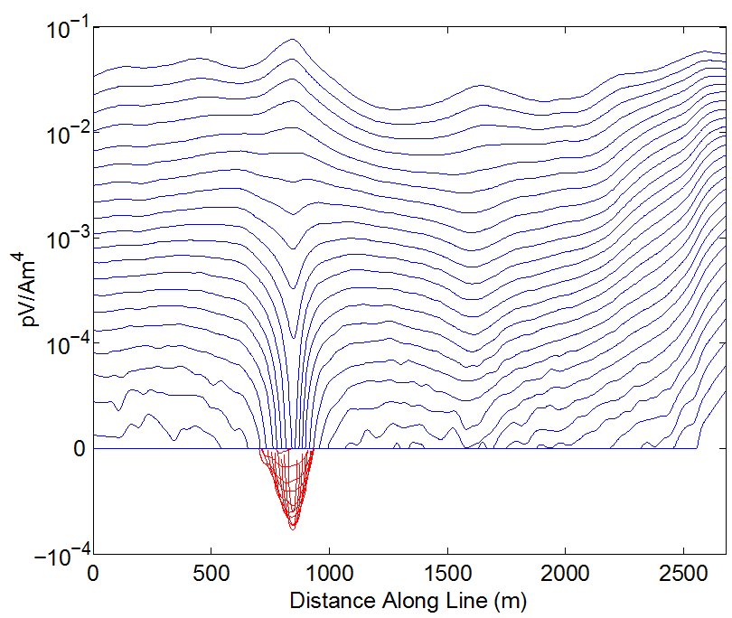
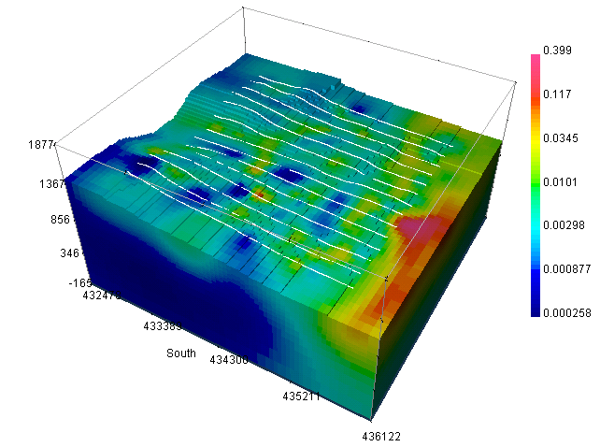
Field example: Mt. Milligan VTEM
(b)
(a)
(c)
Notes:
From the data we observe the effects of the large negative but there are also other minima.
Unfortunately there seems to be systematic biases and we’ve attempted to remove these with the idea that the broad background should be non-chargeable. This is akin to removing a regional and there is the possibiity of throwing the baby out with the bathwater.
Persevere to get …

Slide 10
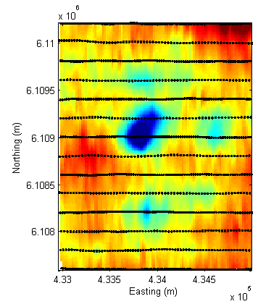
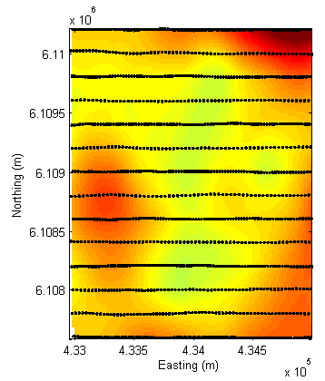
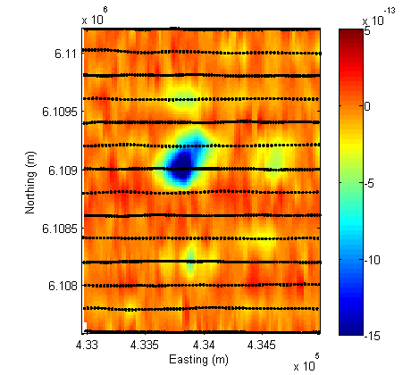
Removal of a regional
d^{IP}
estimated regional
data for inversion
db/dt (T/s)
(a)
(b)
(c)

Slide 11
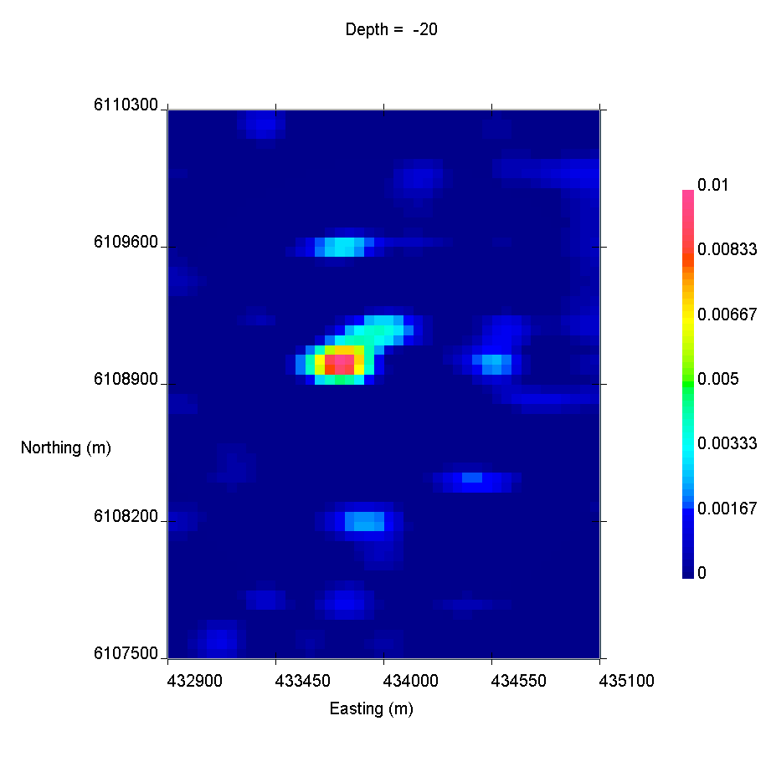
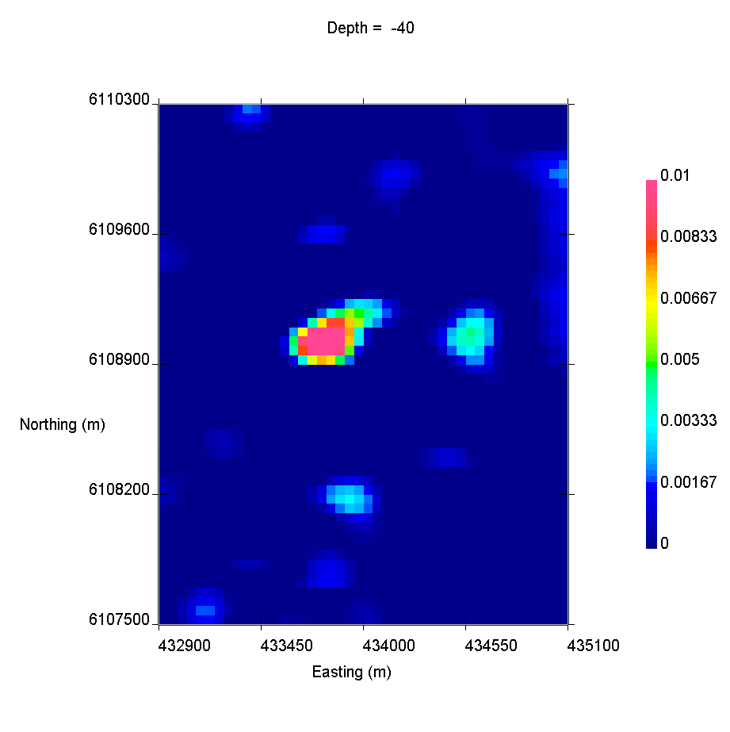
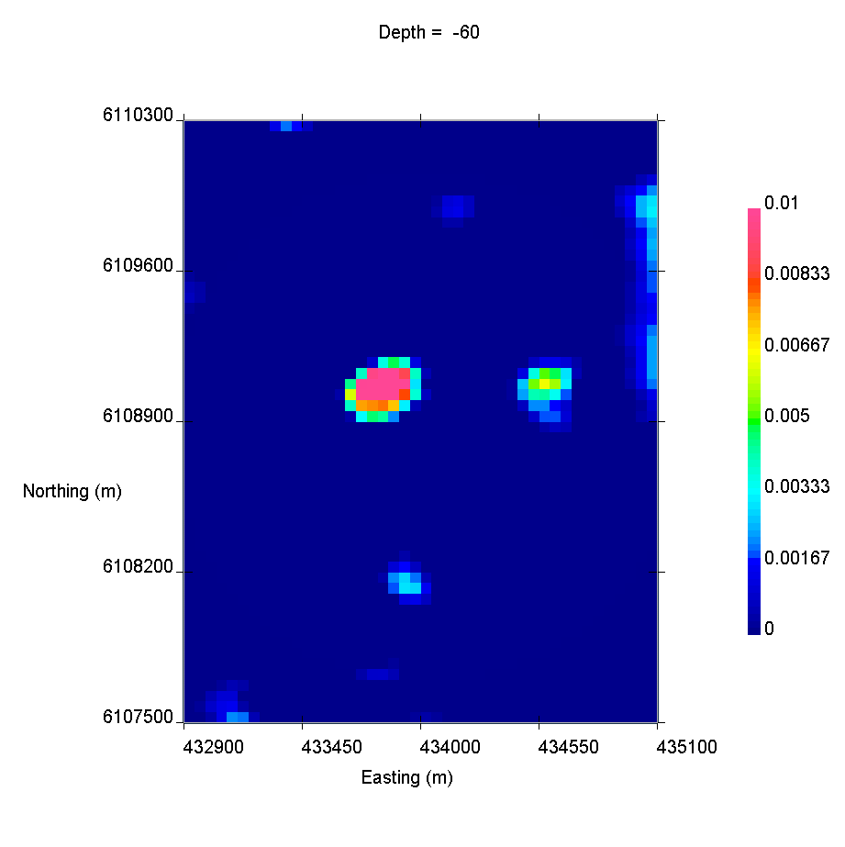
Inversion Results
Depth=20m
Depth=40m
Depth=60m

Slide 12
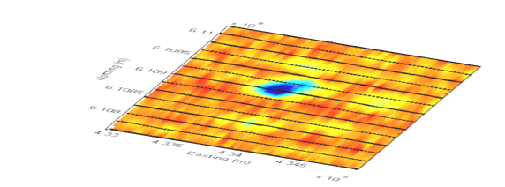
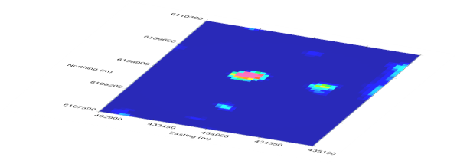
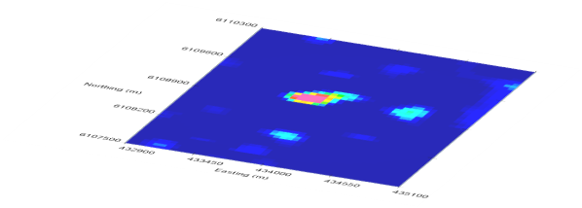
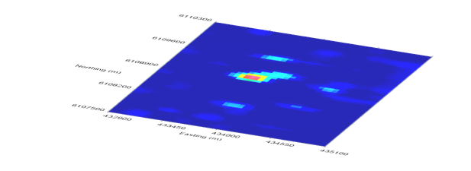
Inversion Results
20
40
Depth (m)
60

Slide 13

Inversion Results
-20
Pseudochargeability
-40
Depth (m)
-60

