Slide 1
Reproducing RRT*
Asymptotic Optimality
A Comparative Study of RRT vs. RRT* in 2D Motion Planning
Shreesh Kulkarni
CS5100: Foundations of Artificial Intelligence | Spring 2026
Northeastern University | Prof. Jonathan Mwaura

Slide 2
The Problem: RRT Is Provably Suboptimal
Sampling-based planners like RRT build random trees to find paths through obstacle spaces.
The problem:
RRT finds a path and stops. The path is suboptimal, and more computation does not help.
Karaman & Frazzoli (2011) proved this mathematically: RRT converges to a suboptimal solution with probability one.
Root cause: each new sample connects to the nearest node and that connection is never reconsidered.
Key Insight
Early greedy decisions get permanently locked into the tree. A bad connection at step 50 can never be fixed, even after 50,000 more steps.
Paper: Karaman, S. & Frazzoli, E. (2011). Sampling-based algorithms for optimal motion planning. IJRR, 30(7).

Slide 3
RRT*: Two Modifications That Fix Everything
1. ChooseParent
2. Rewire
Instead of connecting to the nearest node, scan all nodes within a shrinking radius and pick the one that gives the lowest total cost from the root.
This is a local Dijkstra step at every insertion.
After adding a new node, check if nearby nodes can be reached more cheaply through it. If yes, reparent them.
This lets cost improvements propagate backward through the tree.
Result: RRT* is asymptotically optimal (Theorem 38). Path cost converges to the true minimum as iterations grow.

Slide 4
What I Set Out to Reproduce
1
RRT Plateaus
Once RRT finds a path, more iterations do not reduce cost.
2
RRT* Improves Monotonically
Path cost decreases as the number of iterations N increases.
3
Largest Improvement in Constrained Spaces
RRT* advantage is biggest in narrow-passage environments.
Scope: 2D Euclidean planning with point robots. 50 trials, N = 500 to 5,000, three environments.

Slide 5
Implementation Details
Tech Stack
Critical Implementation Detail
Python 3.11 + NumPy
SciPy KDTree for radius queries
Matplotlib for visualization
18 unit tests
After every rewire, all descendants need their costs updated via BFS. The paper does not emphasize this. Without it, stored costs become inconsistent and subsequent rewire decisions are silently wrong.
Rewiring Radius (Theorem 38)
r(n) = γ · (ln(n) / n)^(1/d), d = 2
The radius shrinks as the tree grows, keeping neighbor queries at O(log N). I added a 10% safety margin on γ and floor the radius at the step size (0.5 units).

Slide 6
Three Test Environments
Env A: Simple
Env B: Narrow Passage
Env C: Maze
Single 3×4 obstacle
Start (1,1) → Goal (9,9)
Forces a basic detour
Two tall walls, 1-unit gap
Start (1,5) → Goal (9,5)
Hardest for both algorithms
6 scattered obstacles
Start (0.5,0.5) → Goal (9.5,9.5)
Forces winding paths
Experimental Protocol
50 seeded trials per condition | N ∈ {500, 1000, 2000, 3000, 5000} | Step size: 0.5 | Goal bias: 5% | 1,500 total runs

Slide 7
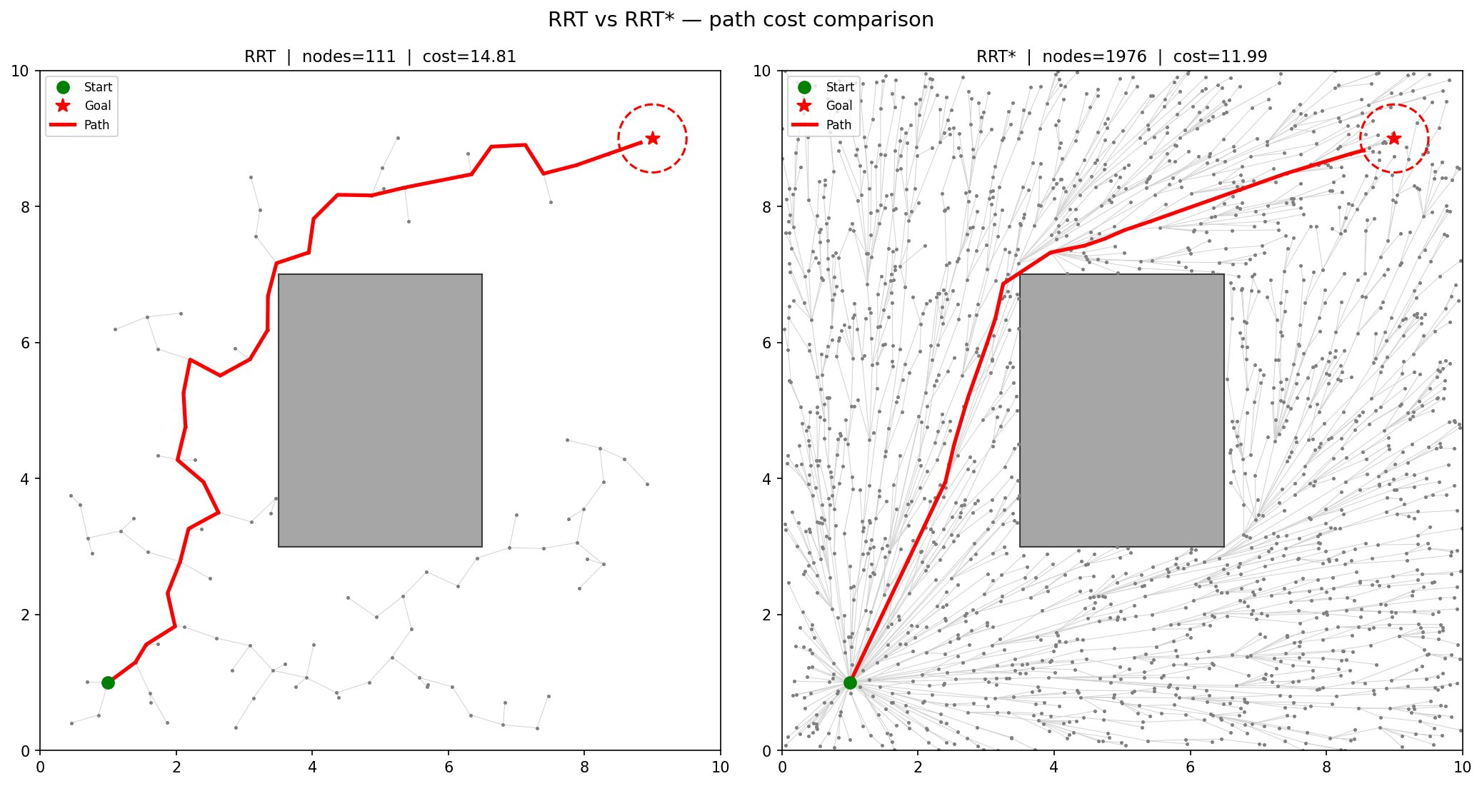
Env A: Single Obstacle — RRT vs. RRT* (N=2000)
RRT: 111 nodes, cost 14.81 | RRT*: 1976 nodes, cost 11.99 | 19% shorter

Slide 8
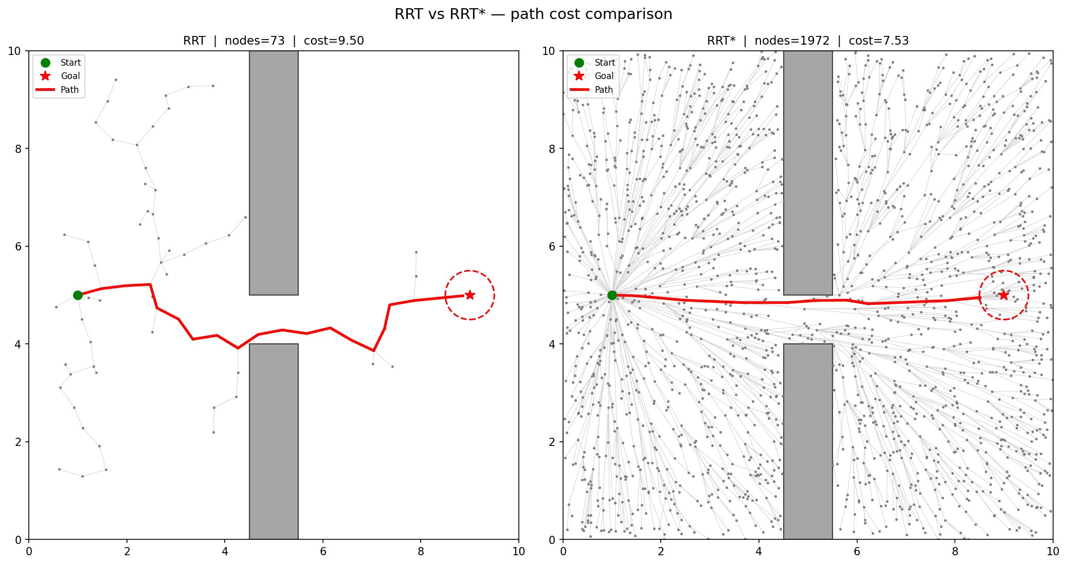
Env B: Narrow Passage — RRT vs. RRT* (N=2000)
RRT: 73 nodes, cost 9.50 | RRT*: 1972 nodes, cost 7.53 | 21% shorter

Slide 9
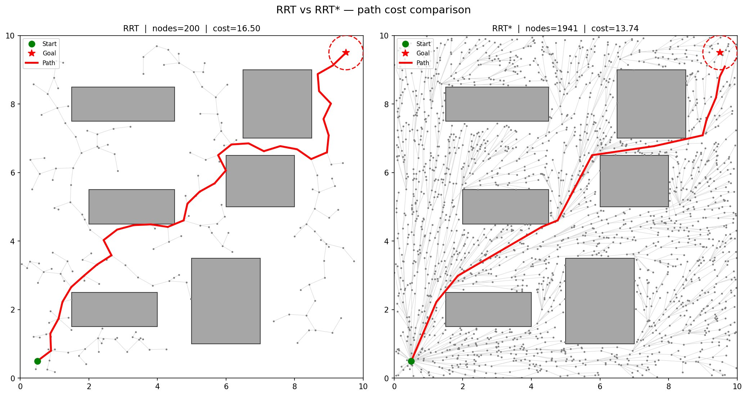
Env C: Maze — RRT vs. RRT* (N=2000)
RRT: 200 nodes, cost 16.50 | RRT*: 1941 nodes, cost 13.74 | 17% shorter

Slide 10
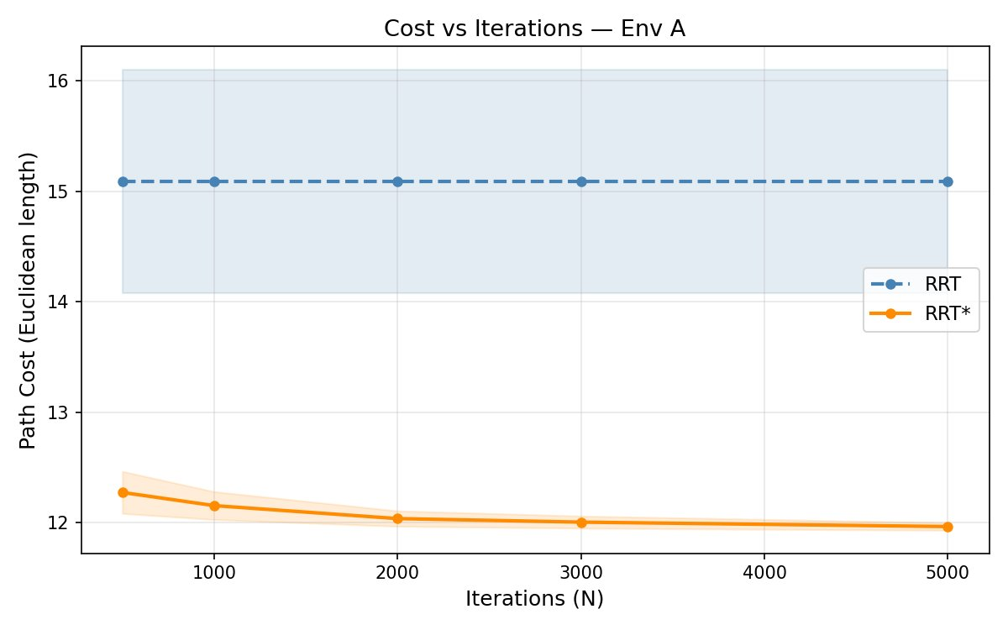
Convergence: Env A
RRT flat at 15.09. RRT* drops from 12.27 to 11.97 (N=500→5000). Std shrinks from 0.19 to 0.03.

Slide 11
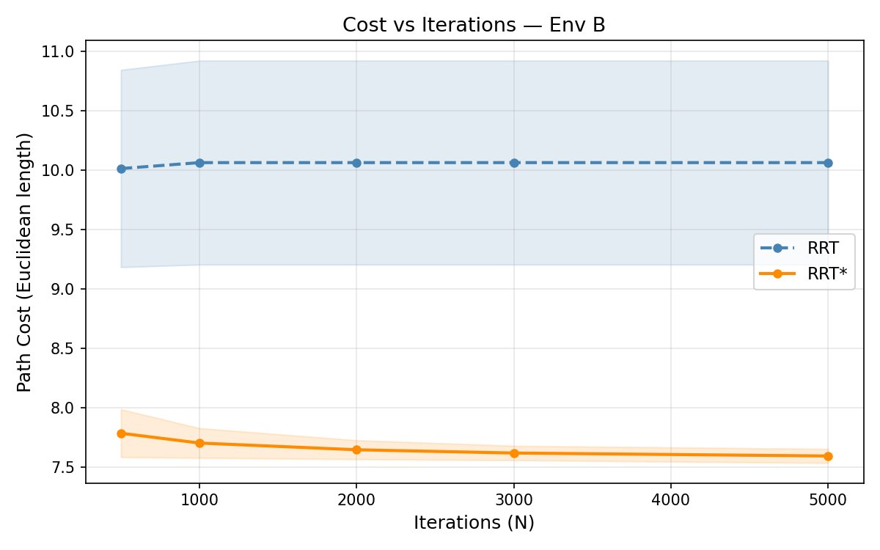
Convergence: Env B (Narrow Passage)
Largest gap: 24.5% improvement at N=5000. RRT* std at N=5000 is just 0.06.

Slide 12
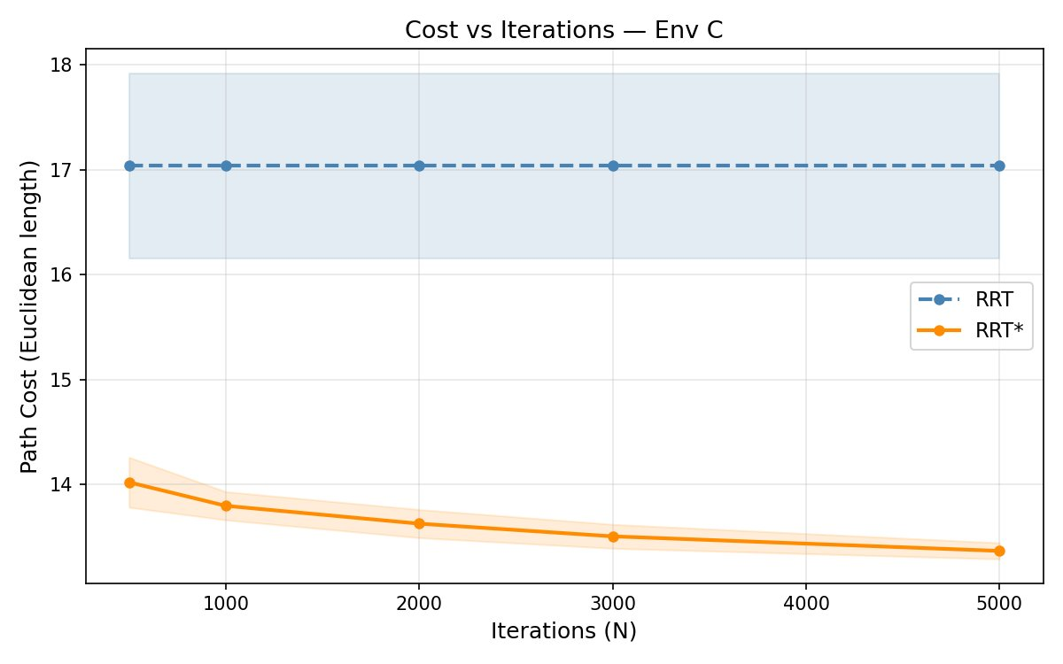
Convergence: Env C (Maze)
RRT* still improving at N=5000 (13.37). 4.7% internal cost reduction from N=500→5000.

Slide 13
Results at a Glance (N = 5,000, 50 trials)
20–25%
10–30×
5–6%
100%
Shorter paths
than RRT
Lower variance
than RRT
Gap to theoretical
optimum
Success rate
at N ≥ 1000
Env | RRT Cost | RRT* Cost | Improvement | RRT* Std
A (Simple) | 15.09 | 11.97 | 20.7% | ±0.03
B (Narrow) | 10.06 | 7.59 | 24.5% | ±0.06
C (Maze) | 17.04 | 13.37 | 21.6% | ±0.08

Slide 14
Challenges and Limitations
Reproduction Challenges
Study Limitations
Cost propagation after rewire: paper does not emphasize it, but without BFS to update all descendants, costs drift silently
Free-space volume estimation for γ: getting this wrong by 2× in either direction degrades results visibly
KDTree rebuild on every insertion: O(N) per step, dominates runtime at N=5000 (~3s per trial)
2D only: paper generalizes to d dimensions and non-holonomic systems, not tested here
Max N = 5,000: modest for asymptotic claims, but sufficient for qualitative confirmation
Axis-aligned rectangles instead of non-convex polygons (does not affect theoretical properties)
No PRM* comparison

Slide 15
Conclusion
All three claims reproduced cleanly:
RRT plateaus: cost identical at every N (byte-for-byte across 50 trials)
RRT* improves monotonically in all environments (2.5–4.7% from N=500→5000)
Largest improvement in narrow passage (24.5%), matching the paper’s prediction
Reproducibility Verdict: Partially Reproducible
Core claims fully confirmed. Implementation requires resolving details the paper leaves underspecified: cost propagation, free-space volume estimation, and KDTree integration.
Thank you | Shreesh Kulkarni | CS5100 Spring 2026

