Slide 1
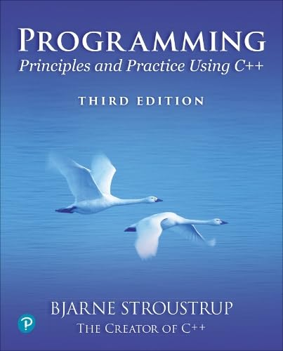
Chapter 5 – Writing a Program
Programming is understanding.
– Kristen Nygaard

Slide 2
Abstract
This lecture and the next describe the process of designing a program through the example of a simple “desk calculator.”

Slide 3
Overview
Some thoughts on software development
The idea of a calculator
Using a grammar
Expression evaluation
Program organization

Slide 4
Building a program
Analysis
Refine our understanding of the problem
Think of the final use of our program
Design
Create an overall structure for the program
Implementation
Write code
Debug
Test
Go through these stages repeatedly

Slide 5
Writing a program: Strategy
What is the problem to be solved?
Is the problem statement clear?
Is the problem manageable, given the time, skills, and tools available?
Try breaking it into manageable parts
Do we know of any tools, libraries, etc. string, that might help?
Yes, even this early: iostreams, vector, etc.
Build a small, limited version solving a key part of the problem
To bring out problems in our understanding, ideas, or tools
Possibly change the details of the problem statement to make it manageable
If that doesn’t work
Throw away the first version and make another limited version
Keep doing that until we find a version that we’re happy with
Build a full-scale solution
Ideally by using part of your initial version

Slide 6
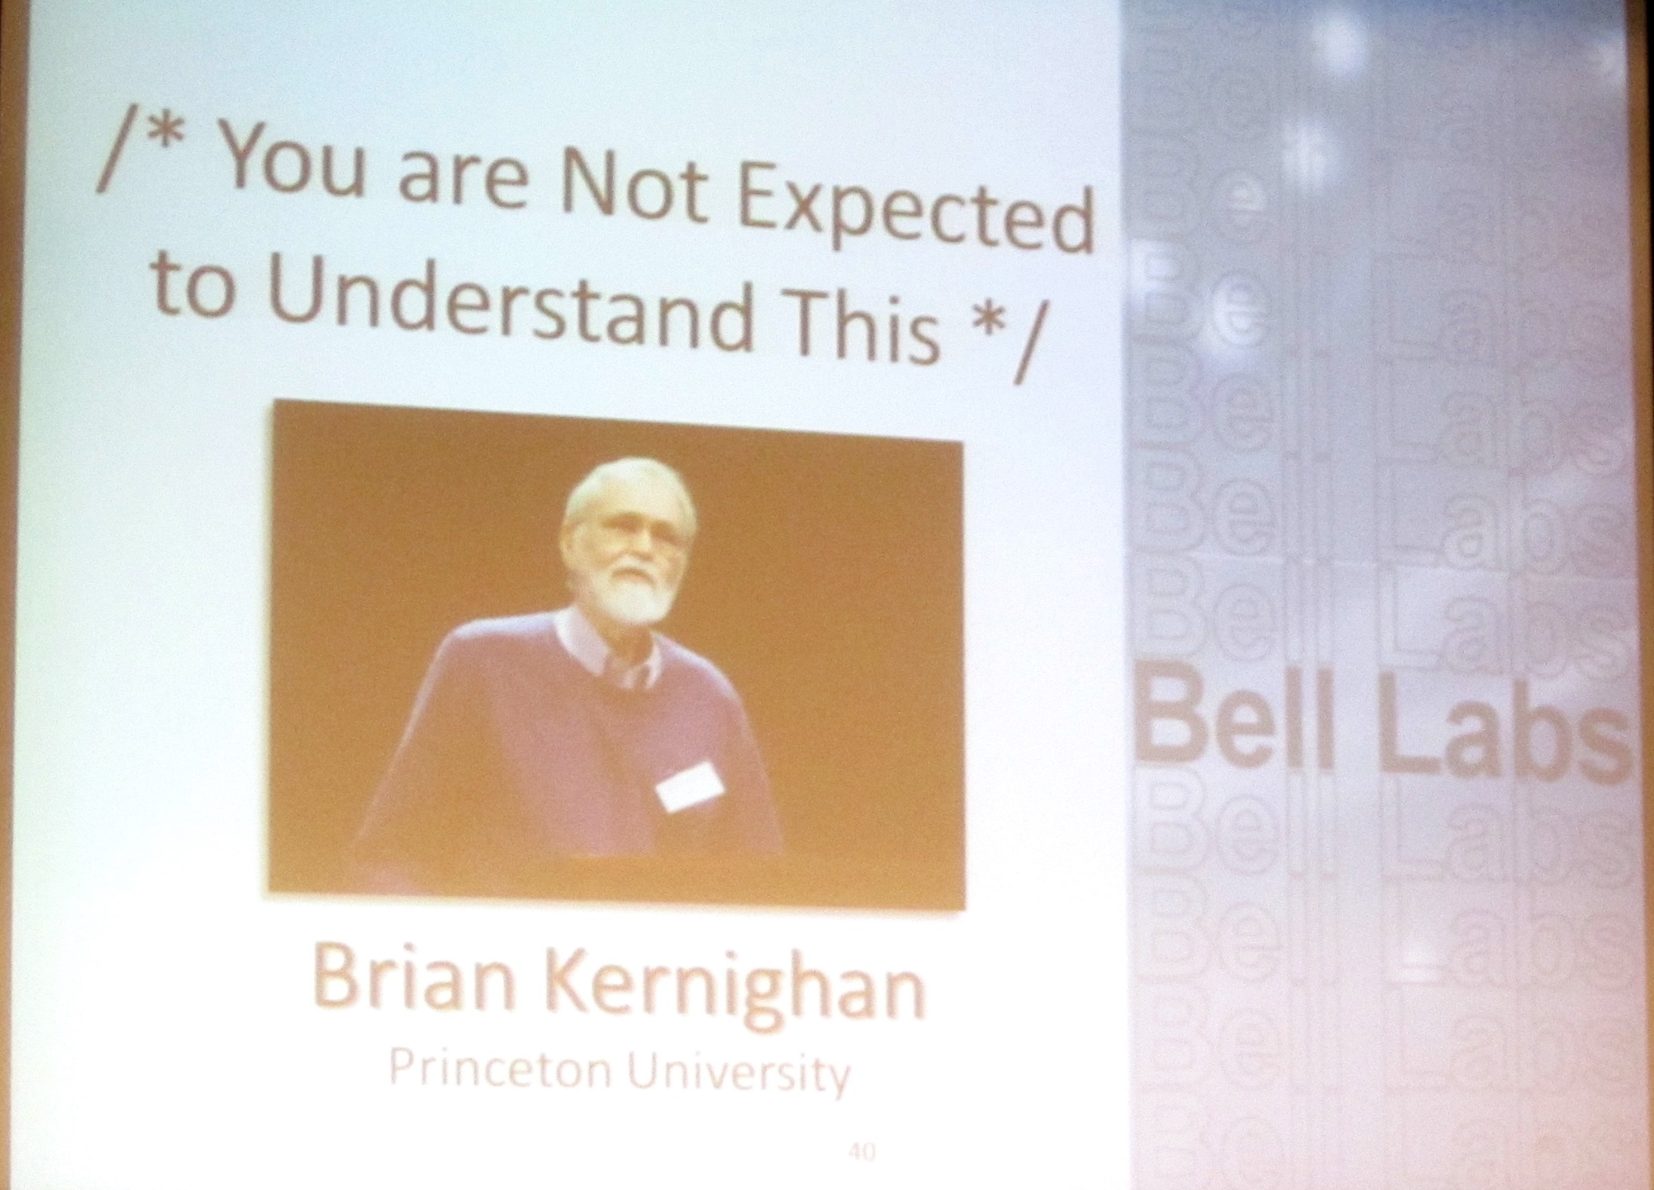
Programming is also a practical still
We learn by example
Not by just seeing explanations of principles
Not just by understanding programming language rules
The more and the more varied examples the better
You won’t get it right the first time
“You can’t learn to ride a bike from a correspondence course”
You can’t learn it all at once
Notes:
Not *all* of this. A famous quote in the original Unix source code. You can’t understand everything – certainly not at first and in detail.
BWK giving a memorial lecture for Dennis Ritchie, the designer of the C programming language.

Slide 7
Writing a program: Example
I’ll build a program in stages, making lot of “typical mistakes” along the way
Even experienced programmers make mistakes
Lots of mistakes; it’s a necessary part of learning
Designing a good program is genuinely difficult
It’s often faster to let the compiler detect gross mistakes than to try to get every detail right the first time
Concentrate on the important design choices
Building a simple, incomplete version allows us to experiment and get feedback
Good programs are “grown”

Slide 8
A simple calculator
Given expressions as input from the keyboard, evaluate them and write out the resulting value
For example:
Expression: 2+2
Result: 4
Expression: 2+2*3
Result: 8
Expression: 2+3-25/5
Result: 0
Let’s refine this a bit more …

Slide 9
Pseudo Code
A first idea:
int main()
{
variables
while (get a line) { // what’s a line?
analyze the expression // what does that mean?
evaluate the expression
print the result
}
}
How do we represent 45+5/7 as data?
How do we find 45 + 5 / and 7 in an input string?
How do we make sure that 45+5/7 means 45+(5/7) rather than (45+5)/7?
Should we allow floating-point numbers (sure!)
Can we have variables? v=7; m=9; v*m (later)

Slide 10
A simple calculator
Wait!
We are just about to reinvent the wheel!
Read Chapter 5 for more examples of dead-end approaches
What would the experts do?
Computers have been evaluating expressions for 50+ years
There has to be a solution!
What did the experts do?
Reading is good for you
Asking more experienced friends/colleagues can be far more effective, pleasant, and time-effective than slogging along on your own
“Don’t re-invent the wheel”

Slide 11
experts usually write a grammar
Expression :
Term
Expression ‘+’ Term e.g., 1+2, (1-2)+3, 2*3+1
Expression ‘-’ Term
Term :
Primary
Term ‘*’ Primary e.g., 1*2, (1-2)*3.5
Term ‘/’ Primary
Term ‘%’ Primary
Primary :
Number e.g., 1, 3.5
‘(‘ Expression ‘)’ e.g., (1+2*3)
Number :
floating-point literal e.g., 3.14, 0.274e1, or 42 – as defined for C++
A program is built out of Tokens (e.g., numbers and operators).
Notes:
A program is built out of Tokens (e.g., numbers and operators).

Slide 12
A side trip: Grammars
What’s a grammar?
A set of (syntax) rules for expressions.
The rules say how to analyze (“parse”) an expression.
Some rules seem hard-wired into our brains
Example, you know what this means:
2*3+4/2
birds fly but fish swim
You know that this is wrong:
2 * + 3 4/2
fly birds fish but swim
How can we teach what we know to a computer?
Why is it right/wrong?
How do we know?

Slide 13
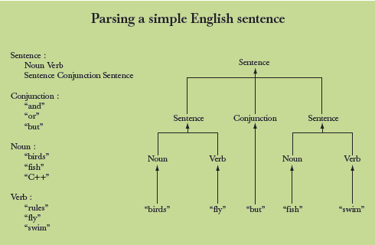
Grammars – “English”

Slide 14
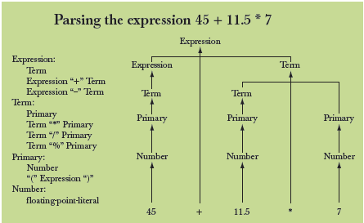
Grammars - expression

Slide 15
Functions for parsing
We need functions to match the grammar rules
get() // read characters and compose tokens; calls cin for input
expression() // deal with + and –; calls term() and get()
term() // deal with *, /, and %; calls primary() and get()
primary() // deal with numbers and parentheses; calls expression() and get()
Note: each function deals with a specific part of an expression and leaves
everything else to other functions – this radically simplifies each function.
Analogy: a group of people can deal with a complex problem by each person
handling only problems in his/her own specialty, leaving the rest for colleagues.

Slide 16
Function Return Types
What should the parser functions return?
How about the result?
Token get_token(); // read characters and compose tokens; return a Token
double expression(); // deal with + and –; return the sum (or difference)
double term(); // deal with *, /, and %; return the product (or …)
double primary(); // deal with numbers and parentheses; return the value
What is a Token?

Slide 17
What is a token?
number
+
4.5
We want to see input as a stream of tokens
We read characters 1 + 4*(4.5-6) (That’s 13 characters incl. 2 spaces)
9 tokens in that expression: 1 + 4 * ( 4.5 - 6 )
6 kinds of tokens in that expression: number + * ( - )
We want each token to have two parts
A “kind”; e.g., number
A value; e.g., 4
We need a type to represent this “Token” idea
We’ll build that in the next lecture, but for now:
get_token() gives us the next token from input
t.kind gives us the kind of the token
t.value gives us the value of the token

Slide 18
Dealing with + and -
Expression:
Term
Expression '+' Term
Expression '-' Term
double expression() // read and evaluate: 1 1+2.5 1+2+3.14 etc.
{
double left = term(); // get the Term; every Expression starts with a Term
while (true) {
Token t = get_token(); // get the next token…
switch (t.kind) { // … and do the right thing with it
case '+': left += term(); break;
case '-': left -= term(); break;
default: return left; // return the value of the expression
}
}
}

Slide 19
Dealing with *, /, and %
Term :
Primary
Term ‘*’ Primary
Term ‘/’ Primary
Term ‘%’ Primary
double term() // exactly like expression(), but for *, /, and %
{
double left = primary(); // get the Primary
while (true) {
Token t = get_token(); // get the next Token…
switch (t.kind) {
case '*': left *= primary(); break;
case '/': left /= primary(); break;
case '%': left %= primary(); break; // Oops: doesn’t compile
// % isn’t defined for floating-point numbers
default: return left; // return the value
}
}
}

Slide 20
Dealing with * and /
Term :
Primary
Term ‘*’ Primary
Term ‘/’ Primary
double term() // exactly like expression(), but for *, and /
{
double left = primary(); // get the Primary
while (true) {
Token t = get_token(); // get the next Token
switch (t.kind) {
case '*': left *= primary(); break;
case '/': left /= primary(); break;
default: return left; // return the value
}
}
}

Slide 21
Dealing with divide by 0
Term :
Primary
Term ‘*’ Primary
Term ‘/’ Primary
double term() // exactly like expression(), but for * and /
{
// …
case '/':
{ double d = primary();
if (d==0)
error("divide by zero");
left /= d;
break;
}
// …
}
Note: when you want to define a value in a case, you need to use a block

Slide 22
Dealing with numbers and parentheses
double primary() // Number or ‘(‘ Expression ‘)’
{
Token t = get_token();
switch (t.kind) {
case '(': // handle ‘(’expression ‘)’
{ double d = expression();
t = get_token();
if (t.kind != ')') error("')' expected");
return d;
}
case '8': // we use ‘8’ to represent the “kind” of a number
return t.value; // return the number’s value
default:
error("primary expected");
}
}

Slide 23
Program organization
Token
get_token()
error()
primary()
istream
cin
>>
term()
expression()
ostream
cout
<<
main()
Who calls whom? (note the loop)

Slide 24
The program
#include “PPP.h"
// Token stuff (explained in the next lecture)
double expression(); // declaration so that primary() can call expression()
double primary() { /* … */ } // deal with numbers and parentheses
double term() { /* … */ } // deal with * and / (pity about %)
double expression() { /* … */ } // deal with + and –
int main() { /* … */ } // on next slide

Slide 25
The program – main()
int main()
try {
while (cin)
cout << expression() << '\n';
}
catch (runtime_error& e) {
cerr << e.what() << '\n';
return 1;
}
catch (…) {
cerr << "exception \n";
return 2;
}

Slide 26
A mystery
2
3
4
2 an answer
5+6
5 an answer
X
Bad token an answer (finally, an expected answer)

Slide 27
A mystery
Expect “mysteries”
Your first try rarely works as expected
That’s normal and to be expected
Even for experienced programmers
If it looks as if it works be suspicious
And test a bit more
Now comes the debugging
Finding out why the program misbehaves
And don’t expect your second try to work either

Slide 28
A mystery
1 2 3 4+5 6+7 8+9 10 11 12
1 an answer
4 an answer
6 an answer
8 an answer
10 an answer
Aha! Our program “eats” two out of three input tokens
How come?
Let’s have a look at expression()

Slide 29
Dealing with + and -
Expression:
Term
Expression ‘+’ Term
Expression ‘-’ Term
double expression() // read and evaluate: 1 1+2.5 1+2+3.14 etc.
{
double left = term(); // get the Term
while (true) {
Token t = get_token(); // get the next token…
switch (t.kind) { // … and do the right thing with it
case '+’: left += term(); break;
case '-': left -= term(); break;
default: return left; // <<< doesn’t use “next token”
}
}
}

Slide 30
Dealing with + and -
So, we need a way to “put back” a token!
Put back into what?
“the input,” of course: we need an input stream of tokens, a “token stream”
double expression() // deal with + and -
{
double left = term();
while (true) {
Token t = ts.get(); // get the next token from a “token stream”
switch (t.kind) {
case '+': left += term(); break;
case '-': left -= term(); break;
default: ts.putback(t); // put the unused token back
return left;
}
}
}

Slide 31
Dealing with * and /
Now make the same change to term()
double term() // deal with * and /
{
double left = primary();
while (true) {
Token t = ts.get(); // get the next Token from input
switch (t.kind) {
case '*’: // deal with *
case '/’: // deal with /
default:
ts.putback(t); // put unused token back into input stream
return left;
}
}
}

Slide 32
The program
It “sort of works”
That’s not bad for a first try
Well, second try
Well, really, the fourth try; see the book
But “sort of works” is not good enough
When the program “sort of works” is when the work (and fun) really start
Now we can get feedback!

Slide 33
Another mystery
2 3 4 2+3 2*3
2 an answer
3 an answer
4 an answer
5 an answer
What! No “6” ?
The program looks ahead one token
It’s waiting for the user
So, we introduce a “print result” command
While we’re at it, we also introduce a “quit” command

Slide 34
The main() program
int main()
{
double val = 0;
while (cin) {
Token t = ts.get(); // rather than get_token()
if (t.kind == 'q’) // ‘q’ for “quit”
break;
if (t.kind == ';') // ‘;’ for “print now”
cout << val << '\n'; // print result
else
ts. putback(t); // put a token back into the input stream
val = expression(); // evaluate
}
}
// … exception handling …

Slide 35
Now the calculator is minimally useful
2;
2 an answer
2+3;
5 an answer
3+4*5;
23 an answer
q

Slide 36
Next lecture
Completing a program
Tokens
Recovering from errors
Cleaning up the code
Code review
Testing

