Slide 1
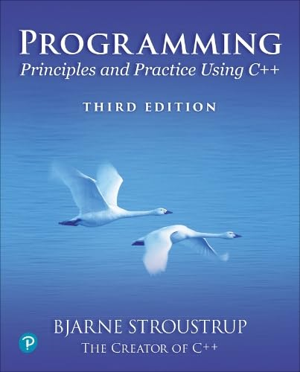
Chapter 7 – Technicalities, Functions, etc.
No amount of genius can overcome
obsession with detail.
– Traditional

Slide 2
Abstract
This lecture and the following present some technical details of the language to give a slightly broader view of C++’s basic facilities and to provide a more systematic view of those facilities. This also acts as a review of many of the notions presented so far, such as types, functions, and initialization, and provides an opportunity to explore our tool without adding new programming techniques or concepts.

Slide 3
Overview
Language Technicalities
Declarations
Definitions
Headers and the preprocessor
Scope
Functions
Declarations and definitions
Arguments
Call by value, reference, and const reference
Namespaces
“Using” declarations

Slide 4
Language technicalities
Are a necessary evil
A programming language is a foreign language
When learning a foreign language, you have to look at the grammar and vocabulary
We will do this in this chapter and the next
Because:
Programs must be precisely and completely specified
A computer is a very stupid (though very fast) machine
A computer can’t guess what you “really meant to say” (and shouldn’t try to)
So we must know the rules
Some of them (the C++23 standard is almost 1900 pages)
However, never forget that
What we study is programming
Our output is programs/systems
A programming language is only a tool

Slide 5
Technicalities
Don’t spend your time on minor syntax and semantic issues. There is more than one way to say everything
Just like in English
Most design and programming concepts are universal, or at least very widely supported by popular programming languages
So what you learn using C++ you can use with many other languages
Language technicalities are specific to a given language
But many of the technicalities from C++ presented here have obvious counterparts in C, Java, C#, etc.

Slide 6
Declarations
A declaration introduces a name into a scope.
A declaration also specifies a type for the named object.
Sometimes a declaration includes an initializer.
A name must be declared before it can be used in a C++ program.
Examples:
int a = 7; // an int variable named ‘a’ is declared
const double cd = 8.7; // a double-precision floating-point constant
double sqrt(double); // a function taking a double argument and returning a double result
vector<Token> v; // a vector variable of Tokens (variable)

Slide 7
Declarations
Declarations are frequently introduced into a program through “headers”
A header is a file containing declarations providing an interface to other parts of a program
This allows for abstraction – you don’t have to know the details of a function like cout in order to use it. When you add
#include “PPP.h"
to your code, the PPP_support declarations (incl. the C++ standard library become available (including cout, etc.).

Slide 8
For example
At least three errors:
int main()
{
cout << f(i) << ′\n′;
}
Add declarations:
#include ″PPP.h″ // we find the declaration of cout in here
int main()
{
cout << f(i) << ′\n′;
}

Slide 9
For example
Define your own functions and variables:
#include ″PPP.h″ // we find the declaration of cout in here
int f(int x ) { /* … */ } // declaration of f
int main()
{
int i = 7; // declaration of i
cout << f(i) << ′\n′;
}

Slide 10
Definitions
A declaration that fully specifies the entity declared is called a definition
Examples
int a = 7;
int b; // an (uninitialized) int
vector<double> v; // an empty vector of doubles
double sqrt(double) { … }; // a function with a body
struct Point { int x; int y; };
Examples of declarations that are not definitions
double sqrt(double); // function body missing
struct Point; // class members specified elsewhere
extern int a; // extern means “not definition” ; “extern” is archaic

Slide 11
Declarations and definitions
You can’t define something twice
A definition says what something is
Examples
int a; // definition
int a; // error: double definition
double sqrt(double d) { … } // definition
double sqrt(double d) { … } // error: double definition
You can declare something twice
A declaration says how something can be used
int a = 7; // definition (also a declaration)
extern int a; // declaration
double sqrt(double); // declaration
double sqrt(double d) { … } // definition (also a declaration)

Slide 12
Why both declarations and definitions?
To refer to something, we need (only) its declaration
Often we want the definition “elsewhere”
Later in a file
In another file
preferably written by someone else
Declarations are used to specify interfaces
To your own code
To libraries
Libraries are key: we can’t write all ourselves, and wouldn’t want to
In larger programs
Place all declarations in header files to ease sharing

Slide 13
Kinds of declarations
The most interesting are
Variables
int x;
vector<int> vi2 {1,2,3,4};
Constants
void f(const X&);
constexpr int = isqrt(2);
Functions (see §7.4)
double sqrt(double d) { /* … */ }
Namespaces (see §7.6)
Modules (see §7.7)
Types (classes and enumerations; see Chapter 8)
Templates (see Chapter 18)
Concepts (see §18.1.3)

Slide 14
Scope
A program can have millions of lines of code
With 100,000s of declarations
Scopes are the construct we use to manage such masses of names
The idea is simple
Keep a names local, except when we want it to be useful elsewhere
Locality is good!
Keep names as local as possible
double my_function(vector<int>& v) // v is local to my_function (and refers to an argument)
{
double sum = 0; // sum is local to my_function
for (int x : v) // x is local to this for-statement
sum+= x;
return x;
}

Slide 15
Scope
A scope is a region of program text
Global scope (outside any language construct)
Module scope
Namespace scope
Class scope
Local scope (between { … } braces)
Statement scope (e.g., in a for-statement)
A name in a scope can be seen from within its scope and within scopes nested within that scope
int next(int x) { return x+1; }
return next2(int x) { next(next(x); } // next() is visible from within next2()
A name can be used only after the declaration of the name (“can’t look ahead” rule)
Except that class members can be used within the class before they are declared

Slide 16
Scope
A module, namespace, or class scope has a name
A namespace or class name can be used to refer to members from elsewhere
struct X {
int set(int x)
{
int old = m;
m = x;
return old;
}
int m = 0;
};
X obj;
int old_x = X::set(7); // X’s set (much more about classes in Chapter 8)

Slide 17
Scopes nest
int x; // global variable – avoid those where you can
int y; // another global variable
int f()
{
int x; // local variable (Note – now there are two x’s)
x = 7; // local x, not the global x
{
int x = y; // another local x, initialized by the global y (Now there are three x’s)
++x; // increment the local x in this scope
}
}
Avoid such complicated nesting and hiding: keep it simple!

Slide 18
Recap: Why functions?
Chop a program into manageable pieces
“divide and conquer”
Match our understanding of the problem domain
Name logical operations
A function should do one thing well
Functions make the program easier to read
A function can be useful in many places in a program
Ease testing, distribution of labor, and maintenance
Keep functions small
Easier to understand, specify, and debug

Slide 19
Functions
General form:
return_type name (formal arguments); // a declaration
return_type name (formal arguments) body // a definition
For example
double f(int a, double d) { return a*d; }
Formal arguments are often called parameters
If you don’t want to return a value give void as the return type
void increase_power_to(int level);
Here, void means “doesn’t return a value”
A body is a block or a try block
For example
{ /* code */ } // a block
try { /* code */ } catch(exception& e) { /* code */ } // a try block
Functions represent/implement computations/calculations

Slide 20
Functions: Call by Value
// call-by-value (send the function a copy of the argument’s value)
int f(int a) { a = a+1; return a; }
int main()
{
int xx = 0;
cout << f(xx) << ′\n′; // writes 1
cout << xx << ′\n′; // writes 0; f() doesn’t change xx
int yy = 7;
cout << f(yy) << ′\n′; // writes 8; f() doesn’t change yy
cout << yy << ′\n′; // writes 7
}
a:
0
copy the value
xx:
0
a:
7
copy the value
yy:
7

Slide 21
Functions: Call by Reference
// call-by-reference (pass a reference to the argument)
int f(int& a) { a = a+1; return a; }
int main()
{
int xx = 0;
cout << f(xx) << ′\n′; // writes 1
// f() changed the value of xx
cout << xx << ′\n′; // writes 1
int yy = 7;
cout << f(yy) << ′\n′; // writes 8
// f() changes the value of yy
cout << yy << ′\n′; // writes 8
}
a:
1st call (refer to xx)
xx:
0
2nd call (refer to yy)
yy:
7

Slide 22
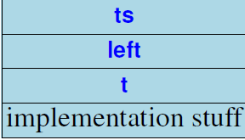
Function call
When you call a function, a “function activation record” hold its arguments, local variables, and what’s needed to return to the caller
For expression() from Chapter 7 (see 7.4.8), we need to store the argument ts and the local variables left and t:
Call of expression():

Slide 23
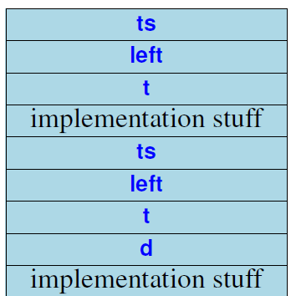
Function call
Activation records are kept in a stack (the call stack).
expression() calls term():
Call of expression():
Call of term():

Slide 24
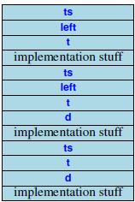
Function call
term() calls primary():
Call of expression():
Call of term():
Call of primary():

Slide 25
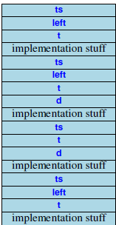
Function call
primary() calls expression():
And the on returns the stack frames are discarded
In the reverse order that they were created
Call of expression():
Call of term():
Call of primary():
Call of expression():

Slide 26
Functions
Avoid (non-const) reference arguments when you can
They can lead to obscure bugs when you forget which arguments can be changed
int incr1(int a) { return a+1; }
void incr2(int& a) { ++a; }
int x = 7;
x = incr1(x); // pretty obvious
incr2(x); // pretty obscure
So why have reference arguments?
Occasionally, they are essential
E.g., for changing several values
For manipulating containers (e.g., vector)
const reference arguments are very often useful

Slide 27
Call by value, reference, and const-reference
void f(int a, int& r, const int& cr) { ++a; ++r; ++cr; } // error: cr is const
void g(int a, int& r, const int& cr) { ++a; ++r; int x = cr; ++x; } // ok
int main()
{
int x = 0;
int y = 0;
int z = 0;
g(x,y,z); // x==0; y==1; z==0
g(1,2,3); // error: reference argument r needs a variable to refer to
g(1,y,3); // ok: since cr is const we can pass “a temporary”
}
// const references are very useful for passing large objects

Slide 28
References
“reference” is a general concept
Not just for call-by-reference
int i = 7;
int& r = i;
r = 9; // i becomes 9
const int& cr = i;
// cr = 7; // error: cr refers to const
i = 8;
cout << cr << endl; // write out the value of i (that’s 8)
You can
think of a reference as an alternative name for an object
You can’t
modify an object through a const reference
make a reference refer to another object after initialization
r
i:
7
cr

Slide 29
For example
A range-for loop:
for (string s : v) cout << s << ″\n″; // s is a copy of some v[i]
for (string& s : v) cout << s << ″\n″; // no copy
for (const string& s : v) cout << s << ″\n″; // and we don’t modify v

Slide 30
Compile-time functions
You can define functions that can be evaluated at compile time: constexpr functions
constexpr double xscale = 10; // scaling factors constexpr double yscale = .8;
constexpr Point scale(Point p) { return {xscale*p.x,yscale*p.y}; };
constexpr Point x = scale({123,456}); // evaluated at compile time
void use(Point p)
{
constexpr Point x1 = scale(p); // error: compile-time evaluation // requested for variable argument
Point x2 = scale(p); // OK: run-time evaluation
}

Slide 31
Guidance for Passing Variables
Use call-by-value for very small objects
Use call-by-const-reference for large objects
Use call-by-reference only when you have to
Return a result rather than modify an object through a reference argument
For example
class Image { /* objects are potentially huge */ };
void f(Image i); … f(my_image); // oops: this could be s-l-o-o-o-w
void f(Image& i); … f(my_image); // no copy, but f() can modify my_image
void f(const Image&); … f(my_image); // f() won’t mess with my_image
Image make_image(); // most likely fast! (“move semantics” – later)

Slide 32
Namespaces
Consider this code from two programmers Jack and Jill
class Glob { /*…*/ }; // in Jack’s header file jack.h
class Widget { /*…*/ }; // also in jack.h
class Blob { /*…*/ }; // in Jill’s header file jill.h
class Widget { /*…*/ }; // also in jill.h
#include "jack.h"; // this is in your code
#include "jill.h"; // so is this
void my_func(Widget p) // oops! – error: multiple definitions of Widget
{
// …
}

Slide 33
Namespaces
The compiler will not compile multiple definitions; such clashes can occur from multiple headers.
One way to prevent this problem is with namespaces:
namespace Jack { // in Jack’s header file
class Glob{ /*…*/ };
class Widget{ /*…*/ };
}
#include "jack.h"; // this is in your code
#include "jill.h"; // so is this
void my_func(Jack::Widget p) // OK, Jack’s Widget class will not
{ // clash with a different Widget
// …
}

Slide 34
Namespaces
A namespace is a named scope
The :: syntax is used to specify which namespace you are using and which (of many possible) objects of the same name you are referring to
For example, cout is in namespace std, you can write:
std::cout << "Please enter stuff… \n";

Slide 35
using Declarations and Directives
To avoid the tedium of
std::cout << "Please enter stuff… \n";
you could write a “using declaration”
using std::cout; // when I say cout, I mean std::cout
cout << "Please enter stuff… \n"; // ok: std::cout
cin >> x; // error: cin not in scope
or you could write a “using directive”
using namespace std; // “make all names from namespace std available”
cout << "Please enter stuff… \n"; // ok: std::cout
cin >> x; // ok: std::cin

Slide 36
Next talk
More technicalities, mostly related to classes

