Slide 1
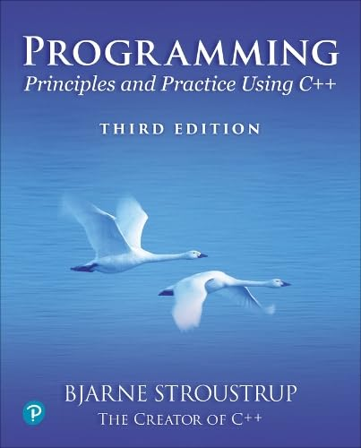
Chapter 12 – A display model
The world was black and white then.
It didn´t turn color
until sometime in the 1930s.
– Calvin´s dad

Slide 2
Abstract
This lecture presents a display model (the output part of a GUI), giving examples of use and fundamental notions such as screen coordinates, lines, and color. Some examples of shapes are Lines, Polygons, Axes, and Text.

Slide 3
Overview
Why graphics?
A graphics model
Examples

Slide 4
Why bother with graphics and GUI?
It’s very common
If you write conventional PC applications, you’ll have to do it
It’s useful
Instant feedback
Graphing functions
Displaying results
It can illustrate some generally useful concepts and techniques

Slide 5
Why bother with graphics and GUI?
It can only be done well using some pretty neat language features ☺
Lots of good (small) code examples
It can be non-trivial to “get” the key concepts
So it’s worth teaching
If we don’t show how it’s done, you might think it was “magic”
Graphics is fun!

Slide 6
Why Graphics/GUI?
WYSIWYG
What you see (in your code) is what you get (on your screen)
Direct correspondence between concepts, code, and output

Slide 7
Display model
Shape
Display
Engine
attach()
draw()
“window”
Square
attach()
Objects (such as graphs) are “attached to” a window.
The “display engine” invokes display commands (such as “draw line from x to y”) for the objects in a window
Objects such as Square contain vectors of lines, text, etc. for the window to draw

Slide 8
Display model
An example illustrating the display model
int main()
{
using namespace Graph_lib; // use our graphics interface library
Application app; // start a Graphics/GUI application
Point tl {900,500}; // to become the top left corner of the window
Simple_window win {tl,600,400,"Canvas“}; // make a simple window
Polygon poly; // make a shape (a polygon, obviously)
poly.add(Point{300,200}); // add three points to the polygon
poly.add(Point{350,100});
poly.add(Point{400,200});
poly.set_color(Color::red); // make the polygon red (obviously)
win.attach(poly); // connect poly to the window
win.wait_for_button(); // give control to the display engine
}

Slide 9
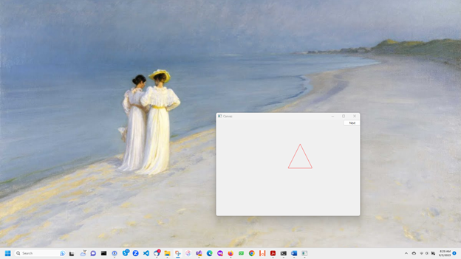
The resulting screen
Notes:
P.S.Krøyer: Skagen Sønderstrand. My screen background.

Slide 10
Graphics/GUI libraries
You’ll be using a few interface classes we wrote
Interfacing to a popular GUI toolkit
GUI == Graphical User Interface
Qt: https://en.wikipedia.org/wiki/Qt_(software)
Installation, etc.
https://github.com/villevoutilainen/ProgrammingPrinciplesAndPracticeUsingQt
If you can, ask an instructor or friend for assistance to install
Our Graphics/GUI model is far simpler than common toolkit interfaces
Our interface library is ~20 classes and ~500 lines of code
Manageable for teaching / early learning
You can write a lot of code with these classes
And you can build more classes on them

Slide 11
Graphics/GUI libraries (cont.)
The code is portable
Windows, Unix, Mac, phones, browsers, etc.
This model extends to most common graphics and GUI uses
The general ideas can be used with any popular GUI toolkit
Once you understand the graphics classes you can easily learn any GUI/graphics library
Well, relatively easily – these libraries are huge

Slide 12
Graphics/GUI libraries
Our code
Our interface library
Our mouse
A graphics/GUI library (here Qt)
Our screen
The operating system (e.g., Windows or Linux)
Our keyboard
Often called “a layered architecture”

Slide 13
Coordinates
0,0
200,0
50,50
0,100
200,100
Oddly, y-coordinates “grow downwards” // right, down
Coordinates identify pixels in the window on the screen
You can resize a window (changing x_max() and y_max())

Slide 14
Interface classes
Line_style
Window
Color
Shape
Point
Simple_window
Line
Lines
Polygon
…
Rectangle
Text
An arrow means “is a kind of”
Color, Line_style, and Point are “utility classes” used by the other classes
Window is our interface to the GUI library (which is our interface to the screen)

Slide 15
Interface classes
Current
Color, Line_style, Font, Point,
Window, Simple_window
Shape, Text, Polygon, Line, Lines, Rectangle, Function, Circle, Ellipse, …
Axis
Easy to add (for some definition of “easy”)
Grid, Block_chart, Pie_chart, etc.
Later, GUI
Button, In_box, Out_box, …

Slide 16
“Boilerplate”
// Getting access to the graphics system (don’t forget to install):
#include "Simple_window.h" // stuff to deal with your system’s windows
#include "Graph.h" // graphical shapes
int main()
{
using namespace Graph_lib; // use our graphics interface library
Application app; // start a Graphics/GUI application
Simple_window win {Point{900,500},600,400,"Canvas“}; // make a simple window
// …
win.wait_for_button(); // give control to the display engine
}

Slide 17
Canvas on screen

Slide 18
Add an x axis
Axis xa {Axis::x, Point{20,300}, 280, 10, “x axis"};
// an axis is a kind of Shape
// Axis::x means horizontal
// starting at (20,300)
// 280 pixels long
// 10 “notches” (“tick marks”)
// label the axis “x axis”
win.attach(xa); // attach axis xa to the window
win.set_label(“X axis"); // re-label the window
win.wait_for_button(); // display!

Slide 19
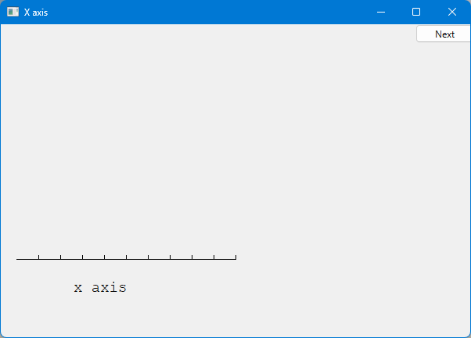
An x axis

Slide 20
Add a y axis
win.set_label("Canvas #3");
Axis ya {Axis::y, Point{20,300}, 280, 10, "y axis"};
ya.set_color(Color::cyan); // choose a color for the axis
ya.label.set_color(Color::dark_red); // choose a color for the text
win.attach(ya);
win.set_label(“Y axis"); // re-label the window
win.wait_for_button();

Slide 21
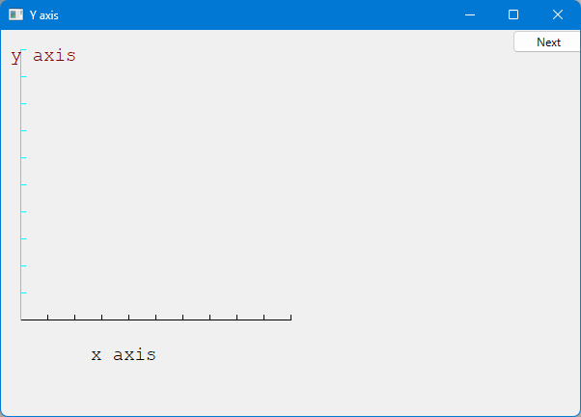
Add a Y-axis (colored)
Yes, it’s ugly, but this is a programming course, not a graphics design course
Notes:
Be restrained in the use of color

Slide 22
Add a sine curve
Function sine {sin,0,100,Point{20,150},1000,50,50}; // sine curve
// plot sin() in the range [0:100)
// with (0,0) at (20,150)
// using 1000 points
// scale x values *50, scale y values *50
win.attach(sine);
win.set_label(“Sine");
win.wait_for_button();

Slide 23
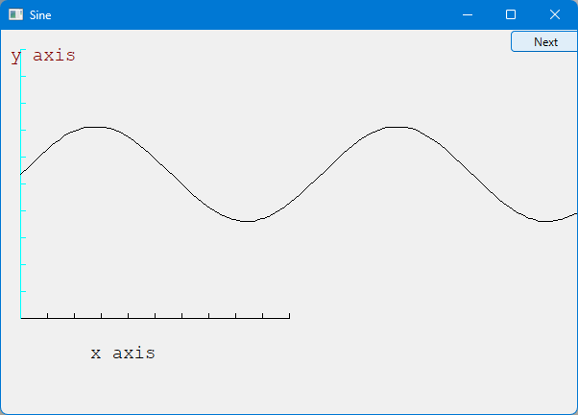
Add a sine curve

Slide 24
Add a polygon
sine.set_color(Color::blue); // I changed my mind about sine’s color
Polygon poly; // make a polygon (a kind of Shape)
poly.add(Point{300,200}); // three points make a triangle
poly.add(Point{350,100});
poly.add(Point{400,200});
poly.set_color(Color::red); // change the color
win.attach(poly);
win.set_label(“Triangle");
win.wait_for_button();

Slide 25
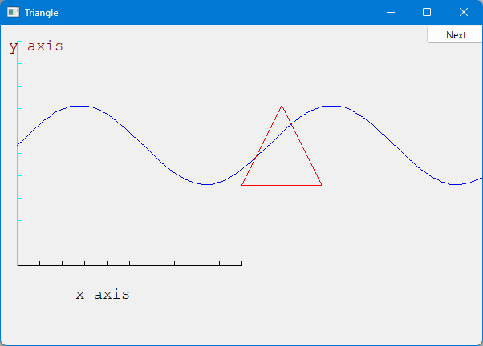
Add a triangle (and color the sine)

Slide 26
Add a rectangle
Rectangle r {Point{200,200}, 100, 50}; // top left point, width, height
win.attach(r);
win.set_label(“Rectangle");
win.wait_for_button();

Slide 27
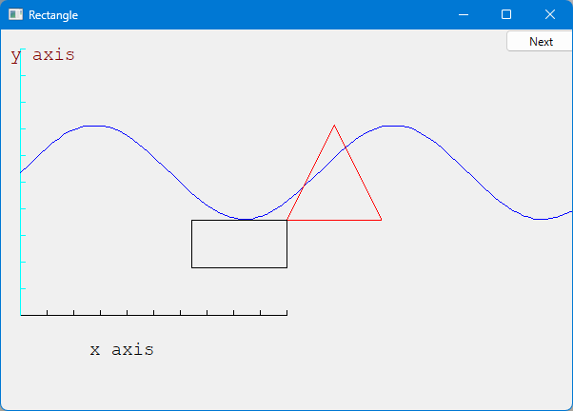
Add a rectangle

Slide 28
Add a shape that looks like a rectangle
Closed_polyline poly_rect;
poly_rect.add(Point{100,50});
poly_rect.add(Point{200,50});
poly_rect.add(Point{200,100});
poly_rect.add(Point{100,100});
win.set_label(“Polyline");
win.attach(poly_rect);
win.wait_for_button();
// a Closed_polyline is a sequence of lines ending at the starting point

Slide 29
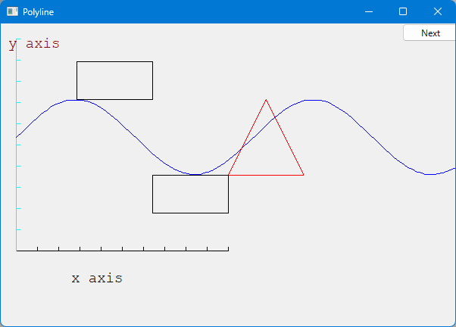
Add a shape that looks like a rectangle
But is it a rectangle?

Slide 30
Mutate the polyline
We can add a point
poly_rect.add(Point{50,75}); // now poly_rect has 5 points
win.set_label(“Polyline2");
win.wait_for_button();
“looking like” is not the same as “is”

Slide 31
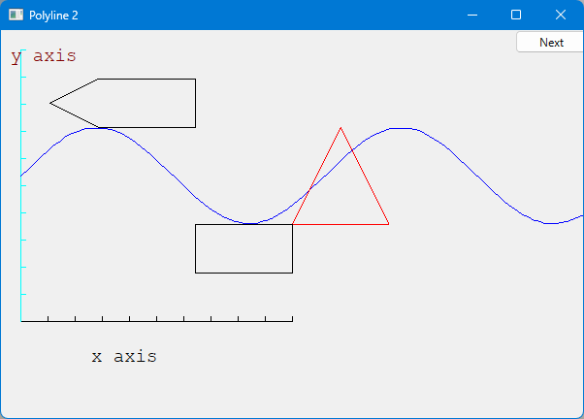
Obviously not a rectangle

Slide 32
Add fill
r.set_fill_color(Color::yellow); // color the inside of the rectangle
poly.set_style(Line_style{Line_style::dash,4}); // make the triangle fat
poly_rect.set_fill_color(Color::green);
poly_rect.set_style(Line_style{Line_style::dash,2});
win.set_label(“Fill");
win.wait_for_button();

Slide 33
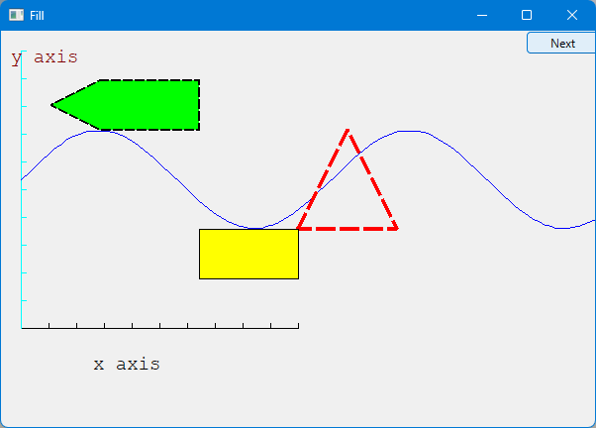
Add fill

Slide 34
Add text
Text t {Point{150,150},"Hello, graphical world!"}; // add text
// point is lower left corner on the baseline
win.set_label(“Text");
win.wait_for_button();

Slide 35
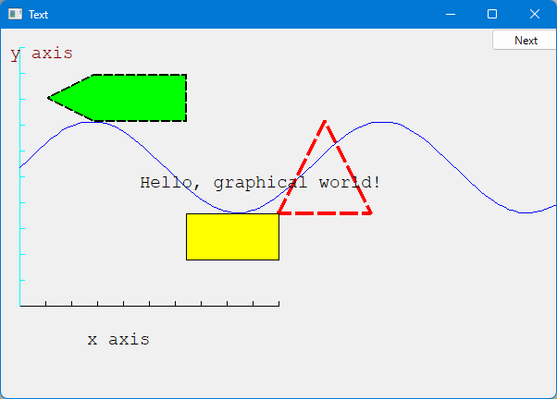
Add text

Slide 36
Modify text font and size
Modify text font and size
t.set_font(Font::times_bold);
t.set_font_size(20); // height in pixels
win.set_label(“Bold text");
win.wait_for_button();

Slide 37
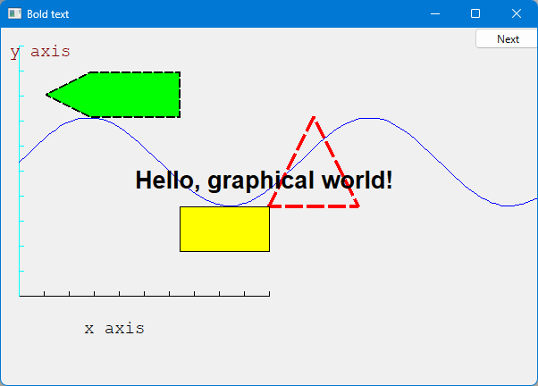
Text font and size

Slide 38
Add an image
Image copter {Point{100,50},“mars_copter.jpg"}; // open an image file
win.attach(copter);
win.set_label(“Mars copter");
win.wait_for_button();

Slide 39
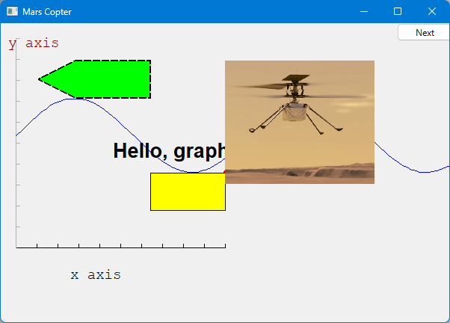
Add an image

Slide 40
Oops!
The image obscures the other shapes
Move it a bit out of the way (“fly it”)
copter.move(100,250); // move 100 pixels to the right (-100 moves left)
// move 250 pixels down (-250 moves up)
win.set_label(“Move");
win.wait_for_button();

Slide 41
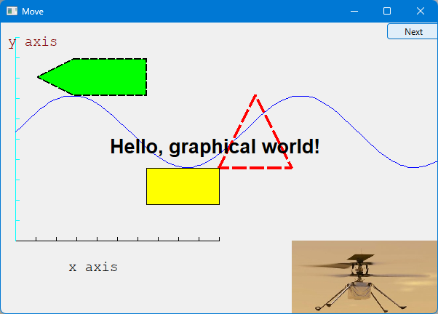
Move the image
Note how the parts of a shape that don’t fit in the window are “clipped” away

Slide 42
Add more shapes and more text
Circle c {Point{100,200},50}; // center, radius
Ellipse e {Point{100,200}, 75,25}; // center, horizontal radius, vertical radius
e.set_color(Color::dark_red);
Mark m {Point{100,200},'x'}; radius
m.set_color(Color::red);
ostringstream oss;
oss << "screen size: " << x_max() << "*" << y_max()
<< "; window size: " << win.x_max() << "*" << win.y_max();
Text sizes {Point{100,20},oss.str()};
Image scan {Point{275,225}, “scandinavia.jfif"};
scan.scale(150,200); // scale the image to taste
// … attach all new objects …
win.set_label(“Final");
win.wait_for_button();

Slide 43
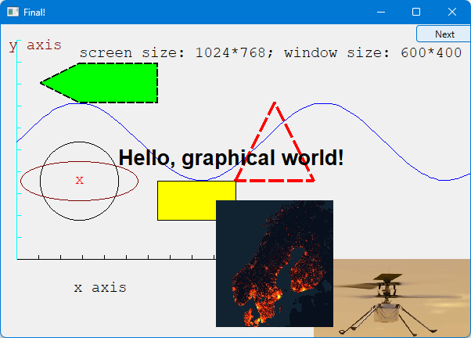
Add more shapes and more text
Notes:
After this, I often went back to the previous slide and have a student come to the screen and explain the code

Slide 44
Boiler plate
#include "Graph.h" // header for graphs
#include “Simple_window.h" // header containing window interface
int main ()
try
{
// … the main part of your code …
}
catch(exception& e) {
cerr << "exception: " << e.what() << '\n';
return 1;
}
catch (...) {
cerr << "Some exception\n";
return 2;
}

Slide 45
Primitives and algorithms
The demo shows the use of library primitives
Just the primitives
Just the use
Typically, what we display is the result of
an algorithm
reading data
Next lectures
11: Graphics Classes
12: Graphics Class Design
13: Graphing Functions and Data
14: Graphical User Interfaces

