Slide 1
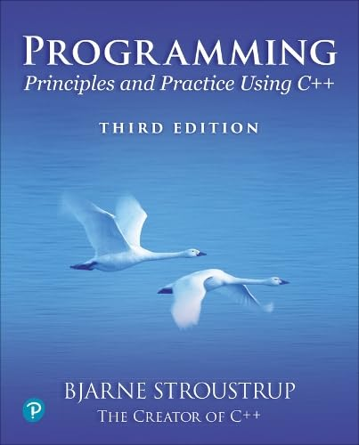
Chapter 11 – Graphics Classes
A language that doesn´t
change the way you think
isn´t worth learning.
– Traditional

Slide 2
Abstract
Chapter 10 demonstrated how to create simple windows and display basic shapes: rectangle, circle, triangle, and ellipse. It showed how to manipulate such shapes: change colors and line style, add text, etc.
Chapter 11 shows how these shapes and operations are implemented and shows a few more examples. In chapter 10, we were basically tool users; here we start to become tool builders.

Slide 3
Overview
Graphing
Model
Code organization
Interface classes
Point
Line and Lines
Grid
Polylines
Color and Fonts
Text
Unnamed objects
Notes:
Constantly explain the correspondence between the code and what appears on the screen. Mention what the new language features do, but don’t go into details.

Slide 4
Display model
Shape
Display
Engine
attach()
draw()
“window”
Square
attach()
Objects (such as graphs) are “attached to” a window.
The “display engine” invokes display commands (such as “draw line from x to y”) for the objects in a window
Objects such as Square contain vectors of lines, text, etc. for the window to draw

Slide 5
Design note
The ideal of program design is to represent concepts directly in code
We take this ideal very seriously
For example:
Window – a window as we see it on the screen
Will look different on different operating systems (not our business)
Simple_window – a window with a “next button”
Line – a line as you see it in a window on the screen
Point – a coordinate point
Shape – what’s common to shapes
(imperfectly explained for now; all details in Chapter 12)
Color – as you see it on the screen

Slide 6
Point
namespace Graph_lib { // our graphics interface is in Graph_lib
struct Point { // a Point is simply a pair of ints (the coordinates)
int x, y;
}; // Note the ';’
// we can compare points:
bool operator==(Point a, Point b) { return a.x==b.x && a.y==b.y; }
bool operator!=(Point a, Point b) { return !(a==b); }
}

Slide 7
Line
struct Shape {
// can hold part of the representation of a Shape
// knows how to display Shapes
// A Line can be represented (in a Shape) as two Points
};
struct Line : Shape { // a Line is a Shape defined by just two Points
Line(Point p1, Point p2) { add(p1); add(p2); } ;
};
Terminology:
Lines “is derived from” Shape
Lines “inherits from” Shape
Lines “is a kind of” Shape
Shape “is the base” of Lines
This is the key to what is called “object-oriented programming”
We’ll get back to this in Chapter 12

Slide 8
Line example
// draw two lines:
using namespace Graph_lib;
Simple_window win{Point{100,100},600,400,“Two lines"}; // make a window
Line horizontal {Point {200,100},Point{200,100}}; // make a horizontal line
Line vertical {Point{150,50},Point{150,150}}; // make a vertical line
win.attach(horizontal); // attach the lines to the window
win.attach(vertical);
win.wait_for_button(); // Display!

Slide 9
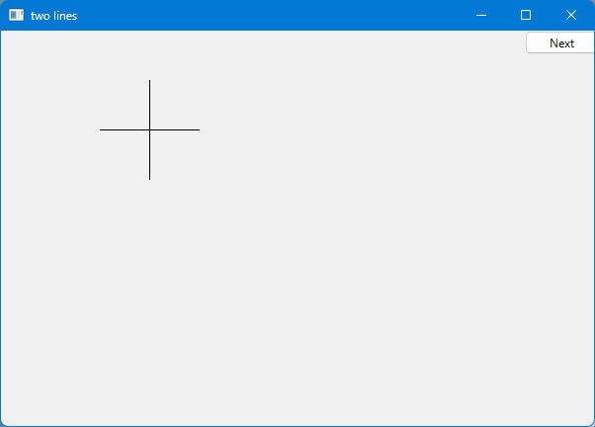
Line example
using namespace Graph_lib;
Simple_window win{Point{100,100},600,400,“Two lines"};
Line horizontal {Point {200,100},Point{200,100}};
Line vertical {Point{150,50},Point{150,150}};
win.attach(horizontal);
win.attach(vertical);
win.wait_for_button();

Slide 10
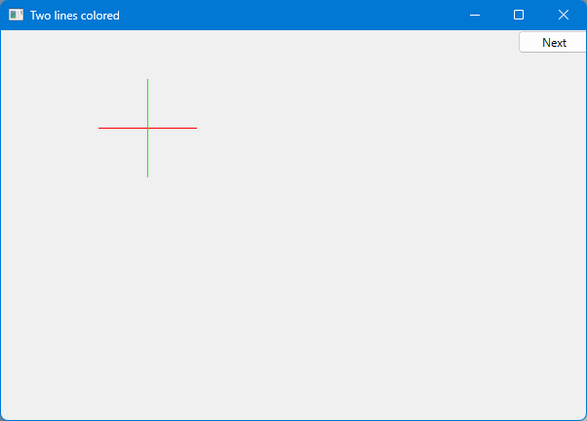
Line example
Individual lines are independent
horizontal.set_color(Color::red);
vertical.set_color(Color::green);

Slide 11
Lines
struct Lines : Shape { // a Lines object is a set of lines
// We use Lines when we want to manipulate
// all the lines as one shape, e.g., move them all
Lines(initializer_list<Point> lst = {}); // initialize from a list (possibly empty)
void add(Point p1, Point p2); // add line from p1 to p2
protected:
void draw_specifics(Painter&) const override;
};
draw_specifics() is to be used only by parts of the Lines implementation. Making it protected ensures that.
Painter is part of the interface to our underlying Qt library. Never used directly by users.
override says that draw_specifics() is to be used instead of Shape’s own draw_specifics().
Implementation details

Slide 12
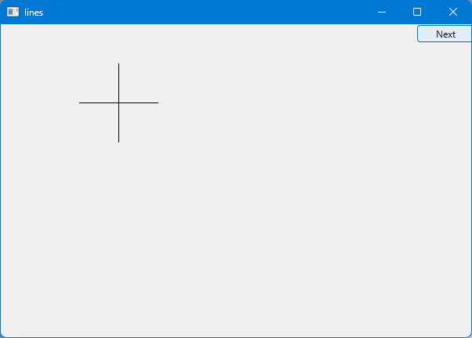
Lines Example
Lines x = {
{Point{100,100}, Point{200,100}}, // first line: horizontal
{Point{150,50}, Point{150,150}} // second line: vertical
};
It looks exactly like the two Lines example
// or even terser this:
Lines x = {
{{100,100}, {200,100}}, {{150,50}, {150,150}}
};
// but don’t overdo abbreviation/terseness
// code is meant to be read

Slide 13
Implementation: Lines
Lines::Lines(std::initializer_list<Point> lst)
: Shape{lst}
{
if (lst.size() % 2)
error("odd number of points for Lines");
}
void Lines::add(Point p1, Point p2) // use Shape’s add()
{
Shape::add(p1);
Shape::add(p2);
redraw(); // we have changed the Lines object; let’s see it
}

Slide 14
Implementation: Lines
void Lines::draw_specifics(Painter& painter) const
{
if (color().visibility())
for (int i=1; i<number_of_points(); i+=2)
painter.draw_line(point(i-1) ,point(i));
}
Note
painter.draw_line() is a basic line drawing function from Qt
Qt is used in the implementation, not in the interface to our classes
We could replace Qt with another graphics library; in fact, Qt did replace another library

Slide 15
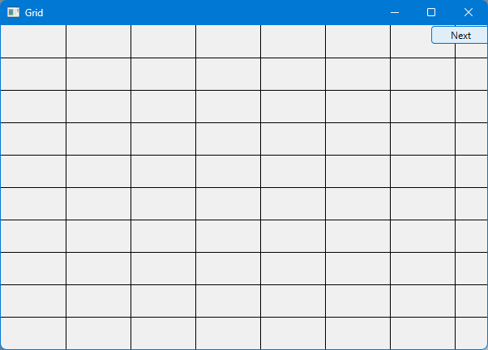
Draw a grid (Why bother with Lines when we have Line?)
// A Lines object may hold many related lines
int x_size = win.x_max();
int y_size = win.y_max();
int x_grid = 80; // make cells 80 pixels wide
int y_grid = 40; // make cells 40 pixels high
Lines grid;
for (int x=x_grid; x<x_size; x+=x_grid) // veritcal
grid.add(Point(x,0),Point(x,y_size));
for (int y = y_grid; y<y_size; y+=y_grid) // horizontal
grid.add(Point(0,y),Point(x_size,y));
win.attach(grid); // attach our grid to our window (note: grid is one object)

Slide 16
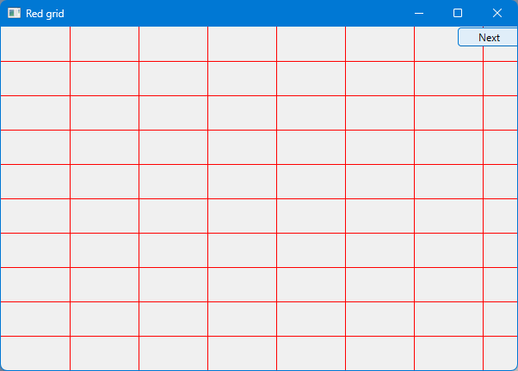
Draw red grid
That grid was a bit pale, let’s add color
grid.set_color(Color::red);

Slide 17
Color
struct Color { // Map Qt colors and scope them; deal with visibility/transparency
enum Color_type {
red, blue, green, yellow, white, black, magenta, cyan, dark_red, // named colors
dark_green, dark_yellow, dark_blue, dark_magenta, dark_cyan,
palette_index, // refers to a set of popular colors
rgb // refers to the usual red-green-blue representation of color
};
enum Transparency { invisible = 0, visible=255 }; // control of visibility
// … constructors and access functions …
private:
int c = 0;
Color_type ct = black;
struct Rgb { int r; int g; int b; };
Rgb rgb_color = {0,0,0};
Transparency v;
};
Notes:
Color is subtle and require detailed management; more about class design in Chapter 12. Here it’s mostly concrete examples.

Slide 18
Color
struct Color {
// …
Color(Color_type cc) :c{cc}, ct{cc}, v{visible} { } // use named colors
Color(Color_type cc, Transparency vv) :c{cc}, ct{cc}, v{vv} { }
Color(int cc) :c{cc}, ct{Color_type::palette_index}, v{visible} { } // choose from palette
Color(Transparency vv) :c{}, ct{Color_type::black}, v{vv} { }
Color(int r, int g, int b) :c{}, ct{Color_type::rgb}, rgb_color{r,g,b}, v{visible} {} // use RGB
int as_int() const { return c; }
int red_component() const { return rgb_color.r; }
int green_component() const { return rgb_color.g; }
int blue_component() const { return rgb_color.b; }
Color_type type() const { return ct; }
char visibility() const { return v; }
void set_visibility(Transparency vv) { v=vv; }
};

Slide 19
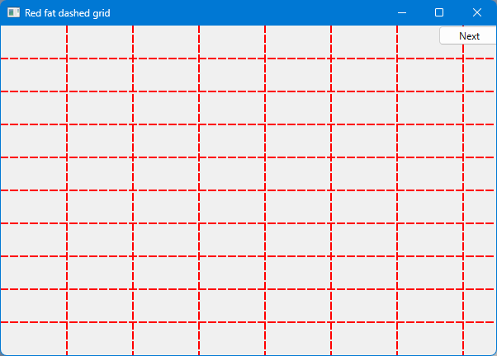
Example: colored fat dash grid
That grid is a bit thin,
and maybe we prefer dashed lines
grid.set_style(Line_style{Line_style::dash,2});
Line styles are named
Line thickness are measures in pixels

Slide 20
Line_style
struct Line_style {
enum Line_style_type {
solid, // -------
dash, // - - - -
dot, // .......
dashdot, // - . - .
dashdotdot // -..-..
};
Line_style(Line_style_type ss) :s{ss} { }
Line_style(Line_style_type ss, int ww) :s{ss}, w(ww) { }
Line_style() {}
int width() const { return w; }
int style() const { return s; }
private:
int s = solid;
int w = 1;
};

Slide 21
Polylines
A polyline is a sequence of connected lines
Open_polyline – the last Point isn’t connected back to the first
Closed_polyline – an Open_polyline where last Point is connected back to the first cleating a closed shape
Marked_polyline – an Open_polyline where each Point is marked with a character
Marks – a Marked_polyline where the lines are invisible; that is a set of marked Points
Mark – a Marks with a single Point

Slide 22
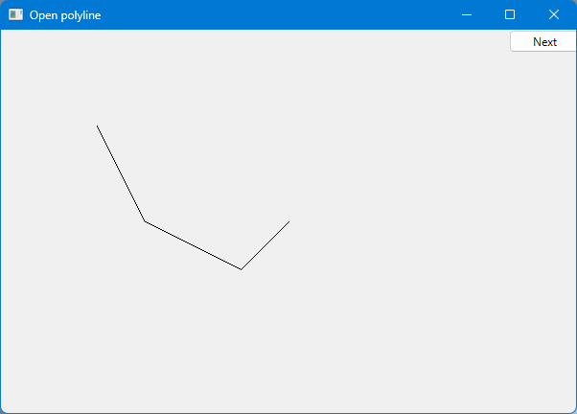
Open_polyline
struct Open_polyline : Shape { // open sequence of lines
Open_polyline(std::initializer_list<Point> p = {}) : Shape(p) {}
void add(Point p) { Shape::add(p); redraw(); }
protected:
void draw_specifics(Painter&) const override;
};
Open_polyline opl = {
{100,100},
{150,200},
{250,250},
{300,200}
};

Slide 23
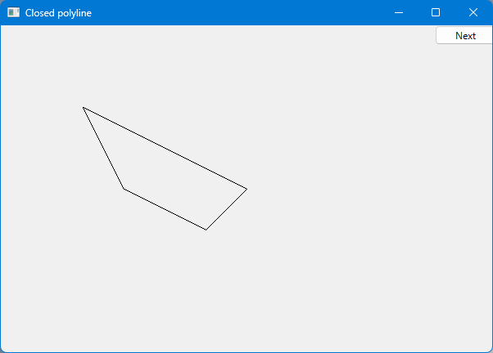
Closed_polyline
struct Closed_polyline : Open_polyline { // closed sequence of lines
using Open_polyline::Open_polyline;
protected:
void draw_specifics(Painter&) const override;
};
Closed_polyline cpl = {
{100,100},
{150,200},
{250,250},
{300,200}
};

Slide 24
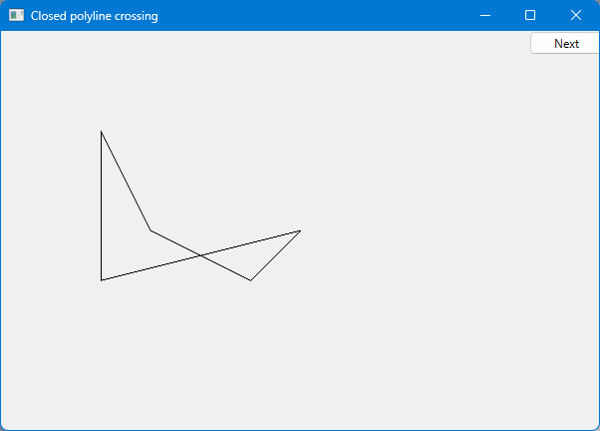
Closed_polyline
A Closed_polyline is not a polygon
some Closed_polylines look like polygons
A Polygon is a Closed_polyline
where no lines cross
A Polygon has a stronger invariant than a Closed_polyline
cpl.add(Point{100,250});

Slide 25
Text
struct Text : Shape {
Text(Point x, const string& s) : lab{ s } { add(x); } // the point is the top left of the first letter
void set_label(const string& s) { lab = s; redraw();} // a text is of a color
string label() const { return lab; }
void set_font(Font f) { fnt = f; redraw();} // a text uses a specific font
Font font() const { return Font(fnt); }
void set_font_size(int s) { fnt_sz = s; redraw();} // the characters of a text has a size
int font_size() const { return fnt_sz; }
protected:
void draw_specifics(Painter&) const override;
private:
string lab; // label; that is the text string
Font fnt = Font::courier;
int fnt_sz = 14; // at least 14 point
};

Slide 26
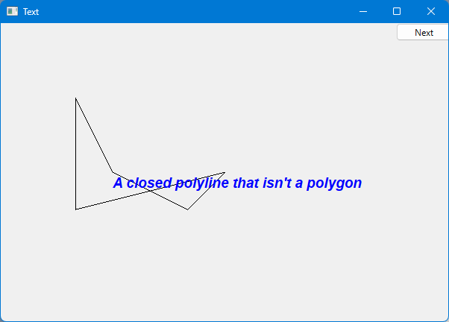
Add text
Text t {Point{150,200}, "A closed polyline that isn’t a polygon"};
t.set_color(Color::blue);
t.set_font(Font::Helvetica_bold_italic);

Slide 27
Font
struct Font {
enum Font_type {
helvetica, helvetica_bold, helvetica_italic, helvetica_bold_italic,
courier, courier_bold, courier_italic, courier_bold_italic,
times, times_bold, times_italic, times_bold_italic,
symbol,
screen, screen_bold,
zapf_dingbats
};
. Font(Font_type ff) :f(ff) { }
int as_int() const { return f; }
private:
int f = courier;
};

Slide 28
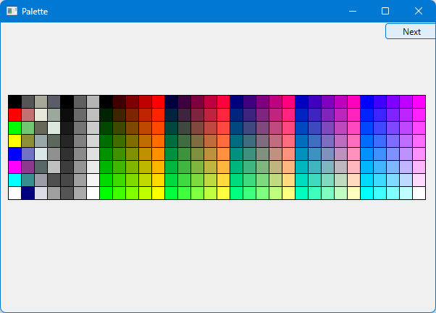
Color matrix (32*8)
Let’s draw a color matrix
To see
some of the colors we have to work with
how messy two-dimensional addressing can be
See PPP2 Chapter 24 for real matrices
how to avoid inventing names for objects

Slide 29
Color matrix (32*8)
Vector_ref<Rectangle> vr; // use like a vector and imagine that it holds Rectangle& elements
const int max = 32; //number of columns
const int side = 18; // size of color rectangle
const int left = 10; // left edge
const int top = 100; // top edge
int color_index = 0;
for (int i = 0; i < max; ++i) { // all columns
for (int j = 0; j < 8; ++j) { // 8 rows in each column
vr.push_back(make_unique<Rectangle>(Point{ i*side+left,j*side+top }, side, side));
vr[vr.size()-1].set_fill_color(color_index);
++color_index; // move to the next color
win.attach(vr[vr.size()-1]);
}
}
Make an unnamed Rectangle
(details in Chapter 18)
Notes:
You can always flip back to show the color matrix.

Slide 30
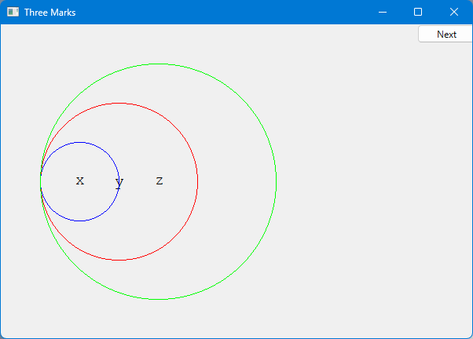
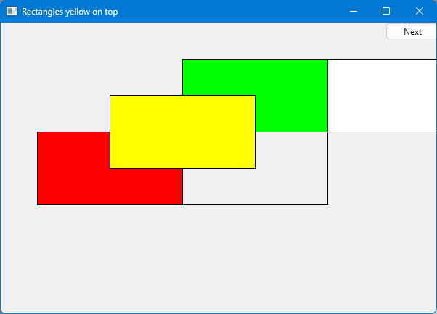
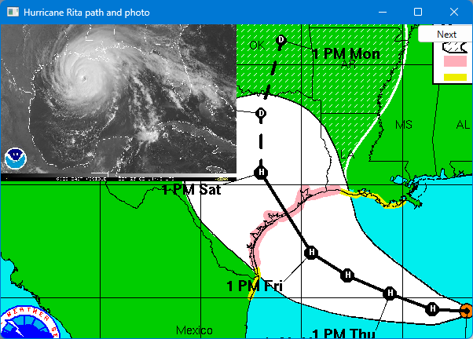
There are more Shapes – and you can make your own
Notes:
I cancelled class when hurricane Rita approached.

Slide 31
Next lecture
What is class Shape?
Introduction to object-oriented programming

