Slide 1
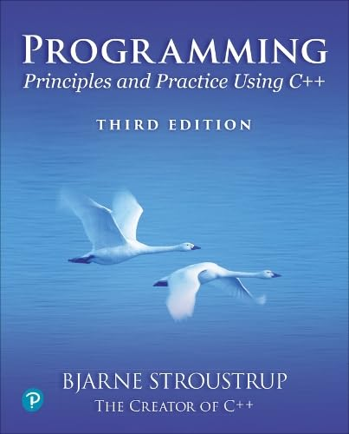
Chapter 13 – Graphing Functions and Data
The best is the enemy of the good.
– Voltaire

Slide 2
Abstract
Here we present ways of graphing functions and data and some of the programming techniques needed to do so, notably scaling.
Graphical function objects
Approximation and precision
Scaling and data
Layout

Slide 3
Note
This course is about programming
The examples – such as graphics – are simply examples of
Useful programming techniques
Useful tools for constructing real programs
Look for the way the examples are constructed
How are “big problems” broken down into little ones and solved separately?
How are classes defined and used?
Do they have sensible data members?
Do they have useful member functions?
Use of variables
Are there too few?
Too many?
How would you have named them better?

Slide 4
Graphing functions
For any new tool, technique, library, or language
Start with something really simple
Always remember “Hello, World!”
We graph functions of one argument yielding one value
Plot (x, f(x)) for values of x in some range [r1,r2)
Let’s graph three simple functions:
double one(double x) { return 1; } // y==1
double slope(double x) { return 0.5*x; } // slope is 0.5
double square(double x) { return x*x; } // y==x*x

Slide 5
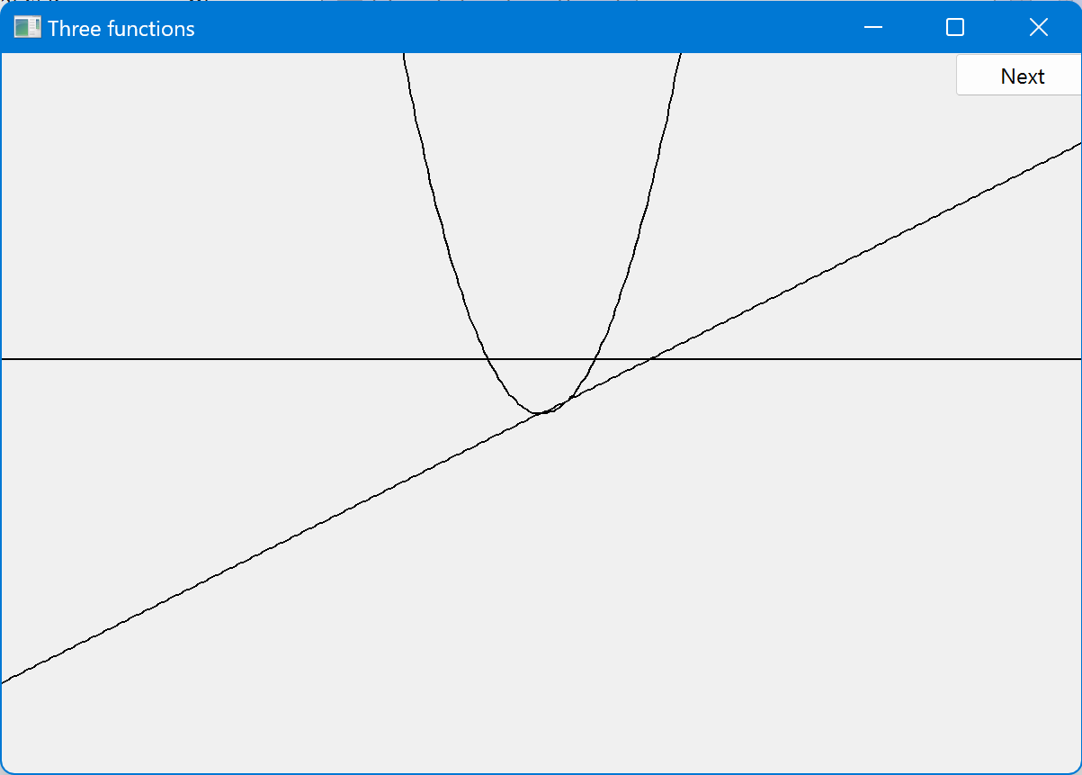
Functions
double one(double x) { return 1; } // y==1
double slope(double x) { return 0.5*x; } // y==0.5*x
double square(double x) { return x*x; } // y==x*x

Slide 6
We need some Constants to control presentation
Choosing a center (0,0), scales, and number of points can be fiddly
The range usually comes from the definition of what you are doing
const int xmax = 600; // window size (600 by 400)
const int ymax = 400;
const int x_orig = xmax/2;
const int y_orig = ymax/2;
const Point orig {x_orig, y_orig}; // position of Cartesian (0,0) in window
const int r_min = -10; // range [-10:11) == [-10:10] of x
const int r_max = 11;
const int n_points = 400; // number of points used in range
const int x_scale = 30; // scaling factors
const int y_scale = 30;

Slide 7
How do we write code to do this?
Simple_window win {Point{100,100},xmax,ymax,“Three function"};
Function s {one, -10,11, orig, n_points, x_scale,y_scale};
Function s2 {slope, -10,11, orig, n_points, x_scale,y_scale};
Function s3 {(square, -10,11, orig, n_points, x_scale,y_scale};
win.attach(s);
win.attach(s2);
win.attach(s3);
win.wait_for_button();
Function to be graphed
First point
“stuff” to make the graph fit into the window
Range in which to graph [x0:xN)

Slide 8
Functions – but what does it mean?
What’s wrong with this?
No axes (no scale)
No labels

Slide 9
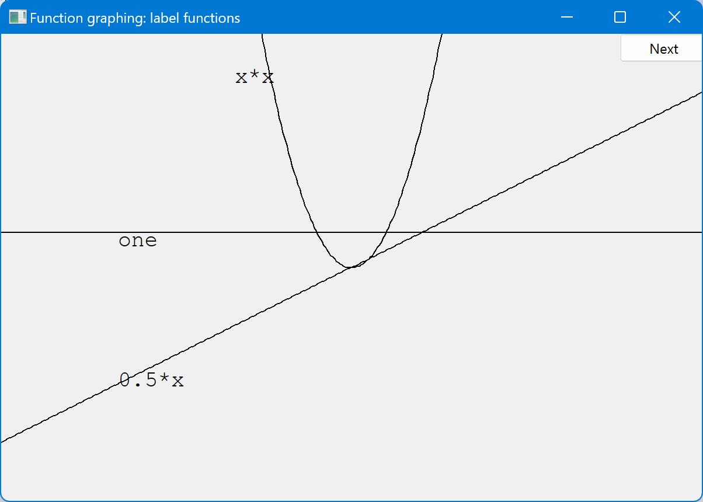
Label the functions
Text ts {Point{100,y_orig-40},"one"};
Text ts2 {Point{100,y_orig+y_orig/2-20},"0.5*x};
Text ts3 {Point{x_orig-90,20),"x*x"};

Slide 10
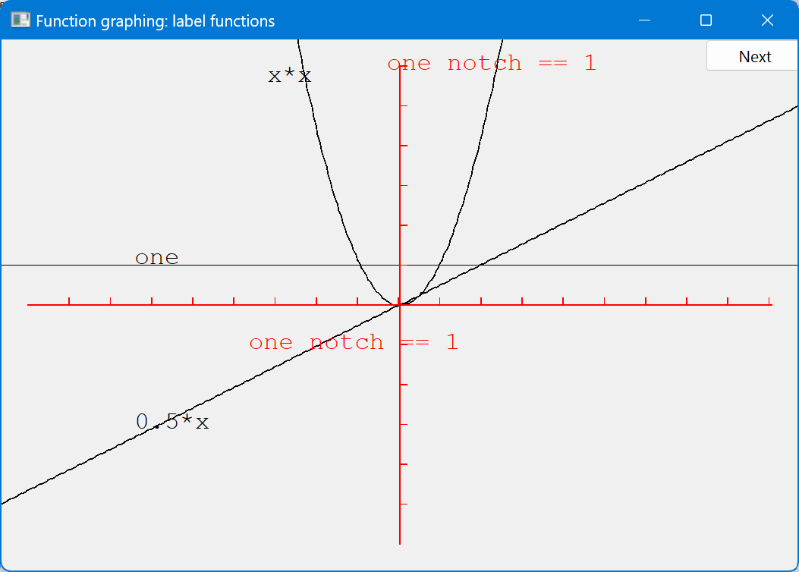
Add x-axis and y-axis
We can use axes to show (0,0) and the scale
Axis x {Axis::x, Point{20,y_orig}, xlength/x_scale, "one notch == 1"};
Axis y {Axis::y, Point{x_orig, ylength+20}, ylength/y_scale, "one notch == 1"};

Slide 11
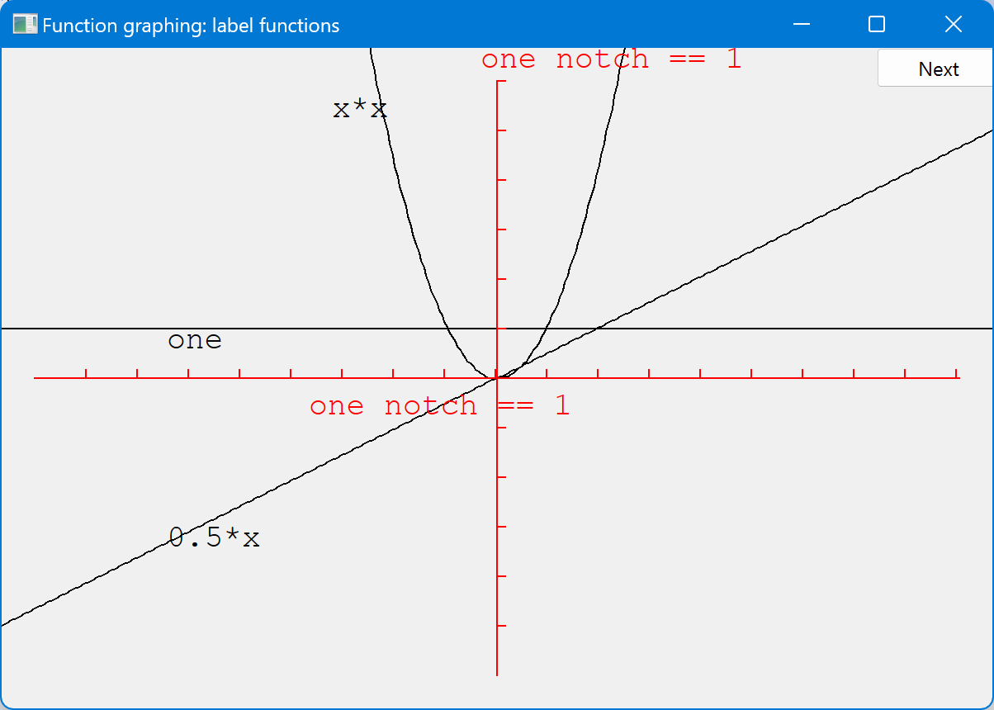
Use color (in moderation)
x.set_color(Color::red);
y.set_color(Color::red);

Slide 12
The implementation of Function
We need a type for the argument specifying the function to graph
using can be used to declare a new name for a type
using Count = int; // now Count means int
Define the type of our desired argument, Fct
using Fct = std::function<(double(double)>; // the type of a function // taking a double argument // and returning a double
Examples of functions of type Fct:
double one(double x) { return 1; } // y==1
double slope(double x) { return 0.5*x; } // y==0.5*x
double square(double x) { return x*x; } // y==x*x

Slide 13
Now Define “Function”
We store the function as a sequence of line segments in a polyline
struct Function : Open_polyline { // all it needs is a constructor! Function(
Fct f,
double r1, double r2, // range
Point orig,
int count = 100, // Number of line segments
double xscale = 25, double yscale = 25 // x and y scaling
);
// the function parameters are not stored
};

Slide 14
Implementation of Function
Function::Function( Fct f,
double r1, double r2,
Point xy,
int count,
double xscale, double yscale )
{
if (r2-r1<=0) error("bad graphing range");
if (count<=0) error("non-positive graphing count");
double dist = (r2-r1)/count;
double r = r1;
for (int i = 0; i<count; ++i) {
add(Point{xy.x+int(r*xscale), xy.y-int(f(r)*yscale)});
r += dist;
}
}

Slide 15
Default arguments
Seven arguments are too many!
Many too many
We’re just asking for confusion and errors
Provide defaults for some (trailing) arguments
Default arguments are often useful for constructors
struct Function : Open_polyline {
Function(Fct f, double r1, double r2, Point xy,
Count count = 100, double xscale = 25, double yscale=25 );
};
Function f1 {sqrt, 0, 11, orig, 100, 25, 25}; // ok (obviously)
Function f2 {sqrt, 0, 11, orig, 100, 25}; // ok: exactly the same as f1
Function f3 {sqrt, 0, 11, orig, 100}; // ok: exactly the same as f1
Function f4 {sqrt, 0, 11, orig}; // ok: exactly the same as f1

Slide 16
Function
Is Function a “pretty class”?
No
Why not?
What could you do with all those position and scaling arguments?
See §13.6.3 for one minor idea
If you can’t do something genuinely clever, do something simple, so that the user can do anything needed
Such as adding parameters so that the caller can control precision
Use default argument to simplify the calling interface

Slide 17
Some more functions
// You can combine functions (e.g., by addition):
double sloping_cos(double x) { return cos(x)+slope(x); }
// cos() is overloaded, here we must say which versions we want
double dcos(double d) { return cos(d); } // dcos() chooses cos(double)
Function s4{ dcos,r_min,r_max,orig,400,30,30 };
s4.set_color(Color::blue);
Function s5{ sloping_cos, r_min,r_max,orig,400,30,30 };
s5.set_color(Color::green);

Slide 18
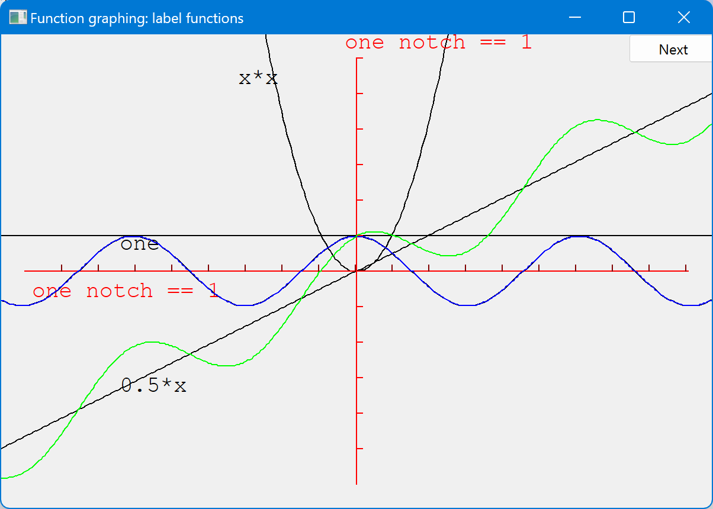
Cos and sloping-cos

Slide 19
Some standard mathematical functions
double abs(double); // absolute value
double ceil(double d); // smallest integer >= d
double floor(double d); // largest integer <= d
double sqrt(double d); // d must be non-negative
double cos(double);
double sin(double);
double tan(double);
double acos(double); // result is non-negative; “a” for “arc”
double asin(double); // result nearest to 0 returned
double atan(double);
double sinh(double); // “h” for “hyperbolic”
double cosh(double);
double tanh(double);

Slide 20
Some standard mathematical functions
double exp(double); // base e
double log(double d); // natural logarithm (base e) ; d must be positive
double log10(double); // base 10 logarithm
double pow(double x, double y); // x to the power of y
double pow(double x, int y); // x to the power of y
double atan2(double y, double x); // atan(y/x)
double fmod(double d, double m); // floating-point remainder; same sign as d%m
double ldexp(double d, int i); // d*pow(2,i)

Slide 21
Why graphing?
Because you can see things in a graph that are not obvious from a set of numbers
How would you understand a sine curve if you couldn’t (ever) see one?
Visualization
Is key to understanding in many fields
Is used in most research and business areas
Science, medicine, business, telecommunications, control of large systems
Can communicate large amounts of data simply

Slide 22
An example: e^{x}
e^{x} == 1
+ x
+ x²/2!
+ x³/3!
+ x⁴/4!
+ x⁵/5!
+ x⁶/6!
+ x⁷/7!
+ …
Where ! means factorial (e.g. 4!==4*3*2*1)
(This is the Taylor series expansion e^{x} about x==0)

Slide 23
Simple algorithm to approximate e^{x}
double fac(int n) { /* … */ } // factorial, n! == n*(n-1)* … *2
double term(double x, int n) // x^{n}/n!
{
return pow(x,n)/fac(n);
}
double exp_n(double x, int n) // sum of n terms of Taylor series for e^{x}
{
double sum = 0;
for (int i = 0; i<n; ++i)
sum+=term(x,i);
return sum;
}

Slide 24
“Animate” approximations to e^{x} (“Boilerplate”)
Application app;
constexpr int xmax = 600; // window size
constexpr int ymax = 400;
constexpr int x_orig = xmax / 2; // position of (0,0) is center of window
constexpr int y_orig = ymax / 2;
constexpr Point orig{ x_orig,y_orig };
constexpr int r_min = -10; // range [-10:11)
constexpr int r_max = 11;
constexpr int n_points = 400; // number of points used in range
constexpr int x_scale = 30; // scaling factors
constexpr int y_scale = 30;

Slide 25
“Animate” approximations to e^{x} (“Boilerplate”)
Simple_window win{ Point{100,100},xmax,ymax,"Real exp" };
constexpr int xlength = xmax - 40; // make the axis a bit smaller than the window
constexpr int ylength = ymax - 40;
Axis x{ Axis::x,Point{20,y_orig}, xlength, xlength / x_scale, "one notch == 1" };
Axis y{ Axis::y,Point{x_orig, ylength + 20}, ylength, ylength / y_scale, "one notch == 1" };
x.set_color(Color::red);
y.set_color(Color::red);
// what we are trying to approximate:
Function real_exp{ [](double d) { return exp(d); },r_min,r_max,orig,200,x_scale,y_scale };
real_exp.set_color(Color::blue);
win.attach(real_exp);
win.attach(x);
win.attach(y);
win.wait_for_button();

Slide 26
“Animate” approximations to e^{x}
for (int n = 0; n<50; ++n) {
ostringstream ss;
ss << "exp approximation; n==" << n ;
win.set_label(ss.str().c_str());
// next approximation:
Function e([n](double x) { return exp_n(x,n); }, // n terms of Taylor series
r_min,r_max,orig,200,x_scale,y_scale);
win.attach(e);
win.wait_for_button(); // give the user time to look
win.detach(e);
}
Lambda expression

Slide 27
Lambda expression
What was this?
([n](double x) { return exp_n(x,n); } // n terms of Taylor series
It’s a lambda, aka lambda expression aka lambda function
It takes n from the context and makes a function object using it
we can only graph functions of one argument,
so we had the language write one for us (grabbing the “n” from the context)
[n](double x) { return expe(x,n); }
Lambda expressions are important in conemporary C++
A shorthand notation for defining function objects
Capture list
starts with [
Argument declaration
starts with (
lambda function body
Starts with {

Slide 28
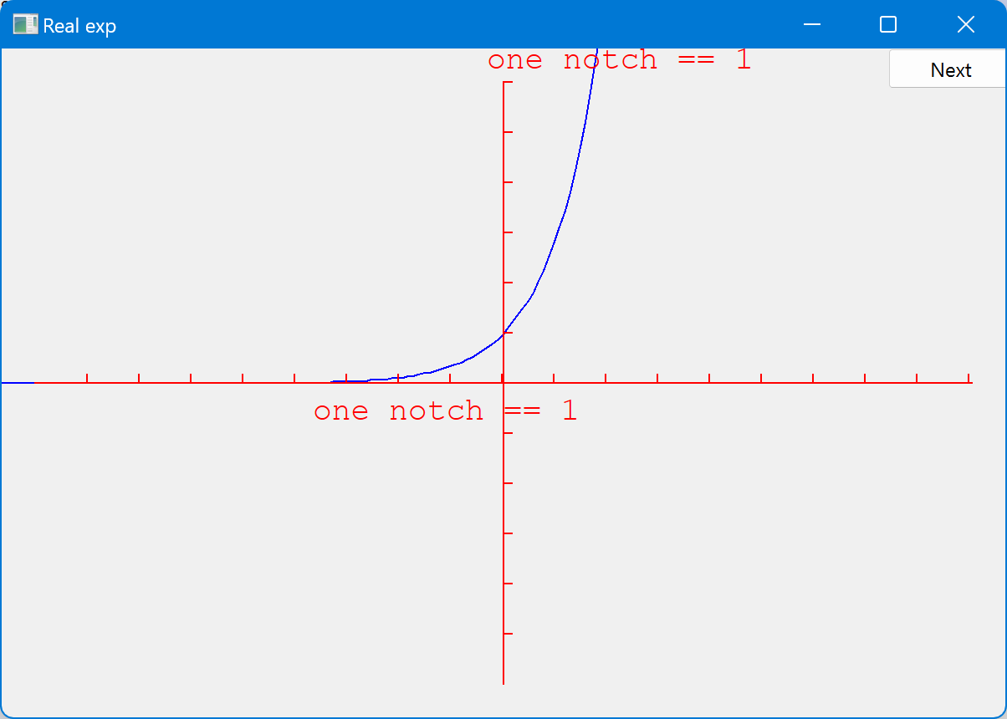
Demo
The following screenshots are of the successive approximations of exp(x) using exp_n(x,n)
Notes:
Explain a bit as you go along. Feel free to ham it up a bit. Most students do not have a feel for sequences

Slide 29
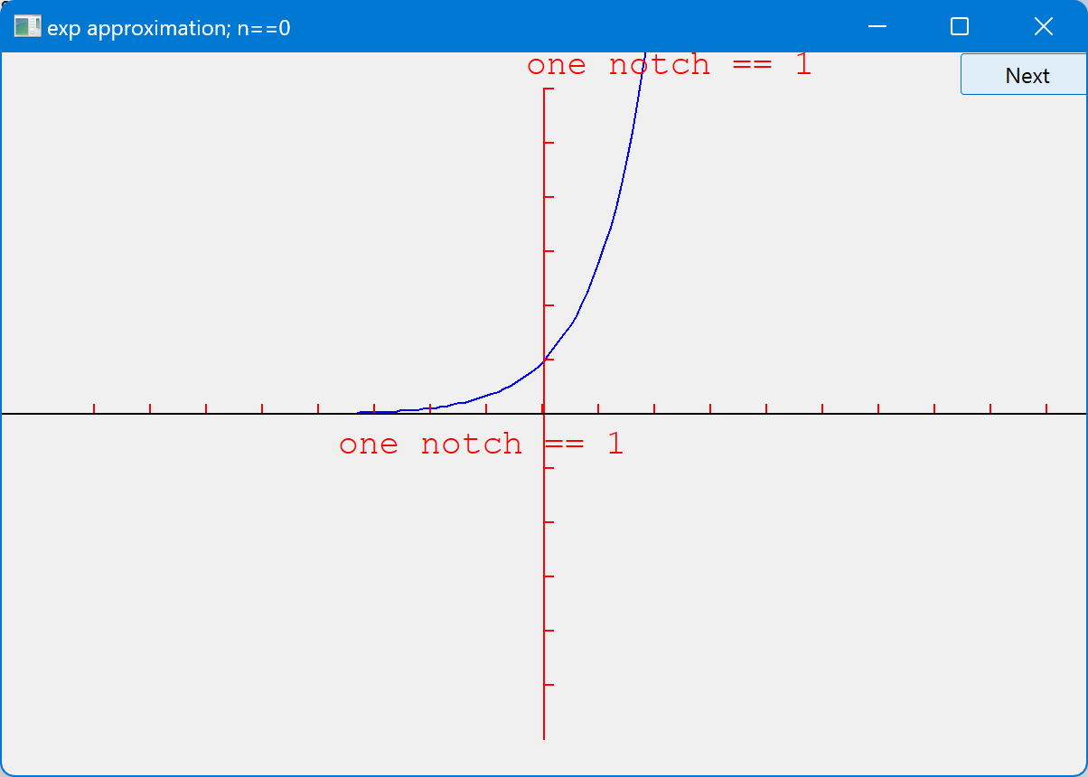
Demo: n = 0

Slide 30
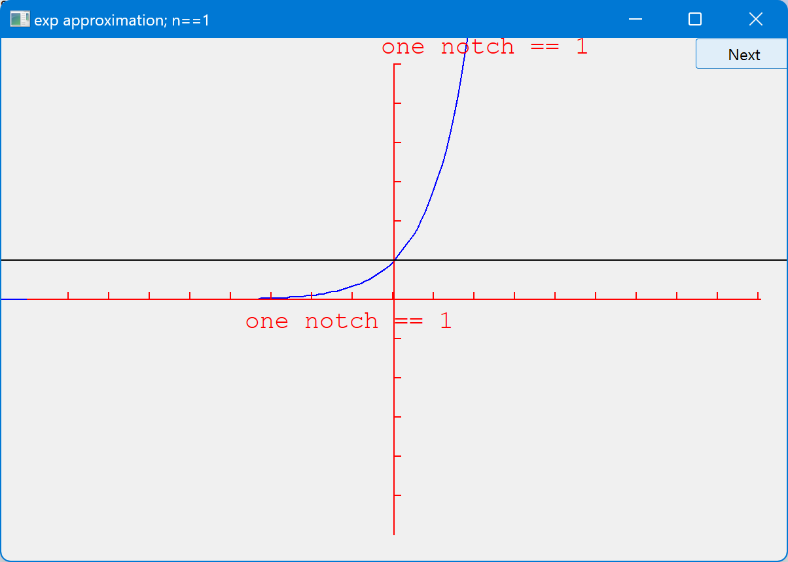
Demo: n = 1

Slide 31
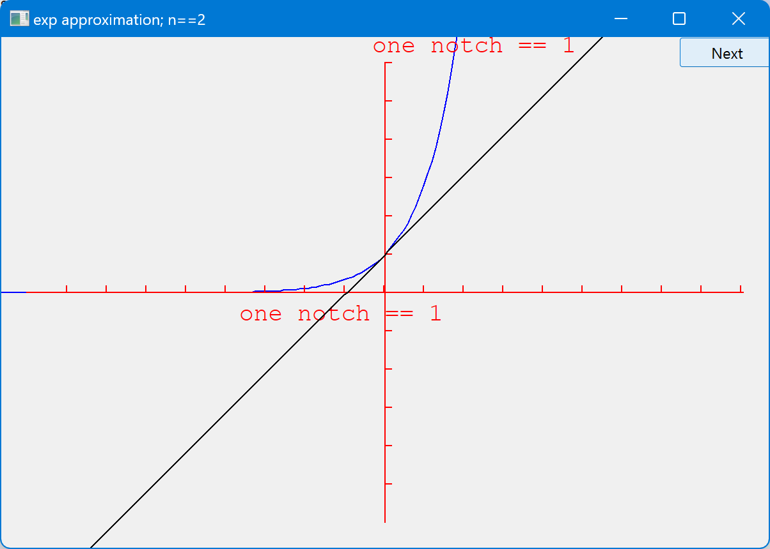
Demo: n = 2

Slide 32
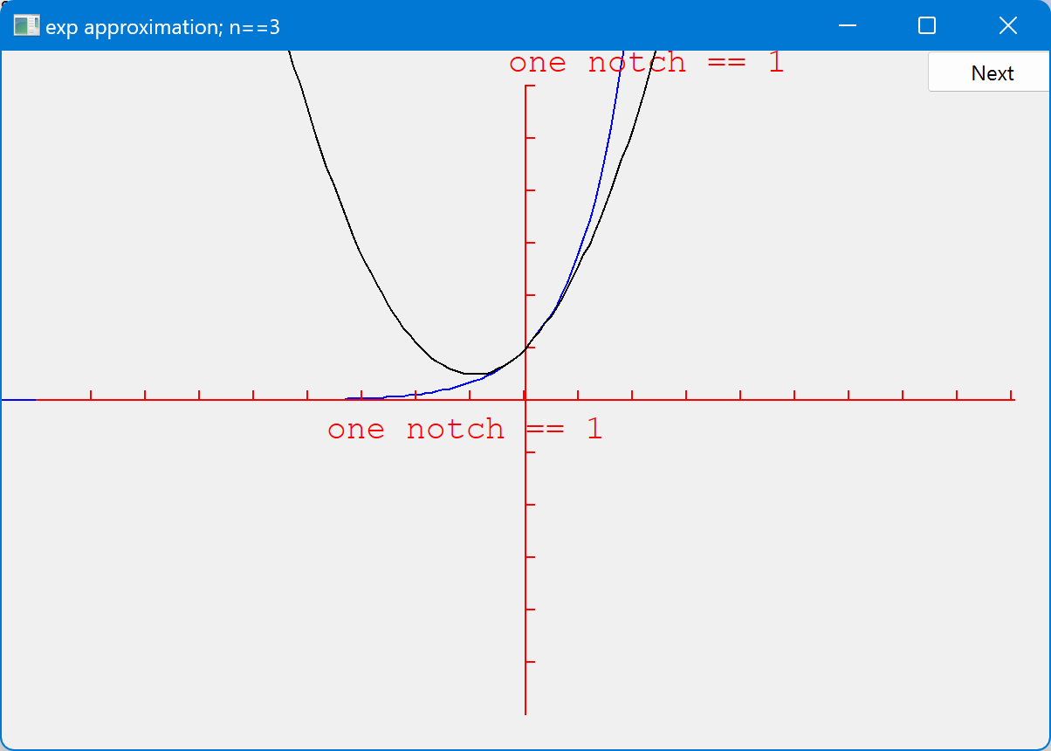
Demo: n = 3

Slide 33
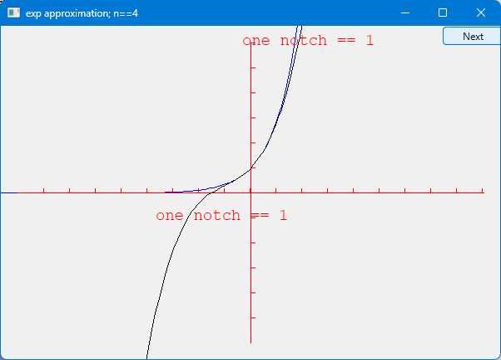
Demo: n = 4

Slide 34
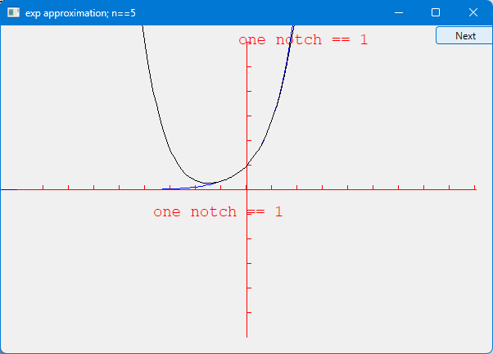
Demo: n = 5

Slide 35
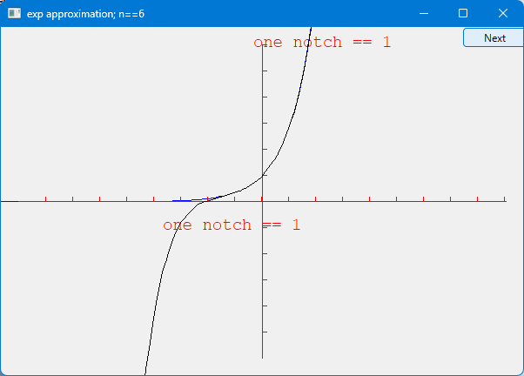
Demo: n = 6

Slide 36
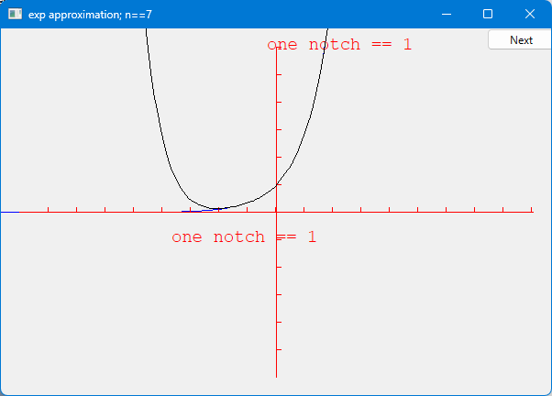
Demo: n = 7

Slide 37
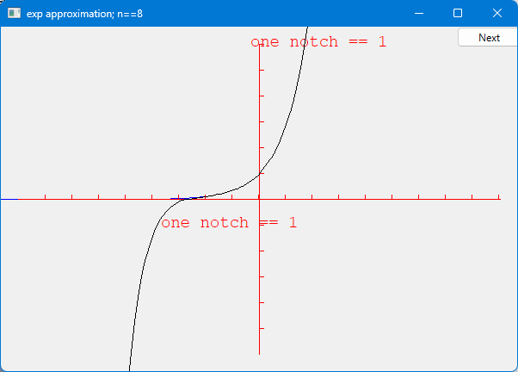
Demo: n = 8

Slide 38
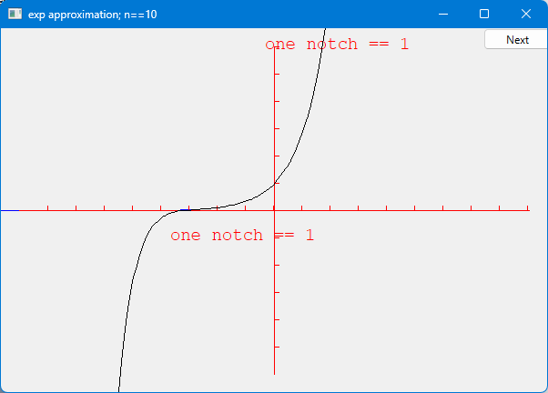
Demo: n = 10

Slide 39
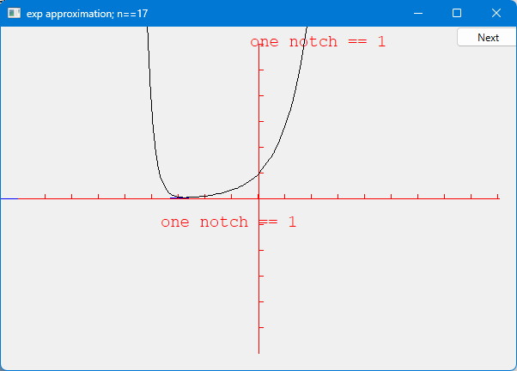
Demo: n = 17

Slide 40
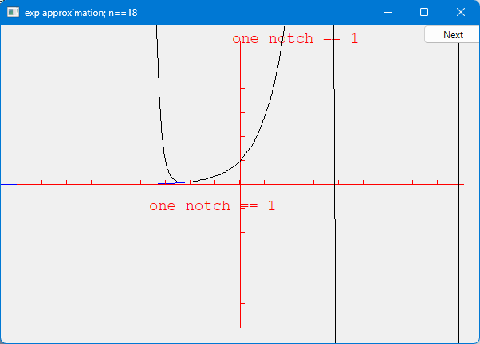
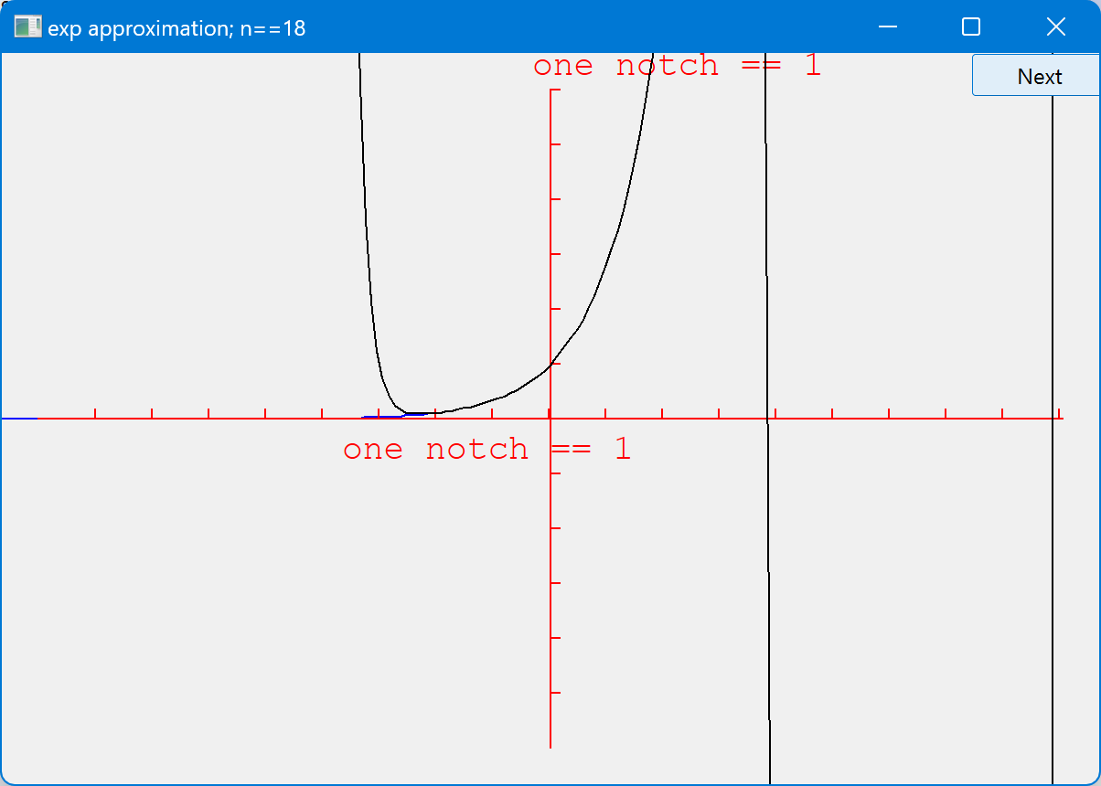
Demo: n = 18
Huh? Vertical lines???

Slide 41
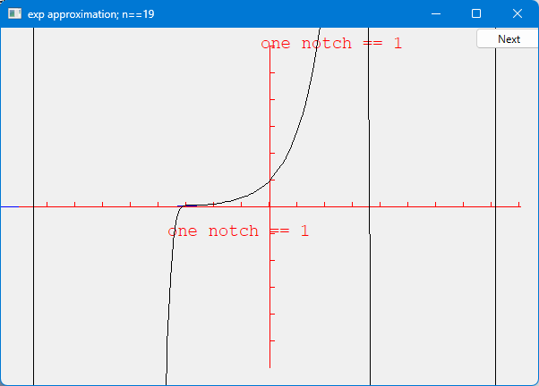
Demo: n = 19

Slide 42
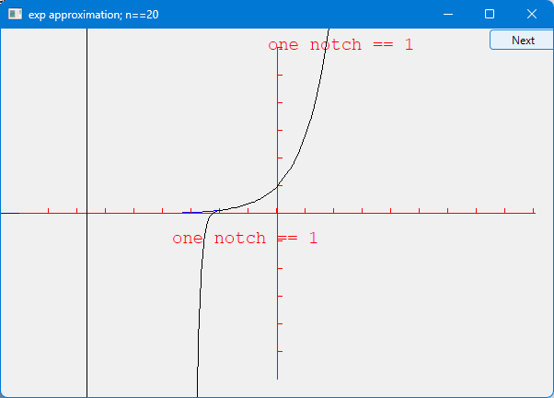
Demo: n = 20

Slide 43

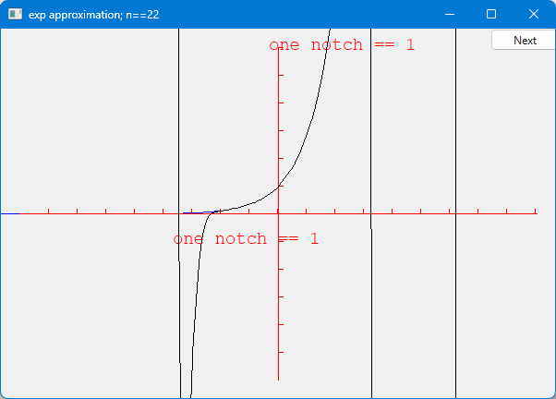
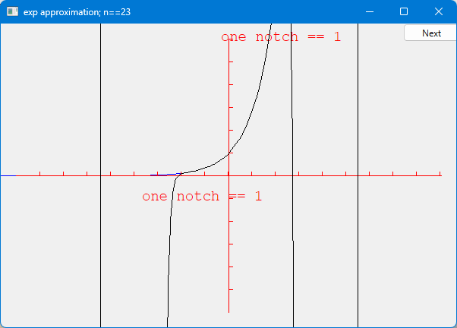
Demo: n = 21

Slide 44
Demo: n = 22

Slide 45
Demo: n = 23

Slide 46
Why did the graph “go wild”?
Floating-point numbers are an approximations of real numbers
Just approximations
In a fixed amount of memory
Real numbers can be arbitrarily large and arbitrarily small
Floating-point numbers are of a fixed size and can’t hold all real numbers
Sometimes the approximation is not good enough for what you do
Small inaccuracies (rounding errors) can build up into huge errors
Always
be suspicious about calculations
always
check your results
Visual representations of values can be most useful
hope that your errors are obvious
You want your code to break early – before anyone else gets to use it

Slide 47
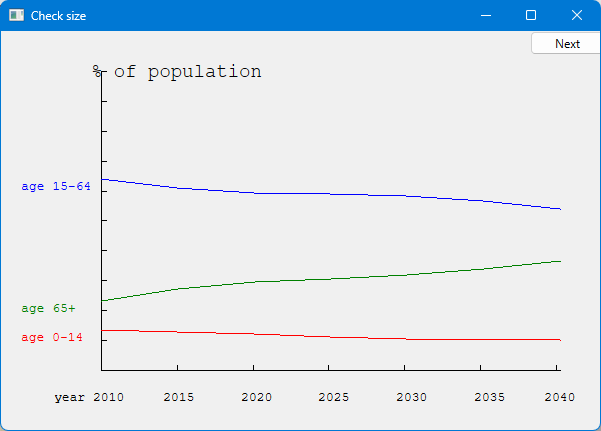
Graphing data
Often, what we want to graph is data, not a well-defined mathematical function
Here, we use three Open_polylines

Slide 48
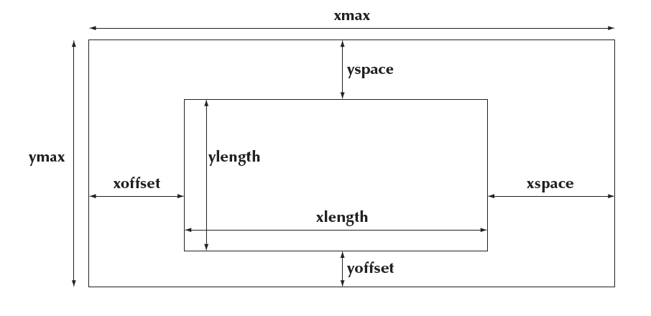
Graphing data
Carefully design your screen layout

Slide 49
Code for Axis
struct Axis : Shape {
enum Orientation { x, y, z };
Axis(Orientation d, Point xy, int length,
int number_of_notches = 0, // default: no notches
string label = "" // default : no label
);
void draw_specifics(Painter& painter) const override;
void move(int dx, int dy) override;
void set_color(Color c);
Text label;
Lines notches;
Line line;
};
Notes:
If there is time. Sometimes, students need to be shown “implementation detail” to remind them to do those well

Slide 50
Axis::Axis(Orientation d, Point xy, int length, int n, string lab)
:label(Point{0,0},lab),
line(xy, (d==x ) ? Point(xy.x+length, xy.y) : Point(xy.x, xy.y-length)) // horizontal or vertical
{
if (length<2) error("bad axis length");
switch (d) {
case Axis::x:
{
// …
break;
}
case Axis::y:
{
// …
break;
}
case Axis::z:
error("z axis not implemented");
}

Slide 51
case Axis::x:
{
int dist = length/n;
int x = xy.x+dist;
for (int i = 0; i<n; ++i) {
notches.add(Point{x,xy.y},Point{x,xy.y-5});
x += dist;
}
label.move(length/3,xy.y+20); // label under the line
break;
}

Slide 52
Axis implementation
void Axis::draw_specifics(Painter& painter) const
{
line.draw(painter); // the line
notches.draw(painter); // the notches may have a different color from the line
label.draw(painter); // the label may have a different color from the line
}
The underlying Qt implementation slightly shines through

Slide 53
Axis implementation
void Axis::move(int dx, int dy)
{
Shape::move(dx,dy); // the line
notches.move(dx,dy);
label.move(dx,dy);
redraw();
}
void Axis::set_color(Color c)
{
Shape::move(dx,dy);
notches.move(dx,dy);
label.move(dx,dy);
redraw();
}

Slide 54
Next Lecture
Graphical user interfaces
Windows and Widgets
Buttons and dialog boxes

