Slide 1
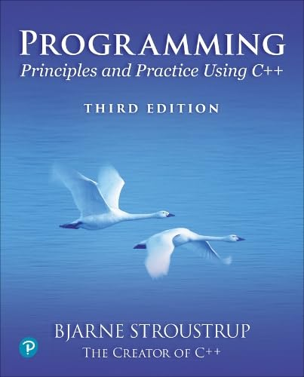
Chapter 14 – Graphical User Interfaces
Computing is not about
computers anymore.
It is about living.
– Nicholas Negroponte

Slide 2
Overview
Perspective
I/O alternatives
GUI
Layers of software
GUI example
GUI code
Callbacks
A simple animation

Slide 3
I/O alternatives
Use console input and output
A strong contender for technical/professional work
Command line interface
Menu driven interface
Graphic User Interface
Use a GUI Library
To match the “feel” of Windows/Mac/Android/iPhone/… applications
When you need drag and drop, WYSIWYG
Event driven program design
A web browser – this is a GUI library application
HTML / a scripting language
For remote access (and more)

Slide 4
Common GUI tasks
Titles / Text
Names
Prompts
User instructions
Fields / Dialog boxes
Input
Output
Buttons
Let the user initiate actions
Let the user select among a set of alternatives
e.g., yes/no, blue/green/red, etc.
Menus
Sliders

Slide 5
Common GUI tasks (cont.)
Display results
Shapes
Text and numbers
Make a window “look right”
Style and color
Note: our windows look different (and appropriate) on different systems
More advanced
Tracking the mouse
Dragging and dropping
Free-hand drawing
Animation

Slide 6
GUI
From a programming point of view GUI is based on two techniques
Object-oriented programming
For organizing program parts with common interfaces and common actions
Events
For connecting an event (like a mouse click) with a program action

Slide 7
Layers of software
When we build software, we usually build upon existing code
Example of a layer
Provides services
Uses services
Our program
Our GUI/Graphics interface library
Qt
The operating system Graphics GUI facilities
Device driver layer

Slide 8
C++ GUI libraries
There are many C++ GUI and Graphics libraries
That’s a problem: how to choose?
FLTK, Gtkmm, Qt, Ultimate++, VxWorks, …
Tradeoffs
Ease of use
Ease of installation
Generality
Range of platforms: Android, Browsers, iPad, Linux, Mac, Windows, embedded systems, …
Footprint
Latency
…
We prefer systems that work on many platforms
PPP2 used FLTK
PPP3 uses Qt

Slide 9
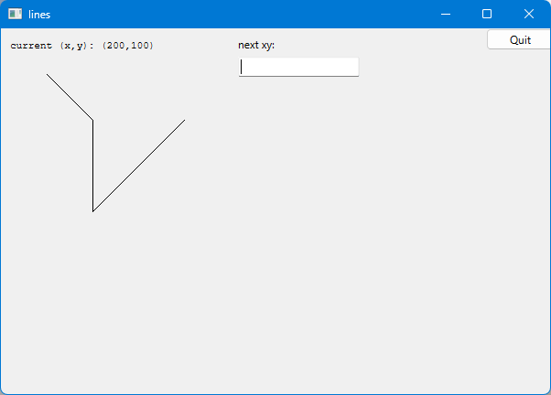
GUI example
Usual window features
Out_box
button
Open_polyline
In_box
Window with
The usual header: label, minimize, maximize, and close
That will look different on a different system
A Button, an In_box, an Out_box, and an Open_polyline

Slide 10
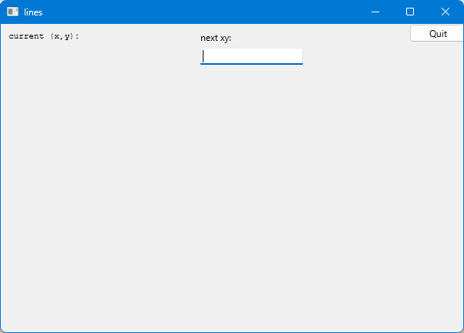
GUI example
Initial window

Slide 11
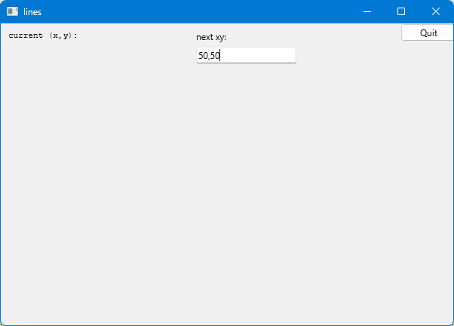
GUI example
Enter a point in the In_box labelled “next xy:”

Slide 12
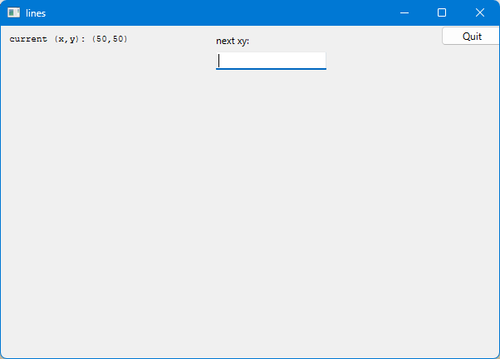
GUI example
Hit “enter” and the point entered appear in the Out_box labelled “current (x,y):”

Slide 13
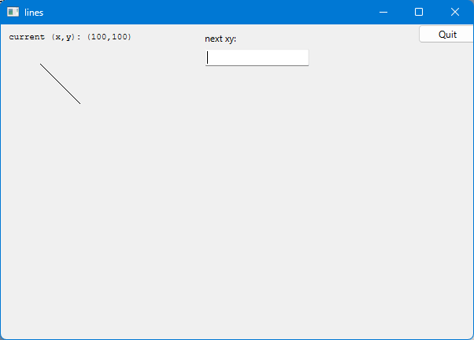
GUI example
Add another point and you have a line

Slide 14
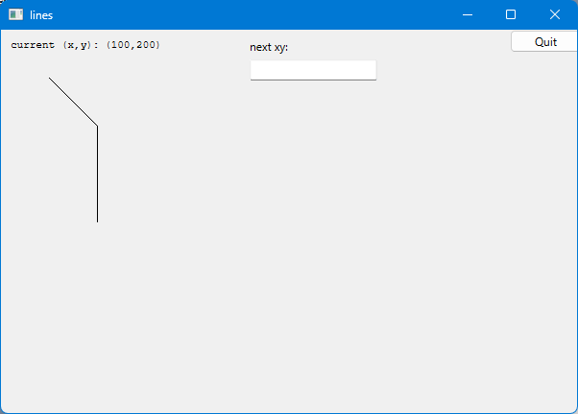
GUI example
Three points give two lines
Obviously, we are building a polyline

Slide 15
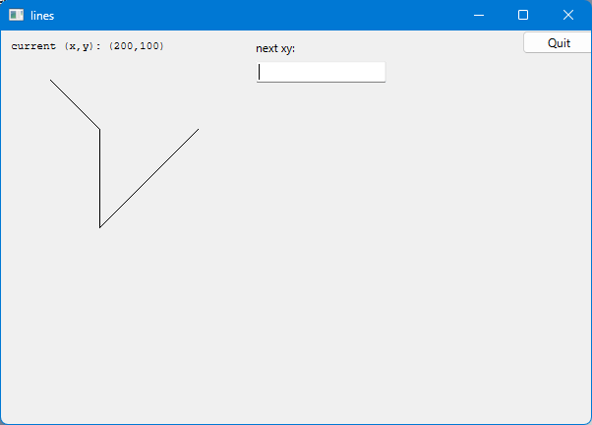
GUI example
And so on, until you hit the Button labelled “Quit”.

Slide 16
So what? And How?
We saw buttons, input boxes and an outbox in a window
How do we define windows, buttons, input boxes, and output boxes?
Click on a button and something happens
How do we specify that action as code?
How do we connect our code to the button?
You type something into an input box
How do we get that value into our code?
How do we interpret the string you type as a numbers?
We saw output in the output box
How do we put the values there?
Lines appeared in our window
How do we store the lines?
How do we draw them?

Slide 17
Mapping
We map our ideas onto the Qt version of the conventional Graphics/GUI ideas

Slide 18
Define class Lines_window
struct Lines_window : Window {
Lines_window(Application* application, Point xy, int w, int h, const string& title);
Open_polyline lines;
void wait_for_button();
private:
Application* app = nullptr;
Button quit_button;
In_box next_xy;
Out_box xy_out;
void next(); // action for next_xy
void quit(); // action for quit
};

Slide 19
GUI example
Usual window features
button
button
Open_polyline
In_box
Window with
A Button, an In_box, and an Out_box

Slide 20
The Lines_window constructor
Lines_window::Lines_window(Application* application, Point xy, int w, int h, const string& title)
:Window{ xy,w,h,title },
app(application),
quit_button{ Point{x_max() - 70,0}, 70, 20, "Quit", [this]() { quit(); } },
next_xy{ Point{250,0}, 50, 20, "next xy:", [this]() { next(); } },
xy_out{ Point{10,10}, "current (x,y): " }
{
xy_out.label.set_font_size(8); // we control the appearance of the label
xy_out.data.set_font_size(8);
attach(quit_button);
next_xy.hide_buttons(); // our In_box shouldn’t offer buttons (just use “enter”)
attach(next_xy);
attach(xy_out);
next_xy.show(); // make sure our In_box can be seen
attach(lines);
}

Slide 21
Widgets, Buttons, and Callbacks
How it works
The application gives a “callback” function to the system to call for an event
When the event happens (e.g., a user clicks on a button), the system calls the callback
Set callback
application
callback
System
click
User action

Slide 22
Widgets, Buttons, and Callbacks
A Widget is a basic concept in window-based systems
Basically, anything you can see on the screen and can do something is a widget
called a “control” by Microsoft
using Callback = std::function<void()>; // can be used to pass a function to the operating system
struct Widget { // a connection to an operating system
Widget(Point xy, int w, int h, const string& s, Callback cb)
:loc(xy), width(w), height(h), label(s), do_it(cb)
{ }
};
struct Button : Widget { // Displays as a rectangle and has an action associated with it
Button(Point xy, int w, int h, const string& label, Callback cb);
};

Slide 23
Widgets, Buttons, and Callbacks
The constructor for a Widget (here a Button) must do a lot of system-specific setup
Fortunately, we don’t often have to see that
just like we rarely have to see how the operating system does it sophisticated “magic”
Just like we rarely have to see how our computer hardware really works
Button::Button(Point xy, int w, int h, const string& label, Callback cb)
:Widget(xy,w,h,label,cb)
{
WidgetPrivate& w_impl = get_impl(); // Qt specific implementation code
QPushButton* button = new QPushButton();
w_impl.widget.reset(button);
button->setText(QString::fromStdString(label));
QObject::connect(button, &QPushButton::clicked, [this]{ do_it(); });
}

Slide 24
Our “action” code: quit()
// The action itself is simple enough to write if (and only if) you know the underlying system
void Lines_window::quit()
{
end_button_wait();
next_xy.dismiss();
app->quit();
}

Slide 25
In_box
struct In_box : Widget { // An In_box is a widget into which you can type characters
In_box(Point xy, int w, int h, const string& s, Callback cb = {});
// … for details see the code …
void attach(Window& win) override;
void hide_buttons(); // A Qt input window can be used with keyboard and/or buttons
void show_buttons();
enum State {idle, accepted, rejected};
State last_result();
void clear_last_result();
string last_string_value();
struct ResultData { /* … */ };
private:
ResultData result;
bool waiting = false;
};

Slide 26
Our “action” code: next()
void Lines_window::next() // read "int,int", e.g. "200,300“ from out In_box
{
if (next_xy.last_result() == In_box::accepted) {
string s = next_xy.last_string_value(); // get the string typed in (if any)
istringstream iss { s };
int x;
char ch;
int y;
iss >> x >> ch >> y; // read coordinates from the In_box’s string
lines.add(Point{ x,y }); // draw the new line
ostringstream oss;
oss << '(' << x << ',' << y << ')’;
xy_out.put(oss.str()); // update current position readout
}
next_xy.clear_last_result(); // remove the string from the In_box
}

Slide 27
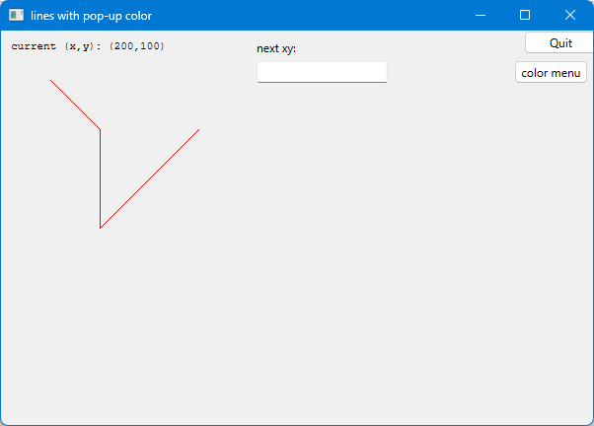
We can build Windows out of Windows
struct Color_window : Lines_window {
Color_window(Application* app, Point xy, int w, int h, const string& title);
private:
void change(Color c) { lines.set_color(c); }
void hide_menu() { color_menu.hide(); menu_button.show(); }
Button menu_button;
Menu color_menu; // See §14.5.2
};

Slide 28
Control Inversion
But where is the program?
Our code just responds to the user using our widgets
No loops?
No if-then-else?
int main ()
{
Application app; // the connection to the underlying system
Lines_window win{ &app, Point{100,100},600,400,"lines" }; // our window with Widgets
app.gui_main(); // an “infinite loop”
}

Slide 29
Control Inversion
Conventional control flow
To many things at once, see concurrency
Event-driven control flow:
To do many things at once, define more windows and widgets
Application
call
Input function
prompt
User responds
Application
callback
System
click
User “action”

Slide 30
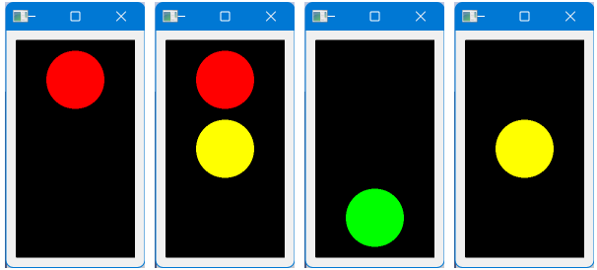
Simple animation
Often, we want a Widget to change without user intervention
Examples: a clock face, a traffic light, a bouncing ball, a growing graph, …
A key function (see §14.6):
void Window::timer_wait(int milliseconds)
{
impl->timer_wait(milliseconds);
}
do_something()
win.timer_wait (1′000);
do_something_else();
// usually in a loop
#1 wait#2 wait #3 wait #4 …

Slide 31
Summary
We have seen
Action on buttons
Interactive I/O
Text input
Text output
Graphical output
Simple animation
Missing
Menu (See §14.5)
Window and Widget (see the code)
Anything to do with tracking the mouse
Dragging
Hovering
Free-hand drawing
What we haven’t shown, you can pick up if you need it

Slide 32
Next lecture
The next three lectures will show how the standard vector is implemented using basic low-level language facilities.
This is where we really get down to the hardware and work our way back up to a more comfortable and productive level of programming.

