Slide 1
Multilevel Versioning of XML Documents
ari.nordstrom@condesign.se

Slide 2
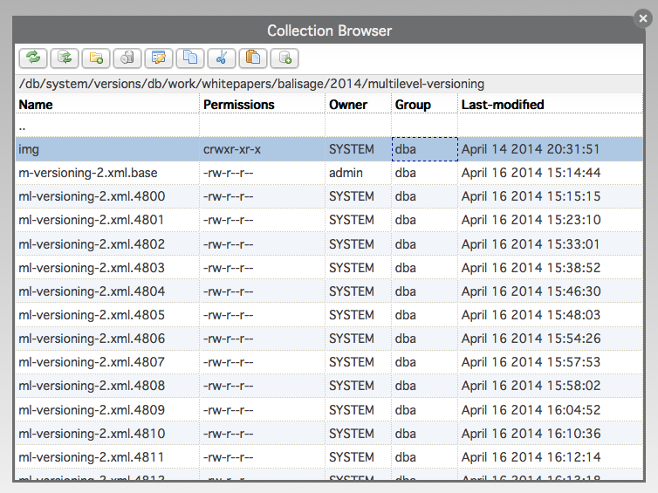
„Straight“ Versioning

Slide 3
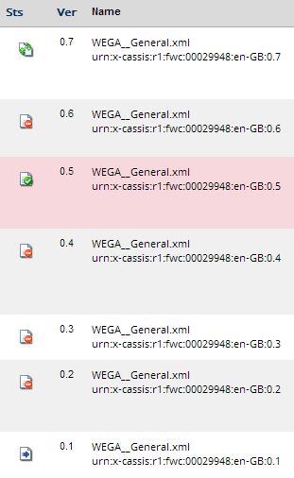
Which Ones Are Significant?
Add workflow

Slide 4
(Significant) Versioning in eXist
Copy significant version to another collection
Version handle each collection with standard eXist versioning module
Copy triggers new version

Slide 5
Something Like This...
Stable
  eXist version 1
  Copy to Stage 1 for edit
Stage 1
  Several new edits, eXist versions 2, 3, 4...
  Copy version 4 to Stable
Stable
  New eXist version 5
  ...

Slide 6
Add A Version abstraction
Stable
  1, 2...
Stage 1
  1.1, 1.2, 1.3

Slide 7
Add Naming Abstraction (Useful Extra)
urn:x-resource:r1:<doc-number>:<lang>:<stable>:<stage1>
urn:x-resource:r1:123456:en-GB:1:0
urn:x-resource:r1:123456:en-GB:1:1
urn:x-resource:r1:123456:en-GB:1:2
urn:x-resource:r1:123456:en-GB:1:3
urn:x-resource:r1:123456:en-GB:1:4
urn:x-resource:r1:123456:en-GB:2:0
...

Slide 8
All We Must Do Now Is To Keep Track
Hmmm... is there such a format?

Slide 9
Mapping URNs
<resources>
<resource>
<urn>urn:x-resource:r1:123456:en-GB:1:3</urn>
<url>xmldb:exist:///db/docs/stage1/mydoc.xml</url>
</resource>
...
</resources>

Slide 10
<?xml version="1.0" encoding="UTF-8"?>
<resource>
<!-- Base URN -->
<base>urn:x-resource:r1:123456</base>
<!-- Stable version 1 -->
<version>
<rev>1</rev>
<url>xmldb:exist:///db/docs/stage1/mydoc.xml.4101</url>
<!-- Stage 1 (decimal versions) -->
<version>
<rev>1</rev>
<url>xmldb:exist:///db/docs/stage1/mydoc.xml.4221</url>
</version>
<version>
<rev>2</rev>
<url>xmldb:exist:///db/docs/stage1/mydoc.xml.4257</url>
</version>
<version>
<rev>3</rev>
<url>xmldb:exist:///db/docs/stage1/mydoc.xml.4438</url>
</version>
<version>
<rev>4</rev>
<url>xmldb:exist:///db/docs/stage1/mydoc.xml.4660</url>
</version>
</version>
<!-- Stable version 2 -->
<version>
<rev>2</rev>
<url>xmldb:exist:///db/docs/stage1/mydoc.xml.4700</url>
</version>
</resource>

Slide 11
<resource>
<!-- Base URN -->
<base>urn:x-resource:r1:123456</base>
<!-- Stable version 1 -->
<version>
<rev>1</rev>
<url>xmldb:exist:///db/docs/stage1/mydoc.xml.4101</url>
...
</version>
...
</resource>
  urn:x-resource:r1:123456:en-GB:1:0

Slide 12
<resource>
<!-- Base URN -->
<base>urn:x-resource:r1:123456</base>
<!-- Stable version 1 -->
<version>
...
<!-- Stage 1 (decimal versions) -->
<version>
<rev>1</rev>
<url>xmldb:exist:///db/docs/stage1/mydoc.xml.4221</url>
</version>
...
</version>
...
</resource>
  urn:x-resource:r1:123456:en-GB:1:1

Slide 13
And So On...

Slide 14
Check-outs Are Copy Operations
Stable => Stage1

Slide 15
Check-ins Are Copy Operations
Stage 1 => Stable

Slide 16
Triggers
Copy triggers new version in target collection

Slide 17
But
Still a lot of saved versions
Most Stage 1 versions still aren't significant
All Stable versions are significant
Some are important for different reasons
  „Approved“, „Published“...
  But also „Reviewing“, „Not approved“...

Slide 18
What To Do?

Slide 19
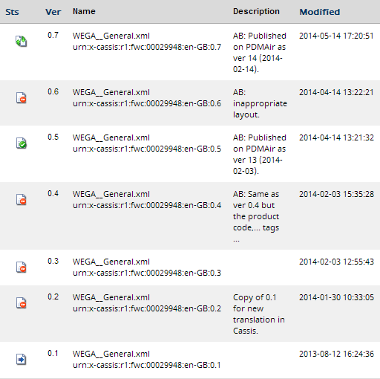
Add Descriptions, Dates...?

Slide 20
There's An Easier Way

Slide 21
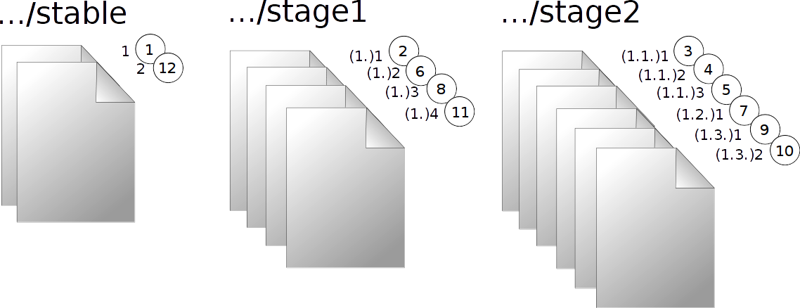
Add A Third Level

Slide 22
<?xml version="1.0" encoding="UTF-8"?>
<resource>
<!-- Base URN -->
<base>urn:x-resource:r1:123456</base>
<!-- Stable version 1 -->
<version>
<rev>1</rev>
<url>xmldb:exist:///db/docs/stage1/mydoc.xml.4101</url>
</version>
</resource>

Slide 23
<?xml version="1.0" encoding="UTF-8"?>
<resource>
<!-- Base URN -->
<base>urn:x-resource:r1:123456</base>
<!-- Stable version 1 -->
<version>
<rev>1</rev>
<url>xmldb:exist:///db/docs/stage1/mydoc.xml.4101</url>
<!-- Stage 1 (decimal versions) -->
<version>
<rev>1</rev>
<url>xmldb:exist:///db/docs/stage1/mydoc.xml.4221</url>
</version>
</version>
</resource>

Slide 24
<?xml version="1.0" encoding="UTF-8"?>
<resource>
<!-- Base URN -->
<base>urn:x-resource:r1:123456</base>
<!-- Stable version 1 -->
<version>
<rev>1</rev>
<url>xmldb:exist:///db/docs/stage1/mydoc.xml.4101</url>
<!-- Stage 1 (decimal versions) -->
<version>
<rev>1</rev>
<url>xmldb:exist:///db/docs/stage1/mydoc.xml.4221</url>
<!-- Stage 2 (centecimal versions) -->
<version>
<rev>1</rev>
<url>xmldb:exist:///db/docs/stage1/mydoc.xml.4227</url>
</version>
</version>
</version>
</resource>

Slide 25
<?xml version="1.0" encoding="UTF-8"?>
<resource>
<!-- Base URN -->
<base>urn:x-resource:r1:123456</base>
<!-- Stable version 1 -->
<version>
<rev>1</rev>
<url>xmldb:exist:///db/docs/stage1/mydoc.xml.4101</url>
<!-- Stage 1 (decimal versions) -->
<version>
<rev>1</rev>
<url>xmldb:exist:///db/docs/stage1/mydoc.xml.4221</url>
<!-- Stage 2 (centecimal versions) -->
<version>
<rev>1</rev>
<url>xmldb:exist:///db/docs/stage1/mydoc.xml.4227</url>
</version>
<version>
<rev>2</rev>
<url>xmldb:exist:///db/docs/stage1/mydoc.xml.4231</url>
</version>
</version>
</version>
</resource>

Slide 26
<?xml version="1.0" encoding="UTF-8"?>
<resource>
<!-- Base URN -->
<base>urn:x-resource:r1:123456</base>
<!-- Stable version 1 -->
<version>
<rev>1</rev>
<url>xmldb:exist:///db/docs/stage1/mydoc.xml.4101</url>
<!-- Stage 1 (decimal versions) -->
<version>
<rev>1</rev>
<url>xmldb:exist:///db/docs/stage1/mydoc.xml.4221</url>
<!-- Stage 2 (centecimal versions) -->
<version>
<rev>1</rev>
<url>xmldb:exist:///db/docs/stage1/mydoc.xml.4227</url>
</version>
<version>
<rev>2</rev>
<url>xmldb:exist:///db/docs/stage1/mydoc.xml.4231</url>
</version>
<version>
<rev>3</rev>
<url>xmldb:exist:///db/docs/stage1/mydoc.xml.4240</url>
</version>
</version>
</version>
</resource>

Slide 27
<?xml version="1.0" encoding="UTF-8"?>
<resource>
<!-- Base URN -->
<base>urn:x-resource:r1:123456</base>
<!-- Stable version 1 -->
<version>
<rev>1</rev>
<url>xmldb:exist:///db/docs/stage1/mydoc.xml.4101</url>
<!-- Stage 1 (decimal versions) -->
<version>
<rev>1</rev>
<url>xmldb:exist:///db/docs/stage1/mydoc.xml.4221</url>
<!-- Stage 2 (centecimal versions) -->
<version>
<rev>1</rev>
<url>xmldb:exist:///db/docs/stage1/mydoc.xml.4227</url>
</version>
<version>
<rev>2</rev>
<url>xmldb:exist:///db/docs/stage1/mydoc.xml.4231</url>
</version>
<version>
<rev>3</rev>
<url>xmldb:exist:///db/docs/stage1/mydoc.xml.4240</url>
</version>
<version>
<rev>4</rev>
<url>xmldb:exist:///db/docs/stage1/mydoc.xml.4250</url>
</version>
</version>
</version>
</resource>

Slide 28
<?xml version="1.0" encoding="UTF-8"?>
<resource>
<!-- Base URN -->
<base>urn:x-resource:r1:123456</base>
<!-- Stable version 1 -->
<version>
<rev>1</rev>
<url>xmldb:exist:///db/docs/stage1/mydoc.xml.4101</url>
<!-- Stage 1 (decimal versions) -->
<version>
<rev>1</rev>
<url>xmldb:exist:///db/docs/stage1/mydoc.xml.4221</url>
<!-- Stage 2 (centecimal versions) -->
...
</version>
<version>
<rev>2</rev>
<url>xmldb:exist:///db/docs/stage1/mydoc.xml.4257</url>
</version>
</version>
</resource>

Slide 29
<?xml version="1.0" encoding="UTF-8"?>
<resource>
<!-- Base URN -->
<base>urn:x-resource:r1:123456</base>
<!-- Stable version 1 -->
<version>
<rev>1</rev>
<url>xmldb:exist:///db/docs/stage1/mydoc.xml.4101</url>
<!-- Stage 1 (decimal versions) -->
<version>
<rev>1</rev>
<url>xmldb:exist:///db/docs/stage1/mydoc.xml.4221</url>
<!-- Stage 2 (centecimal versions) -->
<version>
<rev>1</rev>
<url>xmldb:exist:///db/docs/stage1/mydoc.xml.4227</url>
</version>
<version>
<rev>2</rev>
<url>xmldb:exist:///db/docs/stage1/mydoc.xml.4231</url>
</version>
<version>
<rev>3</rev>
<url>xmldb:exist:///db/docs/stage1/mydoc.xml.4240</url>
</version>
<version>
<rev>4</rev>
<url>xmldb:exist:///db/docs/stage1/mydoc.xml.4250</url>
</version>
</version>
<version>
<rev>2</rev>
<url>xmldb:exist:///db/docs/stage1/mydoc.xml.4257</url>
<version>
<rev>1</rev>
<url>xmldb:exist:///db/docs/stage1/mydoc.xml.4259</url>
</version>
</version>
<version>
<rev>3</rev>
<url>xmldb:exist:///db/docs/stage1/mydoc.xml.4438</url>
<version>
<rev>1</rev>
<url>xmldb:exist:///db/docs/stage1/mydoc.xml.4440</url>
</version>
<version>
<rev>2</rev>
<url>xmldb:exist:///db/docs/stage1/mydoc.xml.4450</url>
</version>
</version>
<version>
<rev>4</rev>
<url>xmldb:exist:///db/docs/stage1/mydoc.xml.4660</url>
</version>
</version>
<!-- Stable version 2 -->
<version>
<rev>2</rev>
<url>xmldb:exist:///db/docs/stage1/mydoc.xml.4700</url>
...
</version>
</resource>

Slide 30
Naming Convention Extended
urn:x-resource:r1:<doc-number>:<lang>:<stable>:<stage1>:<stage2>
  urn:x-resource:r1:123456:en-GB:1:0:0
  urn:x-resource:r1:123456:en-GB:1:1:0
  urn:x-resource:r1:123456:en-GB:1:1:1
  urn:x-resource:r1:123456:en-GB:1:1:2
  urn:x-resource:r1:123456:en-GB:1:2:1
  ...

Slide 31
Levels Add Scoping

Slide 32
Adding Languages
Base document
  urn:x-resource:r1:123456
Rendering language
  urn:x-resource:r1:123456:en-GB
Specific version
  urn:x-resource:r1:123456:en-GB:1:1:1

Slide 33
Three Renditions of the Same Version
<?xml version="1.0" encoding="UTF-8"?>
<resource>
<!-- Base URN -->
<base>urn:x-resource:r1:123456</base>
<!-- Stable version 1 -->
<version>
<rev>1</rev>
<url>xmldb:exist:///db/docs/stage1/mydoc.xml.4101</url>
<!-- Stage 1 (decimal versions) -->
<version>
<rev>1</rev>
<url>xmldb:exist:///db/docs/stage1/mydoc.xml.4221</url>
<!-- Stage 2 (centecimal versions) -->
<version>
<rev>1</rev>
<url lang="en-GB">xmldb:exist:///db/docs/stage1/mydoc.xml.4227</url>
<url lang="fi-FI">xmldb:exist:///db/docs/stage1/mydoc.xml.5119</url>
<url lang="sv-SE">xmldb:exist:///db/docs/stage1/mydoc.xml.5399</url>
</version>
..
</version>
...
</version>
</resource>

Slide 34
Some Notes

Slide 35
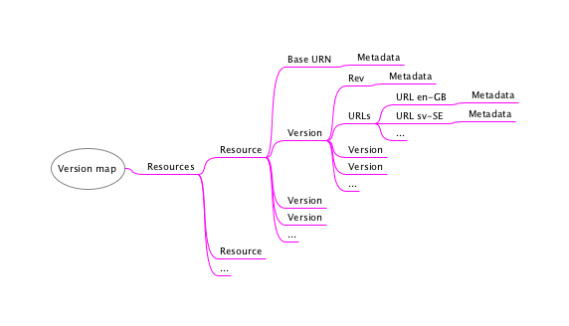
Metadata

Slide 36
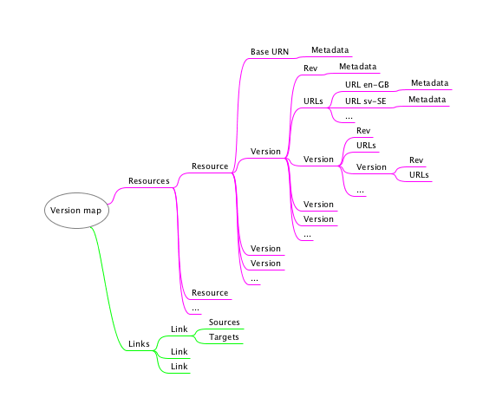
The Version Map As A Linkbase

Slide 37
Links and Scoping
<link xlink:href="urn:x-resources:r1:123456:en-GB:2:2:4"/>

Slide 38
Links and Scoping
<link xlink:href="urn:x-resources:r1:123456:en-GB:2:2:4" scope="1"/>

Slide 39
Targets in Scope
urn:x-resources:r1:123456:en-GB:2:2:4
urn:x-resources:r1:123456:en-GB:2:2:5
urn:x-resources:r1:123456:en-GB:2:3:0
urn:x-resources:r1:123456:en-GB:2:8:1
...

Slide 40
But not...
urn:x-resources:r1:123456:en-GB:2:1:0
urn:x-resources:r1:123456:en-GB:3:0:0
urn:x-resources:r1:123456:en-GB:1:3:0
...

Slide 41
Future Work
An eXist implementation
Version maps as linkbases
Markup considerations
  Workflow
  Metadata
  ...

Slide 42
Thank you

