Slide 1
Virtual Document Management
Ari Nordström
ari@sgmlguru.org

Slide 2
My Two Sources
Balisage
Client system

Slide 3
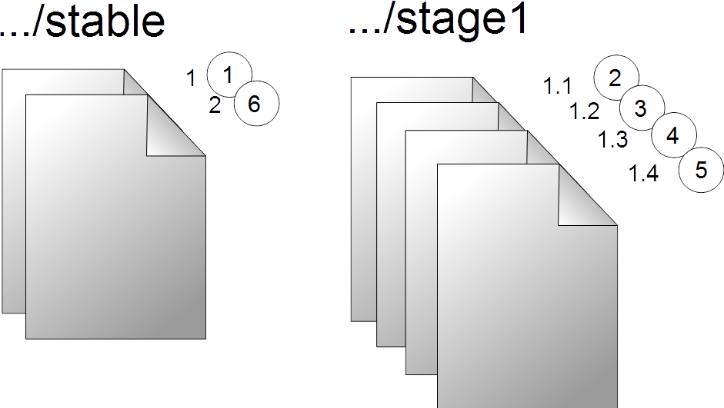
Balisage

Slide 4
<?xml version="1.0" encoding="UTF-8"?>
<resource>
<!-- Base URN -->
<base></base>
<!-- Stable version 1 -->
<version>
<rev></rev>
<url lang="en-GB"></url>
<!-- 1st decimal version -->
<version>
<rev></rev>
<url></url>
</version>
<!-- 2d decimal version -->
<version>
<rev></rev>
<url lang="en-GB"></url>
<url lang="sv-SE"></url>
<url lang="fi-FI"></url>
</version>
</version>
<!-- Stable version 2 -->
<version>
<rev></rev>
<url lang="en-GB"></url>
<url lang="sv-SE"></url>
<url lang="fi-FI"></url>
<!-- Stage 1 (decimal versions) -->
<version>
<rev></rev>
<url></url>
</version>
<version>
<rev></rev>
<url></url>
</version>
</version>
</resource>

Slide 5
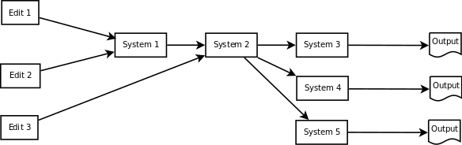
Client System

Slide 6
The Problem
No proper identification of… anything
...therefore no version management

Slide 7
No Traceability

Slide 8
No Traceability

Slide 9
What's in a Name?
Unique
Persistent
Global

Slide 10
Versions
New version = change
New rendition =/= change

Slide 11
Workflows
New workflow status = change?
Edit => Review => Translate => Approve => Publish
  Could happen without any change
  Could require hundreds of changes

Slide 12
URNs
urn:x-myurn-ns:r1:mydocs:00001
urn:x-myurn-ns:r1:mydocs:00001:en-GB
urn:x-myurn-ns:r1:mydocs:00001:en-GB:1
urn:x-myurn-ns:r1:mydocs:00001:en-GB:2
urn:x-myurn-ns:r1:mydocs:00001:en-GB:3
…
urn:x-myurn-ns:r1:mydocs:00001:en-GB:10
urn:x-myurn-ns:r1:mydocs:00001:fi-FI:10

Slide 13
urn:x-myurn-ns:r1:mydocs:00001:en-GB:1:1
urn:x-myurn-ns:r1:mydocs:00001:en-GB:1:2
urn:x-myurn-ns:r1:mydocs:00001:en-GB:1:3
urn:x-myurn-ns:r1:mydocs:00001:en-GB:2:0

Slide 14
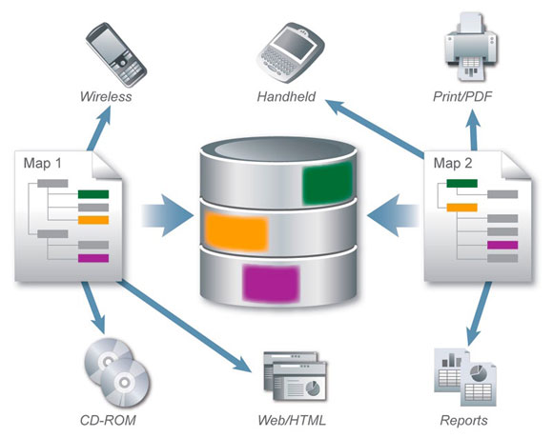
Standard Solution

Slide 15
But...
Business-critical systems
High-profile clients
No time to redo

Slide 16
What If We Only Logged Events?

Slide 17
For Example

Slide 18
Transaction Log
<?xml version="1.0" encoding="UTF-8"?>
<?xml-model href="file:/home/ari/Dropbox/XMLPrague/2016/virtual-document-management/rng/version-xml.rnc" type="application/relax-ng-compact-syntax"?>
<map>
<resources>
<resource>
<!-- Versionless information here -->
<metadata>About the semantic document</metadata>
<!-- Base identifier for document A -->
<base>urn:x-versions:r1:001</base>
<!-- Existing version -->
<version>
<rev>1</rev>
<!-- V 1.0 revisions go here -->
</version>
<!-- New version -->
<version>
<rev>2</rev>
<doc>
<metadata>Output from EDIT 1, EDIT 1 SYSTEM</metadata>
<url>URL TO EDIT 1 VERSION</url>
</doc>
<version>
<rev>1</rev>
<doc>
<metadata>SYSTEM 1 input metadata</metadata>
<url>URL to SYSTEM 1 INPUT</url>
</doc>
<doc>
<metadata>SYSTEM 1 output metadata</metadata>
<url>URL to SYSTEM 1 OUTPUT</url>
</doc>
</version>
<version>
<rev>2</rev>
<doc>
<metadata>SYSTEM 2 input metadata</metadata>
<url>URL to SYSTEM 2 INPUT</url>
</doc>
<doc>
<metadata>SYSTEM 2 output metadata</metadata>
<url>URL to SYSTEM 2 OUTPUT</url>
</doc>
</version>
<version>
<rev>3</rev>
<doc>
<metadata>SYSTEM 3 input metadata</metadata>
<url>URL to SYSTEM 3 INPUT</url>
</doc>
<doc>
<metadata>SYSTEM 3 output metadata</metadata>
<url>URL to SYSTEM 3 OUTPUT</url>
</doc>
<doc>
<metadata>METADATA ABOUT PUBLICATION</metadata>
<url>URL to PUBLICATION</url>
</doc>
</version>
</version>
</resource>
</resources>
</map>

Slide 19
From the Top
<map>
<resources>
<resource>
<!-- Versionless information here -->
<metadata>About the semantic document</metadata>
<!-- Base identifier for document A -->
<base>urn:x-versions:r1:001</base>
<!-- Existing version -->
<version>
<rev>1</rev>
<!-- V 1.0 revisions go here -->
</version>

Slide 20
New Integer Version
<!-- New version -->
<version>
<rev>2</rev>
<doc>
<metadata>Output from EDIT 1, EDIT 1 SYSTEM</metadata>
<url>URL TO EDIT 1 VERSION</url>
</doc>

Slide 21
New Decimal Version
<!-- New version -->
<version>
<rev>2</rev>
<doc>
<metadata>Output from EDIT 1, EDIT 1 SYSTEM</metadata>
<url>URL TO EDIT 1 VERSION</url>
</doc>
<version>
<rev>1</rev>
<doc>
<metadata>SYSTEM 1 input metadata</metadata>
<url>URL to SYSTEM 1 INPUT</url>
</doc>
<doc>
<metadata>SYSTEM 1 output metadata</metadata>
<url>URL to SYSTEM 1 OUTPUT</url>
</doc>
</version>

Slide 22
Second Decimal Version
<version>
<rev>2</rev>
<doc>
<metadata>SYSTEM 2 input metadata</metadata>
<url>URL to SYSTEM 2 INPUT</url>
</doc>
<doc>
<metadata>SYSTEM 2 output metadata</metadata>
<url>URL to SYSTEM 2 OUTPUT</url>
</doc>
</version>

Slide 23
Third Decimal Version
<version>
<rev>3</rev>
<doc>
<metadata>SYSTEM 3 input metadata</metadata>
<url>URL to SYSTEM 3 INPUT</url>
</doc>
<doc>
<metadata>SYSTEM 3 output metadata</metadata>
<url>URL to SYSTEM 3 OUTPUT</url>
</doc>
<doc>
<metadata>METADATA ABOUT PUBLICATION</metadata>
<url>URL to PUBLICATION</url>
</doc>
</version>
</version>
</resource>
</resources>
</map>

Slide 24
Virtual Document Versioning
Unique
Persistent
Mapped to other names, so global

Slide 25
What To Log?
System IDs
Document Ids
Titles
Users
URLs
...

Slide 26
URL?
Original location
Transient document URLs

Slide 27
This Isn't Versioning, Though...
Workflow statuses saved
Versions not saved

Slide 28
For versioning, just save the transient document

Slide 29
When Storing...
Transform the document
Add IDs
Add metadata
...whatever you need!

Slide 30
Implementation
Subscription-based
Few changes to participant systems required
Tracking system passive observer…
...but can be queried by any system
XML database ideal

Slide 31
Use
Traceability
Diffing
Tracking forks

