Slide 1
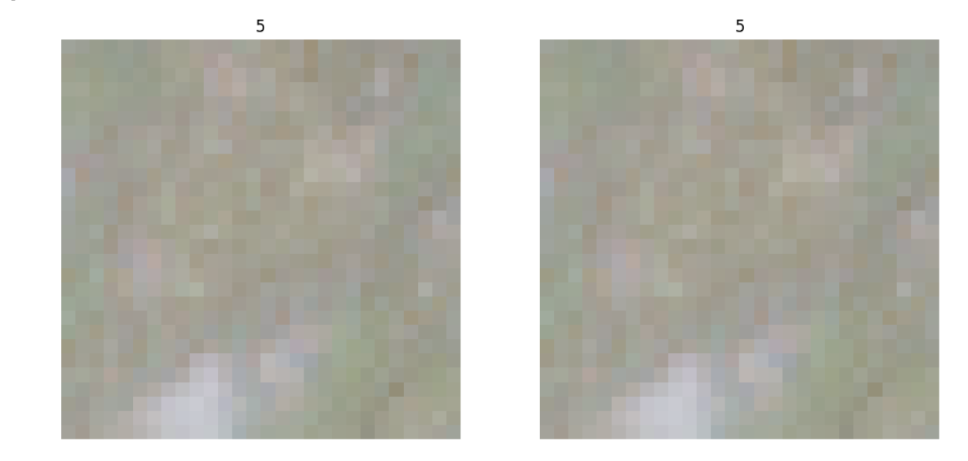
COMP 4447: Final Presentation Detecting Adversarial Attacks on Satellite Imagery Paul Scheidt & Sean Murphy 11 November 2024

Slide 2
Agenda
Problem Space / Background
Initial Insights / Modeling Approach
Key Insights
Results
Libraries Used
Problems Faced

Slide 3
Problem Description
Problem Background:
Deployed Neural Networks can become subject to adversarial attacks focused on breaking models or obtaining sensitive information.
Adversarial attacks use machine learning algorithms to provide inputs that are designed to fool AI algorithms. These methods of attack are designed to circumnavigate traditional cybersecurity methods by masking as legitimate inputs which ultimately return incorrect predictions.
Problem Space:
Develop an attack method that poisons a CNN multi-class classifier, causing one of two scenarios
(A) Attack disrupts the intended classification distribution across all classes
(B) Attack selectively disrupts the intended class distribution towards one group of classes, creating an artificially high confidence in once class, and artificially low confidence in other classes
Notes:
Develop methods or models that identify when an attack occurs, and which data is impacted
Understand key differences in adversarially generated vs ‘clean’ data

Slide 4
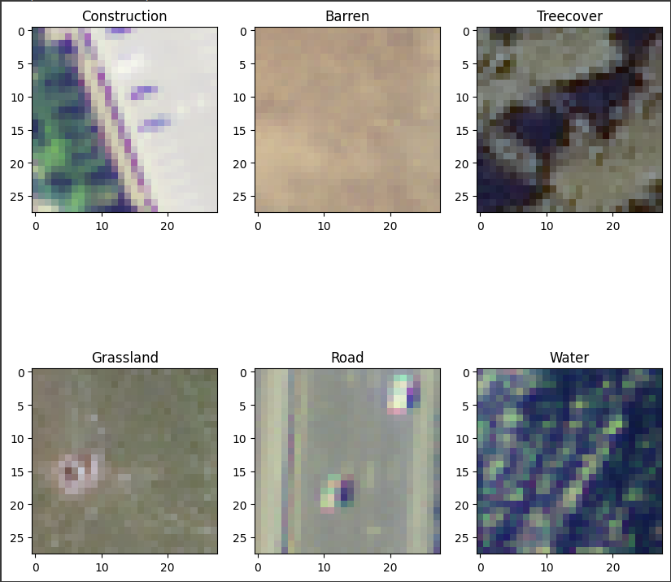
Data Source
General Overview:
Data Source: DEEPSAT-6 (SAT-6) Airborne Dataset
405,00 images covering 6 different landscapes
License: Public Domain
Data Repository Location: https://www.kaggle.com/datasets/crawford/deepsat-sat6

Slide 5
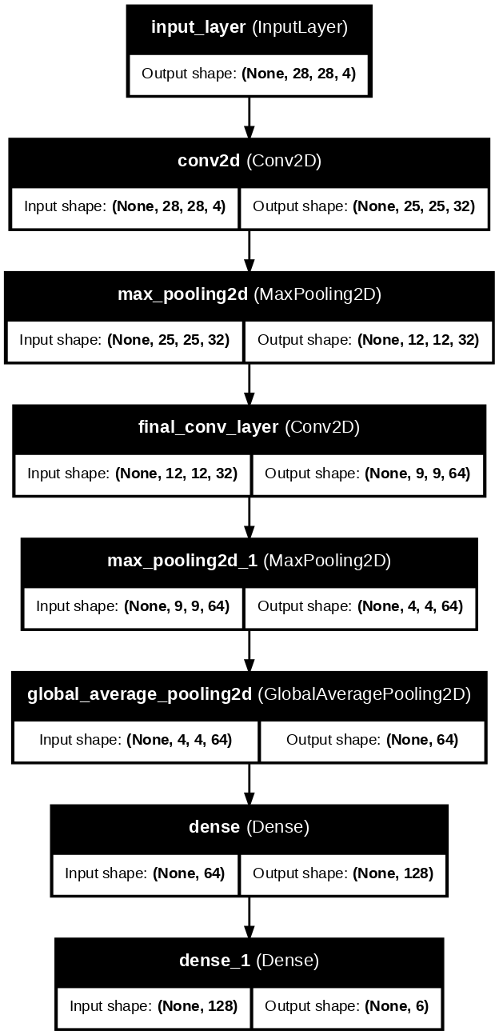
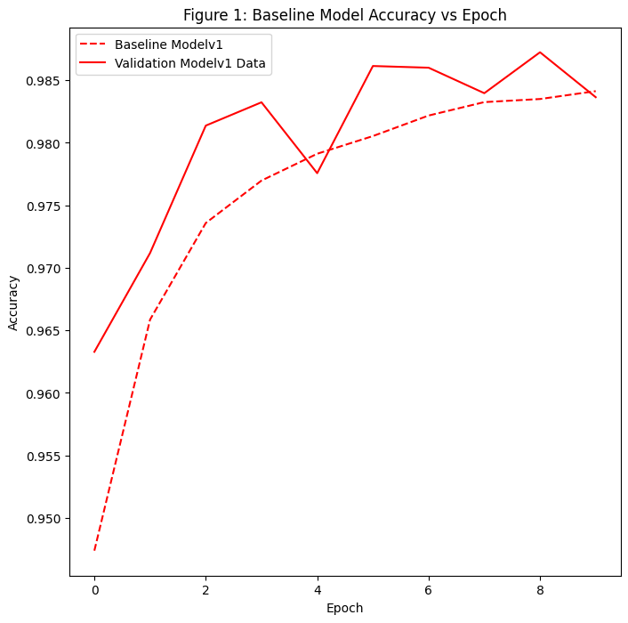
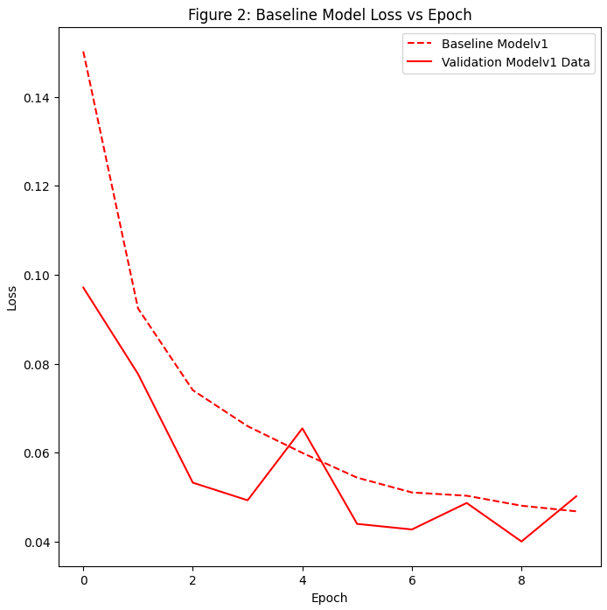
Baseline Model Architecture and Performance
Model Architecture:
Model Performance:
Accuracy: 98%
Loss: 0.0565

Slide 6
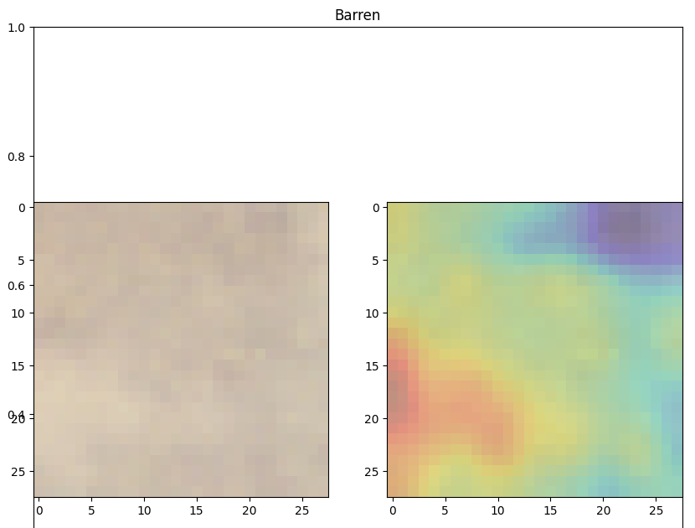
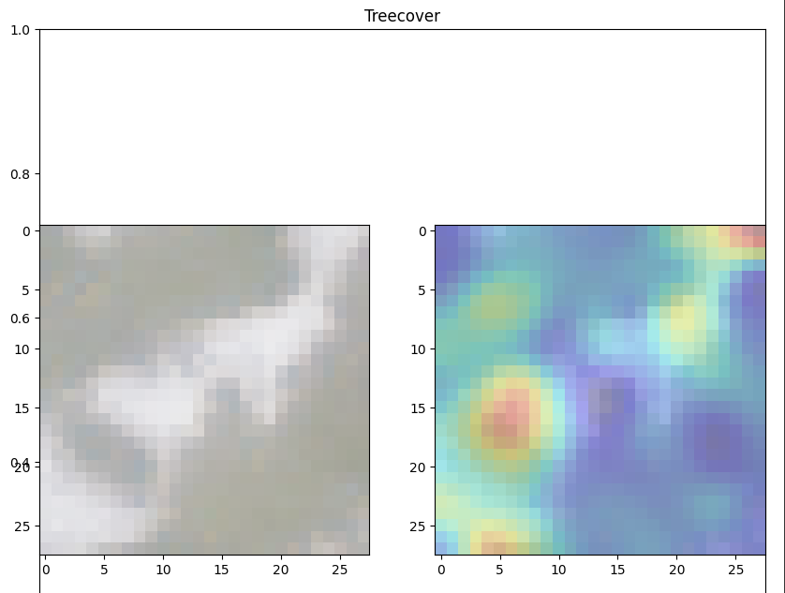
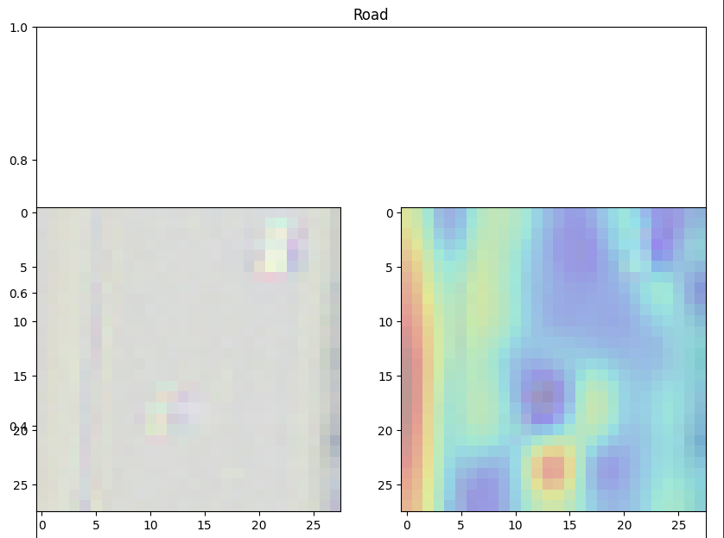
Baseline Model Performance Continued
Grad-CAM Charts
Baseline Model Identifies Logical Image Markers

Slide 7
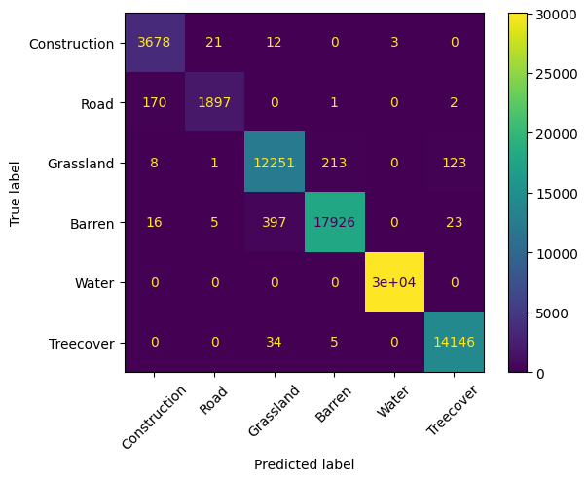
Key Insights – Baseline Model
Confusion Matrix on Classification Performance

Slide 8
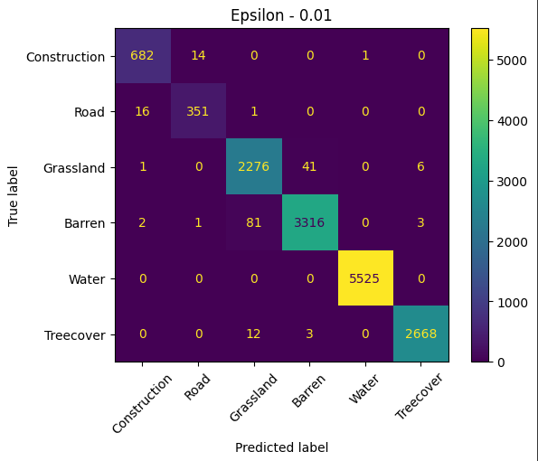
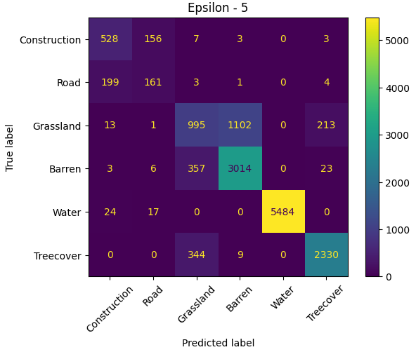
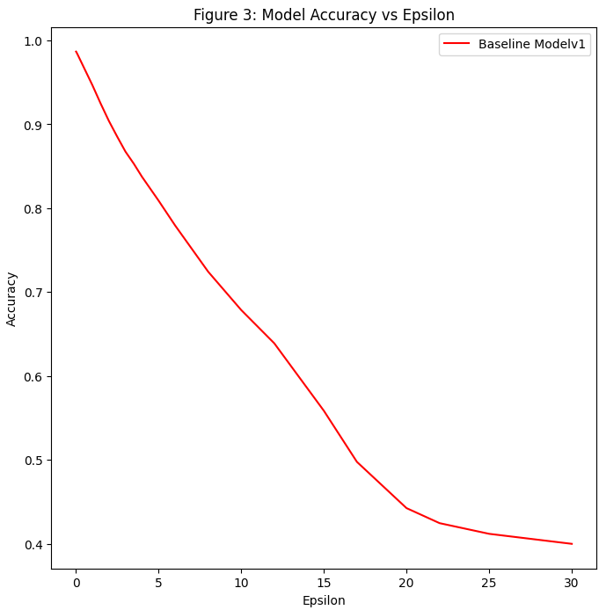
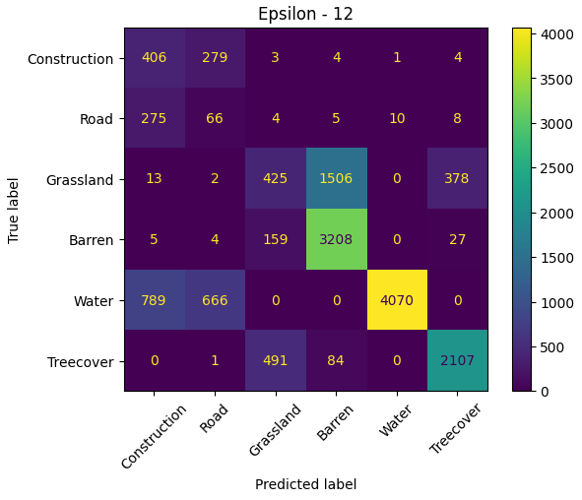
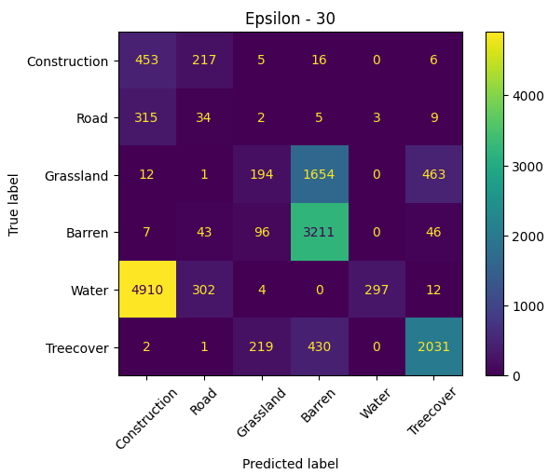
Key Insights Continued
Adjusting Noise Factor in FGSM

Slide 9
Results
Testing accuracy decreased from 94% to 53% in initial modeling efforts with an epsilon value of 1.
Epsilon value is the ‘perturbation’ scaling factor; higher epsilon values return ‘more poisoned’ data. Effective attacks use a low enough epsilon to remain undetected while still disrupting model performance.
With a more robust model, previously shown curve reflects accuracy vs epsilon.
Adversarial Mean: [113.3134 115.37391 114.29599 108.61201]
Adversarial Std: [54.51268 47.67143 36.985027 76.23391 ]
Clean Mean: [113.27197321 115.36691607 114.38267347 109.08337219]
Clean Std: [54.65728377 47.75091567 37.07641239 76.38291389]

Slide 10
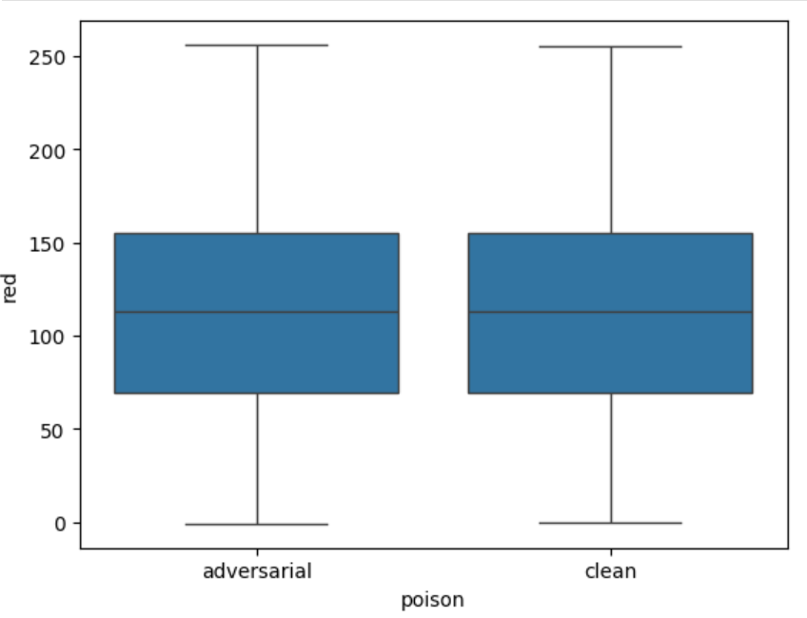
Boxplot of red band in samples
Nearly identical distributions
Reflected in Green, Blue, NIR bands
Massively insignificant ANOVA, t-tests
0.986 p values for both
Are there visual differences?

Slide 11
Can you tell which is adversarial?

Slide 12
Adversarial Clean

Slide 13
Problems Faced
Challenge: Dataset Size
405,00 images ~ 5 GB of Data
Performing analysis on entire data set was time intensive
Solutions:
Leveraged Distributed Computing from Google Colab to access more compute resources
Down sampled dataset to pass into Poisoning Attack
Challenge: Problem Complexity
Developing adversarial image attacks is an advanced topic not covered in school curriculum
A lot of time was spent reading research papers to understand problem space
Challenge: Very robust Model
Large dataset for 6 classes creates a model that performs very well

Slide 14
Libraries Used
Primary Libraries:
TensorFlow
Keras
Sklearn
Google Colab
Numpy
Support Libraries
Pandas
References:
https://arxiv.org/abs/1610.02391
https://arxiv.org/abs/1610.09585

Slide 15
Questions

Slide 16
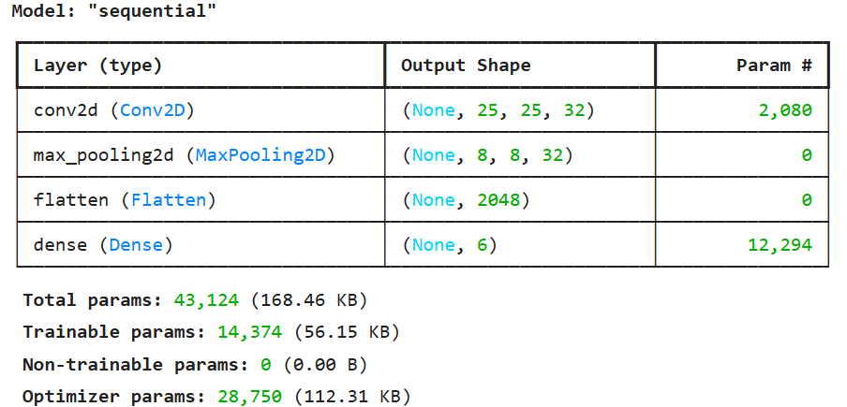
Reference: Simple Model

