Slide 1
COMP 4447: Final Presentation Detecting GAN Attacks on Satellite Imagery Paul Scheidt & Sean Murphy 11 November 2024

Slide 2
Agenda
Problem Space / Background
Initial Insights /Modeling Approach
Key Insights
Results
Libraries Used
Problems Faced

Slide 3
Problem Description
Problem Background:
Deployed Neural Networks can become subject to adversarial attacks focused on breaking models or obtaining sensitive information.
Generative Adversarial Networks (GANs) use machine learning algorithms to provide inputs that are designed to fool AI algorithms. These methods of attack are designed to circumnavigate traditional cybersecurity methods by masking as legitimate inputs which ultimately degrade model performance
Problem Space:
Develop a GAN attack method that poisons a CNN multi-class classifier, causing two scenarios
(A) GAN Attack disrupts the intended classification distribution across all classes
(B) Attack selectively disrupts the intended class distribution towards one group of classes, creating an artificially high confidence in once class, and artificially low confidence in other classes
Develop models that identify when a GAN Attack occurs, and which data is impacted

Slide 4
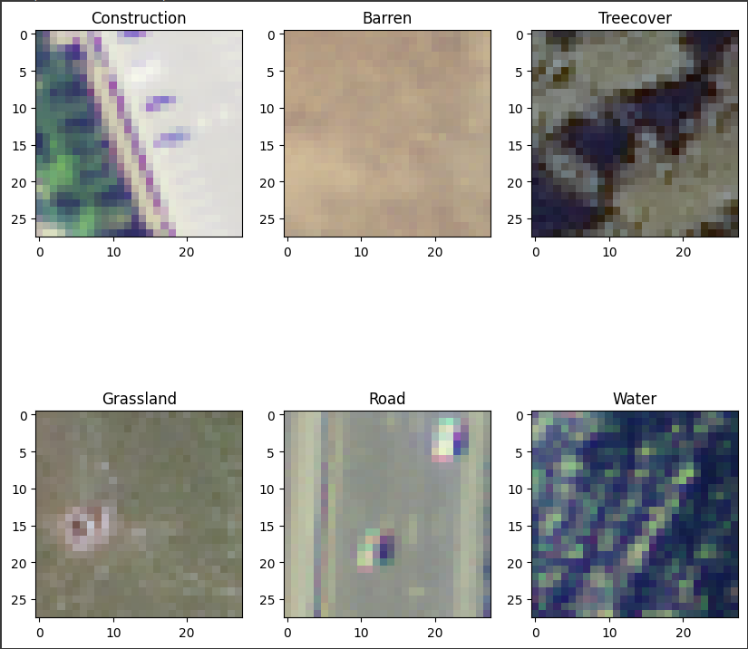
Data Source
General Overview:
Data Source: DeepSat (SAT-6) Airborne Dataset
405,00 images covering 6 different landscapes
License: Public Domain
Data Repository Location: https://www.kaggle.com/datasets/crawford/deepsat-sat6

Slide 5
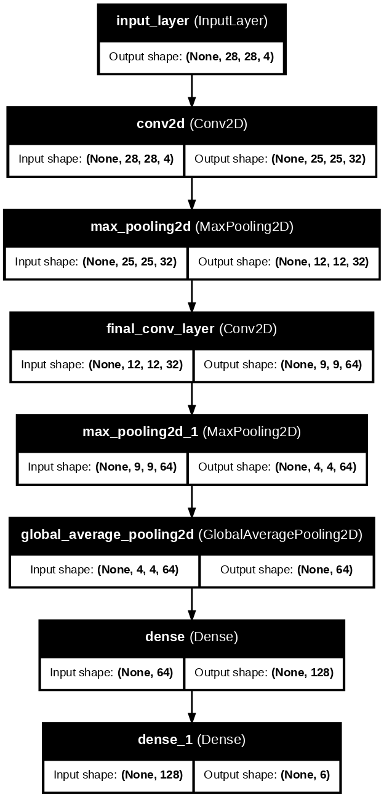
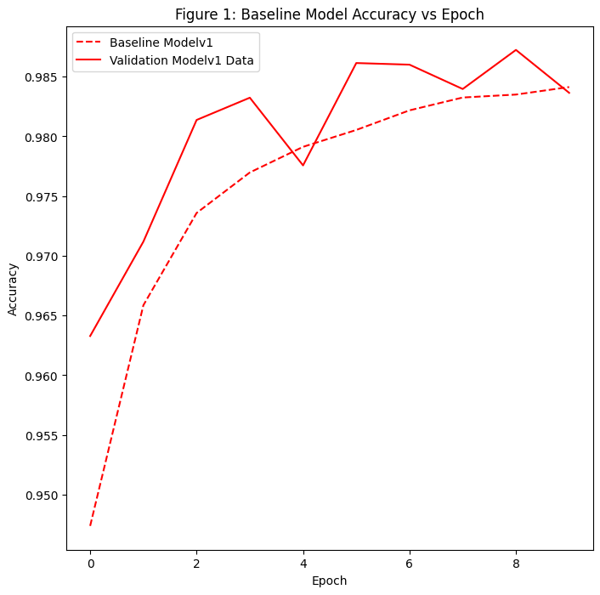
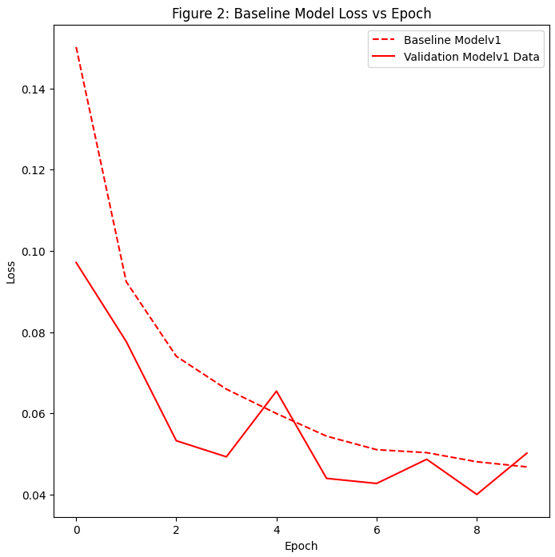
Baseline Model Architecture and Performance
Model Architecture:
Model Performance:
Accuracy: 98%
Loss: 0.0565

Slide 6
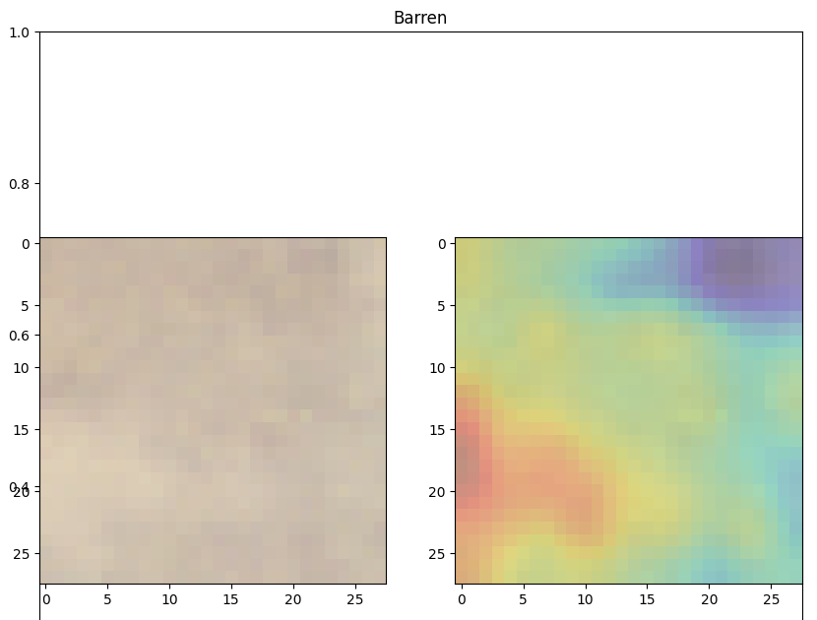
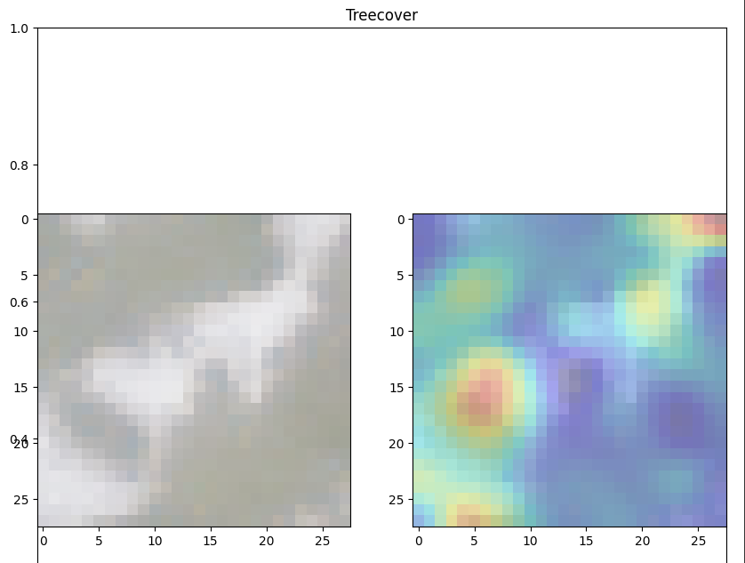
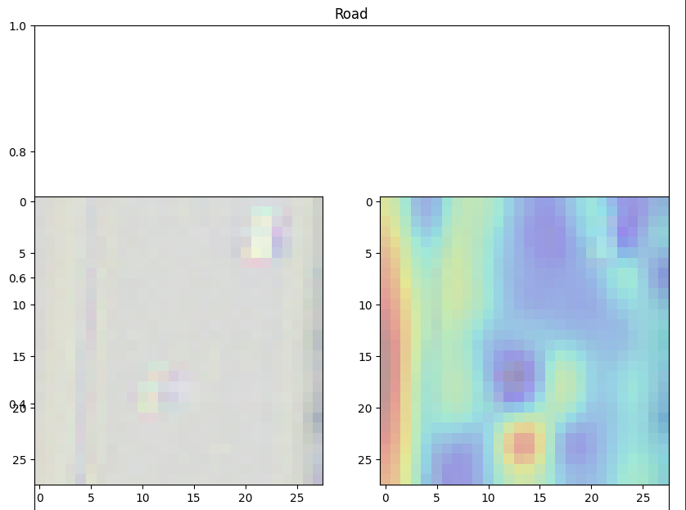
Baseline Model Performance Continued
Grad-CAM Charts
Baseline Model Identifies Logical Image Markers

Slide 7
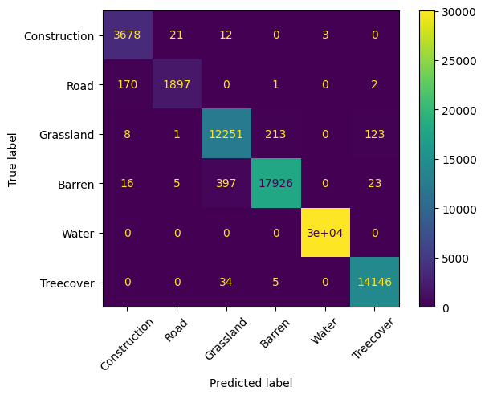
Key Insights – Baseline Model
Confusion Matrix on Classification Performance

Slide 8
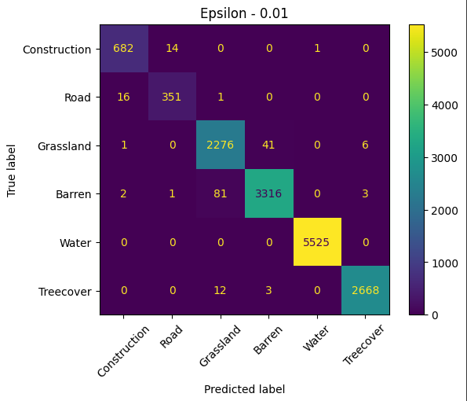
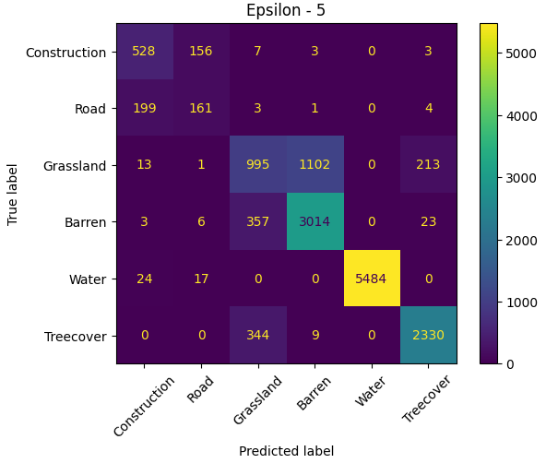
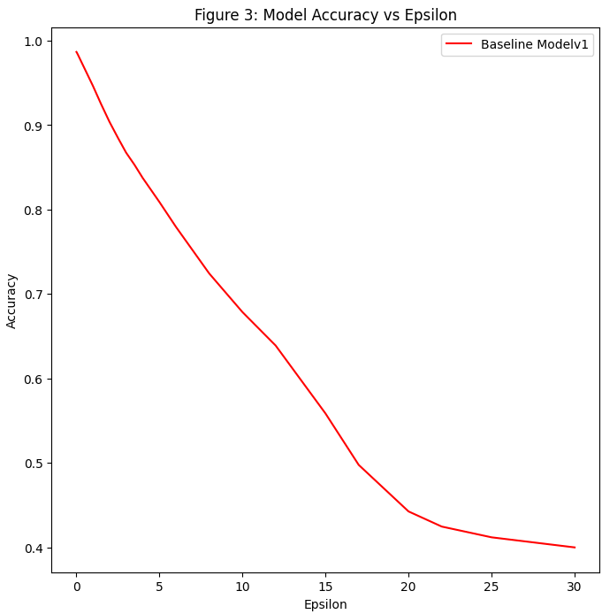
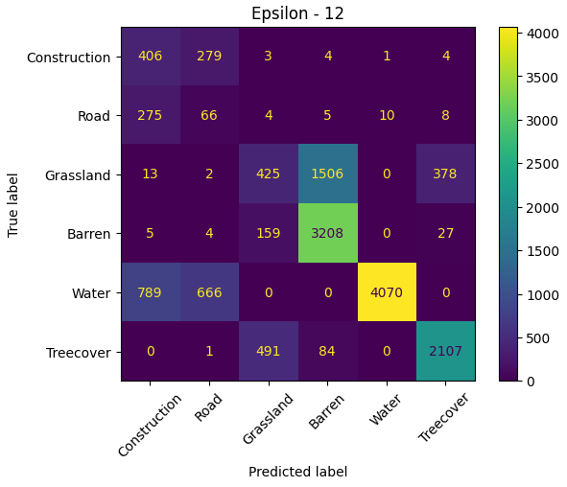
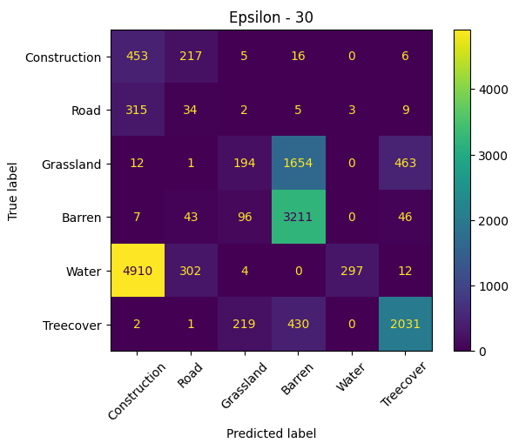
Key Insights Continued
Adjusting Noise Factor in FGSM

Slide 9
Results

Slide 10
Libraries Used
Primary Libraries:
TensorFlow
Keras
Sklearn
Google Colab
Numpy
Support Libraries
Pandas
References:
https://arxiv.org/abs/1610.02391
https://arxiv.org/abs/1610.09585

Slide 11
Problems Faced
Challenge: Dataset Size
405,00 images ~ 5 GB of Data
Performing analysis on entire data set was time intensive
Solutions:
Leveraged Distributed Computing from Google Colab to access more compute resources
Down sampled dataset to pass into Poisoning Attack
Challenge: Problem Complexity
Developing adversarial image CNNs is an advance topic not covered in school curriculum
A lot of time was spent reading research papers to understand problem space
Challenge: Very robust Model
Large dataset for 6 classes creates a model that performs very well

Slide 12
Questions

