Slide 1
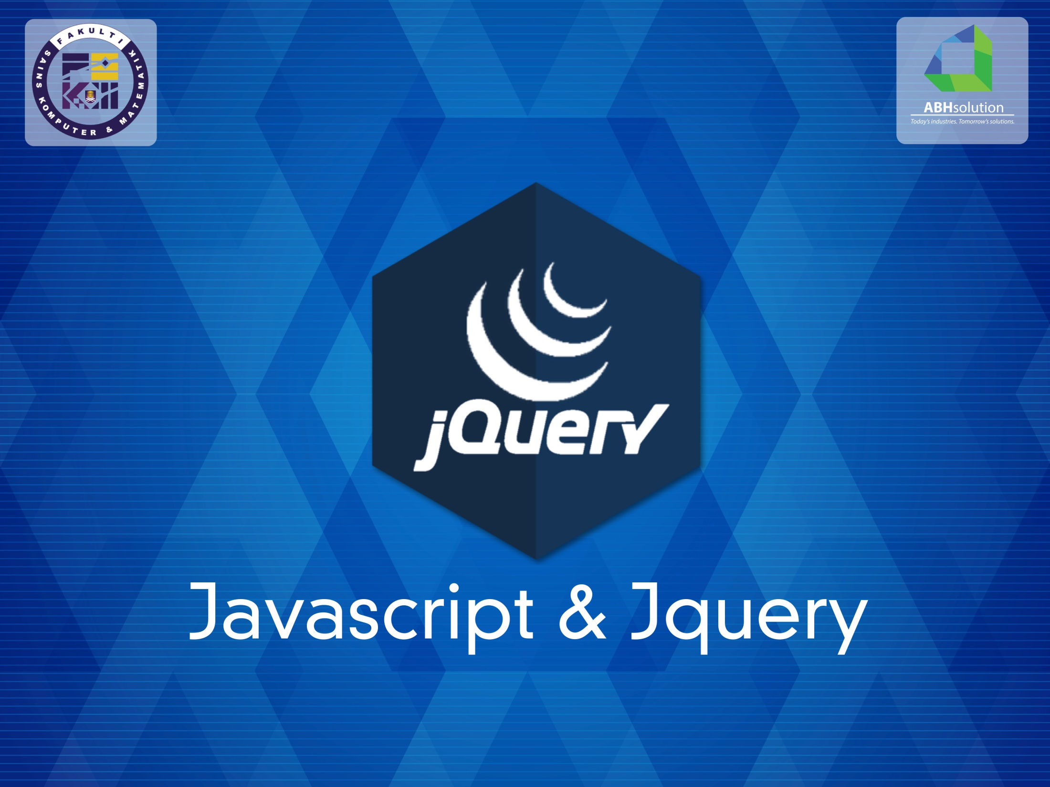
MOHAMMAD BIN AWALUDIN
HAZIMAN HASHIM

Slide 2
What is jQuery ?
jQuery is a fast and concise JavaScript Library that simplifies HTML document traversing, event handling, animating and Ajax interactions for rapid web development. (jQuery.com)

Slide 3
Why learn jQuery ?
Write less, do more:
$("p.neat").addClass("ohmy").show("slow");
Performance
Plugins
It’s standard
… and fun!
Notes:
That little snippet loops through all <p> elements with the class "neat" and then adds the class "ohmy" to it, whilst slowly showing the paragraph in an animated effect. No browser checks, no loop code, no complex animation functions, just one line of code!

Slide 4
Example: Show/Hide Button

Slide 5
Basic Javascript

Slide 6
The Basics
In JavaScript, you can work with the following things:
Strings: textual content. wrapped in quotation marks (single or double).
'hello, my name is Karl'
"hello, my name is Karl"
Numbers: integer (2) or floating point (2.4)
Booleans: true or false

Slide 7
The Basics
In JavaScript, you can work with the following things:
Arrays: simple lists. indexed starting with 0
['Karl', 'Sara', 'Ben', 'Lucia']
['Karl', 2, 55]
[ ['Karl', 'Sara'], ['Ben', 'Lucia']]
Objects: lists of key, value pairs
{firstName: 'Karl', lastName: 'Swedberg'}
{parents: ['Karl', 'Sara'], kids: ['Ben', 'Lucia']}

Slide 8
Variables
Always declare your variables!
If you don't, they will be placed in the global scope (more about that later).
bad: myName = 'Karl';
good: var myName = 'Karl';
still good: var myName = 'Karl'; // more stuff myName = 'Joe';

Slide 9
Conditionals and Operators
Conditionals:
if, else
Switch
Operators:
+, -, *, %, ++, --
>, <, ==, !=, >=, <=, ===, !==
!, &&, ||

Slide 10
Loops
Loops iterate through a list of some kind.
A common pattern in JavaScript is to build a list, or collection, and then do something with each item in that list.

Slide 11
Loops
CSS uses implicit iteration.
div { color: red; } /* applies to ALL divs */
JavaScript relies on explicit iteration. Must explicitly loop through each div
jQuery allows for both (because it does the looping for you)

Slide 12

Loops
The two most common loops...
for loops — for general-purpose iteration. Used with arrays or array-like objects)
for-in loops — used with arrays or objects (but don't use with arrays)
The other two are...
while loops
do-while loops

Slide 13
for Loops
Three statements and a code block
Initial value
Condition
Increment
for (initial value; condition; increment) {
// code block
}

Slide 14
for Loops
for (var i = 0; i < 3; i++) {
alert(i+1);
}
This is your variable, so it can be anything!
(but developers often use “i”)

Slide 15
for Loops
var divs = document.getElementsByTagName('div');
for (var i = 0; i < divs.length; i++) {
// do something with each div individually
divs[i].style.color = 'red';
}

Slide 16
for-in Loops
var family = {
dad: 'Karl',
mom: 'Sara',
son: 'Benjamin',
daughter: 'Lucia'
}
for (var person in family) {
alert('The ' + person + ' is ' + family[person]);
}
This is your variable, so it can be anything!

Slide 17
while and do-while
var i = 1;
while (i < 4) {
alert(i);
i++;
}
var j = 1;
// code block always executed at least once
do {
alert(j);
j++;
} while (j < 4)

Slide 18
Objects
In JavaScript, everything is an object. Well, almost everything.
Objects are objects : { }
Arrays are objects : [ ]
even Functions are objects : function( ) { }
jQuery is an object
Numbers, strings, and booleans (true/false) are primitive data types, but they have object wrappers.

Slide 19
Global Object
In the browser environment, the global object is window
It collects all functions and variables that are global in scope.
Usually implied.
Comes with some useful properties and methods:
location
parseInt(); parseFloat()
isNaN()
encodeURI(); decodeURI()
setTimeout(); clearTimeout()
setInterval(); clearInterval()

Slide 20
Date Object
var now = new Date(); // current date and time
var then = new Date('08/12/2000 14:00');
console.log( then.getTime() ); // 966103200000
console.log( then.toString() );
// Sat Aug 12 2000 14:00:00 GMT-0400 (EDT)
console.log( then.getMonth() ); // 7 !!!!

Slide 21
The Basics: Functions
In JavaScript, you can also work with functions:
Functions allow you to define a block of code, name that block, and then call it later as many times as you want.
function myFunction( ) { /* code goes here */ } // defining
myFunction( ) // calling the function myFunction
You can define functions with parameters
function myFunction(param1, param2 ) { /* code goes here */ }
You can call functions with arguments:
myFunction('one', 'two')

Slide 22
Functions
// define a function
function doSomething() {
alert('I am something');
}
// call the function
doSomething();

Slide 23
Functions
// define a function
function sumThing(a, b) {
return a + b;
}
// call the function
alert( sumThing(1, 2) );

Slide 24
Functions
// define a function
function sumThing(a, b) {
return a + b;
}
var mySum = sumThing(1, 2);
// call the function
alert( mySum );

Slide 25
The arguments Object
Every function has an arguments object
A collection of the arguments passed to the function when it is called
An "array-like object" in that it is indexed and has a length property but can't attach array methods to it
Can be looped through
Allows for variable number of arguments

Slide 26
Functions
// call the function
function logThing() {
for (var i=0; i < arguments.length; i++) {
console.log(arguments[i]);
}
}
// call the function
logThing(1, 2, 'three');
/* prints to the console:
>> 1
>> 2
>> three
*/

Slide 27
Exercise
Convert the sumThing function to allow for variable number of arguments.
function sumThing(a, b) {
return a + b;
}
Use a for loop to loop through the arguments object, adding to a "sum" variable with each iteration.
After the loop, return sum.

Slide 28
(Simple) Solution
// define a function
function sumThing() {
var sum = 0,
countArgs = arguments.length;
for (var i = 0; i < countArgs; i++) {
sum += arguments[i];
}
return sum;
}
// call the function
console.log( sumThing(1, 2, 4 ) );

Slide 29
Returning Functions
Functions can return other functions
function multiple(n) {
function f(x) {
return x * n;
}
return f;
}
var triple = multiple(3);
var quadruple = multiple(4);
console.log( triple(5) ); // 15
console.log( quadruple(5) ); // 20
console.log( multiple(4)(5) ); // 20

Slide 30
Named vs. Anonymous Functions
Named:
function foo() { } // function declaration
var foo = function foo() { }; // function expression
Anonymous:
var foo = function() { }; // function expression

Slide 31
Anonymous Functions
Prevalent in jQuery
Good for creating closures
Used as "callback" functions
Can be used as object properties (methods)
let’s take a look ...

Slide 32
Anonymous Functions
Prevalent in jQuery
$(document).ready(function() {
});

Slide 33
Anonymous Functions
Good for creating closures
function() {
// variables are defined within this scope
// avoid name collisions
}

Slide 34
Anonymous Functions
Good for creating closures
Can be defined and then immediately invoked: “immediately invoked function expression,” ( a.k.a. IIFE; pronounced “iffy”)
(function() {
// variables are defined within this scope
// avoid name collisions
})();

Slide 35
Anonymous Functions
Good for creating closures
Used by plugins to keep jQuery safe.
(function($) { // "$" is the function's param
})(jQuery); // function is called with "jQuery"

Slide 36
Anonymous Functions
Used as "callback" functions
$('p').slideDown('slow', function() {
// code in here is not executed
// until after the slideDown is finished
// jQuery calls the code in here when effect ends
});

Slide 37
window.onload
We cannot use the DOM before the page has been constructed. jQuery gives us a more compatible way to do this.
The DOM way
The direct jQuery translation
The jQuery way
window.onload = function() { // do stuff with the DOM }
$(document).ready(function() { // do stuff with the DOM });
$(function() { // do stuff with the DOM });

Slide 38
Aspects of the DOM and jQuery
Identification:
how do I obtain a reference to the node that I want.
Traversal:
how do I move around the DOM tree.
Node Manipulation:
how do I get or set aspects of a DOM node.
Tree Manipulation:
how do I change the structure of the page.

Slide 39
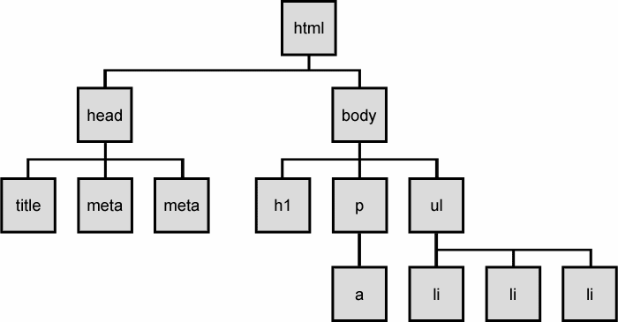
The DOM tree

Slide 40
Selecting groups of DOM objects
Name | Description
getElementById | returns array of descendents with the given tag, such as "div"
getElementsByTagName | returns array of descendents with the given tag, such as "div"
getElementsByName | returns array of descendents with the given name attribute (mostly useful for accessing form controls)
querySelector * | returns the first element that would be matched by the given CSS selector string
querySelectorAll * | returns an array of all elements that would be matched by the given CSS selector string

Slide 41
jQuery node identification
// id selector
var elem = $("#myid");
// group selector
var elems = $("#myid, p");
// context selector
var elems = $("#myid < div p");
// complex selector
var elems = $("#myid < h1.special:not(.classy)");

Slide 42
jQuery Selectors
http://api.jquery.com/category/selectors/

Slide 43
jQuery / DOM comparison
DOM method | jQuery equivalent
getElementById("id") | $("#id")
getElementsByTagName("tag") | $("tag")
getElementsByName("somename") | $("[name='somename']")
querySelector("selector") | $("selector")
querySelectorAll("selector") | $("selector")

Slide 44
Exercise
Use jQuery selectors to identify elements with these properties in a hypothetical page:
All p tags that have no children, but only if they don't have a class of ignore
Any element with the text "REPLACE_ME" in it.
All div tags with a child that has a class of special
All heading elements (h1, h2, h3, h4, h5, h6)
Every other visible li.
Use the DOM API to target the #square and periodically change it's position in a random direction.
Use jQuery selectors instead of the DOM API.

Slide 45
jQuery Terminology
The jQuery function
refers to the global jQuery object or the $ function depending on the context
A jQuery object
the object returned by the jQuery function that often represents a group of elements
Selected elements
the DOM elements that you have selected for, most likely by some CSS selector passed to the jQuery function and possibly later filtered further

Slide 46
The jQuery object
The $ function always (even for ID selectors) returns an array-like object called a jQuery object.
The jQuery object wraps the originally selected DOM objects.
You can access the actual DOM object by accessing the elements of the jQuery object.
// false
document.getElementById("id") == $("#myid");
document.querySelectorAll("p") == $("p");
// true
document.getElementById("id") == $("#myid")[0];
document.getElementById("id") == $("#myid").get(0);
document.querySelectorAll("p")[0] == $("p")[0];

Slide 47
Using $ as a wrapper
$ adds extra functionality to DOM elements
passing an existing DOM object to $ will give it the jQuery upgrade
// convert regular DOM objects to a jQuery object
var elem = document.getElementById("myelem");
elem = $(elem);
var elems = document.querySelectorAll(".special");
elems = $(elems);

Slide 48
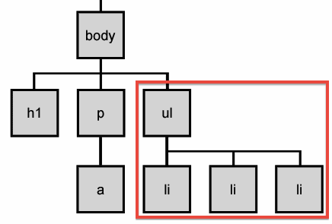
DOM context identification
You can use querySelectorAll() and querySelector() on any DOM object.
When you do this, it simply searches from that part of the DOM tree downward.
Programmatic equivalent of a CSS context selector
var list = document.getElementsByTagName("ul")[0];
var specials = list.querySelectorAll('li.special');

Slide 49
find / context parameter
jQuery gives two identical ways to do contextual element identification
var elem = $("#myid");
// These are identical
var specials = $("li.special", elem);
var specials = elem.find("li.special");

Slide 50
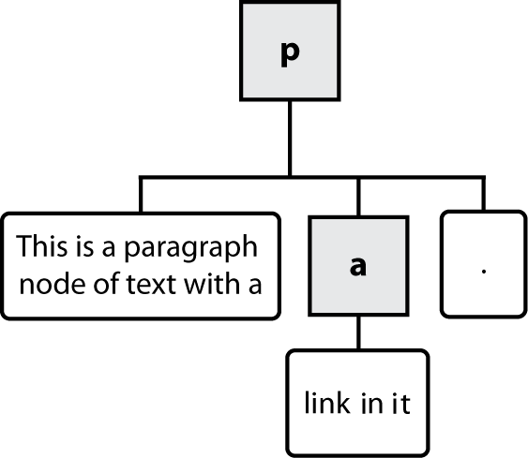
Types of DOM nodes
<p>
This is a paragraph of text with a
<a href="/path/page.html">link in it</a>.
</p>

Slide 51
Traversing the DOM tree
Name(s) | Description
firstChild, lastChild | start/end of this node's list of children
childNodes | array of all this node's children
nextSibling, previousSibling | neighboring nodes with the same parent
parentNode | the element that contains this node
complete list of DOM node properties
browser incompatiblity information (IE6 sucks)

Slide 52
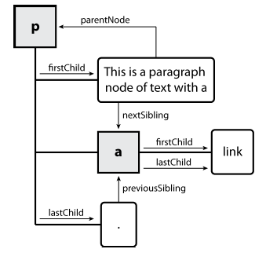
DOM tree traversal example
<p id="foo">This is a paragraph of text with a
<a href="/path/to/another/page.html">link</a>.</p> HTML

Slide 53
Elements vs text nodes
<div>
<p>
This is a paragraph of text with a
<a href="page.html">link</a>.
</p>
</div> HTML
Q: How many children does the div above have?
A: 3
an element node representing the <p>
two text nodes representing "\n\t" (before/after the paragraph)
Q: How many children does the paragraph have? The a tag?

Slide 54
jQuery traversal methods
http://api.jquery.com/category/traversing/

Slide 55
jQuery: Events
$('div').onHover(function(){ // JavaScript });
General Events | ready, load, scroll
Mouse Events | click, hover, mouseenter, mouseleave
Keyboard Events | keypress, keydown, keyup
Forms Events | submit, focus, blur
http://api.jquery.com/category/events/
Notes:
jQuery makes it easy to bind events to DOM elements.
This is called event binding.

Slide 56
jQuery: Live Events
$('li').click(function(){ // meh. Ok.
// Do something
});
$('li').live('click', function(){ // VedyNice.
// Do More Somethings
});
A normal event binding attaches to all matched elements when it is called. A live event calls the callback function when the event occurs on all matched element, current and future.
http://api.jquery.com/category/events/
Notes:
What if you do it too early?
Don't be premature. If you bind to an element in the page that isn't there yet… well, you're SOL. Better to use a live event. Never worry about the ordering, new ones being created, etc.

Slide 57
CSS Tip
Object literal notation looks a lot like CSS style rule notation!
CSS:
h3 {
font-size: 1.2em;
line-height: 1;
}
JS:
var h3 = {
fontSize: '1.2em',
'line-height': 1
};

Slide 58
Object Literals
person is the object
firstName and lastName are properties
hello is a method (a property that is a function)
var person = {
firstName: 'Karl',
lastName: 'Swedberg',
hello: function() {
return 'Hello, my name is ' +
this.firstName + ' ' + this.lastName;
}
};

Slide 59
Object Literals
interests is a property and an object
var person = {
firstName: 'Karl',
lastName: 'Swedberg',
hello: function() {
return 'Hello, my name is ' +
this.firstName + ' ' + this.lastName;
},
interests: {
athletic: ['racquetball', 'karate', 'running'],
musical: ['rock', 'folk', 'jazz', 'classical']
}
};

Slide 60
Object Literals
var person = {
firstName: 'Karl',
lastName: 'Swedberg',
hello: function() {
return 'Hello, my name is ' +
this.firstName + ' ' + this.lastName;
} // ⬅ notice, no comma here!
};

Slide 61
Object Literals
“dot” notation
var person = {
firstName: 'Karl',
lastName: 'Swedberg',
hello: function() {
return 'Hello, my name is ' +
this.firstName + ' ' + this.lastName;
}
};
// "dot" notation
person.firstName; // 'Karl'
person.lastName; // 'Swedberg'
person.hello() // 'Hello, my name is Karl Swedberg'

Slide 62
Object Literals array notation
var person = {
firstName: 'Karl',
lastName: 'Swedberg',
hello: function() {
return 'Hello, my name is ' +
this.firstName + ' ' + this.lastName;
}
};
// array notation
person['firstName']; // 'Karl'
person['lastName']; // 'Swedberg'
person['hello']() // 'Hello, my name is Karl Swedberg'

Slide 63
Object Literals
var person = {
firstName: 'Karl',
lastName: 'Swedberg',
hello: function() {
return 'Hello, my name is ' +
this.firstName + ' ' + this.lastName;
},
interests: {
athletic: ['racquetball', 'karate', 'running'],
musical: ['rock', 'folk', 'jazz', 'classical']
}
};
// person['interests']['musical'][1] == ??
// == person.interests.musical[1]

Slide 64
Object Literals
var person = {
firstName: 'Karl',
lastName: 'Swedberg',
hello: function() {
return 'Hello, my name is ' +
this.firstName + ' ' + this.lastName;
}
};
person.firstName = 'Karl';
var prop = 'firstName';
person[ prop ]; // 'Karl'
prop = 'lastName';
person[ prop ]; // 'Swedberg'

Slide 65
Object Literals
var blah;
var person = {
firstName: 'Karl',
lastName: 'Swedberg',
hello: function() {
return 'Hello, my name is ' +
this.firstName + ' ' + this.lastName;
}
};
for (var el in person) {
blah = typeof person[el] == 'function' ?
person[el]() :
person[el];
console.log( blah );
}

Slide 66
Object Literals
Great as function arguments
single argument allows flexibility when calling the function
doSomething({
speed: 'fast',
height: 500,
width: 200,
somethingElse: 'yes'
});
doSomething({width: 300});

Slide 67
JSON JavaScript Object Notation
a data interchange format. In other words, a format for passing data back and forth
“discovered” and popularized by Douglas Crockford
a subset of JavaScript Object Literal Notation
a tree-like structure of object(s) and/or array(s)
no functions
all strings, including object keys, take double quotes

Slide 68
JSON
{
"firstName": "Karl",
"lastName": "Swedberg",
"age": 24,
"interests": {
"athletic": [
"racquetball",
"karate"
]
}
}

Slide 69
JSON
{"firstName":"Karl","lastName":"Swedberg","age":24,"interests":{"athletic":["racquetball","karate"]}}

Slide 70
Ajax with jQuery
The most basic call:
$.get("data.txt",
function(data) { alert("received reply! " + data); } );
Full Options:
var ajaxSettings = {
type: “POST",
url: "data.txt",
data: "name=chambers&location=USNA",
success: function(data) {
$('#target').append("<p>"+data+"</p>").css("color","blue"); },
error: function(xhr, status, error) { alert("error: " + error); } };
$.ajax(ajaxSettings);
NO messing with browser differences!
No more status code checking!
NOTE: can send data

Slide 71
HTML5 PROMISE
Have you ever encounter a situation where you need to do a sequential AJAX request?
E.g: Select Box 1 (Companies) → Select Box 2 (Employee Name) → Table 3 (Employee Details)
You must hate nesting those 3 AJAX request.
HTML5 Promise comes to the rescue.

Slide 72
BADASS JS - HTML5 PROMISE
Anatomy:
var companyPromise = function() {
return new Promise(
function(resolve, reject){
$.get('url', function(data){
resolve(data);
}).error(function(x,h,r){
reject(x,h,r);
});
}
));
};
companyPromise will return a Promise object that have a .then method which takes in a function() that will be invoked after resolve(data) or reject(data) is called. More on next slide >>

Slide 73
BADASS JS - HTML5 PROMISE
var promise2 = function(){
return new Promise(function(resolve, reject){
// another asynchronous process (e.g: AJAX)
});
};
companyPromise().then(function(data){
// this will be executed when resolve(data)
return promise2(); // ***
}, function(x,h,r){
// while this is done when reject(x,h,r)
}).then(function(){
// this will wait for companyPromise() to complete
// if promise2 (***) is done.
// else it will be executed immediately.
});

Slide 74
BADASS JS – REGULAR EXPRESSION
Regular expression (Regex) is what makes any language very powerful. Even JavaScript. It can compare a string with a set of given rules.
Regex Notation: /([a-z]+)/gmi
[a-z]+ means this regex will match one or more characters that is from a – z (case sensitive!)
( ) means it will collect any matched string inside the brackets a.k.a match group
g (global), m (multiline), i (ignore case)
Refer cheatsheet for more info.
Playground: http://www.regexr.io/

Slide 75
jQuery tutorials
Code Academy
http://www.codecademy.com/courses/you-and-jquery/0?curriculum_id=4fc3018f74258b0003001f0f#!/exercises/0
Code School:
http://www.codeschool.com/courses/jquery-air-first-flight

