Slide 1
DeltaProof
See what a small change really changes
Private AI scope review for software agencies
Notes:
Built for AI Builders Hackathon 2026. Synthetic demo data. Shikhar, sgoel2be24-cyber.

Slide 2
The expensive moment before “yes”
A client asks for spreadsheet exports and team invitations.
The reviewer needs to establish what the agreement covers and which dependent work changes.
DeltaProof makes that review visible before anyone commits.
Notes:
Target user: small software agency owner or project manager. This is a problem hypothesis, not validated customer research. No savings claim.

Slide 3
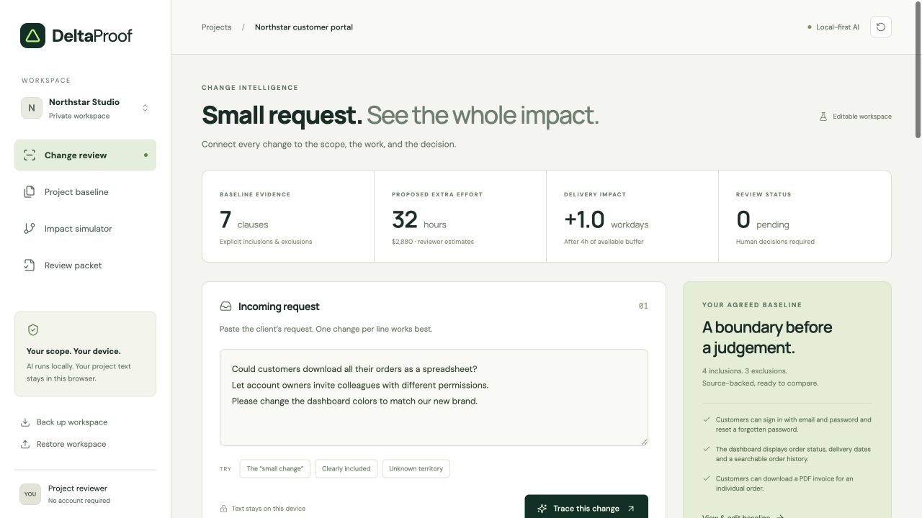
A complete review workspace
Notes:
Actual screenshot from the running application. Synthetic Northstar baseline.

Slide 4
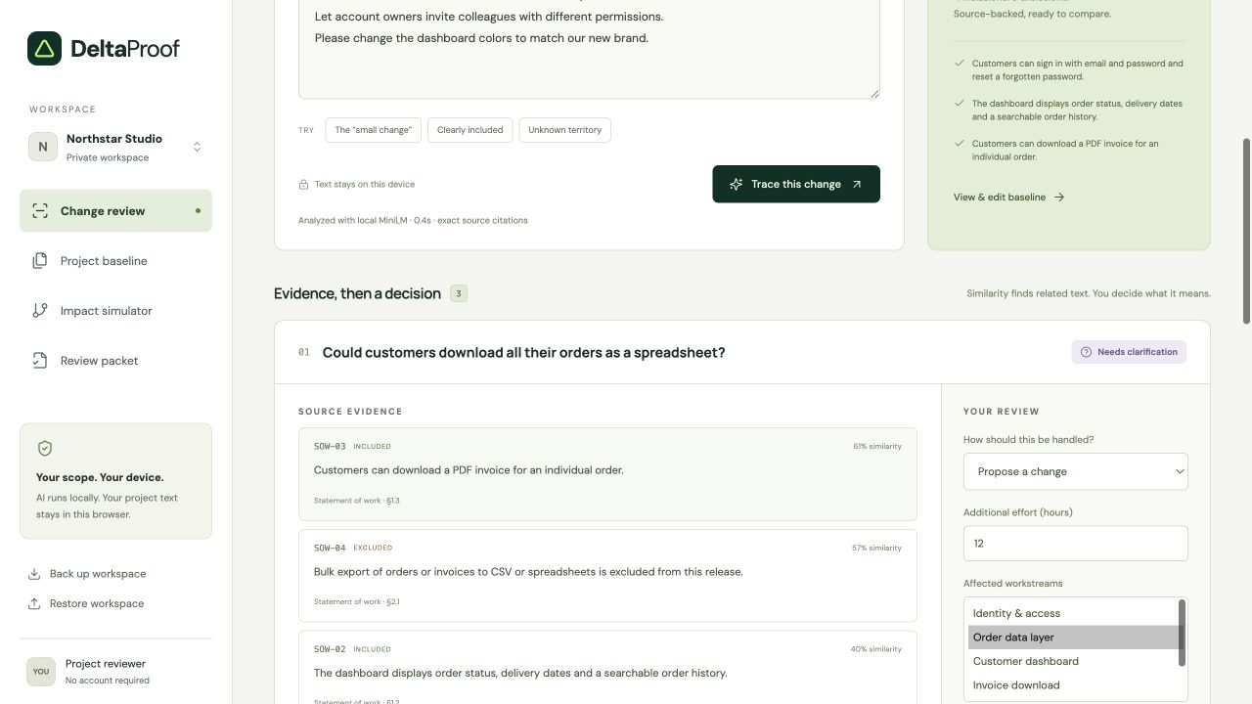
The AI exposes the scope boundary
Exact quotations
Visible uncertainty
Human decisions
Notes:
Actual browser screenshot. Spreadsheet request retrieves an invoice inclusion and bulk export exclusion. The deterministic policy asks for clarification.

Slide 5
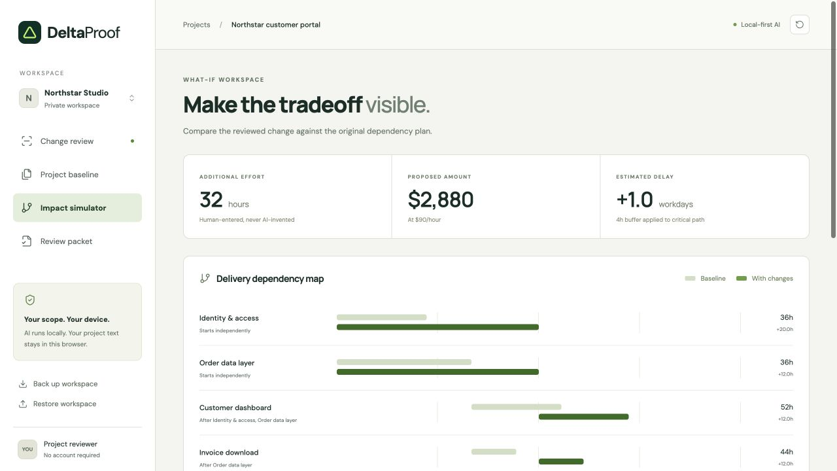
A dependency plan makes tradeoffs concrete
32 extra hours
$2,880 proposal
Deferring invites
removes 20 hours
and $1,800
Notes:
Actual simulation. Synthetic estimates: 12h on data, 20h on identity at USD90/hour. 32h effort, USD2880, 1.0 workday delay after a 4h buffer. Independent paths overlap. Unlimited staffing assumption.

Slide 6
Local inference and explicit control
MiniLM embeds short requests and scope clauses in a browser worker.
Cosine retrieval finds related text. Deterministic rules surface weak or conflicting evidence.
The reviewer estimates effort. A dependency graph computes impact and creates an internal packet.
Notes:
Architecture: src/ai.worker.ts, engine.ts, schema.ts, main.ts. Model: https://huggingface.co/Xenova/all-MiniLM-L6-v2. Transformers.js: https://huggingface.co/docs/transformers.js/pipelines. No customer text sent to an AI API. Local storage is not encrypted.

Slide 7
Evidence can be challenged
Remove a retrieved clause and inspect the new recommendation.
Without the team-account exclusion, the invitation request moves from a related exclusion to insufficient evidence.
The original review stays intact.
Notes:
Verified in the browser: remove SOW-05. RELATED_EXCLUSION becomes LOW_EVIDENCE. This filters the original top-three evidence set, not a full retrieval rerun. Editing the baseline permits a full rerun.

Slide 8
What we verified and what remains uncertain
22 deterministic tests pass.
Real model inference matches the expected source or abstention in 10 of 12 synthetic smoke cases.
Browser checks cover review, deferral, evidence removal, export and reload persistence.
Notes:
Evidence: docs/evaluation.json and docs/VERIFICATION.md. Small developer-authored synthetic smoke set. Two observed misses remain disclosed: spreadsheet top-1 retrieval and color paraphrase threshold. This is not a contractual accuracy benchmark or independent user study.

Slide 9
A practical next step
Today: a private, working review tool with no API key or account.
Next: test five real agency reviews with consent and measure review time and missed changes.
Later: document import, capacity-aware scheduling and authenticated team approvals.
Notes:
Roadmap items are not implemented. Current app has no document parser, backend, team sync, legal advice or signed client approval. Potential subscription business model remains unvalidated.

Slide 10
Try DeltaProof
Open the seeded workspace. Trace the request.
Review the evidence and compare the proposal.
Every consequential decision stays with the reviewer.
Notes:
Public source and demo links are in README.md and docs/DEVPOST.md. No hackathon submission has been sent.

