Slide 1
ML BUBBLE 2026 · TE-BE DESIGN & SOLVE
Predicting 30-Day
Hospital Readmission
Turning 101,766 discharge records into a ranked call list for a follow-up team that can only reach one patient in five.
40.2%
2.05×
0.238
of readmissions caught
lift over random calling
PR-AUC vs 0.113 base rate
Held-out test set · 19,773 encounters · 13,998 patients unseen in training
By – Shikhar Goel,
Ishpreet Singh
1

Slide 2
THE PROBLEM
A capacity problem, not a prediction problem
“We can call 20% of today’s discharges. Which 20%?”
THE DATA
Diabetes 130-US Hospitals, 1999–2008
UCI ML Repository dataset 296 · 10 years across 130 hospitals
About 1 in 9 diabetic discharges returns within 30 days — many are preventable: a phone call, a medication check, an earlier appointment.
A discharge-planning team can reach only a fraction of patients per day, so the useful question is which patients get that scarce attention.
The team works down a ranked list — ranking quality matters more than absolute probability, and the threshold comes from budget, not an arbitrary 0.5 cutoff.
101,766
71,518
raw encounters
distinct patients
99,340
11.4%
encounters modelled
readmitted <30 days
Consequence: the model is optimised for PR-AUC and recall-at-capacity — never accuracy.
Binarised <30 vs everything else • 2,423 death/hospice discharges removed • '?' kept as an explicit Unknown category — missingness carries signal • 39 engineered features survive to modelling.
2

Slide 3
METHOD
From raw encounter to ranked call list — without cheating
1
2
3
4
5
Clean
Engineer
Split
Compare
Calibrate
Remove death/hospice discharges. Keep '?' as an explicit category.
2,000+ ICD-9 codes → 9 chapters. Utilisation & regimen-churn features.
GroupShuffleSplit on patient_nbr. Train/val/test = 63.6k / 16.0k / 19.8k.
6 models, 5-fold GroupKFold. Winner picked on validation PR-AUC.
Platt scaling, then a threshold set from follow-up capacity.
The test set is read exactly once, at the very end. Model choice, hyperparameters, calibration and threshold are all fixed against validation.
THE TRAP
99,340 encounters belong to only 69,987 patients — one appears 40 times
✕ Split by row
Same patient lands in train and test — the model memorises individuals instead of learning transferable risk. Every metric comes out inflated.
✓ Split by patient_nbr
GroupShuffleSplit for train/val/test, GroupKFold for every CV fold. No patient can appear on both sides — enforced by a test, not convention.
test_split_never_puts_a_patient_on_both_sides — a materially higher ROC-AUC on this dataset almost always means a leaked split, not a better model. Published results sit at 0.64–0.70.
3

Slide 4
MODEL SELECTION
Six models, one selection rule — chosen before the test set was read
5-fold GroupKFold on training patients for selection; a single held-out test evaluation at the end.
Test PR-AUC (base rate 0.113)
CLASS IMBALANCE — 11.4% positives, handled explicitly
Left alone, every model collapses to ‘no readmission’ for everyone — 88.6% accuracy, catches nothing.
Logistic reg. | balanced
Random forest | balanced
XGBoost | ~7.8×
LightGBM | balanced
MLP | unweighted — judged on ranking
SMOTE was measured, not assumed away. Oversampling inside each CV fold scored 0.2194 PR-AUC vs 0.2200 for class weighting — no better, and it adds a resampling step to serving. Kept on the evidence.
Selected: LightGBM — Test PR-AUC 0.238 · ROC-AUC 0.684 · Recall 40.2% at 20% capacity.
Which gaps are real? Paired bootstrap on Δ PR-AUC — vs XGBoost: +0.0022 [−0.0017, +0.0058], not resolved (a coin flip). vs Random forest / Logistic reg.: resolved in LightGBM’s favour. Boosting beats bagging and linear models; which booster wins is not resolved by this data.
The cost of class weighting. It deliberately distorts predicted probabilities upward — fine for ranking, wrong for a number a clinician reads. That’s why calibration is a separate step (next).
4

Slide 5
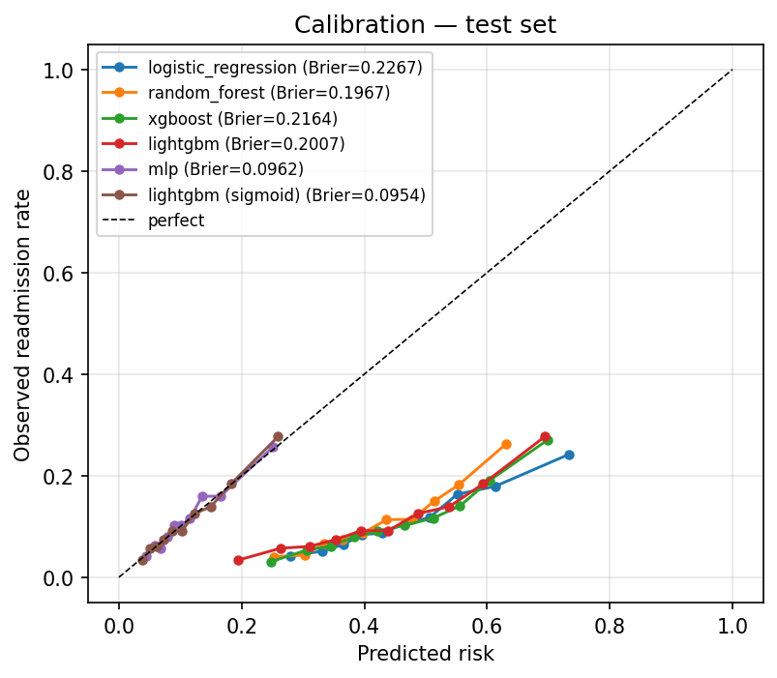
WHY NOT ACCURACY
78.2% accurate. So is doing nothing — at 88.6%.
CALIBRATION — making the number mean what it says
78.2%
88.6%
88.8%
Class weighting is what makes ranking work and probabilities wrong. Platt scaling fixes the probabilities without touching the ranking.
our model
“nobody is readmitted”
best accuracy at any threshold
 | Brier | ROC-AUC | PR-AUC
LightGBM, raw | 0.2007 | 0.6839 | 0.2376
+ Platt scaling | 0.0954 | 0.6839 | 0.2376
40.2% of readmissions caught
0% caught — flags no one
flags 0.4% of patients
With an 11% positive rate, accuracy rewards inaction — nothing here was selected using it. The deployed threshold is 0.166, not 0.5: at 0.5 the calibrated model flags zero patients.
Brier more than halves; discrimination is bit-identical. Platt scaling is strictly monotonic — it cannot reorder a single patient. The call list is unchanged while a predicted 18% now means roughly 18%.
5

Slide 6
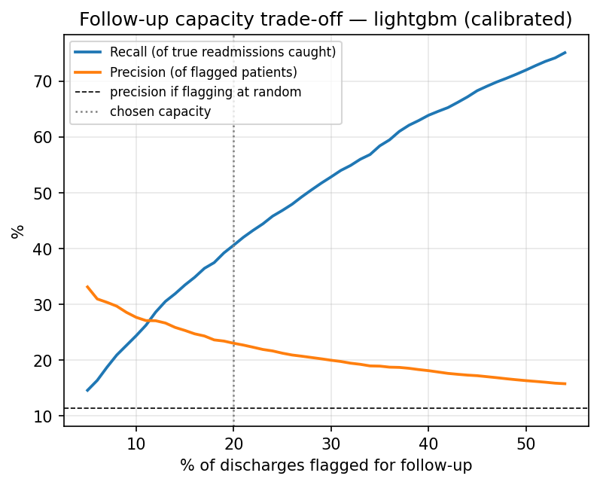
OPERATING POINT & CLINICAL VALUE
The threshold is a budget decision — and acting on it beats the alternatives
Precision & recall vs. follow-up call capacity
CLINICAL VALUE — does acting on it beat what they do today?
Decision curve analysis: pt is the risk at which a call becomes worthwhile — it encodes the cost ratio of a call vs. a missed readmission.
+0.0157
−0.0617
0.0000
Use the model
Call everyone
Call nobody
Net benefit
15.6 extra readmissions caught per 1,000 discharges, net of the false alarms they cost. The model beats both alternatives for pt between 0.025 and 0.43 — every realistic hospital sits inside that range. Note ‘call everyone’ is worse than doing nothing at this exchange rate: false-alarm burden swamps the benefit.
Capacity | Recall | Precision
20% ← deployed | 40.6% | 23.1%
40% | 63.9% | 18.1%
Doubling capacity from 20% to 40% buys 23 points of recall for 5 points of precision. At 20%: 901 true positives, 2,965 false alarms, 1,343 missed. Whether the trade is worth taking is a hospital finance question — the model supports either answer without retraining.
6

Slide 7
EXPLAINABILITY, ROBUSTNESS & ABLATION
What the model reads — and whether the number holds up
Permutation importance and SHAP agree on the top of the list.
ROBUSTNESS — is 0.684 real?
1
Prior inpatient admissions
Across 7 random seeds, the pipeline averages PR-AUC 0.224 ± 0.010 and ROC-AUC 0.678 ± 0.006. 95% CI from 2,000 cluster resamples of patients:
Utilisation history beats anything measured during the stay.
2
Where the patient is discharged to
ROC-AUC 0.684 [0.671, 0.698] · PR-AUC 0.238 [0.213, 0.265] · Recall 40.2% [37.6%, 42.7%]
Home lowers risk; a care facility raises it — a proxy for frailty.
3
Depth of prior encounter history
How often this patient has been through the system before.
ABLATION — seven approaches tried, none beat the baseline
4
Primary diagnosis group
Circulatory pushes risk up; respiratory pushes it down.
Variant | CV PR-AUC | Δ
A — current, 39 features | 0.2200 | baseline
F — soft-vote RF+XGB+LGBM | 0.2191 | −0.0009
G — SMOTE, not weighting | 0.2194 | −0.0006
Nothing suspicious at the top — no identifier, no date artefact.
Every delta is inside the ±0.0069 fold-to-fold noise — no measurable difference. Seven approaches converging on 0.22 is itself the finding. That’s a ceiling on method — the learning curve (still rising, +0.0049 from the last 43% of data) shows it isn’t a ceiling on data.
7

Slide 8
FAIRNESS
The subgroup gap that would block deployment
Per-subgroup performance at the deployed threshold. Groups under 200 test encounters are suppressed.
Age band | Flag rate | Recall | ROC-AUC
Under 40 | 20.2% | 58.0% | 0.784
40–60 | 14.8% | 39.6% | 0.712
60–80 | 20.8% | 39.7% | 0.673
80 and over | 23.0% | 35.8% | 0.613
Race and gender gaps are modest — age is the problem. The two large racial groups get near-identical flag rates and recall. Patients over 80 are flagged most often (23.0%) while the model ranks them worst (ROC-AUC 0.613) — the tool spends disproportionate follow-up capacity where its ordering is least trustworthy. This is not fixable by tuning.
EQUITY EXPERIMENT — we tried the obvious fix
ROOT CAUSE — a data limit, not a modelling one
One capacity threshold per age band. Recall drops 40.2% → 39.7% (901 → 891 true positives); 80+ ROC-AUC is unchanged at 0.613 under both policies. Thresholds move capacity — they cannot change ranking.
Every feature’s signal decays with age — an 80+ patient carries about a third the separable signal of a <40 patient. A dedicated 80+ model is worse (0.588 vs 0.613): exposure to younger patients helps rank older ones. Closing this needs frailty and functional-status data this dataset doesn’t carry.
8

Slide 9
DEPLOYMENT & WHAT WE'D TELL A HOSPITAL
Decision support, not autonomous action
The model produces a ranked call list. A clinician decides what to do with it.
ARCHITECTURE
WHAT WE’D SAY TO A HOSPITAL — honest about the ceiling
Nightly batch — The discharge list becomes a ranked worklist, written straight into the follow-up team’s queue.
Discrimination is modest — and that’s a ceiling on method. 0.684 sits inside the 0.64–0.70 band published for this dataset. Seven approaches converged there.
Real-time endpoint — FastAPI /score returns risk, flag, band and disclaimer. Sub-millisecond tree inference.
Insurance coding is not physiology. payer_code_Unknown is a top-6 driver — it may not transfer to a new hospital; first thing to re-examine on local data.
The data is 1999–2008. Coding standards, drug availability and discharge policy have all moved. Recalibration is mandatory.
One 5 MB artefact — Preprocessing, booster, calibrator and threshold travel together in a single joblib file.
The oldest patients cannot be ranked well — and we know why. Every feature’s signal decays with age. Three fixes failed; it needs frailty data this dataset lacks.
Two serving bugs offline metrics could never have caught:
• Feature engineering required the readmitted label — which doesn’t exist at discharge.
• prior_encounters was counted per-batch — a single-row request always came out zero, killing the model’s strongest feature.
Monitor flag rate, realised-vs-predicted readmission rate, calibration drift and subgroup gaps — on a schedule, not once at launch.
github.com/sgoel2be24-cyber/hospital-readmission-risk make setup && make data && make train · 27 tests · ~60s end to end
9

