Slide 1
ML BUBBLE 2026 · TE-BE DESIGN & SOLVE
Predicting 30-Day
Hospital Readmission
Turning 101,766 discharge records into a ranked call list for a follow-up team that can only reach one patient in five.
40.2%
2.05×
0.238
of readmissions caught
lift over random calling
PR-AUC vs 0.113 base rate
Held-out test set · 19,773 encounters · 13,998 patients unseen in training
Notes:
The framing is the point: this is not 'who will be readmitted' but 'given we can call 20% of discharges, which 20%'. Every modelling decision follows from that. Headline: 40.2% of readmissions caught by calling the top-ranked fifth.

Slide 2
THE QUESTION
A capacity problem, not a prediction problem
What a hospital actually faces
Reframed
“We can call 20% of
today's discharges.
Which 20%?”
About 1 in 9 diabetic discharges returns within 30 days.
Many are preventable — a phone call, a medication check, an earlier appointment.
A discharge-planning team can reach only a fraction of patients per day.
So the useful question is which patients get that scarce attention.
That reframing changes what counts as success. The team works down a ranked list, so ranking quality matters more than absolute probability — and the decision threshold comes from budget, not from an arbitrary 0.5 cutoff.
Consequence: the model is optimised for PR-AUC and recall-at-capacity — never accuracy.
Notes:
Everything downstream — metric choice, threshold, calibration — is a consequence of this reframing.

Slide 3
THE DATA
Diabetes 130-US Hospitals, 1999–2008
UCI ML Repository dataset 296 · 10 years of care across 130 hospitals · downloaded reproducibly via make data
101,766
71,518
50
11.4%
raw encounters
distinct patients
raw columns
readmitted <30 days
Target definition
Cleaning that changes the label
readmitted has three values: <30, >30, NO
Binarised to <30 vs everything else — the window used by readmission-penalty programmes
A return 14 months later is not a discharge-planning failure, so >30 is a negative
2,423 death / hospice discharges removed — those patients cannot be readmitted, and labelling them 'not readmitted' teaches the model that dying is a good outcome
weight dropped (97% missing); examide and citoglipton are constant
'?' kept as an explicit Unknown category — missingness here is administrative, and it carries signal
99,340 encounters and 39 engineered features survive to modelling.
Notes:
The death/hospice filter is the one cleaning step that changes the label rather than the features. Also worth mentioning: max_glu_serum uses the literal string 'None' for 'never tested' — pandas turns that into NaN by default and destroys an informative level.

Slide 4
THE TRAP
99,340 encounters belong to only 69,987 patients
The single decision that separates an honest result from a meaningless one.
✕ Split by row
✓ Split by patient_nbr
The same patient lands in train and test
The model memorises individuals instead of learning transferable risk
Every metric comes out inflated
One patient appears 40 times
GroupShuffleSplit for train / val / test
GroupKFold for every cross-validation
No patient can appear on both sides
Enforced by a test, not by convention
test_split_never_puts_a_patient_on_both_sides
Two further leakage paths are closed the same way: identifiers dropped after splitting, unscoreable outcomes removed.
A materially higher ROC-AUC on this dataset almost always means a leaked split rather than a better model.
Notes:
This is the slide to linger on. Published results for this dataset sit at 0.64–0.70. If someone reports 0.85, they split by row. Our three leakage guards are each covered by a test that fails the build.

Slide 5
METHOD
From raw encounter to ranked call list
1
2
3
4
5
Clean
Engineer
Split
Compare
Calibrate
Remove death/hospice
discharges. Keep '?' as
an explicit category.
2,000+ ICD-9 codes into
9 chapters. Utilisation
and regimen-churn features.
GroupShuffleSplit on
patient_nbr. Train / val /
test = 63.6k / 16.0k / 19.8k.
6 models under 5-fold
GroupKFold. Winner picked
on validation PR-AUC.
Platt scaling, then a
threshold set from
follow-up capacity.
The test set is read exactly once, at the very end.
Model choice, hyperparameters, the calibration method and the decision threshold are all fixed against validation. That discipline is what makes 0.684 an estimate of future performance rather than the best of a dozen peeks.
Notes:
Reproducible end to end: make setup, make data, make tune, make train, make experiments, make explain, make test.

Slide 6
CLASS IMBALANCE
11.4% positives — handled explicitly, not hopefully
Left alone, every model collapses to predicting 'no readmission' for everyone. That scores 88.6% accuracy and catches nothing.
Logistic regression
class_weight='balanced'
SMOTE was measured, not assumed away
Random forest
class_weight='balanced_subsample'
Oversampling inside each CV fold scored 0.2194 PR-AUC against 0.2200 for class weighting — no better, and it adds a resampling step to the serving path.
Class weighting kept on the evidence.
XGBoost
scale_pos_weight ≈ 7.8
LightGBM
class_weight='balanced'
MLP
none available — judged on ranking
The cost of class weighting
It deliberately distorts predicted probabilities upward. Fine for ranking, wrong for a number a clinician reads — which is why calibration is a separate step.
Notes:
The MLP exception is informative: because it is unweighted, it ends up the best-calibrated model while ranking worst.

Slide 7
COMPARATIVE ANALYSIS
Six models, one selection rule
5-fold GroupKFold on training patients for selection; a single held-out test evaluation at the end.
Selected: LightGBM
Test PR-AUC 0.238 · ROC-AUC 0.684 · recall 40.2% at 20% capacity. Chosen on validation PR-AUC, before the test set was read.
Which gaps are real?
Paired bootstrap on Δ PR-AUC:
vs XGBoost +0.0022 [−0.0017, +0.0058] not resolved
vs Random forest +0.0124 [+0.0064, +0.0189] resolved
vs Logistic reg. +0.0249 [+0.0177, +0.0321] resolved
Boosting genuinely beats bagging and linear models. Which booster wins is not resolved by this data.
Notes:
If asked why LightGBM over XGBoost: validation PR-AUC, and it is genuinely a coin flip. Saying so is more credible than claiming a 0.0003 win.

Slide 8
THE METRIC TRAP
Our model is 78.2% accurate.
A model that does nothing is 88.6% accurate.
78.2%
88.6%
88.8%
our model
“nobody is readmitted”
best accuracy at any threshold
40.2% of readmissions caught
0% caught — flags no one
flags 0.4% of patients
With an 11% positive rate, accuracy rewards inaction. Optimising it means optimising toward a model that never flags anyone — so nothing in this project was selected using it.
This is also why the deployed threshold is 0.166, not 0.5 — at 0.5 the calibrated model flags zero patients.
Notes:
Expect the accuracy question from judges. Answer with the 88.6% baseline. Accuracy is reported in metrics.json for completeness; it selected nothing.

Slide 9
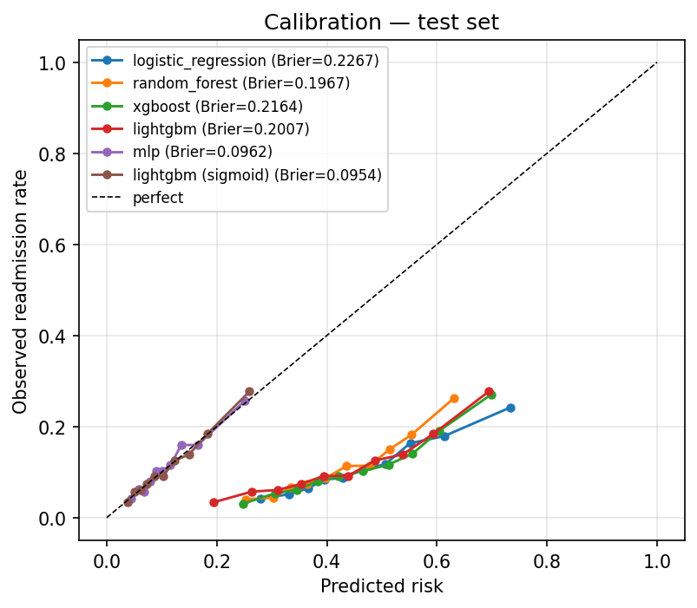
CALIBRATION
Making the number mean what it says
Class weighting is what makes ranking work and probabilities wrong. Platt scaling fixes the probabilities without touching the ranking.
 | Brier | ROC-AUC | PR-AUC
LightGBM, raw | 0.2007 | 0.6839 | 0.2376
+ Platt scaling | 0.0954 | 0.6839 | 0.2376
Brier more than halves. Discrimination is bit-identical.
Platt scaling is strictly monotonic, so it cannot reorder a single patient — the call list is unchanged while the risk numbers become trustworthy. A predicted 18% now means roughly 18%.
Why not isotonic?
It won validation Brier by 0.0005 but is a step function — it ties scores together and cost 0.004 PR-AUC. The rule: among calibrators within 0.002 Brier of the best, take the one that ranks better.
Notes:
The uncalibrated curves sitting below the diagonal are the class-weighting distortion made visible.

Slide 10
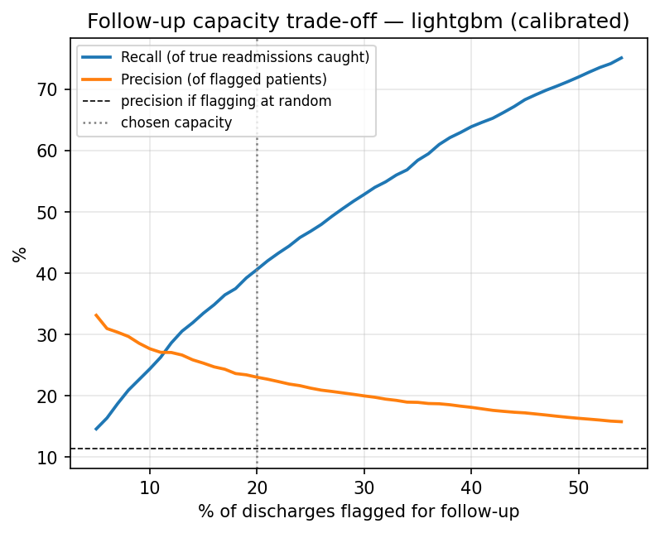
OPERATING POINT
The threshold is a budget decision
Precision and recall as a function of how many discharges the follow-up team can call.
Capacity | Recall | Precision
10% | 24.4% | 27.7%
20% ← deployed | 40.6% | 23.1%
30% | 52.9% | 20.0%
40% | 63.9% | 18.1%
50% | 72.1% | 16.4%
Doubling capacity from 20% to 40% buys 23 more points of recall for 5 points of precision.
Whether that trade is worth taking depends on the cost of a call against the cost of a readmission — a hospital finance question. The model supports either answer without retraining.
At 20%: 901 true positives, 2,965 false alarms, 1,343 missed.
Notes:
Capacity-sweep rows use test-quantile thresholds, so they differ marginally from the deployed 40.2%/23.3%, where the threshold is fixed on validation.

Slide 11
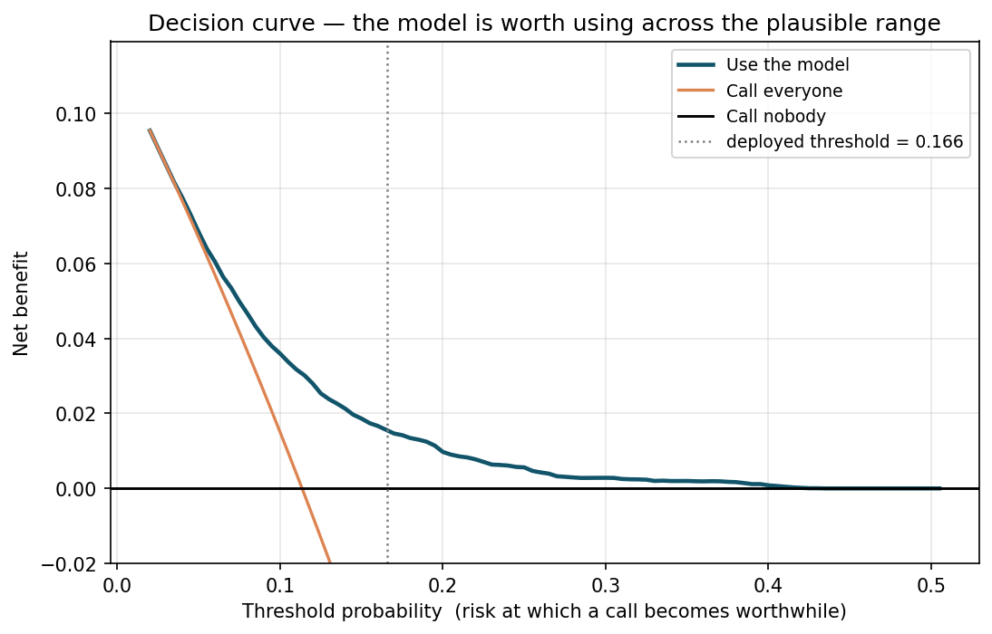
CLINICAL VALUE
Is acting on it better than what they do today?
Discrimination says the ranking is good. It does not say that using it beats calling everyone, or calling nobody.
Decision curve analysis
net benefit = TP/N − (FP/N) × pt/(1−pt)
pt is the risk at which a call becomes worthwhile — it encodes the cost ratio.
Policy | Net benefit
Use the model | +0.0157
Call everyone | −0.0617
Call nobody | 0.0000
15.6 extra readmissions caught per 1,000 discharges, net of the false alarms they cost.
Model beats both alternatives for pt between 0.025 and 0.43 — every realistic hospital sits inside that range.
Notes:
Note that 'call everyone' is worse than doing nothing at this exchange rate: the false-alarm burden swamps the benefit. That is precisely the situation a triage model exists to fix. Vickers & Elkin 2006 is the reference.

Slide 12
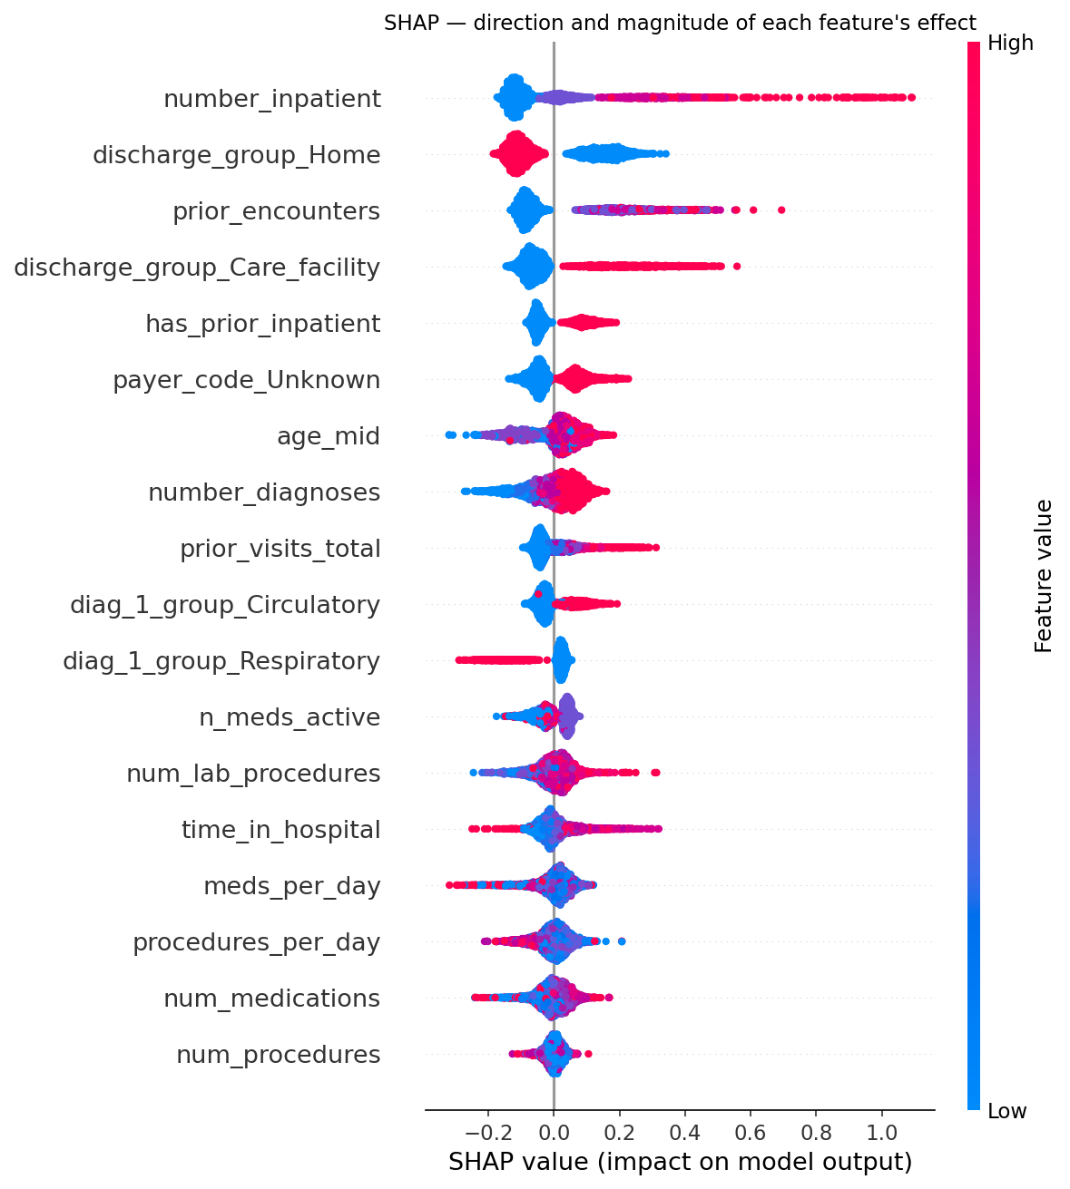
EXPLAINABILITY
What the model is actually reading
Permutation importance on held-out data and SHAP agree on the top of the list.
1
Prior inpatient admissions
Utilisation history beats anything measured during the stay.
2
Where the patient is discharged to
Home lowers risk; a care facility raises it — a proxy for frailty.
3
Depth of prior encounter history
How often this patient has been through the system before.
4
Primary diagnosis group
Circulatory pushes risk up; respiratory pushes it down.
Nothing suspicious at the top — no identifier, no date artefact.
Notes:
Per-patient reason codes ship with every score — a nurse needs the three facts behind a number, not the number alone.

Slide 13
ABLATION STUDY
Seven approaches tried. None beat the baseline.
All scored with identical 5-fold GroupKFold on training patients. The test set was not read during any of this.
Variant | CV PR-AUC | Δ | Adopted
A — current, 39 features | 0.2200 | — | baseline
B — drop payer_code | 0.2180 | −0.0020 | no
C — +10 engineered features | 0.2196 | −0.0005 | no
D — B and C combined | 0.2178 | −0.0023 | no
E — native categorical splits | 0.2194 | −0.0007 | no
F — soft-vote RF+XGB+LGBM | 0.2191 | −0.0009 | no
G — SMOTE, not class weighting | 0.2194 | −0.0006 | no
Every delta is inside noise
Fold-to-fold standard deviation is ±0.0069. Every difference above is smaller than that, so the honest reading is “no measurable difference”, not “slightly worse”.
Why this matters
Seven independent approaches converging on 0.22 is itself the finding: more modelling sophistication does not help here.
That is a ceiling on method — the learning curve shows it is not a ceiling on data.
Reproduce with make experiments · reports/ablation_study.csv
Notes:
Ensembling buying nothing tells you the three tree models make correlated errors — they read the same limited signal.

Slide 14
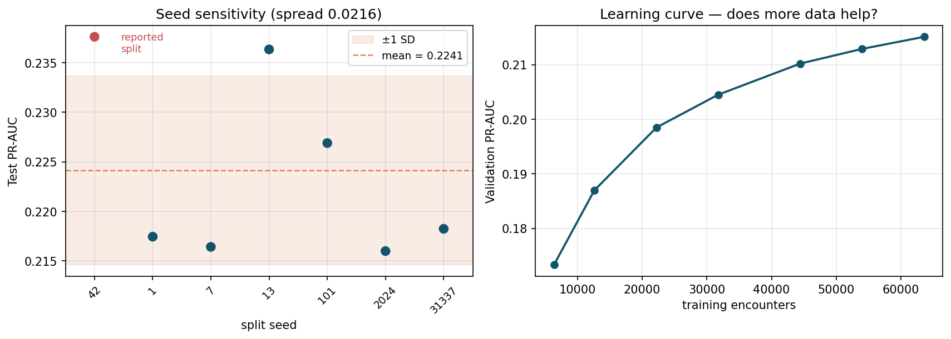
ROBUSTNESS
Is 0.684 real, and is it the ceiling?
Two questions the headline number depends on but cannot answer on its own.
The reported split is the luckiest of seven
Across seven seeds the same pipeline averages PR-AUC 0.224 ± 0.010 and ROC-AUC 0.678 ± 0.006.
Seed 42 was fixed before any evaluation, so this is luck rather than selection — but we report it rather than bury it.
95% confidence intervals
This corrected one of our own claims
ROC-AUC 0.684 [0.671, 0.698] · PR-AUC 0.238 [0.213, 0.265]
Recall 40.2% [37.6%, 42.7%]
2,000 cluster resamples of patients, not rows.
We had called 0.22 the information ceiling of the data. The learning curve is still rising — the last 43% of training data bought +0.0049. The ceiling is on method, not on data.
Notes:
This slide is the answer to 'how do you know that number is real'. It is also the slide where we correct ourselves: the ablation shows a method ceiling, the learning curve shows more patients would still help slightly. That points at a multi-hospital dataset, not a better booster, as the next real improvement.

Slide 15
FAIRNESS
The subgroup gap that would block deployment
Per-subgroup performance at the deployed threshold. Groups under 200 test encounters are suppressed.
Age band | n | Flag rate | Recall | Precision | ROC-AUC
Under 40 | 1,289 | 20.2% | 58.0% | 34.9% | 0.784
40–60 | 5,376 | 14.8% | 39.6% | 27.9% | 0.712
60–80 | 9,277 | 20.8% | 39.7% | 21.8% | 0.673
80 and over | 3,831 | 23.0% | 35.8% | 19.0% | 0.613
Before deployment
A separate model for the oldest band
Or an age-stratified threshold
Or restrict the tool to under-80s and triage older patients by existing clinical judgement
Race and gender gaps are modest. Age is the problem.
The two large racial groups get near-identical flag rates and recall. Patients over 80, however, are flagged most often (23.0%) while the model ranks them worst (ROC-AUC 0.613) — so the tool spends disproportionate follow-up capacity on the group where its ordering is least trustworthy.
Almost everything the model relies on is a proxy for frailty, and nearly all patients over 80 look frail — so the features stop separating within that group.
This is not fixable by tuning.
Notes:
Protected attributes are kept as features on purpose. Dropping race does not remove its influence — it is reconstructable from other columns — it only removes the ability to measure the disparity.

Slide 16
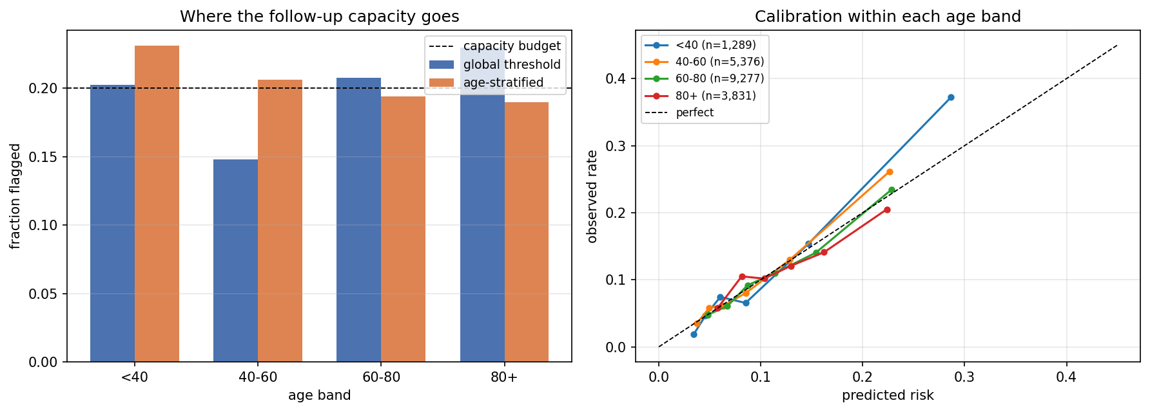
EQUITY EXPERIMENT
We tried the obvious fix. It does not fix it.
One capacity threshold per age band, each fitted on validation, so every band flags 20% of its own members.
Policy | Recall | TP
Global threshold | 40.2% | 901
Age-stratified | 39.7% | 891
Stratifying moves calls away from the oldest band and toward the 40–60 band, at a cost of 10 true positives.
80+ ROC-AUC is 0.613 under both policies.
Thresholds move capacity. They cannot change ranking.
And is stratifying even fairer?
The 80+ problem is discrimination, not calibration. No threshold policy repairs it — a real fix has to be upstream: features that separate frailty within an elderly population, or a model fitted for that group.
Patients over 80 have the highest base rate in the data (12.2%). A policy that calls fewer of them equalises exposure but withdraws attention from the highest-risk group. That is a hospital's value judgement, not a metric.
Notes:
The honest framing: two definitions of fairness disagree here. Equal flag rate vs attention proportional to risk. We measured the trade and handed the choice to the hospital rather than picking one silently.

Slide 17
ROOT CAUSE
The signal is not in the data — measured, not assumed
Univariate AUC of each feature within each age band. Model-free: how well one raw number separates outcomes.
Feature | <40 | 40-60 | 60-80 | 80+
number_inpatient | 0.710 | 0.635 | 0.592 | 0.574
prior_visits_total | 0.709 | 0.631 | 0.588 | 0.573
prior_encounters | 0.669 | 0.624 | 0.577 | 0.566
number_diagnoses | 0.587 | 0.574 | 0.537 | 0.509
mean |AUC − 0.5| | 0.075 | 0.053 | 0.035 | 0.027
Three fixes tried. None win.
Global model (current)
0.6134
Dedicated 80+ model
0.5876
Sample weight ×3
0.6087
Every feature decays with age. An 80+ patient carries about a third of the separable signal.
Sample weight ×6
0.6003
These features work by spotting patients who look sick and use the system heavily. Among the over-80s, almost everyone does — so they stop separating.
ROC-AUC on the 3,831-encounter 80+ test slice.
A data limit, not a modelling one
Closing this needs variables the dataset does not carry — frailty index, functional status, cognition, social support at home.
The dedicated model is the worst option: exposure to younger patients helps the global model rank older ones.
Notes:
This is the payoff for diagnosing before prescribing. Also worth raising if asked: competing risk. A patient discharged alive who dies at home inside 30 days is recorded as 'not readmitted'. That misclassification concentrates in the oldest band by construction and would depress measurable discrimination exactly where we see it. No post-discharge mortality in this dataset, so it stays a hypothesis.

Slide 18
DEPLOYMENT
Decision support, not an autonomous action
The model produces a ranked call list. A clinician decides what to do with it.
Nightly batch
Real-time endpoint
One 5 MB artefact
The discharge list becomes a ranked worklist for the follow-up team, written straight into their queue.
FastAPI service — /score returns risk, flag, band and disclaimer. Sub-millisecond tree inference.
Preprocessing, booster, calibrator and threshold travel together in a single joblib file.
Two serving bugs that offline metrics could never have caught
Feature engineering required the readmitted label — which does not exist at discharge.
prior_encounters was counted within the batch, so a single-row request scored every patient as a first-ever admission — zeroing out the model's strongest feature.
Serving reuses data_prep.py directly — a second copy of the feature logic is how models quietly degrade in production.
Monitor flag rate, realised vs predicted readmission rate, calibration drift and the subgroup gaps — on a schedule, not once at launch.
Notes:
The data is from 1999–2008. Recalibration on recent local data is mandatory before any real use, not optional.

Slide 19
WHAT WE WOULD SAY TO A HOSPITAL
Honest about the ceiling
Discrimination is modest — and that is the ceiling.
0.684 sits inside the 0.64–0.70 band published for this dataset. Seven approaches converged there.
payer_code_Unknown is a top-6 driver.
Insurance coding is not physiology. It may not transfer to a new hospital — first thing to re-examine on local data.
The data is 1999–2008.
Coding standards, drug availability and discharge policy have all moved. Recalibration is mandatory.
The oldest patients cannot be ranked well, and we know why.
Every feature's signal decays with age. Three fixes failed. It needs frailty data this dataset lacks.
github.com/sgoel2be24-cyber/hospital-readmission-risk
make setup && make data && make train · 17 tests · ~60 s end to end
Notes:
Close on credibility rather than on a number. The limitations slide is the one that separates a model that was measured from a model that was demoed.

