Slide 1

SAMSUNG PRISM
Generative AI
Hackathon
3rd Edition 2026 – 27
Theme ID - 03 · Teachable Voice Automation
Team Name - Update
College Name - Thapar Institute of Engineering and Technology (TIET), Patiala
Member Name & Email 1 - Shikhar Goel · sgoel2_be24@thapar.edu
Member Name & Email 2 - Ishpreet Singh · isingh4_be24@thapar.edu
Submission Github link - github.com/sgoel2be24-cyber/prism-teachable-voice
Notes:
Theme 03, Teachable Voice Automation. Team Update from TIET: Shikhar Goel and Ishpreet Singh, third-year Computer Engineering. One sentence: you teach the phone a task by doing it once while it listens and watches; after that you just say it, with different values or wording, and it does it through the accessibility service, stopping before payment.

Slide 2

Theme
THEME 03 · THE PROBLEM, IN OUR WORDS
Teachable Voice Automation
What the theme asks for — and what we built
Voice assistants stop where an app’s own integrations stop. Ordering a pizza on Zomato or adding something to an Amazon cart still takes ten or more taps, every time.
The user already knows those taps. There is no way to hand that knowledge to the assistant — and have it cope with new values, new wording and a changed screen.
Teach by voice and taps, once
say the command, then do the task; every tap is recorded
A reusable flow, not a tap replay
values from the command become slots: item, quantity, address
Paraphrases and changed values
“Get me a farmhouse from dominos” runs the same task
Replay when screens change
pop-ups, sponsored results, another restaurant — ask only when stuck
Target apps
Zomato — order from Domino’s (item, quantity, address)
Amazon — search, add the first real result to the cart
Myntra — the Amazon task, run in a similar app
No credential capture
stops at payment, OTP, password and login: “Your turn.”
Notes:
Theme 03 in our words: assistants only reach what apps expose, so in-app tasks take many taps. The theme asks us to learn a task from one demonstration by voice and taps, generalise it into slots, match paraphrases and new values, cope with changed screens, and never touch credentials. Our target apps are Zomato, Amazon, and Myntra for the cross-app bonus.

Slide 3
Existing Solutions & Gaps
WHERE TODAY’S OPTIONS FALL SHORT
Approach | What it does | The gap
Voice assistants Google Assistant / Gemini, Siri, Bixby, Alexa | Act through the few actions an app chooses to expose | Everything else inside Zomato or Amazon is out of reach; it falls back to a web result
Routines and macro apps Bixby Routines, Tasker, MacroDroid | Chain device actions; add-ons can tap on-screen elements | Built step by step by hand, with fixed values; a changed screen breaks the macro
LLM screen agents research prototypes such as AppAgent, Mobile-Agent | A large model reads the screen and decides every single step | A model call per step: slower, costlier, varies from run to run, can wander near payment
Programming by demonstration SUGILITE (CMU, 2017) | Learns a parameterised task from one demo plus the spoken command | Pre-LLM research prototype: no model to recover when a screen differs from the demo
Teachable Voice (ours) | Learns from one demo; replays with a scored matcher; the model only on unfamiliar screens | Asks when a value is missing or a choice is personal; always hands back at payment and login
Notes:
Existing options: assistants reach only exposed app actions; macro apps are hand-built and brittle; LLM screen agents call a model for every step, which is slow, costly and not repeatable; programming by demonstration, like SUGILITE, had the right idea but no way to recover when a screen changes. We combine demonstration with a deterministic replay engine and use the model only as a fallback, with a hard hand-off at payment and login.

Slide 4

Our Solutions & Architecture Diagram
1
Teach
Say the command, do the task once
2
Generalise
Command words become slots
3
Replay by voice
New wording, values, even another app
4
Ask or hand back
One question; “Your turn.” at payment
ARCHITECTURE · ALL ON THE PHONE, THROUGH ANDROID’S ACCESSIBILITY SERVICE
Teach once
Voice command
speech → text
Recorder
tap-capture overlay + UI-tree snapshot per tap
Generaliser
slots from command words, card anchors
LLM
Refine
slot names, step intents, noise, goals
User review
steps shown in words
Recipe store
JSON on the phone
Run on command
Voice command
or typed
LLM
LLM
Matcher
speech → intent: flow + slots + app
Executor
fast path → scroll / search → LLM action → ask
Checks
cart count, the right dish, not an ad
Guard
payment, login, OTP, password
Done / hand back
spoken reply + run log
Fireworks AI · gpt-oss-120b — the only network call: refine a demo once, understand a paraphrase, choose one action on an unfamiliar screen (1–2 s). Known screens replay with no model call.
Notes:
Four stages on top: teach, generalise, replay by voice, and ask or hand back. Below, the architecture: two pipelines on the phone. Teach: voice command, the recorder with our tap-capture overlay and a UI-tree snapshot per tap, the generaliser that turns command words into slots, one LLM call to refine, a review screen, and a JSON recipe. Run: the matcher turns speech into a flow with slot values, offline first; the executor escalates from a scored fast path to scrolling and page search, and only then an LLM action or a question; checks demand proof on screen; the guard stops at payment, login, OTP and password. The violet tags mark the only places the LLM is used.

Slide 5
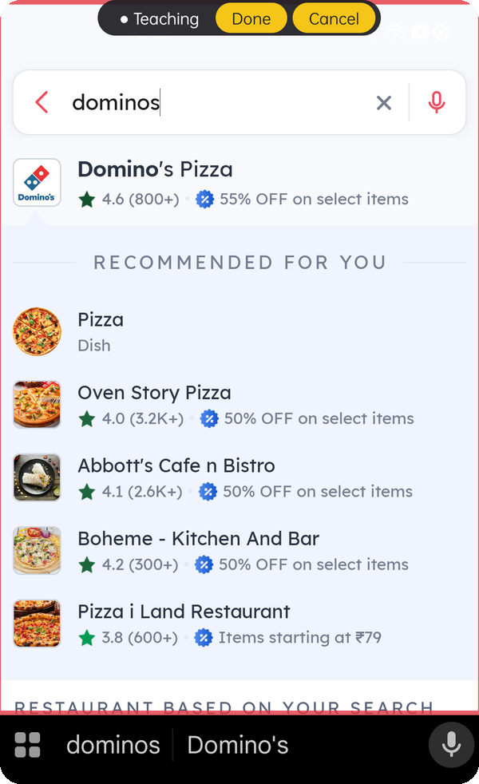
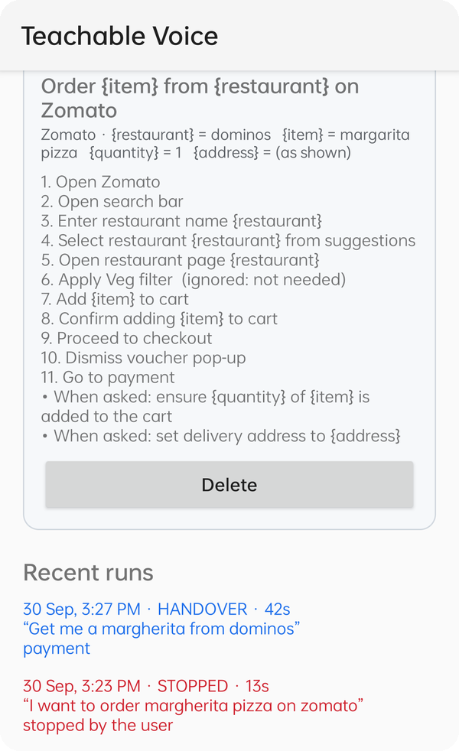
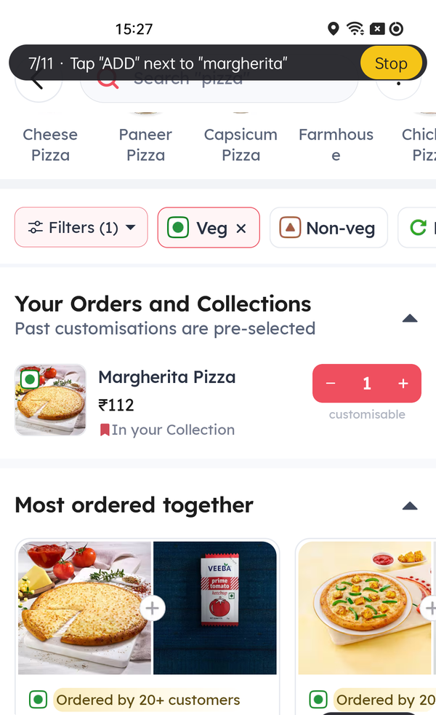
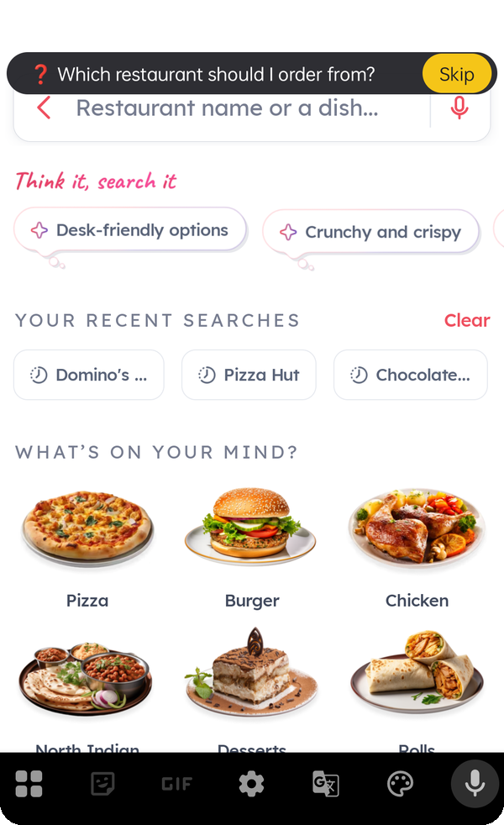
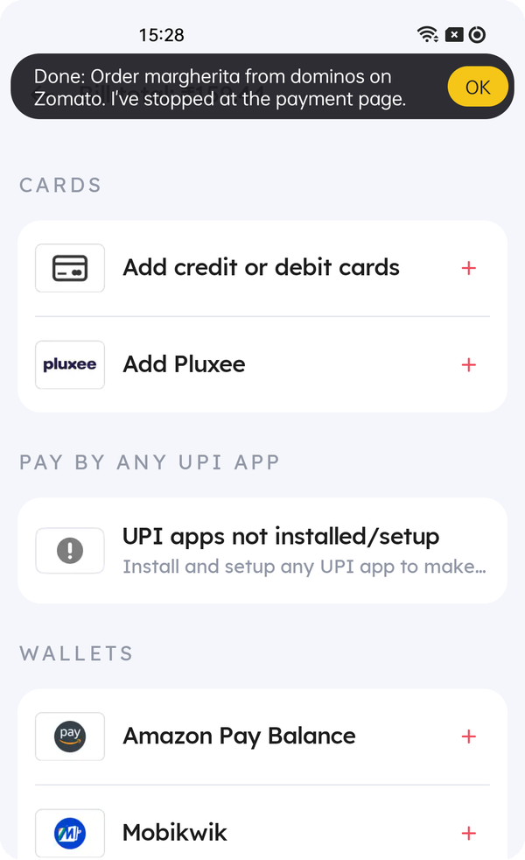

Demo & Product Walkthrough
1
Teach it once
2
It learns the task
3
Replay by voice
4
Asks what’s missing
5
Stops before paying
Say the command, then do it. A red border and a “Teaching” pill while it watches.
Steps in words, your values as {slots}, the stray Veg filter tap marked “not needed”.
“Get me a margherita from dominos”: it runs the 11 steps and shows each one.
No restaurant in the command? It asks at the step that needs one, then carries on.
At the payment page it hands back: “Your turn.” It never pays or signs in.
SAME TASK, OTHER WORDS AND VALUES each replayed on the phone to the checkout hand-back (eval, 30 Sep)
Order garlic bread from dominos
Order two Margherita pizzas from Domino’s
Order a margherita pizza from Pizza Hut on Zomato
Demo video (≤ 5 min, one unedited take): teach by voice + taps → exact replay → a paraphrase → a changed value → a question. Link in the README and the form.
Notes:
Five moments from one Zomato task, captured on the phone on 30 Sep. 1: teaching, the red border and the Teaching pill with Done and Cancel. 2: what it learned, the steps in words with the command's values as slots, and the Veg filter tap marked not needed. 3: a replay by voice, the pill shows step 7 of 11, Tap ADD next to margherita. 4: a command without a restaurant, so it asks at the step that needs one. 5: it stops at the payment page and hands back. Below: three more commands from the 30 Sep evaluation that ran the same task with new values, a quantity, and a restaurant it was never taught on.

Slide 6



Tools and tech stack used
On the phone
AI model
Build
Testing
• Kotlin
• AccessibilityService
• Accessibility overlay (tap capture)
• SpeechRecognizer · TextToSpeech
• JSON recipes and run log
• Android 9+ · target SDK 35
• Fireworks AI
• gpt-oss-120b, low reasoning effort
• JSON-only prompts: match, act, refine
• Hard timeout per call
• Separate spend-limited key in the APK
• Gradle (Android SDK 35)
• Dockerfile builds the APK
• Keys kept out of git
• Release APK on GitHub
• adb benches: cold start, repeat runs
• Auto-answer for spoken questions
• Python eval of command matching
• Screen dumps on every failure
~4,300 lines of Kotlin, 17 files
1 library: Kotlin coroutines
3.5 MB release APK
0 app SDKs, deep links or root
Notes:
Plain native Android in Kotlin; no root, no app SDKs. One hosted model through Fireworks' OpenAI-compatible API. Everything is reproducible with the Dockerfile, and the test benches drive the phone over adb.

Slide 7




Impact & Use case
ONE ZOMATO ORDER
Everyday repeats
Accessibility
11 steps
Reorder from the same restaurant, restock the same item, check the same page: said with today’s values.
For people who find many small taps hard, one sentence replaces a whole flow — and it asks rather than guesses.
→ one sentence
Taught once by doing it. Then 36–66 s hands-free with a new pizza, a quantity or a delivery address — stopping before payment every time.
Set up once for family
Built for India
Someone teaches a task once; a parent just says it. It never pays, logs in or picks a personal option alone.
Hinglish commands work (“amazon pe pencil box search karke…”); the guard knows Hindi payment and login phrases.
“Order two Margherita pizzas from Domino’s.”
As a worklet: a Galaxy assistant that learns in-app tasks from its own user, through the accessibility layer every app already has — no partner integration, and the user stays in charge of money and logins.
Notes:
Impact: the Zomato order we taught is eleven steps; after one demonstration it's one sentence and under a minute hands-free. Use cases: everyday repeats, accessibility for people who find many small taps hard, a family member setting up tasks once for a parent, and Hinglish commands. As a worklet, it extends an assistant into any app through accessibility, without partner integrations.

Slide 8












Innovation highlights, results and limitations
Innovation highlights
Results on a real phone
Known limitations
Tap capture everywhere
our overlay hit-tests every touch, even where apps report none
8 / 8
14 / 14
Paraphrases need the model
exact commands work offline
judges’ sentence, 0 LLM calls
Amazon, taught by hand
The model only when needed
known screens replay with a scored matcher, no network
Another app is slower
45–60 s on Myntra vs 35–50 s on Amazon
7 / 7
14 / 14
Proof-checked steps
cart count, − 1 +, the dish’s name before “done”
Myntra (Amazon task)
theme test cases T1–T14
Screen on, phone unlocked
services can’t act on a locked screen
Clean tasks from messy demos
mis-taps, a call, an unneeded filter are dropped
“Order garlic bread from dominos” → Classic Stuffed Garlic Bread
Sideloading in India
Play Protect: install over USB or pause it
Taught on Domino’s, ran on Pizza Hut (63 s)
One demo, similar apps
the Amazon task runs on Myntra, skips “AD” tiles
Taught in English, app in Hindi
stops and says so; re-teach in Hindi
App switched to Hindi → says why in 5 s
Asks like a person
one question when a value is missing or personal
Loose dish names
“garlic bread” → the closest name on screen
Every judges’ sentence handled, verbatim
Oppo Reno3, Android 12 · 28–30 Sep · app force-stopped before every run · full tables in docs/ of the repository
Notes:
Left: six ideas that make one demonstration dependable; the language model is a fallback, not the engine. Middle: measured cold-start runs; the judges' sentence reached payment eight times out of eight with no language-model call, and all fourteen theme test cases pass, including the rubric's garlic-bread example. Right: what we know today and how the assistant behaves in each case; all of these are in the README too.

Slide 9



What’s next
On-device model
TOWARDS A WORKLET
Run matching and single actions on a small on-device model: private, offline, faster.
An assistant that learns in-app tasks from its own user, through the accessibility layer every app already has.
The pieces that make it safe to ship are already there: proof-checked steps, a hand-off at payment and login, and a readable log of every run.
Share what you taught
Export a learned task so family or a team can run it without re-teaching.
Routines
Run a taught task on a schedule, or chain two of them: “every Friday, order…”.
“Did the last run succeed?”
More languages
Hindi and other Indian languages for commands and questions, not just Hinglish.
Notes:
Where it goes next: an on-device model for privacy and speed, sharing taught tasks, routines, and more Indian languages. As a worklet, the safety pieces are already in place.

Slide 10

Brownie points slide( differentiation)
THE THREE BONUS CRITERIA — AND WHAT GOES BEYOND THEM
+3
Touches the task didn’t need
+4
The same task in a similar app
+3
A missing value, asked mid-flow
A mis-tap that was undone, an answered call, a Veg filter and a pop-up in our demos were dropped on their own — shown as “ignored: not needed”.
Taught on Amazon, run on Myntra 7/7: it found “Add to Bag”, skipped the “AD” tiles and asked for the size.
“Order pizza.” → “Which restaurant should I order from?”, then “Which pizza?” — and it carries on with the answers.
Taught on an app it had never seen: GitHub
Also
One demo with pytorch → learned “Open {repository} repository on GitHub”
No per-app code path — not even for our target apps
“Open the tensorflow repository on GitHub” opened · 18 s · no LLM calls
App switched to Hindi → says why in 5 s
“open the linux repository on github” torvalds/linux · 17 s · no LLM calls
Payment and login guard knows Hindi phrases
“show me the react repo on github” paraphrase understood · opened
Learns from a typed prefix + a tapped suggestion
Notes:
All three bonus criteria are met with evidence from real runs. Beyond them: to check nothing is tuned to our target apps, we taught a task on GitHub, which the assistant had never seen, and new repository names replayed in 17 to 18 seconds with no model calls.

Slide 11
Checklist- Updated on Public GitHub
Y
Working prototype code — public or shared GitHub repo
github.com/sgoel2be24-cyber/prism-teachable-voice · release tag PRISM_GENAI_HACKATHON_Y2026
Y
README with reproducible setup instructions
README with setup steps, a Dockerfile that builds the APK, and the installable APK in the GitHub release
Y
Demo video, max 5 minutes (YouTube or Drive link)
One unedited take in the order the theme asks for; the link is in the README and the form
Y
Presentation file (PPT or PDF)
TIET_Update_Submission_ppt.pptx, in the repository
Y
Architecture, target apps and known limitations (Theme 3)
docs/architecture.md with diagrams; target apps and limitations in the README
Notes:
Everything the submission asks for is in the public repository under the release tag: code, README with setup and a Dockerfile, the APK, the demo video link, this presentation, and the architecture and limitations the theme asks for.

Slide 12
Thank you
Team Update · TIET — Shikhar Goel, Ishpreet Singh
github.com/sgoel2be24-cyber/prism-teachable-voice
Organised by the Language AI Team and the PRISM Team, Samsung R&D Institute India
Notes:
Thank you. The repository has the code, README, Dockerfile, APK and every evaluation table.

